Slide 1
Antireflection Coating for Infrared Wavelength
Optimization of Rectangular-Shaped Microstructure
COMSOL

Slide 2
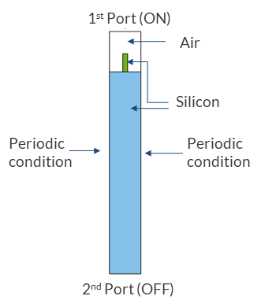
Geometry Assumptions
Pitch of the periodic structure is 780 nm
Thickness of the silicon pillar is 125 nm
Height of the silicon pillar is 450 nm

Slide 3
Modeling Assumptions
Out of plane polarization is considered
The ± 1 out of plane diffraction orders were added to the second Port to account for higher order diffraction wave propagation

Slide 4
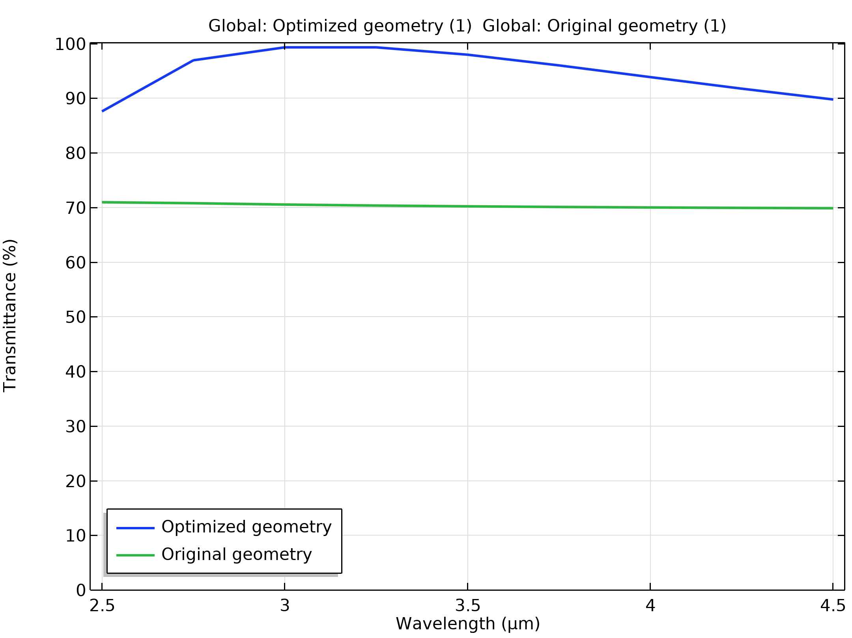
Transmission for Optimized and Original Geometry

Slide 5
Observations
The rectangular silicon microstructure increases the transmittance from bulk Si with ~70% to more than 92% between 2.5 um and 4.5 um spectrum.
The transmittance reduces with the increase in angle of incidence.
The results matched well with the Hobbs et al. paper [1].

Slide 6
Reference
1. Douglas S. Hobbs, Bruce D. MacLeod, "Design, fabrication, and measured performance of anti-reflecting surface textures in infrared transmitting materials," Proc. SPIE 5786, Window and Dome Technologies and Materials IX, (18 May 2005); doi: 10.1117/12.604532.

