Slide 1
Antireflection Coating for Infrared Wavelength
Pyramid-Shaped Microstructure
COMSOL

Slide 2
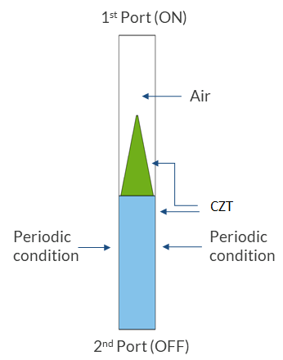
Geometry Assumptions
Pitch of the periodic structure is 2.4 um
Height of the CZT pyramid is 5 um
Top width of the CZT pyramid is 100 nm
Bottom width of the CZT pyramid is 2.16 um
Single unit cell model

Slide 3
Modeling Assumptions
Out of plane polarization is considered
The ± 1 out of plane diffraction orders were added to the second Port to account for higher order diffraction wave propagation

Slide 4
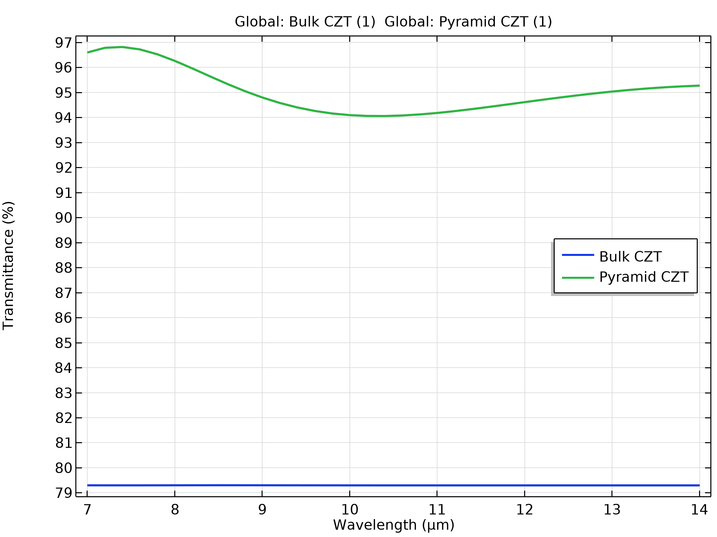
Transmission Profile

Slide 5
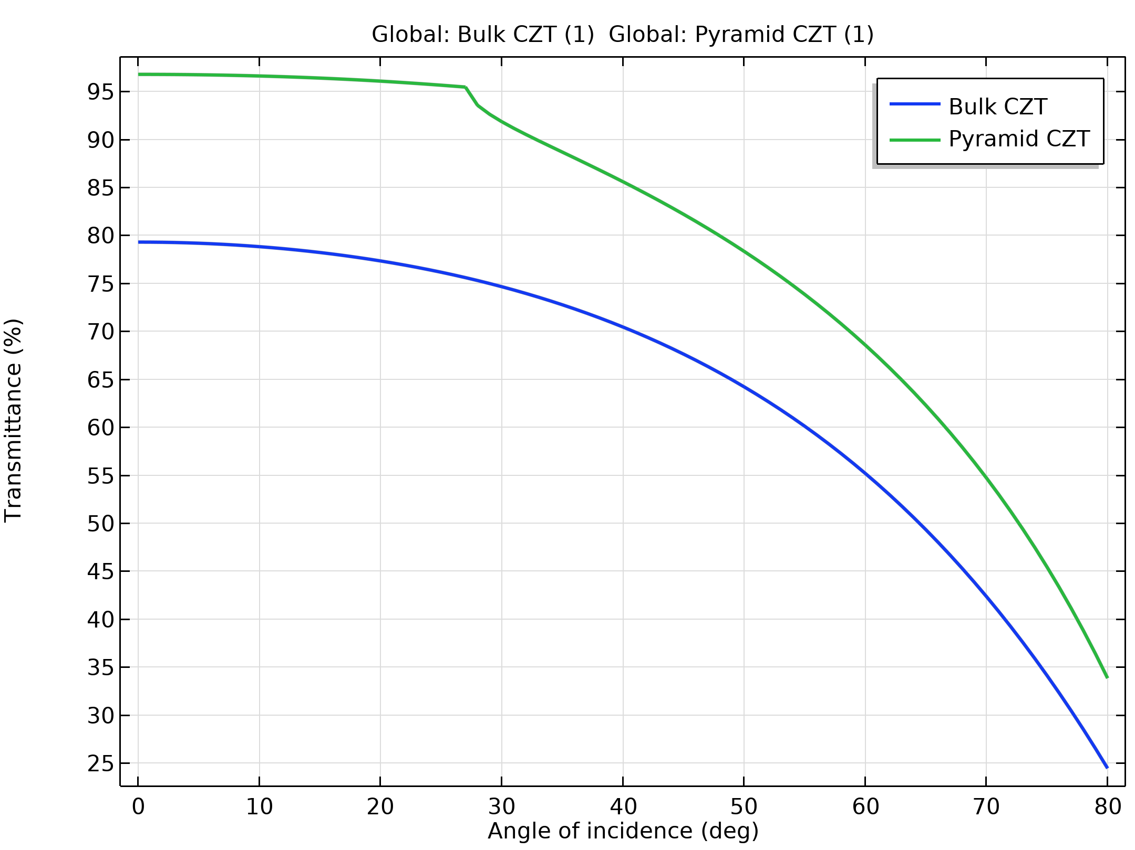
Transmission Profile

Slide 6
Observations
The pyramidal CZT microstructure increases the transmittance from bulk CZT ~79% to more than 94% between the 7 um and 14 um spectrum.
The transmittance reduces with the increase in angle of incidence.
The results matched well with the Hobbs et al. paper [1].

Slide 7
Reference
1. Douglas S. Hobbs, Bruce D. MacLeod, "Design, fabrication, and measured performance of anti-reflecting surface textures in infrared transmitting materials," Proc. SPIE 5786, Window and Dome Technologies and Materials IX, (18 May 2005); doi: 10.1117/12.604532.

