Slide 1
Eddy Current Non-Destructive Evaluation

Slide 2
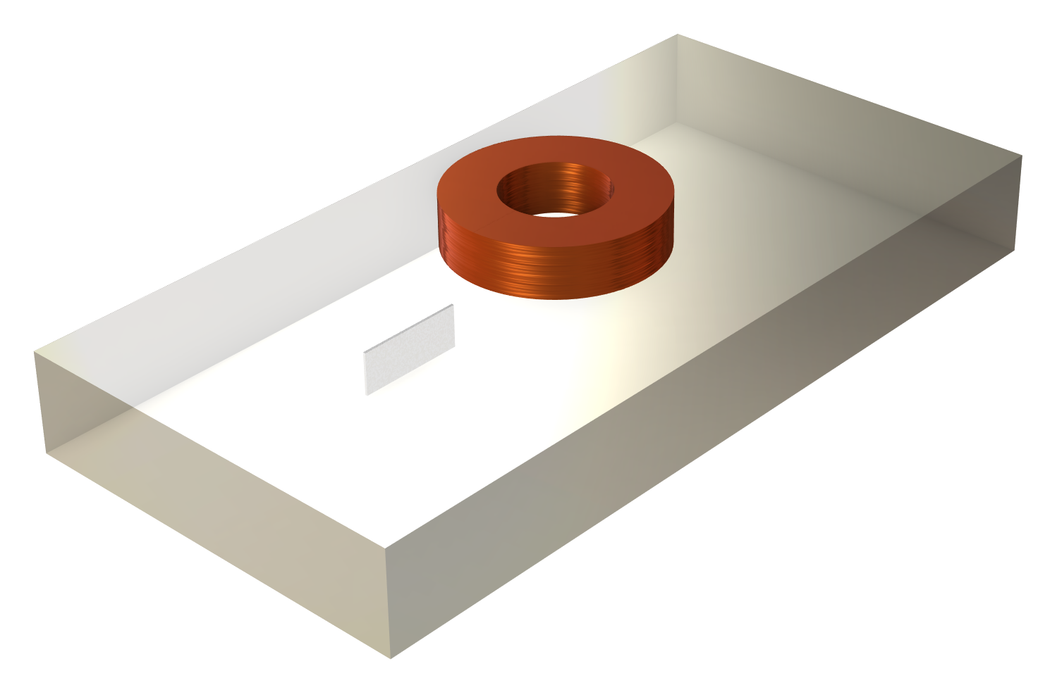
Objective
To find the change in coil impedance as it scans the conducting plate with a flaw.
  Principle: Presence of crack will change the eddy current distribution in a conductive plate which can be detected in terms of lumped coil parameters – Coil Resistance and Coil Inductance
COMSOL simulation results will be compared against results published at http://www.compumag.org/jsite/team.html
Crack defect

Slide 3
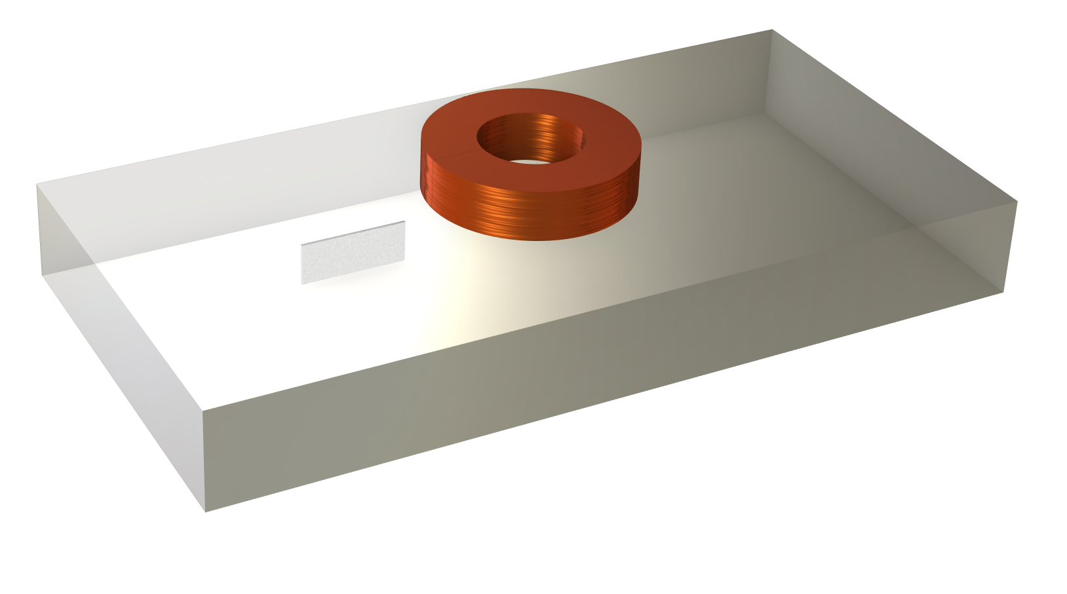
Model Setup
Air-cored coil
Crack defect
Test specimen/
conducting plate

Slide 4
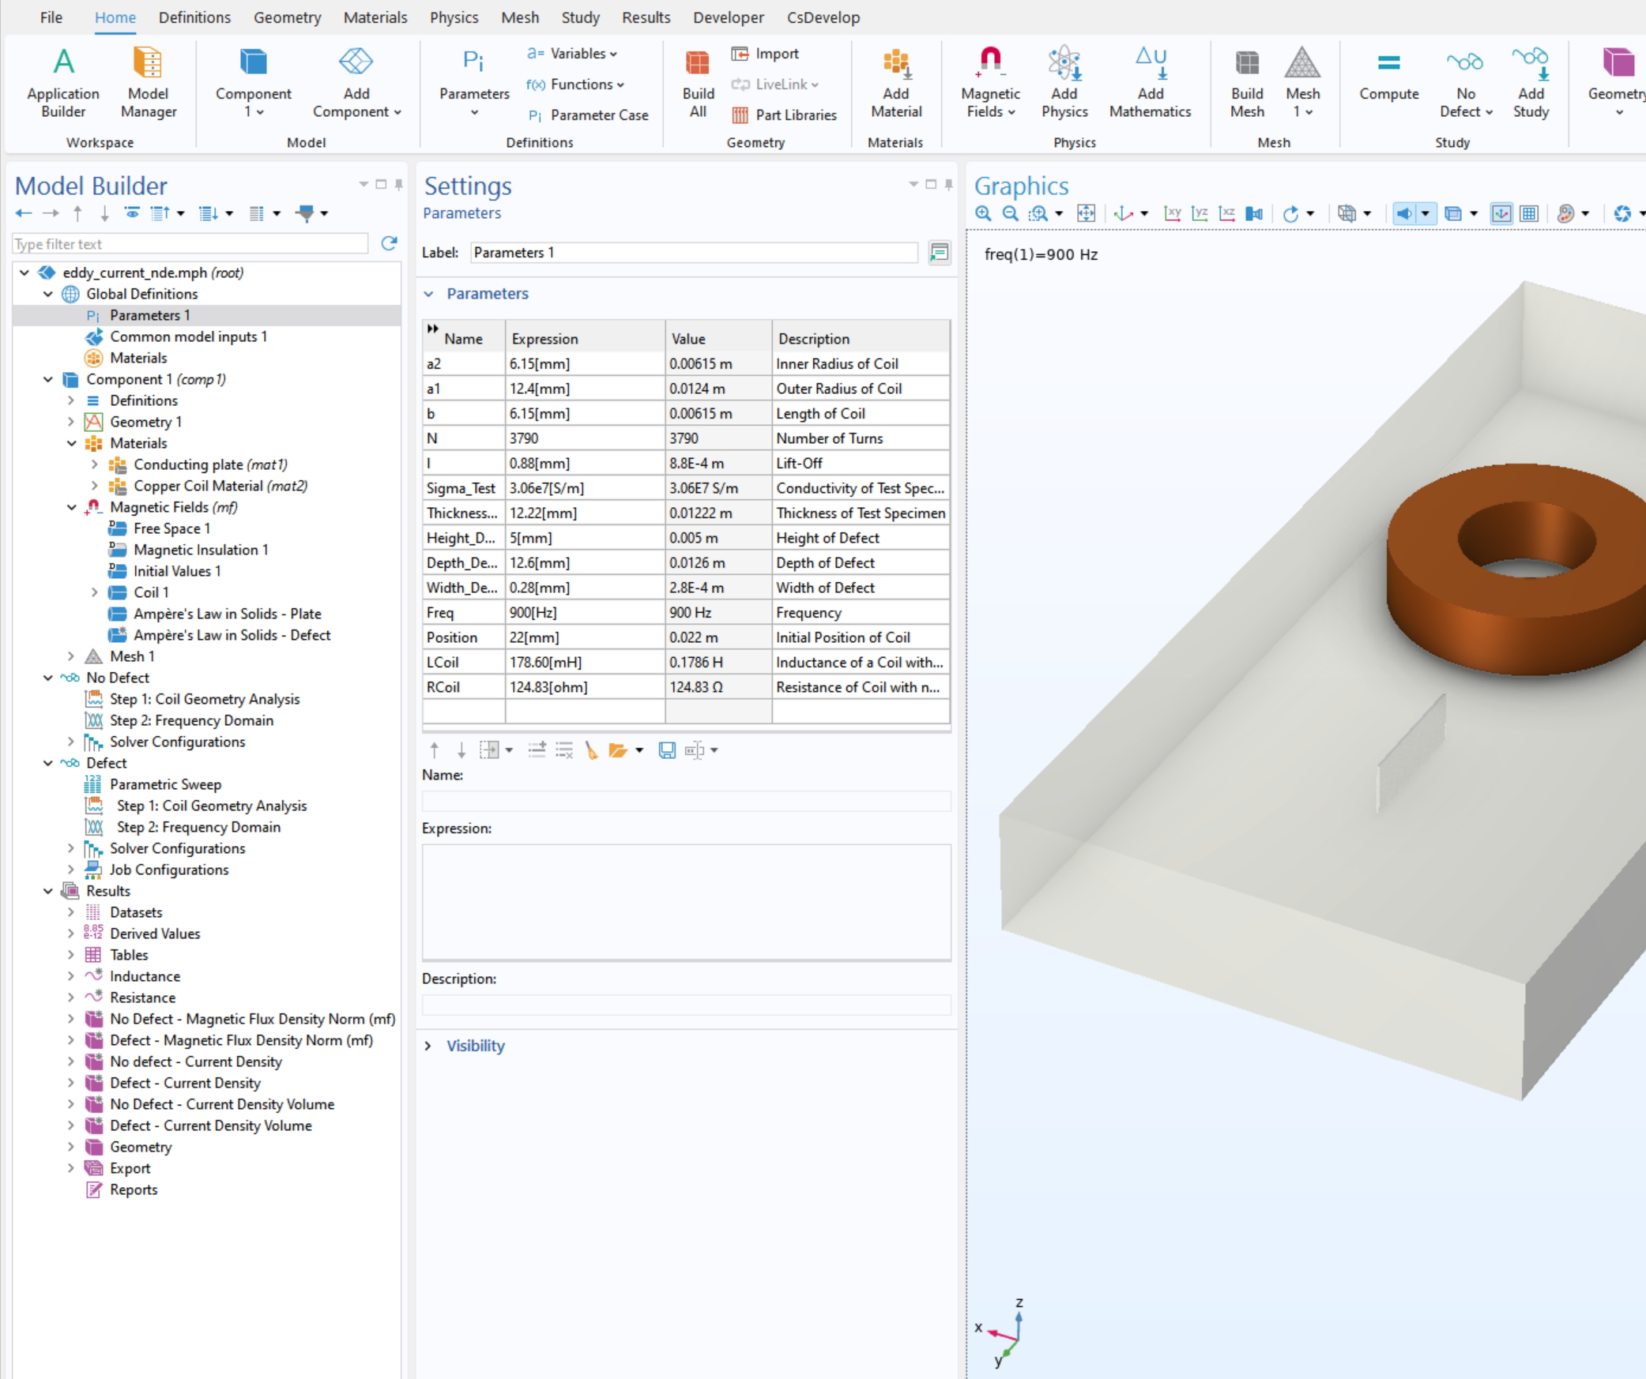
Input Parameters
Number of turns: 3790
Frequency: 900 [Hz]
Conductivity of plate:
3.06e7 [S/m]
Defect parameters
  Length: 12.60 [mm]
  Depth: 5.00 [mm]
  Width: 0.28 [mm]

Slide 5
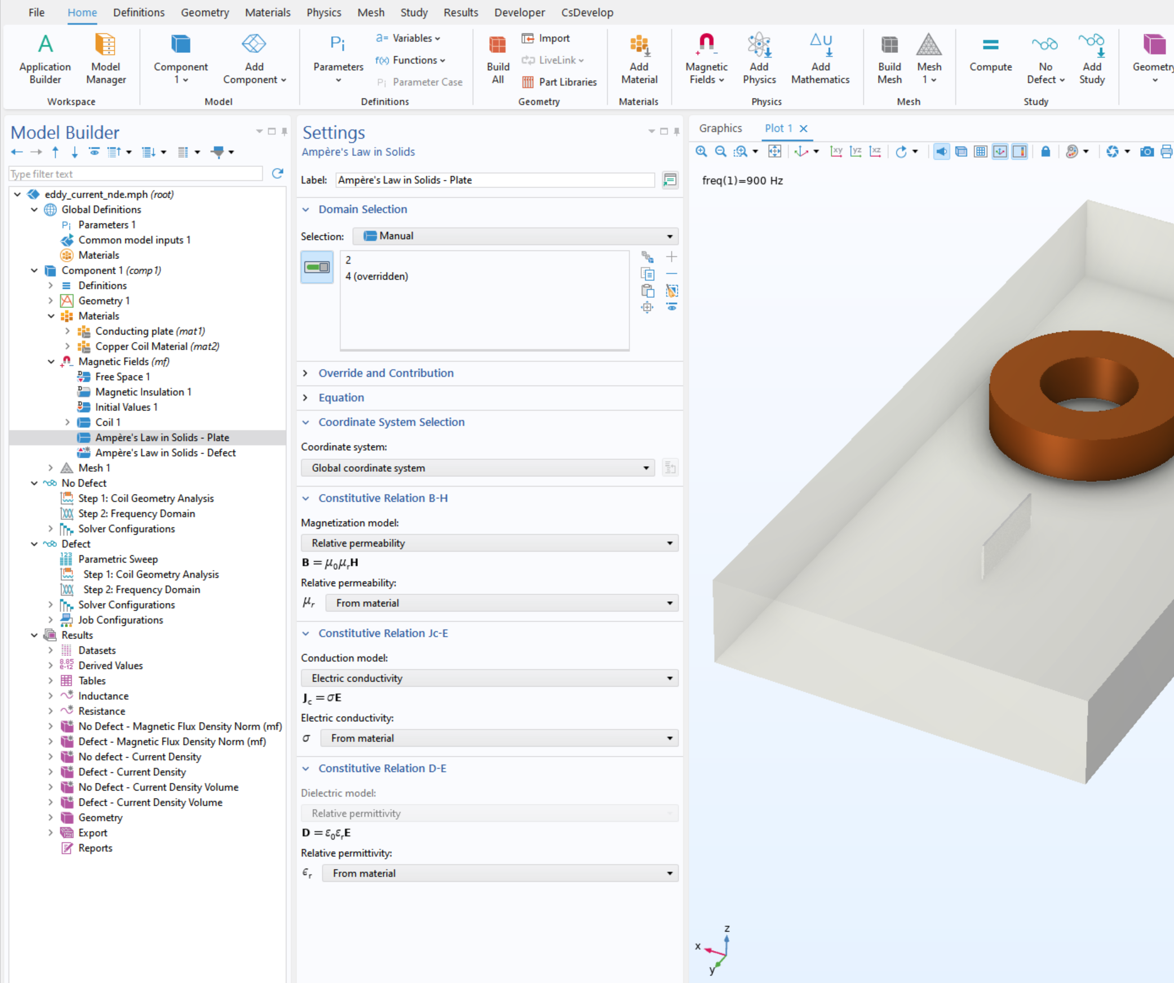
Model Setup
Magnetic Fields interface
Frequency Domain study
Defect is modelled using an electrical conductivity of 0.1 S/m.
Parametric sweep to change
coil position

Slide 6
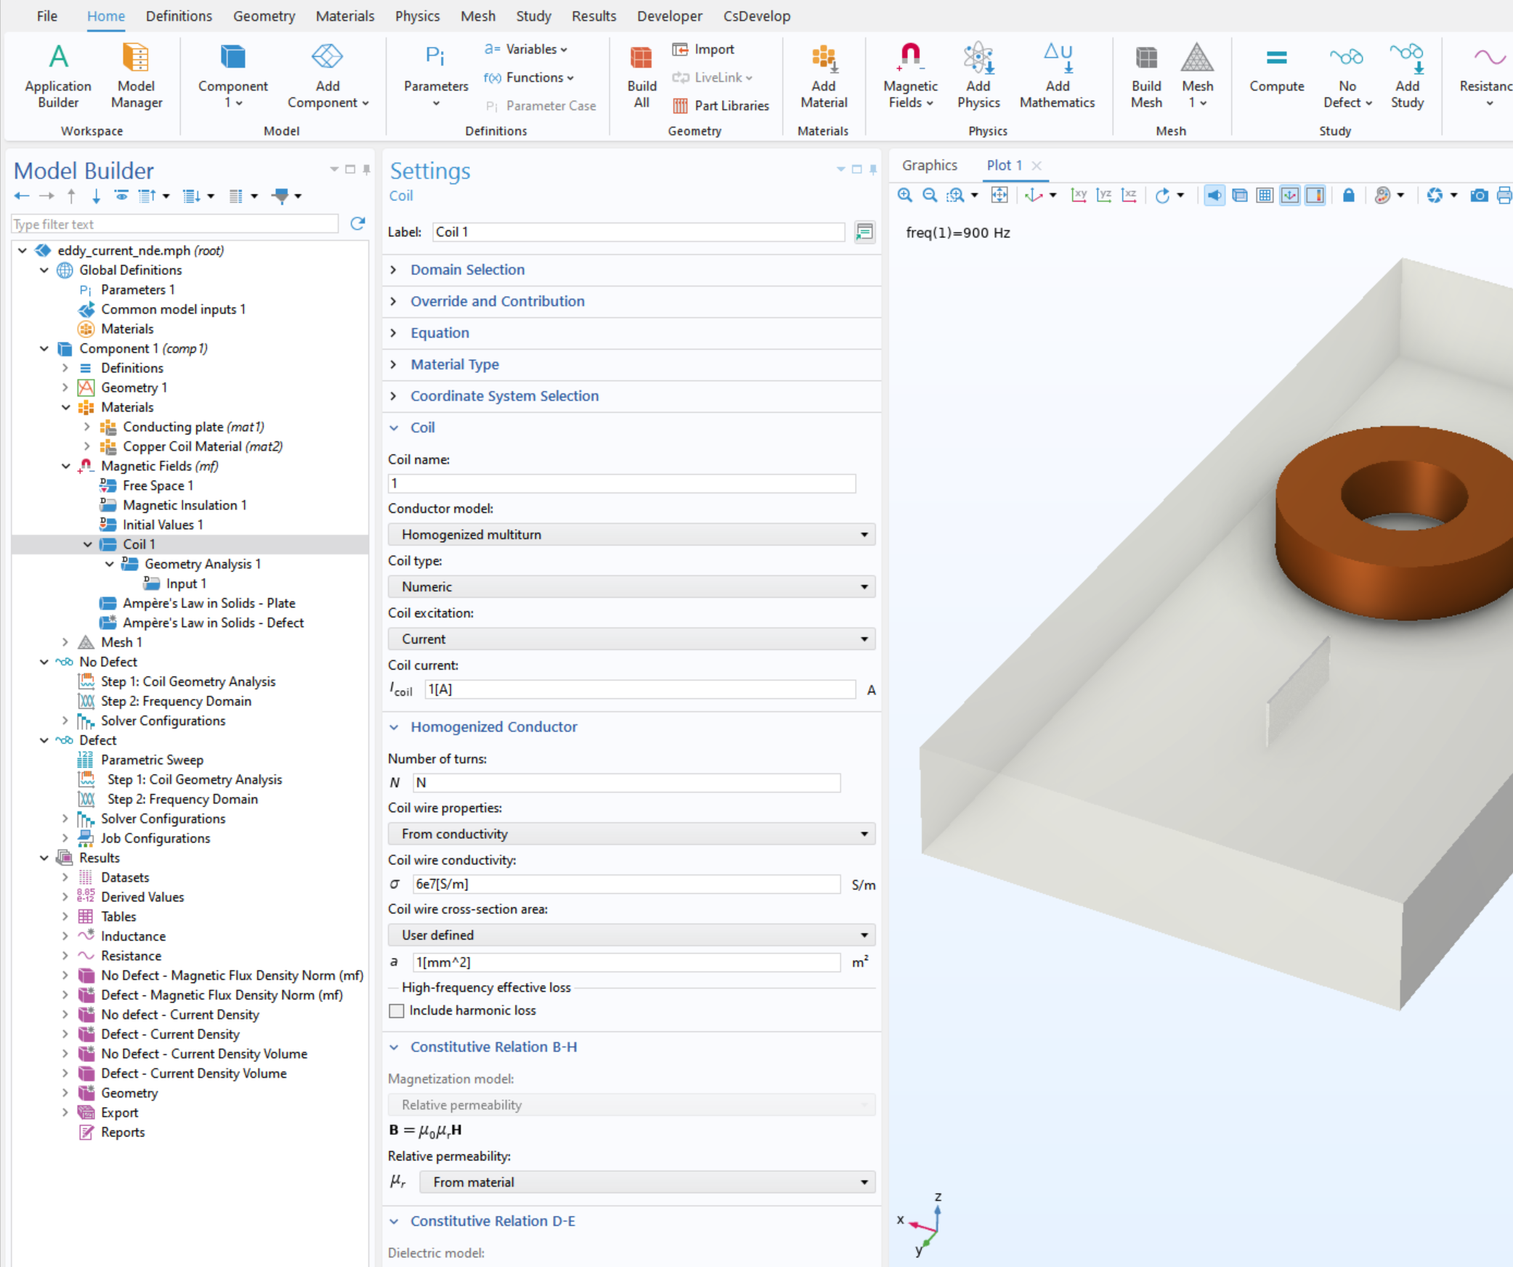
Coil Settings
Homogenized Multi Conductor
Geometry analysis
Input

Slide 7
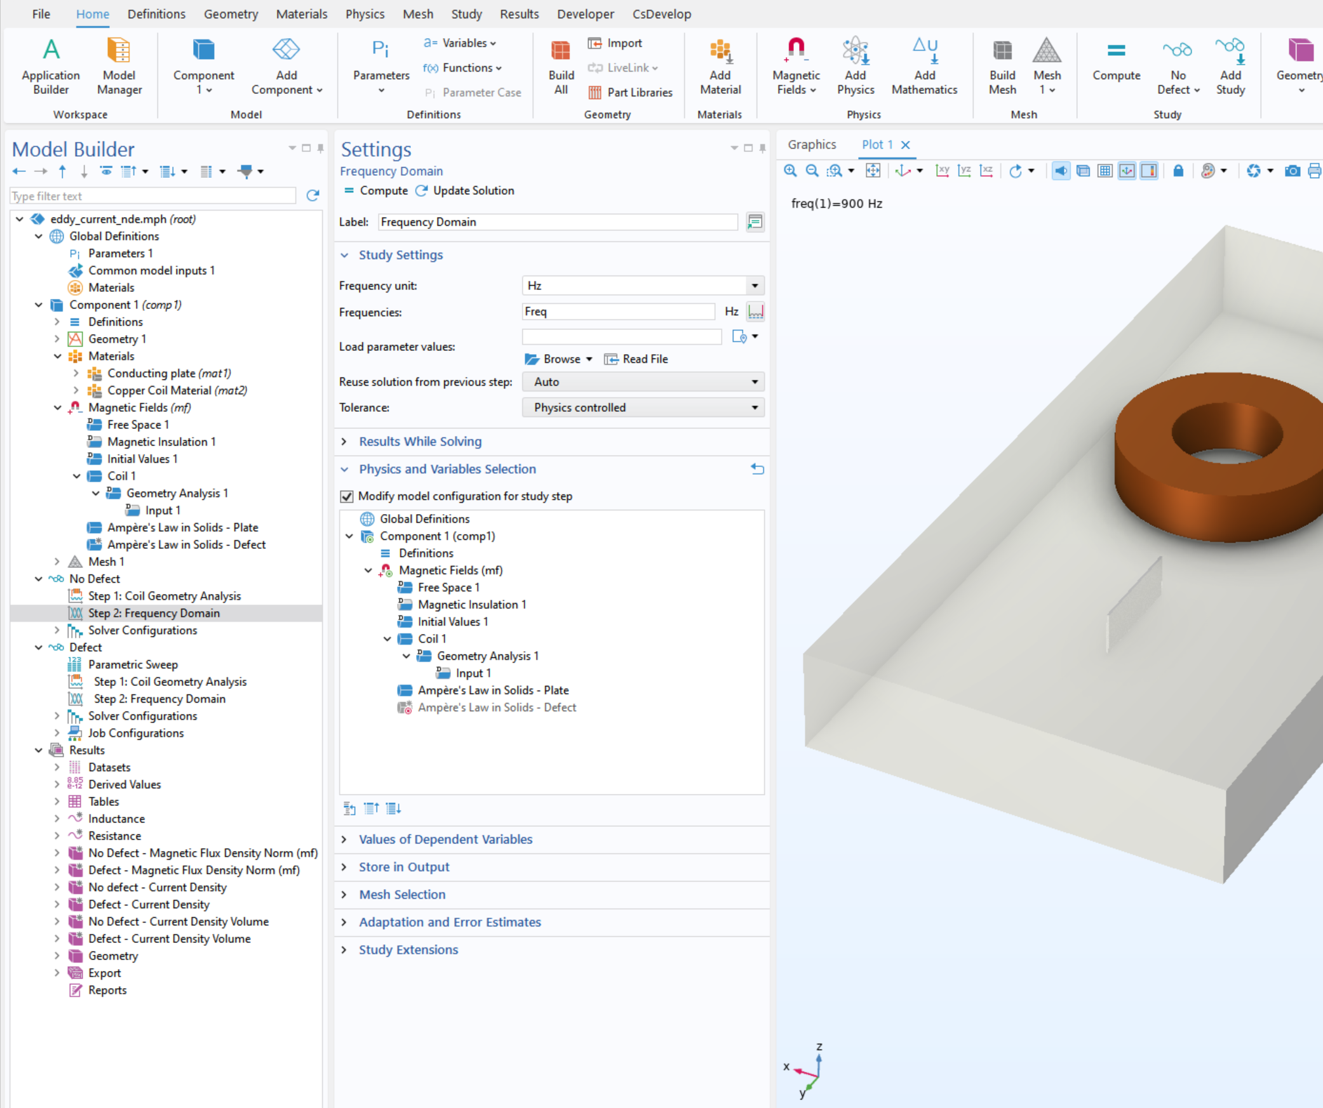
Study Setup
No defect: Defect part takes material properties of conducting plate
Change in Coil Position
  Defect part takes material properties of air
  Parametric sweep is used to the
  coil position

Slide 8
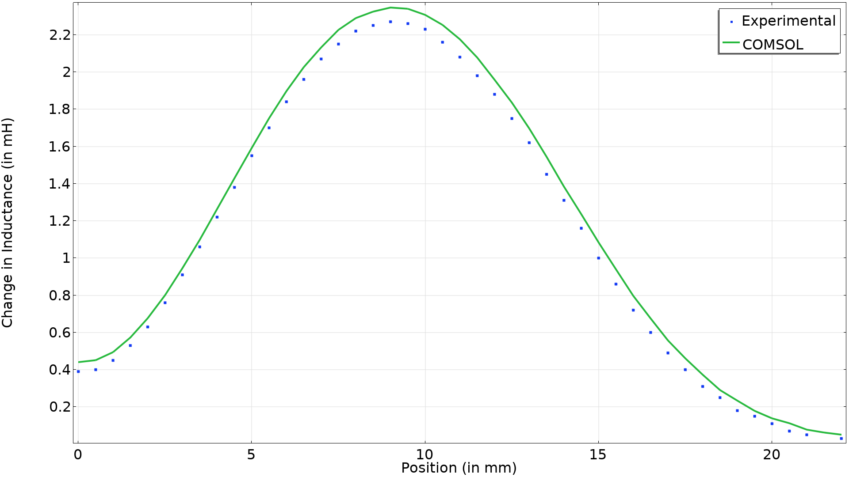
Results: Change in Inductance

Slide 9
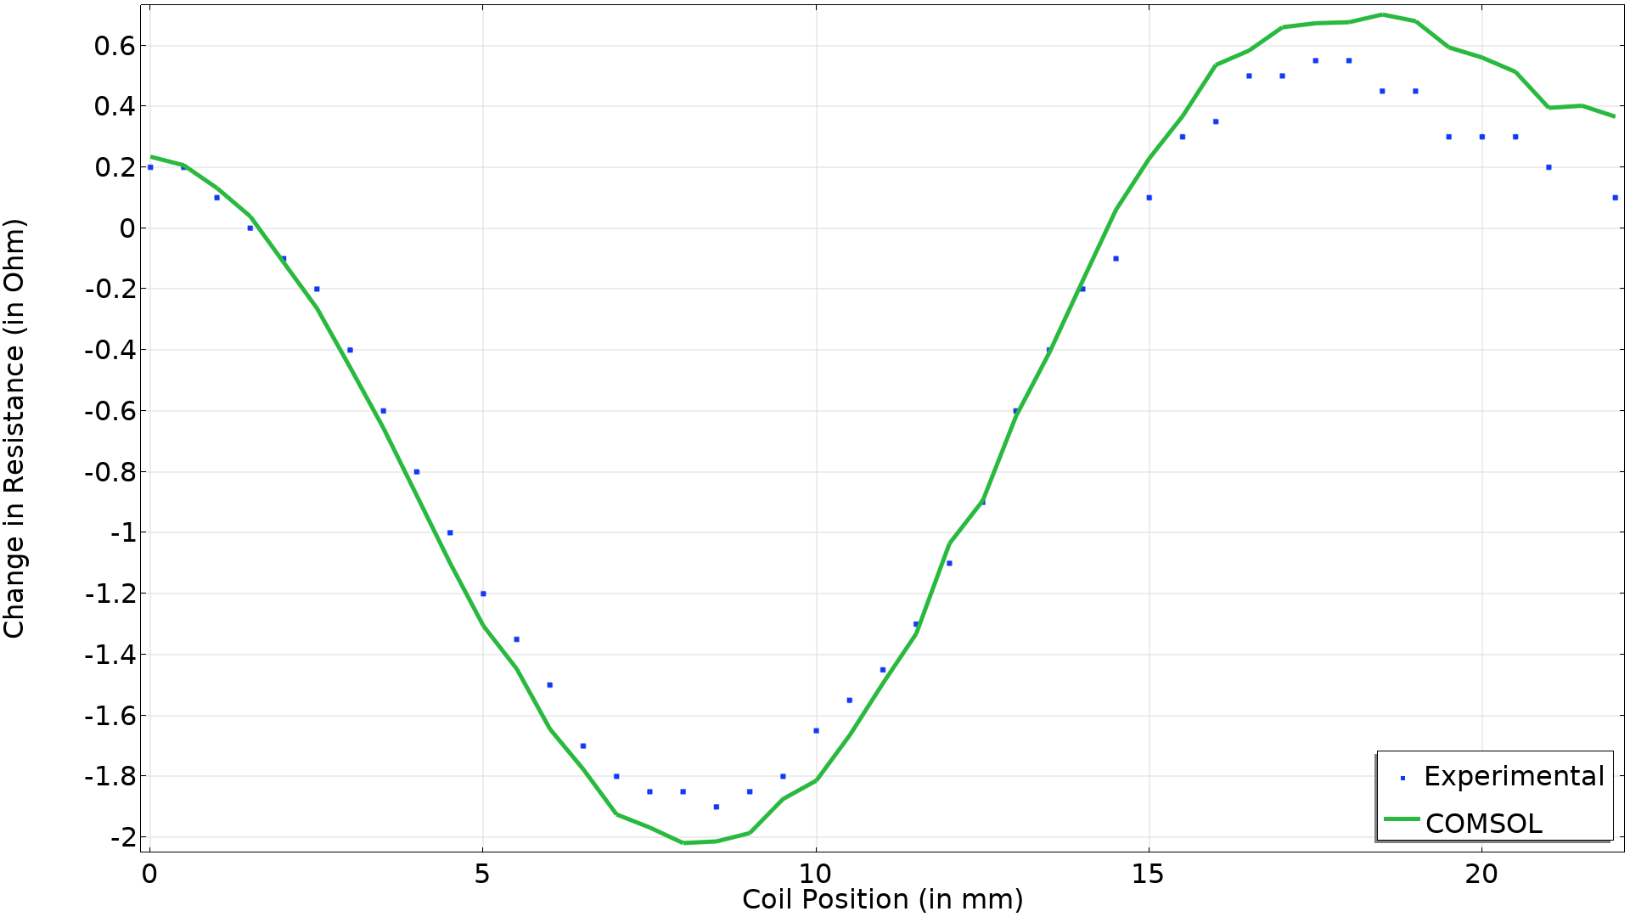
Results: Change in Resistance

Slide 10
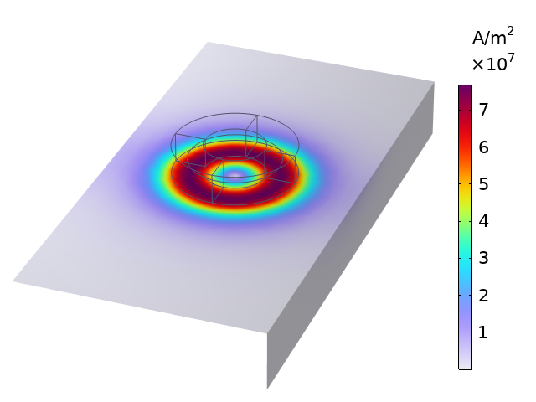
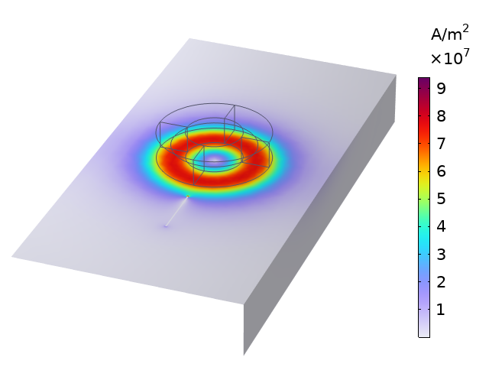
Current Density
Without crack defect
With crack defect

Slide 11
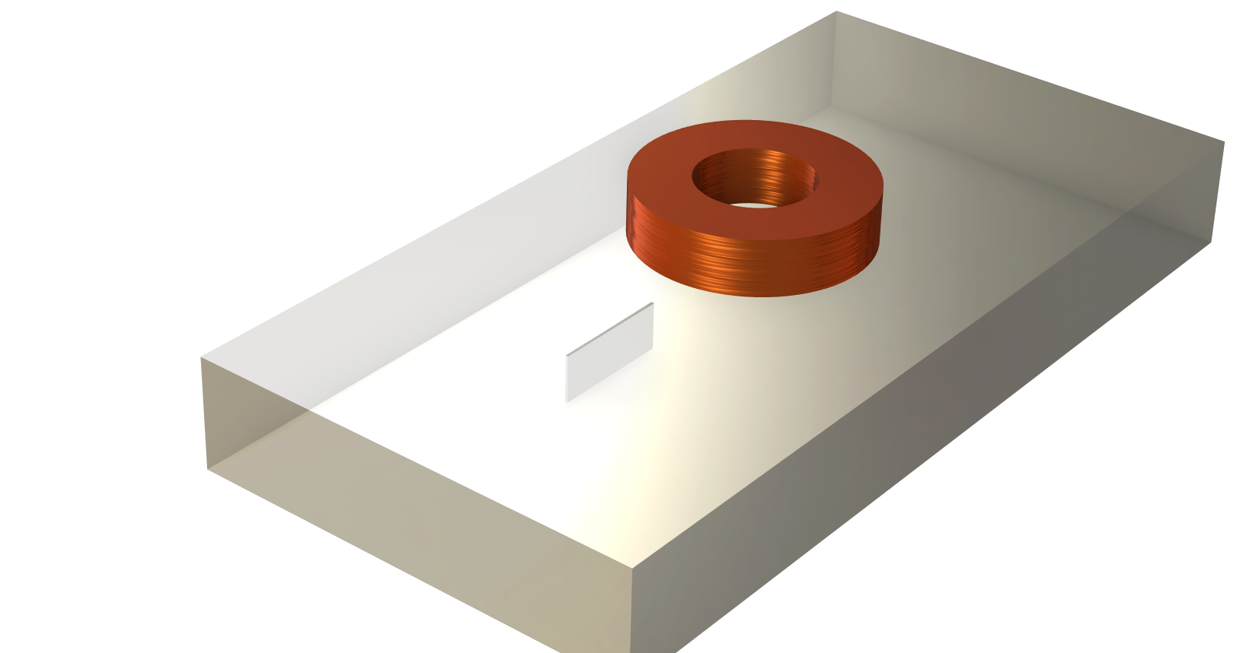
BENCHMARKS RESULTS
CONCLUDING REMARKS
COMSOL results are in good agreement with benchmark studies in the literature.

