Slide 1
Frequency Domain Study of a Single-Phase Motor in 2D
Verification Model
COMSOL

Slide 2
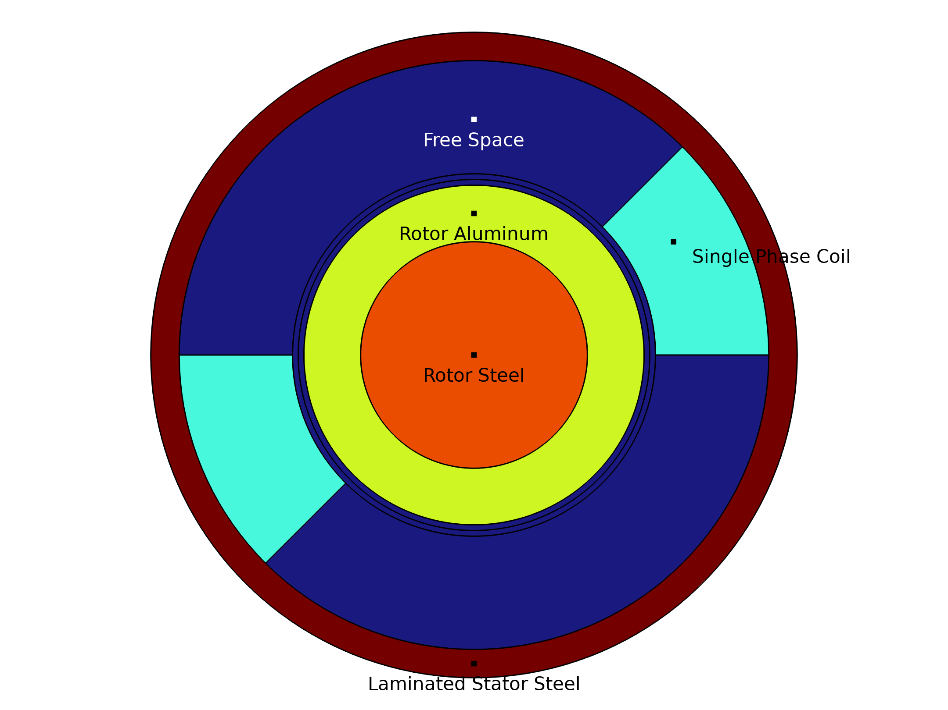
Geometry of the Single Phase Induction Motor

Slide 3
Introduction
A single phase Induction motor is modeled and compared with the TEAM benchmark model problem 30.
The motor has two major parts, a stator and a rotor. The stator is made of laminated steel and has a single phase coil. The rotor consists of conductive steel and aluminum.
The time harmonic currents on the stator windings will induce eddy currents in the rotor. The magnetic fields from these two currents will interact with each other to generate torque.

Slide 4
Parameters
The dimensions of the motor, operating frequency, rotor speed and the number of turns in the coil are defined as parameters in the model.
Parameters 1
Name | Expression | Value | Description
r1 | 2[cm] | 0.02 m | Outer radius of rotor steel
r2 | 3[cm] | 0.03 m | Outer radius of rotor aluminum
r3 | 3.2[cm] | 0.032 m | Inner radius of windings
r4 | 5.2[cm] | 0.052 m | Inner radius of stator steel
r5 | 5.7[cm] | 0.057 m | Outer radius of stator steel

Slide 5
Parameters
Parameters 1
Name | Expression | Value | Description
win_angle | 45[deg] | 0.7854 rad | Phase span of a winding
airgap | r3 - r2 | 0.002 m | Airgap between stator and rotor
f0 | 60[Hz] | 60 Hz | Supply frequency
w0 | 2*pi*f0 | 376.99 Hz | Supply angular frequency
n0 | 2045.175 | 2045.2 | Number of turns
L | 1[m] | 1 m | Length of the motor
RPM | 0[rad/s] | 0 rad/s | Motor rpm

Slide 6
Modeling Approach - Materials
All of the electrical and magnetic material properties are assumed to be linear.
Material Properties
Material | Electrical Conductivity (σ) | Relative permeability (μr) | Density (ρ)
Rotor steel | 1.6e6 [S/m] | 30 | 7850 [kg/m3]
Stator steel | 0 [S/m] | 30
Rotor aluminum | 3.72e7 [S/m] | 1 | 2700 [kg/m3]

Slide 7
Modeling Approach
A 2D Magnetic Fields (mf) physics interface is used to model the induction motor in frequency domain operating at a frequency of 60[Hz].
The motor is represented using four nodes in the mf interface:
  Ampère's Law in Solids
  Coil
  Velocity (Lorentz Term)
  Force Calculation

Slide 8
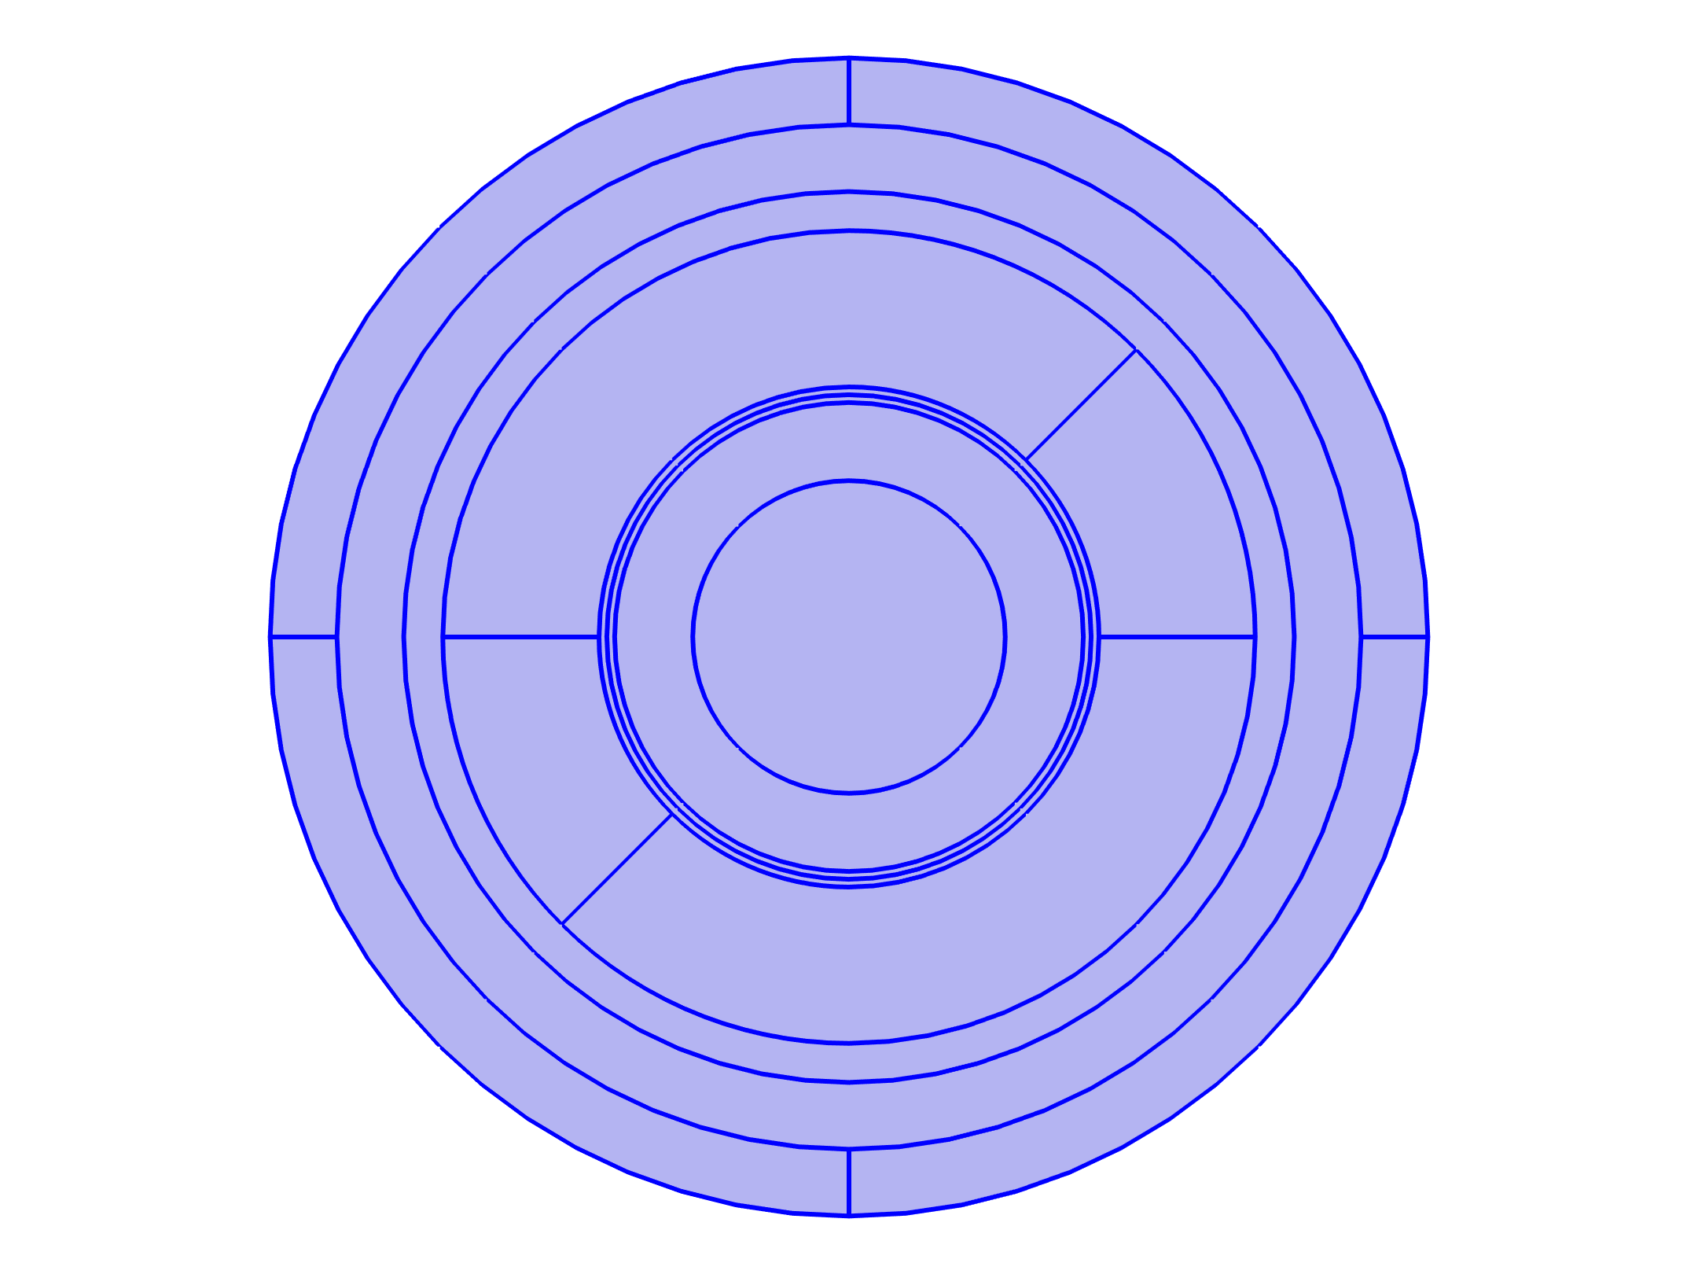



Modeling Approach
Magnetic Fields

Slide 9
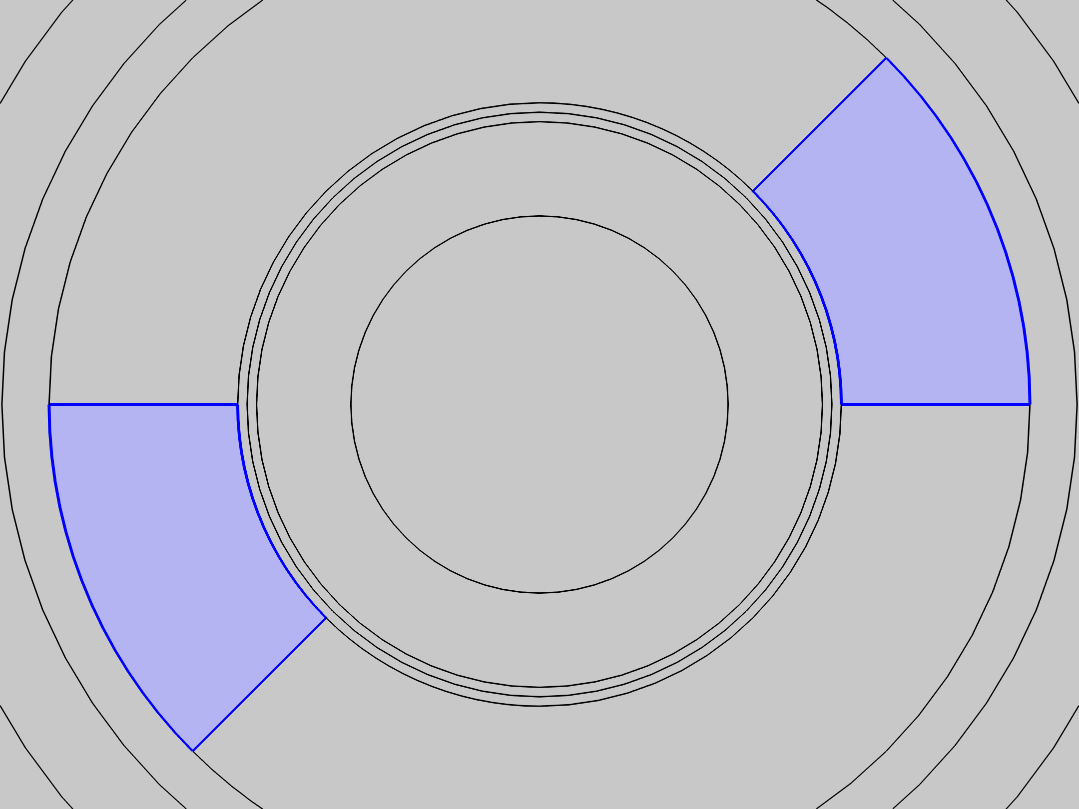
Modeling Approach
Coil 1: Phase A

Slide 10
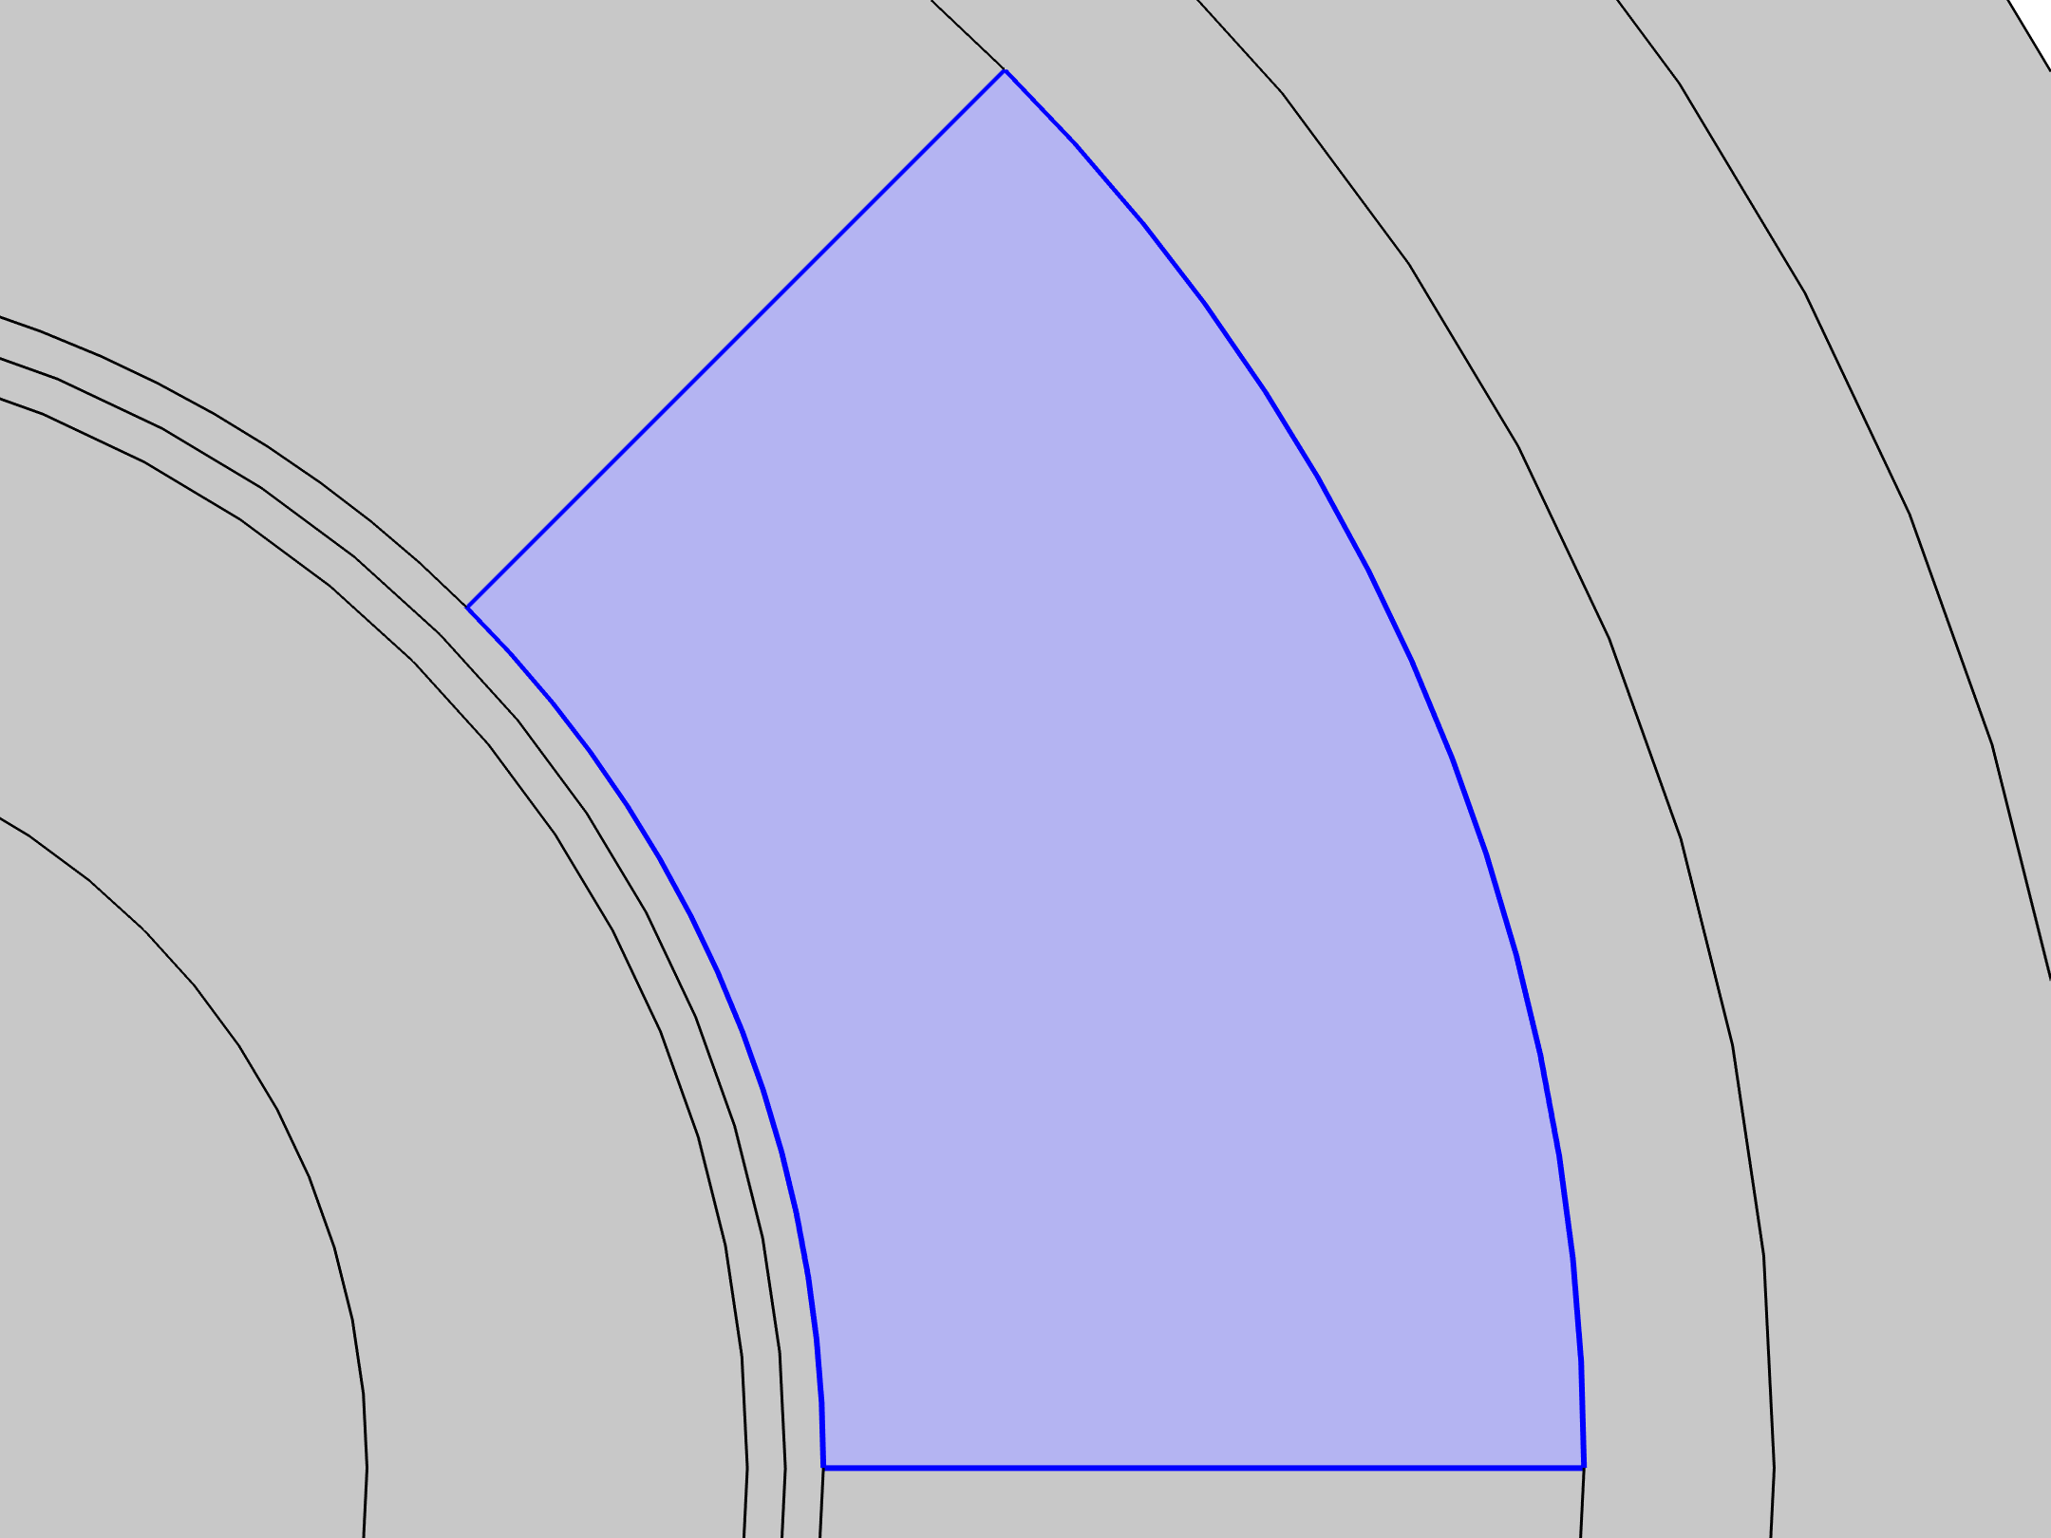
Modeling Approach
The coils in the stator are modeled as ‘Homogenized Multi-Turn Conductor’ with n0 = number of turns
The current in the single phase coil is defined as:
    I_{A}=1[A]*sqrt(2)
Note: sqrt(2) term is included to turn the RMS value of current to peak value.
The ‘Coil Group’ checkbox is checked to connect the coils in series and reversed current direction is used to specify the current in negative direction.
Reversed Current Direction 1

Slide 11
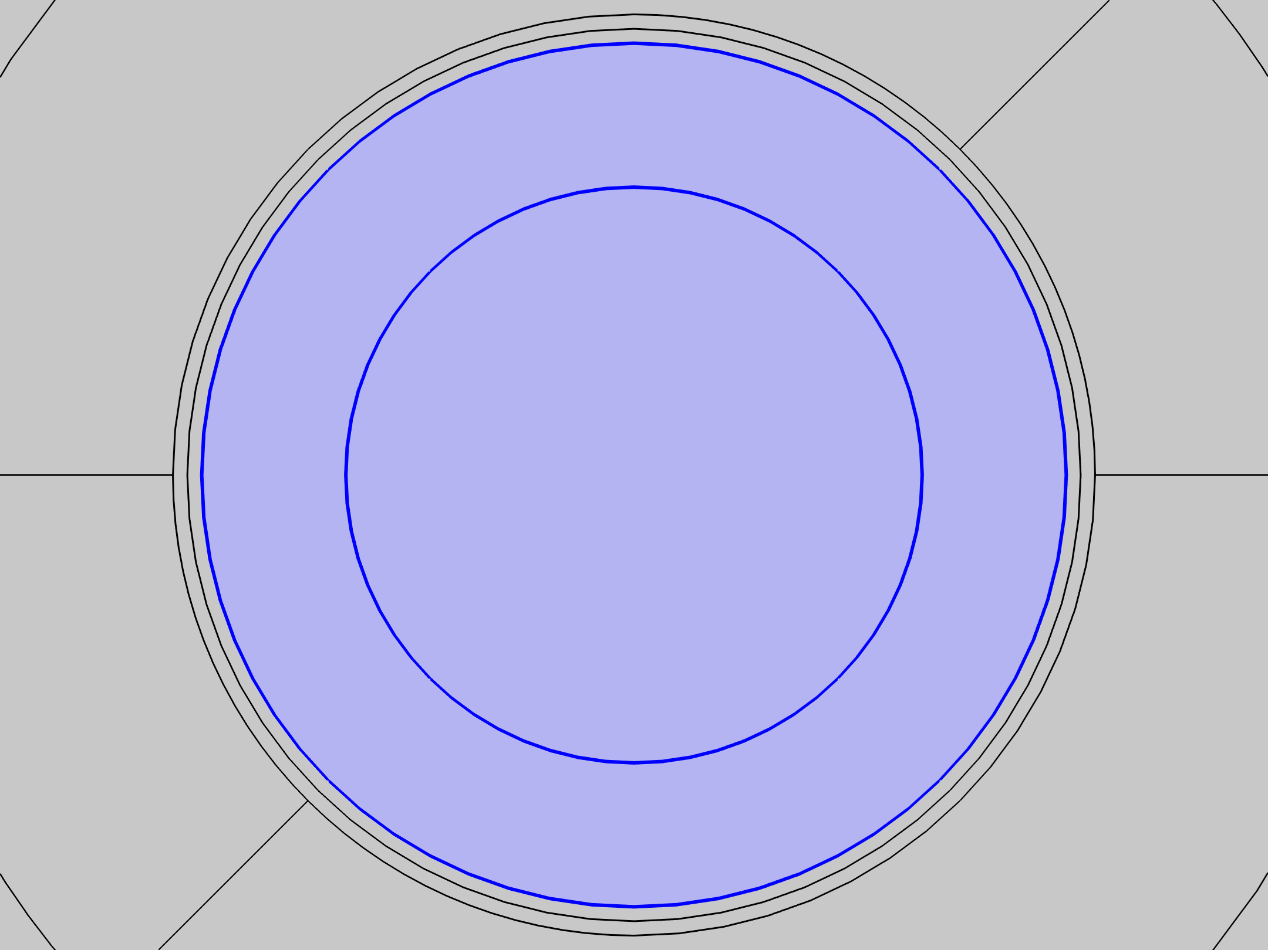
Modeling Approach
The rotational motion of the rotor is modeled using the ‘Velocity (Lorentz Term)’
A new cylindrical coordinate system is defined to specify the rotation in ‘phi’ direction using 'RPM*sys2.r'.
Velocity (Lorentz Term) 1

Slide 12
Modeling Approach
The force on the rotor is calculated using the in-built ‘Force Calculation’ domain feature.
The force and the resulting torque are calculated by integrating the ‘Maxwell’s Stress Tensor’ over the exterior boundaries of the rotor.
Force Calculation 1

Slide 13
Modeling Approach
A parametric sweep for various speeds of the rotor is run. The parameter ‘RPM’ is varied from 0 to 358.14 rad/s. The figure below shows it’s implementation.
The frequency domain analysis study at an operating frequency of 60 Hz is done to compare the results with the benchmark model

Slide 14
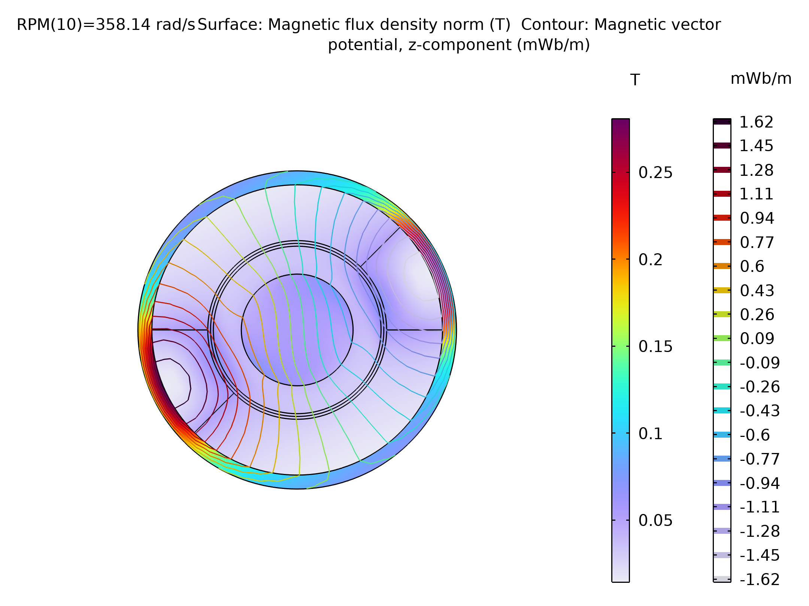
Results
The Electromagnetic Torque, induced voltage and rotor losses at various speeds are calculated and compared with the data from the TEAM Problem 30
Norm of Magnetic Flux Density (Surface plot) and Magnetic Vector Potential (Contour plot) at a velocity of 358.14 rad/s

Slide 15
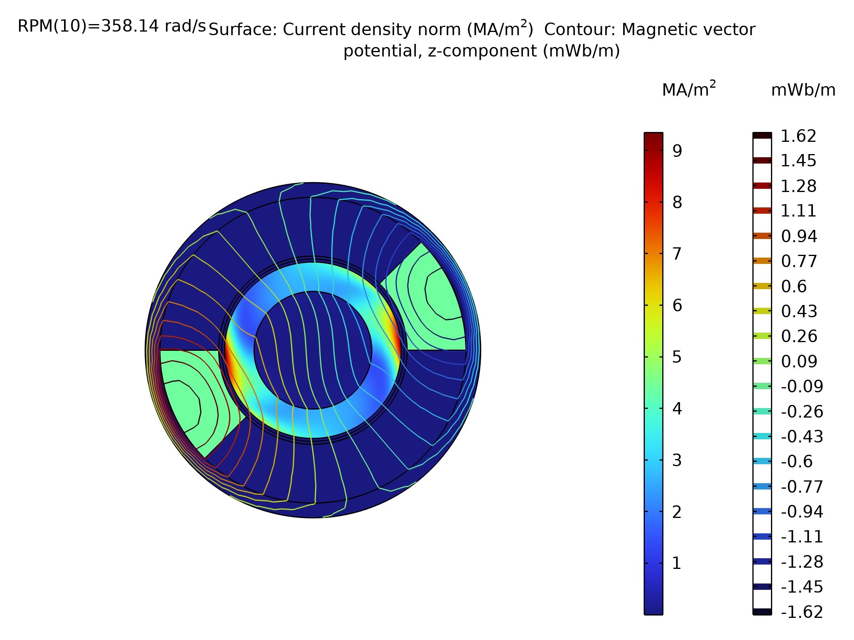
Results
Current density, normJ, (Surface plot) and Magnetic Vector Potential (Contour plot) at a velocity of 358.14 rad/s

Slide 16
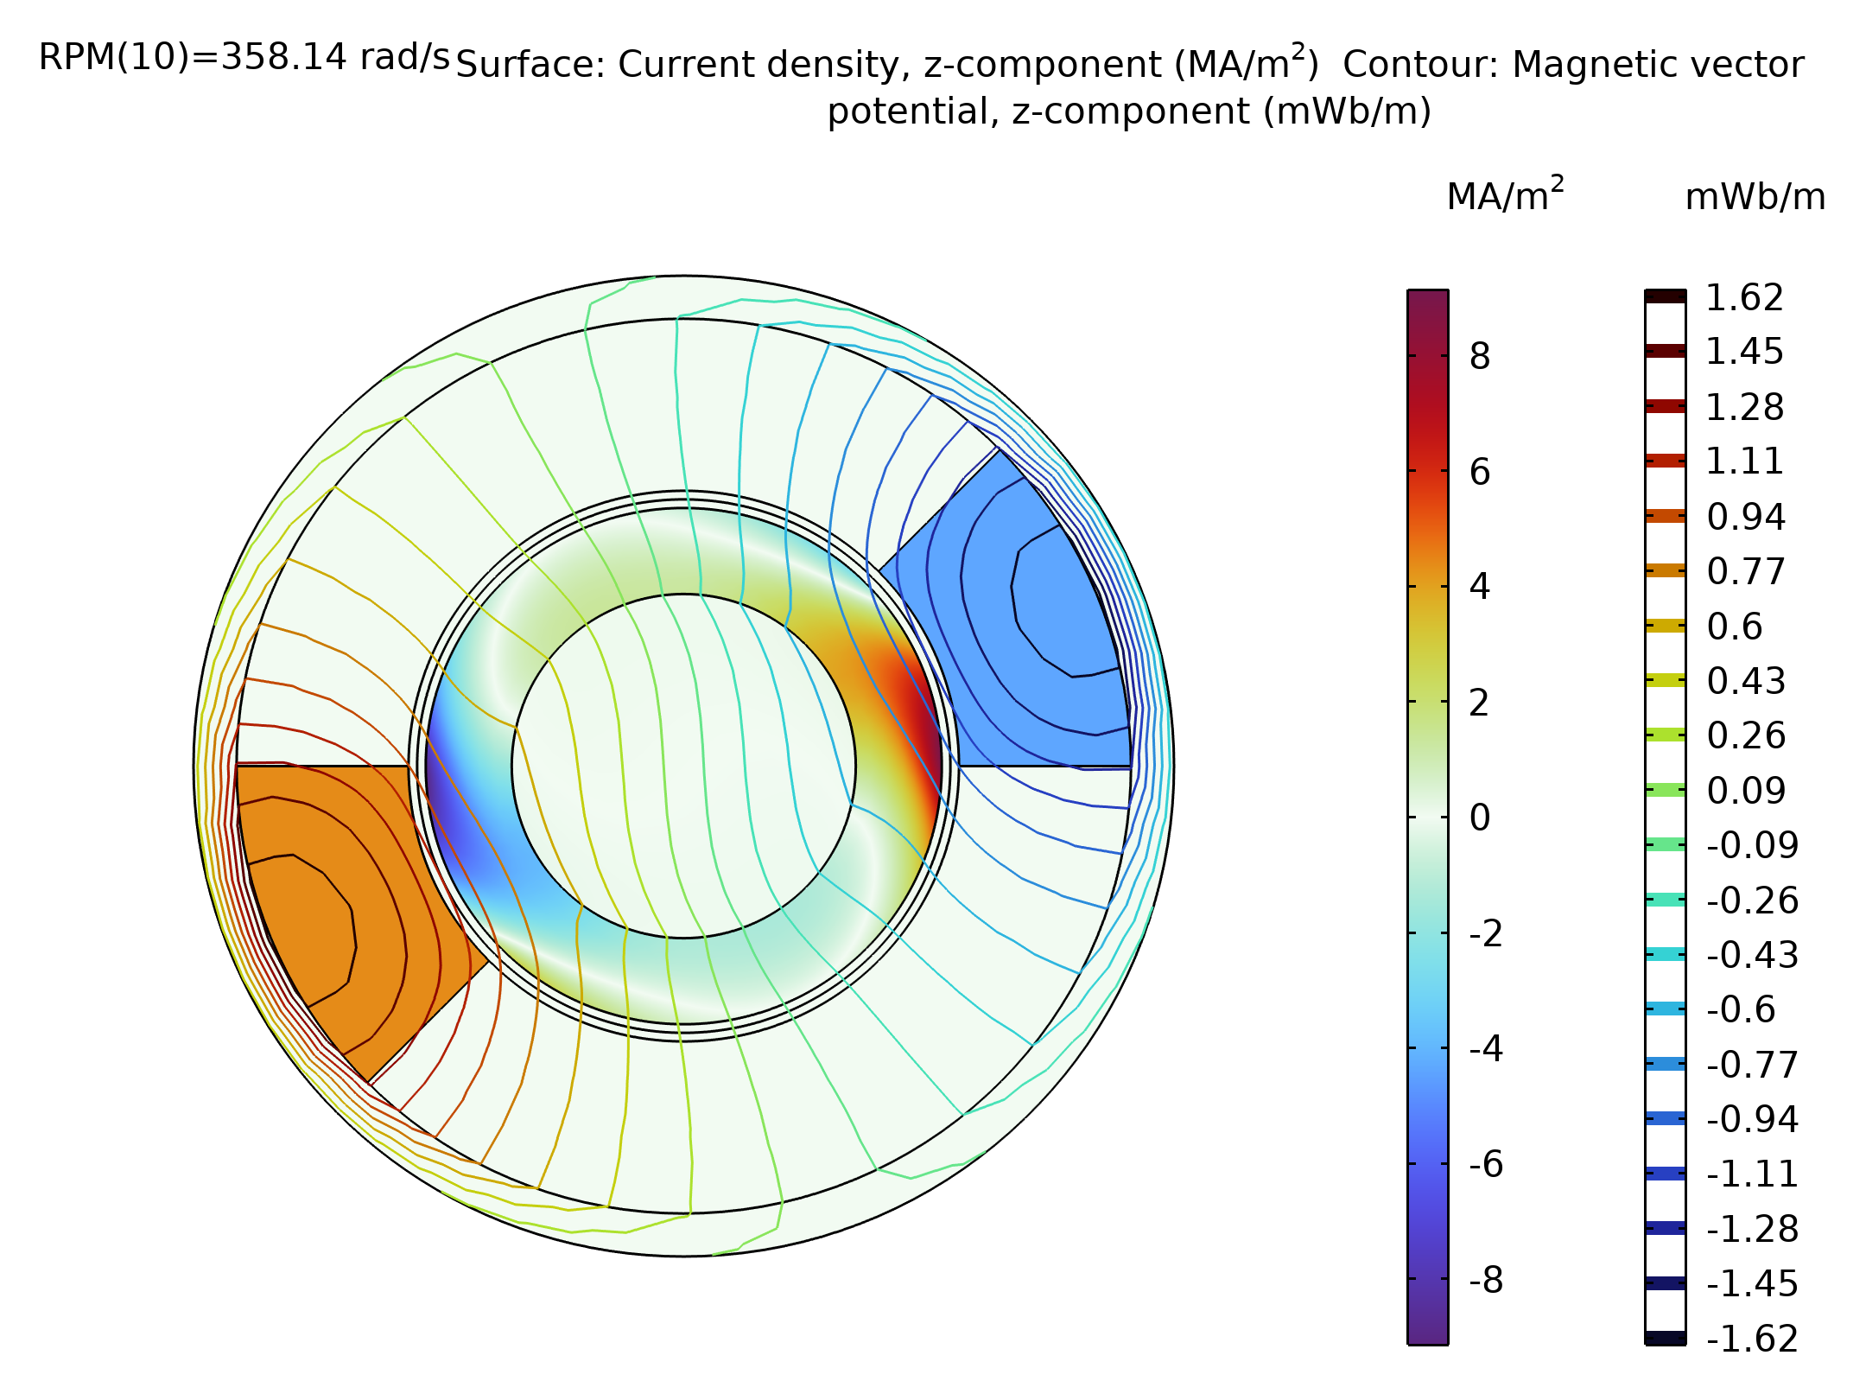
Results
Axial Component of the current density, Jz, (Surface plot) and Magnetic Vector Potential (Contour plot) at a velocity of 358.14 rad/s

Slide 17
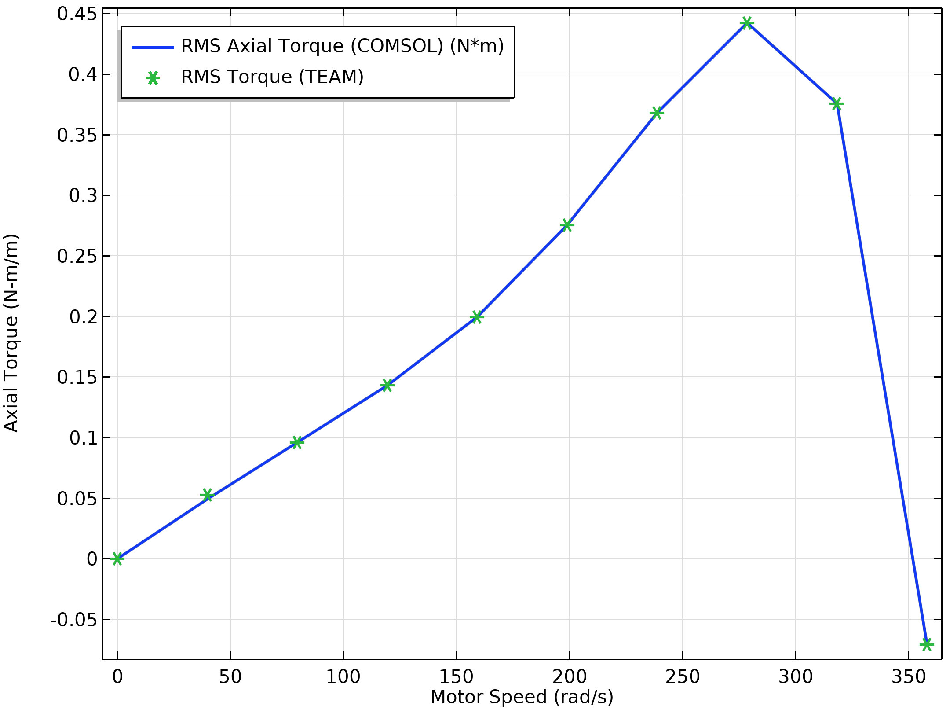
Results
Torque comparison at various speeds of the rotor

Slide 18
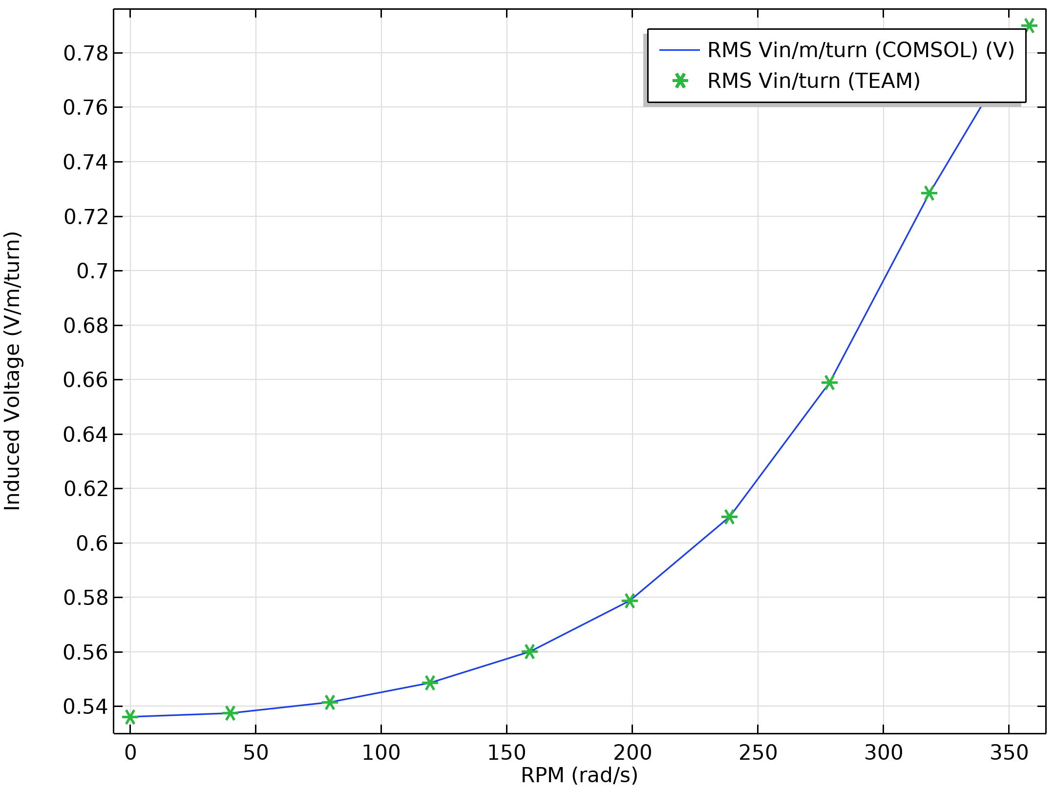
Results
Voltage comparison at various speeds of the rotor

Slide 19
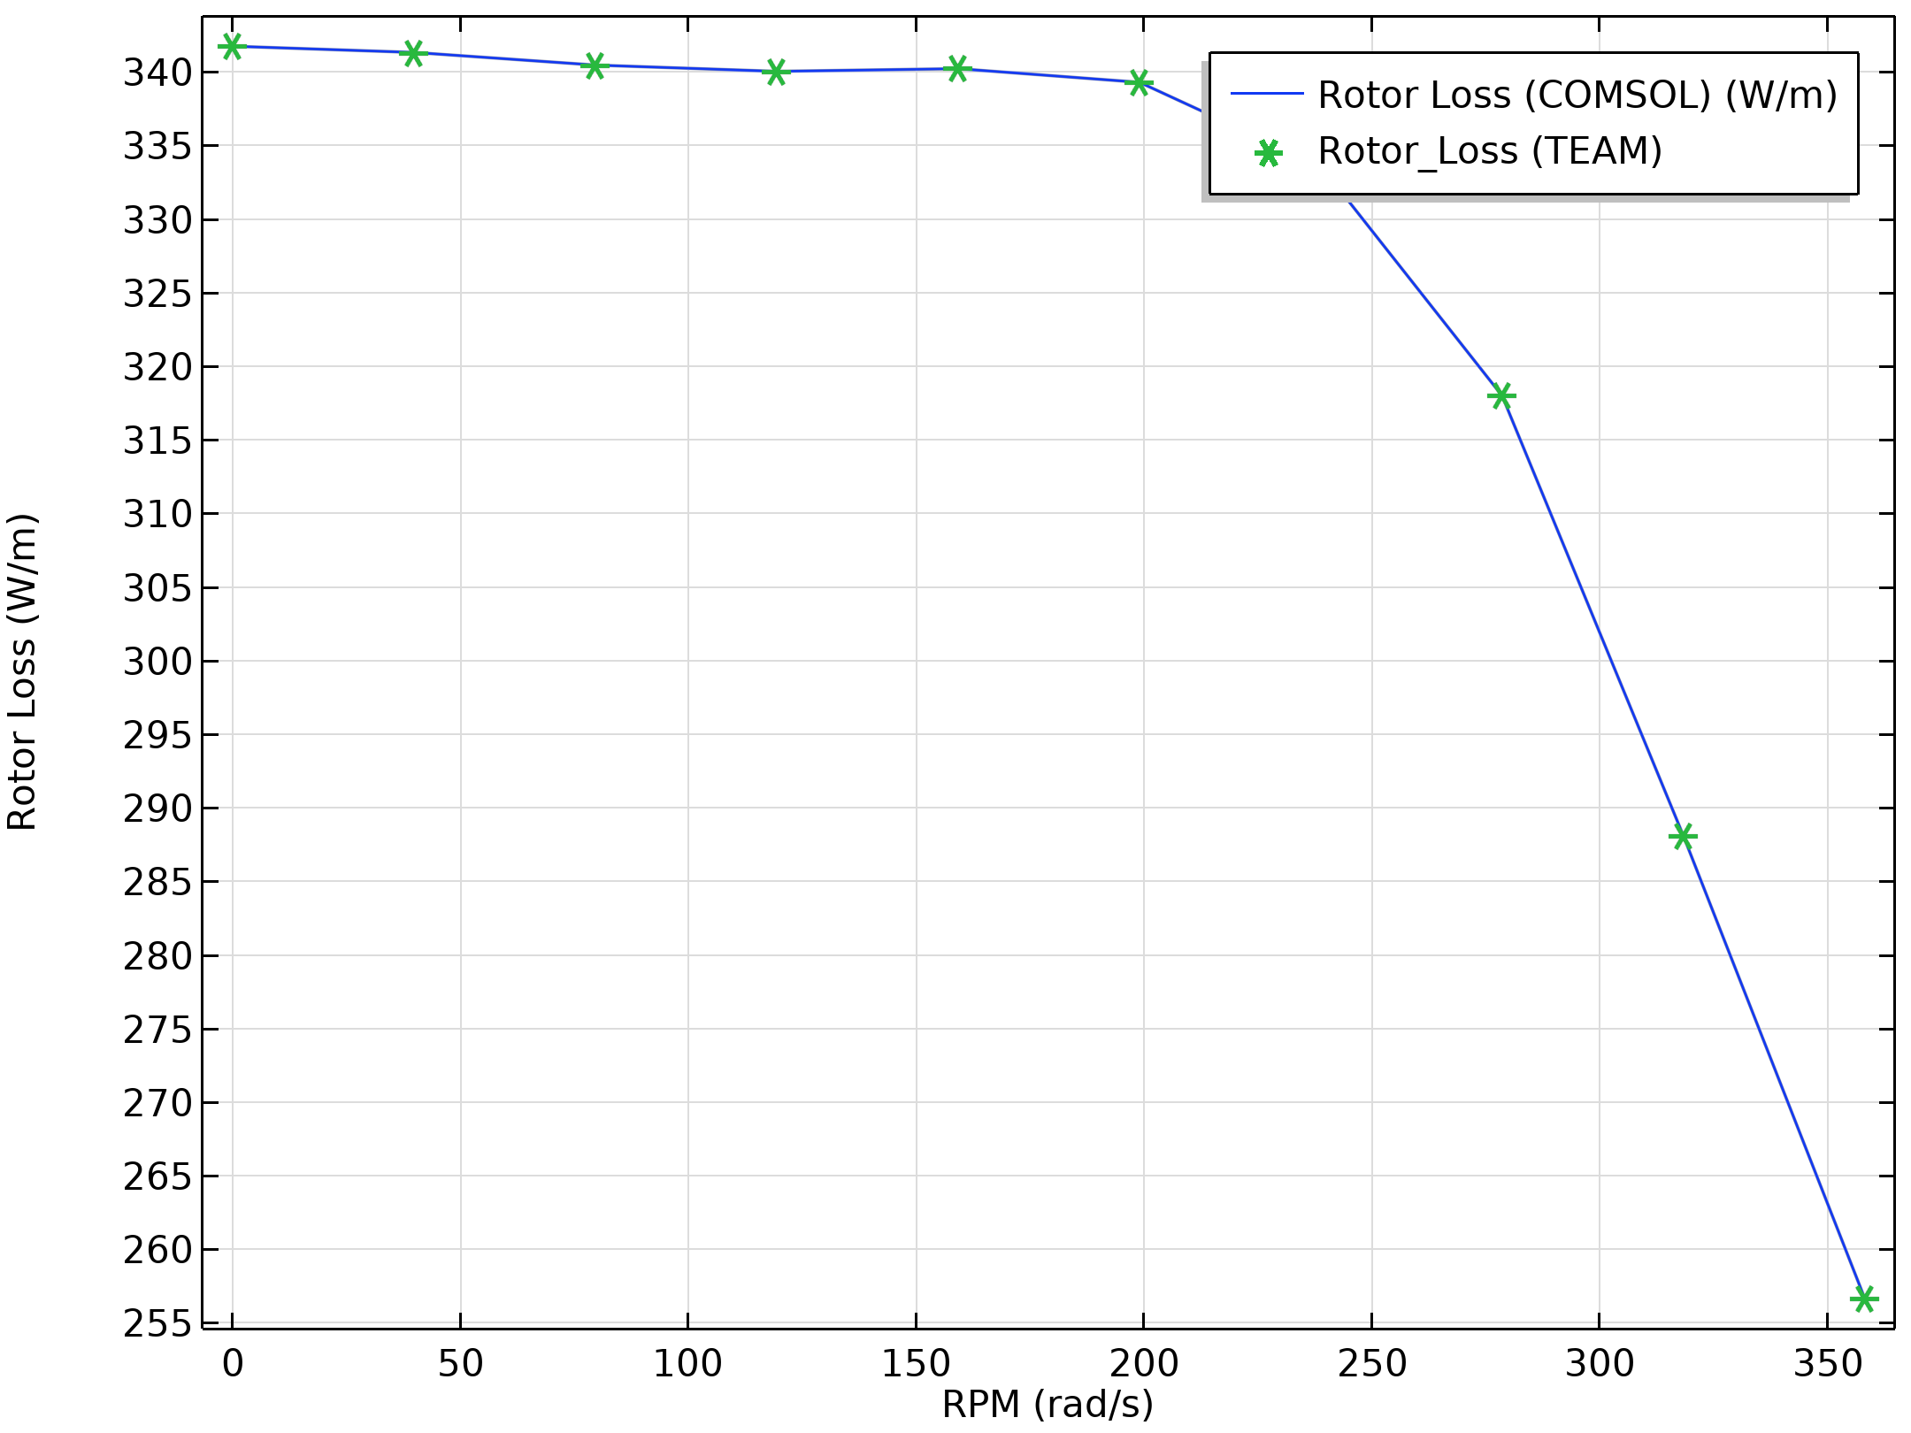
Results
Rotor losses comparison at various speeds of the rotor

Slide 20
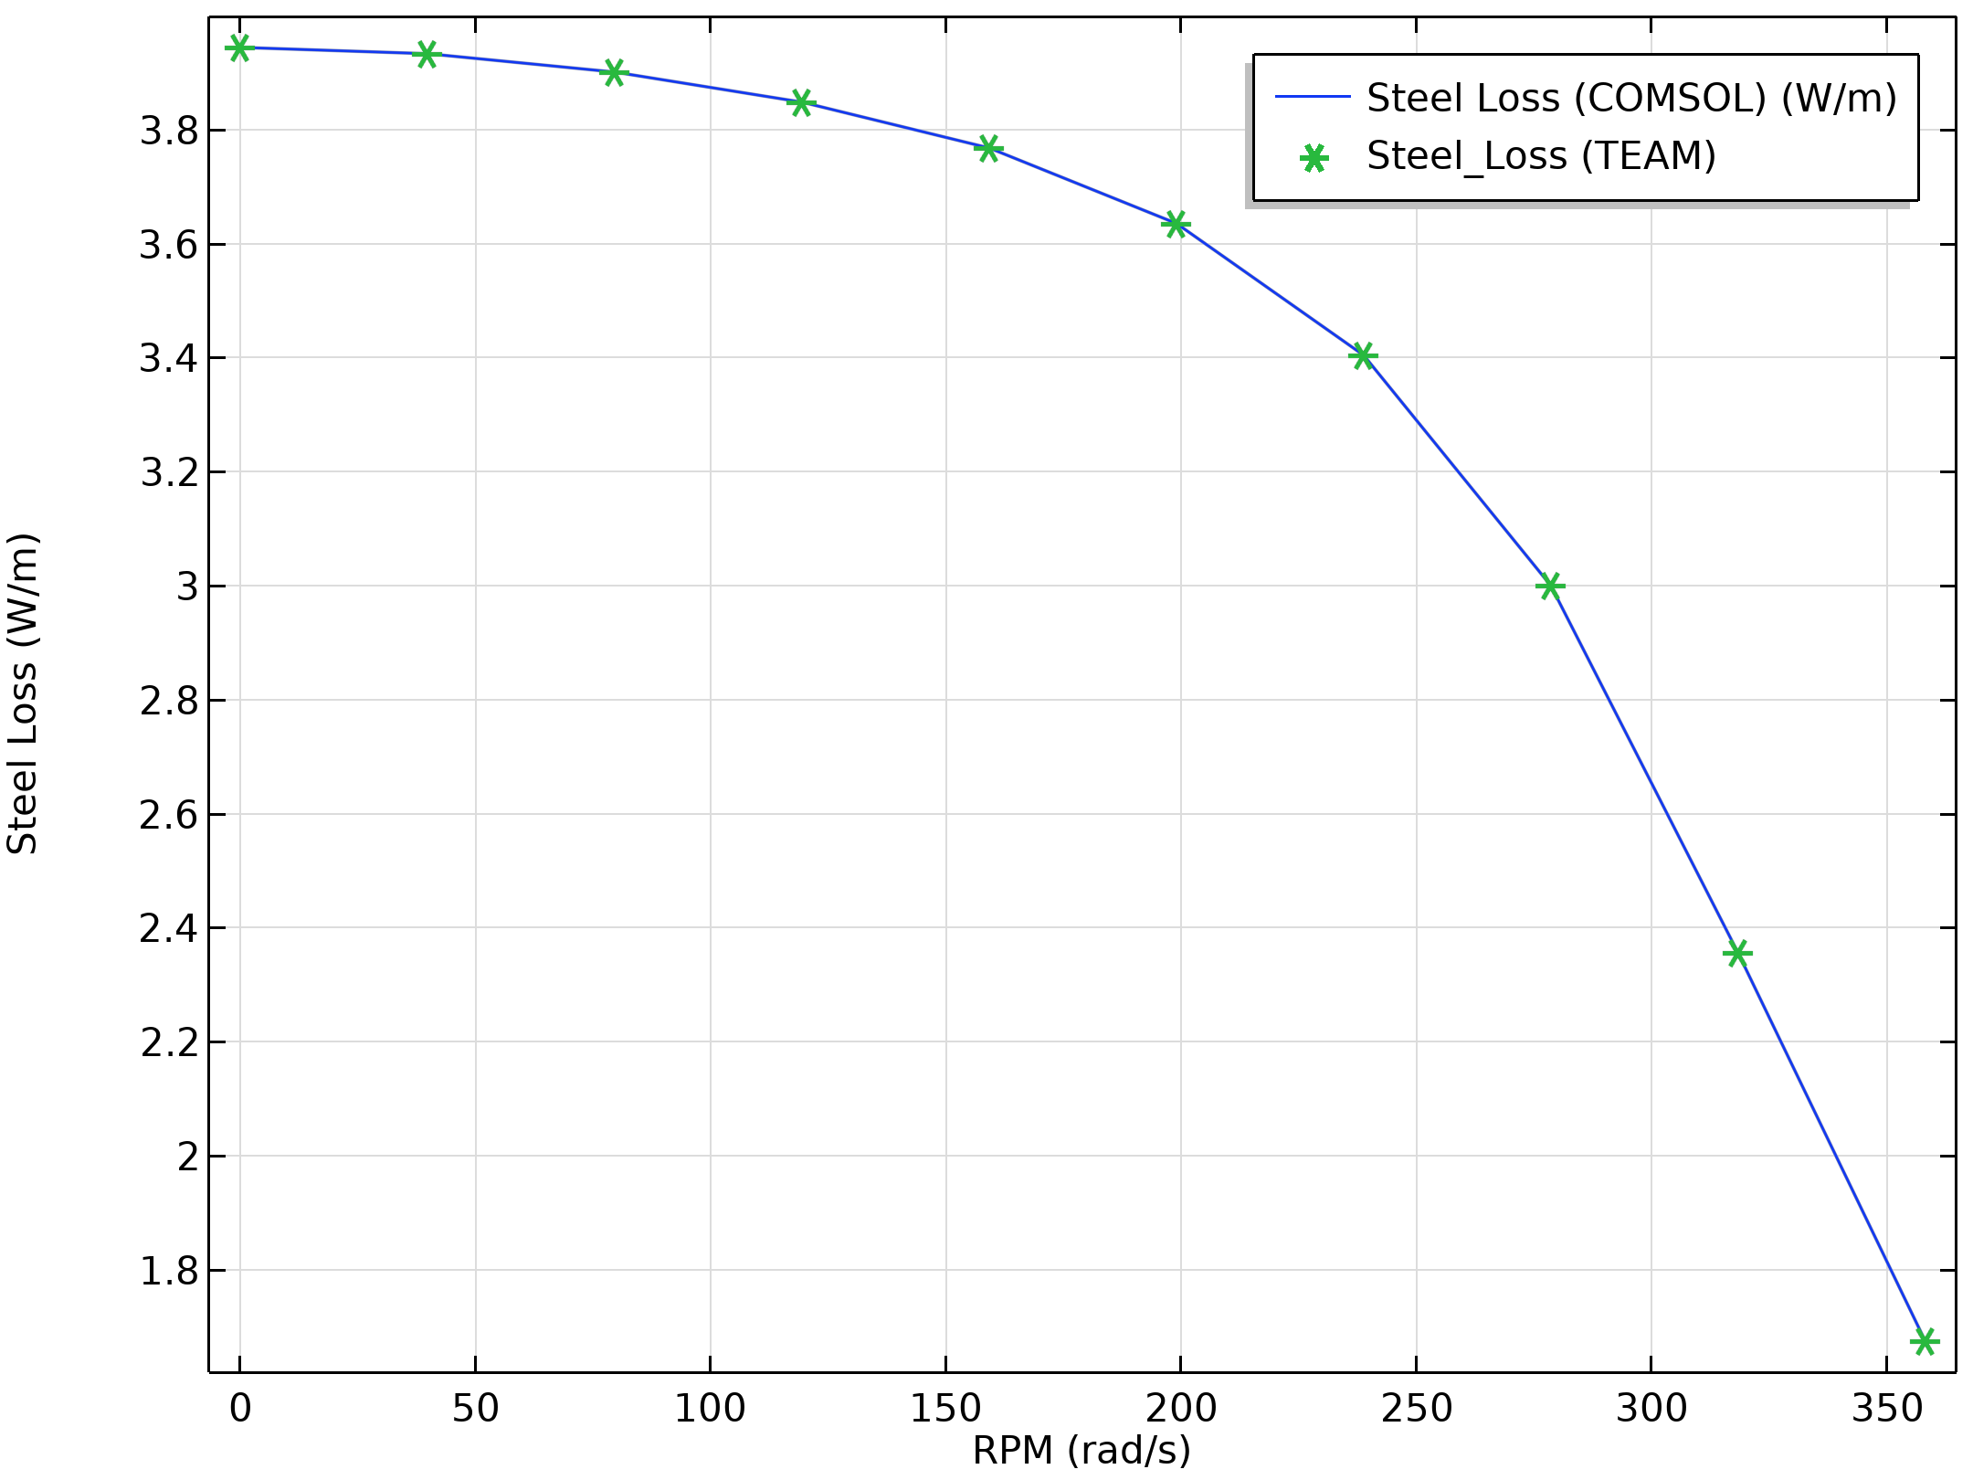
Results
Losses in steel comparison at various speeds of the rotor

Slide 21
Conclusion
A Single phase Induction motor is modeled and compared with the TEAM benchmark model problem 30
A close match in the values of Torque, Voltage and Losses is obtained in comparison to the benchmark model
This model can be further extended by converting this into an App by using COMSOL ‘Application Builder’ similar to the one described in the following blog post for 3-phase induction motor.
https://www.comsol.com/blogs/how-to-automate-winding-design-in-electrical-machineswith-an-app/

