Slide 1
Loudspeaker Radiation:
BEM Acoustics Tutorial

Slide 2
Background and Motivation
In this tutorial, the acoustic radiation pattern from a small generic loudspeaker is analyzed using the boundary element method (BEM). The loudspeaker is located on a small table above the floor and at a given distance from a wall. The model is set up using the Pressure Acoustics, Boundary Elements physics interface of the Acoustics Module.
The model shows the basics of setting up such an exterior radiation model with BEM as well as common postprocessing.

Slide 3
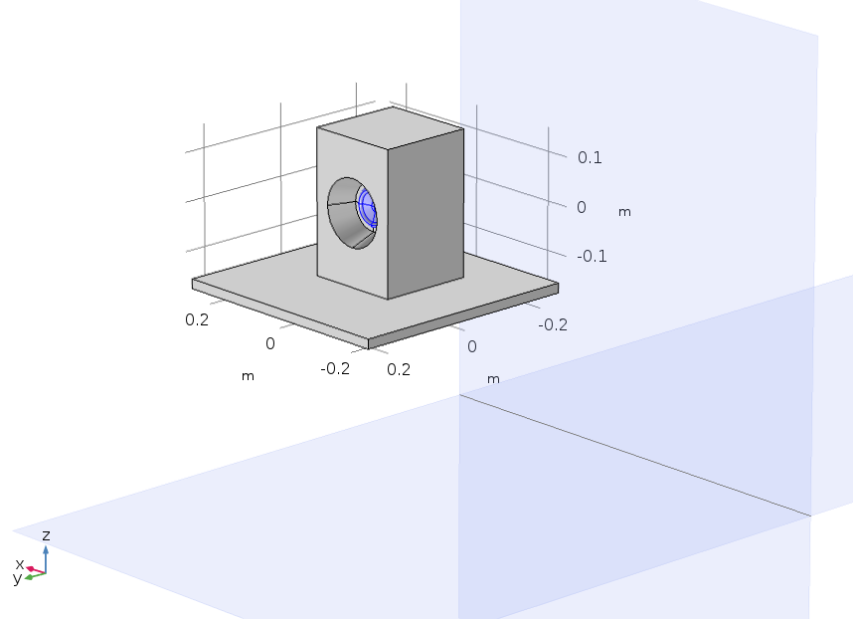
Model Setup
Speaker
0.5 m
Table
Wall
Unit velocity in the axial
direction of the cone
Infinite sound
hard boundaries
0.5 m
Floor
Note: The legs of the table are not modelled.

Slide 4
Postprocessing BEM
When a model based on the boundary element method is solved, the solution (the pressure and its normal derivative) exists on boundaries. This is where the degrees of freedom (DOFs) live.
On boundaries, the solution can readily be plotted by plotting the DOFs. For other quantities, boundary postprocessing variables exist, like pabe.p_t_bnd. Moreover, on interior boundaries both up and down variables are defined, like pabe.p_t_up and pabe.p_t_down. All the boundary postprocessing variables can be found in the Boundary variables group in the plot list.
When postprocessing the BEM solution within the domains, the pressure field has to be reconstructed using a kernel evaluation.
  The Grid 3D and Grid 2D data sets are specially designed for evaluating the solution within domains where there is no mesh. A grid data set can be used as input to a Cut Plane, a Cut Line, and a Cut Point dataset.
  Parametrized curves and surfaces can be used directly to evaluate the BEM solution when the option Only evaluate globally defined expressions is selected.
  The dedicated acoustics plots like the Radiation Patter plot and the Directivity plot can be used directly with, for example, the sound pressure level variable pabe.Lp as expression.
Examples of all of the above plot types are given in this small loudspeaker tutorial model.

Slide 5
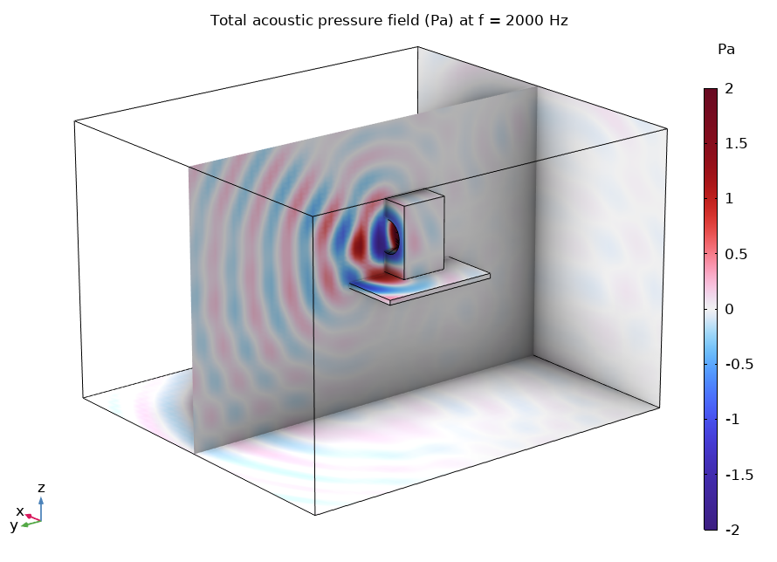
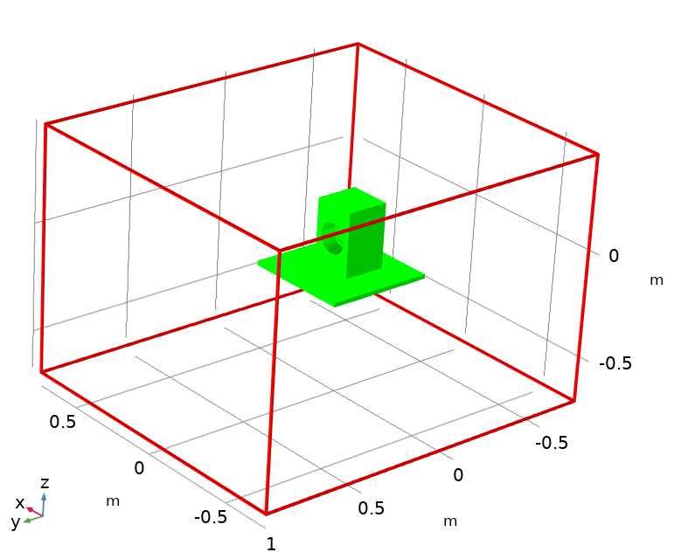
Results
Note that the Grid 3D data set bounds (visualized above by using the preview Plot on the Grid data set) can be changed in order to plot the solution in a larger/smaller domain. It is also important to set a proper resolution in the data set when visualizing wave phenomena.

Slide 6
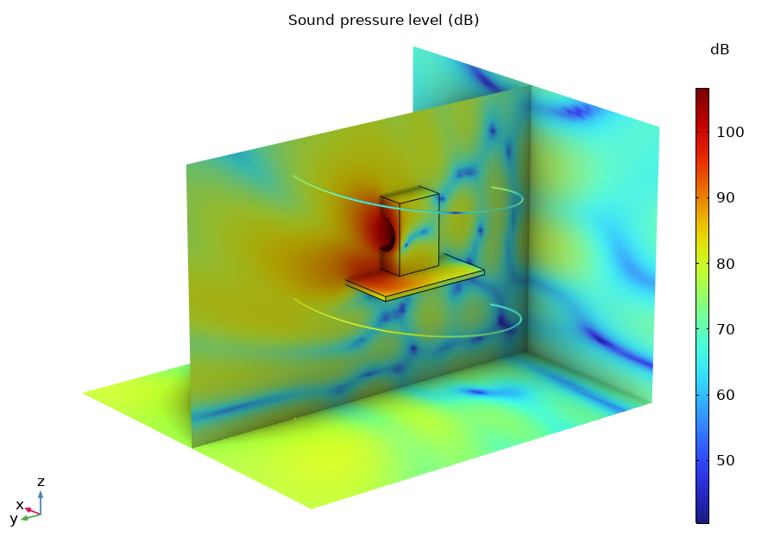
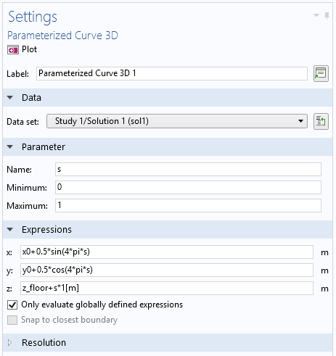
Results
Sound Pressure Level plotted on the speaker surface, in cross sections, and along the Parametrized Curve 3D.

Slide 7
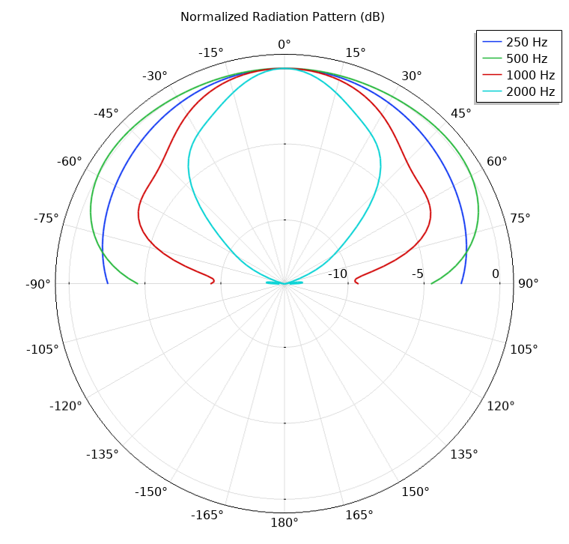
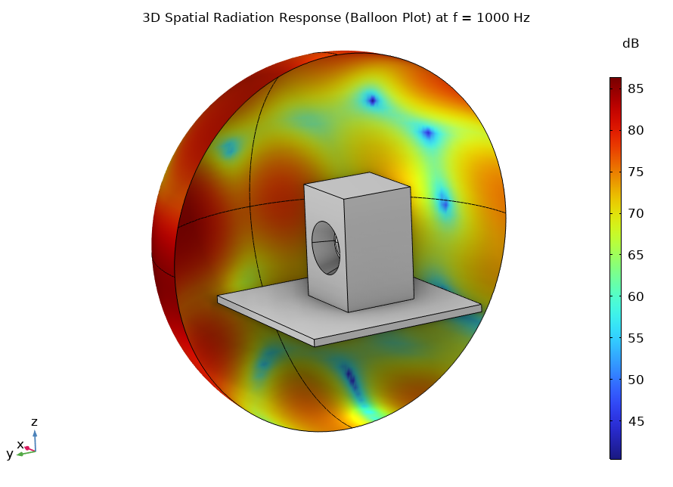
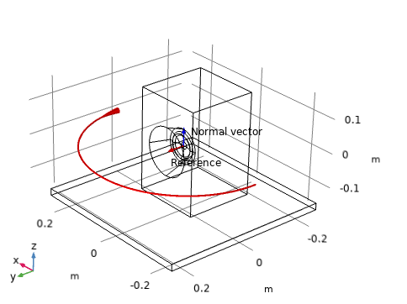
Results

