Slide 1
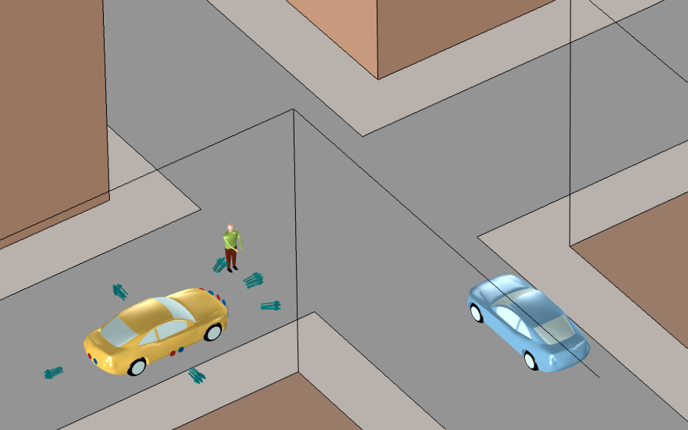
Light Detection and Ranging (Lidar)

Slide 2
Objective
Light detection and ranging (lidar) is used extensively in self-driving cars to perform quantitative ranging of the surrounding obstacles
The lidar system consists of a laser beam that gets broadened using a MEMS mirror with a particular horizontal and vertical field of view (FOV)
The light source hits the nearby surrounding obstacles and scatters
These scattered rays are detected by the array of photodetectors of the lidar subsystem
The objective of this model is to detect and range the surrounding obstacles, such as pedestrian and car, with a particular arrangement of source and detector array

Slide 3
Model Setup
Building walls
Car acting as an obstacle
Pedestrian
Car with lidar subsystem
Lidar system
Rays launched by laser source
Road
Footpath

Slide 4
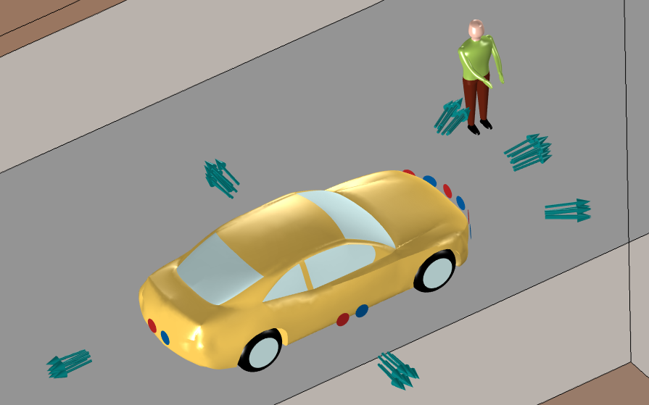
Model Setup
The Ray Optics Module was used to release the laser source with a particular cone angle representing the field of view (FOV)
Different boundary conditions were applied to nearby obstructions, such as building walls, roads, car body, and car glass
Operating wavelength of lidar subsystem is 905 nm
For simplicity, we have omitted the rays that reflect two or more times without reaching a detector

Slide 5
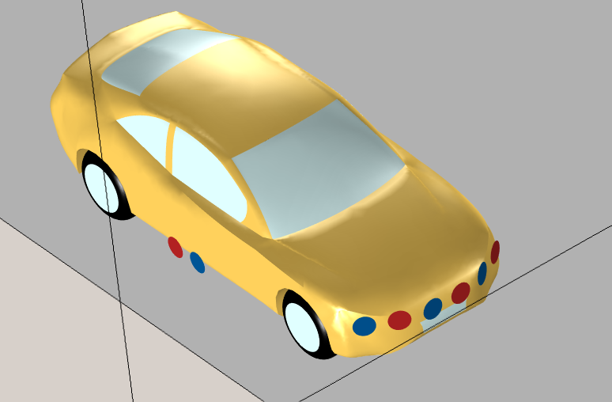
Lidar System
Each laser source is modeled as an Release from Boundary condition with a cone angle of 5˚
The laser sources are placed around the car to observe the obstructions
Each of the front sources releases 62,500 rays, while each of the sideways and rear sources releases 10,000 rays
An array of photodetectors is placed adjacent to each laser source
Arrangement of sources (in red) and detectors (in blue)

Slide 6
Material Properties
Defining different boundaries in the model [1]:
  Type 1 (diffuse scattering): car body, roads, walls of building, and pedestrian
  Type 2 (specular reflection): car tail lights, license plates, and road signs
  Type 3 (pass through): car window glass
The refractive index of the ambient atmosphere is approximated as 1, which represents clear air
Ref [1]: H. Rasshofer, R & Spies, M & Spies, H. (2011). Influences of weather phenomena on automotive laser radar systems. Advances in Radio Science. 9. . 10.5194/ars-9-49-2011.

Slide 7
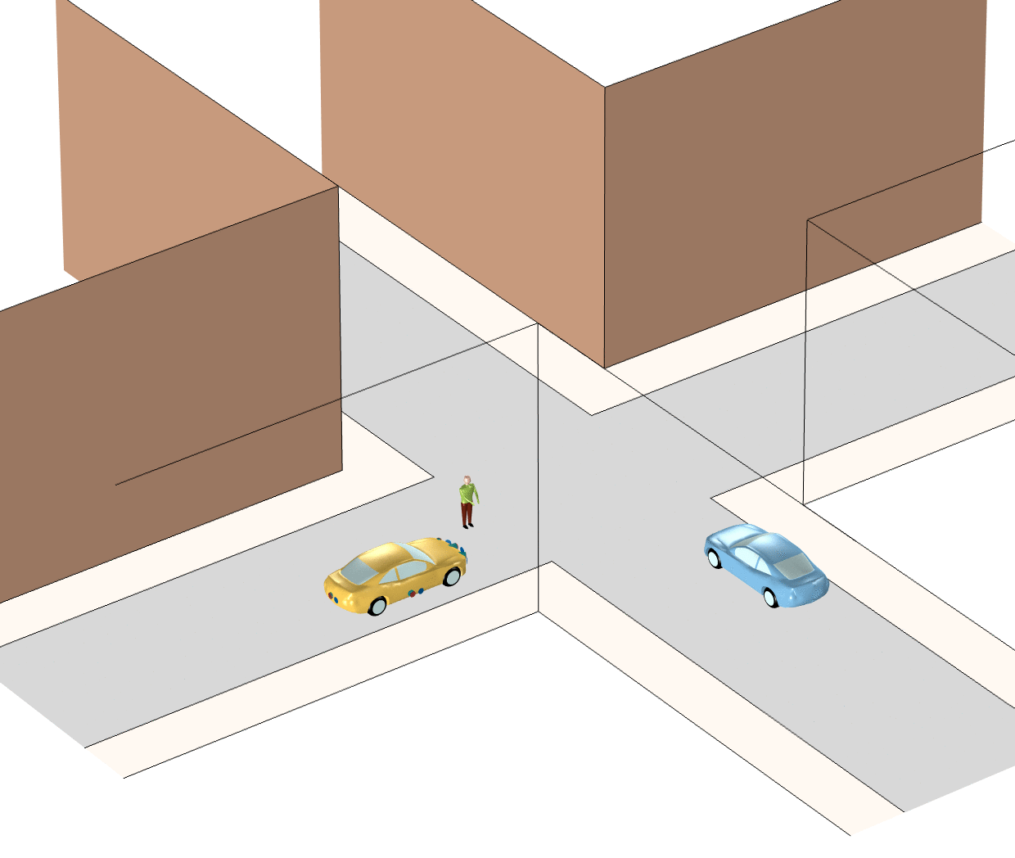
Results: Ray Propagation from Lidar

Slide 8
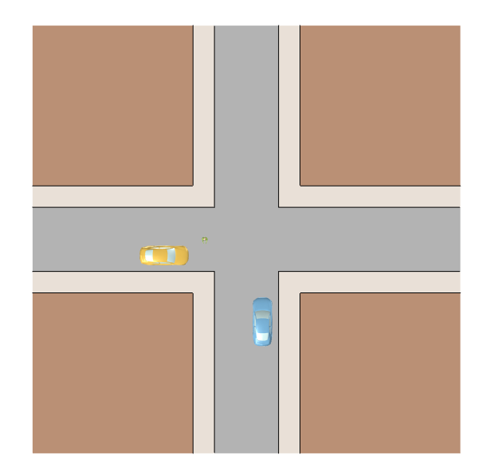
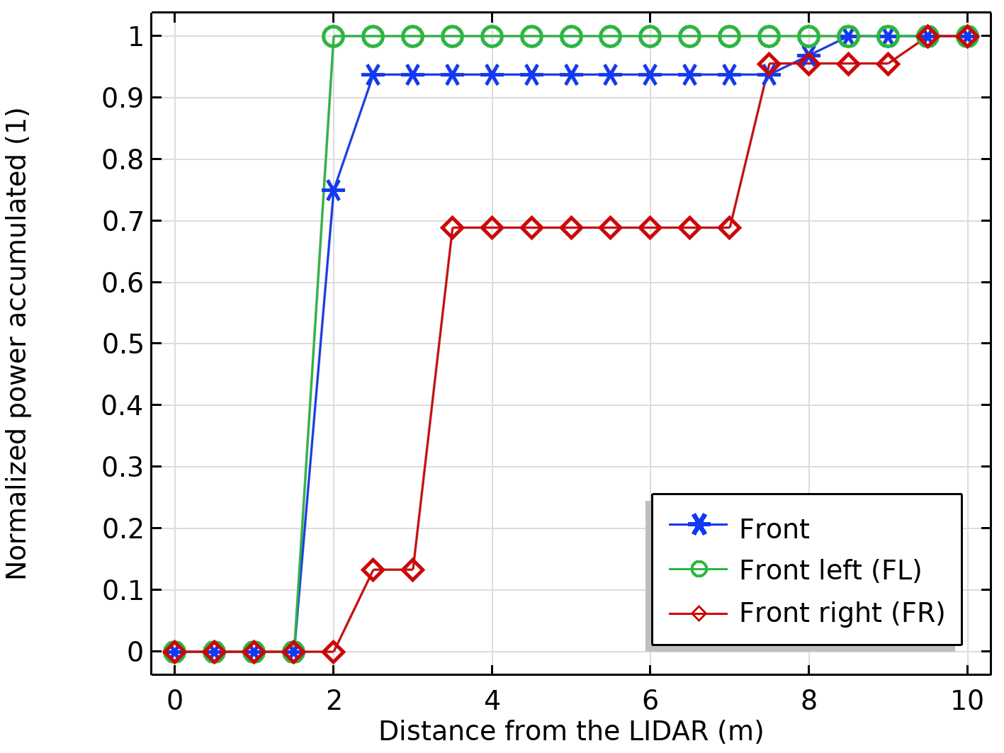
Results: Front Detectors
Road
Building 1
Building 2
Building 3
Building 4
The front and front left detectors peak at 2 m detecting the pedestrian. The front right detector peaks at 7.5 m detecting the obstacle car.
Car with lidar
Obstacle car
Pedestrian

Slide 9
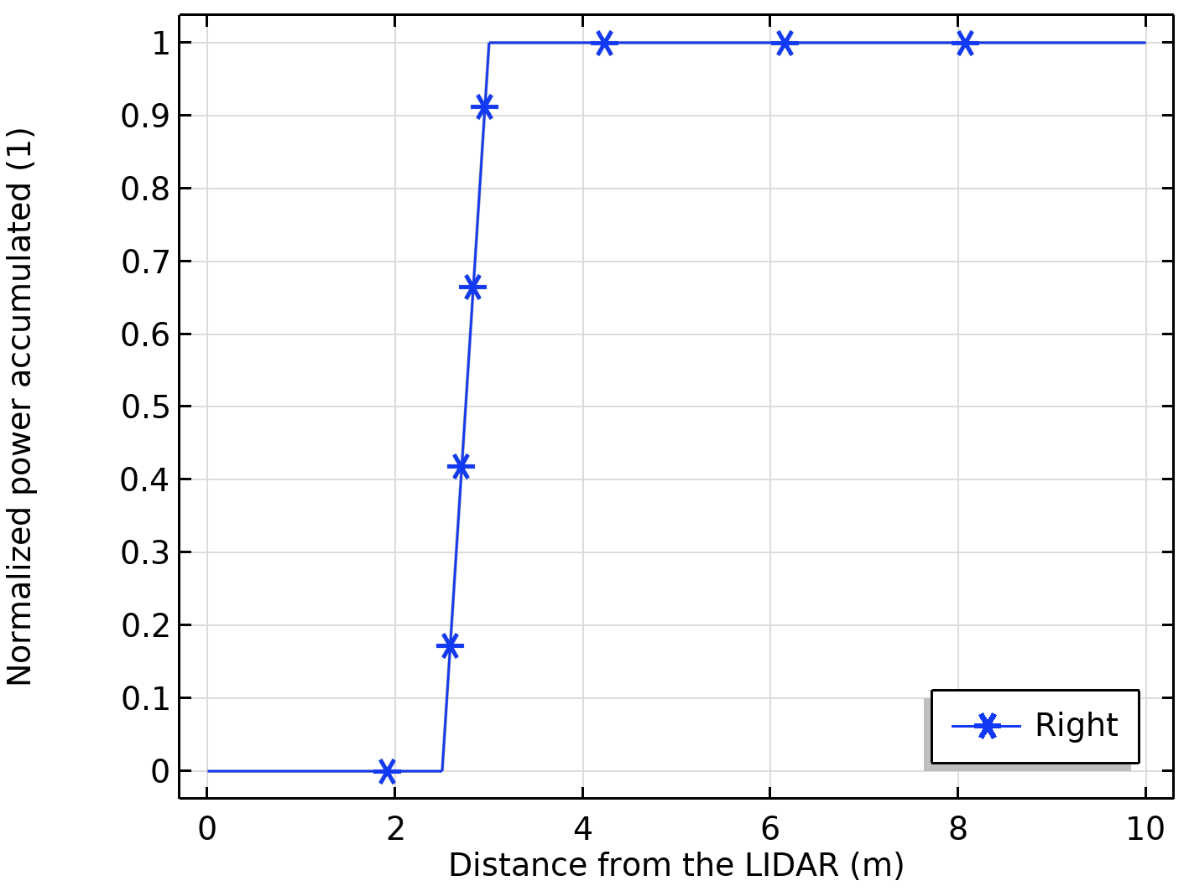
Results: Right Detector
Road
Building 1
Building 2
Building 3
Building 4
The right detector peaks at 2.5 m detecting the wall of Building 3
Car with lidar
Obstacle car
Pedestrian

Slide 10
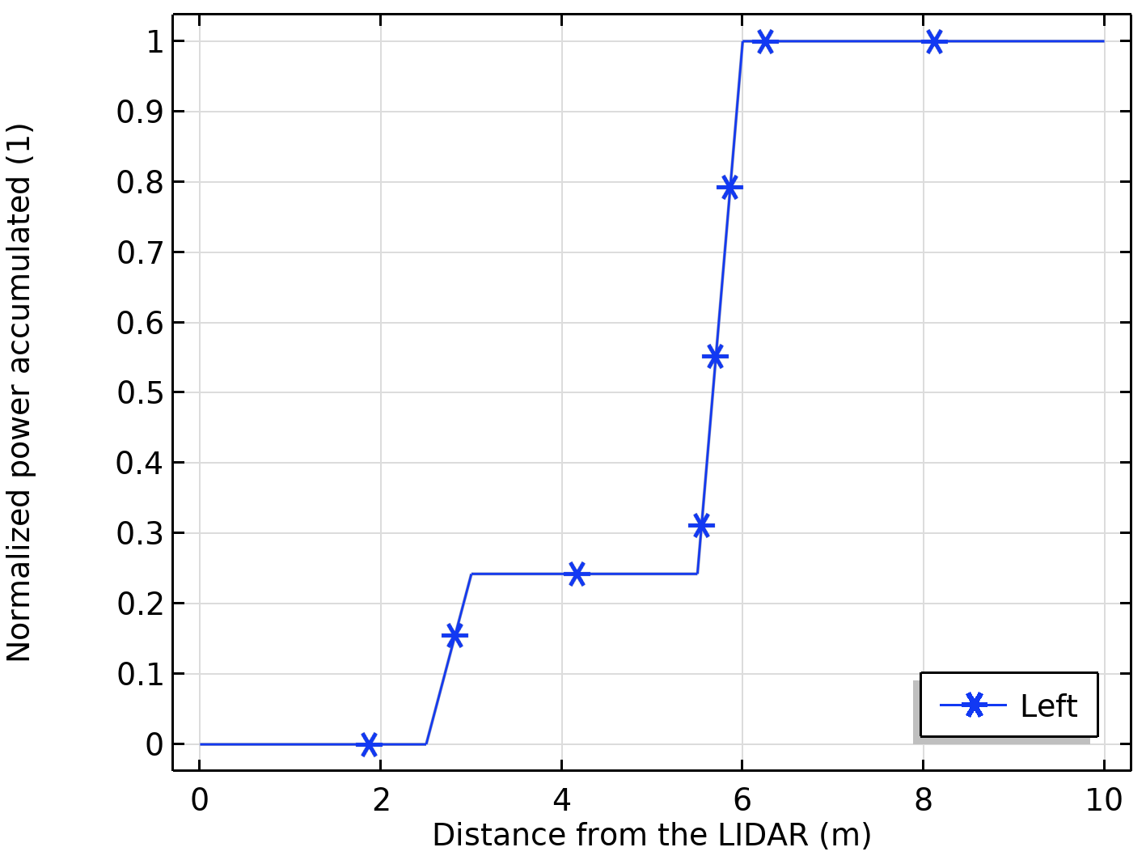
Results: Left Detector
Road
Building 1
Building 2
Building 3
Building 4
The left detector peaks at 5.5 m detecting the wall of Building 1
Car with lidar
Obstacle car
Pedestrian

Slide 11
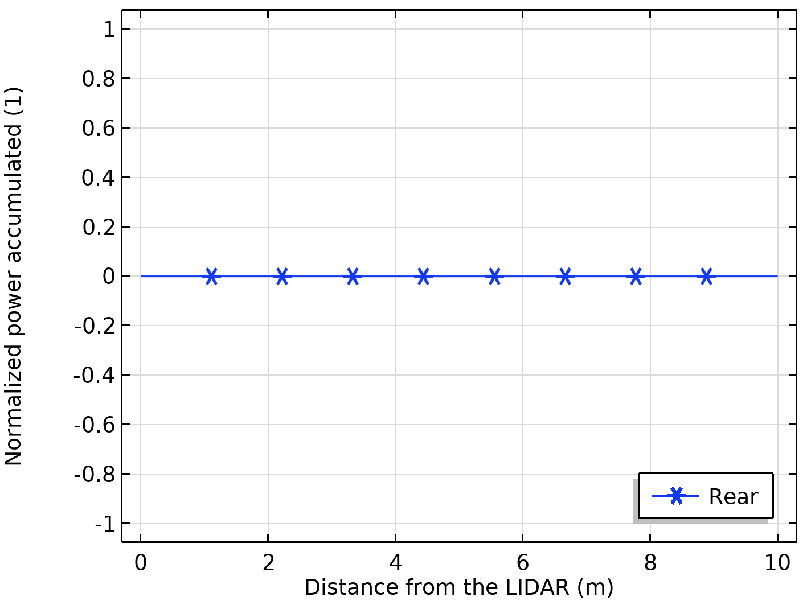
Results: Rear Detector
Road
Building 1
Building 2
Building 3
Building 4
No detection by the rear detectors
Car with lidar
Obstacle car
Pedestrian

Slide 12
Conclusion
The model was able to successfully detect and range the pedestrian and the car in front using the ray optics approach
Boundary conditions such as diffuse scattering, pass through, and specular reflection were used to define different boundaries in the modeling domain
With this model, one can range obstacles on the order of tens of meters
Future work may include accounting for losses when the rays hit different boundaries

