Slide 1
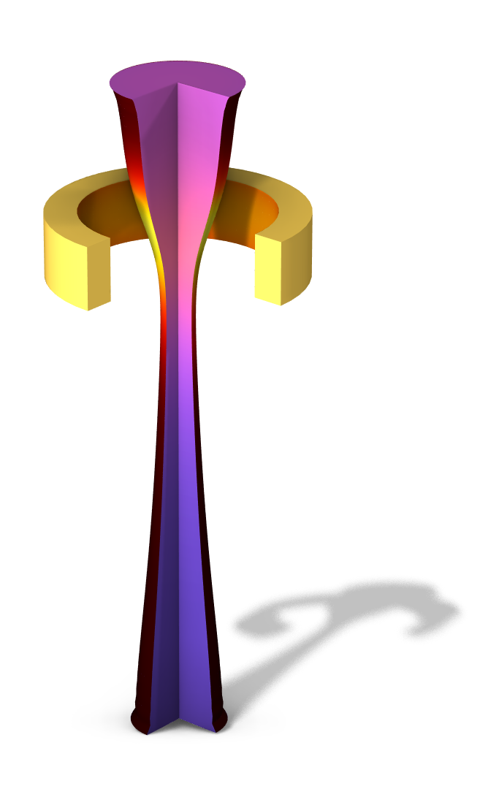
Fiber Drawing Process

Slide 2
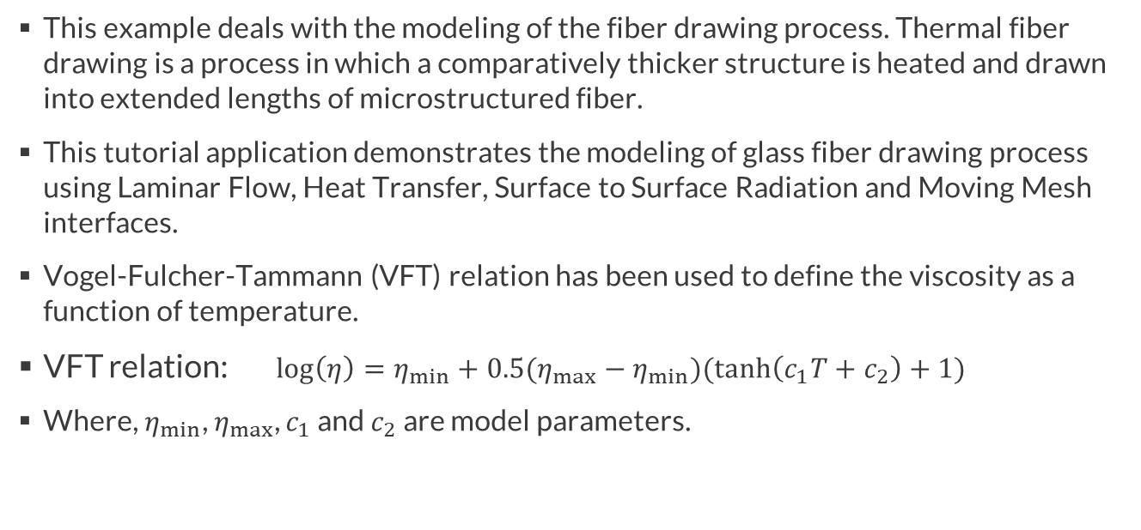
Background and Motivation
This example deals with the modeling of the fiber drawing process. Thermal fiber drawing is a process in which a comparatively thicker structure is heated and drawn into extended lengths of microstructured fiber.
This tutorial application demonstrates the modeling of glass fiber drawing process using Laminar Flow, Heat Transfer, Surface to Surface Radiation and Moving Mesh interfaces.
Vogel-Fulcher-Tammann (VFT) relation has been used to define the viscosity as a function of temperature.
VFT relation: $\log\left(η\right)=η_{min}+0.5(η_{max}−η_{min})(\tanh\left(c_{1}T+c_{2}\right)+1)$
Where, $η_{min}$, $η_{max}$, $c_{1}$ and $c_{2}$ are model parameters.

Slide 3
Objective
Demonstrate the model setup for fiber drawing process using Laminar Flow, Heat Transfer, Surface to Surface Radiation and Moving Mesh interfaces.
Examine the influence of pulling velocity on the radius of fiber.

Slide 4
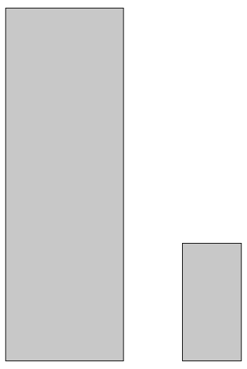

Initial Geometry, and Mesh
1 [mm]
3 [mm]
0.5 [mm]
1 [mm]
Mesh
Symmetry axis

Slide 5
Model Parameters and Material Properties
Model Parameter | Value
Pull velocity | 0.05 [mm/s]
Glass fiber initial height | 3 [mm]
Glass fiber initial radius | 1 [mm]
Glass fiber | Value
Density | 2530 [kg/m^3]
Thermal conductivity | 1.3 [W/(m*K)]
Heat capacity | 1400 [J/(kg*K)]
Emissivity | 0.9
Furnace | Value
Density | 8960 [kg/m^3]
Thermal conductivity | 400 [W/(m*K)]
Heat capacity | 385 [J/(kg*K)]
Emissivity | 0.95

Slide 6
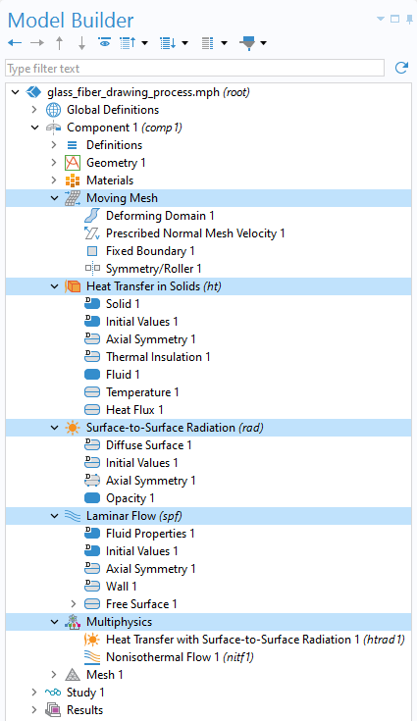
Physics Interfaces
Moving Mesh
Heat Transfer in Solid
Surface-to-Surface Radiation
Laminar Flow
Multiphysics
  Heat Transfer with Surface-to Surface Radiation
  Nonisothermal Flow

Slide 7
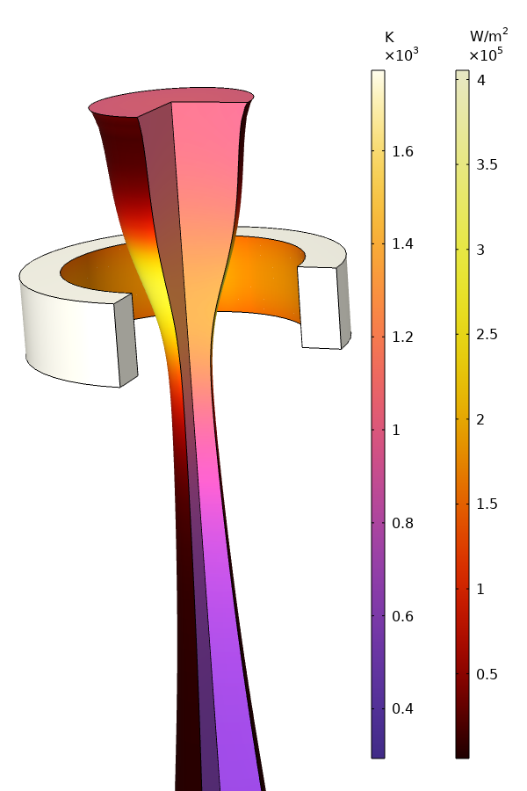
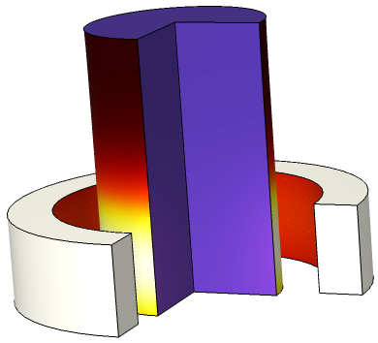
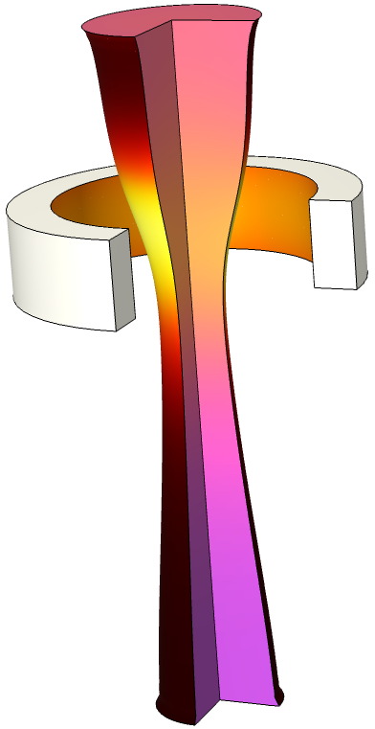
Results: Temperature and Surface Irradiation
Temperature and surface irradiation at t=1 s, t=100 s and t=150 s

Slide 8
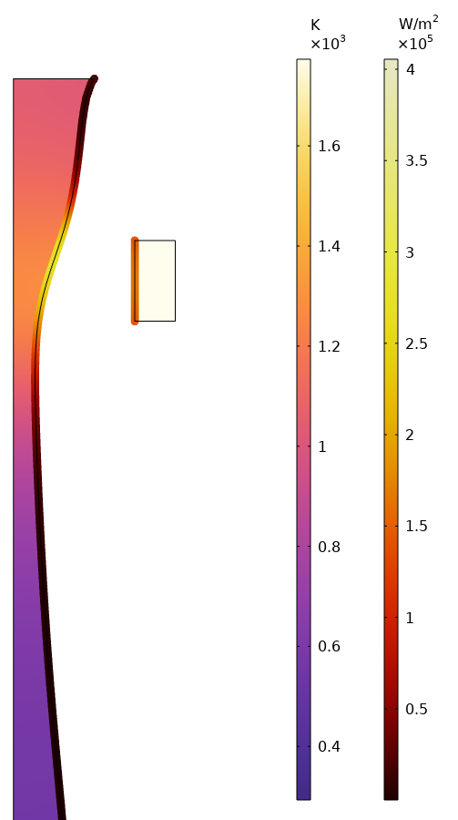
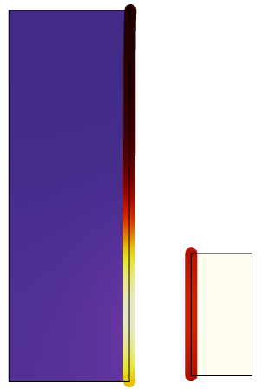
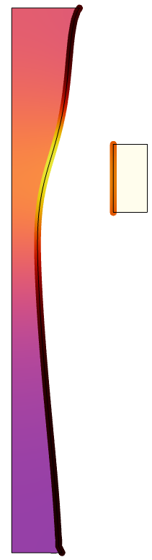
Results: Temperature and Incident Irradiation
Temperature and incident irradiation at t=1 s, t=100 s and t=150 s

Slide 9
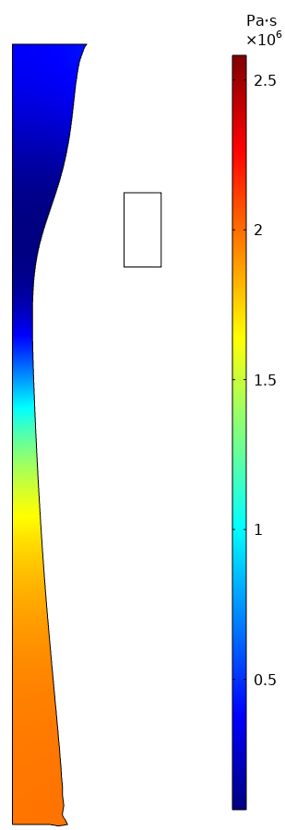
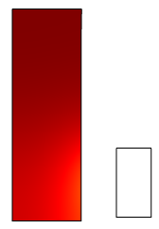
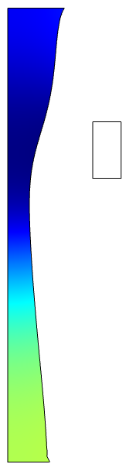
Results: Viscosity
Viscosity at t=1 s, t=100 s and t=150 s

Slide 10
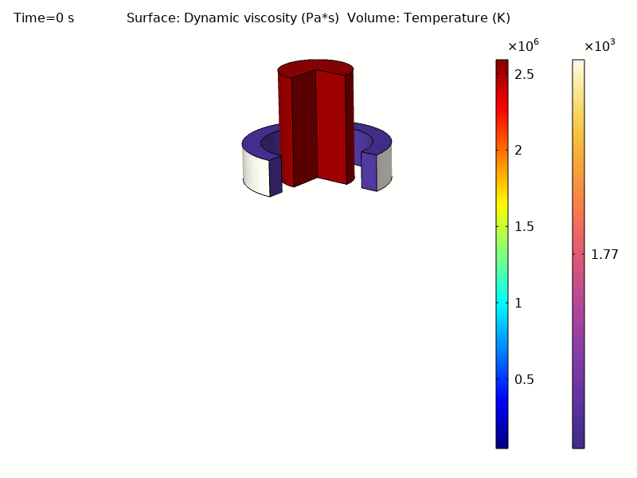
Results: Animation

Slide 11
Conclusion
Drawing of glass fiber has been simulated using Laminar Flow, Heat Transfer, Surface to Surface Radiation and Moving Mesh interfaces.
The model can be used to investigate the influence of the pulling velocity on the forming process.

