Slide 1
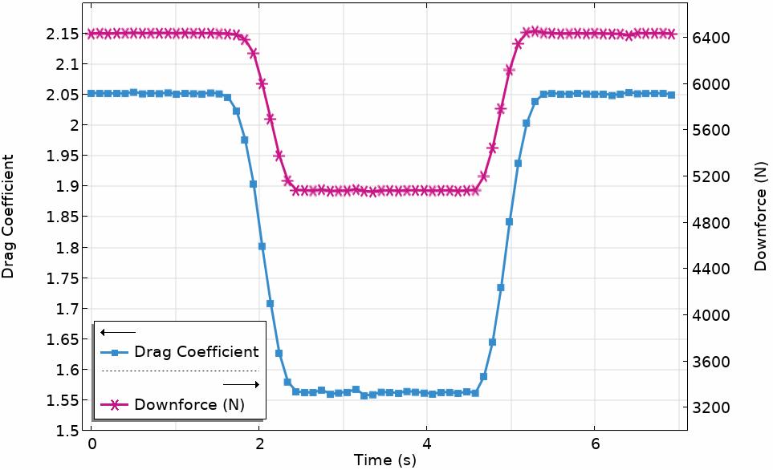
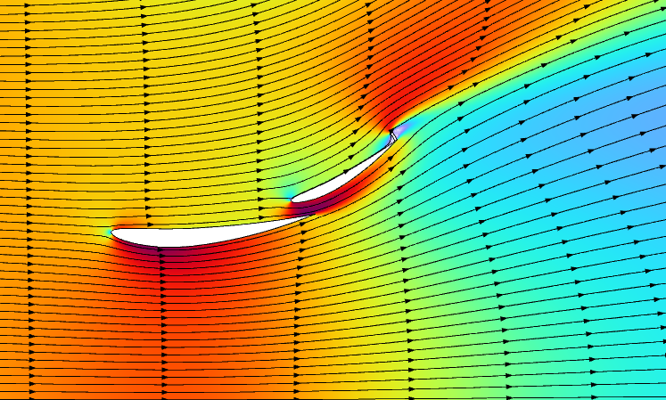
Drag Reduction System in Motorsport
COMSOL

Slide 2
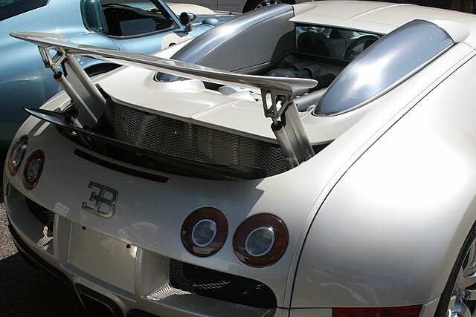
Active Aerodynamics in Vehicles
The automotive industry is rapidly innovating to produce greener cars. This innovation includes the development of cutting-edge technologies, such as active aerodynamics systems.
Active aerodynamics actuate components on the vehicle dynamically to offer a more refined driving experience.
For example, cars may be equipped with:
  An adjustable rear wing that can either reduce drag for speed or increase it to act as an air brake (Ref. 1)
  Active air flaps in the front grille that open or close depending on the cooling needs of the engine (Ref. 2)
  An adjustable front splitter for enhanced handling (Ref. 1)
This technology improves fuel efficiency, optimizes cooling, and enhances stability (Ref. 3).
The Bugatti Veyron® tail wing rises to generate more downforce at high speeds. Image in the public domain, via Wikimedia Commons.

Slide 3
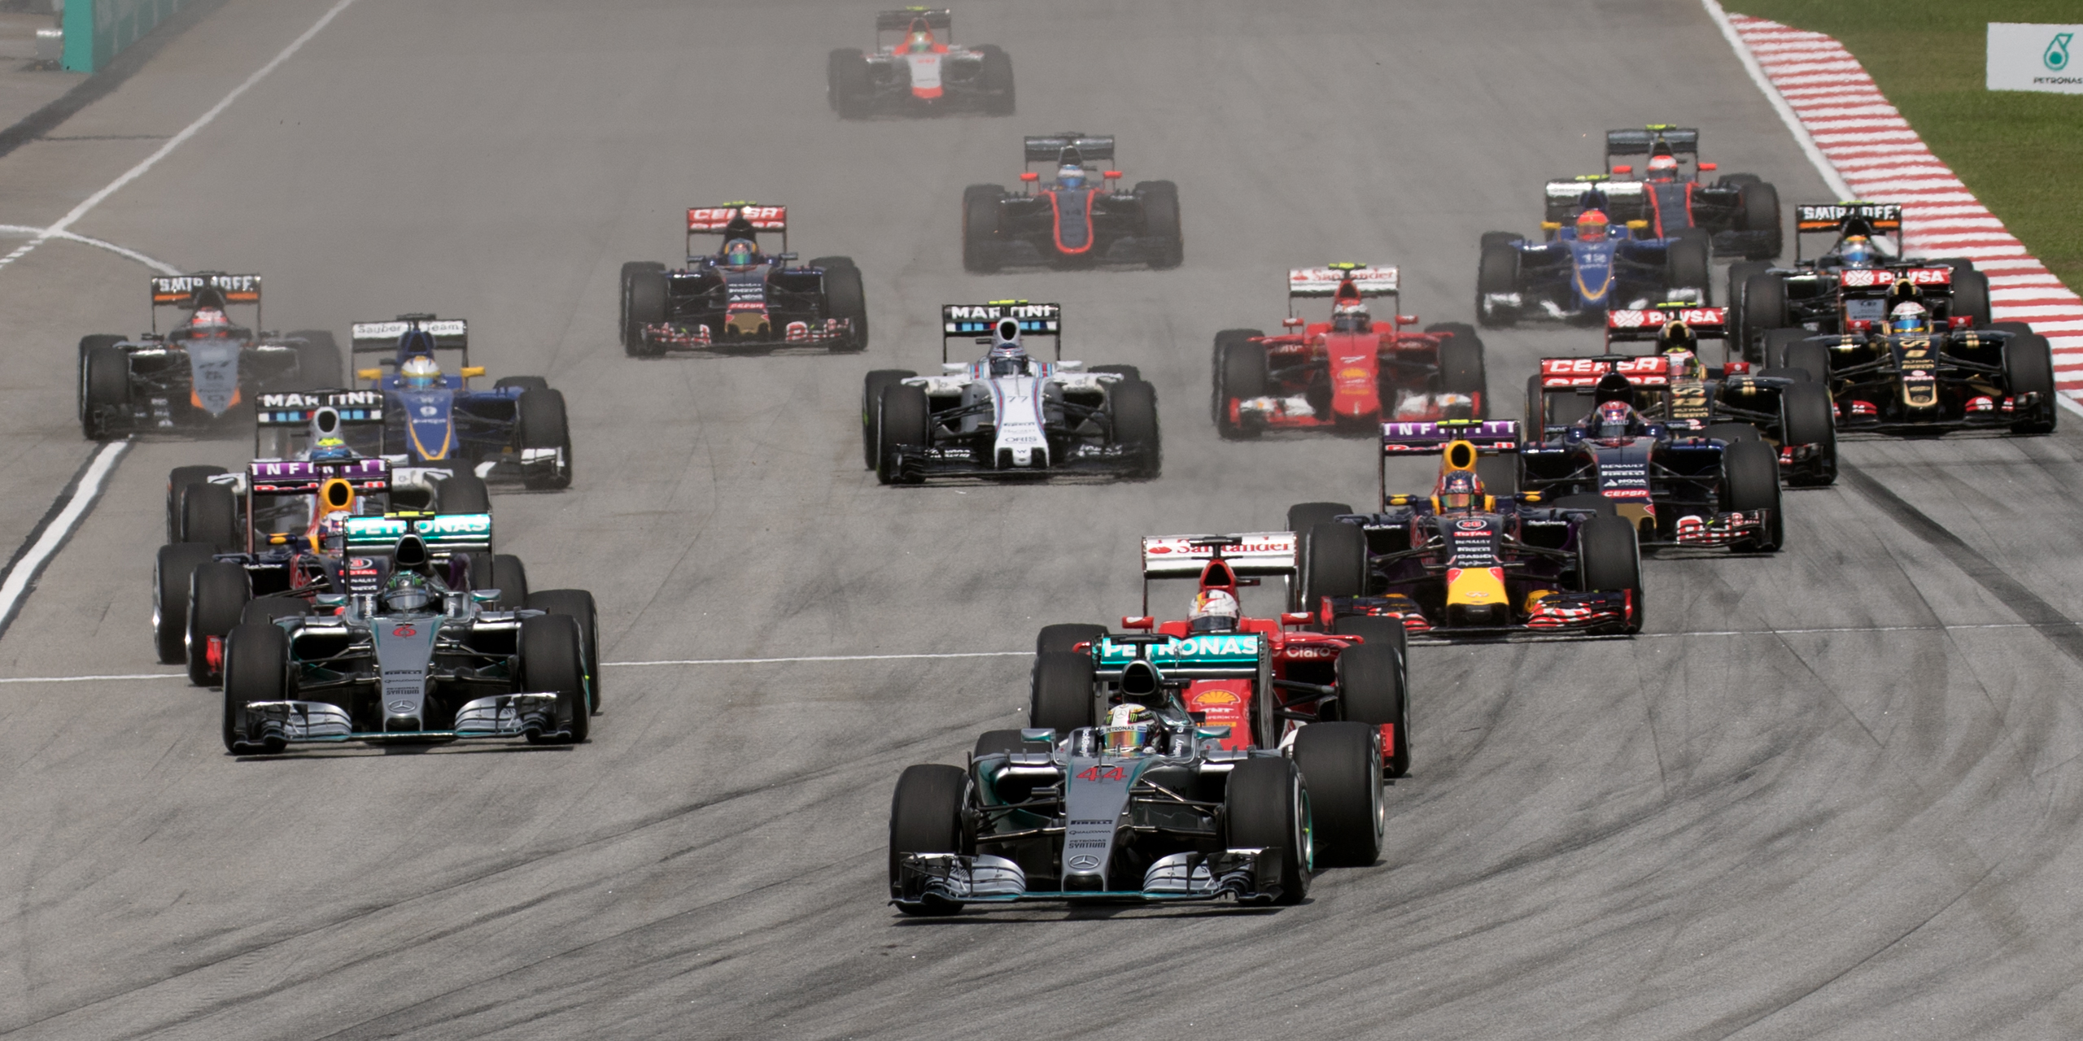
Drag Reduction System (DRS)
DRS is an example of innovative active aerodynamics in Formula 1 designed to reduce aerodynamic drag.
DRS reduces drag and helps drivers gain a speed advantage on straight sections of a track (known as “straights”), making it easier to overtake cars ahead of them.
Since the drag is reduced at the cost of reduced downforce, DRS is deployed only on straights instead of corners, where cars are more prone to losing grip.
2015 Malaysian Grand Prix. Image available from Wikimedia Commons, licensed under the Creative Commons Attribution-Share Alike 4.0 International license.

Slide 4
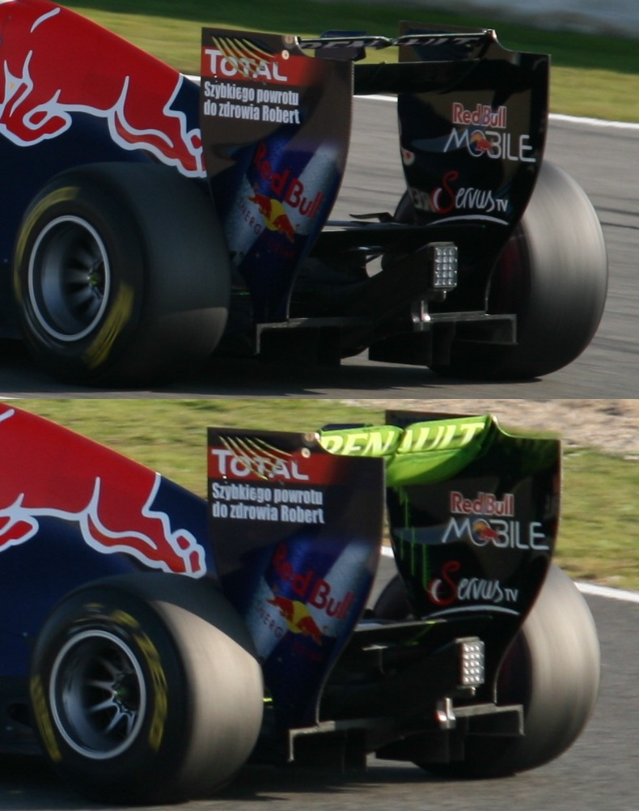
How DRS Works
A typical rear wing assembly in a Formula 1 car consists of two wings that span the width of the car. The core component of DRS is the adjustable upper wing, which will be referred to here as the “DRS flap”.
When activated, the DRS flap rises (top image) to reduce the angle of attack, i.e., aligns its plane to the direction of airflow. This decreases aerodynamic drag and downforce, allowing the car to achieve higher speeds on a straight.
Upon deactivation, the DRS flap drops (bottom image), restoring normal levels of drag and downforce to improve the car's grip.
An adjustable rear wing in a Red Bull-sponsored Formula 1® racing car. Image available via Wikimedia Commons, licensed under the Creative Commons Attribution 2.0 Generic license.

Slide 5
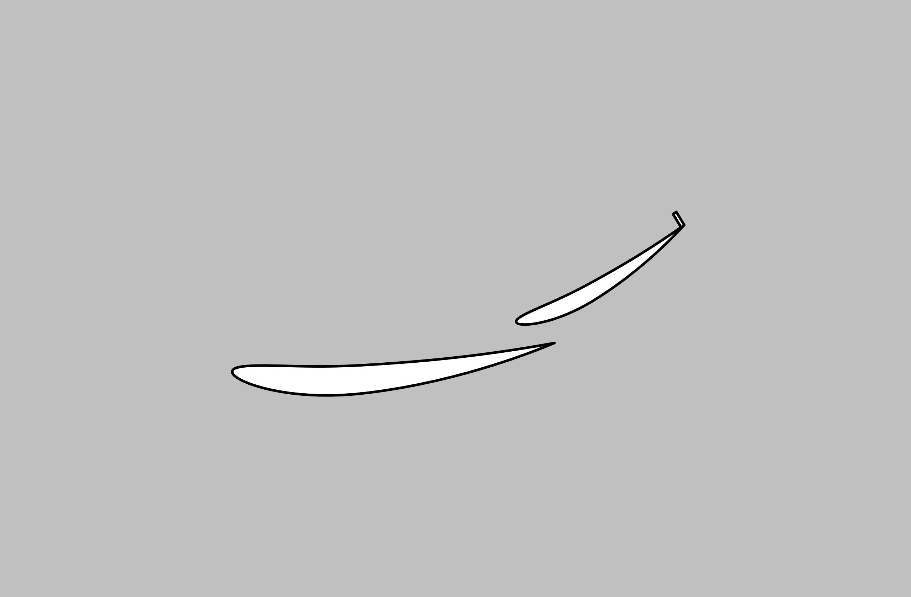
Numerical Setup
Goal: to quantify the reduction in aerodynamic drag and downforce on the rear wing
Geometry:
  A 2D cross section of the rear wing is modeled.
  The NACA N6409 airfoil is used for both the main flap (the lower wing) and the DRS flap.
  A gurney flap is fixed to the tail end of the DRS flap.
  The wings are assumed to be perfectly rigid.
While the NACA N6409 airfoil does not truly represent the rear wing of a Formula 1 car, this model is intended to simply demonstrate the effects of an adjustable flap on aerodynamic drag and downforce.
Gurney flap
DRS flap
Main flap

Slide 6
Numerical Setup
Physics:
  Moving Mesh is used to model the adjustable flap such that it rises no more than 85 mm (as regulated by Formula 1) from the main flap.
  Turbulent Flow, k-ε is employed to solve for the flow profile of air, which enters the domain at a velocity of 90 m/s (201 mph).
Study steps:
  A stationary study is computed to obtain the steady-state flow profile when DRS is inactive.
  A time-dependent study is then performed to model the transient effects of the adjustable flap.
Open Boundary
Inlet
Outlet
Slip wall

Slide 7
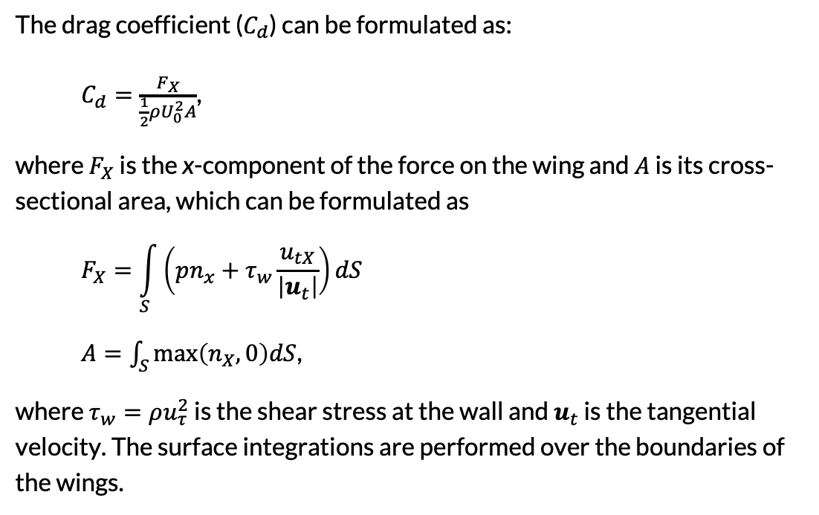
Evaluation of Drag Coefficient
The drag coefficient ($C_{d}$) can be formulated as:
$C_{d}=\frac{F_{X}}{\frac{1}{2}ρU_{0}^{2}A}$,
where $F_{X}$ is the x-component of the force on the wing and $A$ is its cross-sectional area, which can be formulated as
$$F_{X}=\int_{S}^{ }{\left(pn_{x}+τ_{w}\frac{u_{tX}}{\left|u_{t}\right|}\right)dS}$$
$A=\int_{S}^{ }{\text{max}\left(n_{X},0\right)dS}$,
where $τ_{w}=ρu_{τ}^{2}$ is the shear stress at the wall and $u_{t}$ is the tangential velocity. The surface integrations are performed over the boundaries of the wings.

Slide 8
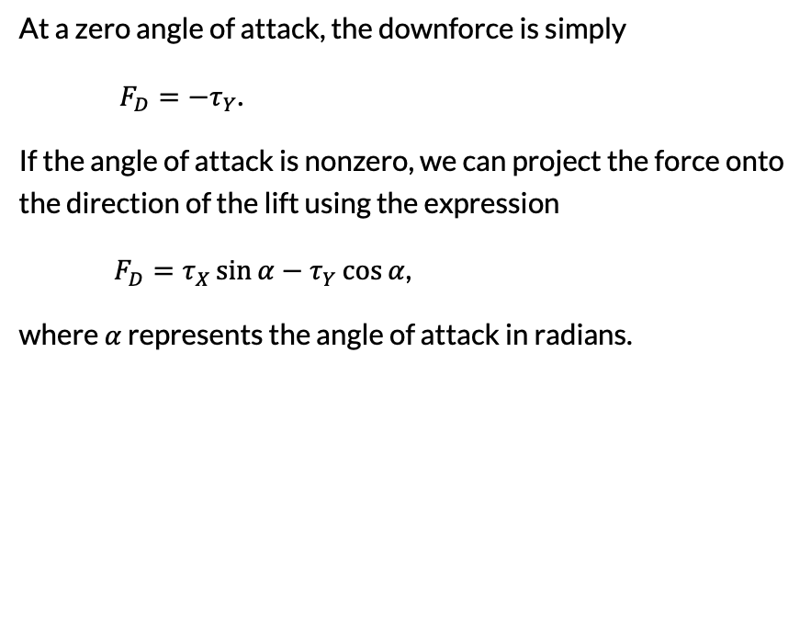
Evaluation of Downforce
At a zero angle of attack, the downforce is simply
$F_{D}={−τ}_{Y}$.
If the angle of attack is nonzero, we can project the force onto the direction of the lift using the expression
$F_{D}=τ_{X}\sin{α}−τ_{Y}\cos{α}$,
where $α$ represents the angle of attack in radians.

Slide 9
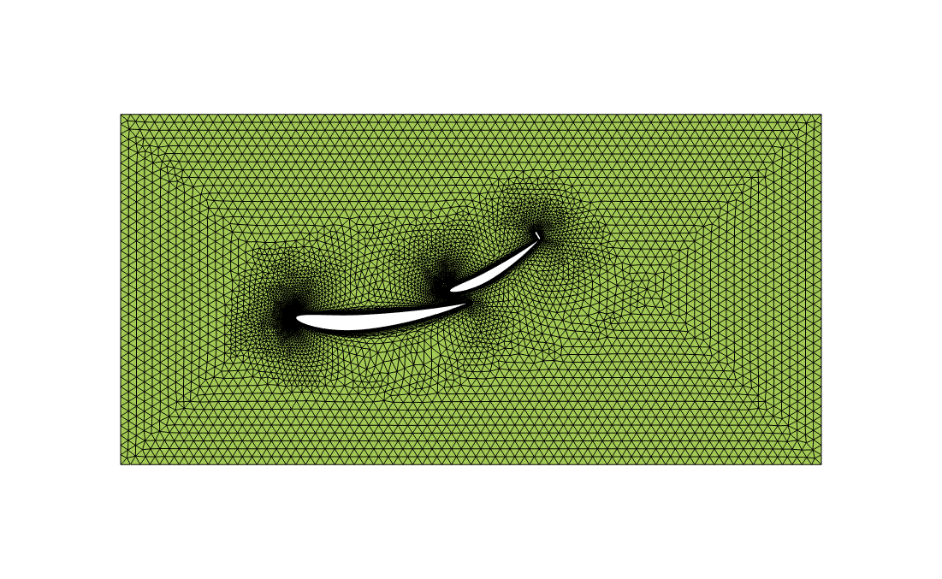
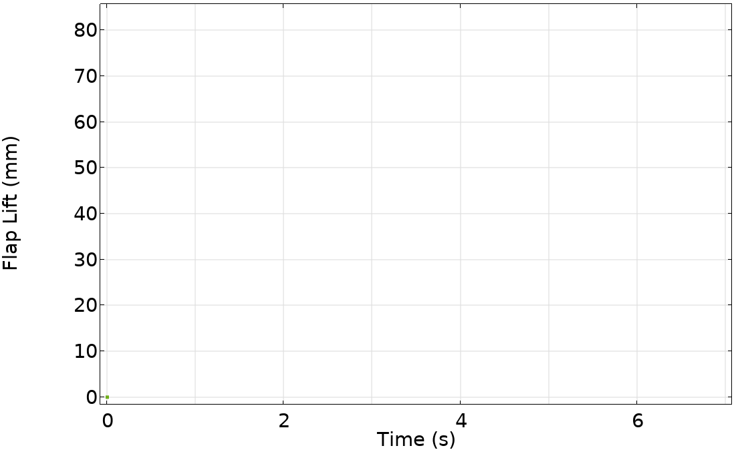
Results — Moving Mesh
DRS active zone
The plot (left) shows the DRS flap lift with time. DRS is activated 2 seconds after the study begins and is then active for roughly 3 seconds.
A 19.5˚ rotation of the DRS flap corresponds to a rise of 84 mm from the main flap, which is within regulation.
The mesh elements (right) move to describe the flap adjustment. Boundary layers remain at the surface of the flap.

Slide 10
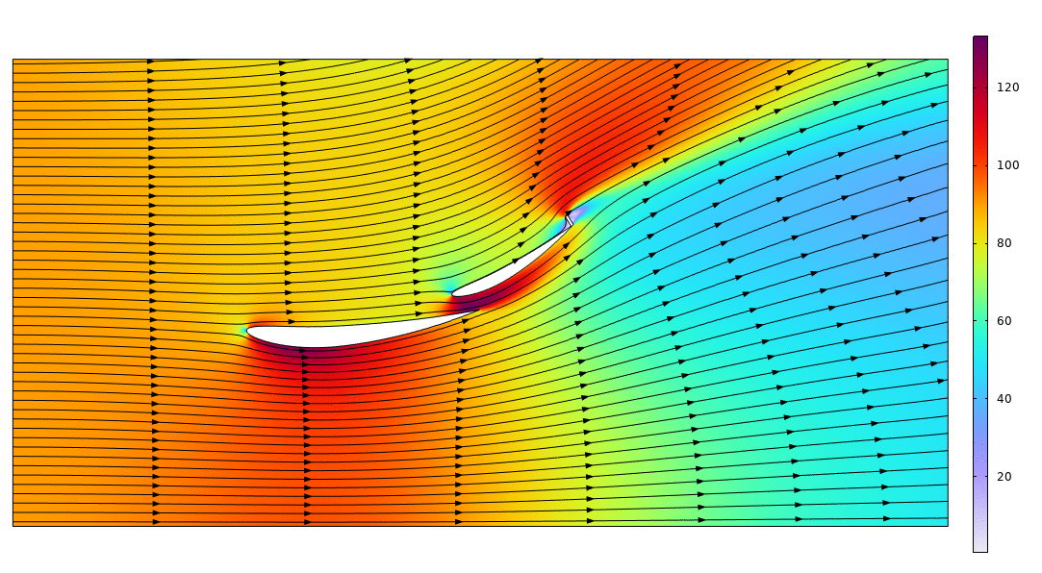
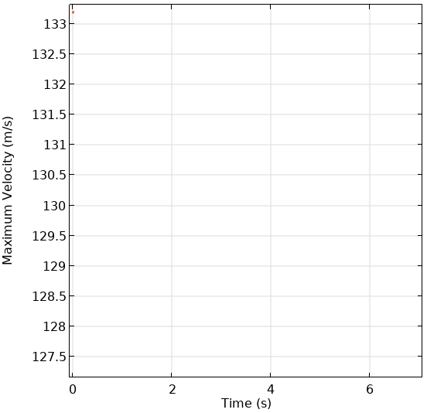
Results — Velocity Field
DRS active zone
The maximum velocity of air is lower when DRS is active, i.e., when the flap is raised.
Note that this should not be confused with the velocity of the car, which will be higher when the flap is raised.

Slide 11
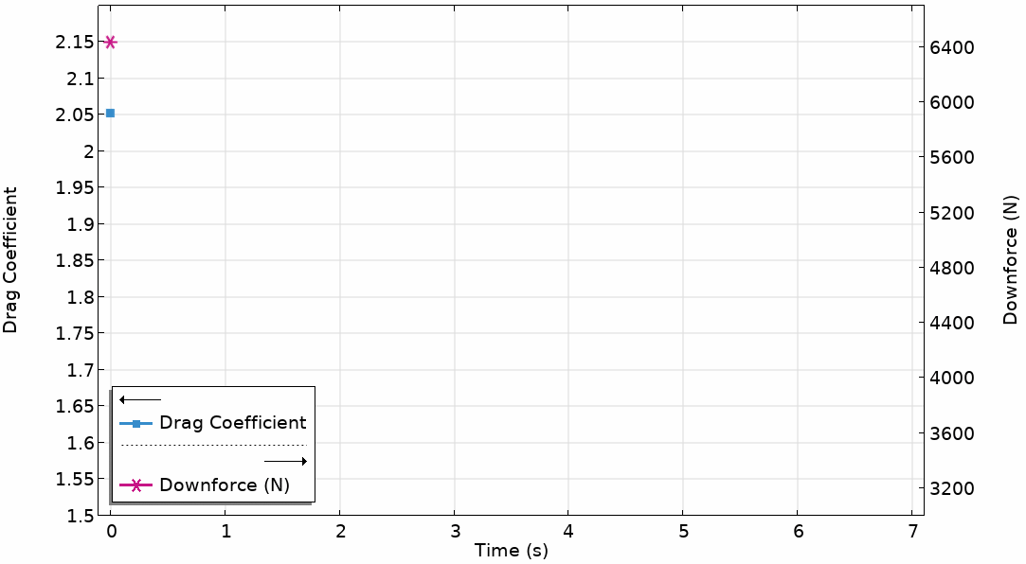
Results — Drag and Downforce
DRS active zone
The drag coefficient of the rear wing decreases by up to 27.1% when DRS is activated.
The downforce on the flap decreases by up to 23.6% when DRS is activated.
In Formula Student competition vehicles, DRS can reduce drag by up to 78% (Ref. 4). This reduction can vary based on the car’s speed, the aerodynamic setup, and the specific DRS design, as well as the track layout.

Slide 12
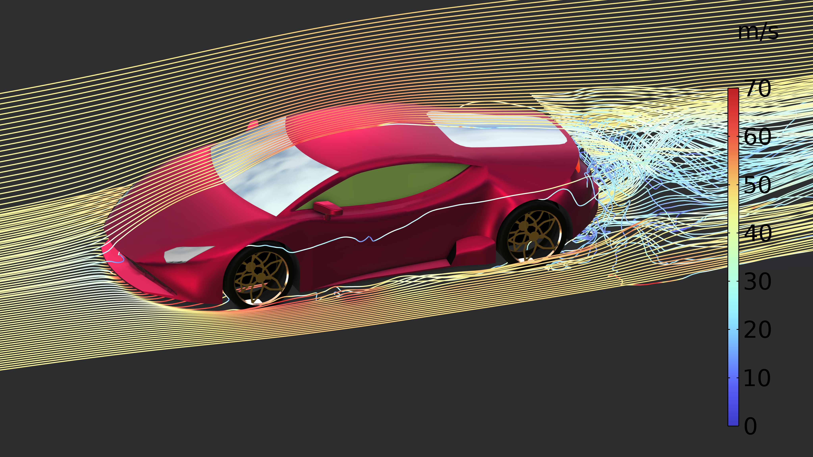
Concluding Remarks
The model demonstrates the effects of an adjustable flap on drag and downforce using a simple cross-sectional 2D representation of the rear wing assembly in a race car.
Such simple models can aid with the instruction of CFD principles and showcase the exciting applications of aerodynamics.
The setup can be extended to model structural deformation of the flaps as they respond to pressure stresses using the Fluid-Structure Interaction multiphysics coupling.
Studying the aerodynamics of a car model.

Slide 13
References
1. J. Piechna, “A Review of Active Aerodynamic Systems for Road Vehicles,” Energies, 2021.
2. C. Pfeifer, “Evolution of active grille shutters,” SAE Technical Paper, 2014.
3. W. Yu and G. Wei, “A Review of the influence of active aerodynamic tail on vehicle handling stability,” Journal of Physics: Conference Series, 2021.
4. R. Loução, D. Gonçalo, and M. Mendes, “Aerodynamic study of a drag reduction system and its actuation system for a formula student competition car,” Fluids, 2022.
All trademarks are the property of their respective owners.

