Slide 1
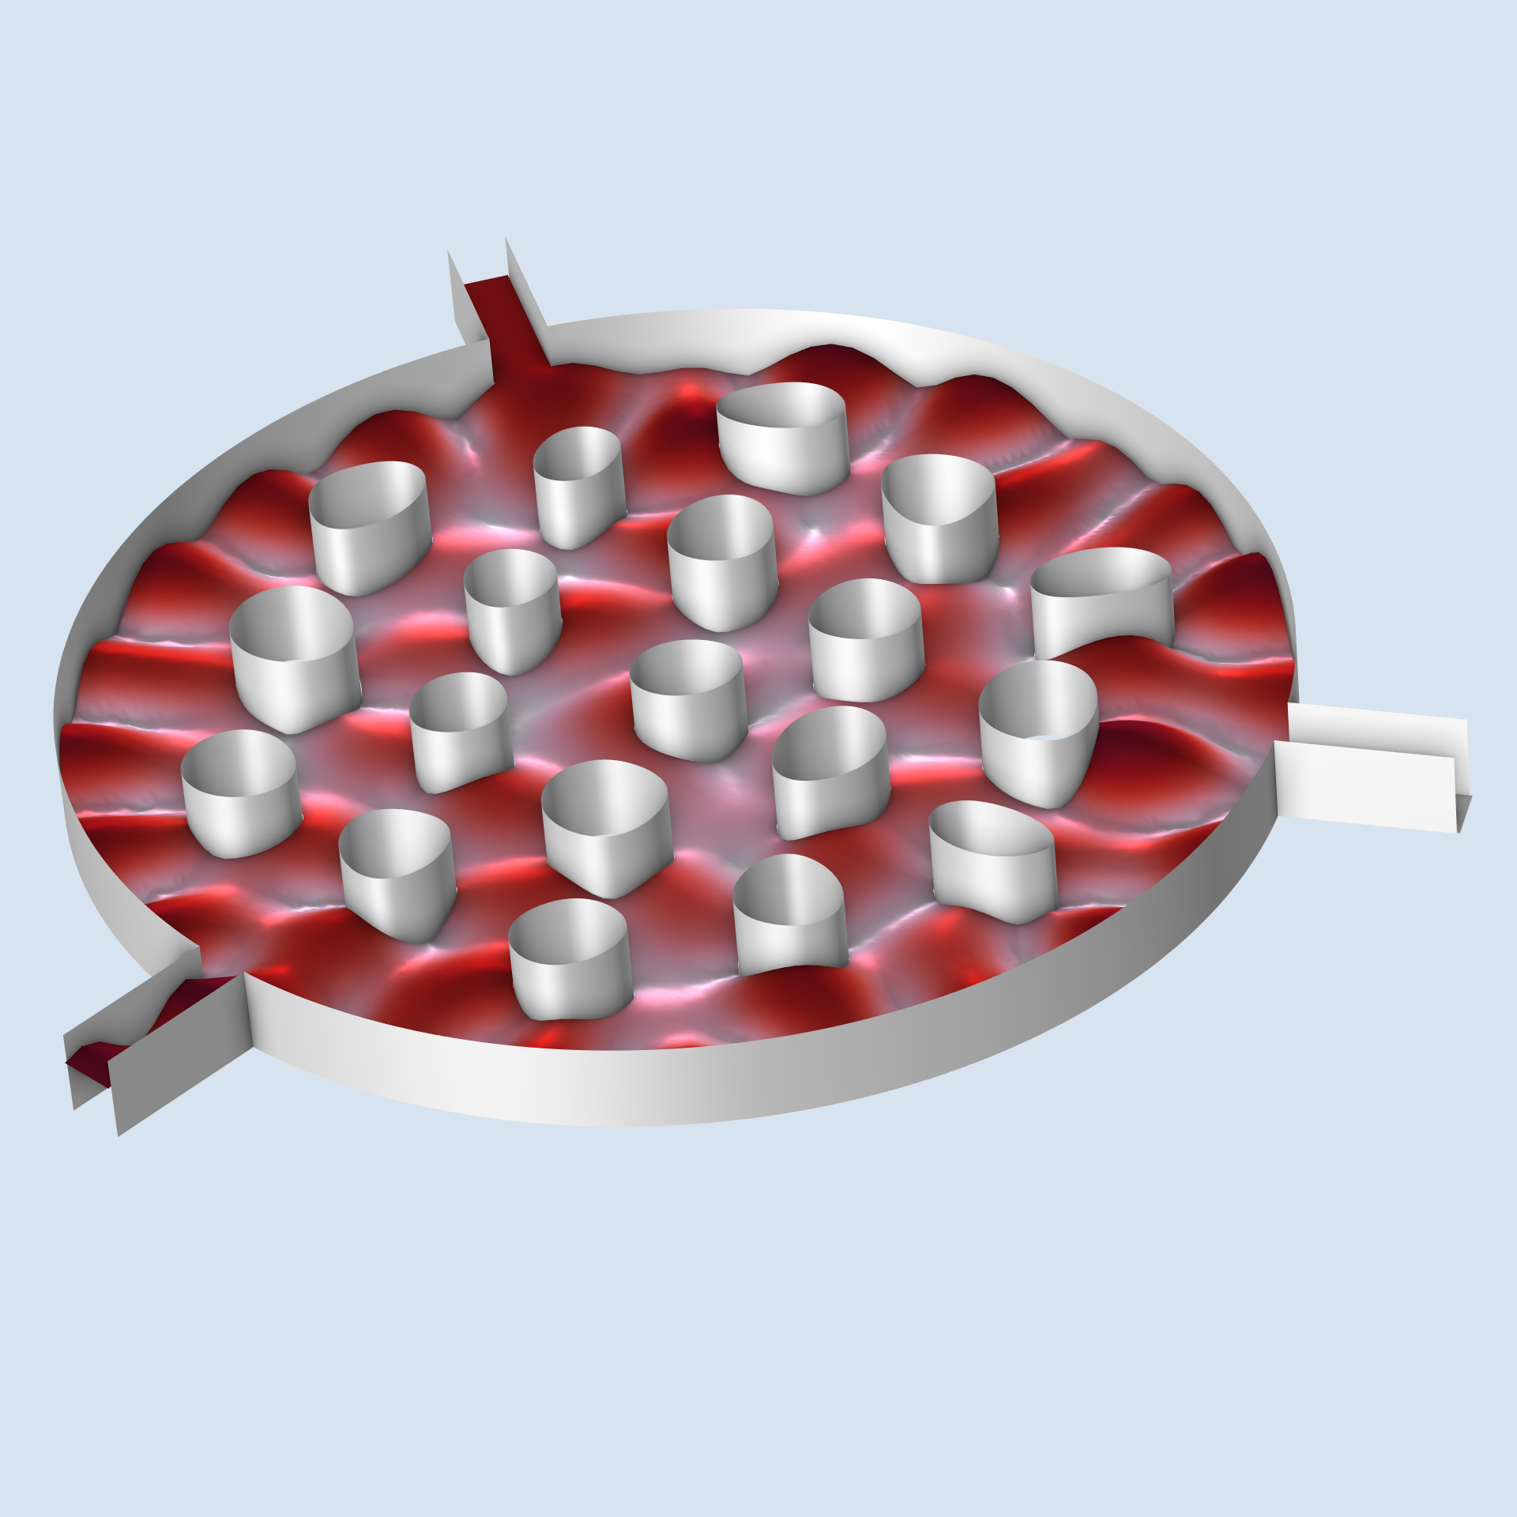
Shape Optimization of an Acoustic Demultiplexer

Slide 2
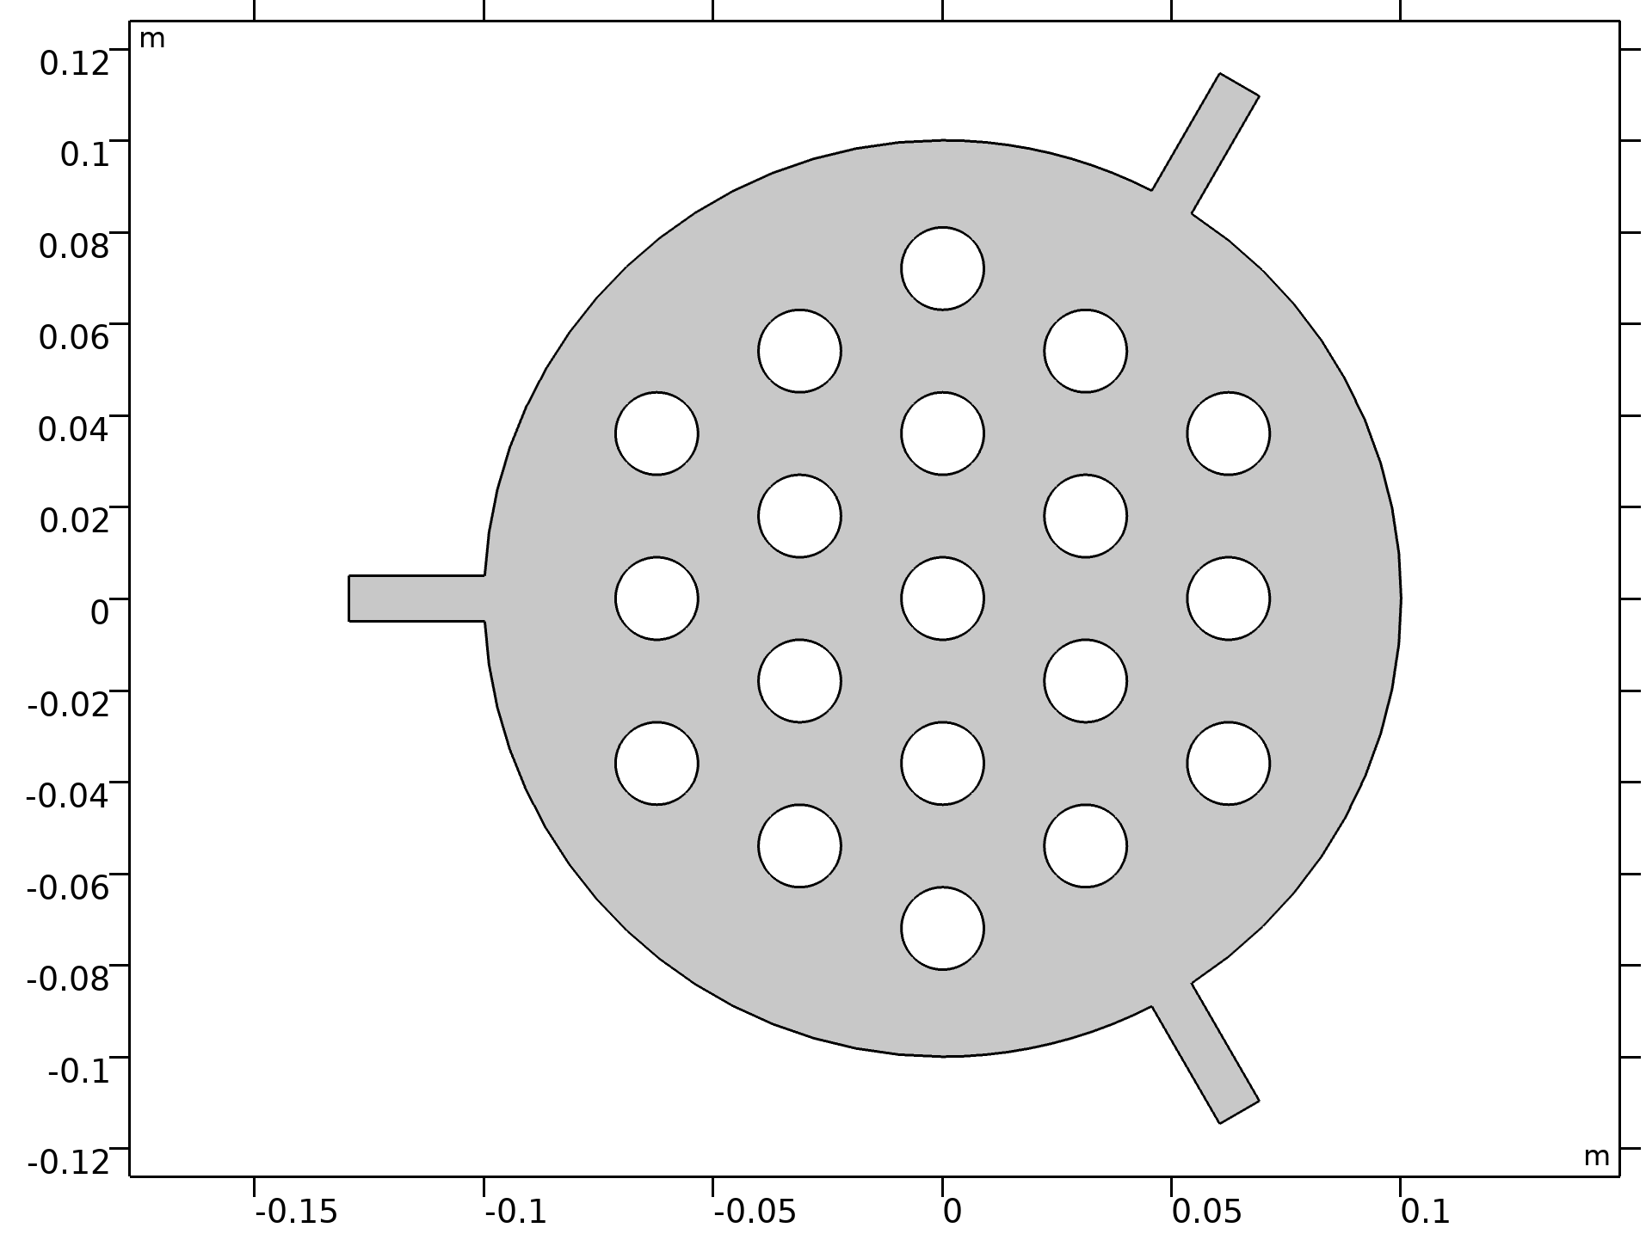
Shape Optimization of an Acoustic Demultiplexer
Introduction
A demultiplexer is a device that directs different
frequency bands to different outputs.
In this model we will design a demultiplexer by
performing shape optimization on the circular cavities
illustrated to the right.
The model uses shape optimization with Helmholtz
regularization together with a MinMax formulation for
the power ratio of the two output ports.

Slide 3
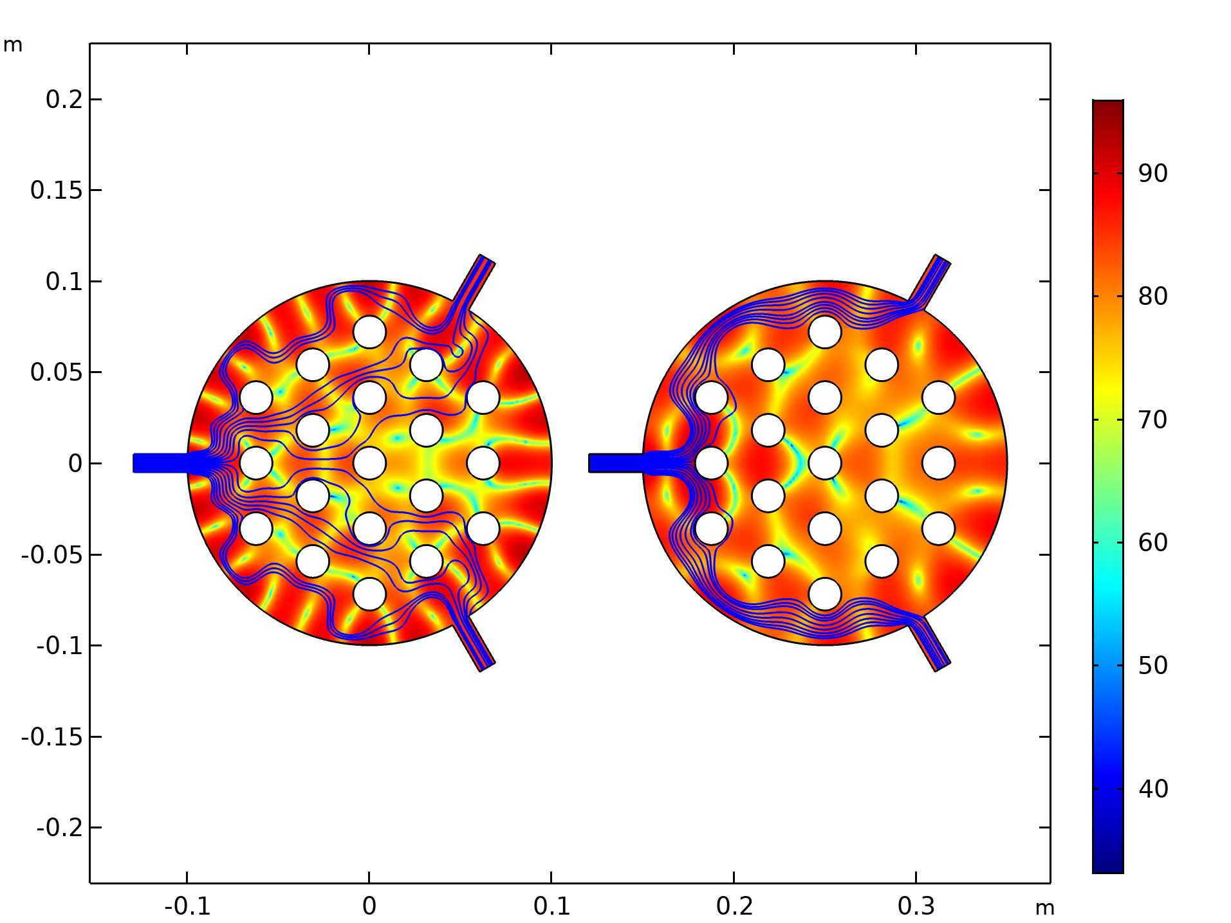
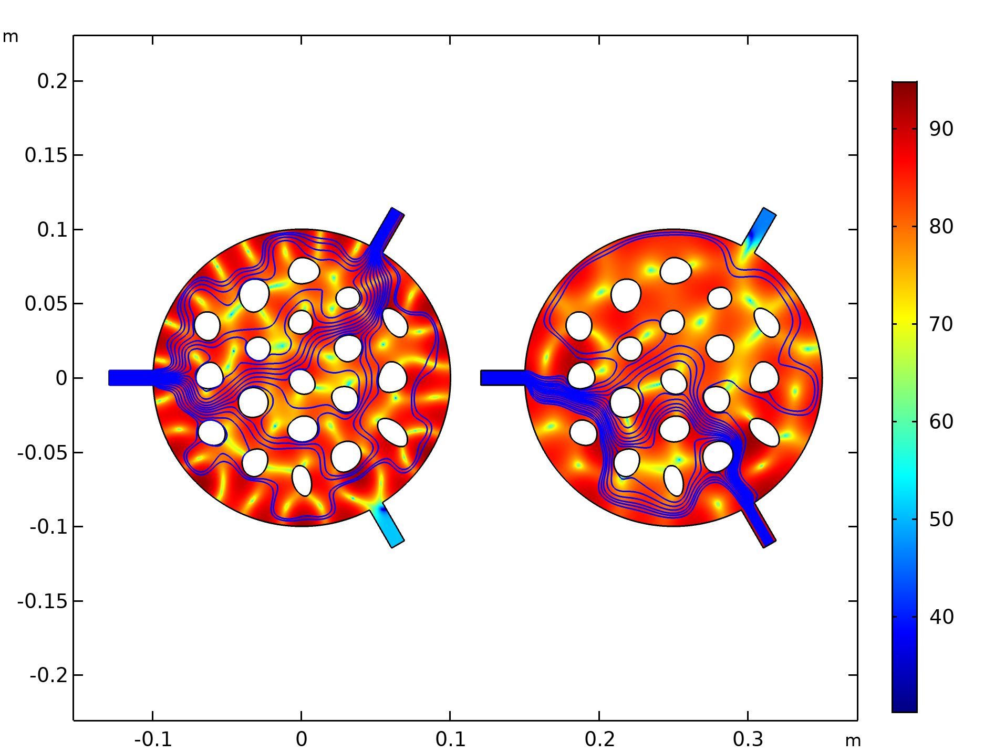
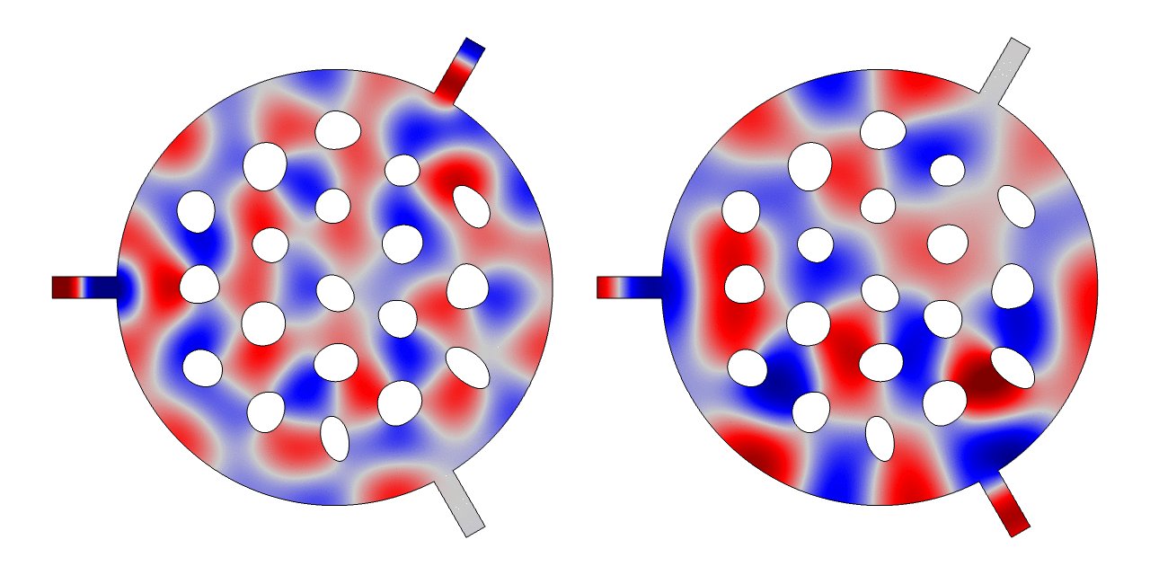
Shape Optimization of an Acoustic Demultiplexer
5.5 kHz
7.5 kHz

Slide 4
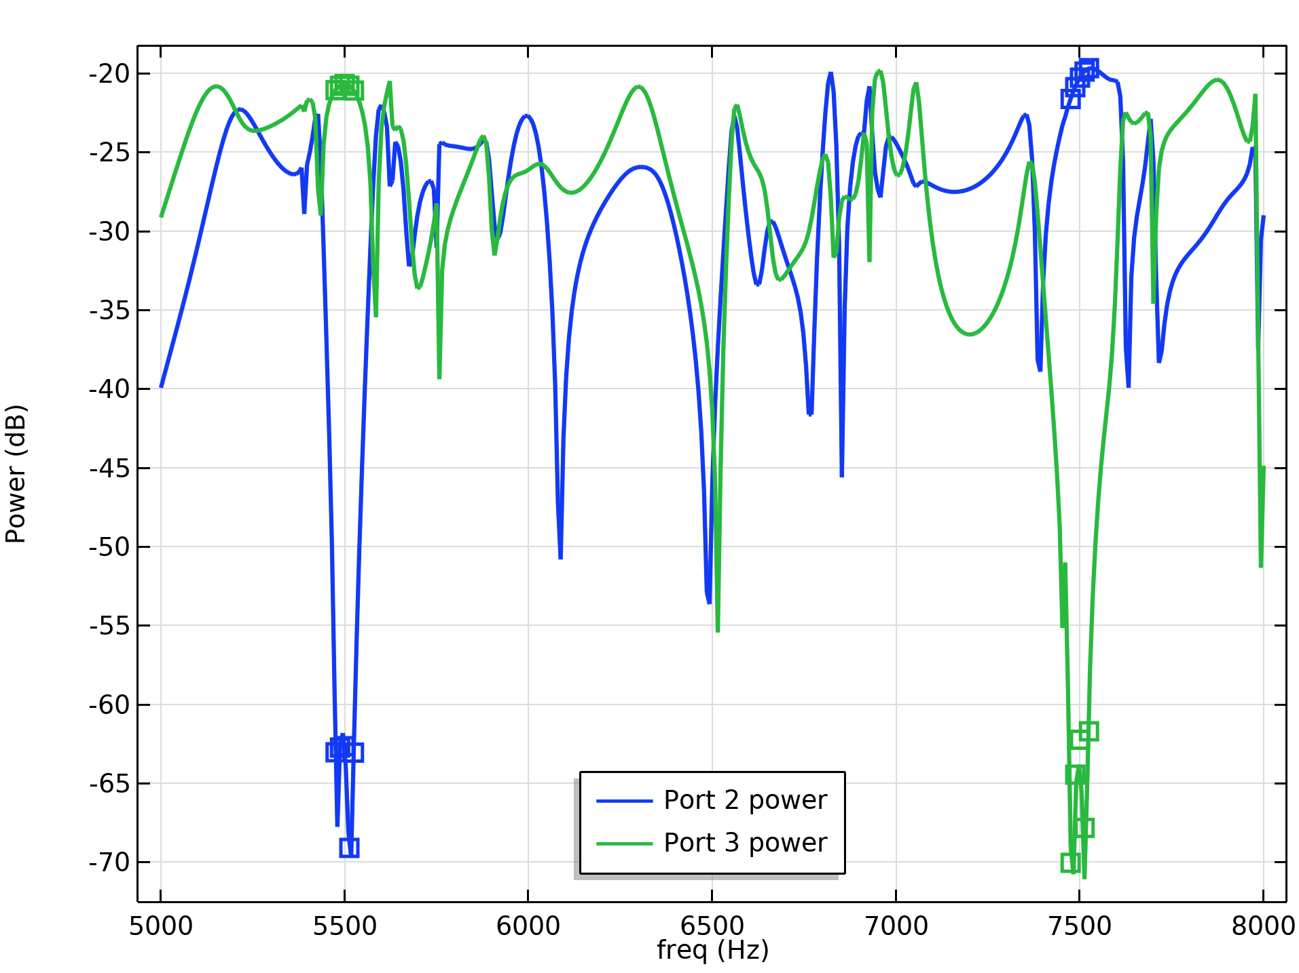
Shape Optimization of an Acoustic Demultiplexer
Fine mesh generated in the deformed configuration
35 dB

