Slide 1
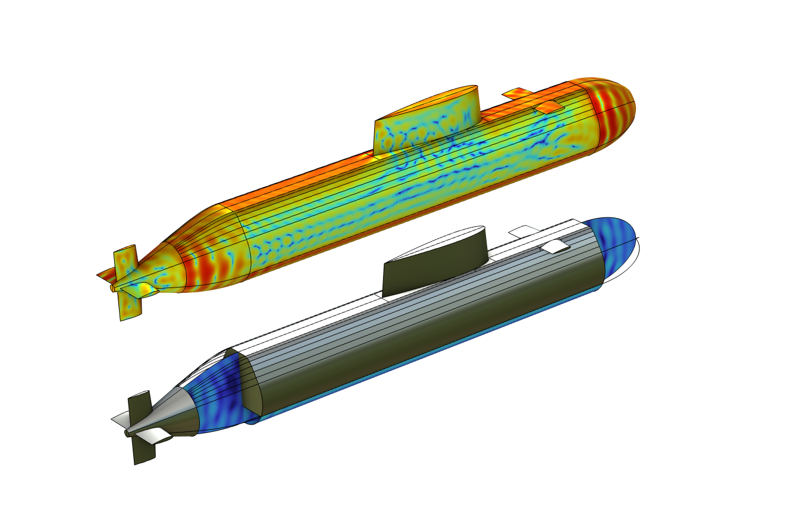
Target Strength of
Submarine with
Outer Hull Using FEM-BEM

Slide 2
Background and Motivation
This tutorial shows an approach to model the acoustic scattering off a submarine including the outer hull. The flooded volumes between the outer hull and the pressure hull are modeled with Pressure Acoustics, Frequency Domain (FEM) and the outside water domains with Pressure Acoustics, Boundary Elements (BEM). The properties of the outer hull are modeled using an approximate transfer impedance model of a thin plate. The impedance is added when coupling the FEM and the BEM domains using the Acoustic BEM-FEM Boundary multiphysics coupling.

Slide 3
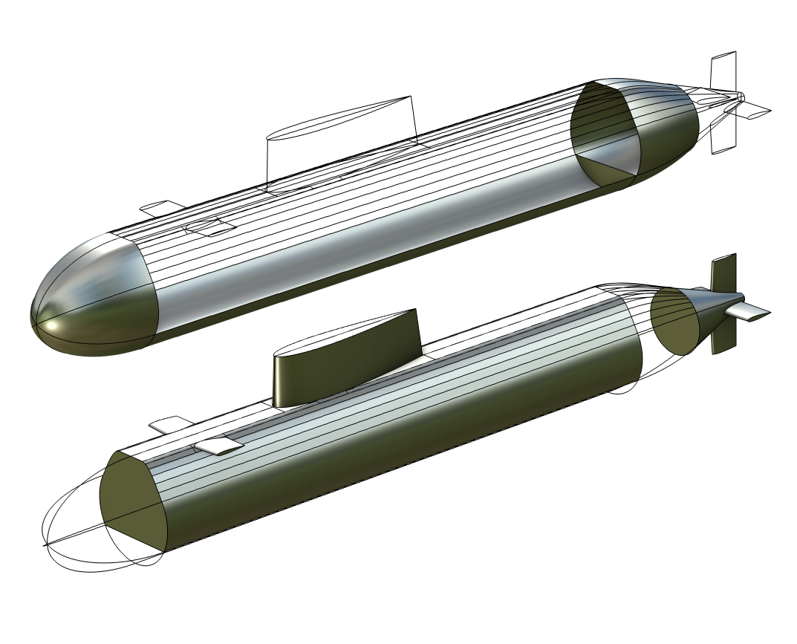
FEM and BEM
The model includes the outer hull as well as the pressure hull. The domain between these is flooded and also modeled. The configuration is that of simplified conceptual model.
The exterior acoustics are modeled with Pressure Acoustics, Boundary Elements (BEM)
The interior acoustics with Pressure Acoustics, Frequency Domain (FEM)
Outer hull (top) and pressure hull (bottom) in a simplified conceptual model setup.

Slide 4
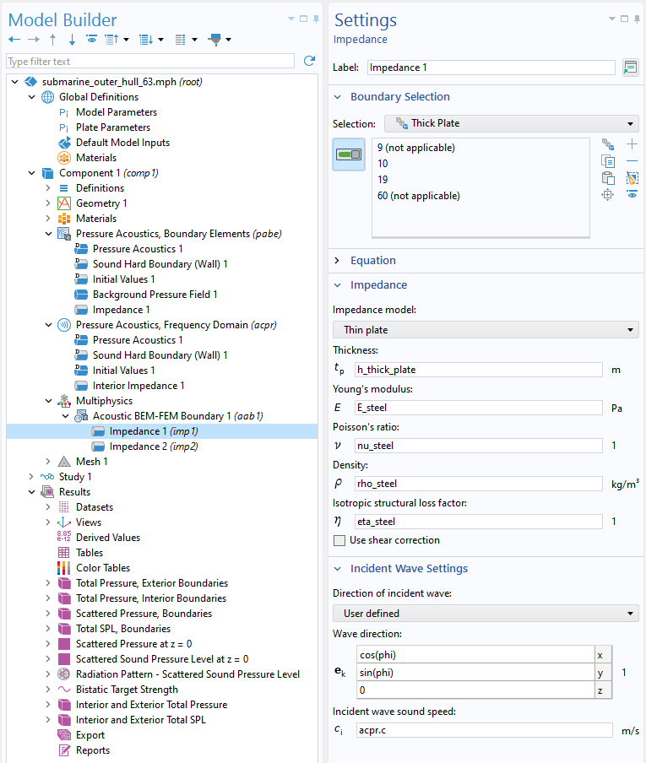
Model Setup
①
The Thin plate (interior) impedance model is added between the BEM and FEM domains.
The Thin plate is also added as an Interior impedance to model a plate in the FEM domain.
①
②
①
②
②

Slide 5
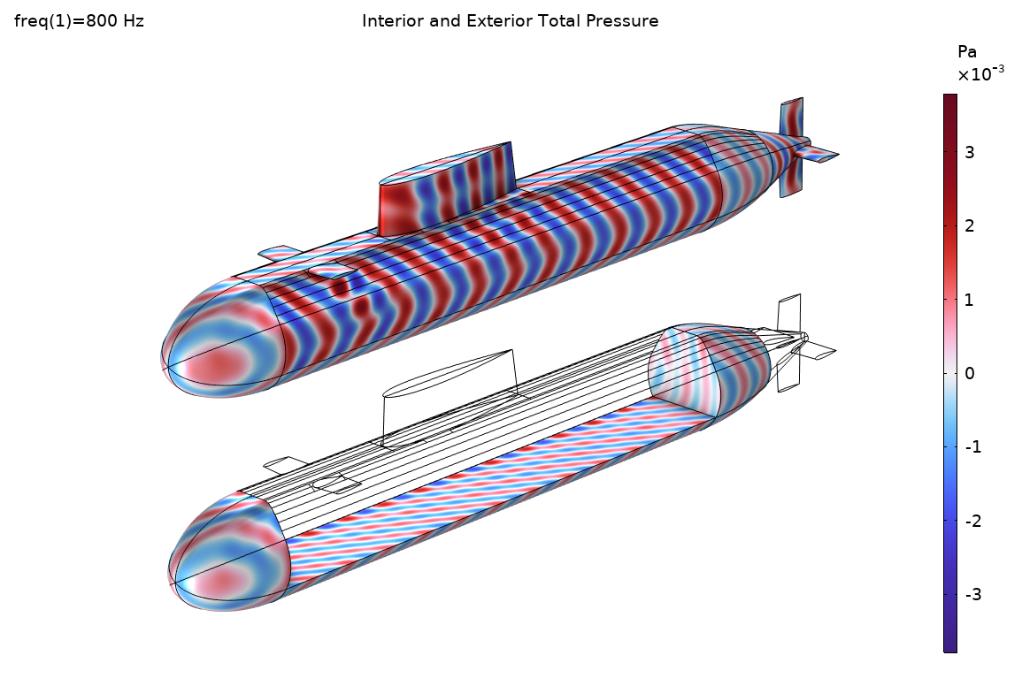
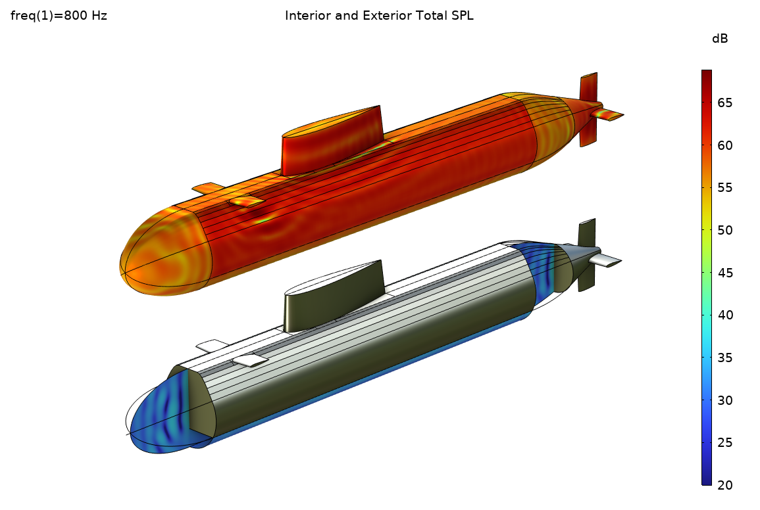
Results

Slide 6
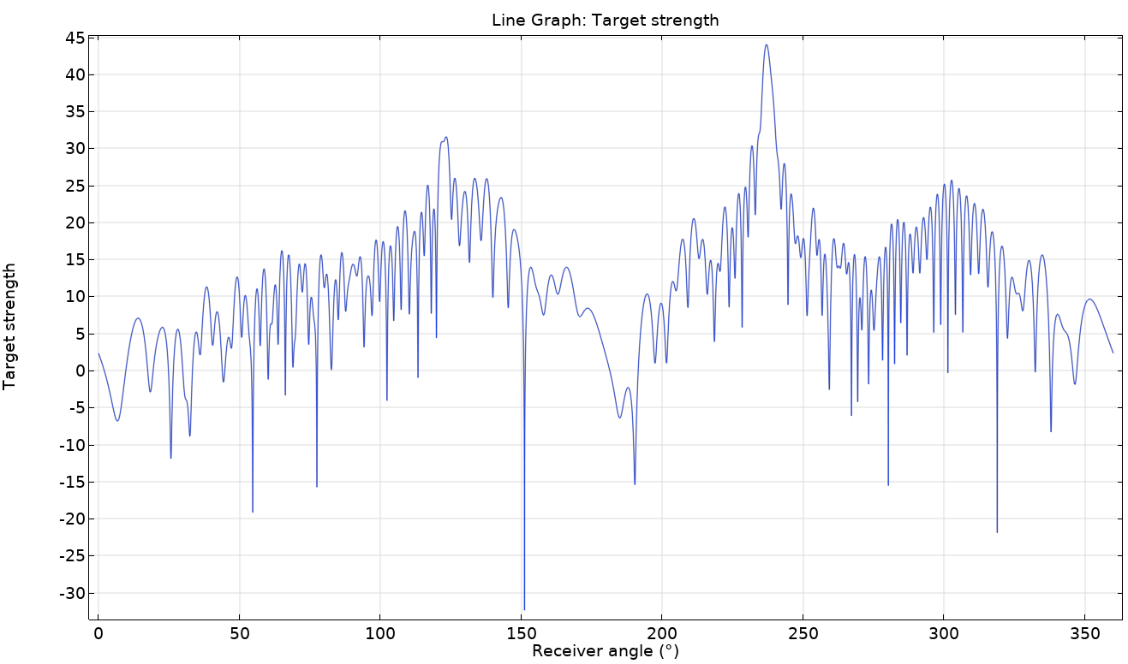
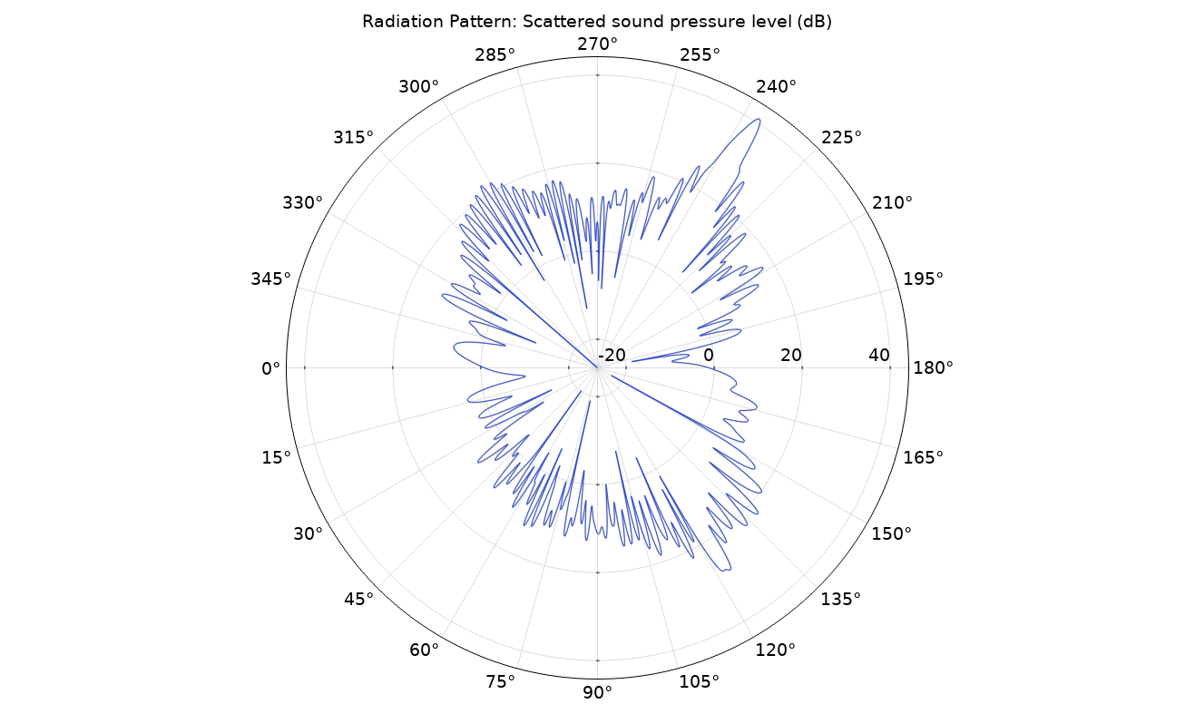
Results

