Slide 1
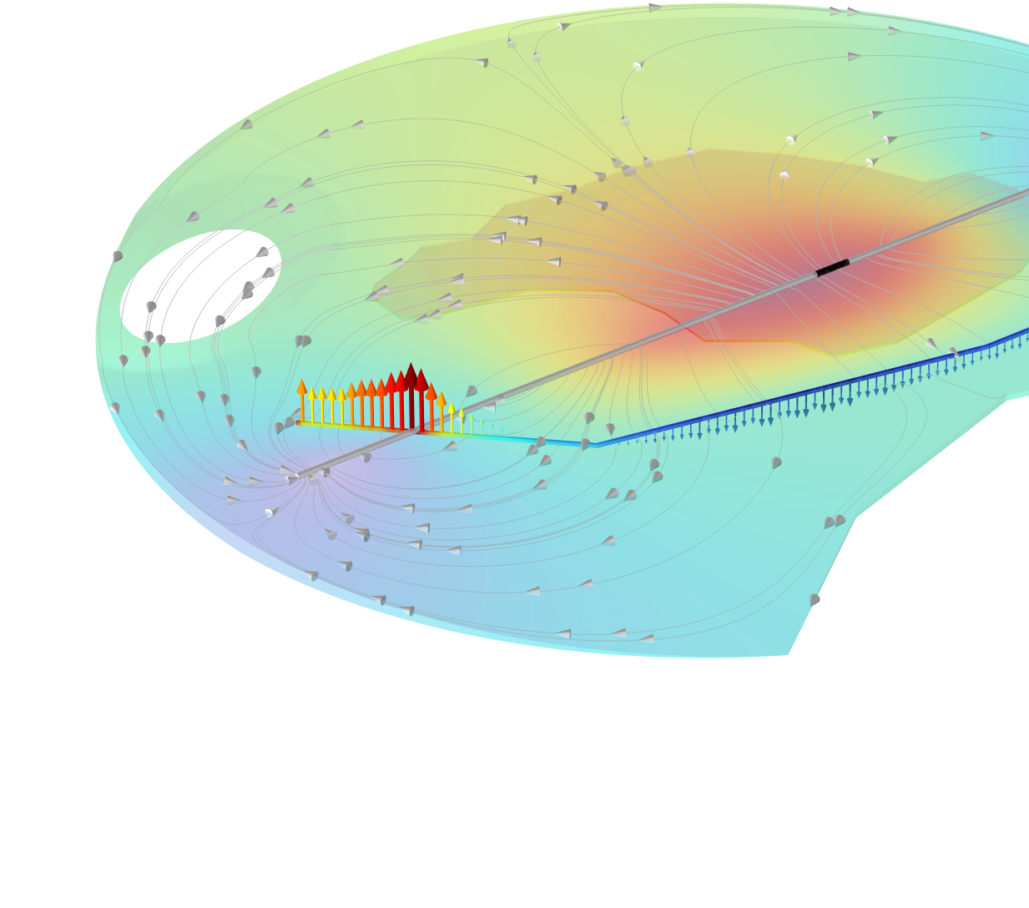
Stray Currents from a
Train in a Light Rail Transit System

Slide 2
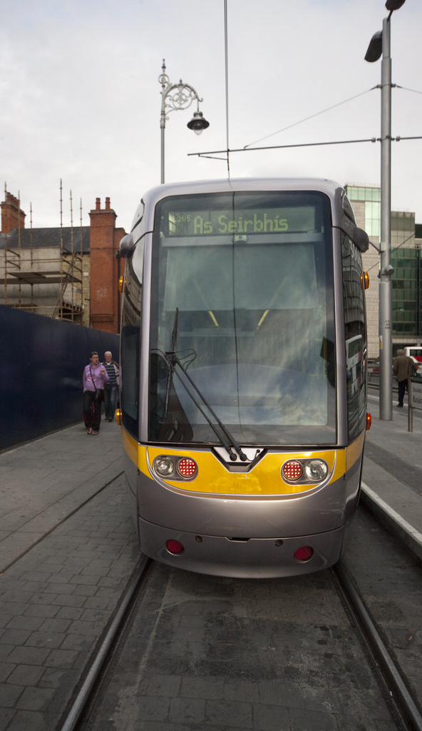
Introduction
Light rail transit (LRT) systems often utilize DC power for train propulsion
In these systems, trains operate with current fed from traction substations (TSS) through overhead lines and the rails serve as conductors for the returning current
In this example the Cathodic Protection interface, using Edge Electrode nodes, is used to model stray currents from a moving train and the resulting corrosion of a nearby pipe
The 3D domain surrounding the railway and the pipe features different soil conductivities
The impact of changed soil conductivities and pipe position is also investigated
This Photo by Unknown Author is licensed under CC BY-SA

Slide 3
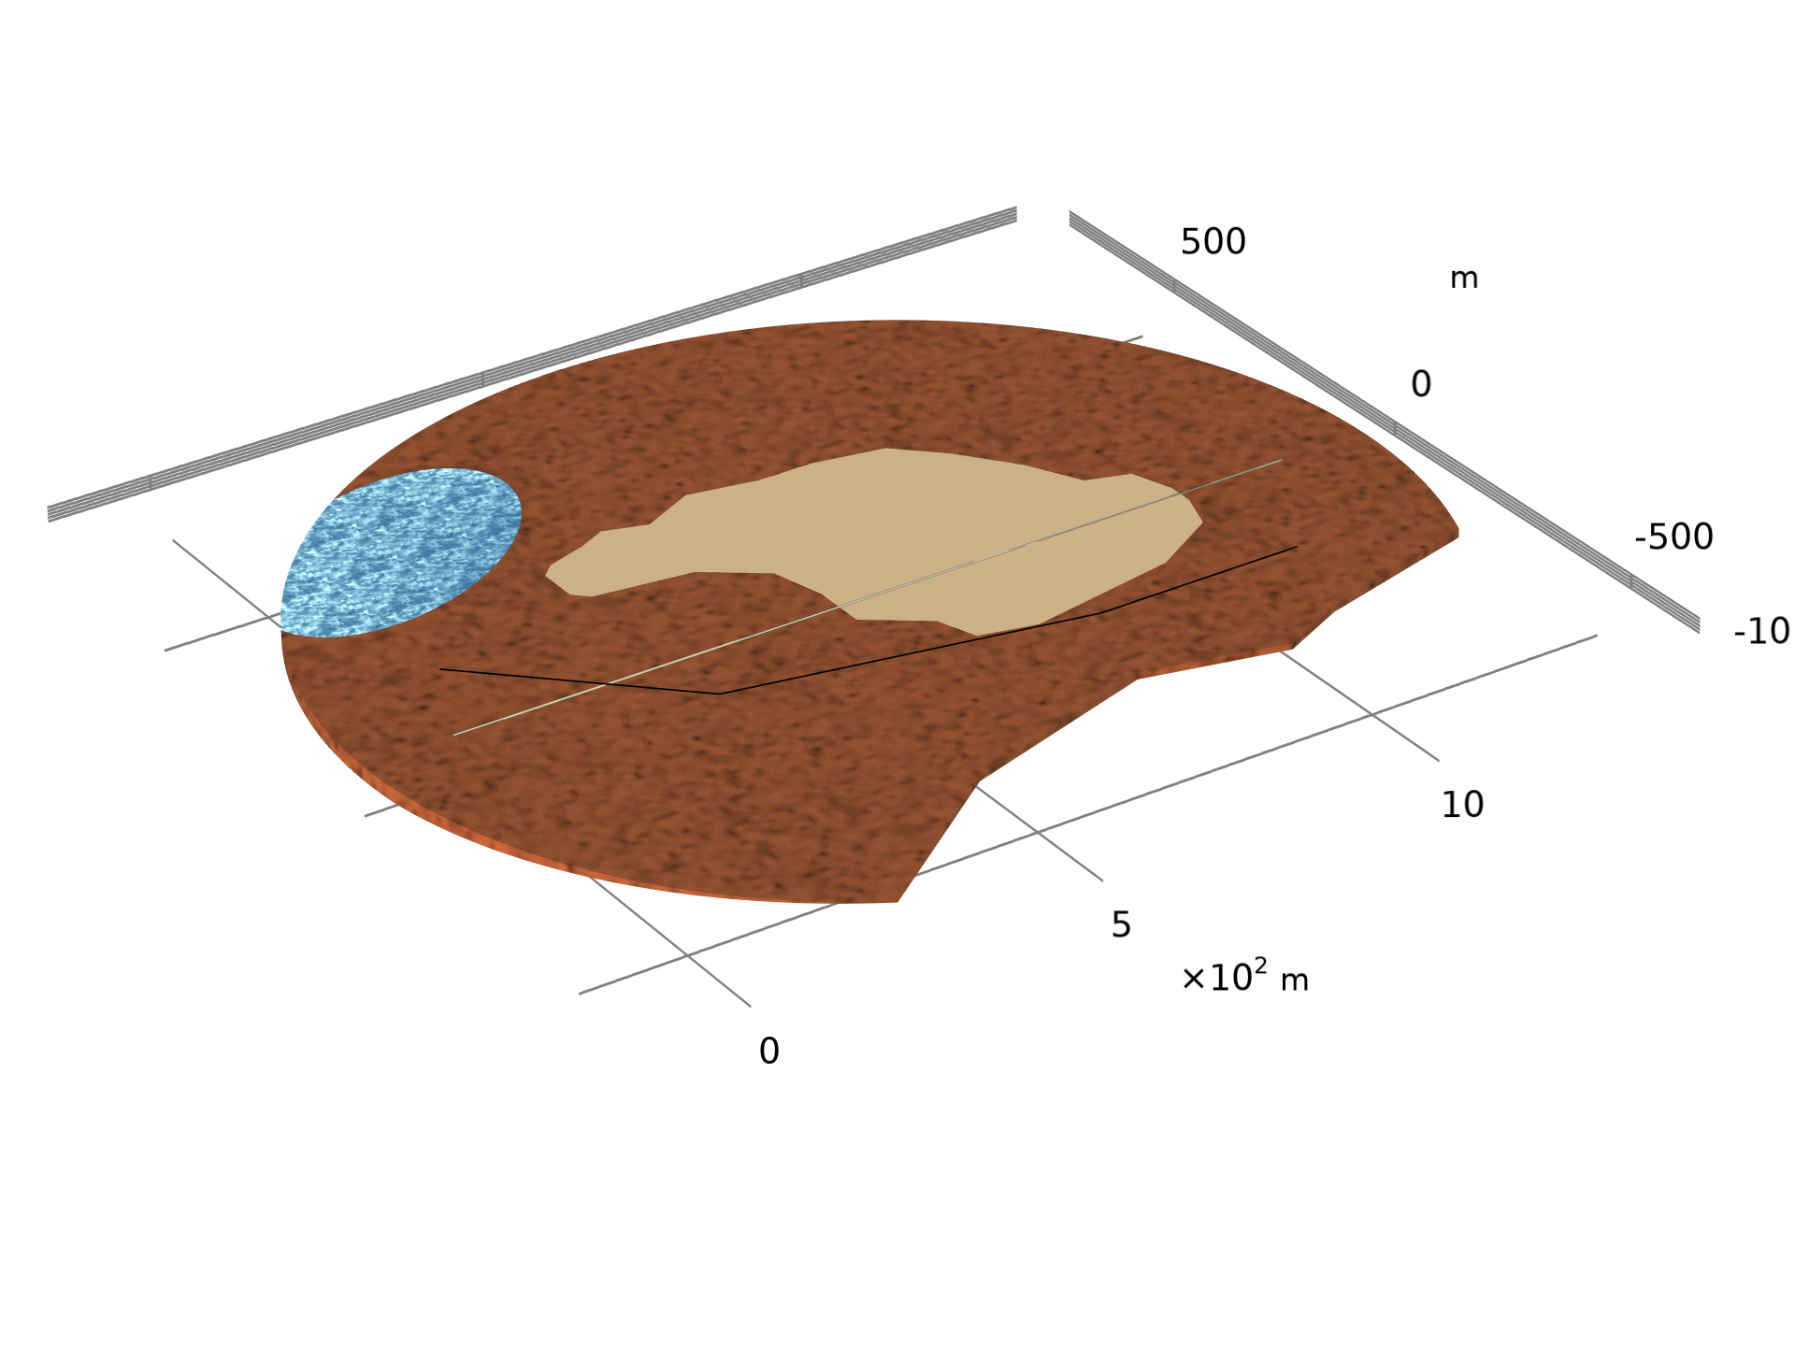
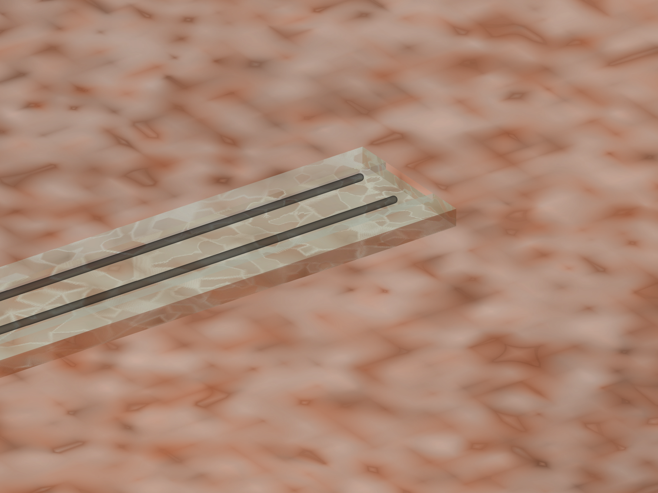
Geometry
Two parallel rails are located between two traction substations (TSS) over a 3D soil profile
  Rails sit on ties and gravel
  1.24 km between the substations
Stray currents originate from the current return in the rails as the rails are in contact with the surrounding soil
Soil profile confined by insulating rock
  Area 1.77 km²
  Maximum clay depth 20 m
Clay
TSS 2
Pond
Sandy clay
Tracks
Pipe
TSS 1
Ties
Rails
Gravel

Slide 4
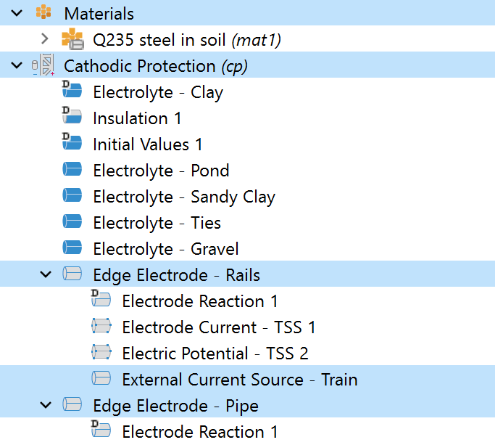

Rails and Pipe
Cathodic Protection, Edge Electrode nodes
  The Electrode Reaction features define stray current leaving and entering rails and pipe due to electrochemical reactions
  Reaction expression taken from Q235 steel in soil available in Material Library, Corrosion
  Electrode Current features at TSS 1 define total currents per rail , I_{TSS1}. Function of train location, x_{train}, and current, I_{train}, for the rail length, L_{rail}:
  Electric Potential feature sets potential equal to 0 at TSS 2, grounded
Current source in rails at train location
  Added with the External Current Source feature
$$I_{TSS1}=\frac{I_{train}}{2}\left(1−\frac{x_{train}}{L_{rail}}\right)$$

Slide 5
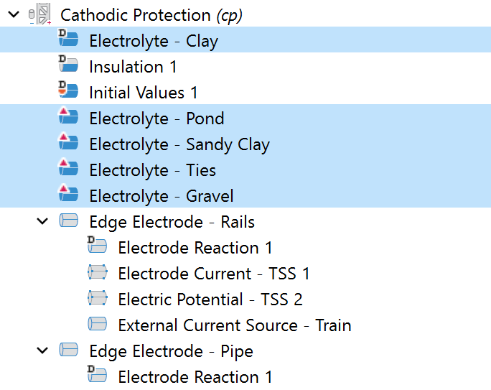
Conductivities
Electrolyte conductivities defined individually for each material in the soil using user-defined values
Anisotropic electrolyte conductivity set at ties

Slide 6
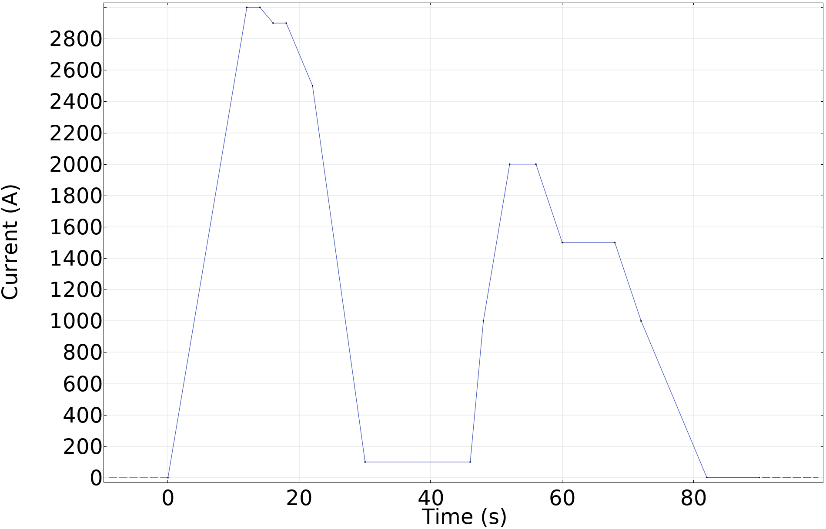
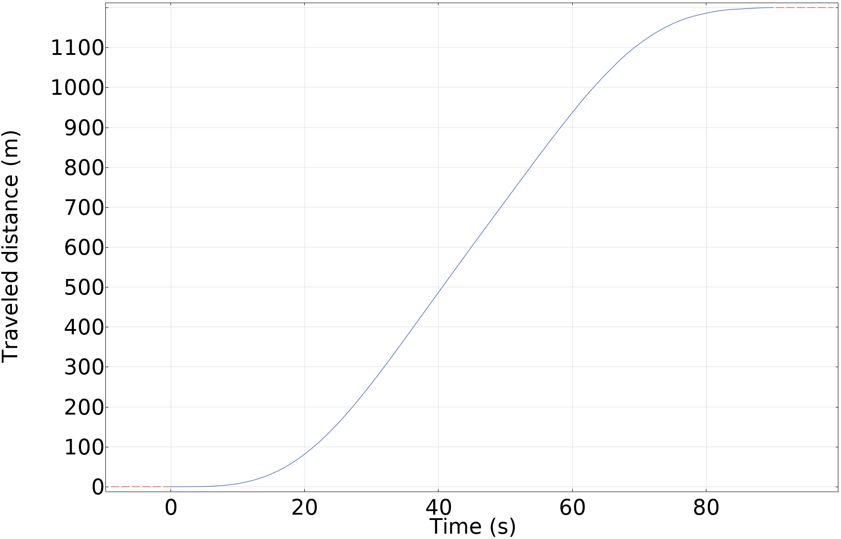
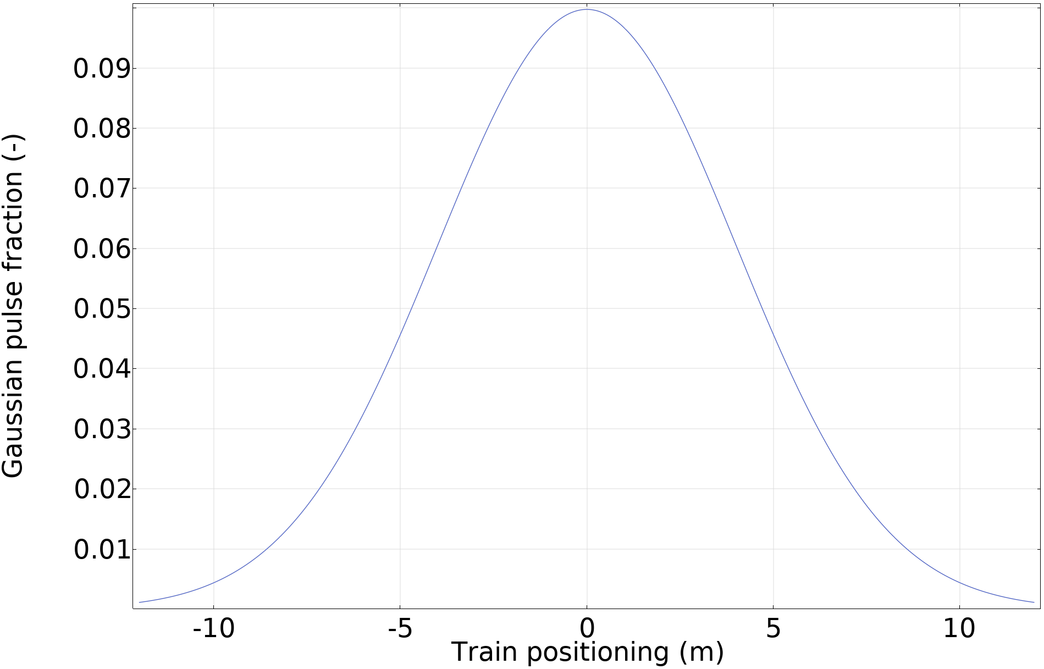
Train Propulsion Functions
Current
Location
Shape of Positioning
Train propulsion current depends on acceleration, braking, and idle periods
Traction substations supply the current
Traveled distance from TSS 1 over time to define train location
Positioning of train on rails with Gaussian puse representation (integrated value equal 1)
Gaussian-pulse shaped current drawn at train location

Slide 7
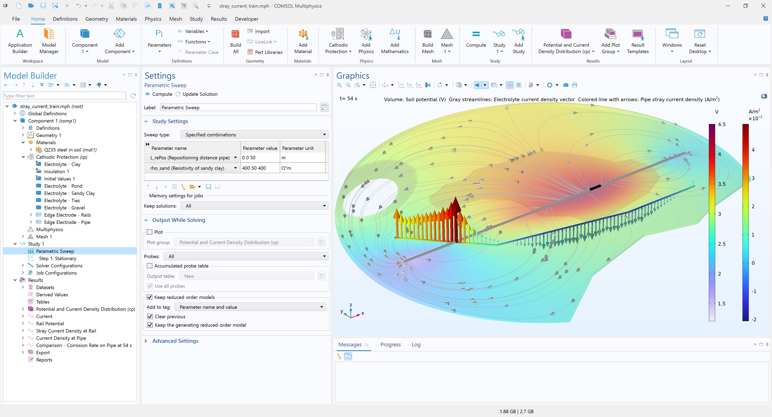
Study
Parametric sweep to investigate three different scenarios:
  Base scenario, ρ_{sand}= 400 Ωm and L_{RePos}=0 m
  Sandy clay treated as clay, ρ_{sand} = ρ_{clay}= 50 Ωm
  Pipe repositioned +50 m in y-direction, L_{RePos}=50 m
To vary the train location, a Stationary Study step using Auxiliary sweep for the traveled time, t_train, is used

Slide 8
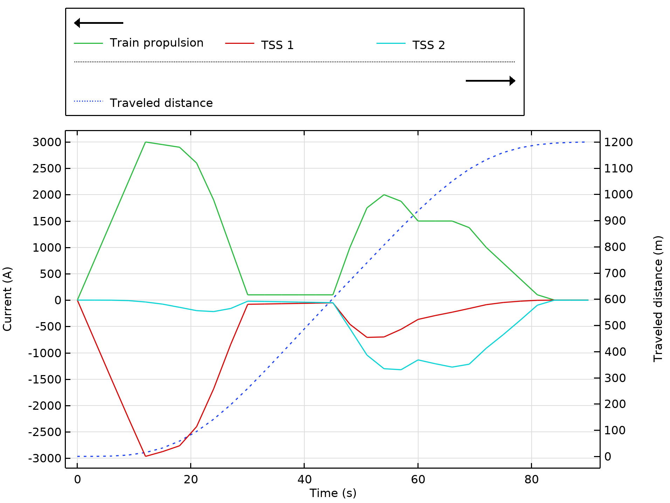
Currents and Train Location
Simulated TSS currents

Slide 9
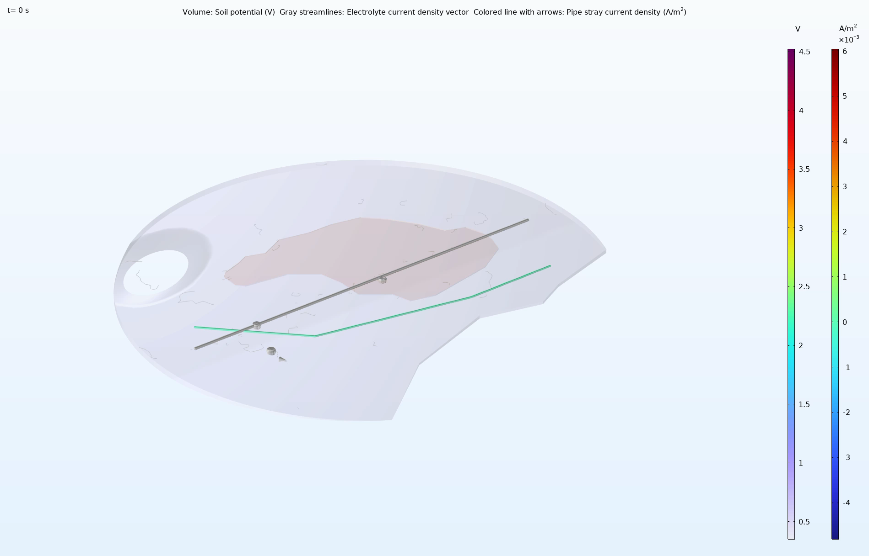
Base Scenario Results
Soil potential and current

Slide 10
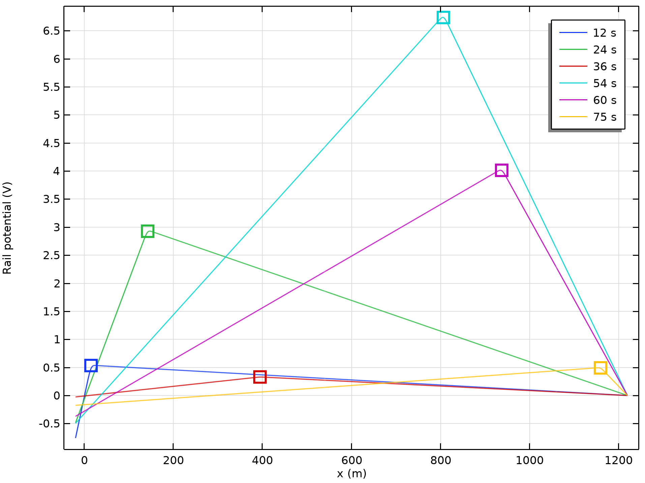
Base Scenario Results
Rail potential

Slide 11
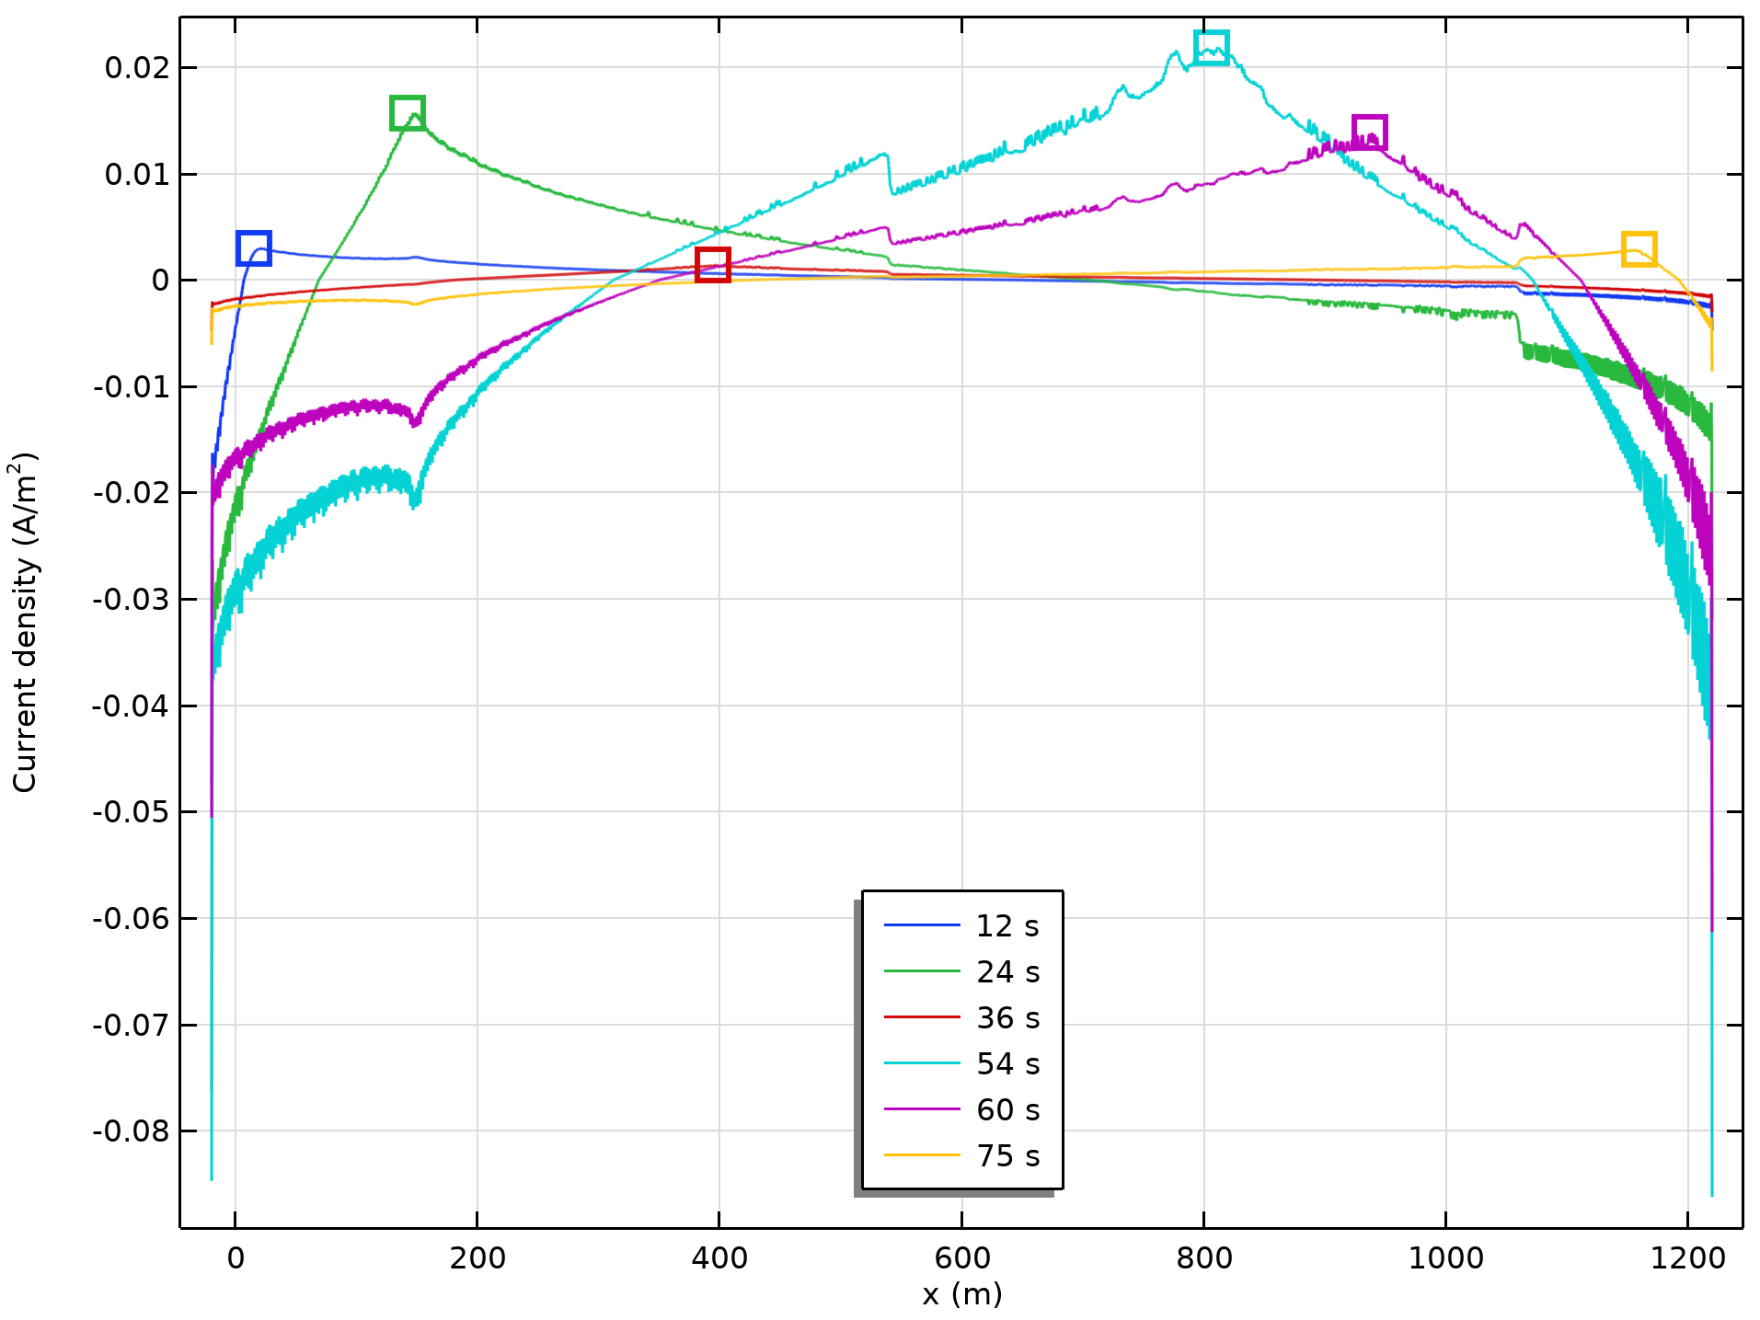
Base Scenario Results
Stray current density at rails

Slide 12
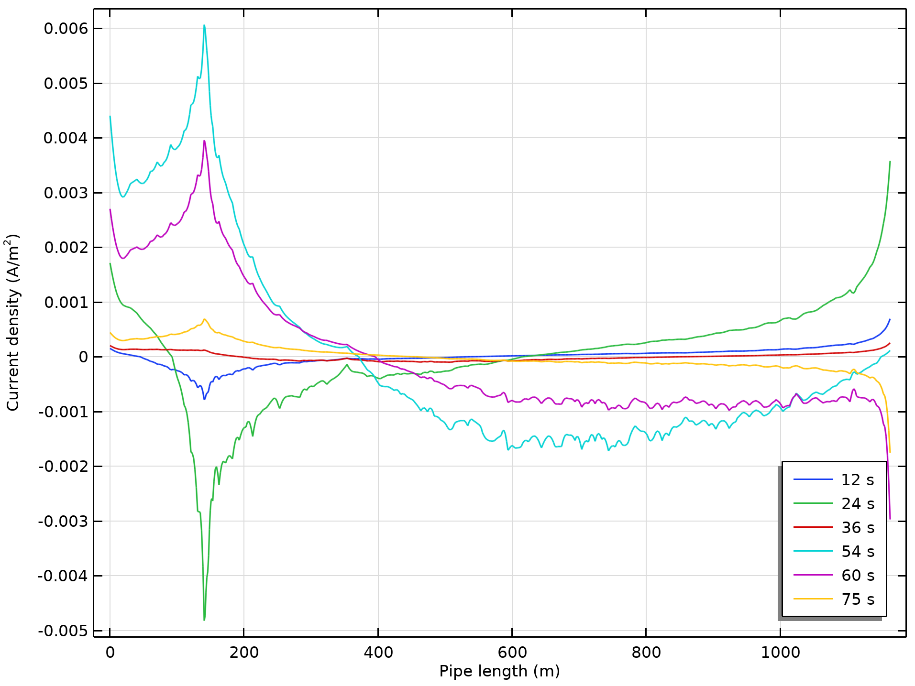
Base Scenario Results
Current density at pipe

Slide 13
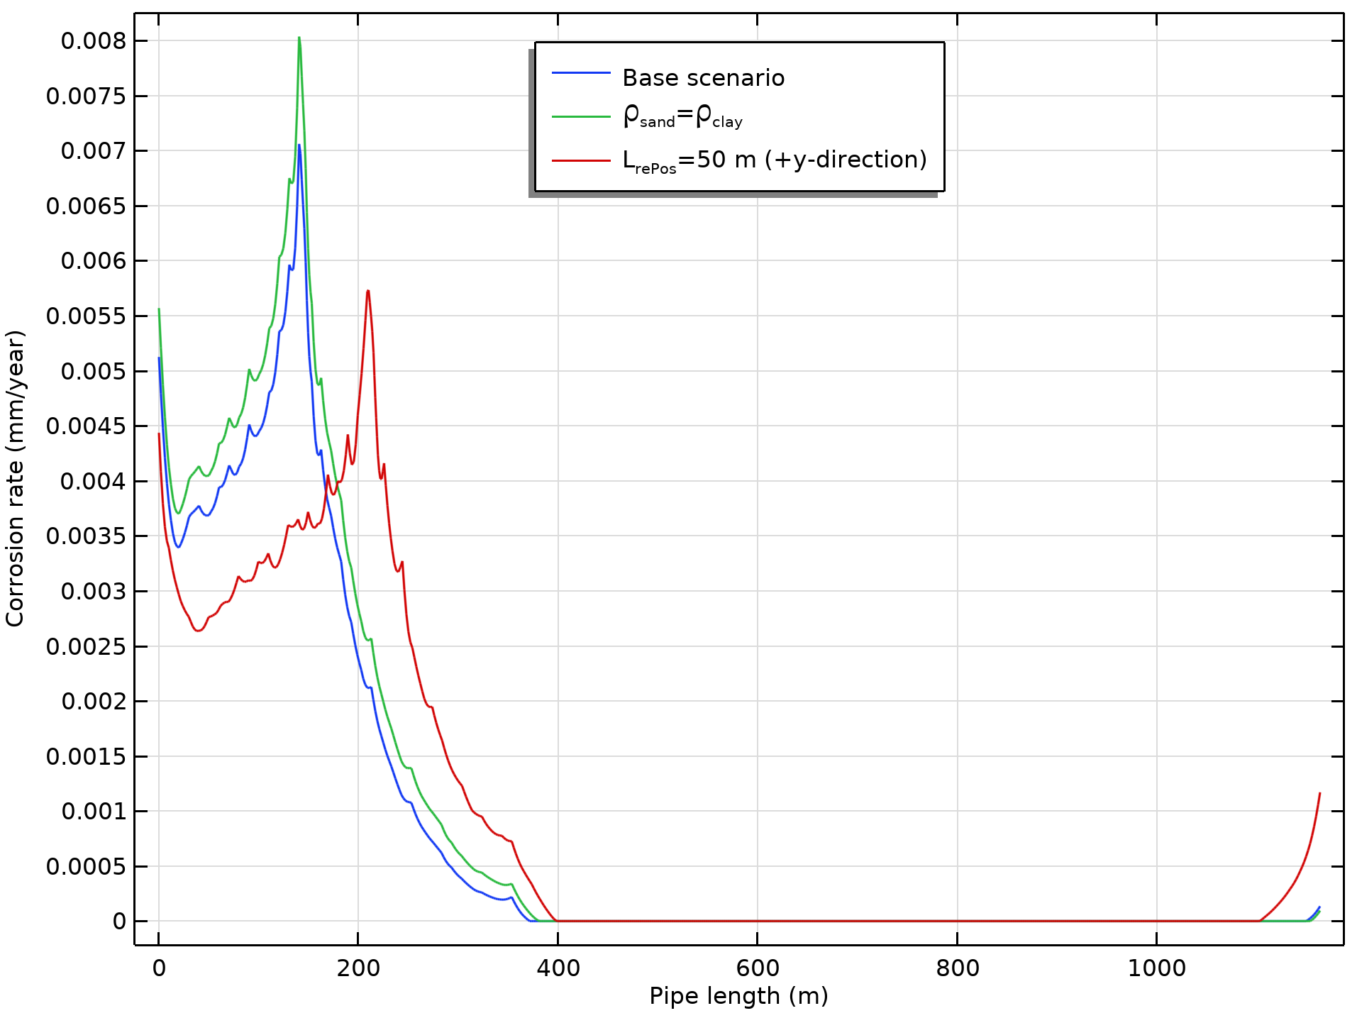
Comparison Results
Higher resistivity in soil reduces the corrosion rate
Repositioning of pipe has an impact on the rate
Pipe corrosion rate for the investigated scenarios at 54 s

Slide 14
References
Z. Cai, X. Zhang, and H. Cheng, “Evaluation of DC-Subway Stray Current Corrosion With Integrated Multi-Physical Modeling and Electrochemical Analysis,” IEEE Access, vol. 7, 168404, 2019. http://doi.org/10.1109/ACCESS.2019.2953960
S. Aatif, H. Hu, F. Rafiq, and Z. He, “Analysis of rail potential and stray current in MVDC railway electrification system,” Railway Engineering Science, vol. 29, 394, 2019. http://doi.org/10.1007/s40534-021-00243-0
G. Du, D. Zhang, G. Li, C. Wang, and J. Liu, “Evaluation of Rail Potential Based on Power Distribution in DC Traction Power Systems,” Energies, vol. 9, 729, 2016. http://doi.org/10.3390/en9090729

