Slide 1
Pore-Scale Flow
COMSOL

Slide 2
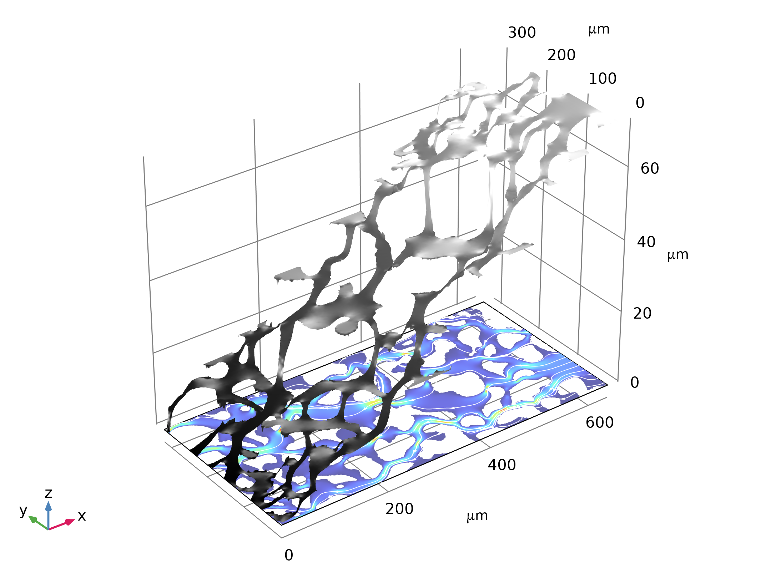
Introduction
This exercise is based on pore-scale flow experiments conducted by A. Keller, M. Auset, and S. Sirivithayapakorn, University of California, Santa Barbara.
  Keller, A. A., M. J. Blunt and P. V. Roberts (1997)
  Auset, M., and Keller, A. A. (2004)
  Sirivithayapakorn, S. and Keller, A. A. (2004)
The flow in a porous medium is simulated using the Creeping Flow interface and the Brinkman Equations interface, respectively.
Velocity (Surface) and Pressure Head (Height)

Slide 3
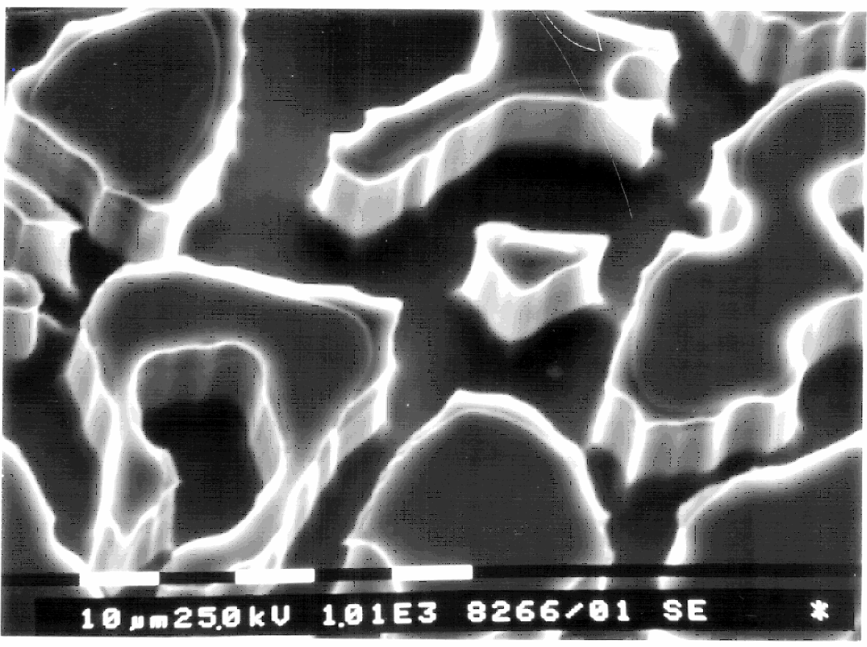
Component 1
The first model takes an electron microscope images of Keller and others and solves for the flow velocity and pressure drop in the pore throats using the Creeping Flow interface.
The geometry is imported as a binary file and only the pore space is meshed but not the solid regions.

Slide 4
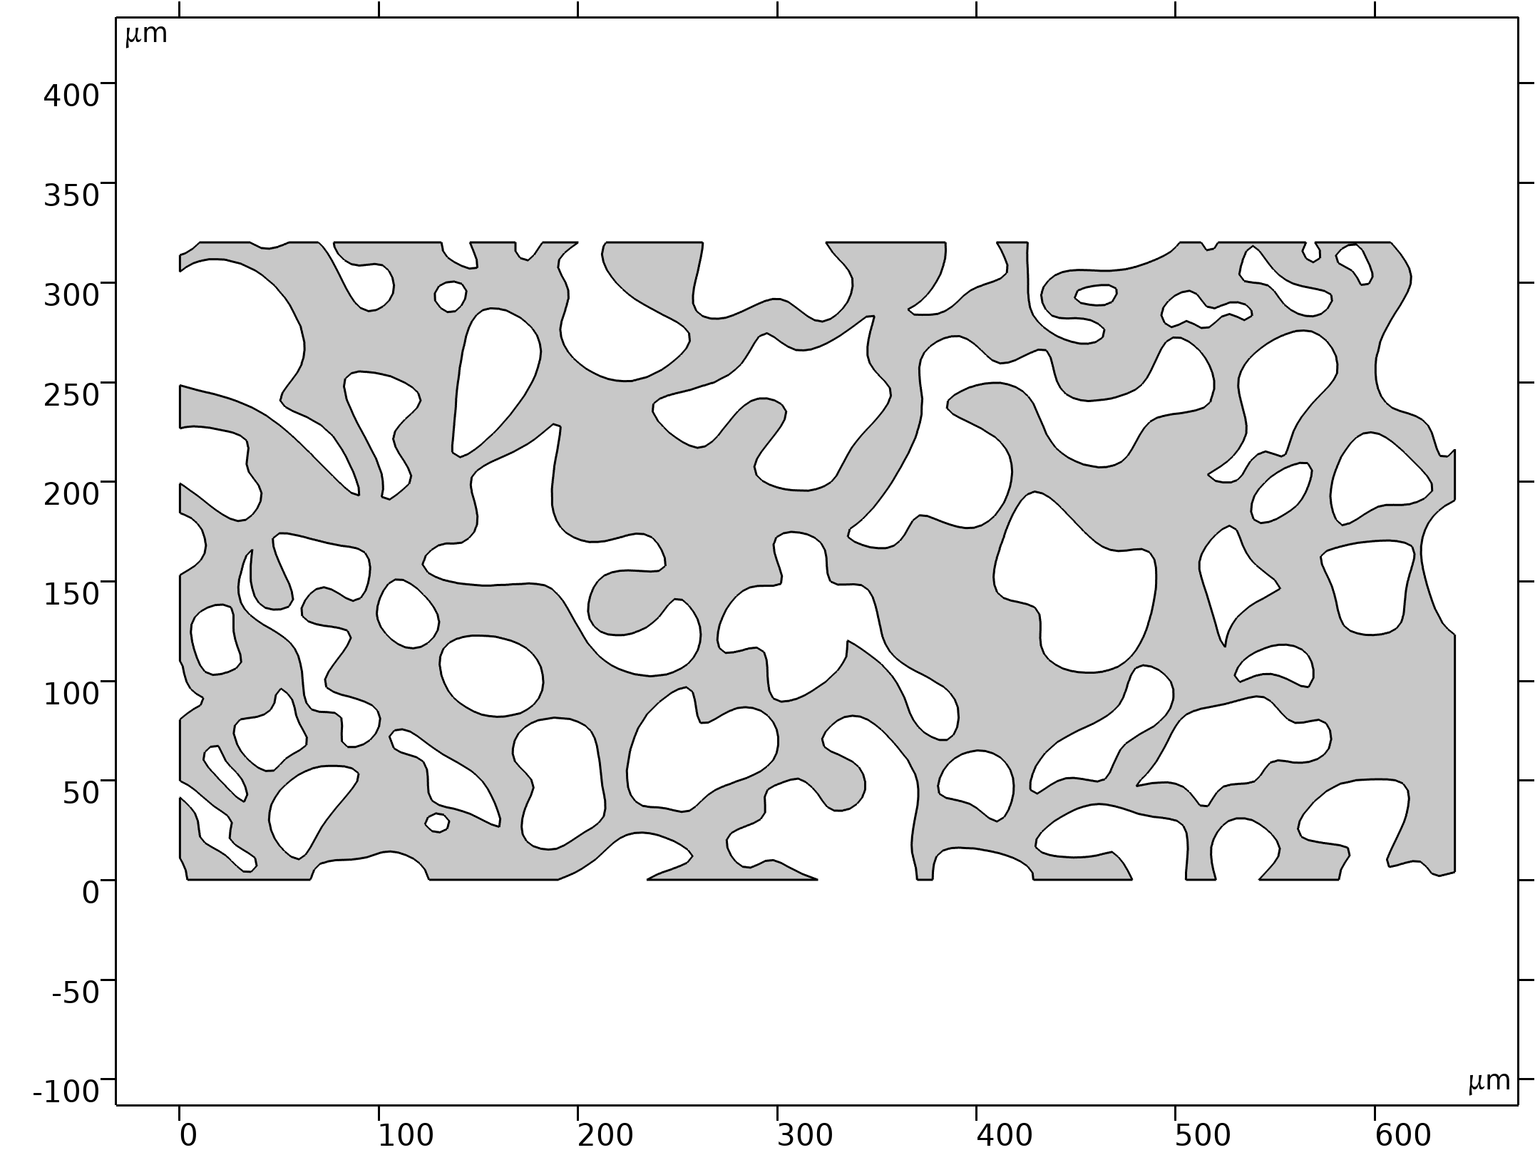
Model Setup for Component 1
The model covers 640 by 320 μm².
Water moves from right to left across the geometry.
The flow in the pores does not penetrate the solid grains.
The inlet and outlet fluid pressures are given.
Assume no flow at the top and bottom boundaries.
The fluid is considered isothermal and incompressible.
Geometry 1

Slide 5
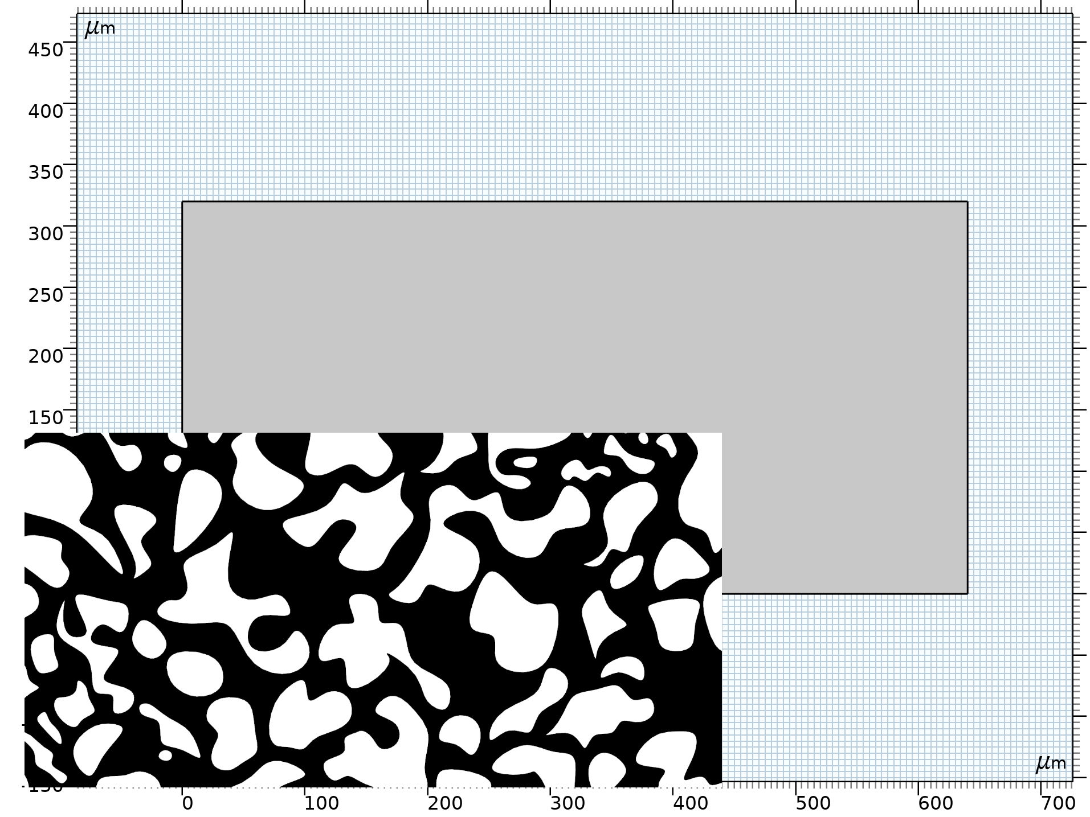
Component 2
The second model is devoted to the modeling of the whole slice, by importing the SEM image and deriving porous medium properties, such as porosity and permeability for further use in the Brinkman Equations interface.

Slide 6
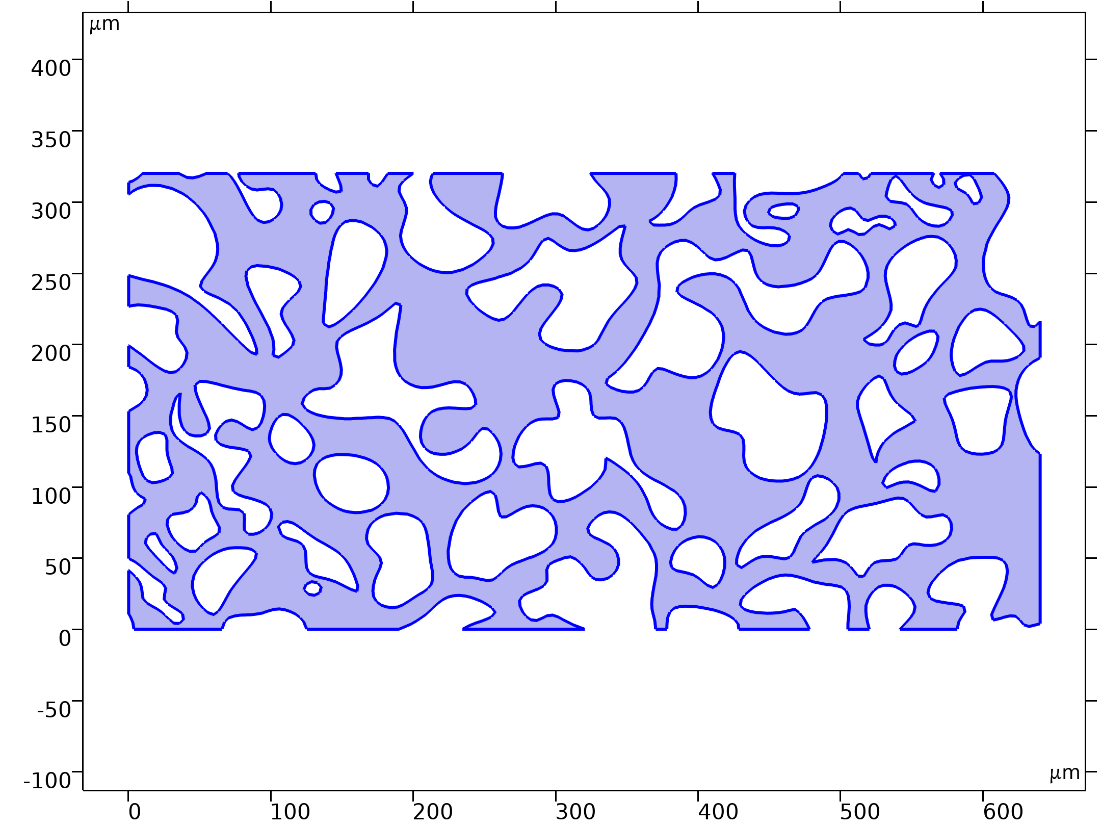


Model Equations
Creeping Flow (Stokes Flow)
Creeping Flow

Slide 7
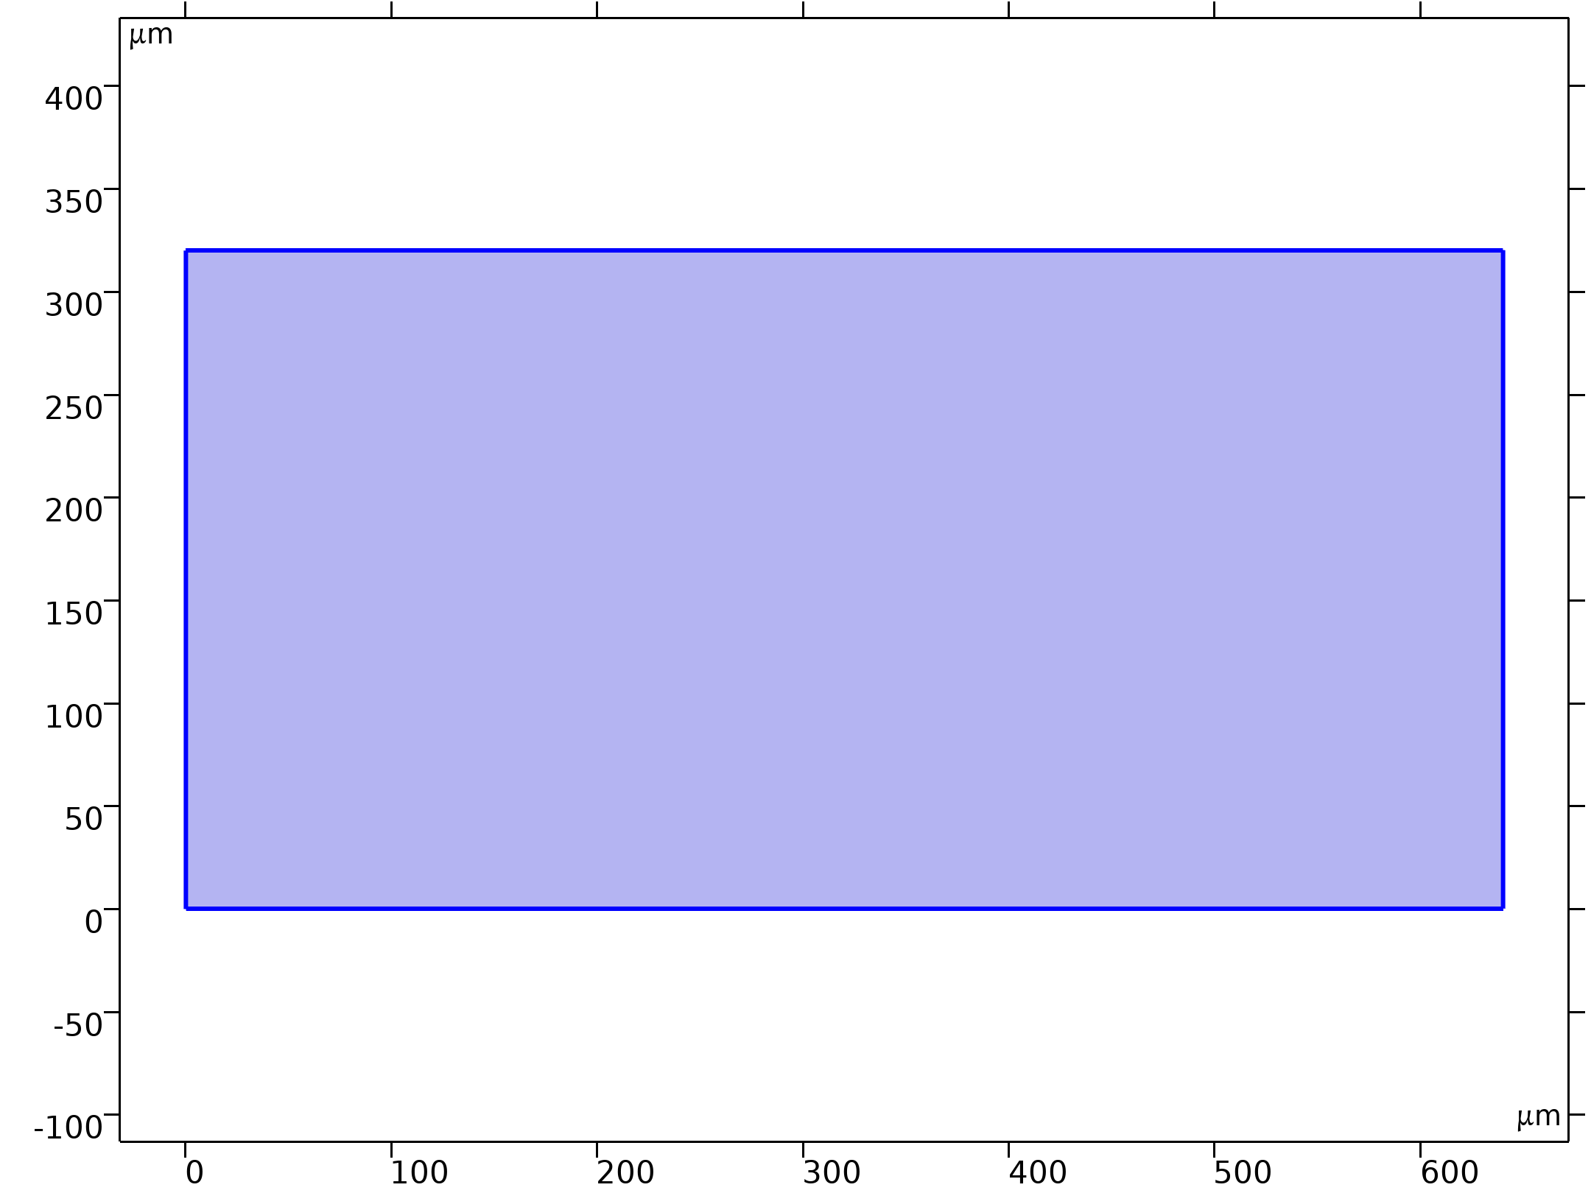
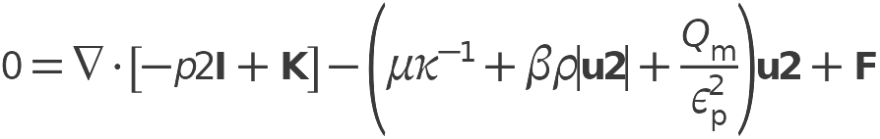

Model Equations
Brinkman Equations
Brinkman Equations

Slide 8
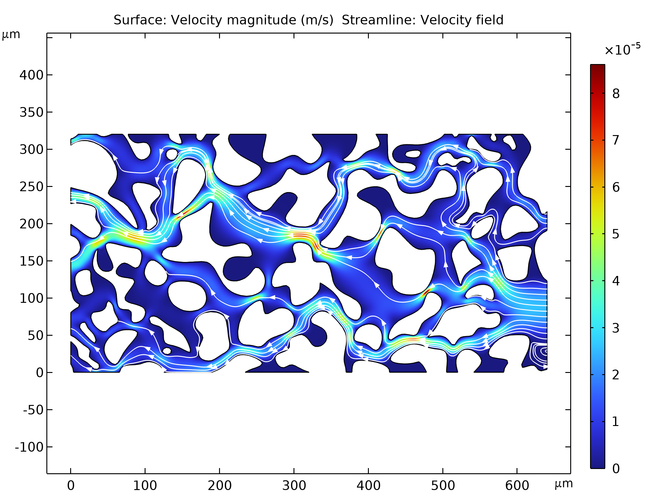
Results
The resulting velocity fields calculated from the Creeping Flow interface and the Brinkman Equations interface are in qualitatively good agreement.
Velocity Field for the Creeping Flow Analysis

Slide 9
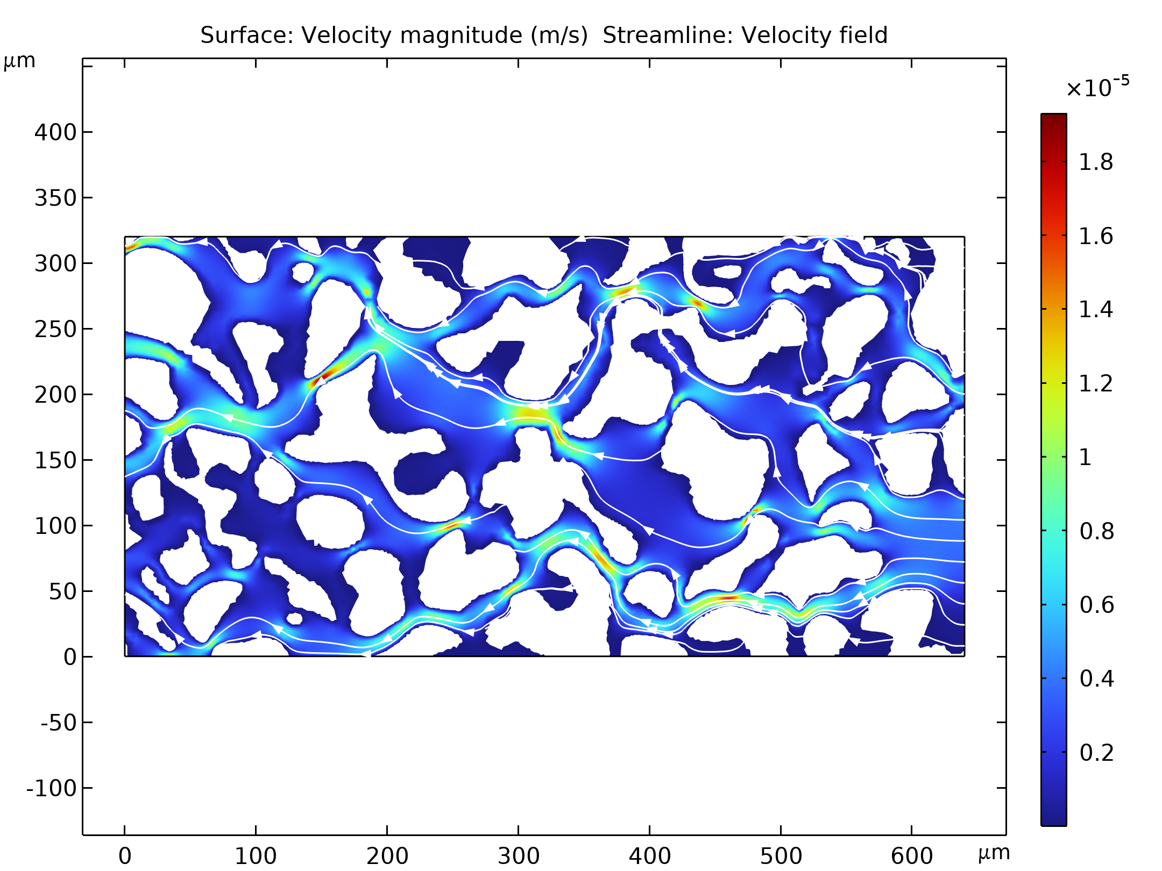
Results
Velocity Field calculated by the Brinkman Equations Interface

