Slide 1
Forchheimer Flow
COMSOL

Slide 2
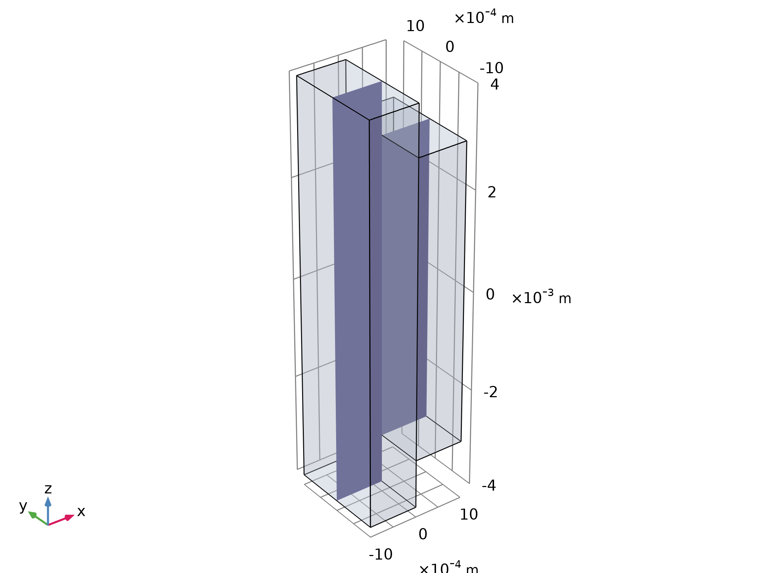
Introduction
This is a tutorial of the coupling between flow of a fluid in an open channel and in a porous medium attached to one of the channel walls
The coupling of free and porous media flow is common in the fields of earth sciences and chemical engineering, for example in
  Flows in media with large pores
  Packed beds in chemical process industry
  Cooling and drying towers
  Fruit and vegetable drying
Depiction of the modeling geometry and domain. The 3D geometry can be reduced to a 2D representation assuming that changes through the thickness are negligible

Slide 3
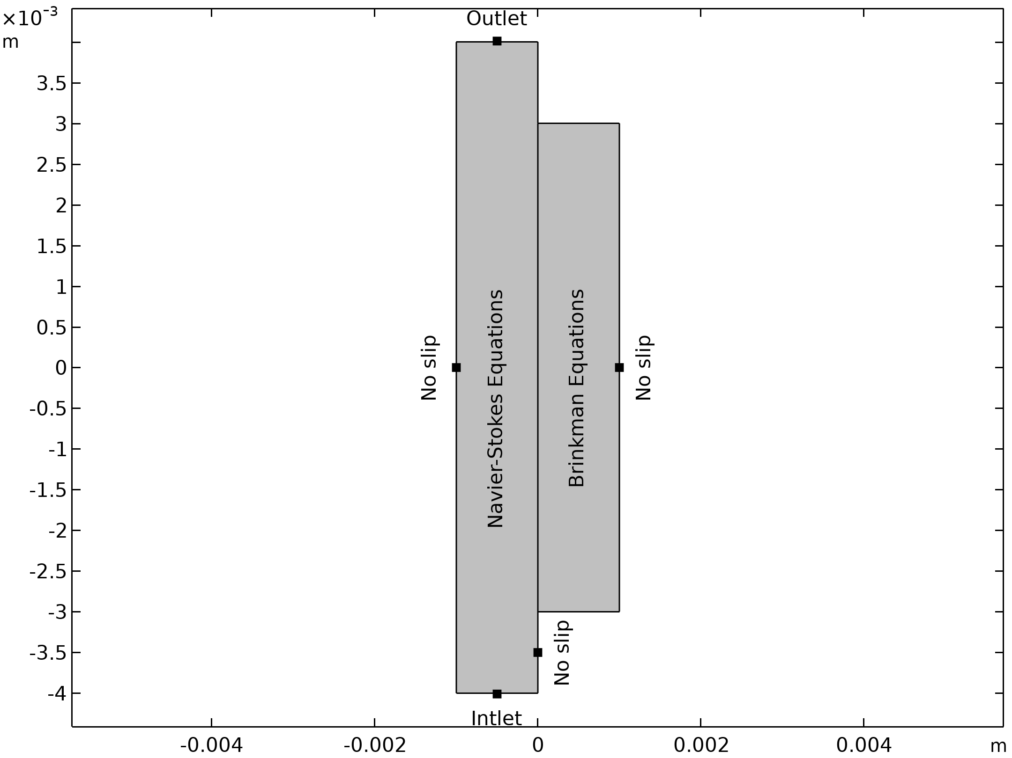
Model Setup
The free flow channel is on the left hand side, while the porous domain is attached to it on the right hand side
The flow enters the model domain at the bottom and leaves at the top
The other boundaries are solid walls with a no-slip boundary condition
Modeled domain and boundary conditions

Slide 4
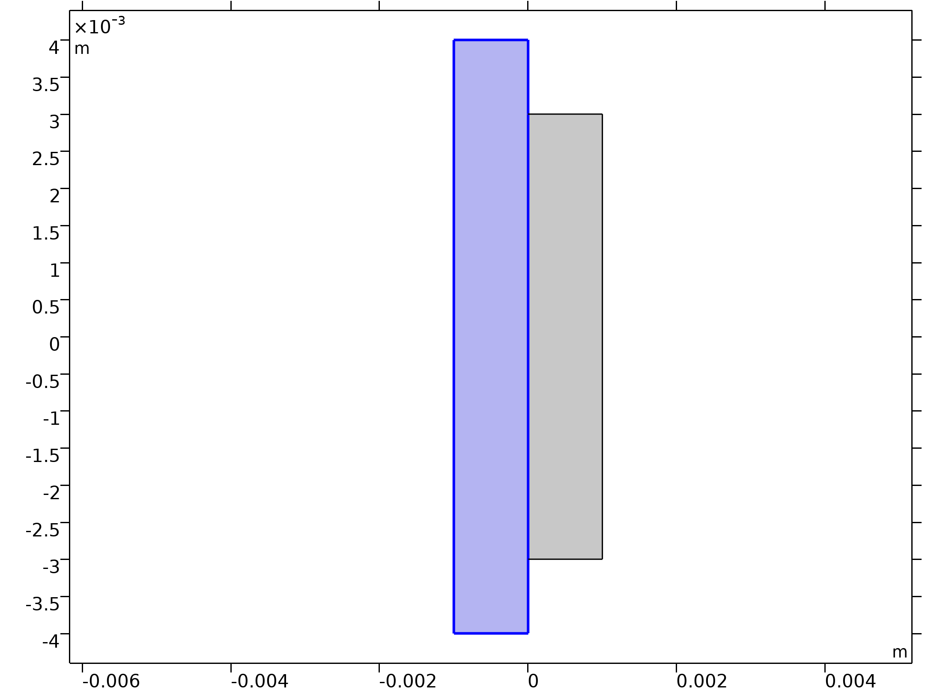



Navier-Stokes Equations
Fluid Properties 1

Slide 5
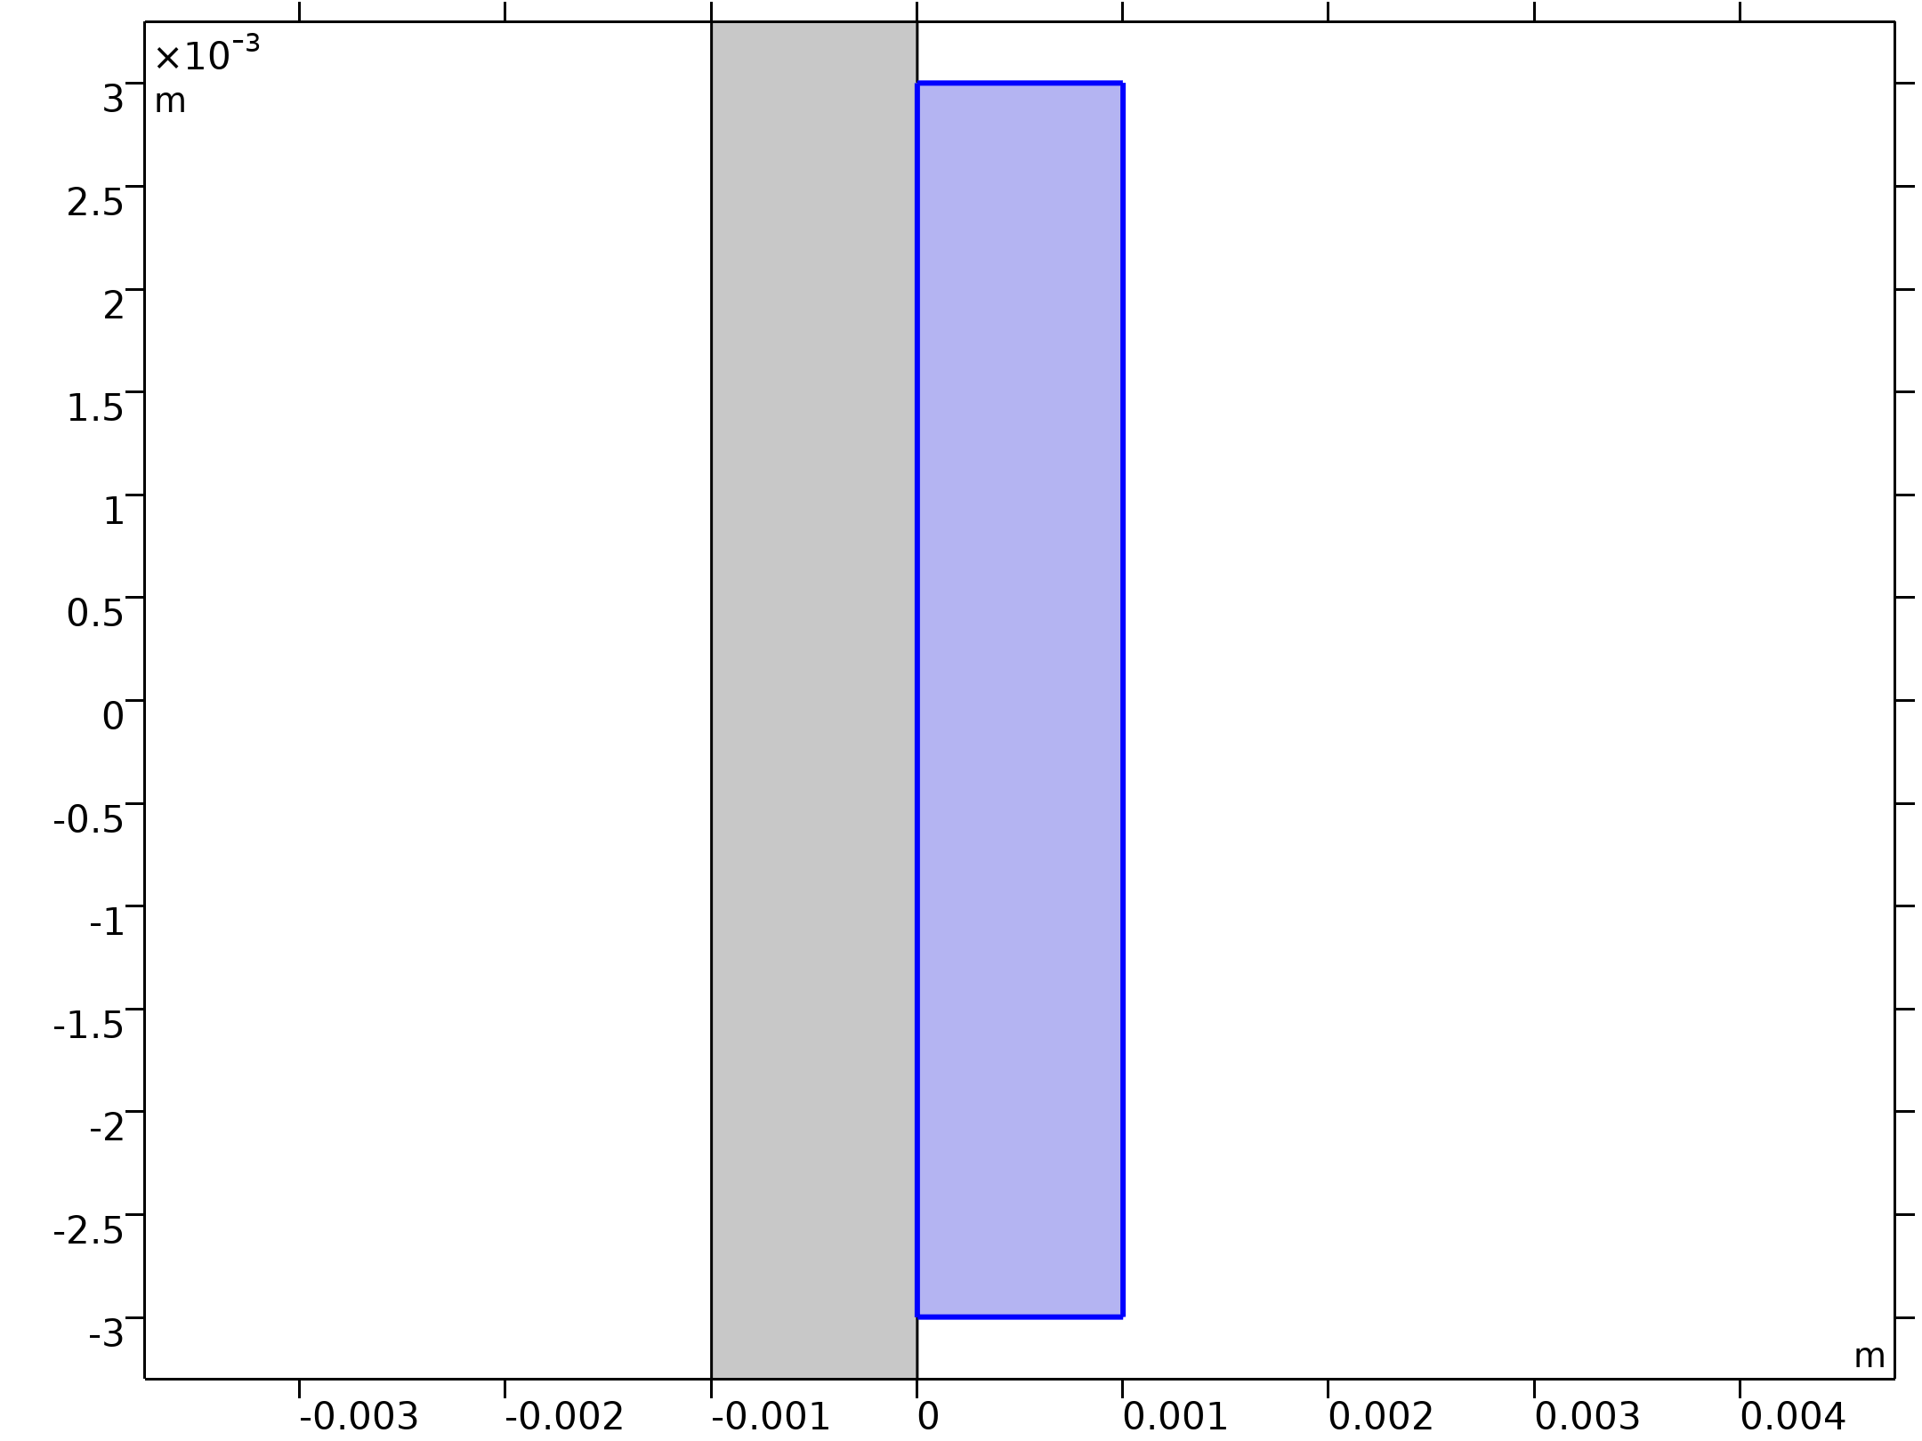
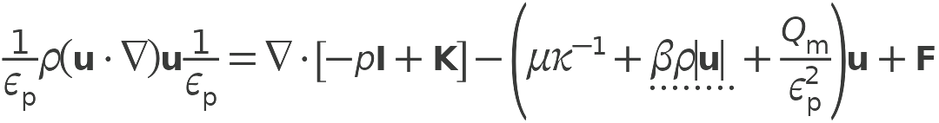

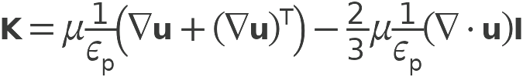
Brinkman Equations
Porous Medium 1

Slide 6
Brinkman Equations
Fluid 1

Slide 7
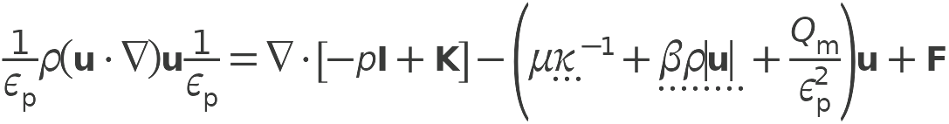
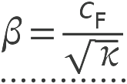
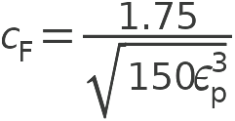
Brinkman Equations
Porous Matrix 1

Slide 8
Brinkman Equations
β ρ |u| is the Forchheimer correction term for turbulent drag contributions
C_{F} is the Forchheimer parameter or dimensionless friction coefficient
Porous Matrix 1

Slide 9
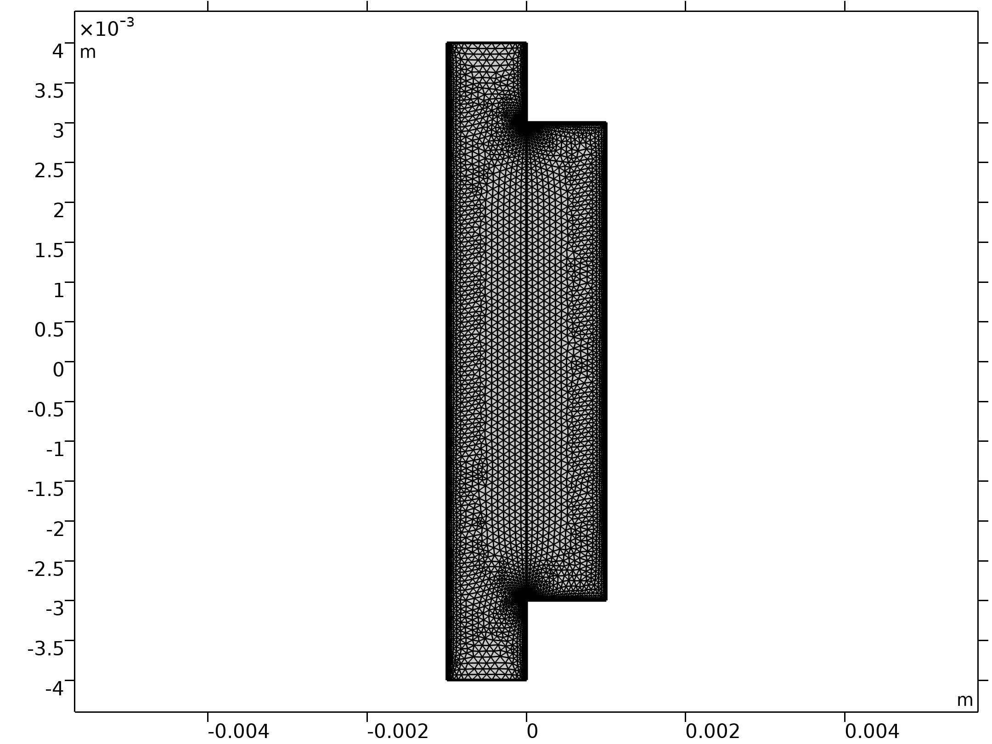
Mesh
A physics-controlled mesh is used where the solid walls are automatically meshed with boundary layer mesh elements
Mesh 1

Slide 10
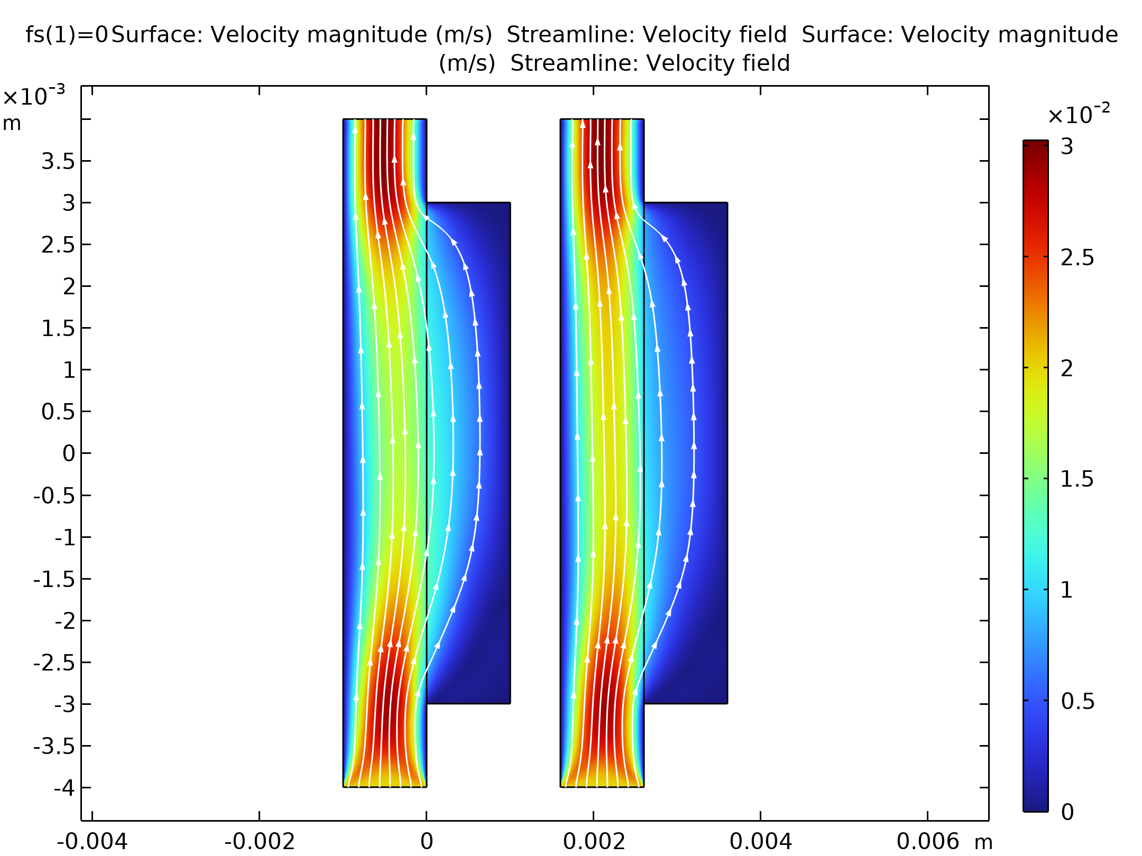
Results
The velocity field is plotted without Forchheimer correction (left) and with Forchheimer correction (right).
Without the Forchheimer correction the resistance to flow is underestimated in the porous domain
The added correction gives a solution with slower flow in the porous domain and a faster flow in the free domain
Velocity field without Forchheimer correction (left) and with Forchheimer correction (right).

Slide 11
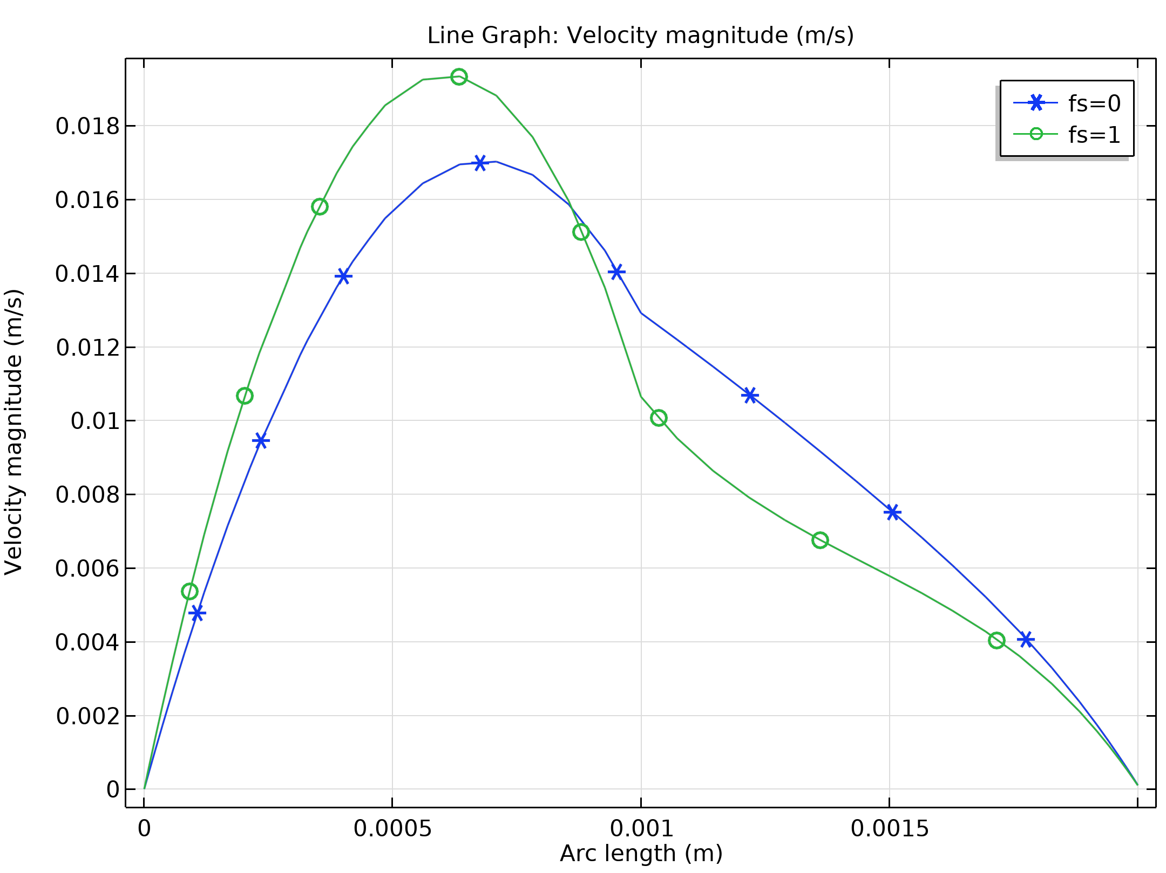
Results
This can also be seen in a cross section through the model domain. f_{s}=0 means Forchheimer correction is switched off.
Velocity magnitude along a cross section in the middle of the model domain with (green) and without (blue) Forchheimer correction.

