Slide 1
Elastic cloaking with Polar Material
COMSOL

Slide 2
Introduction
"Cloaking" refers to the capability of making inclusions neutral to probing incident wave fields. This is obtained by surrounding the inclusion with a so-called "invisibility cloak", designed such that outside it the field produced by external sources is unperturbed by the presence of the inclusion.
In the context of linear elastodynamics, the inclusion must be neutral with respect to both P and S waves at the same time.
This example demonstrates how to implement the anisotropic linear elastic material model comprising nonsymmetric stresses that is theoretically needed to obtain exact cloaking of an infinite cylinder.

Slide 3
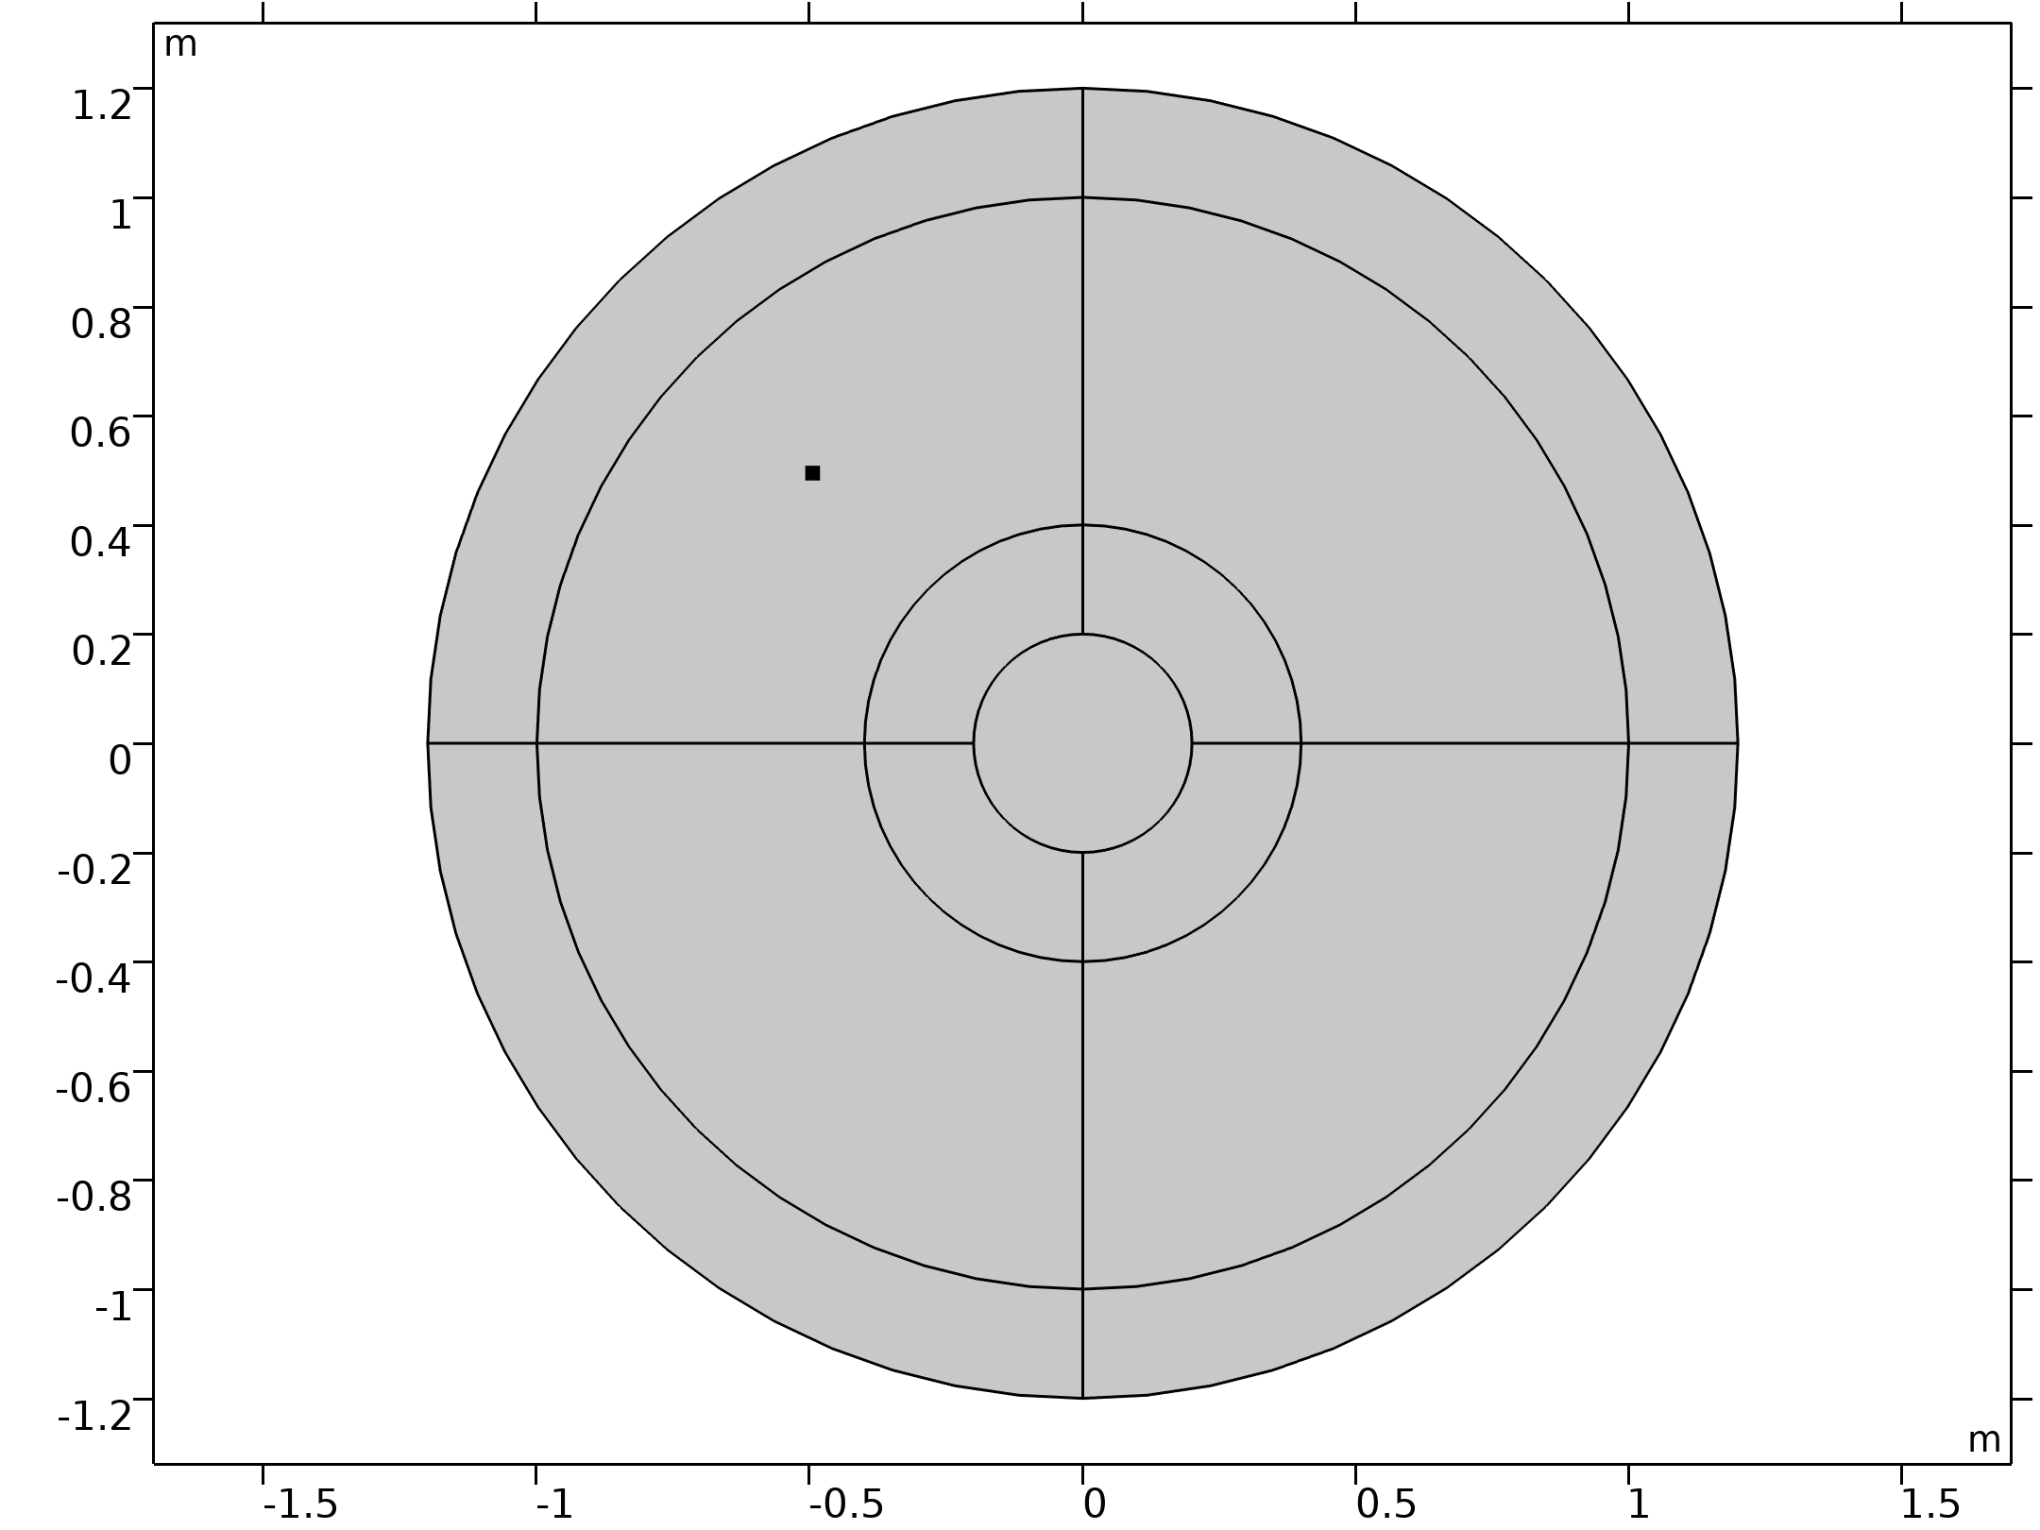
Model Definition
An infinite cylinder with radius r₀ is covered by a cloak of radius 2r₀.
A point load produces an oscillating force in the x direction.
A Perfectly Matched Layer is used to truncate the computational domain in order to mimich an infinite solid surrounding the cloak.
Plane strain modelling is used throughout the simulation to model P and SV waves.
Geometry 1

Slide 4
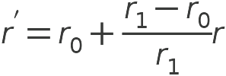


Governing Equations
In order to compute the required material properties, the singular map x'=χ(x) is defined in cylindrical coordinates as:
This map is used as a coordinate transformation for the elastodynamic equations:
Considering u'(x')=u(χ⁻¹(x')), this ultimately leads to:

Slide 5


Material Properties
The components of the elasticity tensor are computed as:
The density is computed as:
The elasticity tensor possesses the major symmetries but not the minor ones. To implement this material model, an External Stress attribute is used to add the nonsymmetric part of the stress tensor to the symmetric one.

Slide 6
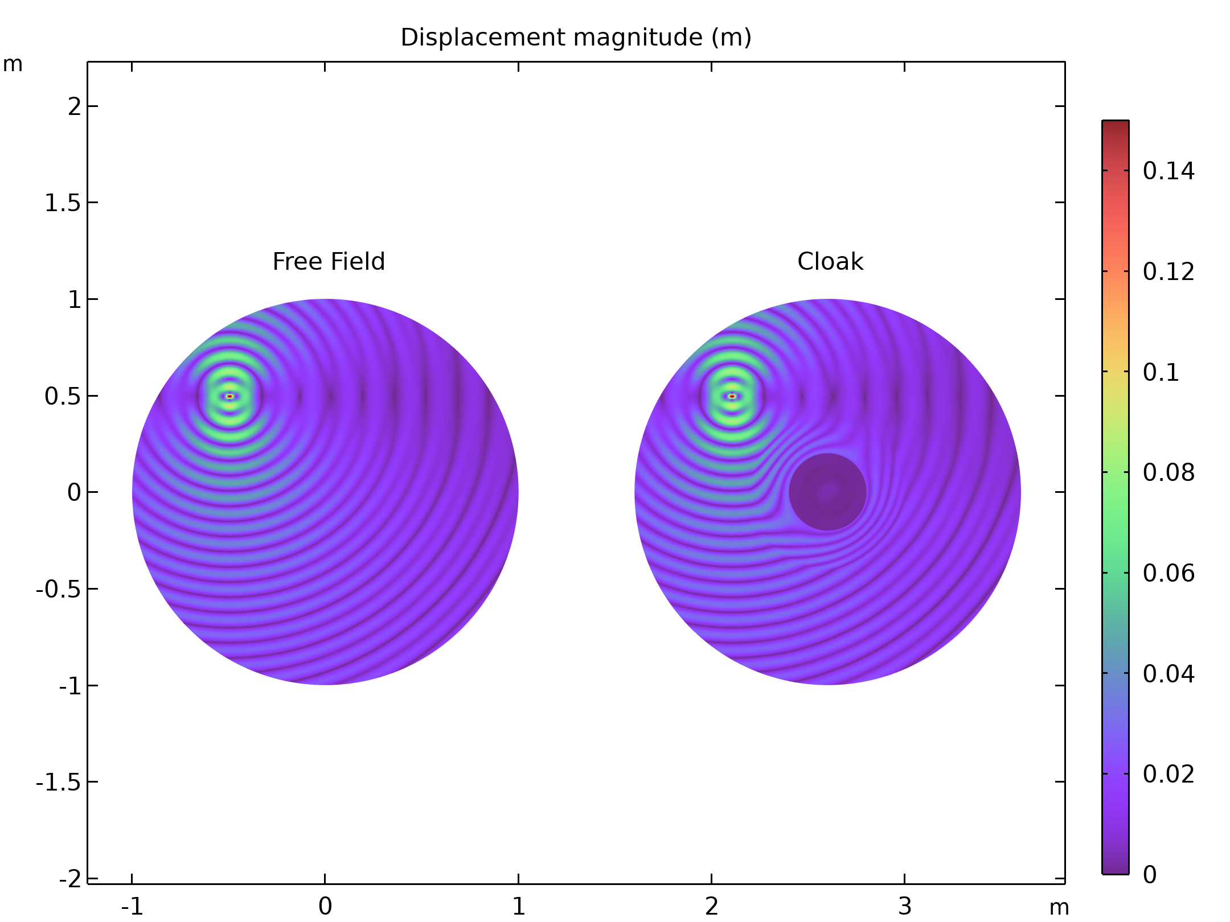
Results
The figure shows the magnitude of the displacement vector, comparing the free field case with the case in which the obstacle is surrounded by the cloak. Both S and P waves are emanated from the point source, hence an interference pattern can be observed also in the free field scenario.
Displacement magnitude (m)

Slide 7
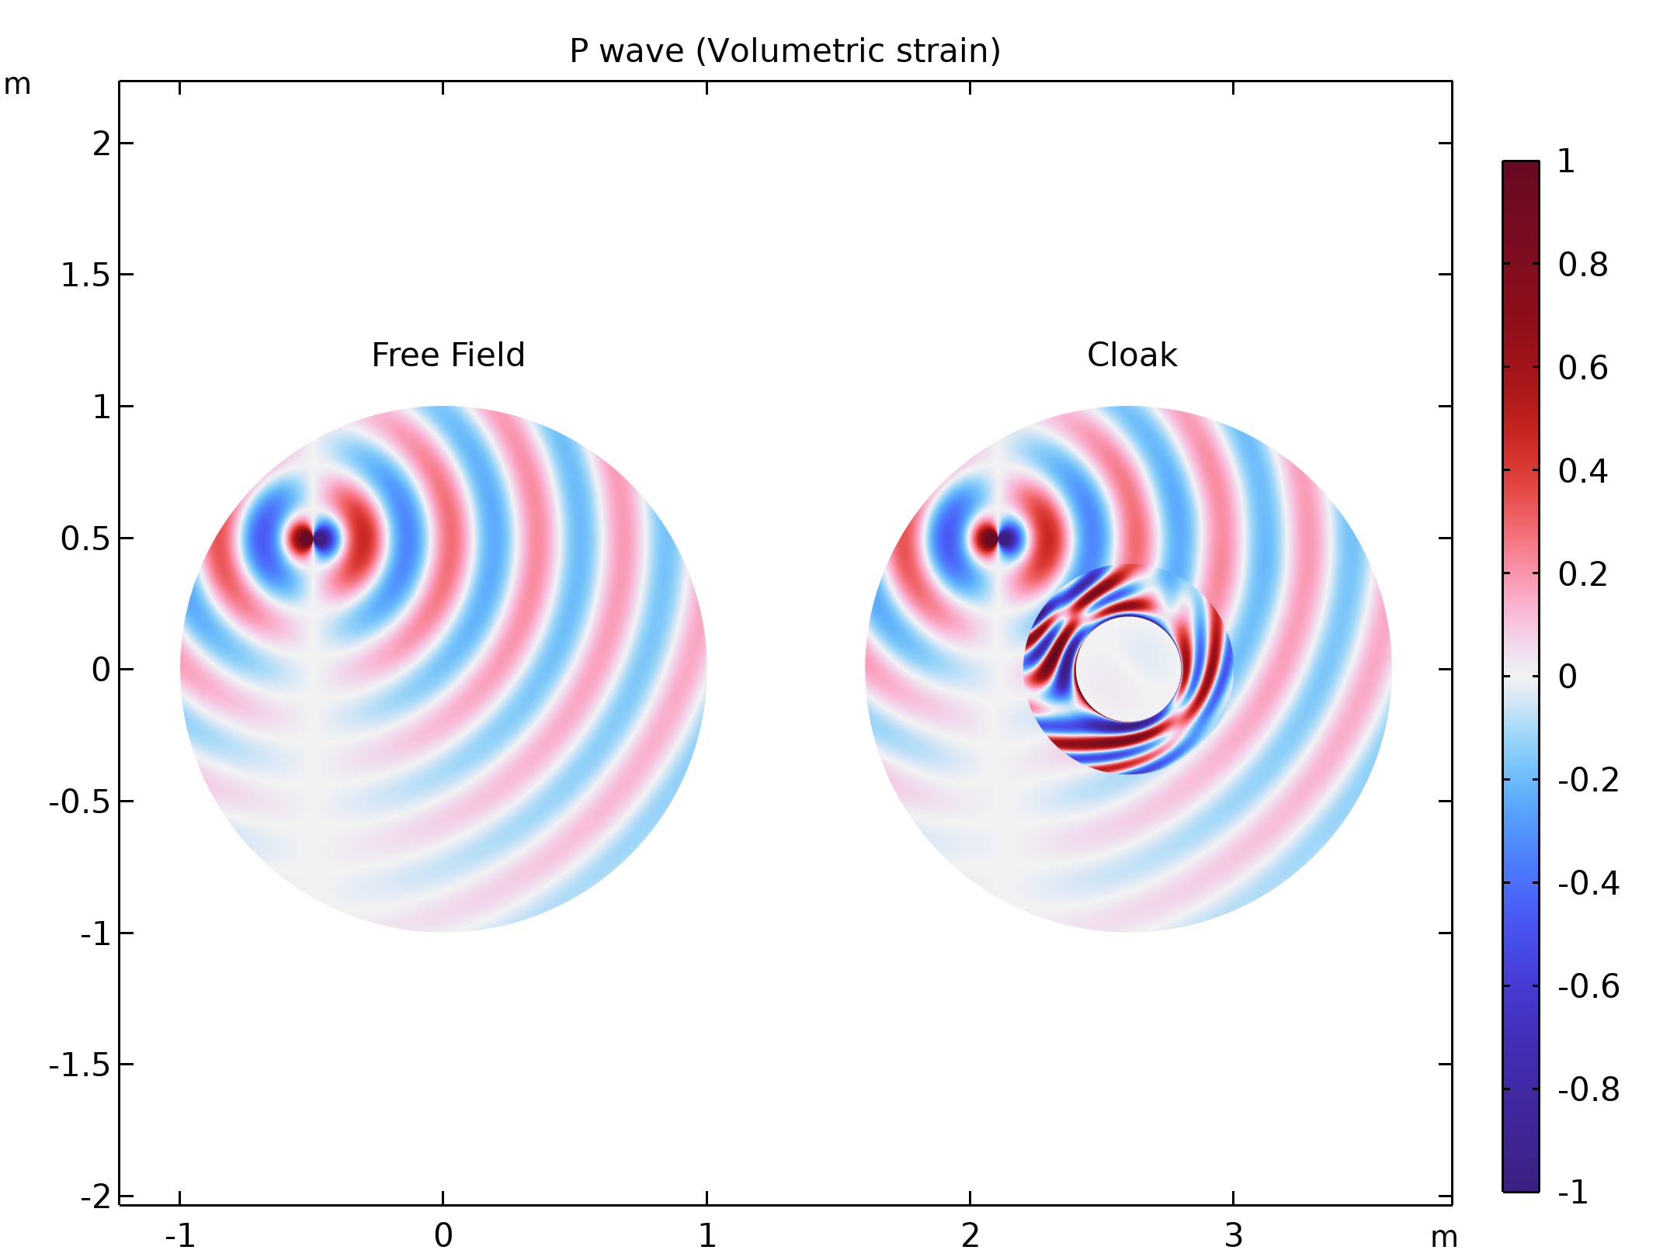
Results
P waves can be inspected by plotting the volumetric deformation. The harmonic force applied along the x direction acts as a dipole oriented horizontally.
P wave (Volumetric strain)

Slide 8
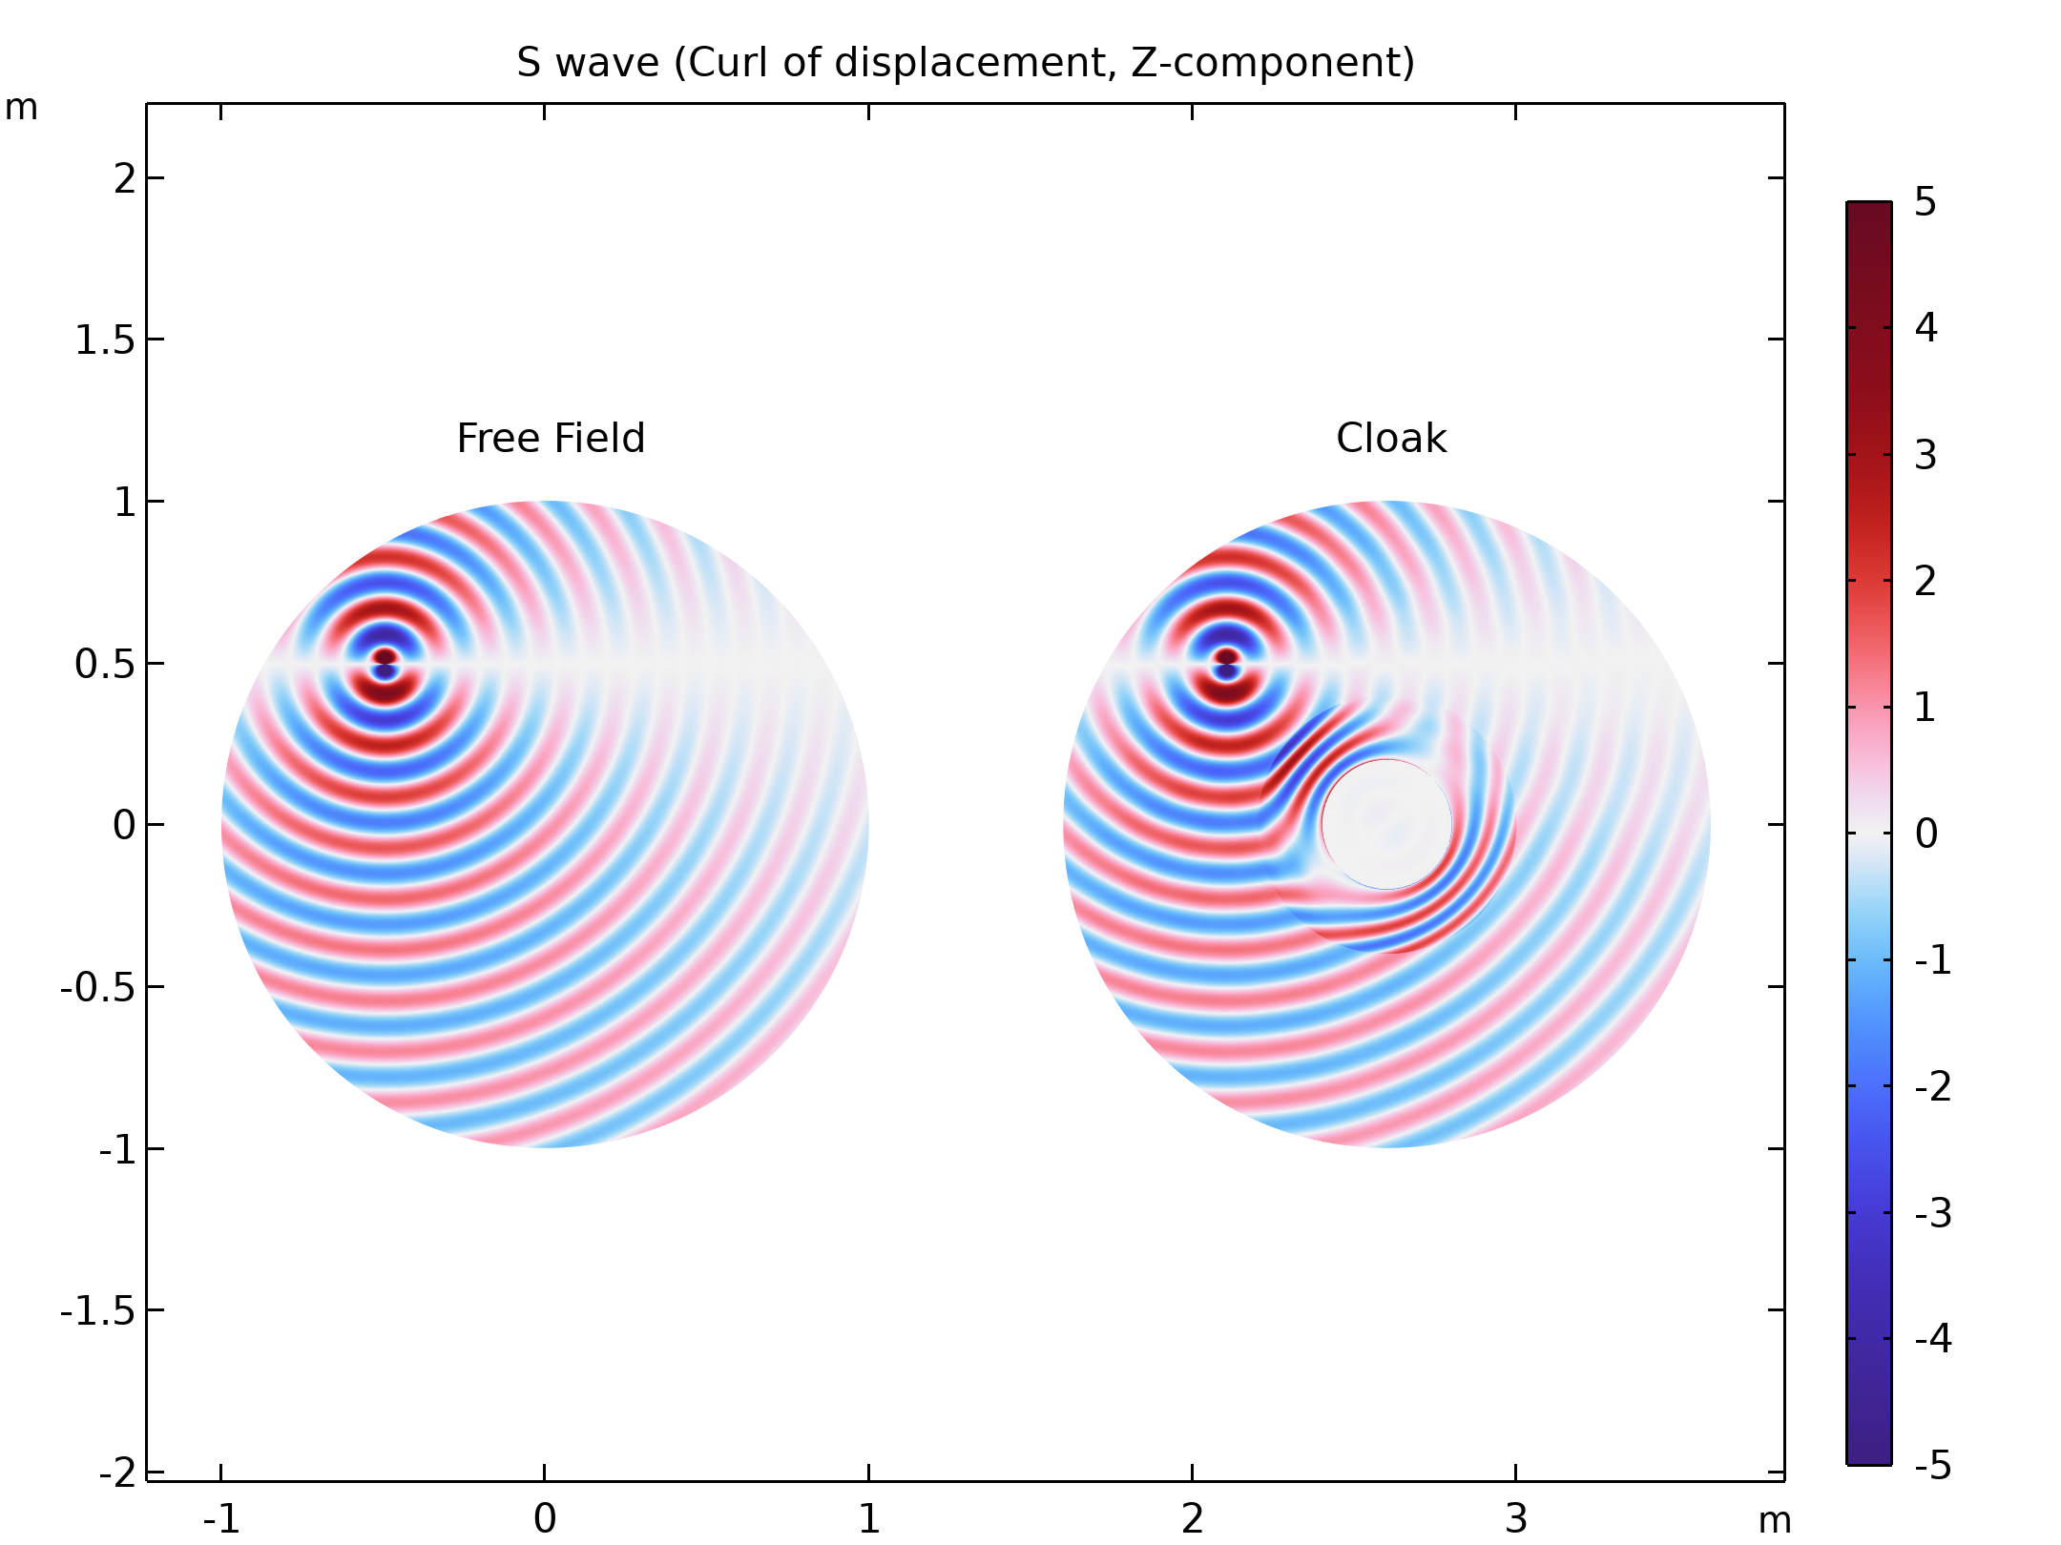
Results
S waves can be inspected plotting the out of plane component of the curl of the displacements. The harmonic force applied along the x direction acts as a dipole oriented vertically.
S wave (Curl of displacement, Z-component)

