Slide 1
Packed Bed Latent Heat Storage
COMSOL

Slide 2
Introduction
Thermal energy storage (TES) units are used to accumulate thermal energy from solar, geothermal, or waste heat sources
The simplest TES units are built from water tanks, often found in households, where the solar energy is stored as sensible heat
These systems are called sensible heat storage (SHS) units
The thermal capacity of these tanks can be further increased by including latent heat, which gives rise to latent heat storage (LHS) units
Typically, LHS tanks contain spherical capsules filled with paraffin as phase change material
Paraffin is a suitable phase change material to include the effect of latent heat, as it is relatively inexpensive, reliable, and nontoxic, and it is commercially available for a wide range of melting temperatures

Slide 3
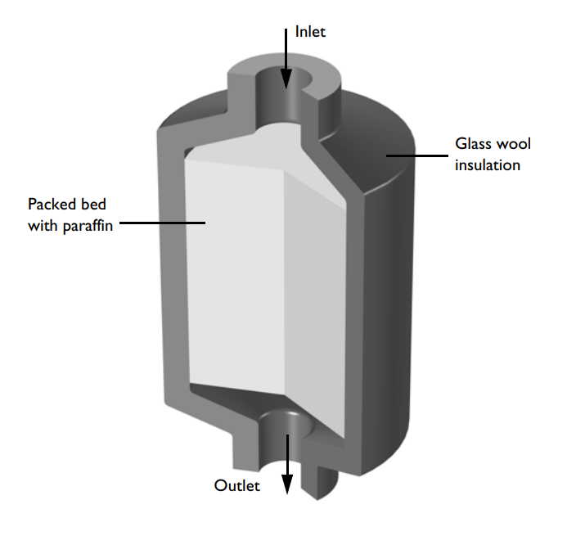
Model Definition
The model geometry is shown in figure
Model setup

Slide 4
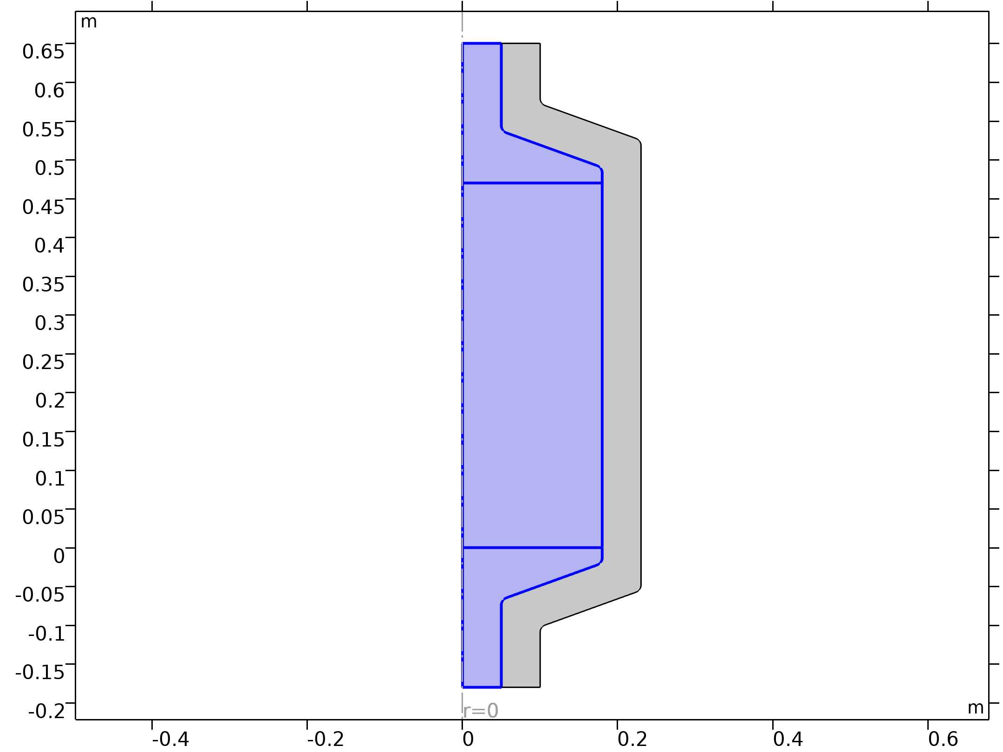


Model Definition
Free and Porous Media Flow, Brinkman

Slide 5
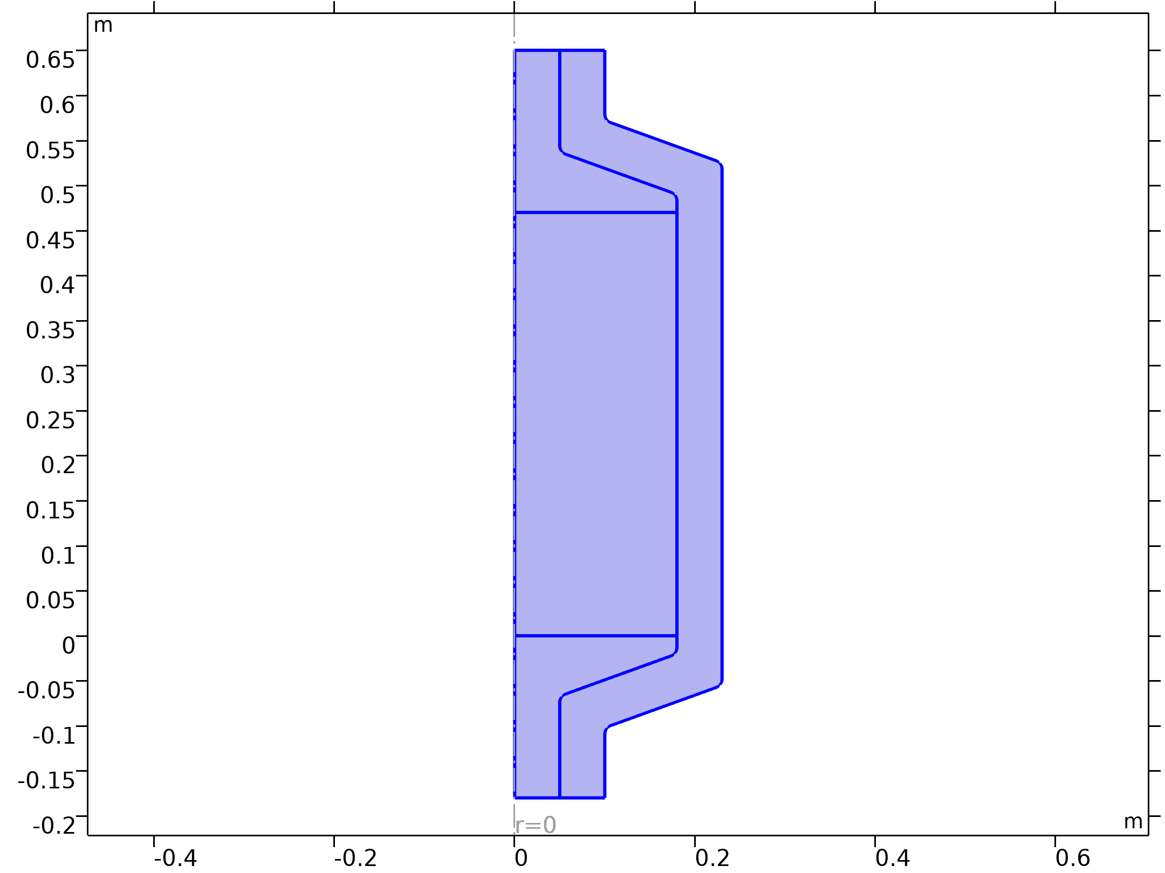


Model Definition
Heat Transfer in Solids and Fluids

Slide 6
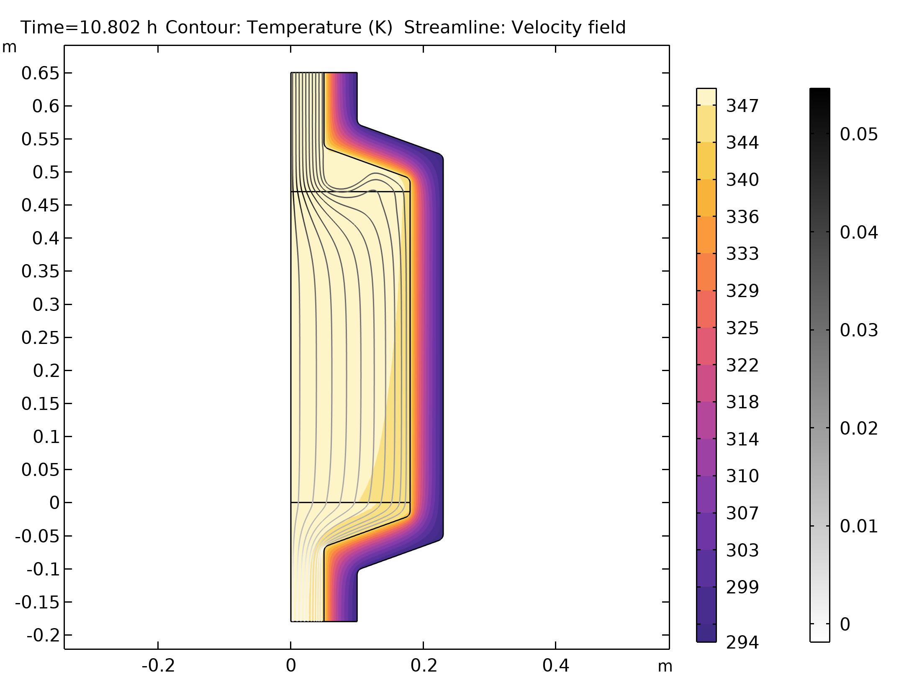
Results
The tank reaches a temperature of 70°C after approximately 11 hours
The figure shows the resulting velocity and temperature distribution
Velocity field (streamlines) with the gray color indicating the pressure and temperature field (color) after 13 hours

Slide 7
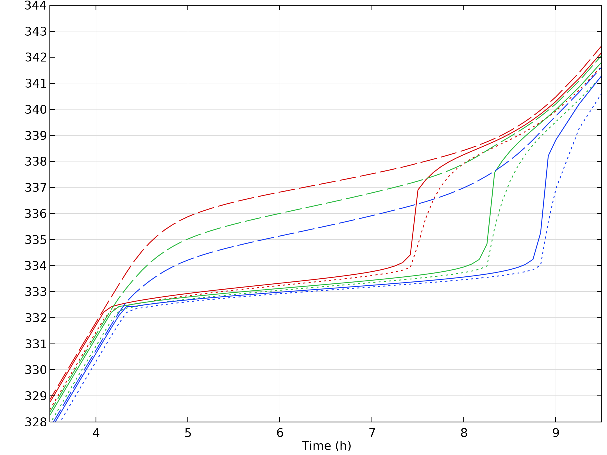
Results
The figure shows the evolution of the paraffin temperature, the water temperature, and the weighted average (porous-medium) temperature
During the phase change, the encapsulated paraffin is not in thermal equilibrium with the surrounding water
Measuring the water temperature at the inlet or the outlet does not give accurate information about neither the temperature inside the capsules nor the phase in which the paraffin wax is
Evolution of water (dashed), paraffin (dotted) and average porous medium temperature (solid) during phase change for top (red), center (green) and low (blue) position

Slide 8
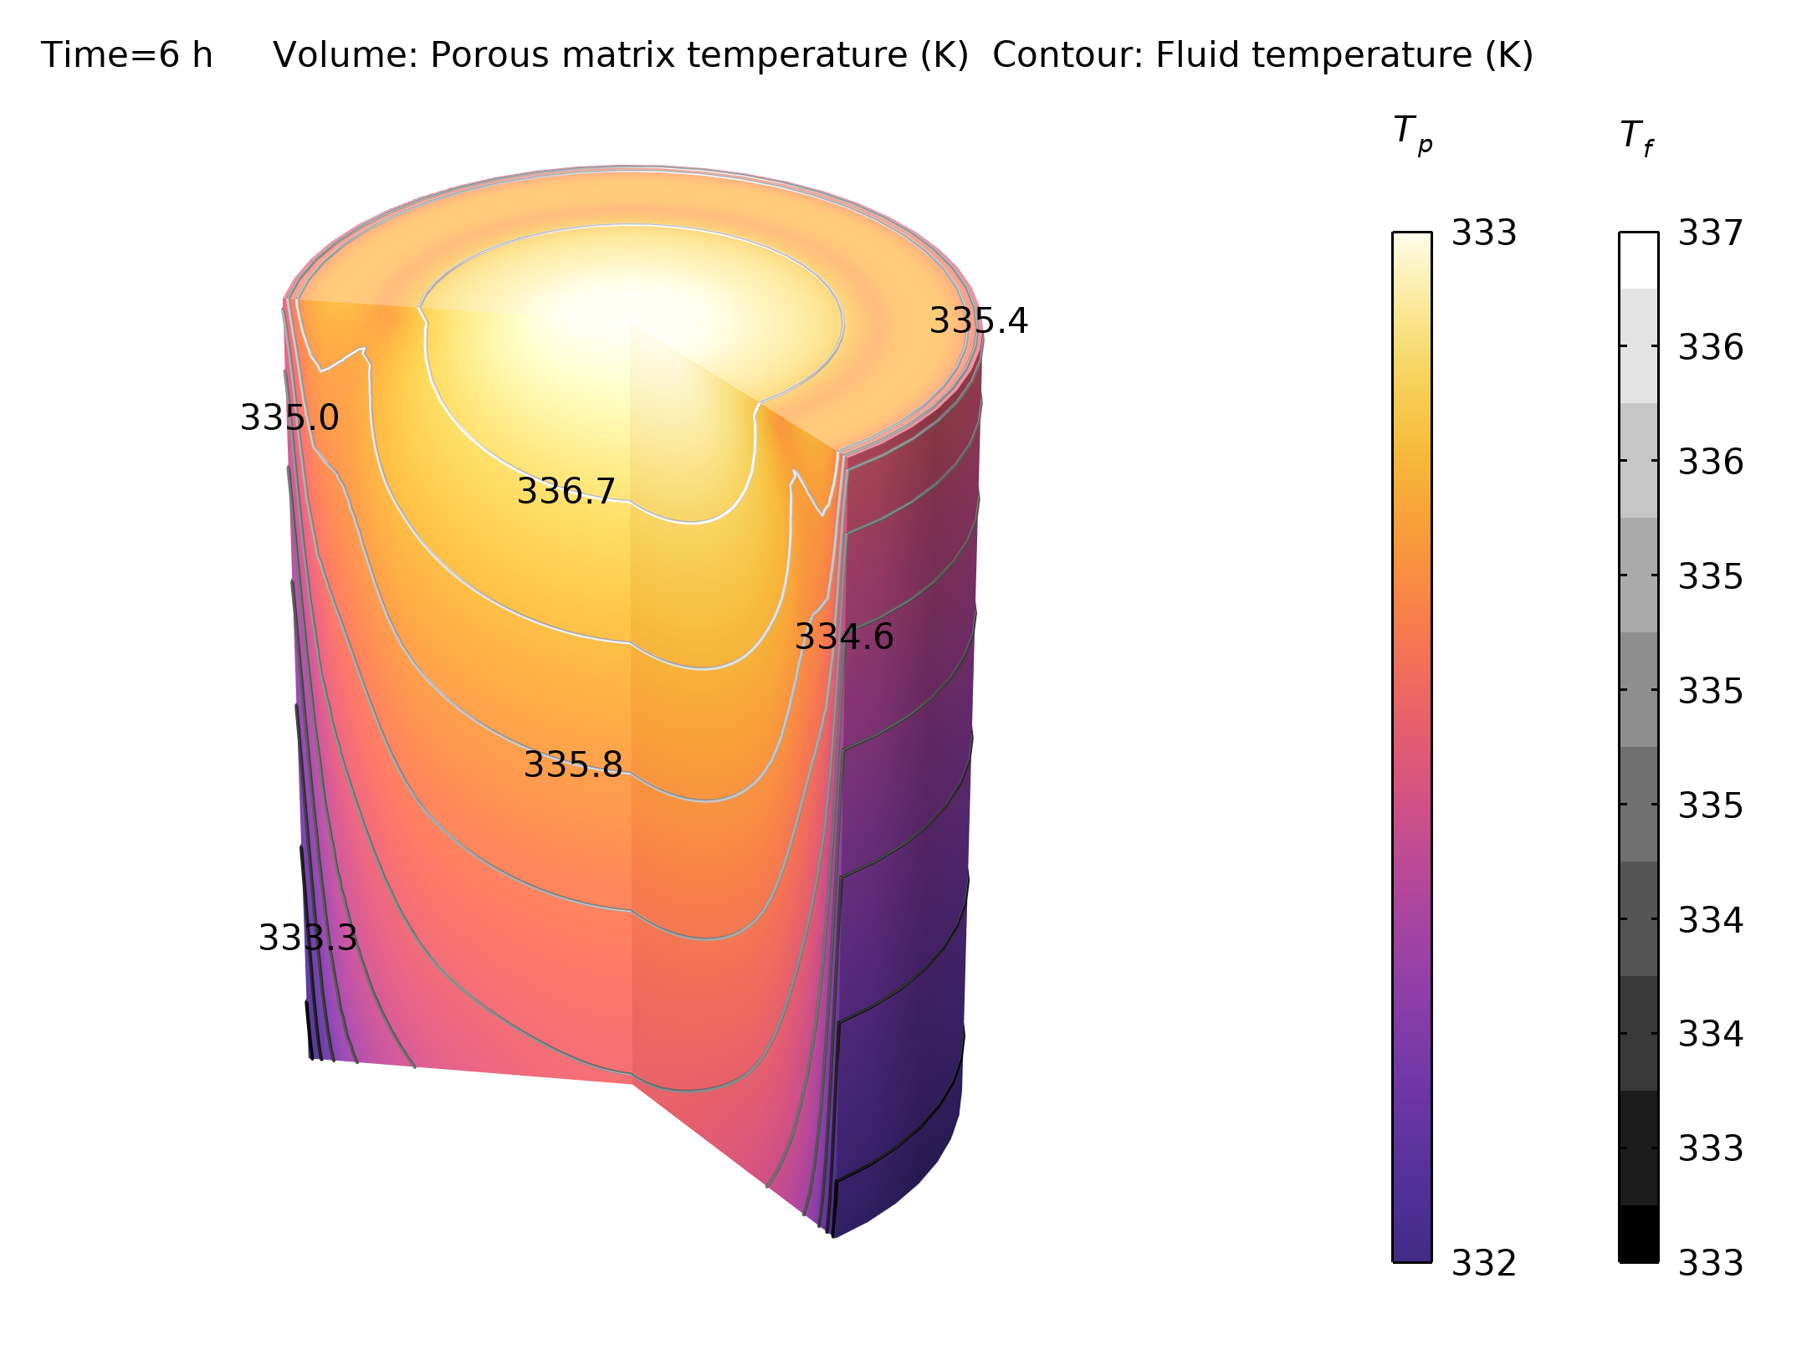
Results
During phase change, the pellets remain nearly constant at 333 K, while the fluid temperature ranges from 333 K to 337 K, indicating that thermal equilibrium has not yet been reached.
Pellet and Fluid temperature after 6 hours, during phase change

Slide 9
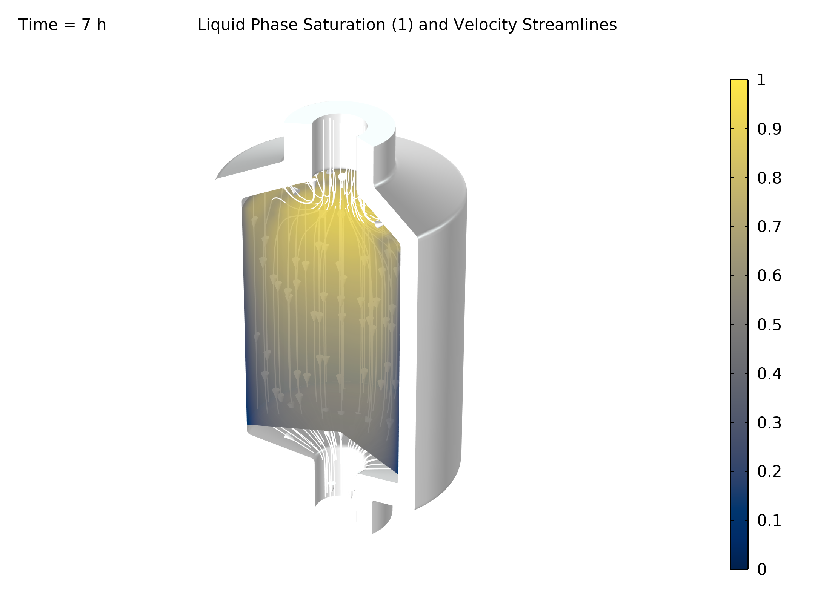
Results
The figure shows the phase distribution after 7 hours
Near the walls, where the flow velocity is negligible, the phase transition has not yet begun while it is already completed in the center of the tank
Distribution of solid phase (blue) and liquid phase (yellow) after 7 hours

Slide 10
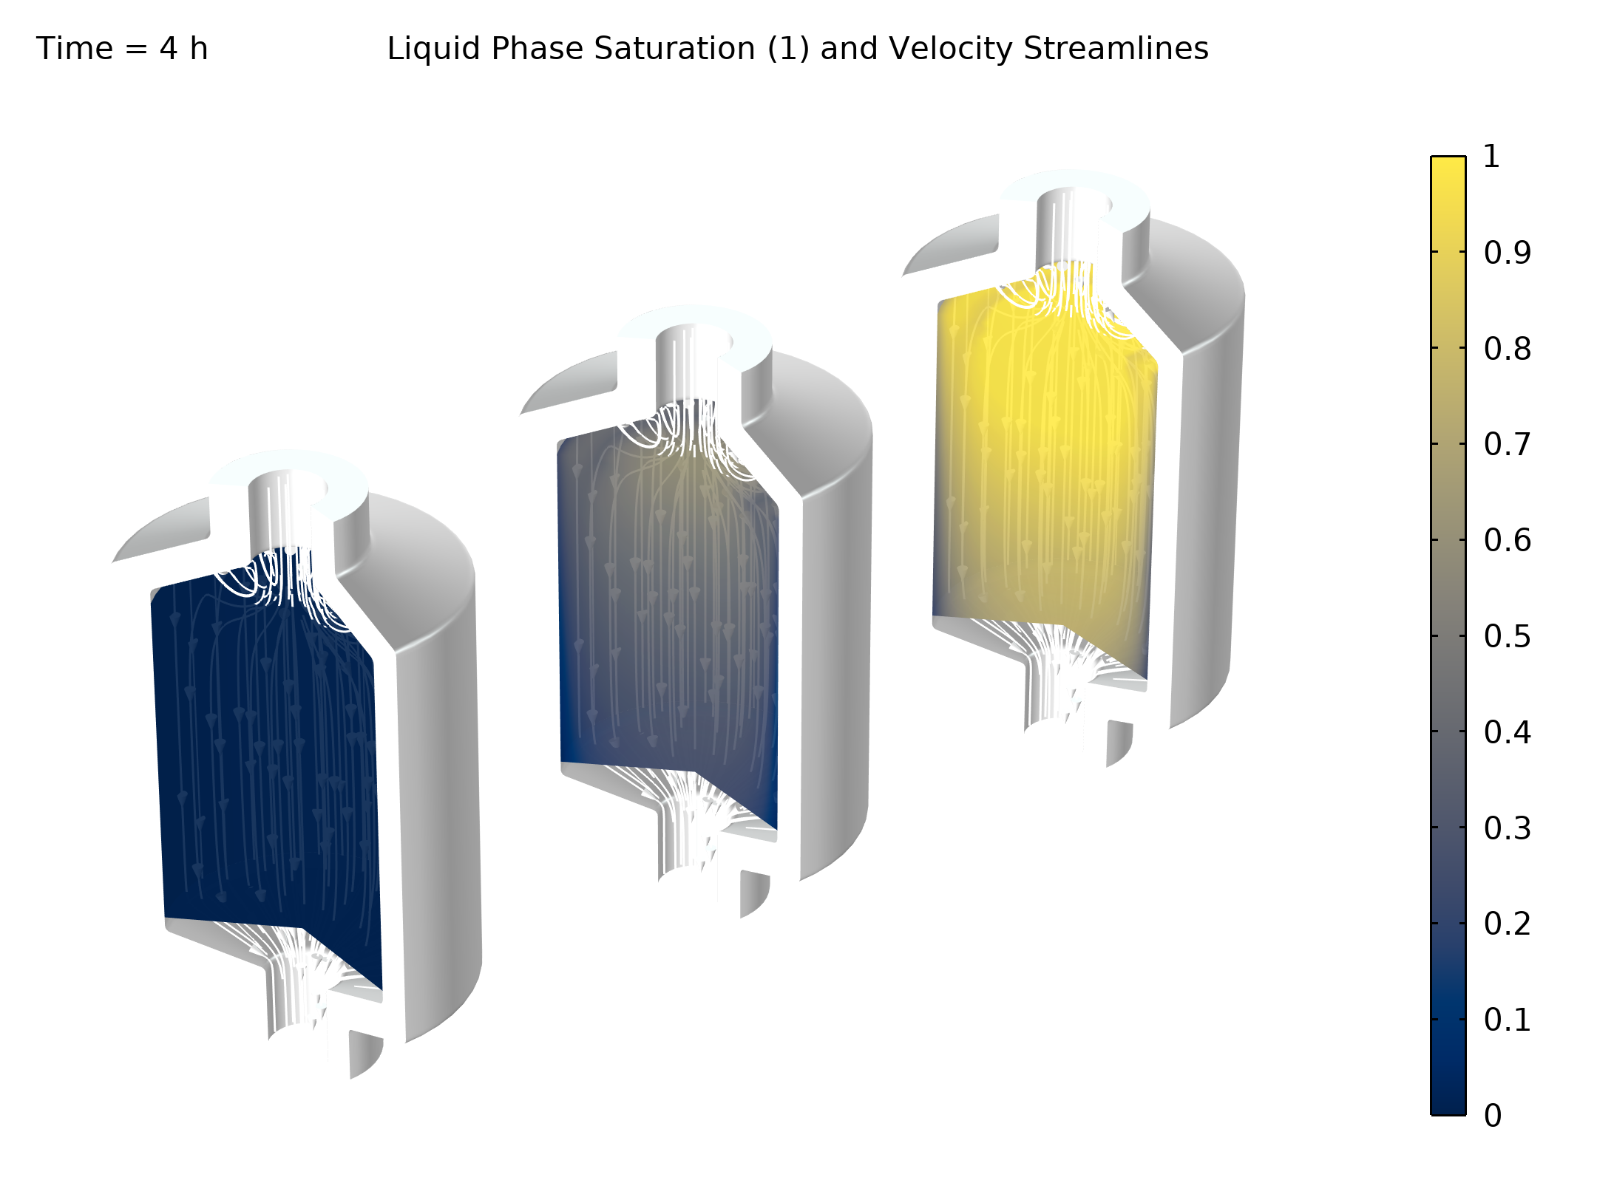
Results
The evolution of the paraffin phase distribution is visualized in the figure
It starts at about 4 hours when water is heated up to the melting temperature of 60°C
Paraffin is completely molten after about 10 hours
The latent heat storage tank is considered fully charged as soon as a temperature of 70°C is reached everywhere, which happens after approximately 11 hours.
Phase distribution after 4, 6, and 8 hours

