Slide 1
Shape Memory Alloy Self-Expanding Stent
COMSOL

Slide 2
Introduction
This model studies an arterial stent made of shape memory alloy (SMA)
The main benefit of SMA stents compared to usual metallic stents is their ability to self-expand, so they do not require the insertion and inflation of a balloon to give them the desired shape
The SMA stent is manufactured with a diameter higher than the diameter of the destination artery
It is then crimped to the diameter of the artery at low temperature
Due to the low operating temperature, the material partially transforms from austenite to martensite at low stress levels
When the stent is inserted in the artery, its temperature increases to the human body temperature
Then the yield stress increases so the force applied by the stent on the inner wall of the artery increases

Slide 3
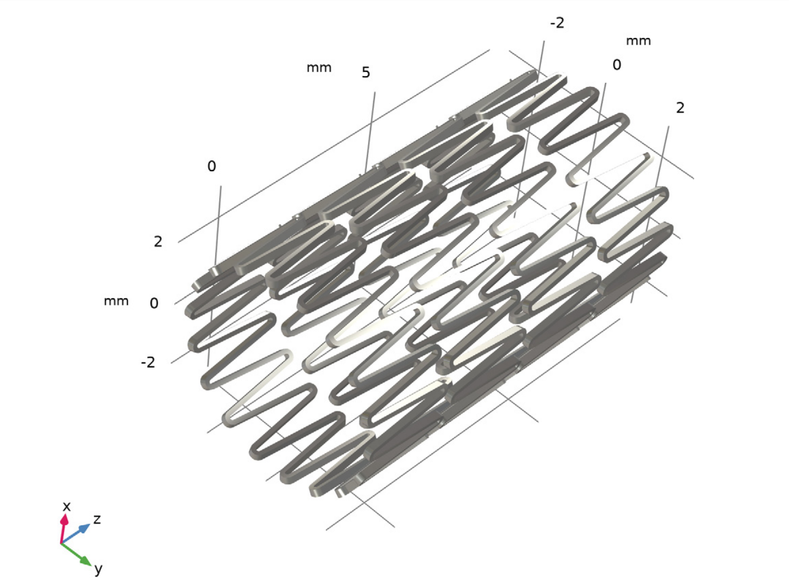
Model Definition
The stent is made of 4 levels of SMA wire
Each level is made of 18 “V” sections
Entire geometry of the stent

Slide 4
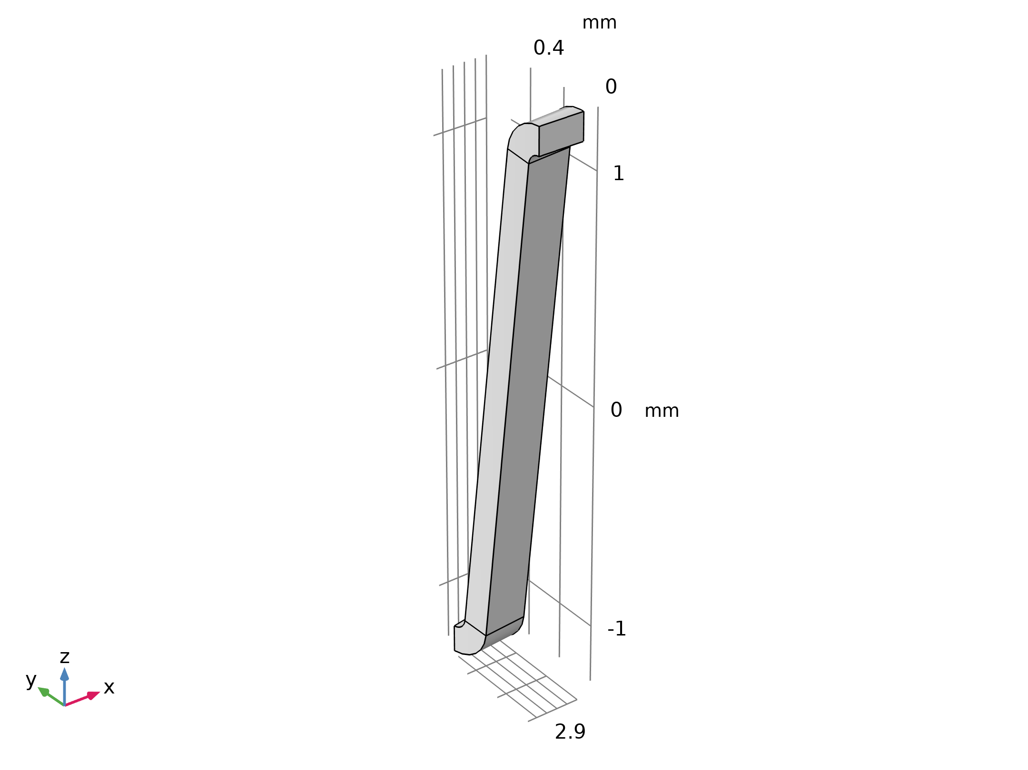
Model Definition
The figure shows a 10° sector of the full stent
Geometry 1

Slide 5
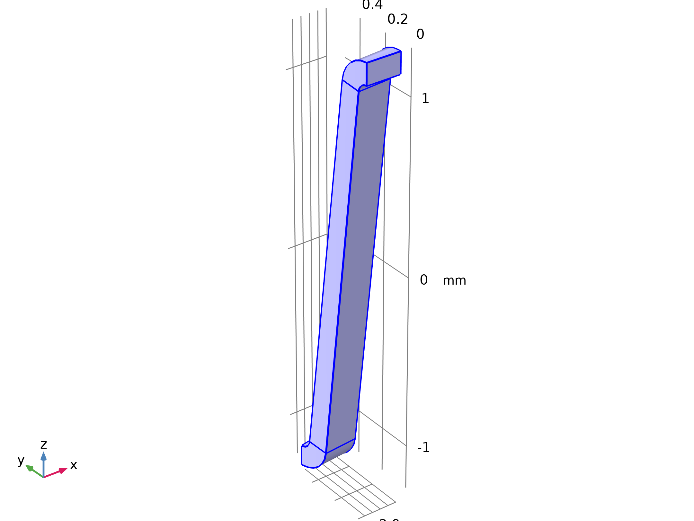

Model Definition
Solid Mechanics

Slide 6
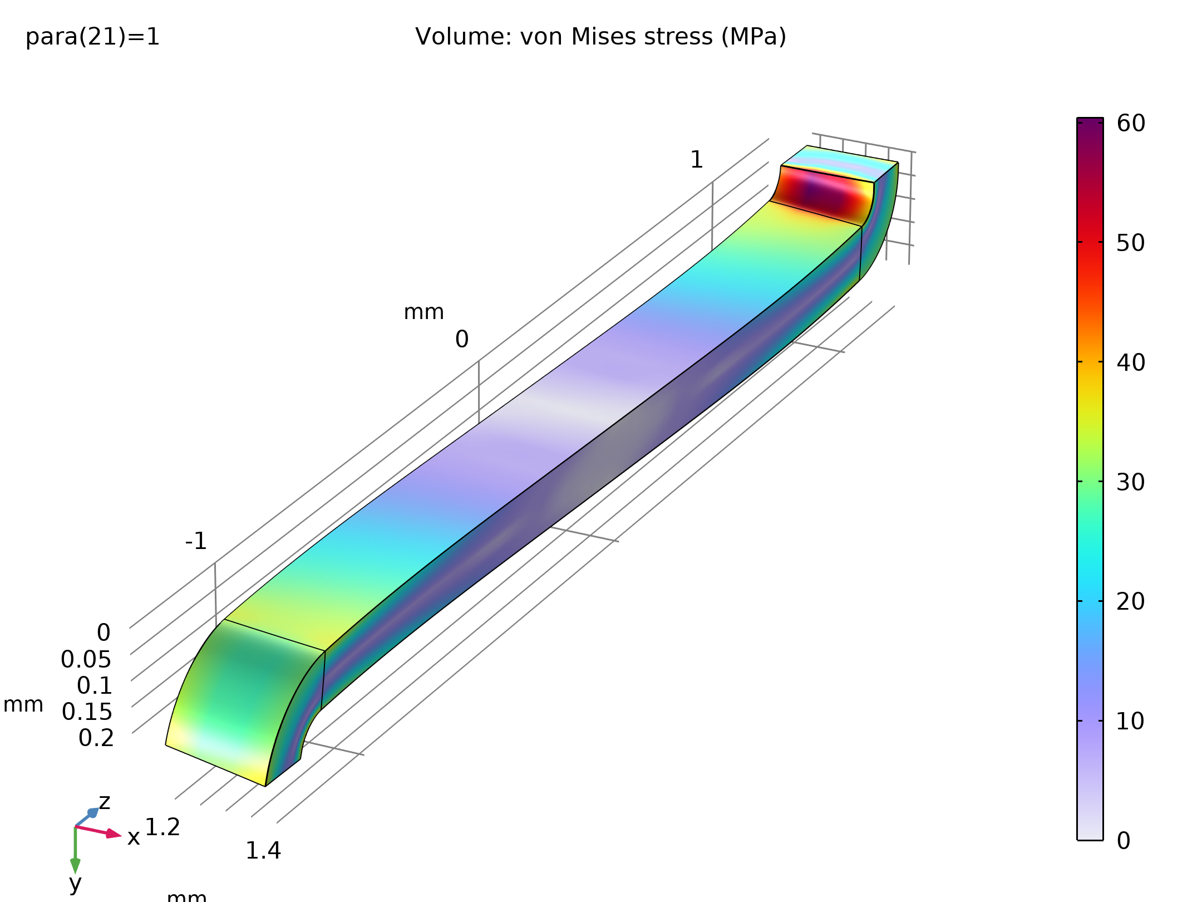
Results
The figure shows that after crimping the stress is concentrated at the inner face of the bend
The locations where the stress is maximal are the locations where the martensite volume fraction is higher as well
Nonzero martensite volume fraction means that transformation occurred, so residual strain remains
Stress and transformation state of one arm of the stent after crimping

Slide 7
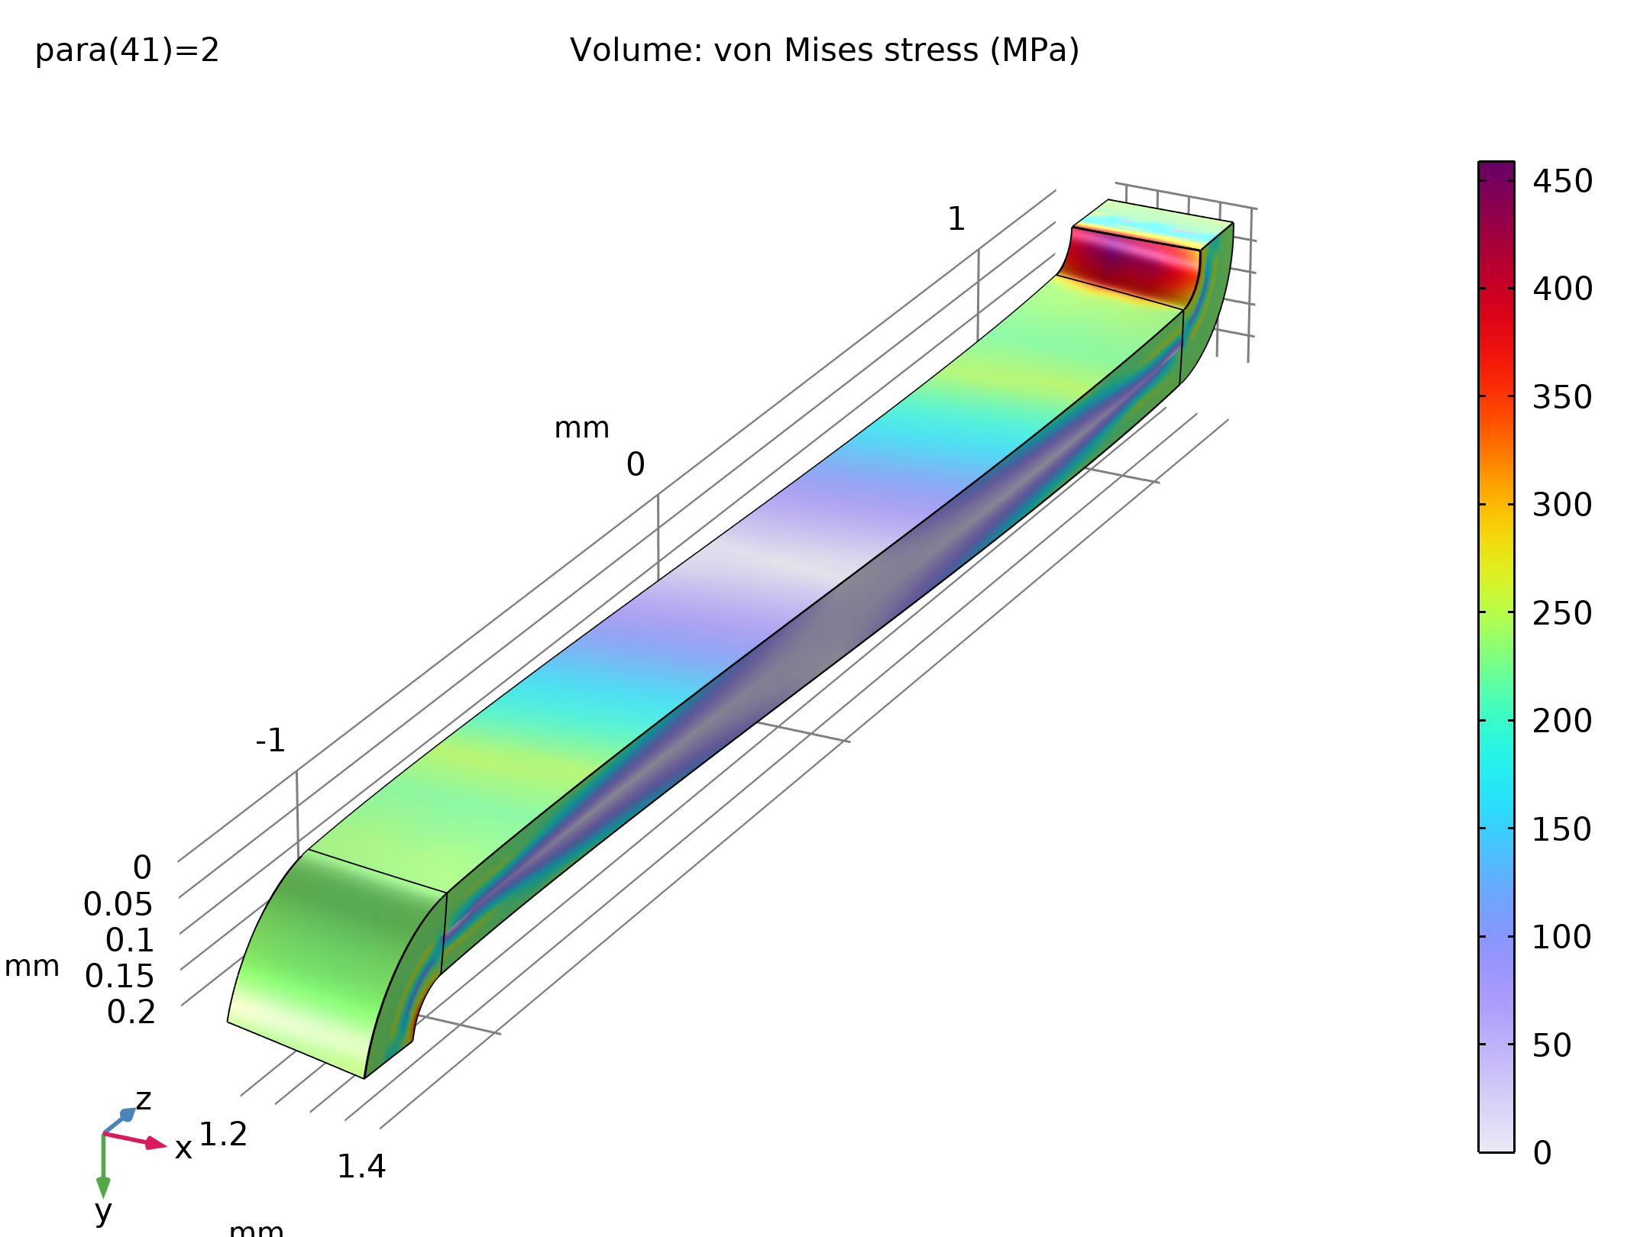
Results
Comparison with the figure shows that heating to body temperature has two effects: the maximum stress becomes far higher because the limit stress has increased, and the zone of transformation has reduced, which shows that reverse transformation has partially occurred
Stress in the stent after crimping

Slide 8
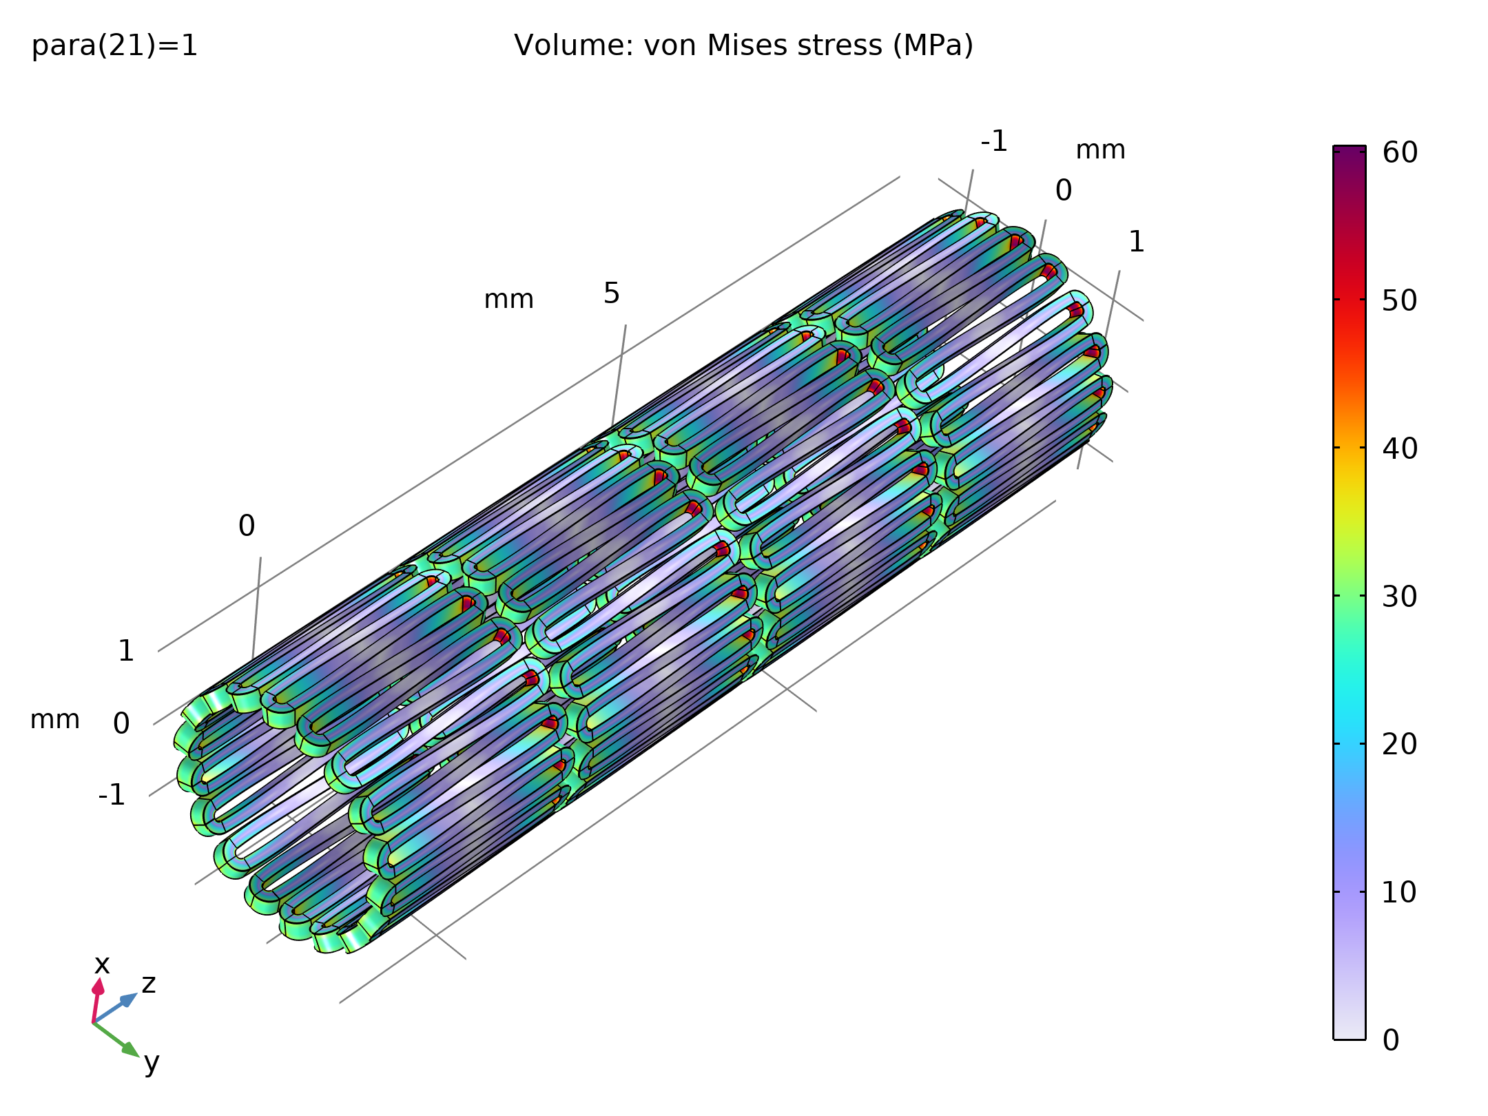
Results
Comparison with the previous figure that shows heating to body temperature has two effects: the maximum stress becomes far higher because the limit stress has increased, and the zone of transformation has reduced, which shows that reverse transformation has partially occurred
Those effects can be noticed on these figures of whole stent as well
Stress in the stent after crimping

Slide 9
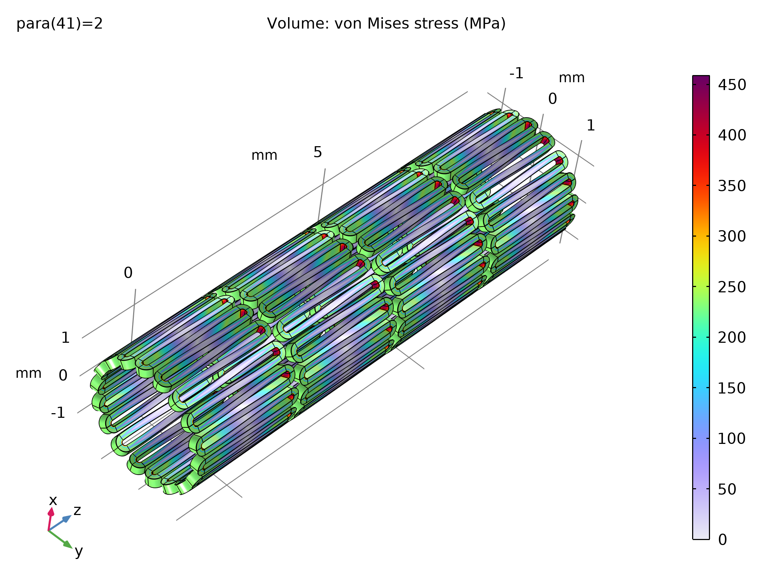
Results
The figure shows the stress in the stent in the human body
Stress in the stent in the human body

Slide 10
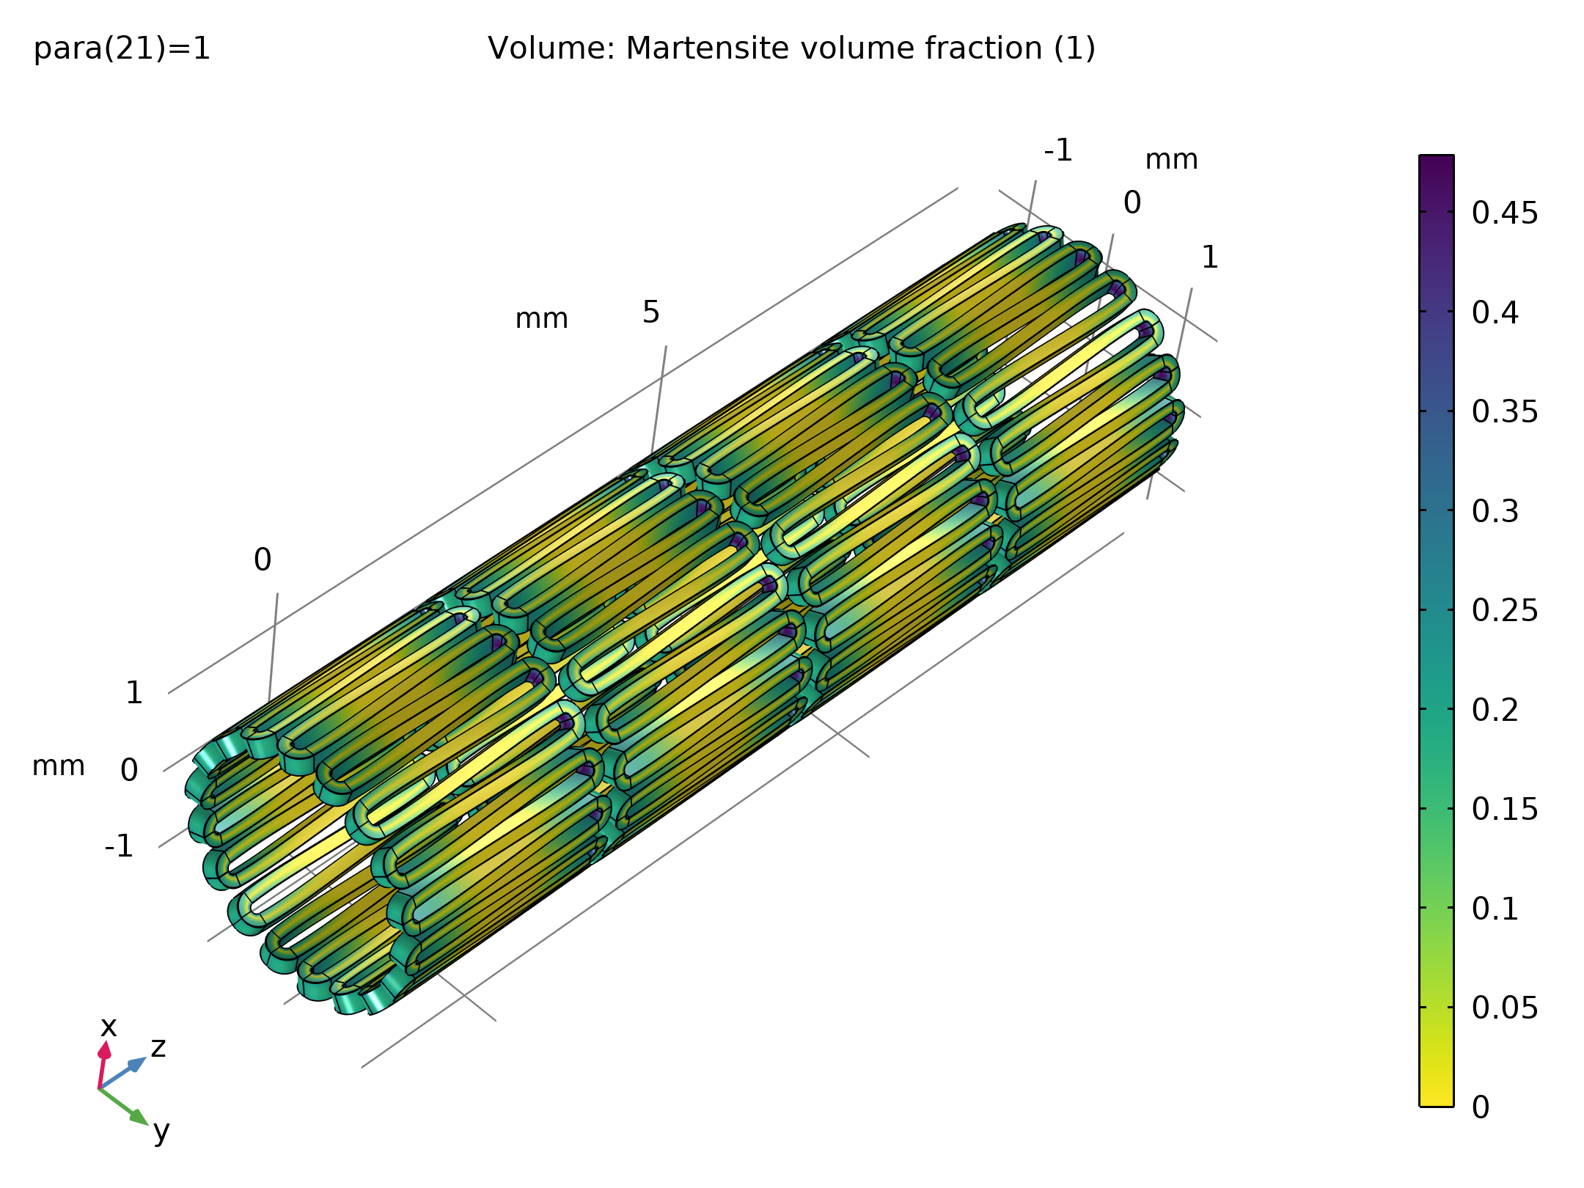
Results
Martensite volume fraction in the stent after crimping

Slide 11
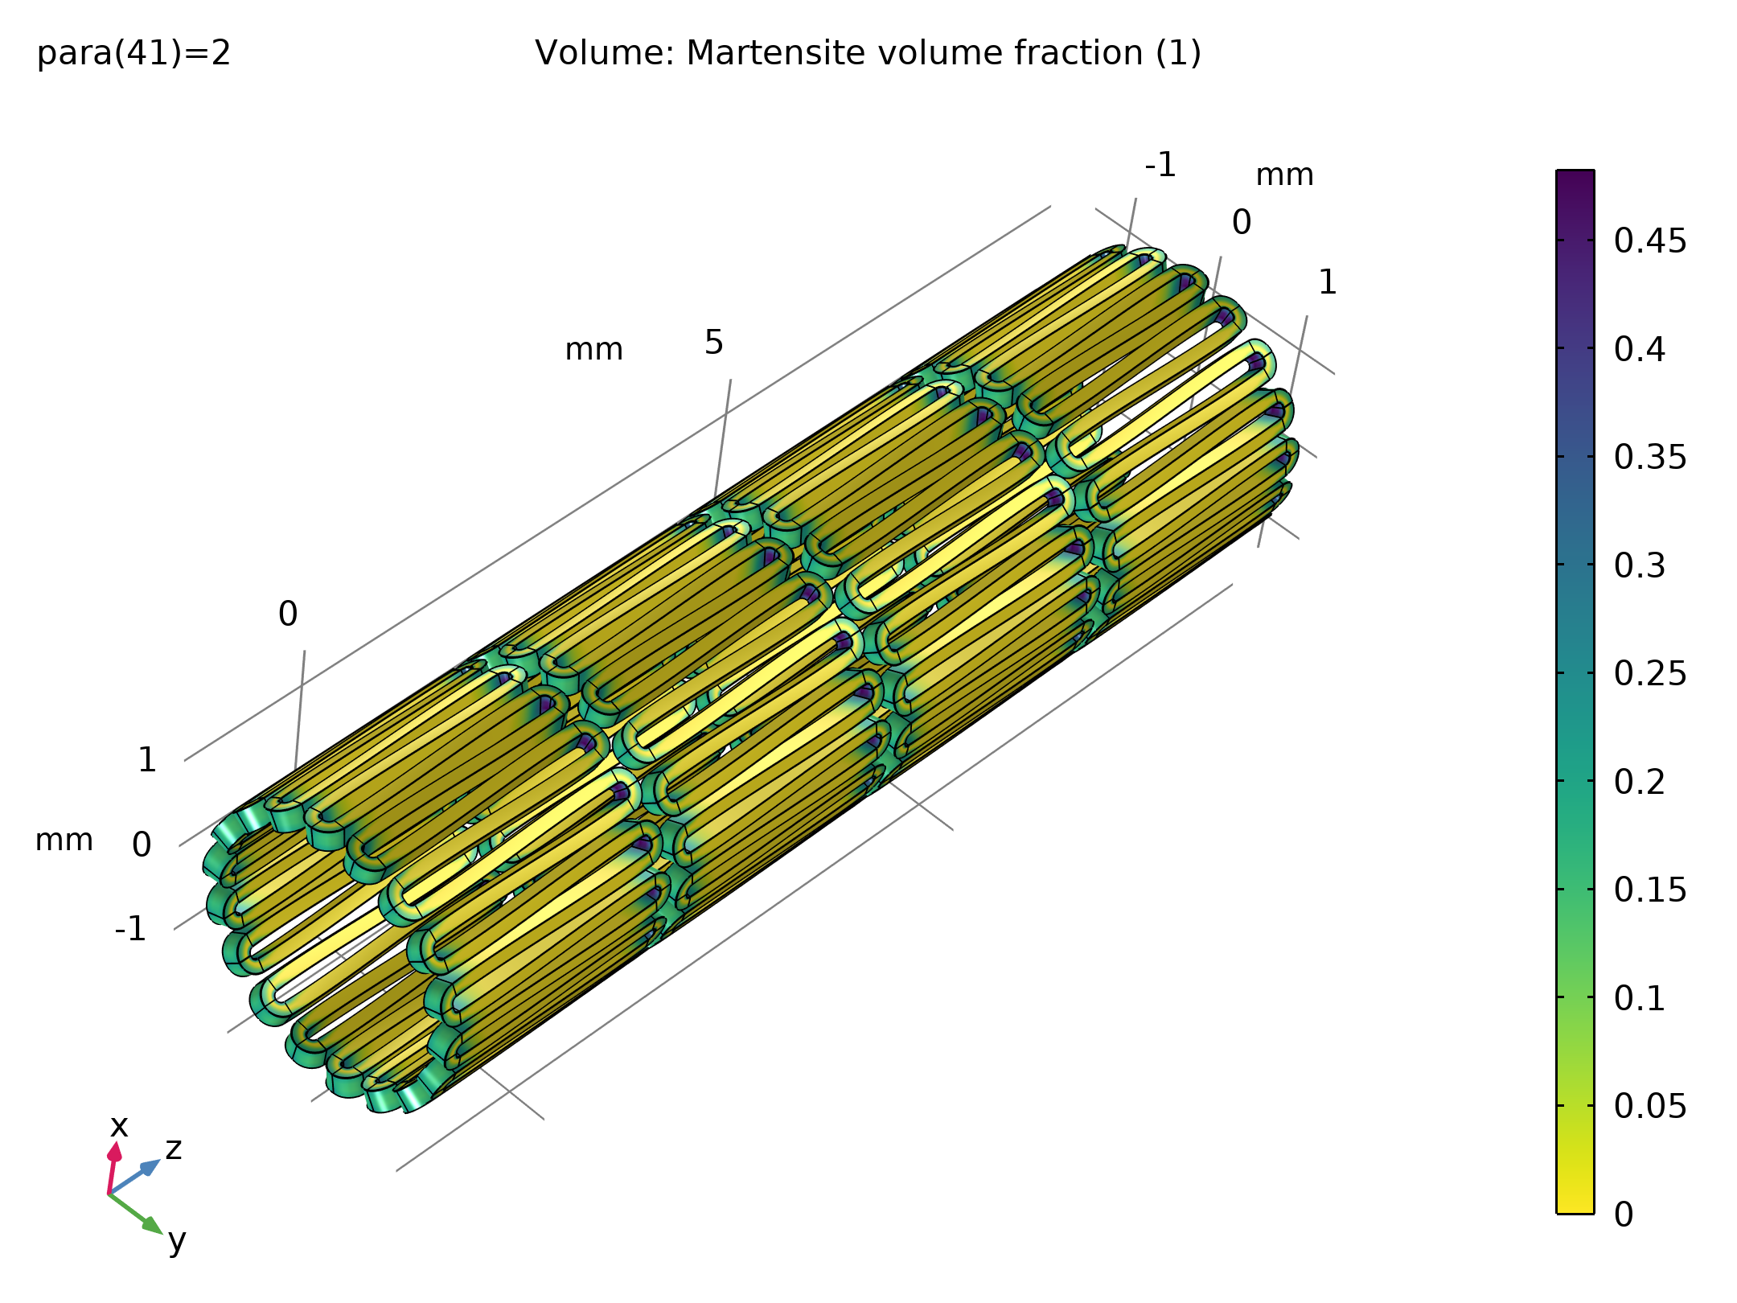
Results
Martensite volume fraction in the stent in human body

Slide 12
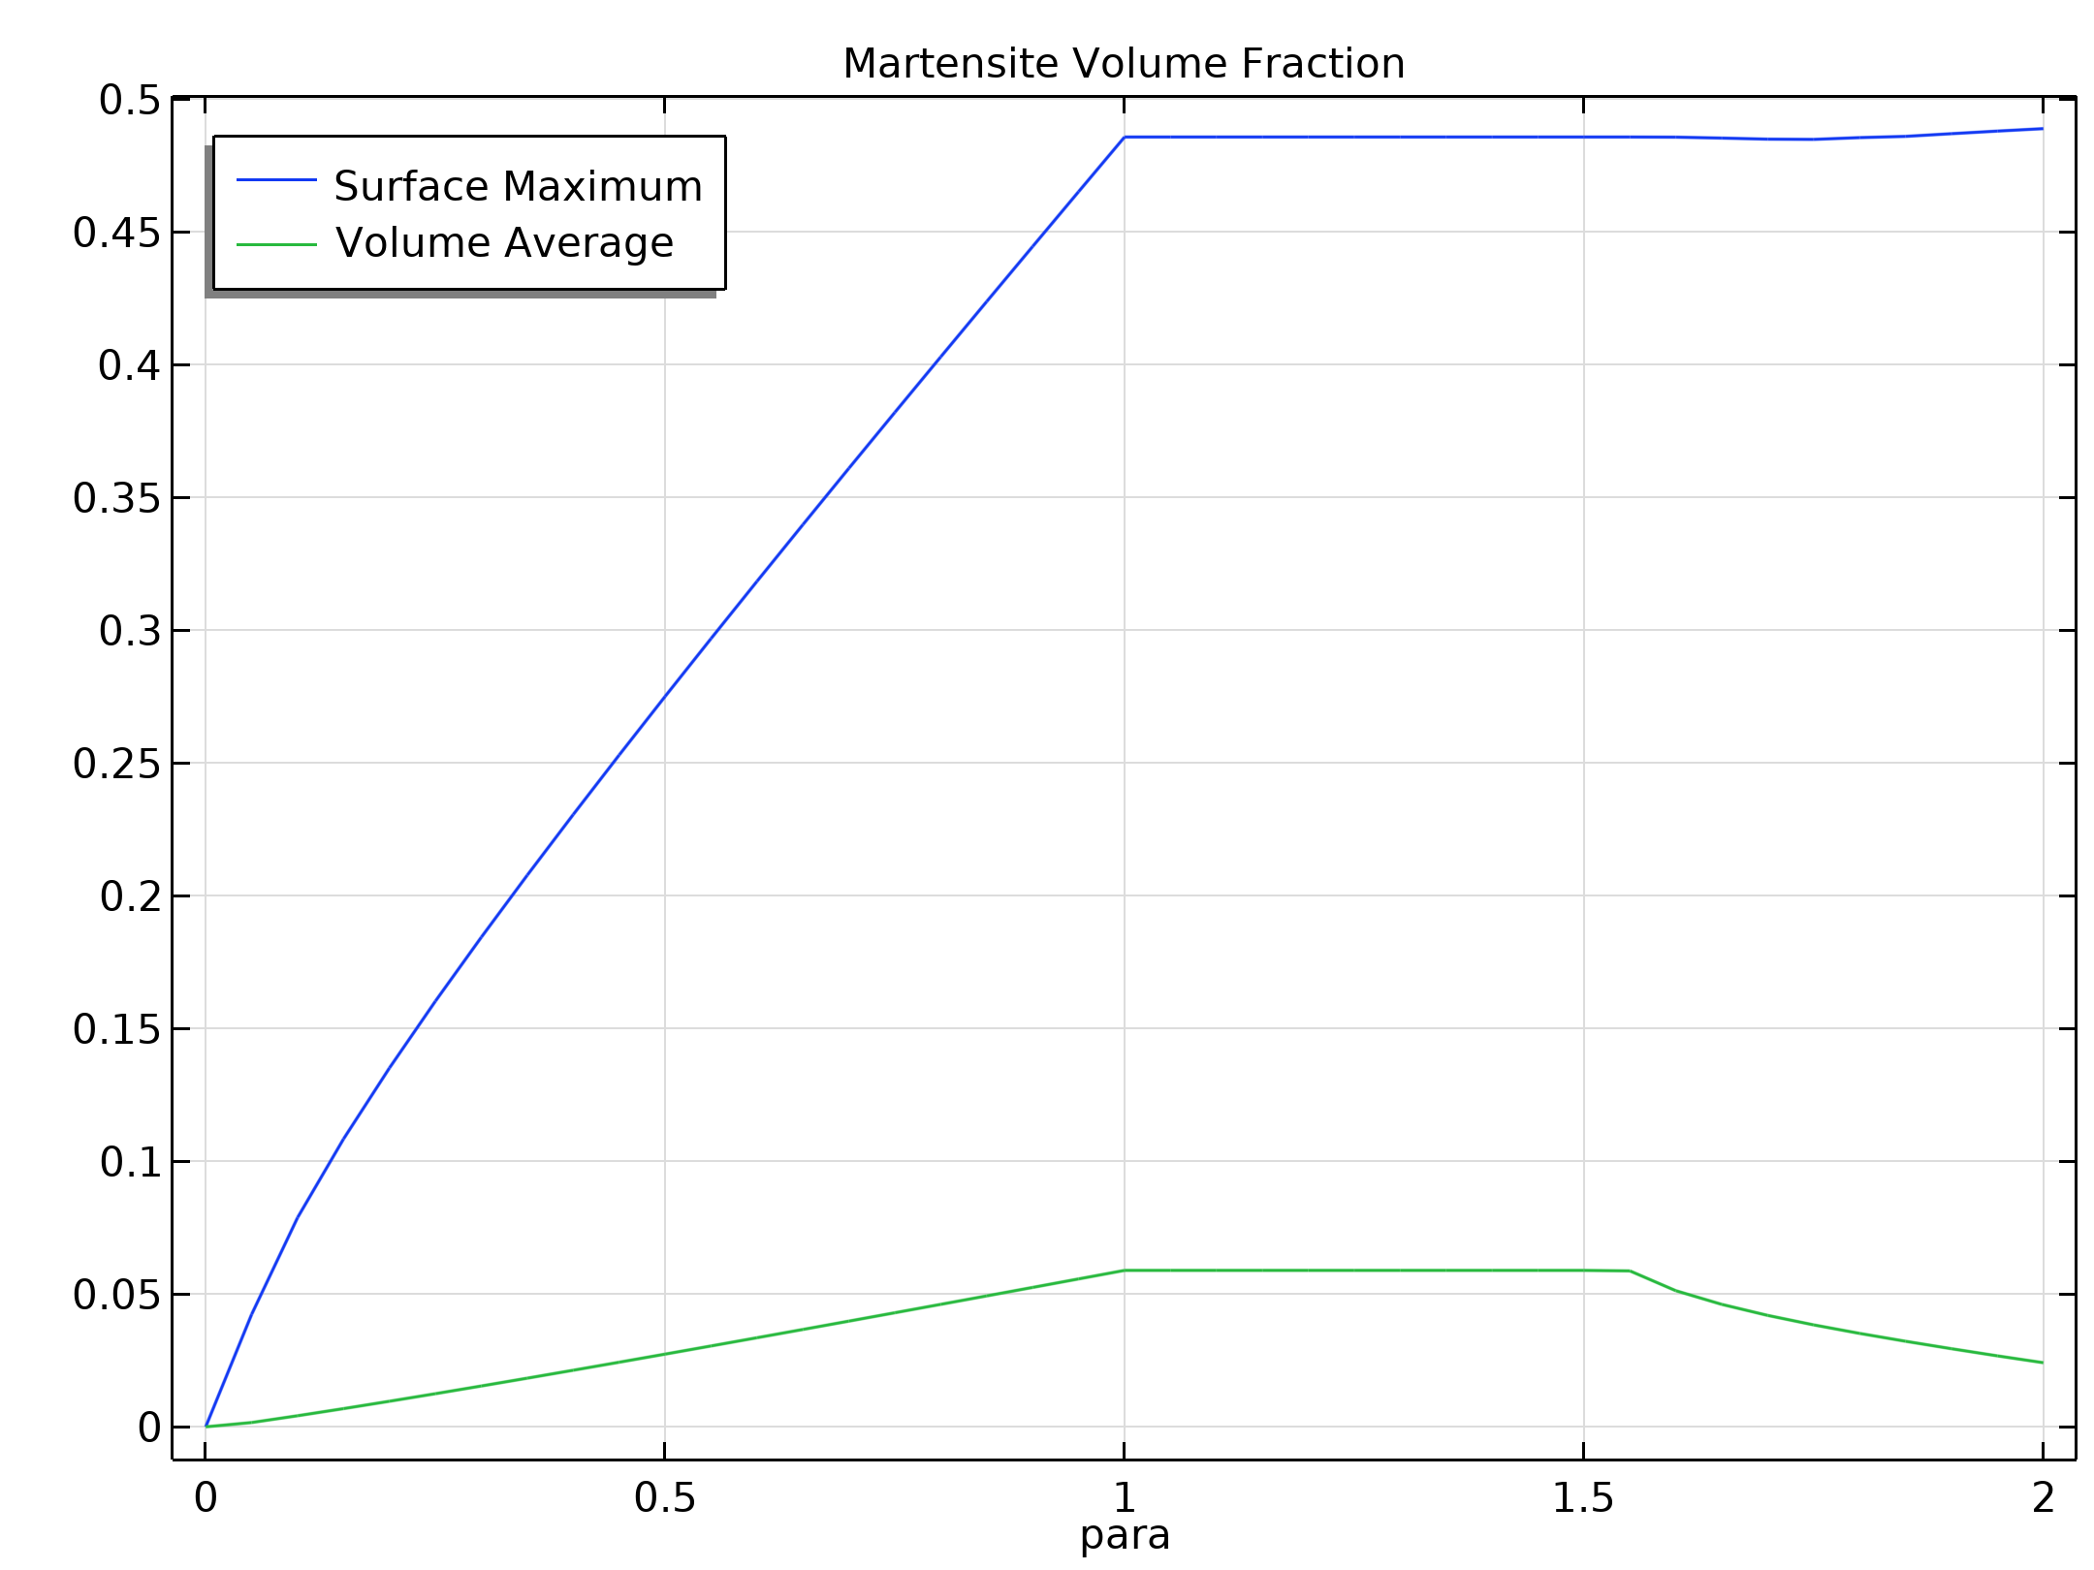
Results
The figure shows the development of the martensite during the different steps of the solution
Maximum and average volume fraction history during crimping and release

Slide 13
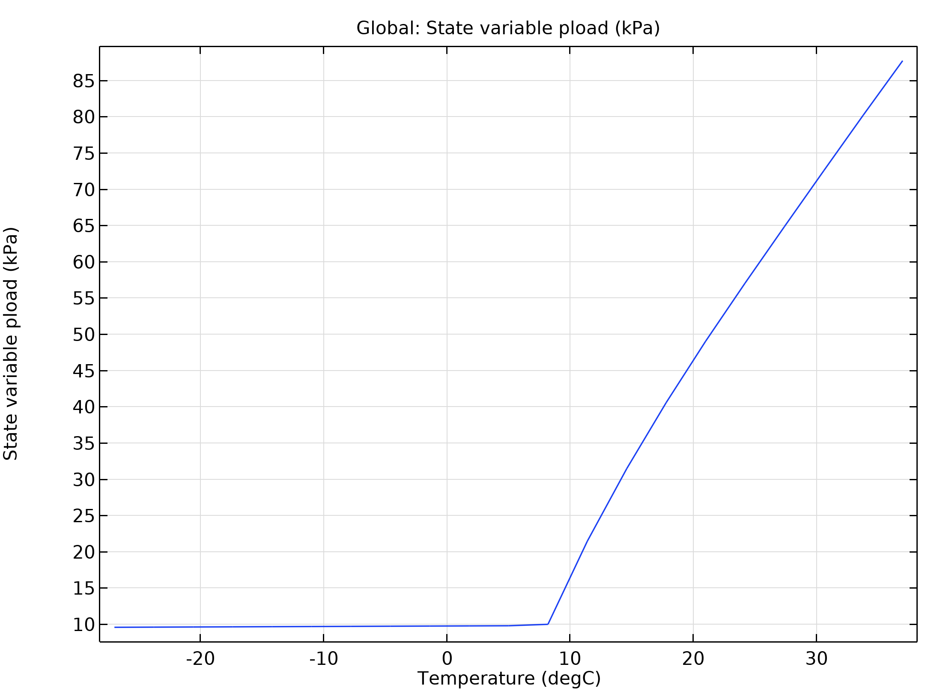
Results
The figure shows the pressure on the inner wall of the artery during the release of the stent
Pressure applied on the inner wall of the artery during stent release

