Slide 1
Chloroprene Rubber Compression Test
COMSOL

Slide 2
Introduction
Elastomers and biological materials exhibit strain rate dependent mechanical behavior and hysteresis when subjected to cyclical loads.
The Bergstrom–Boyce material model has been successfully used to capture such phenomena in application cases where such nonequilibrium effects are important in the modeling.
This example demonstrates the use of the Polymer Viscoplasticity feature available in the Nonlinear Structural Materials Module.

Slide 3
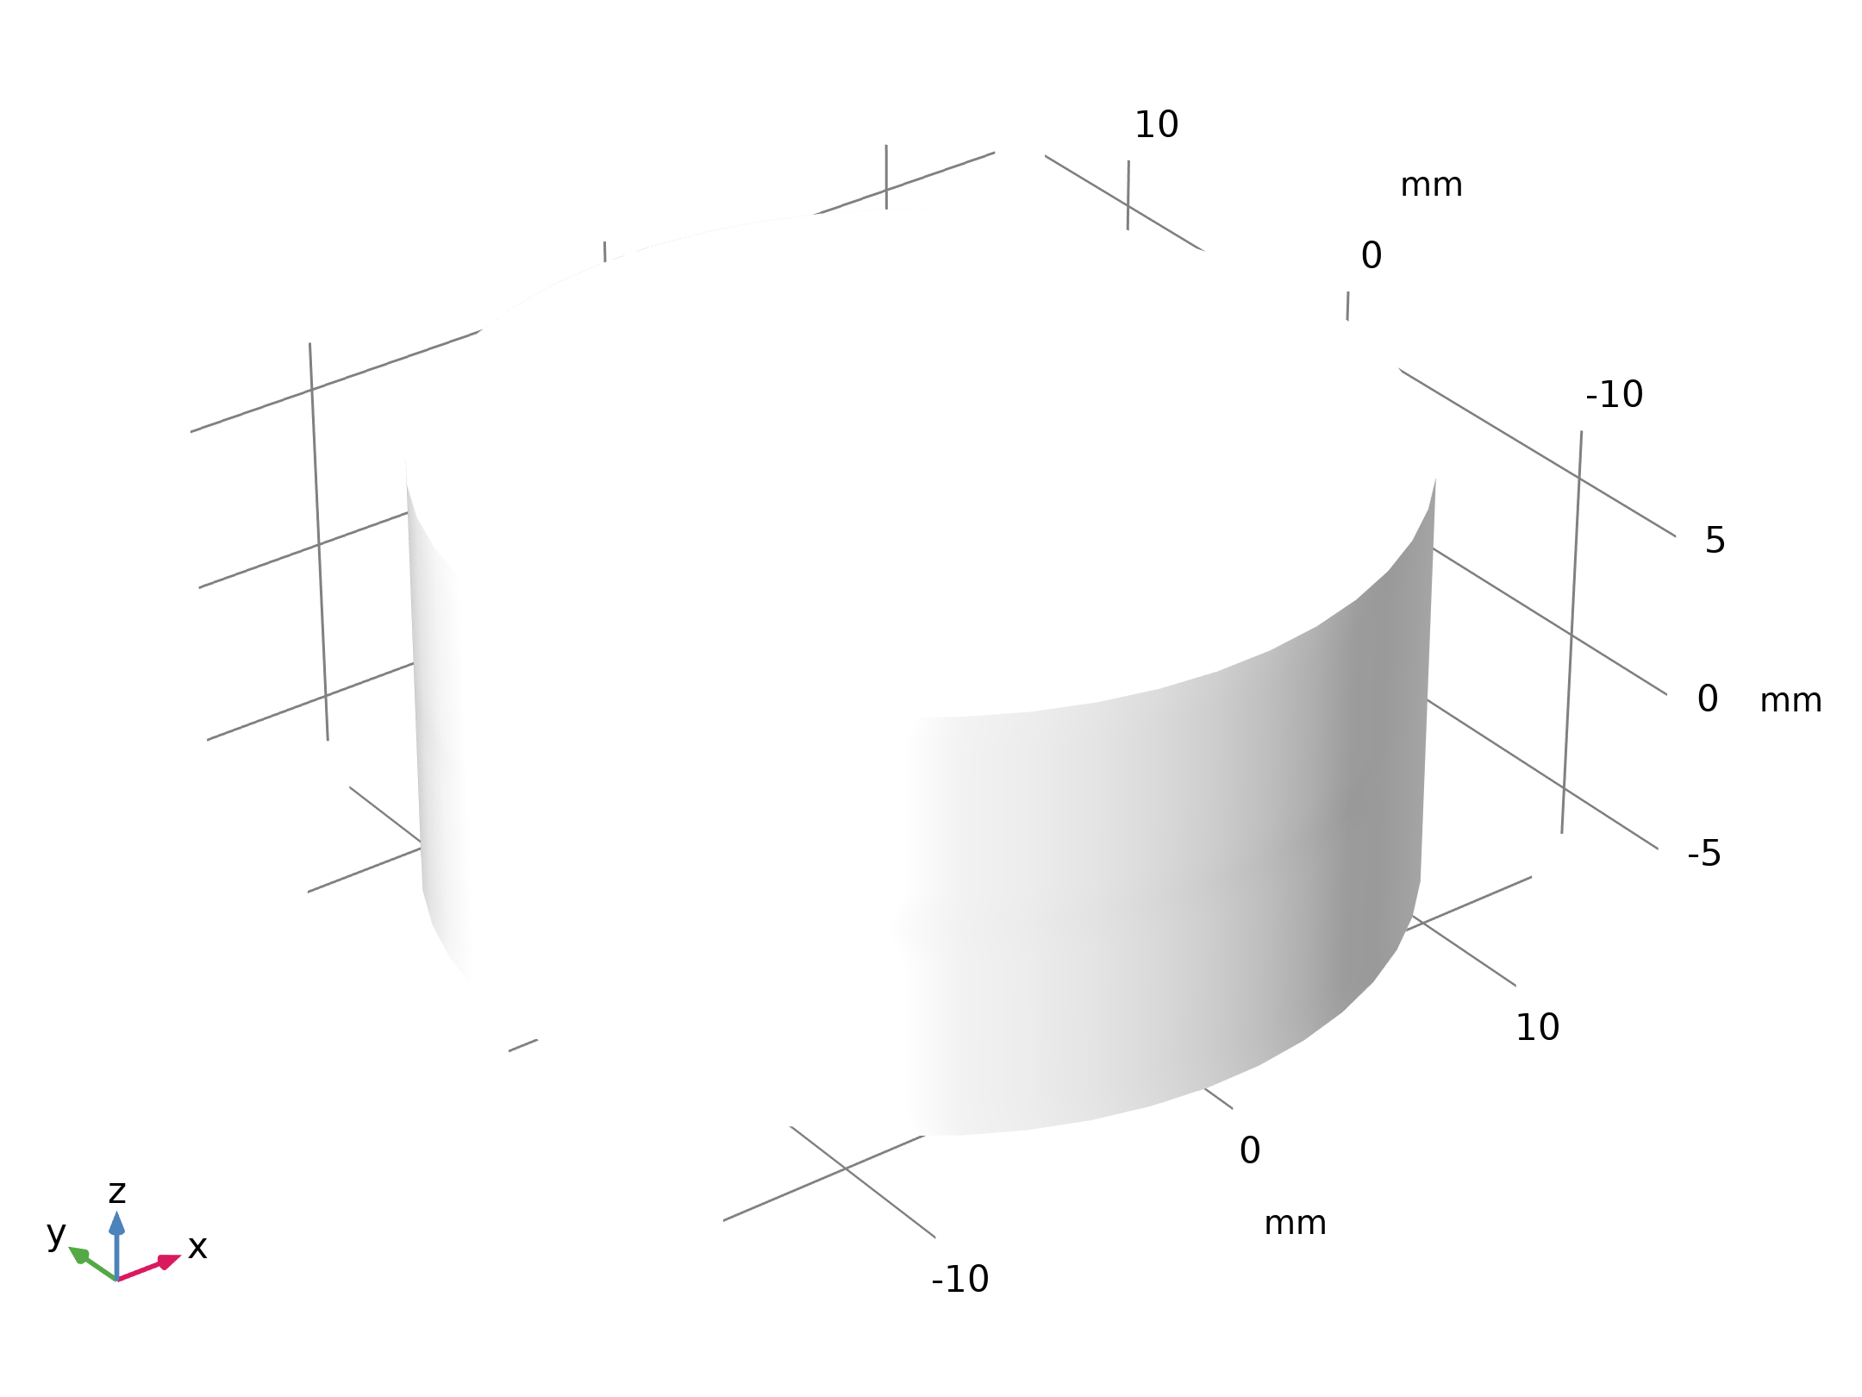
Model Definition
A cylindrical rubber specimen with a height, H, of 13 mm and a diameter, D, of 68 mm, is subjected to compression.
The geometry exhibits 2D axial symmetry as well as a reflection symmetry in the mid cross section of the cylinder. It is therefore possible to reduce the model geometry to a rectangle.

Slide 4
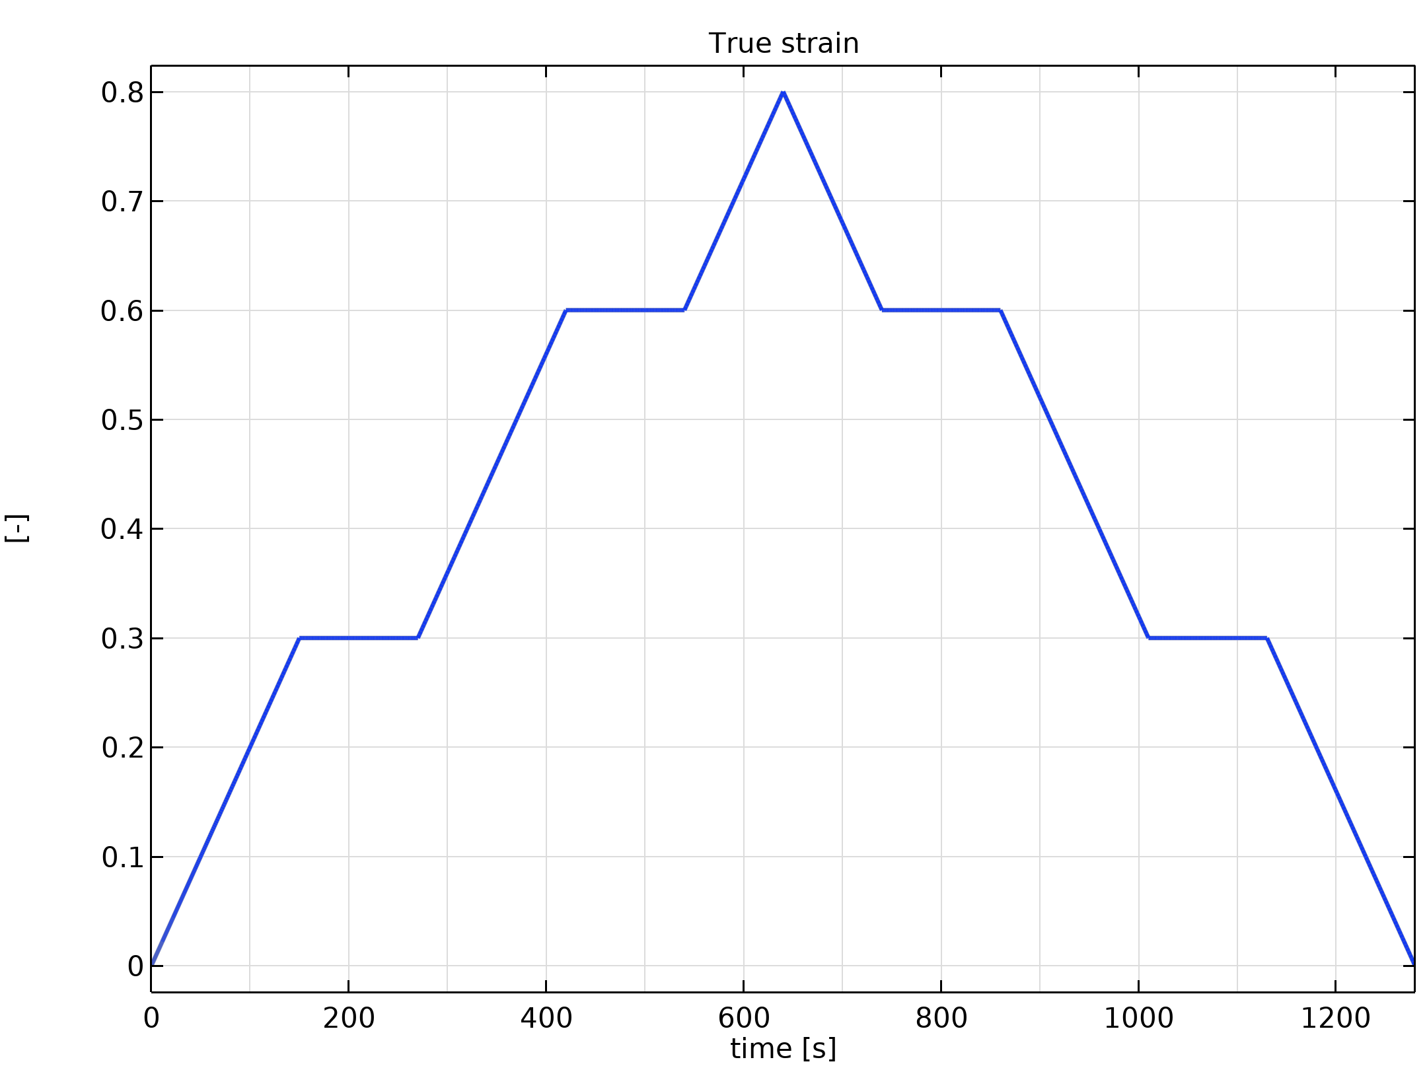
Model Definition
The specimen is loaded at a constant true strain rate of 0.002 1/s and the strain is held constant for 120 s when the strain level reaches 0.3 and 0.6. The unloading phase is symmetric with respect to the loading one.
True strain

Slide 5
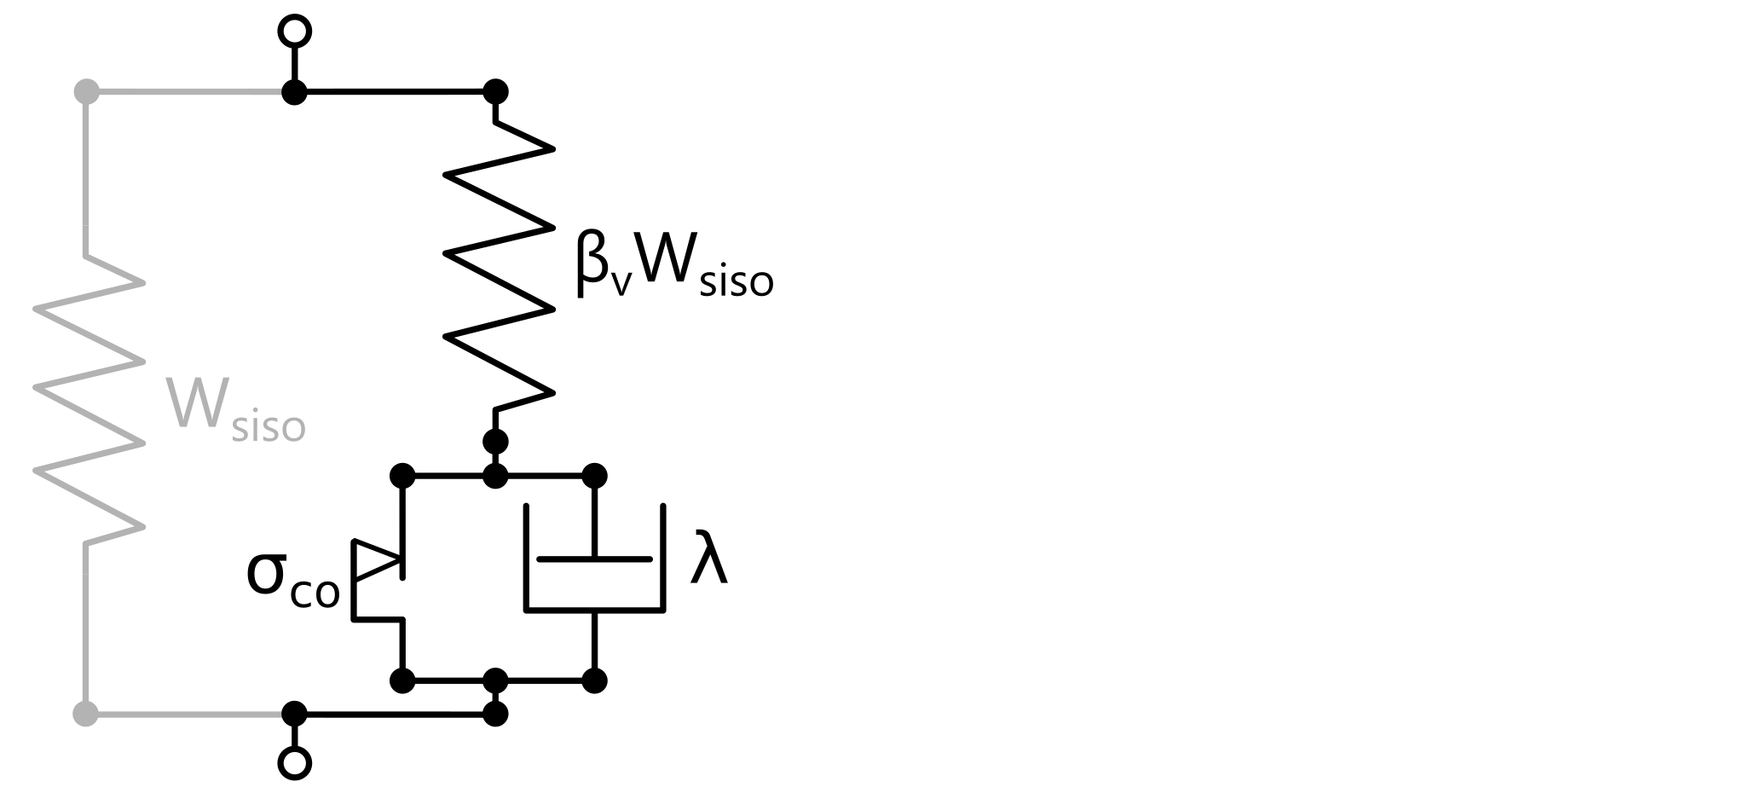
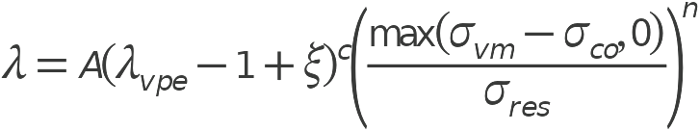
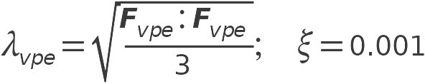
Material Model
The viscoplastic flow in the Bergstrom–Boyce model is characterized by the following rate multiplier:
Rheology of the Bergstrom–Boyce material model
A, σ_{co}, c, n, σ_{ref} are material parameters.

Slide 6
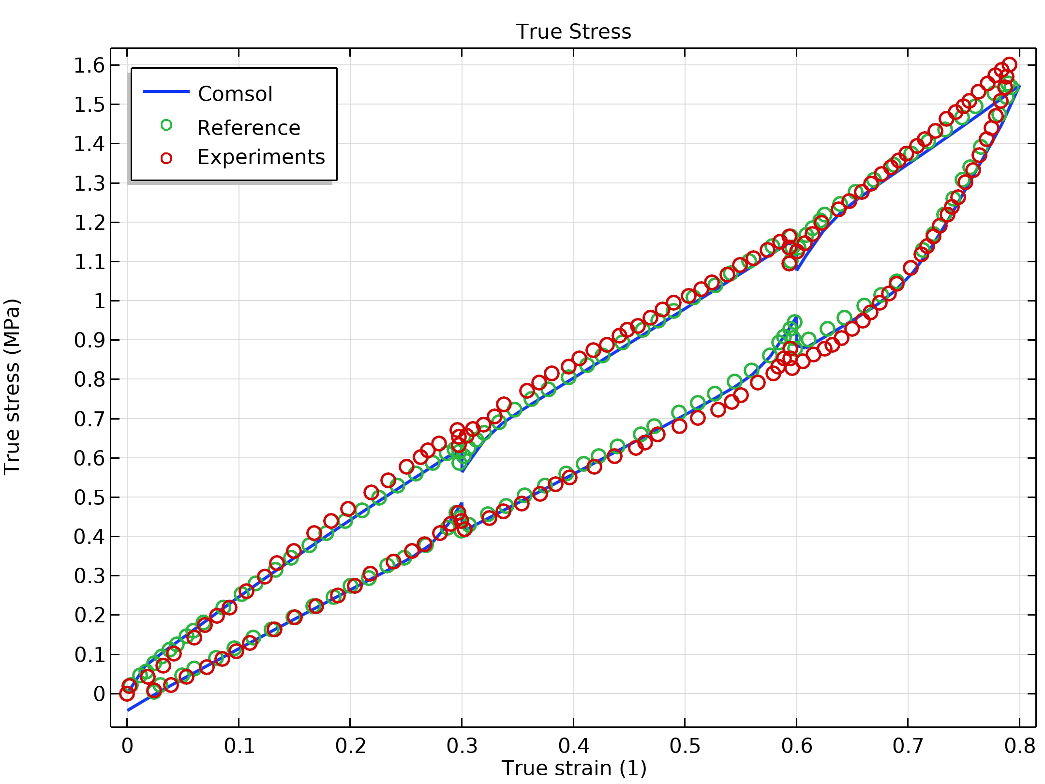
Results
When the strain is held constant, during both the loading phase and the unloading phase, the stress tends to the same equilibrium value, that is, the one given by the pure elastic network only.
True Stress

Slide 7
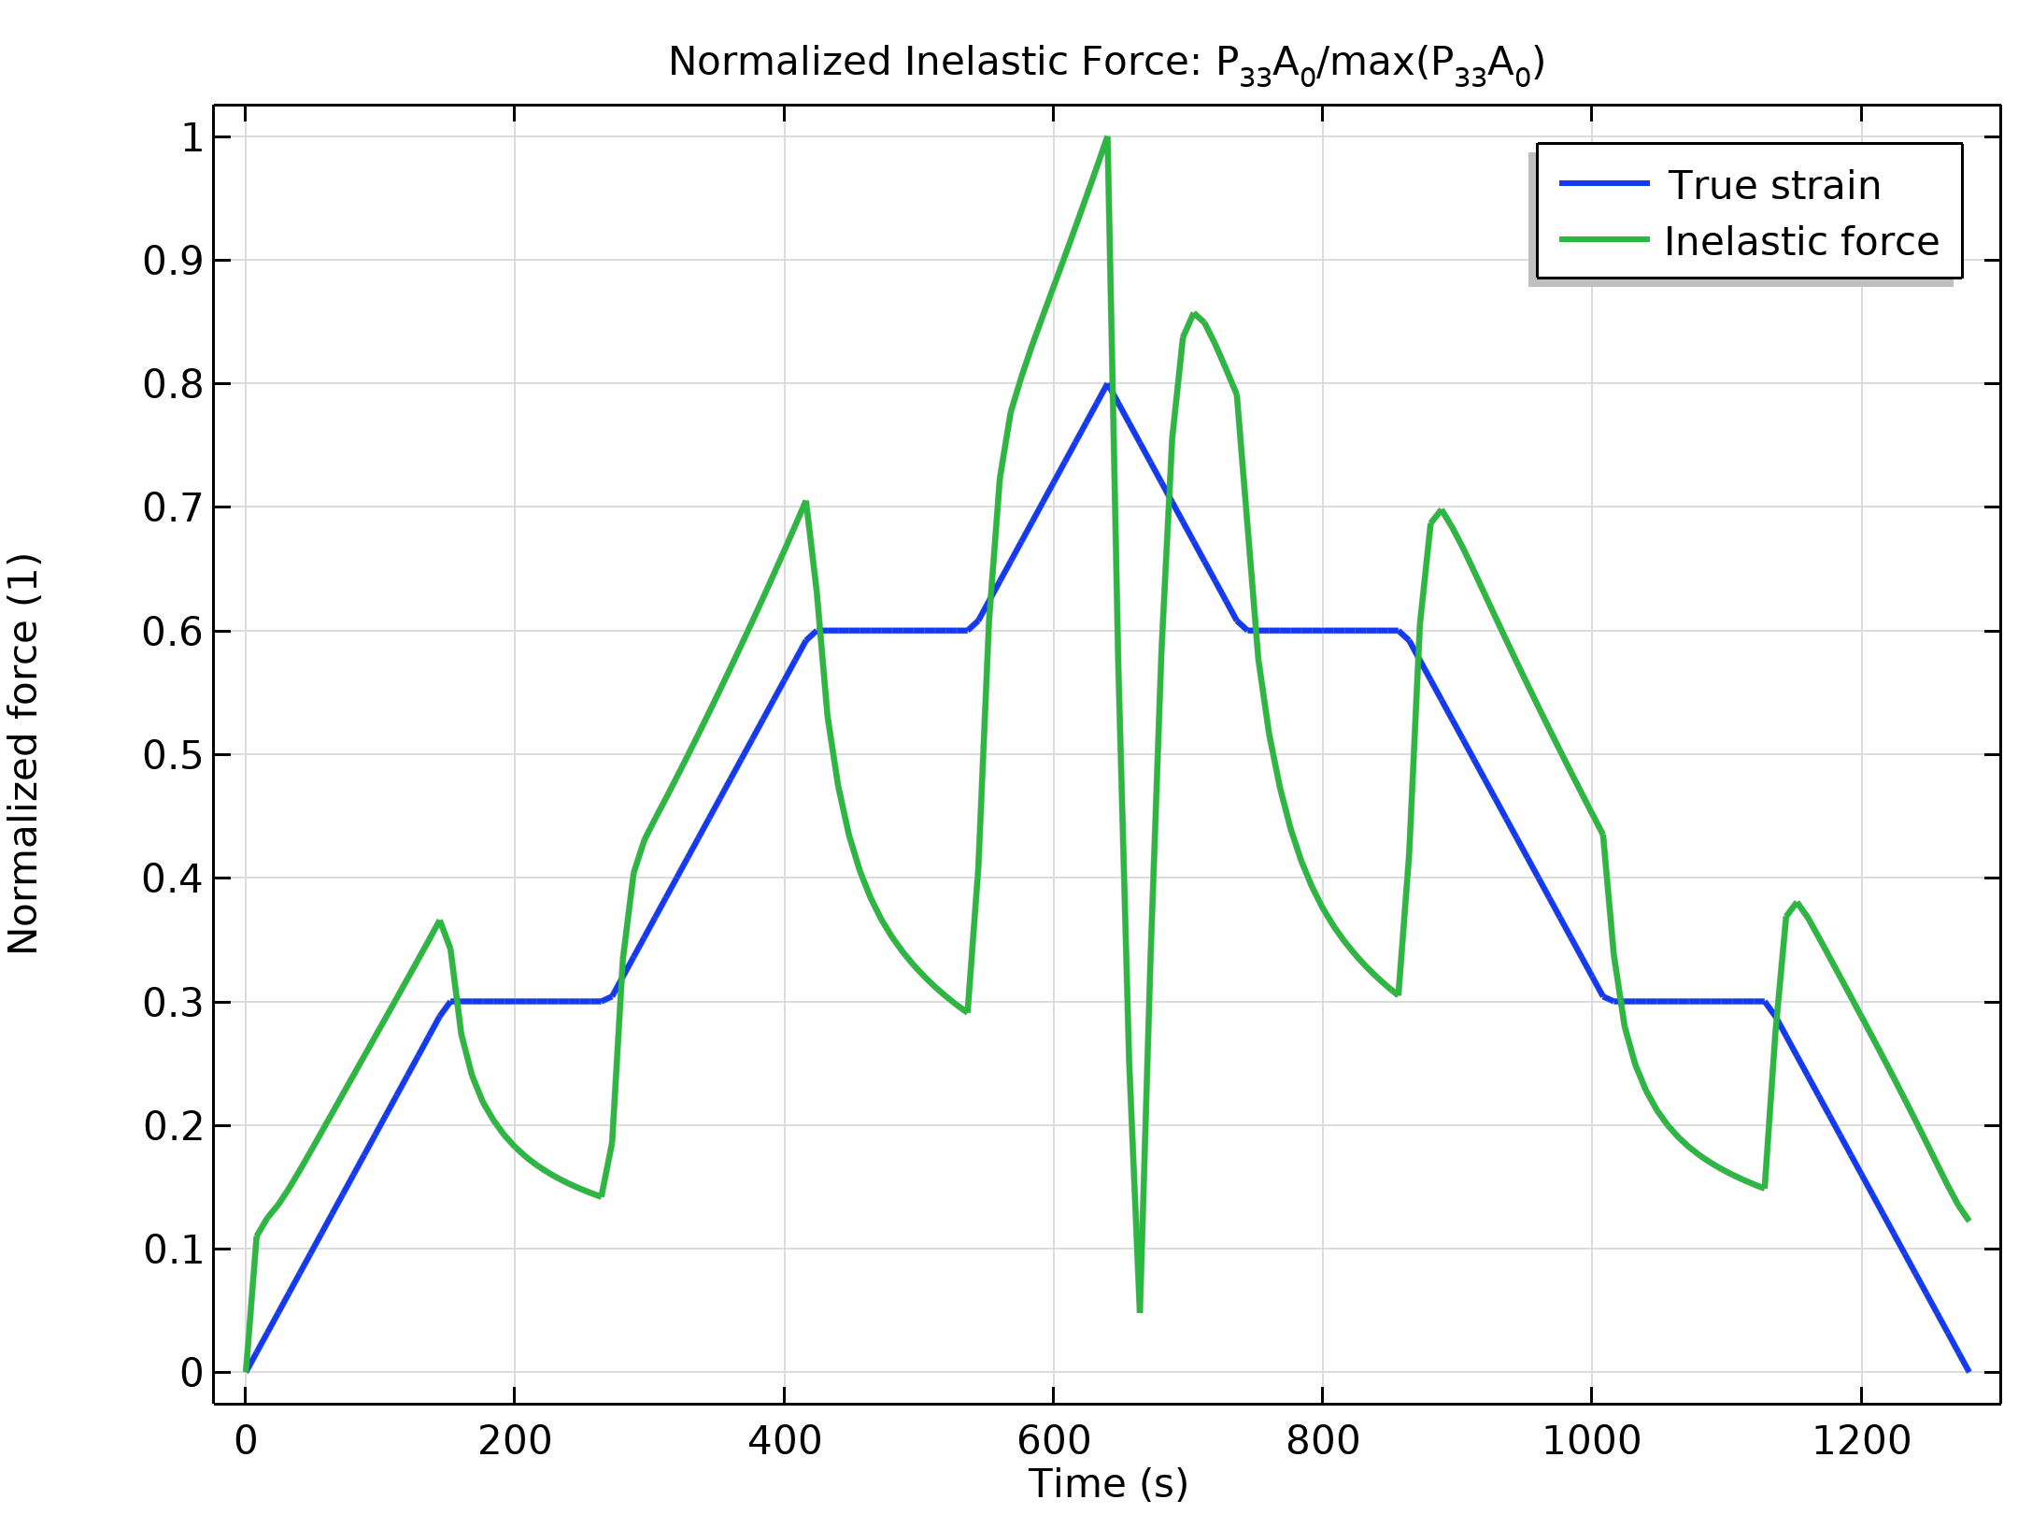
Results
The force developed in the nonequilibrium network relaxes during the time spans where the strain is kept fixed.
Normalized Inelastic Force: P₃₃A₀/max(P₃₃A₀)

Slide 8
References
  D. Husnu and M.Kaliske, “Bergstrom–Boyce model for nonlinear finite rubber viscoelasticity: theoretical aspects and algorithmic treatment for the FE method,” Computational Mechanics, vol. 44, pp. 809–823, 2009.
  J. S. Bergström and M. Boyce, “Constitutive modeling of the large strain time-dependent behavior of elastomers”, Journal of the Mechanics and Physics of Solids, vol. 46, pp. 931–954, 1998.

