Slide 1
Biventricular Cardiac Model
COMSOL

Slide 2
Background and Motivation
During the cardiac cycle (heartbeat) an electrical stimulus propagates throughout the entire heart
The excited cardiac cells are subjected to an electric potential jump across their membranes allowing the passage of ions. Chemical reactions are triggered and the muscle tissue contracts allowing blood to be pumped into the arteries
The muscle tissue (myocardium) is mainly composed of myocardial cells grouped in layered sheets that are aligned in a preferential direction (fibers). The fiber orientation strongly affects the mechanical and electrical tissue properties
The electric potential evolution is described by the Aliev–Panfilov equations with a nonlinear current-voltage relation. This electrochemical model describes the quick rise of the cell’s transmembrane electric potential (depolarization) and the return to its resting value (repolarization)

Slide 3
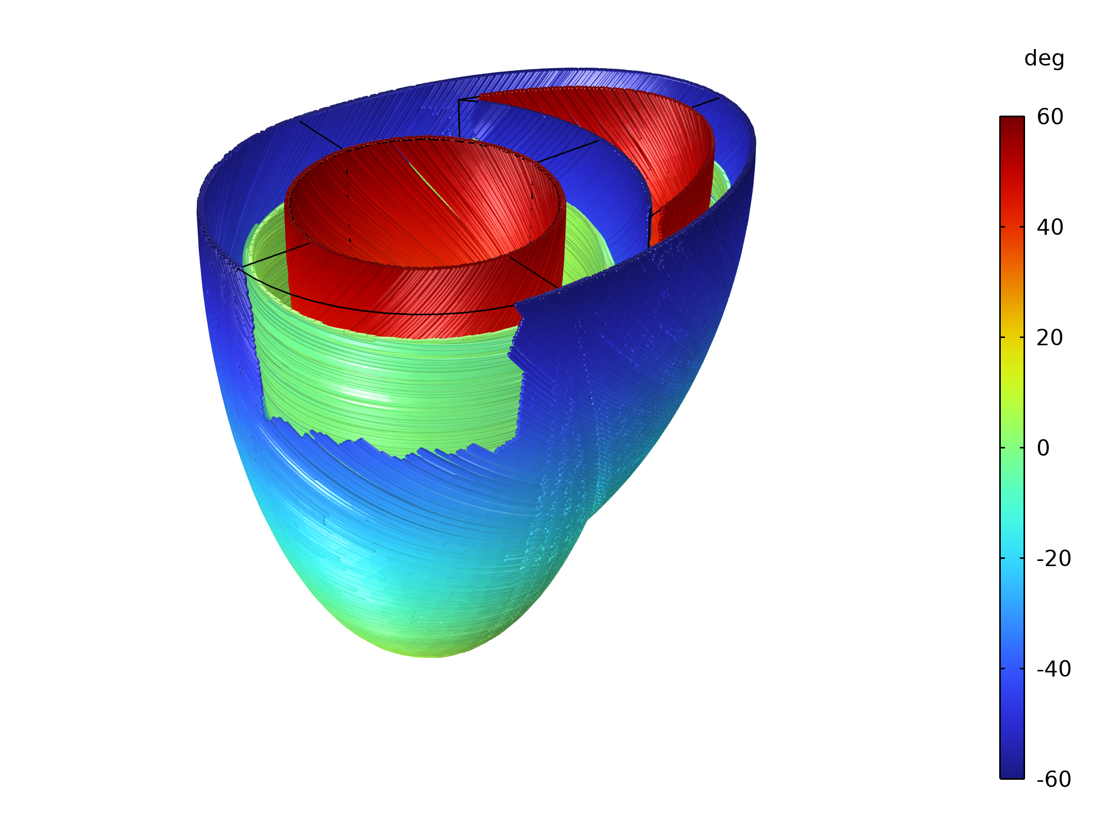
Objective
Simulate a cardiac contraction
Generate complex fiber paths using the Wall Distance and Curvilinear Coordinates interfaces
Apply Holzapfel-Gasser-Ogden hyperelastic material model using the Fiber feature
Display complex fibers pattern using the Fiber Default Plot
Obtain an electro-structural coupling using the External Stress feature and PDE interface

Slide 4
Fiber Paths

Slide 5
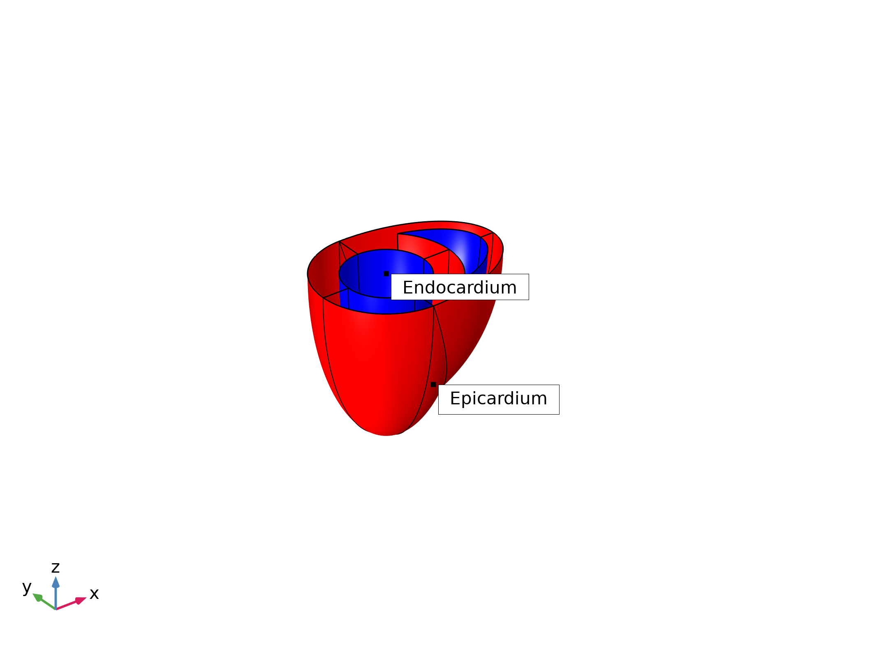
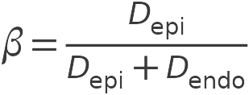
Wall Distance
Wall Distance interfaces are used to compute the distances from the epicardium D_{epi} and endocardium D_{endo}

Slide 6
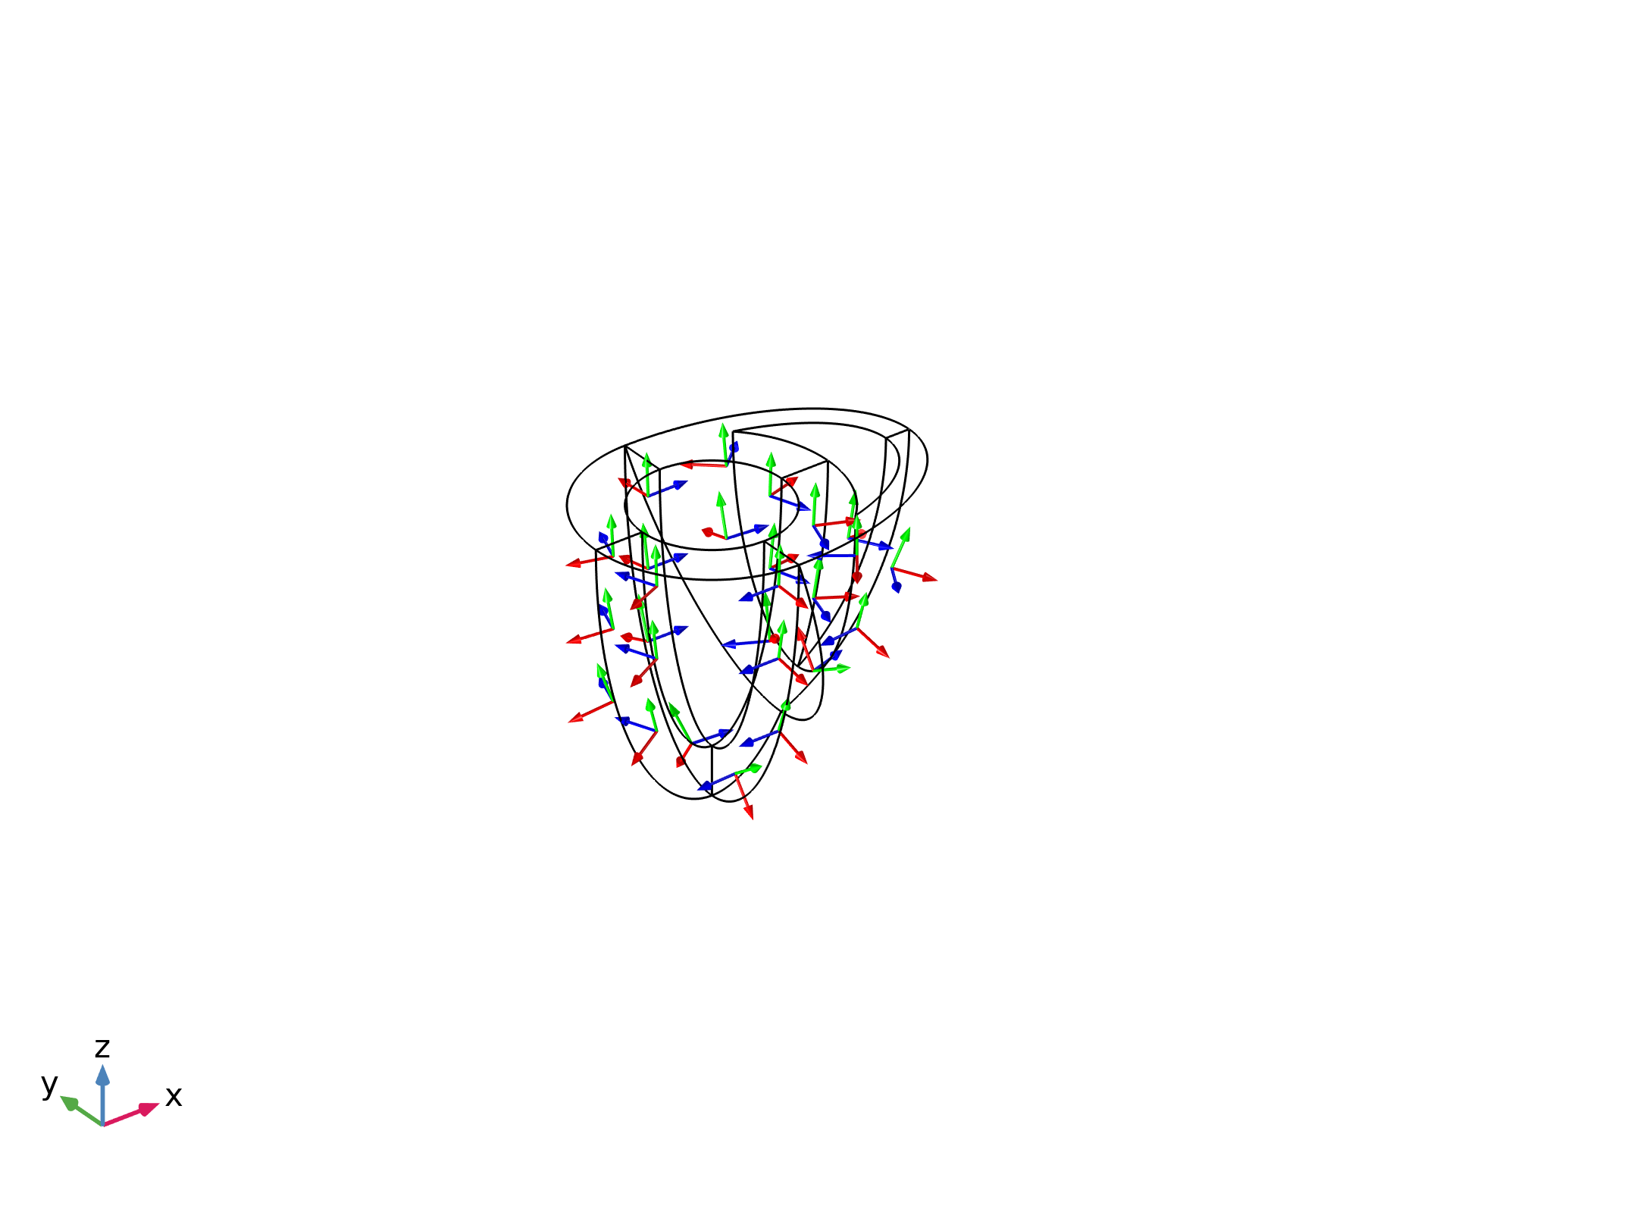
Transmural direction
The transmural direction is computed by the Curvilinear Coordinates interface
The transmural direction coincides with the first axis of the generated Base Vector System

Slide 7
Fiber Coordinate System
A linear variation β of the angle θ of the fibers across the wall is assumed
This angle goes linearly to zero at the left ventricle apex
The desired fiber axis orientation is obtained with a Composite System
  Base Vector System: generated by Curvilinear Coordinatesinterface
  Rotated System: rotate Base Vector System by an angle θ around the transmural direction

Slide 8
Model Definition

Slide 9


Solid Mechanics
The elastic stress is augmented with a potential dependent stress S_{a}, active stress, using the External Stress feature
The strain energy density is decomposed in an isotropic (Neo-Hookean) and anisotropic (Holzapfel–Gasser–Ogden) part. HGO is included through the Fiber feature

Slide 10


Electrophysiology: Current Balance
A monodomain equation is derived from the balance of electric current across the cell membrane
The conductivity tensor D is anisotropic and dependent on the fibers direction

Slide 11
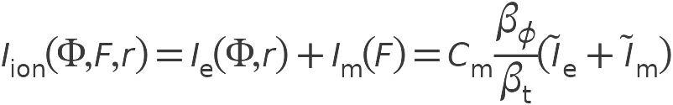
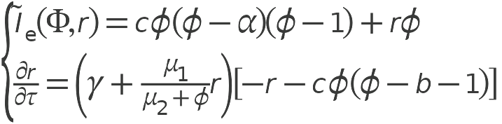
Electrophysiology: Ionic Current
The ionic current is split in an purely electrical induced I_{e} and a stretch-induced part I_{m}
Alief-Panfilov equations are used to represent the purely electrical part of the ionic current

Slide 12


Coupling: Solid Mechanics to Electrophysiology
The stretch-induced electric current I_{m} depends on the stretch λ along the fiber directions
It is active only when fibers are in tension to simulate the opening of the ion-channels

Slide 13
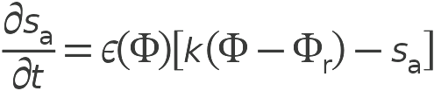
Coupling: Electrophysiology To Solid Mechanics
The active stress (scalar) represents the stress caused by the contraction of the myocardium due to depolarization
The active stress tensor is added to the elastic stress through the External Stress feature and its structure depends on the layout of the fibers

Slide 14
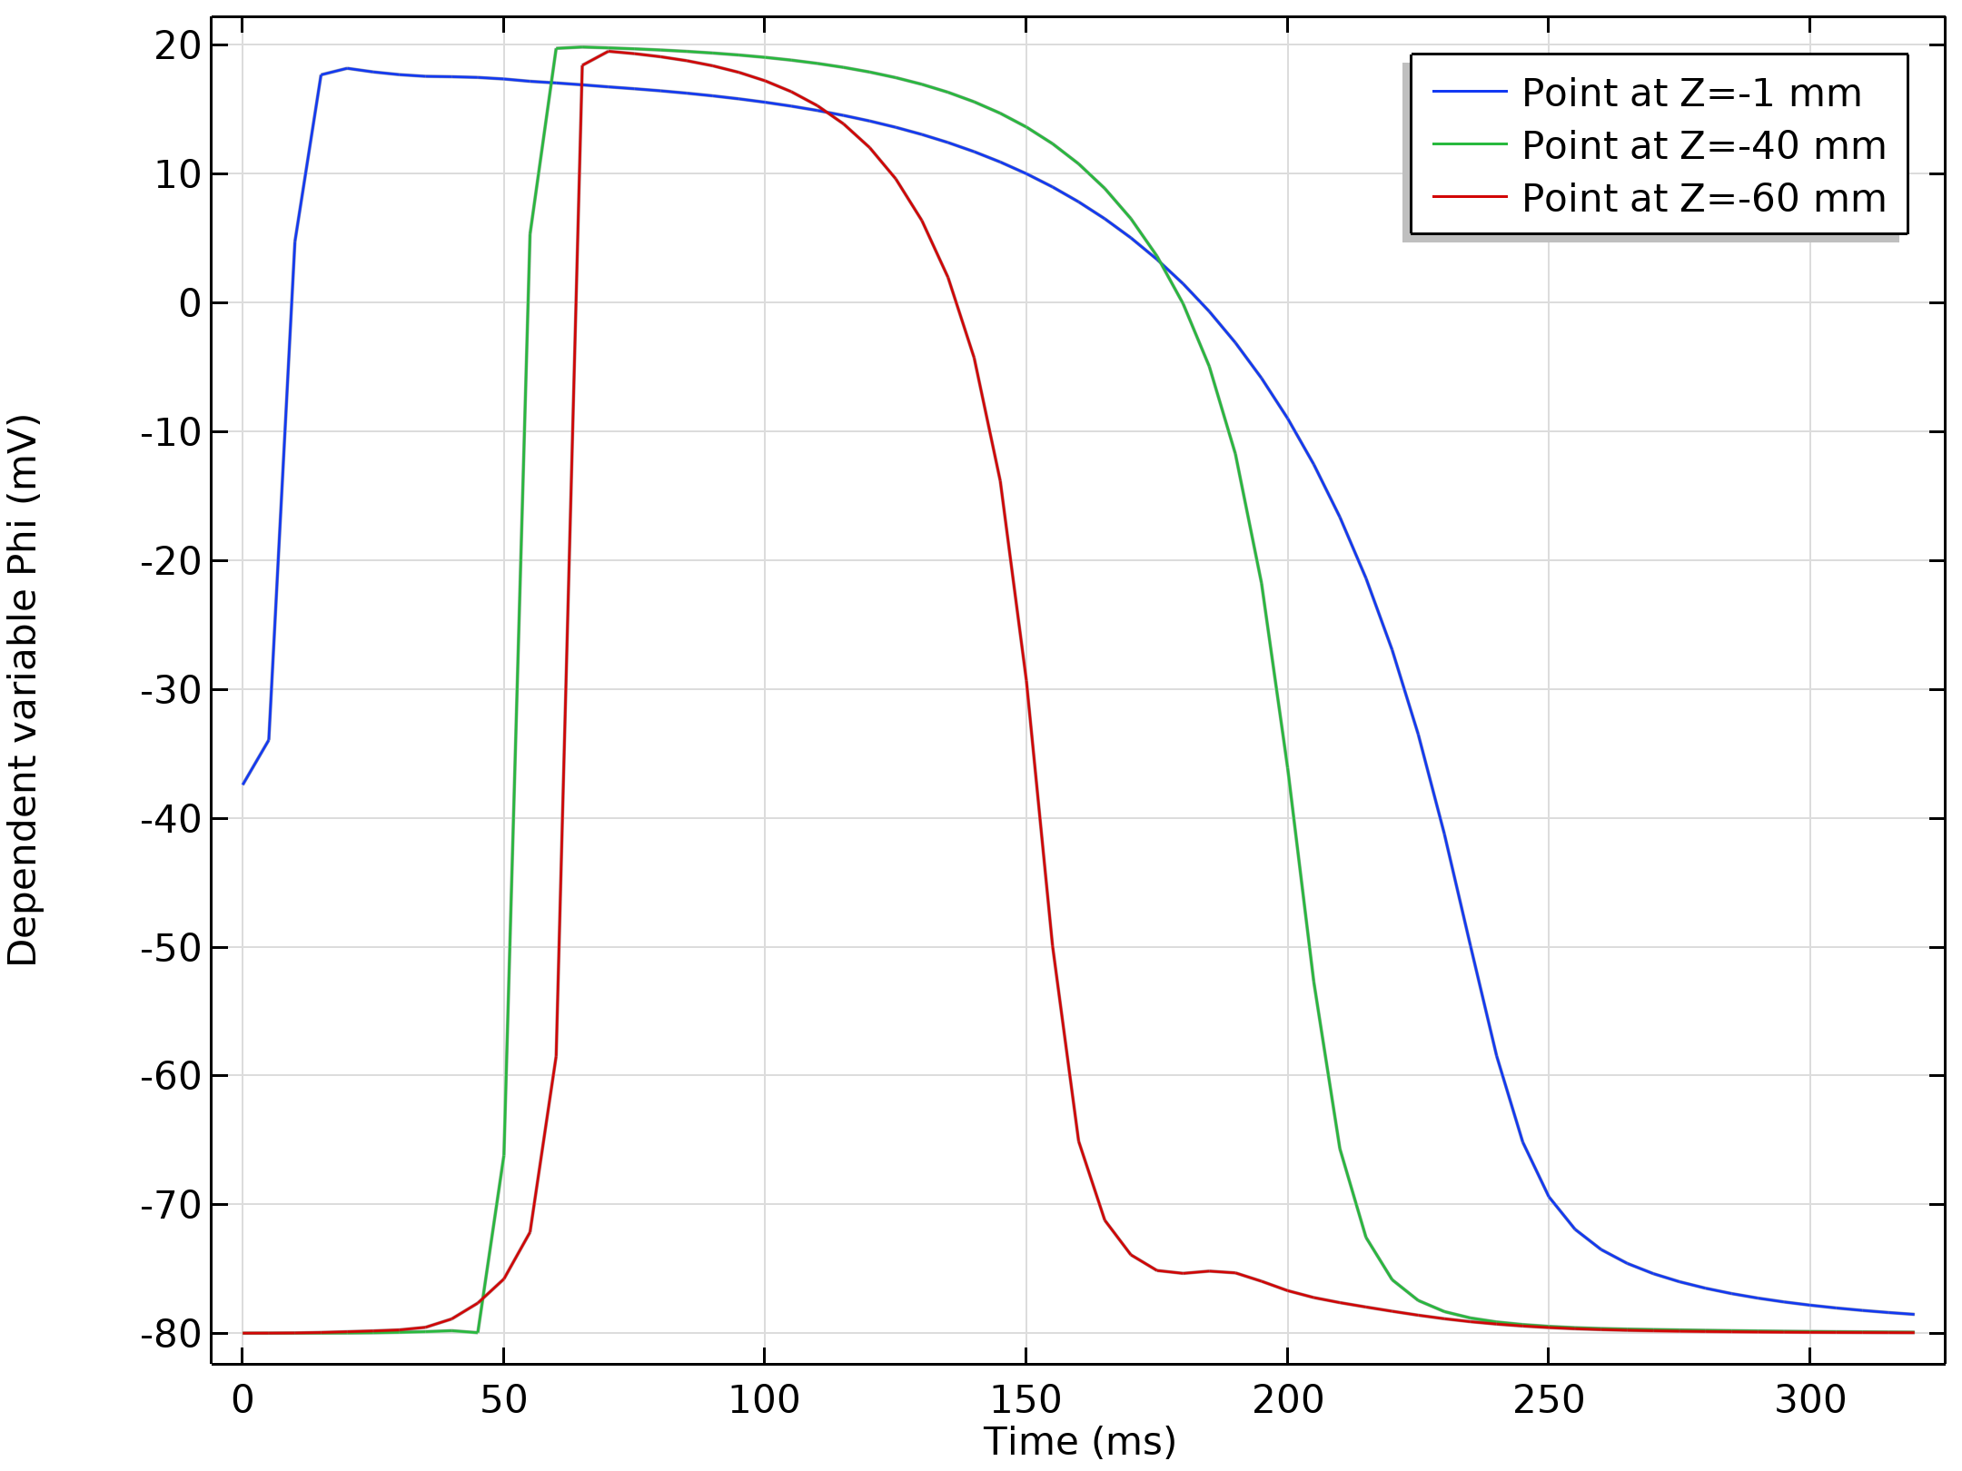
Activation Time
During the cardiac cycle the activation lapse is not constant throughout the myocardium. Regions that are depolarized last are the first to repolarize
This effect is obtained through a space dependent time scale β_{t}
Potential values at three different locations.

Slide 15
Results

Slide 16
Myocardiac Cells Orientation
Obtained with a prestudy
Fiber orientation strongly affects the mechanical and electrical properties of the tissue properties:
  Stress activation tensor S_{a}(a₀, s₀, n₀)
  Conductivity tensor D(a₀)
Fibers path at the epicardium, endocardium, and in between. There is a linear variation of the angle across the transmural direction and a linear variation from the basal surface to the apex.

Slide 17
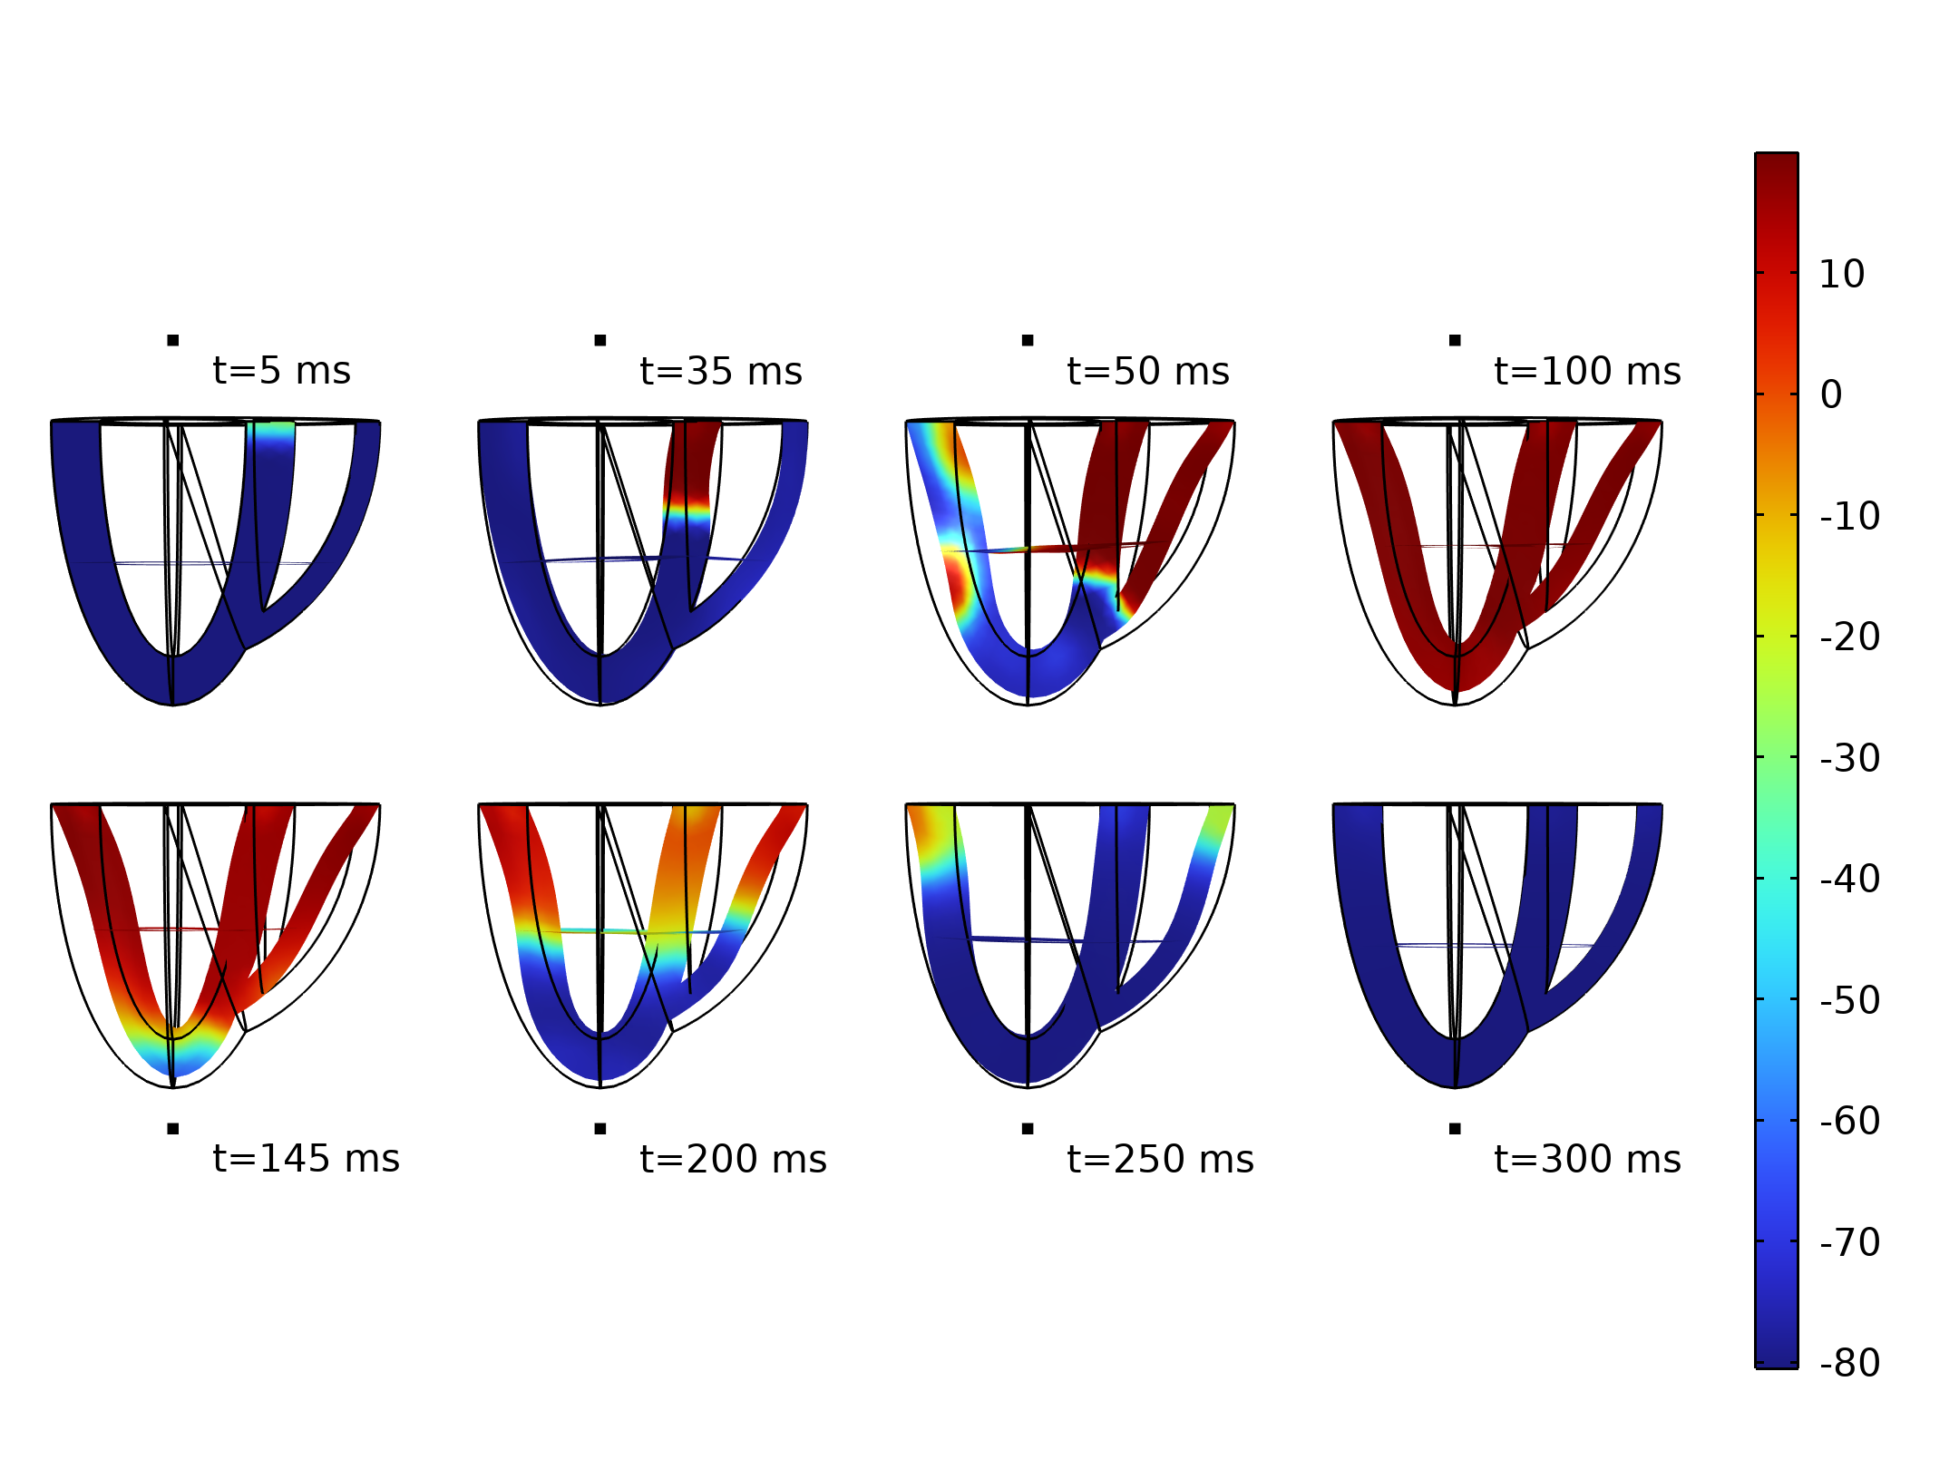
Contraction
The active stress generated by the depolarization of the cells causes the deformation of the cardiac walls
Contraction and relaxation during a heartbeat.

Slide 18
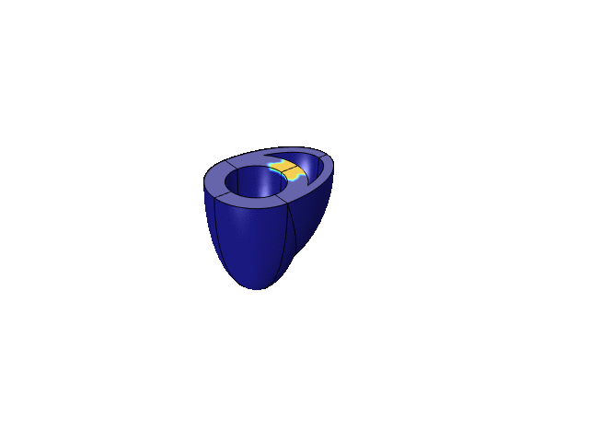
Contraction
An initial impulse is applied on a rectangular area on the basal surface in between the ventricles

Slide 19
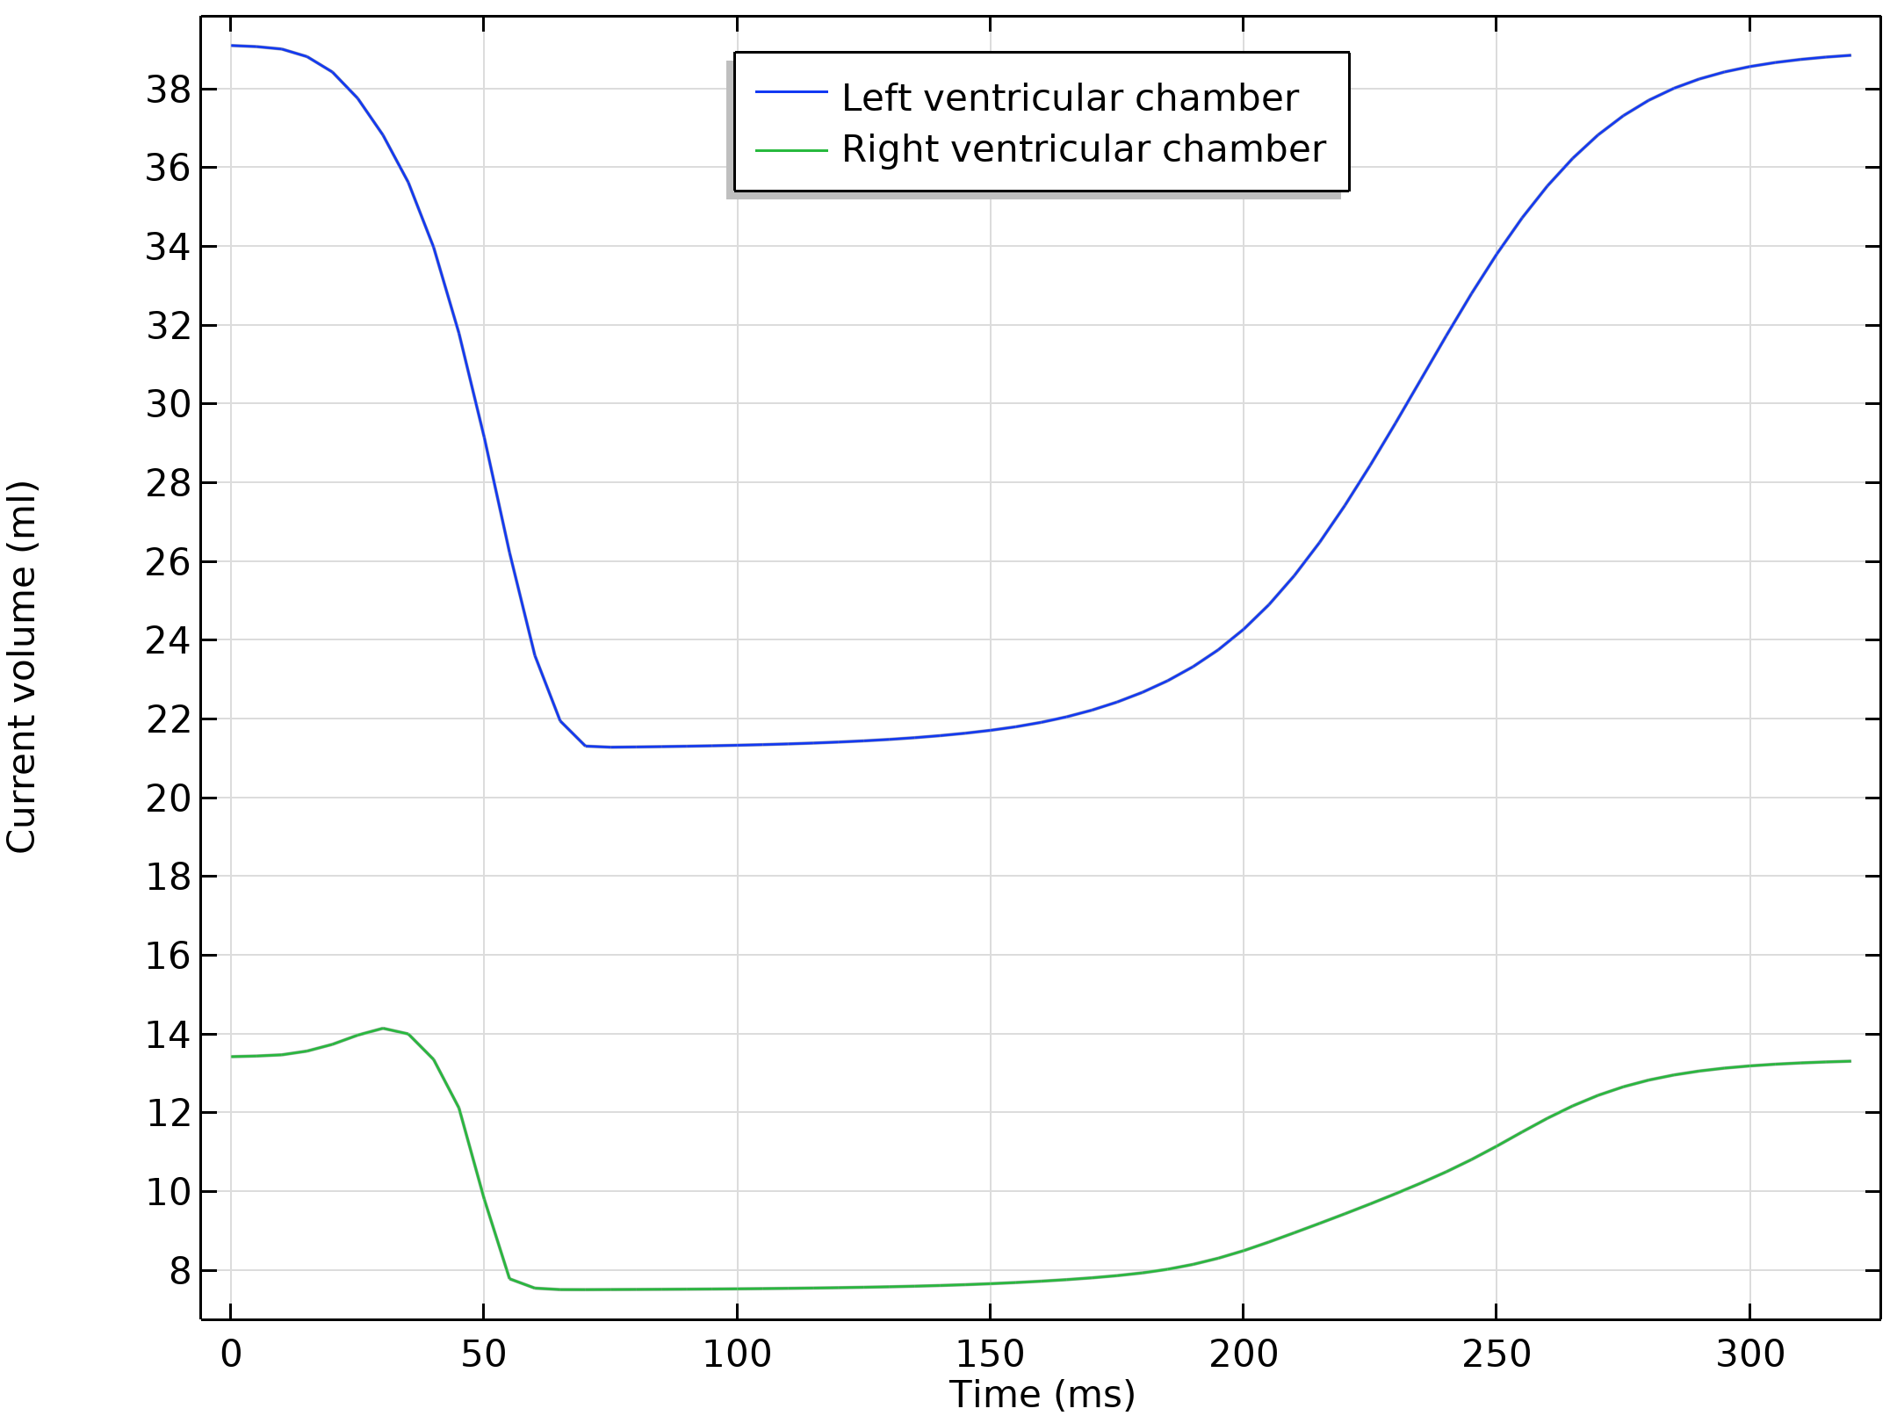
Volume Change
Both chambers contract during the depolarization of the excited myocardiac cells causing a reduction of the internal volume
Slowly return to their initial configuration for the next heartbeat
Internal volume variation during a hearbeat.

