Slide 1
Differential Pumping
COMSOL

Slide 2
Introduction
Differentially pumped vacuum systems use a small orifice or tube to connect two parts of a vacuum system at very different pressures. Such systems are necessary when processes run at higher pressures and are monitored by detectors that require UHV for operation
In this model, the gas flow through a narrow tube connecting a high-vacuum chamber to a chamber held at a lower pressure is approximated using an analytic expression for the flow rate down the tube
The flow is assumed to be isothermal (in practice this may be a rather poor assumption, but it is straightforward to adapt the model to use experimental data directly in place of the analytic expressions)

Slide 3
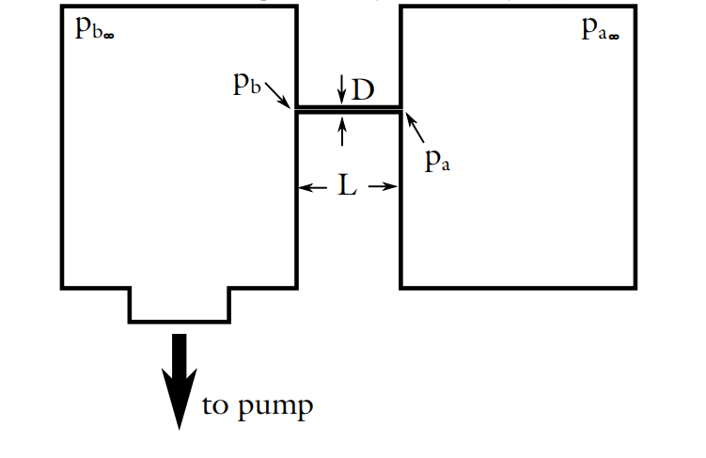
Model Definition
The figure shows a schematic representation of the model
There are two large reservoirs (named a and b) connected by a small tube of diameter D and length L
Each reservoir has its own steady state pressure defined by variables p_{a∞} in a and p_{b∞} in b
Reservoir b is connected to a vacuum pump and has a steady-state pressure p_{b∞} that is smaller than reservoir a (p_{a∞}>p_{b∞})
Not-to-scale schematic of the model. It consists of two large reservoirs at different pressures connected by a small tube

Slide 4
Model Definition
Note that the tube has a finite length and thus, you can expect to see a difference in pressure between the reservoirs and the tube entrances; that is, p_{a}>p_{a∞} and p_{b}>p_{b∞}, where p_{a} and p_{b} are the inlet and outlet pressure, respectively
In the steady state, the mass flow rate is constant in every region of the tube (entrances and central sections)
Not-to-scale schematic of the model. It consists of two large reservoirs at different pressures connected by a small tube

Slide 5
Model Definition
Note that this model also uses the assumption of an isothermal flow (that is, a constant temperature everywhere in the system)
Not-to-scale schematic of the model. It consists of two large reservoirs at different pressures connected by a small tube

Slide 6
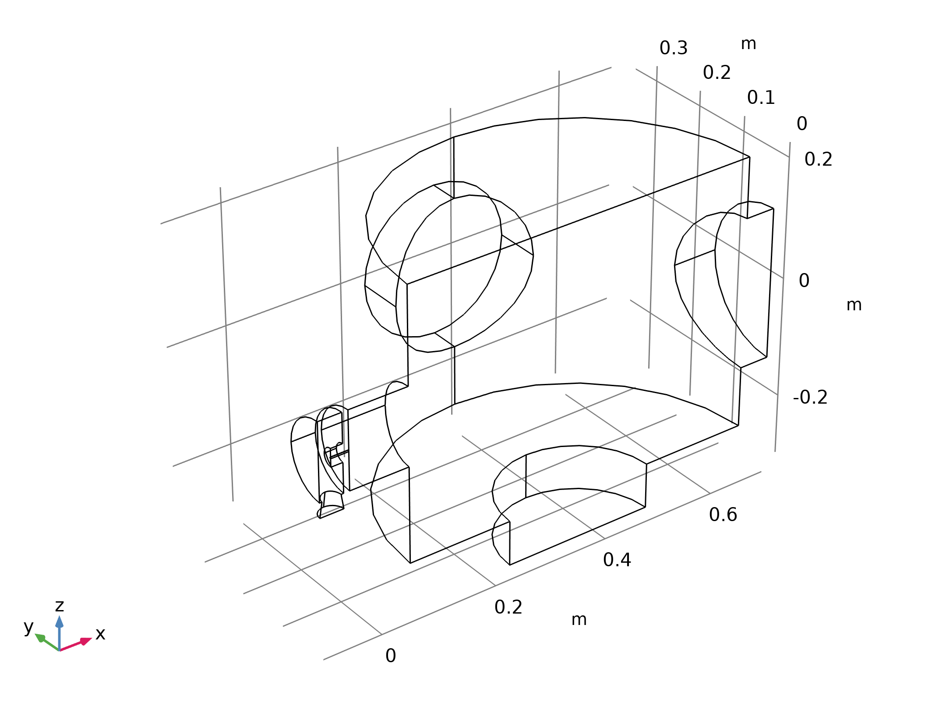
Model Definition
The figure shows the model geometry
Note that only the high-vacuum chamber is included in the model — the low-vacuum chamber geometry does not need to be modeled in detail
Geometry 1

Slide 7
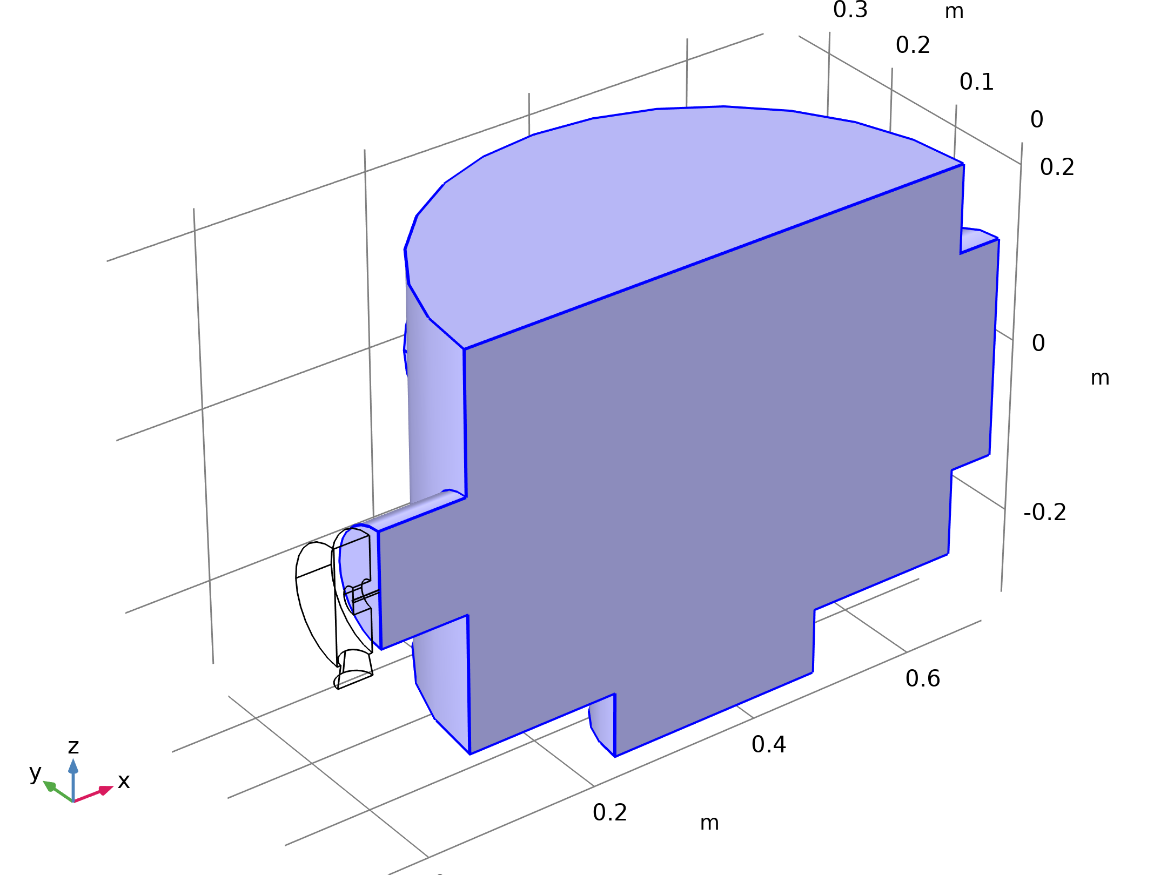
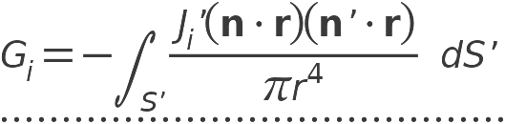
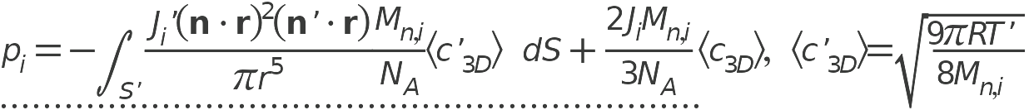
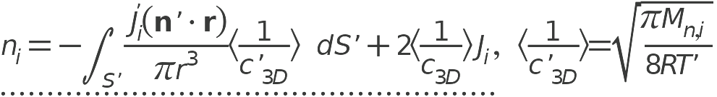
Model Definition
Free Molecular Flow

Slide 8
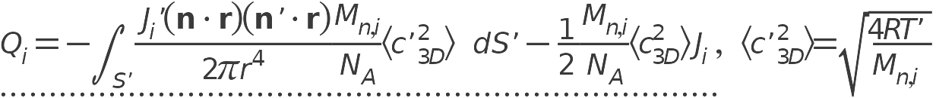
Model Definition
Free Molecular Flow

Slide 9
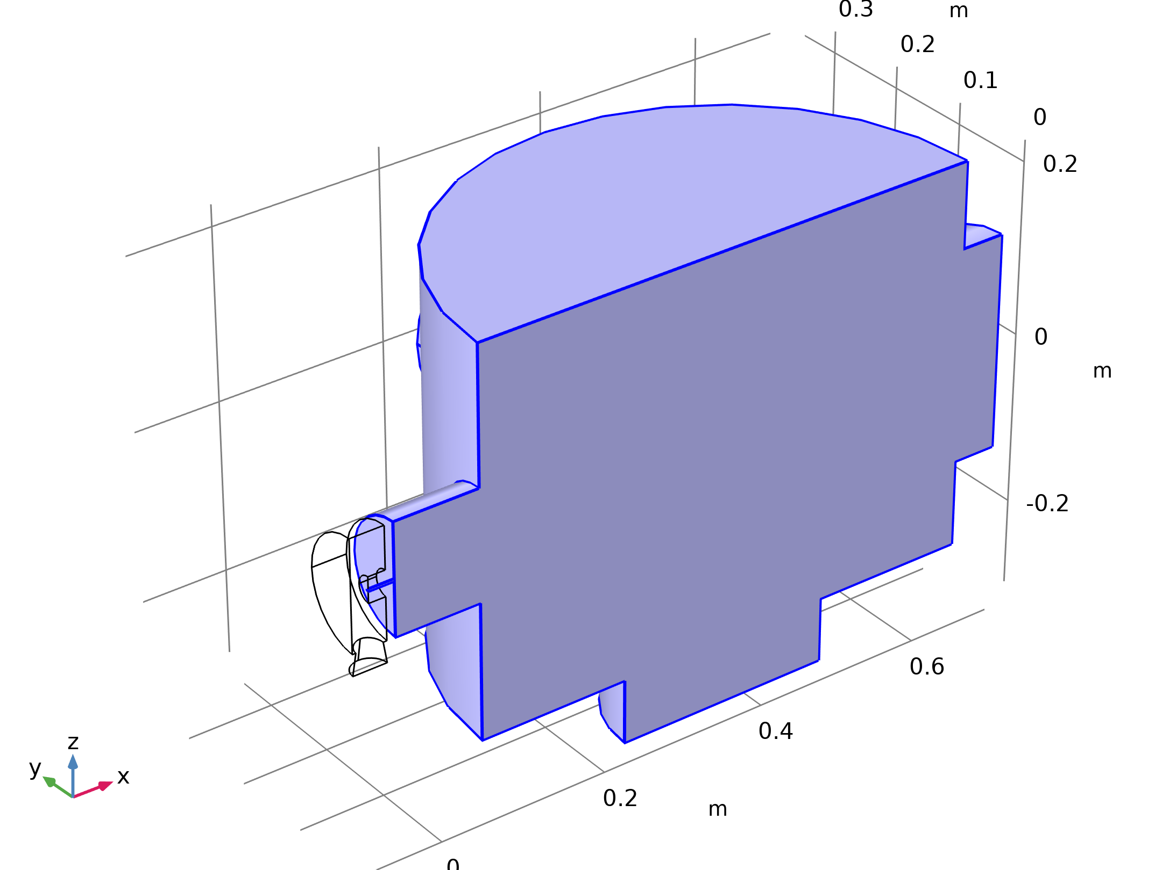
Model Definition
Free Molecular Flow 2

Slide 10
Model Definition
Free Molecular Flow 2

Slide 11
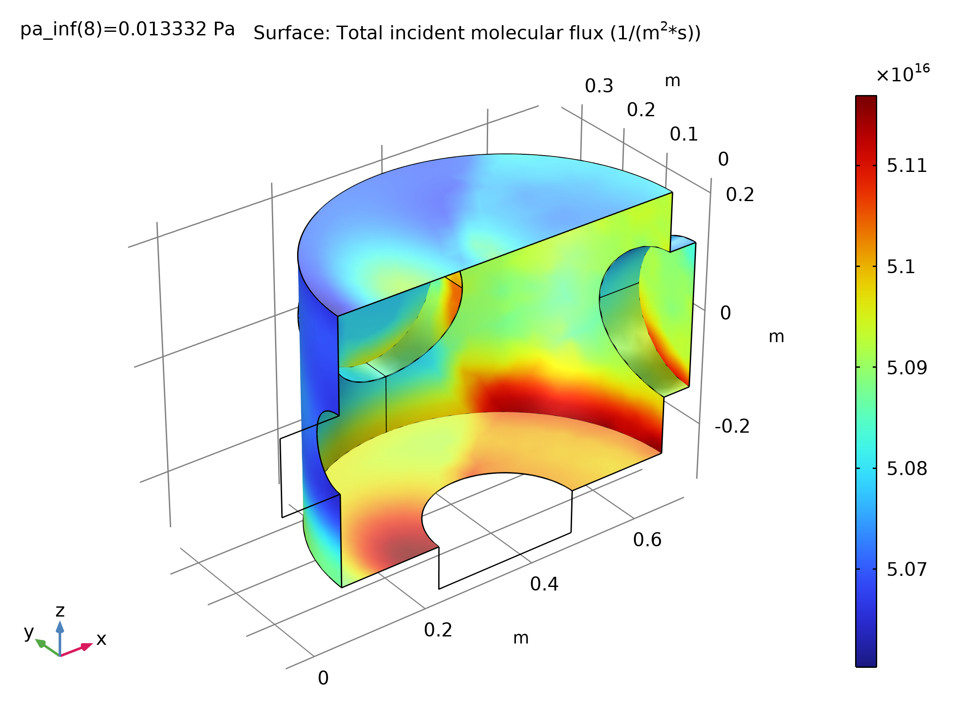
Results
The figure shows the incident molecular flux on the surface of the high-vacuum chamber at the lowest applied pressure
Surface: Total incident molecular flux (1/(m²*s))

Slide 12
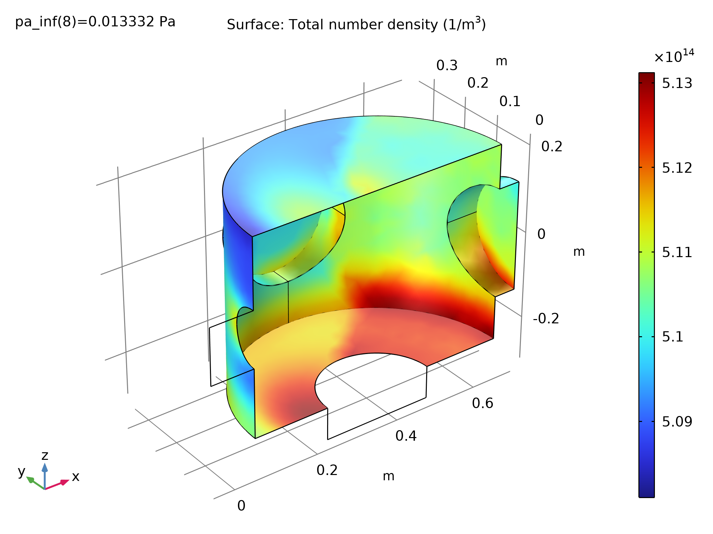
Results
The figure shows the corresponding number density
The flux and number density distributions are similar for all parameters
This is expected since no geometrical changes have been made
Number density on the surface of the high-vacuum chamber when the pressures in the low-vacuum chamber (p_{pa,inf}) is 0.1 mTorr

Slide 13
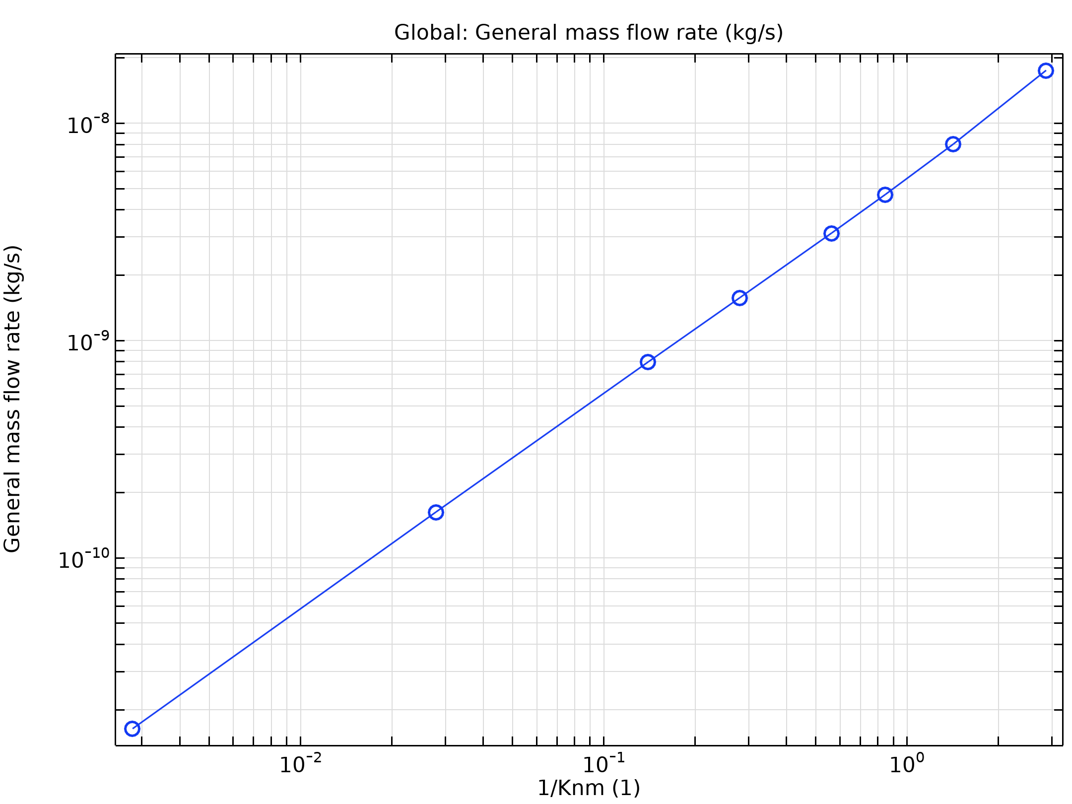
Results
The figure shows the mass flow rate through the tube, as a function of the applied pressure
The minimum is not apparent in the figure, due to the effect of the pump, which is assumed to have a constant pump speed and consequently produces different pressures on the high-vacuum side, depending on the mass flow into this part of the chamber
Mass flow rate through the tube as a function of the pressure in the low-vacuum reservoir

Slide 14
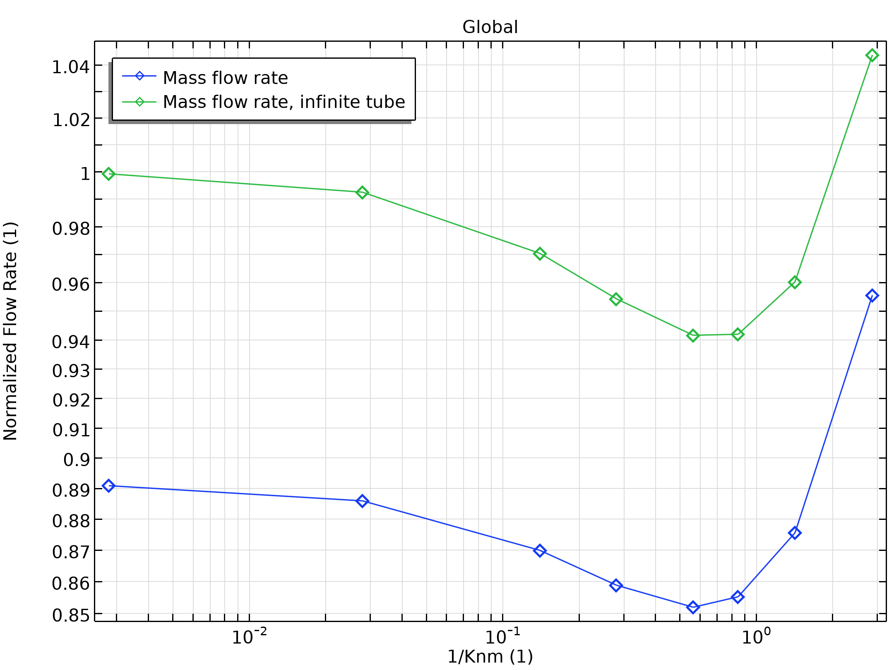
Results
When the flow rate is normalized to the flow that would occur in an infinite tube (for which entry and exit effects can be neglected) a clear minimum in the flow rate as a function of pressure can be seen in the figure
This is known as Knudsen’s minimum
Mass flow rate through the tube, normalized to the flow rate through an infinite tube in the free molecular flow limit. The normalized flow rate through an infinite tube (with no pressure drop at the inlet or outlet) is also shown for comparison

Slide 15
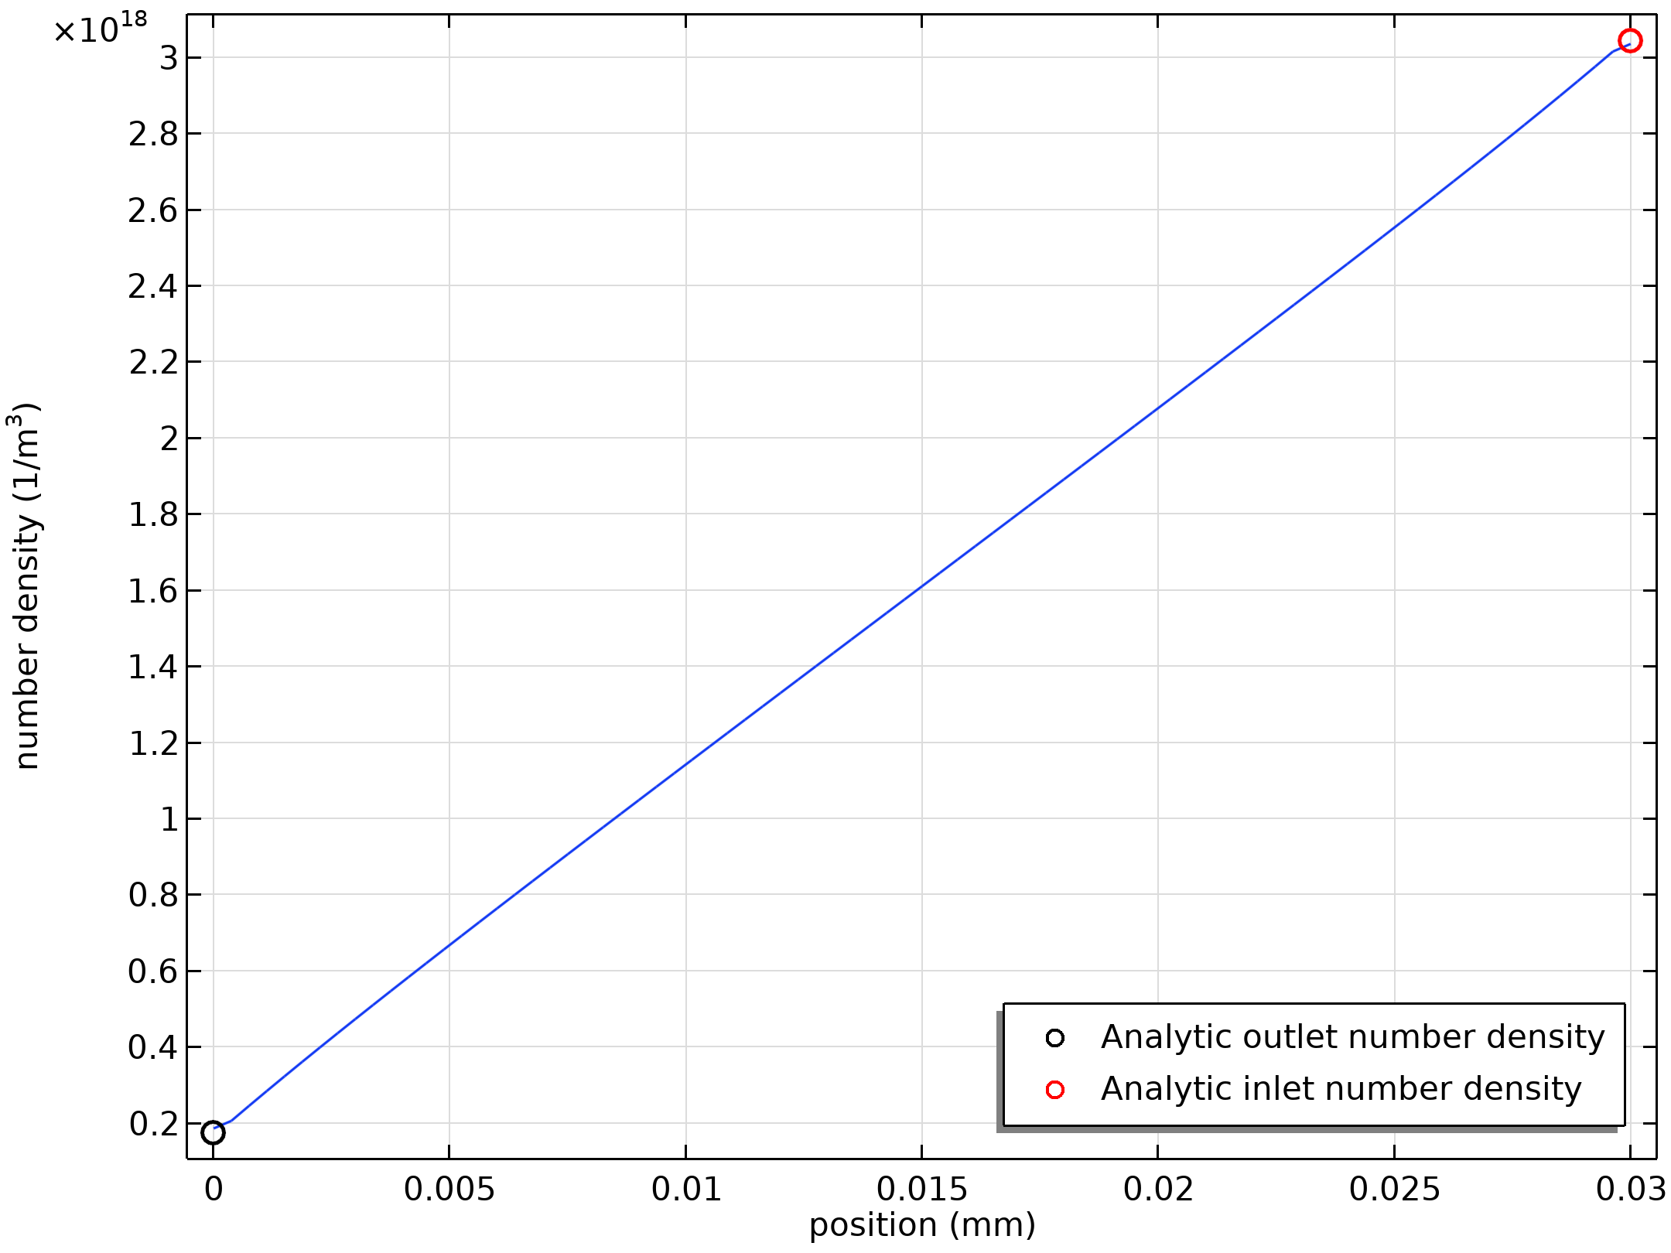
Results
The mass flow rate into the chamber computed by Study 2 (1.65×10⁻¹¹ kg/s) agrees well with that produced by the analytic expression (1.63×10⁻¹¹ kg/s)
Mass conservation in the model is also reasonable — the mass flow out of the pump is 1.66×10⁻¹¹ kg/s, which differs from the mass flow into the system by less than 1%
Finally the number density in the tube, which is expected to vary linearly along the tube in the free molecular flow limit agrees well with the number density profile predicted by the model, as shown in the figure
Number density on the inside of the tube computed in study 2 (line) compared with the results from the analytic expression at the entrance and exit from the tube (symbols). A linear variation of the number density in the tube is expected in the free molecular flow limit

Slide 16
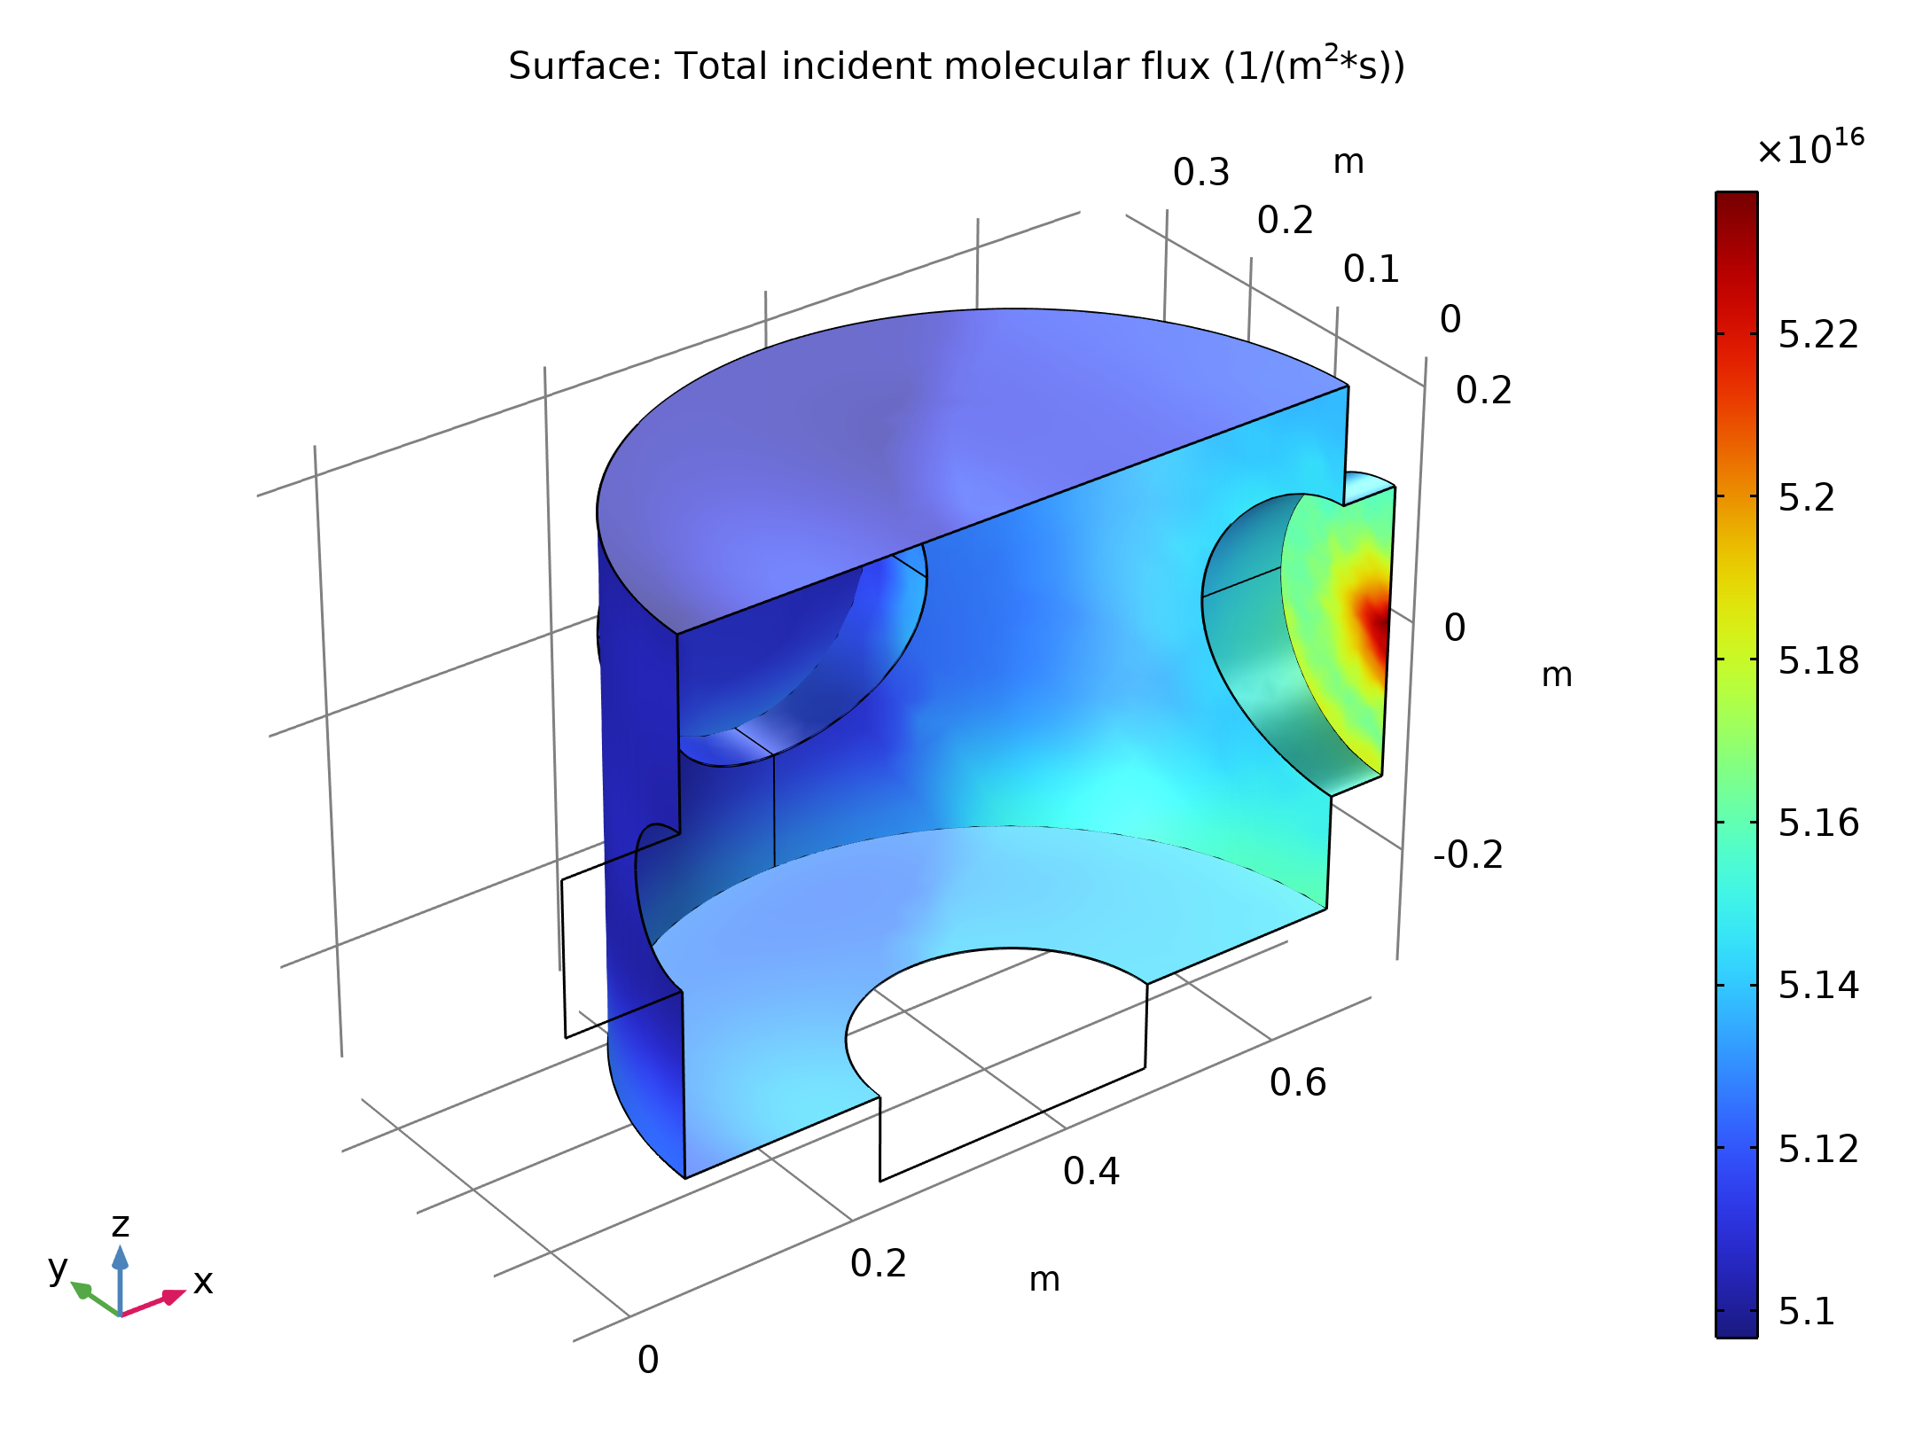
Results
The figure shows the pressure and number density within the high-vacuum chamber for this study
Incident molecular flux on the surface of the high-vacuum chamber when the pressure in the low-vacuum chamber (p_{a,inf}) is 0.1 mTorr. Flow through the tube is modeled using the Free Molecular Flow interface and the reservoir boundary condition. Molecular beaming (focusing of the flow from the outlet) can be seen on the port opposite the tube

Slide 17

Results
The figure shows the pressure and number density within the high-vacuum chamber for this study
Number density on the surface of the high-vacuum chamber when the pressure in the low-vacuum chamber (p_{a,inf}) is 0.1 mTorr. Flow through the tube is modeled using the Free Molecular Flow interface and the reservoir boundary condition. Molecular beaming (focusing of the flow from the outlet) is apparent

