Slide 1
Neutralization of a Proton Beam Through a Charge Exchange Cell
COMSOL

Slide 2
Introduction
Collisions of neutral particle beams with target materials at various projectile energies are important in a number of applications ranging from plasma physics to material processing
Beams of high-velocity neutral particles can be obtained using charge exchange cells
A charge exchange cell is a region of high-density gas placed on the path of an ion beam
The region of high gas density creates a medium in which fast ions can be neutralized to generate a beam of neutral particles at the exit of the cell

Slide 3
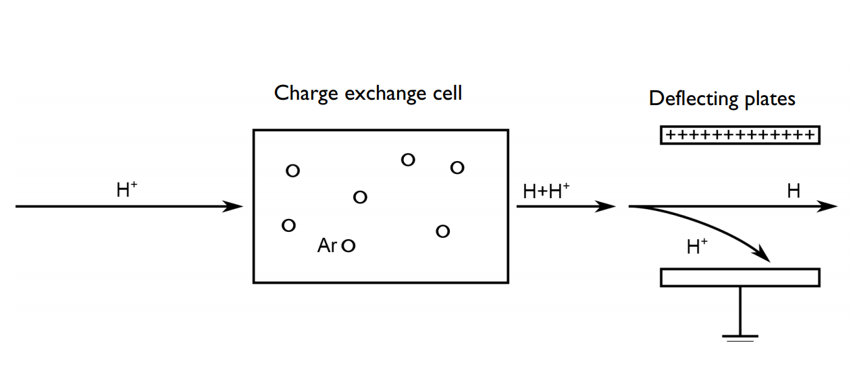
Introduction
The figure shows the concept behind a charge exchange cell
Protons are accelerated toward a cell filled with neutral argon
When they pass through the charge exchange cell, the protons can capture electrons from the argon atoms and exit the cell as fast neutral hydrogen atoms
Since the probability of electron capture is not very high, charged particles are still present in the beam as it exits the cell
Schematic of a simplified charge exchange cell neutralization process

Slide 4
Introduction
To get a pure neutral beam at the end of the process, charged plates can be used to deflect the charged particles before the beam reaches its target
Schematic of a simplified charge exchange cell neutralization process

Slide 5
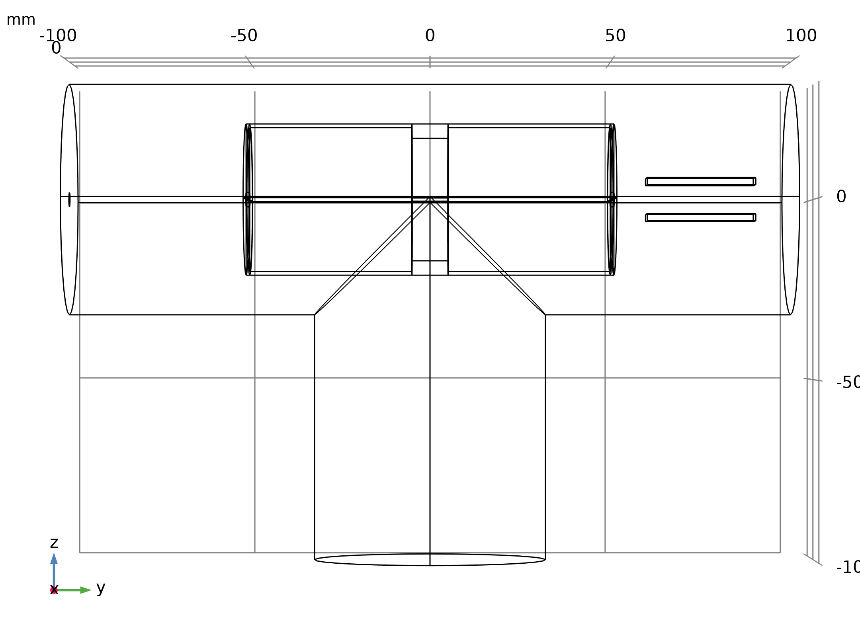
Model Definition
The figure shows the geometry used in the model
The gas cell consists of a tube 40 mm in diameter and 100 mm long
The tube has end caps with 2 mm diameter apertures along the cylinder axis
The argon gas is introduced into the gas cell through a shower head ring located in the center of the cell
Geometry 1

Slide 6
Model Definition
The microchannels of the shower head charge exchange cell deflecting plates are used to control the neutral gas density in the cell and create a high-pressure region within the main vacuum system of the instrument
To model the gas inflow the outgassing wall boundary condition is used
The gas cell is mounted in a vacuum “T”, which is pumped by a turbomolecular pump (pumping speed of 63 L/s)
Geometry 1

Slide 7
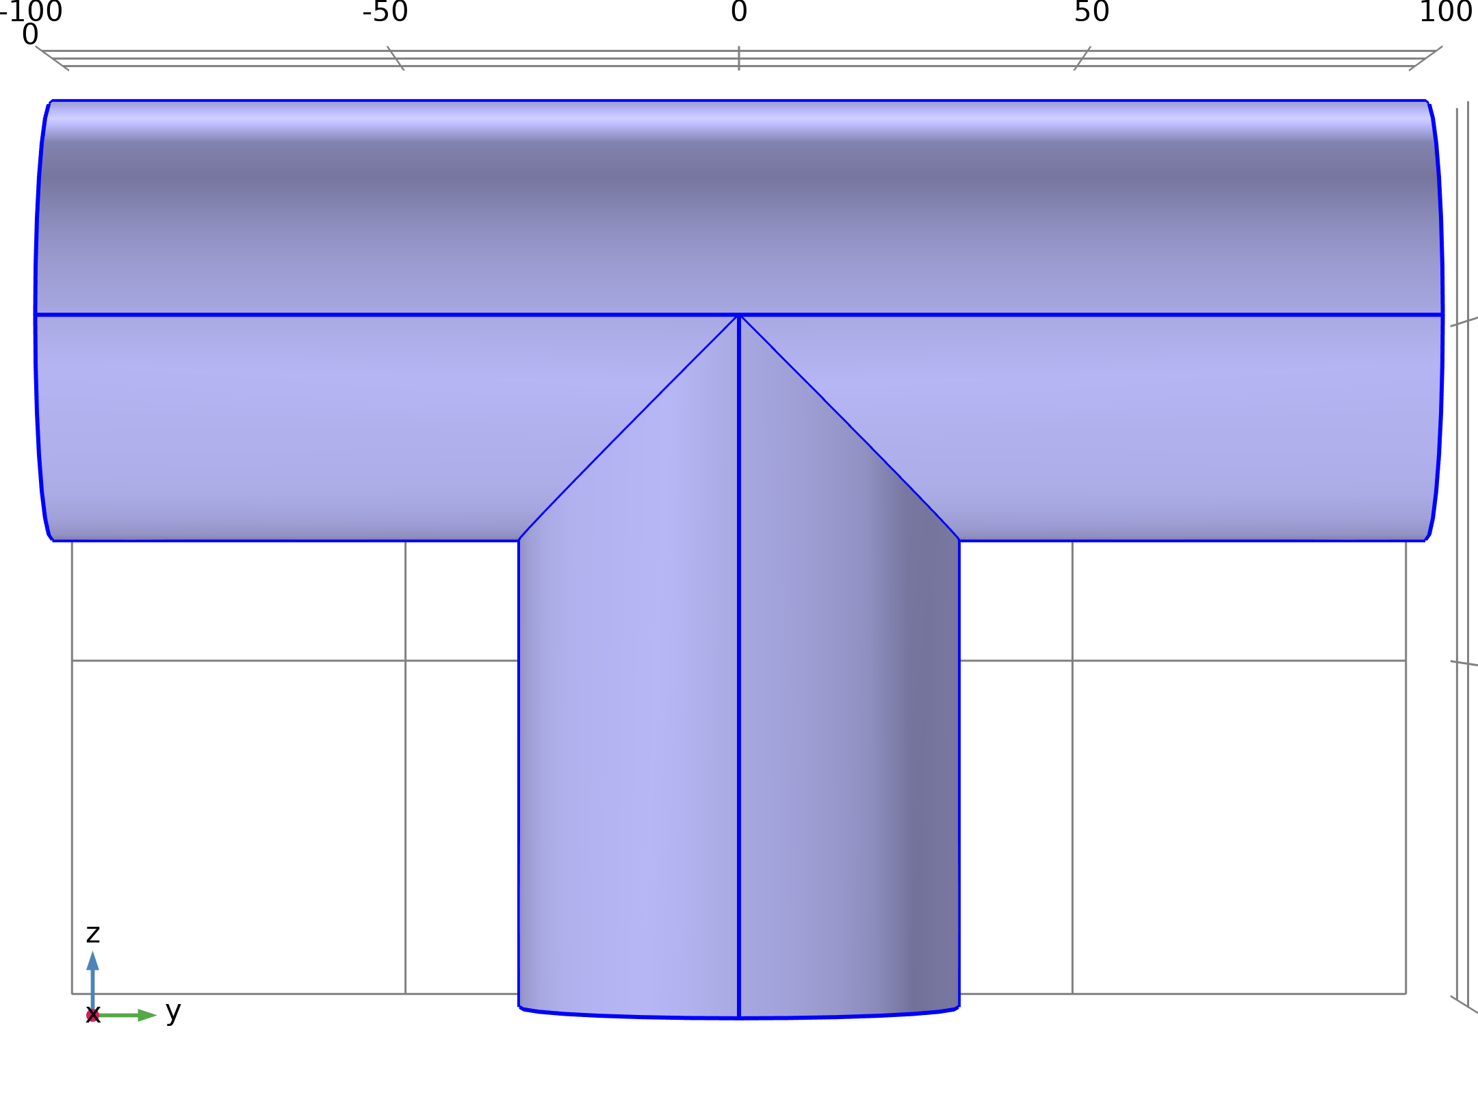
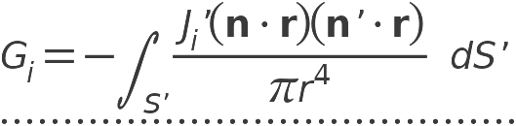
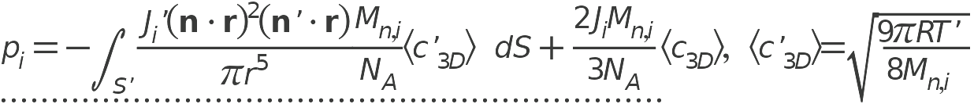
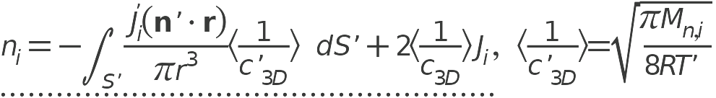
Model Definition
Free Molecular Flow

Slide 8
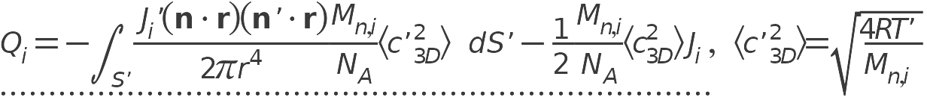
Model Definition
Free Molecular Flow

Slide 9


Model Definition
Electrostatics

Slide 10
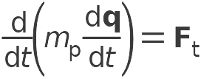
Model Definition
Charged Particle Tracing

Slide 11
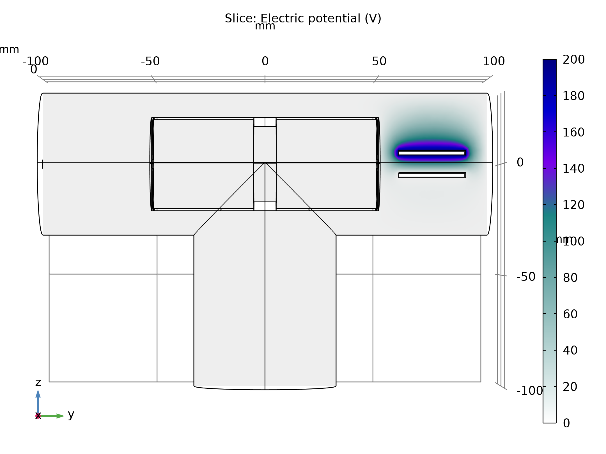
Results
The electric potential distribution in the region surrounding the two plates is plotted in the figure
Electric potential in the vacuum housing

Slide 12
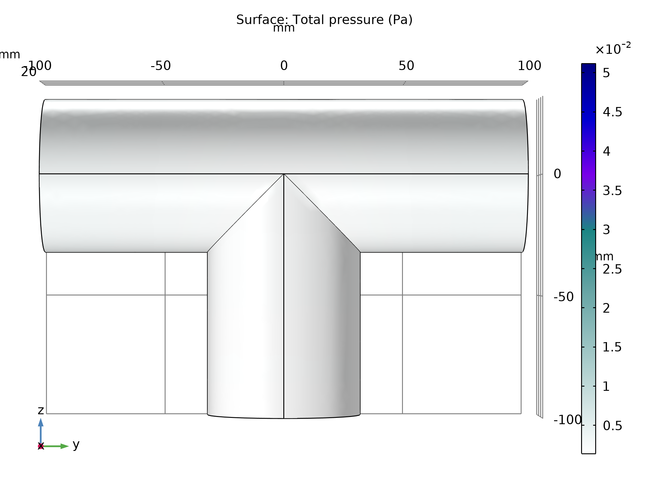
Results
The figure shows a surface plot of the pressure in the apparatus
Pressure in the apparatus

Slide 13
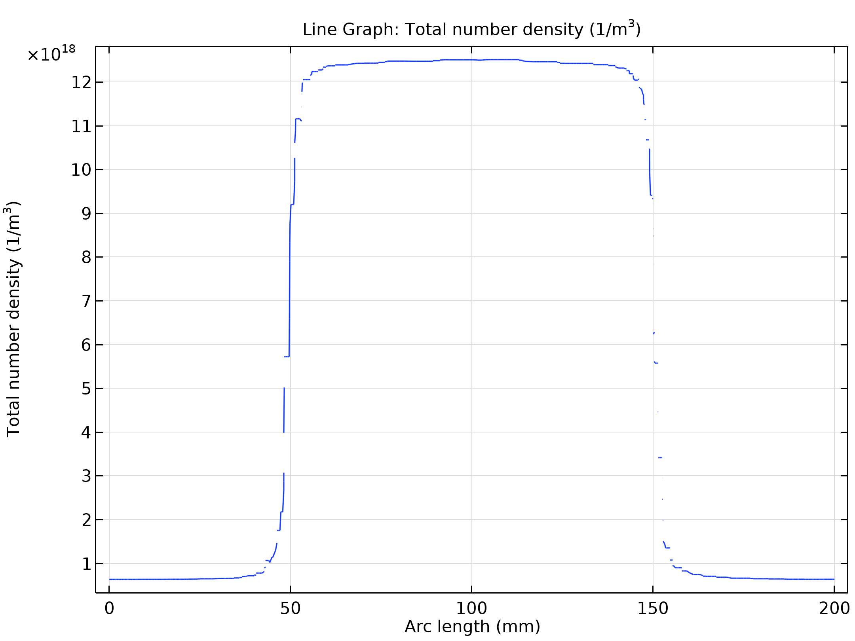
Results
The corresponding number density is computed along the symmetry axis of the cylindrical cell and is plotted in the figure
Axial number density through the gas cell and vacuum housing for argon for a constant mass flow rate of 0.05 sccm into the gas cell

Slide 14
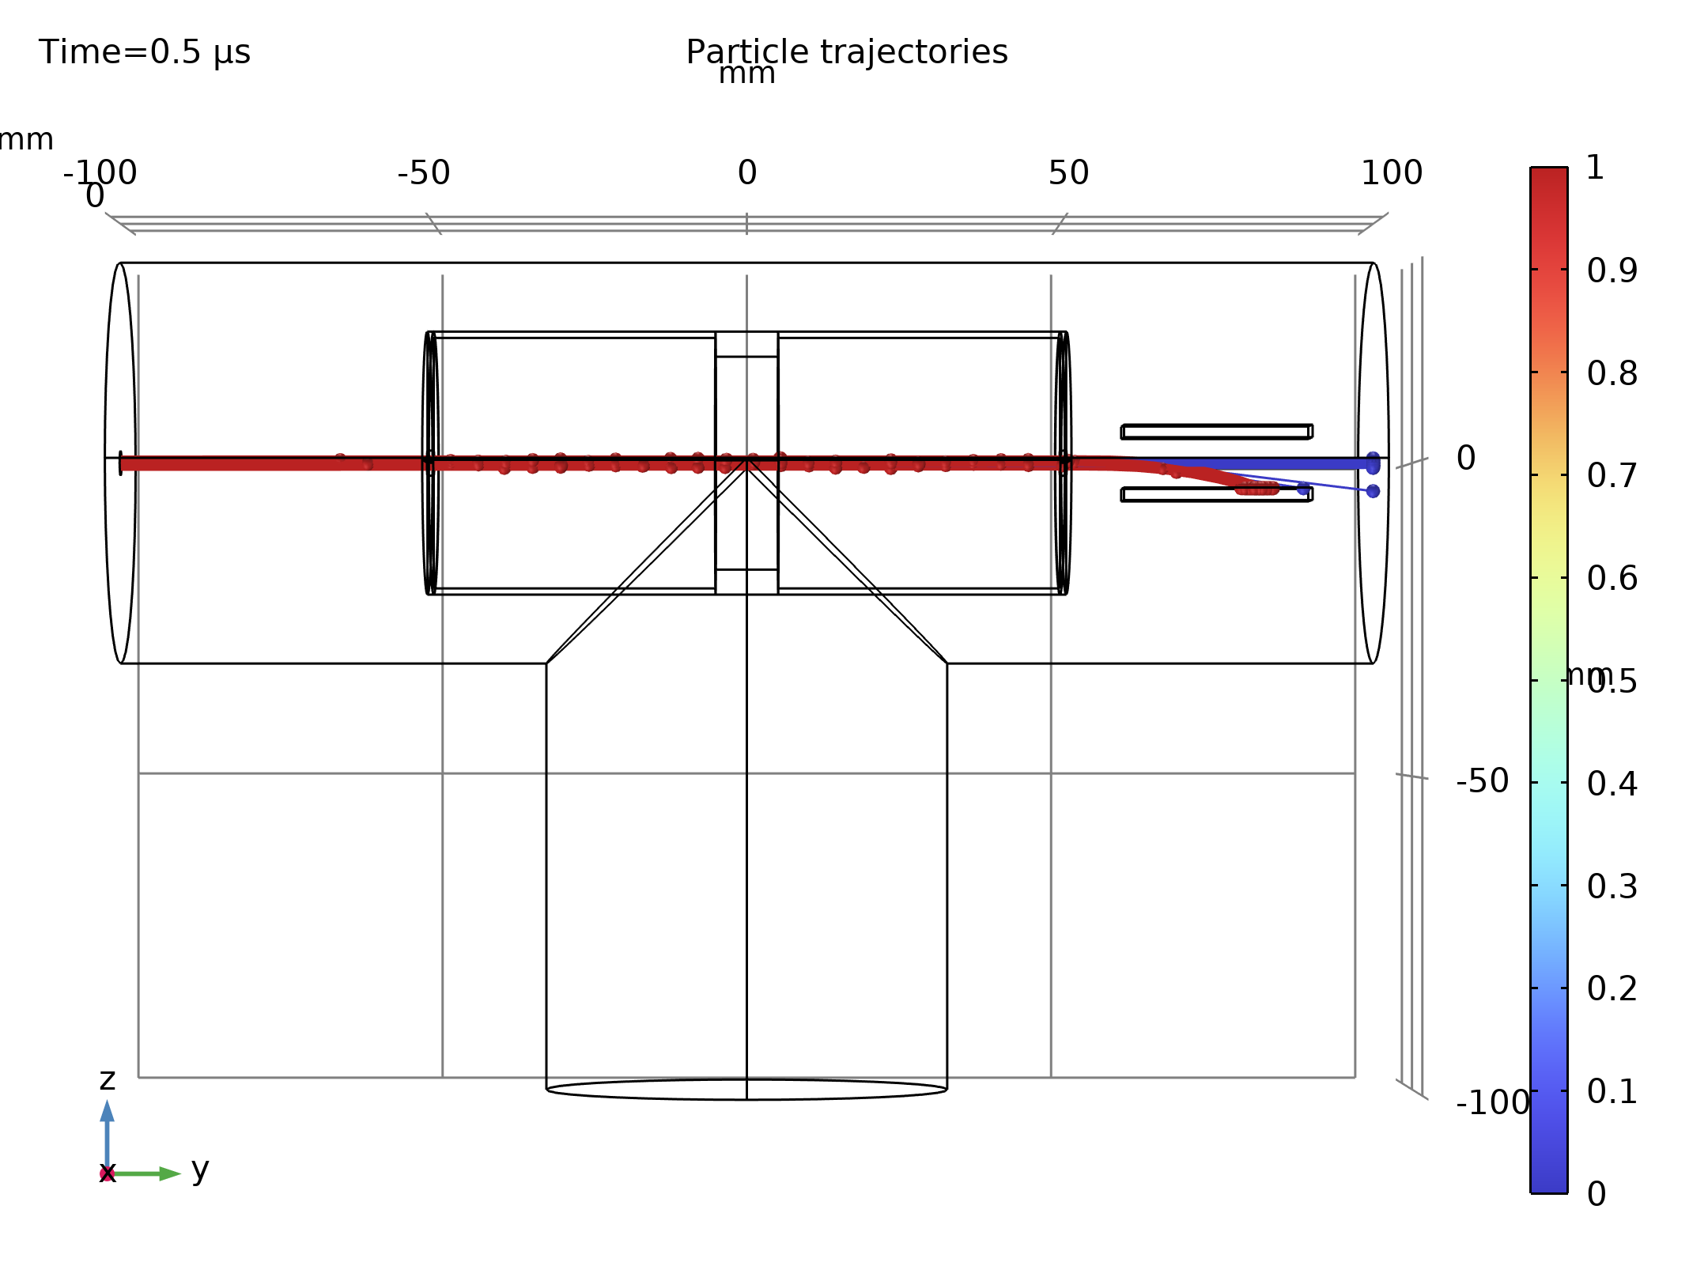
Results
The particle trajectories are plotted in the figure
The color expression in this plot indicates the charge number of the atoms, which decreases from 1 (red) to 0 (blue) for particles that undergo charge exchange reactions in the cell
By comparing the number of particles on the plate to the total number of particles in the model, the neutralization efficiency is estimated to be 13.8%
Particle trajectories. Ions are shown in red while neutrals are displayed in blue

Slide 15
Results
Because the implementation of the charge exchange reactions is stochastic in nature, this value may change slightly when the model is rerun, depending on the seeding of random numbers
Particle trajectories. Ions are shown in red while neutrals are displayed in blue

