Slide 1
Pull-In of an RF MEMS Switch
COMSOL

Slide 2
Introduction
This model analyzes an RF MEMS switch consisting of a thin micromechanical bridge suspended over a dielectric layer
A DC voltage greater than the pull-in voltage is applied across the switch, causing the bridge to collapse onto the dielectric layer with a resulting increase in the capacitance of the device
A penalty-based contact force is implemented to model the contact forces as the bridge comes into contact with the dielectric
The capability of the electromechanics multiphysics interface to handle both conducting and dielectric materials is also demonstrated

Slide 3
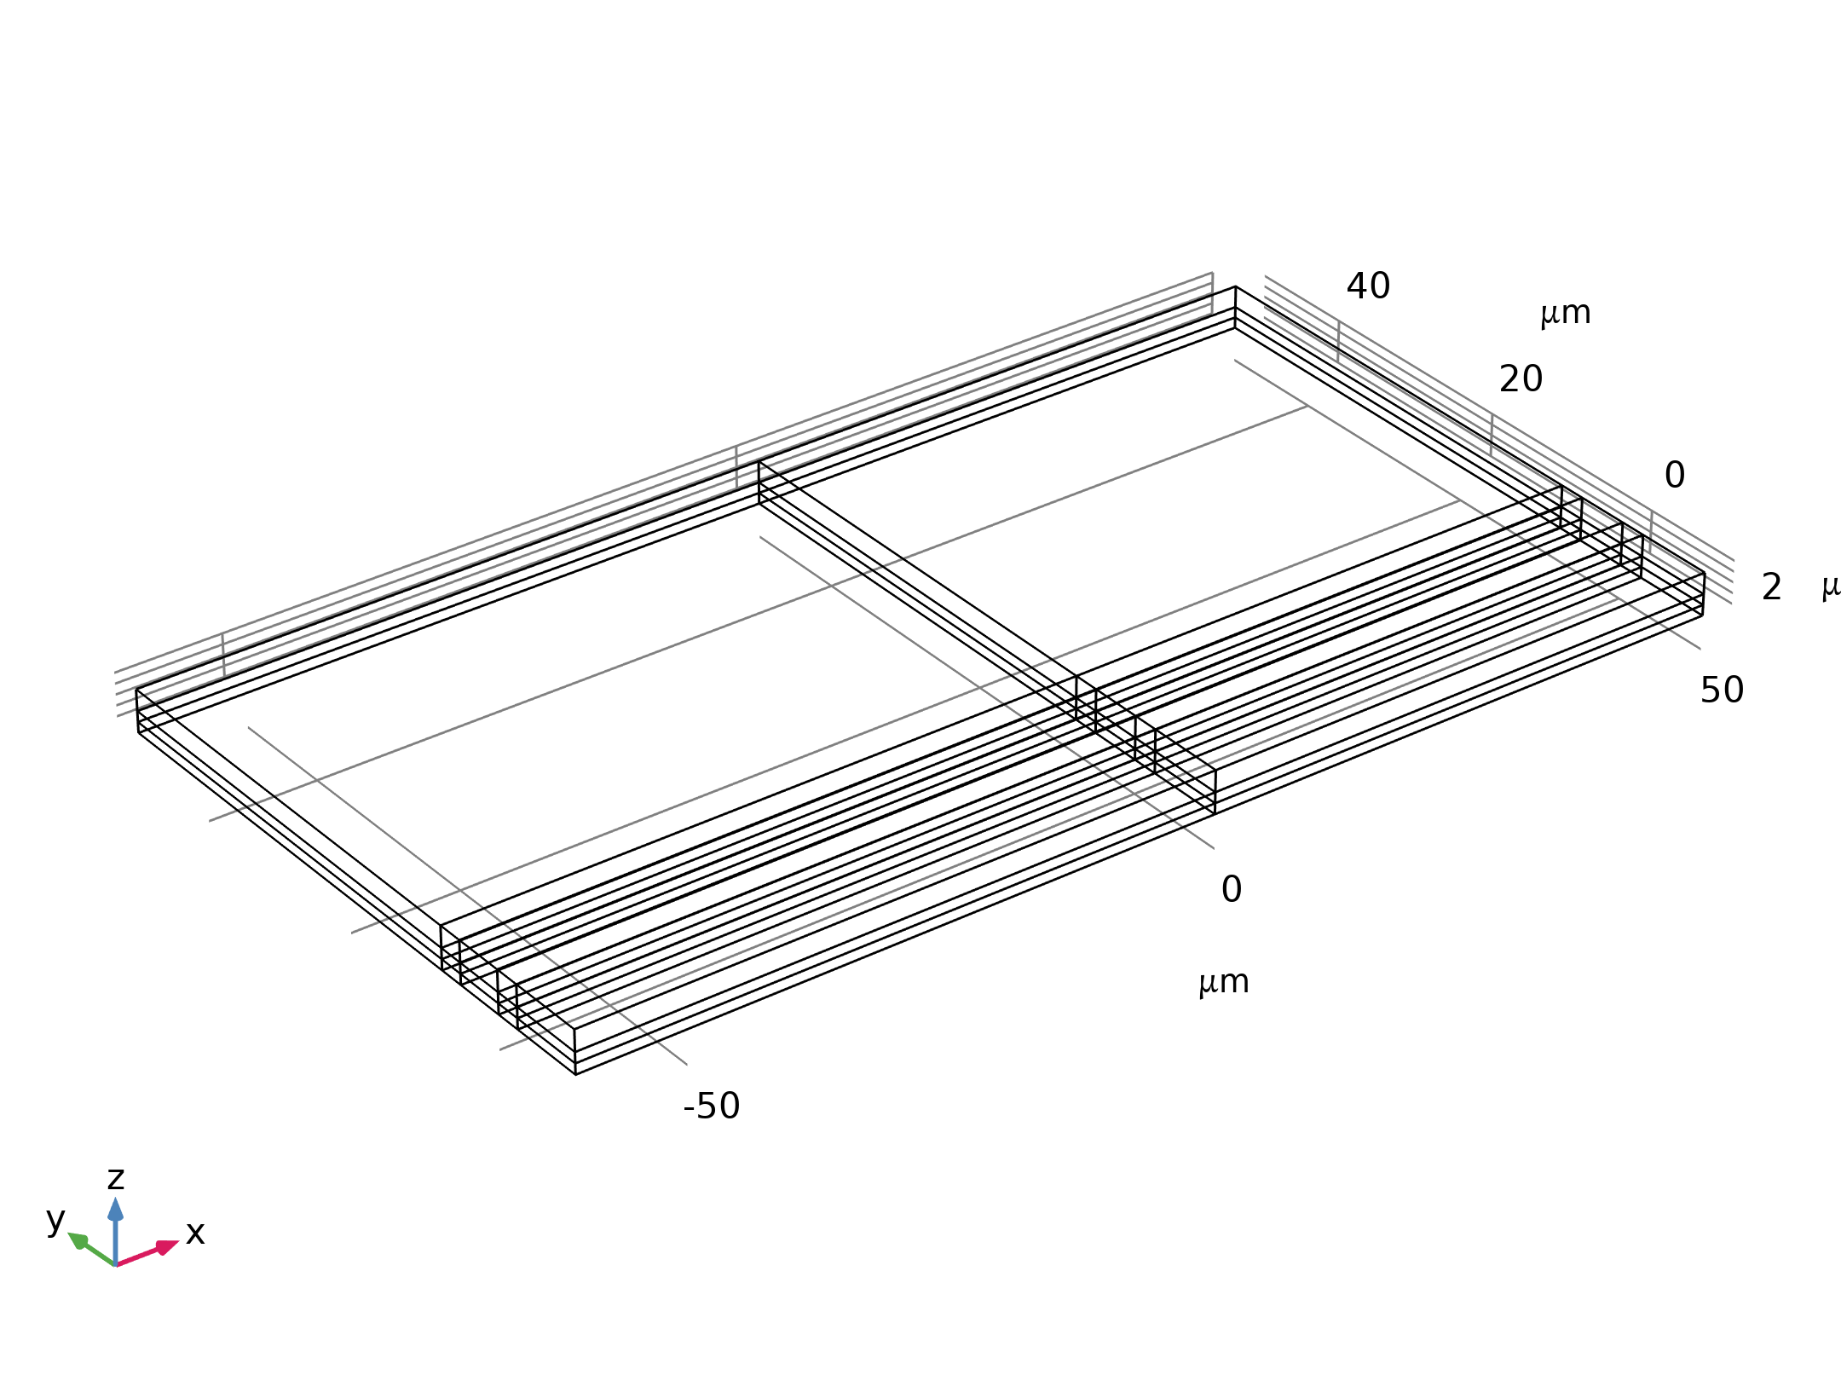
Model Definition
The figure shows the device geometry
The switch consists of a square polysilicon plate suspended 0.9 μm above a 0.1 μm thick thin film of silicon nitride (dielectric constant 7.5)
Beneath the substrate is a silicon counter electrode that is grounded
The suspended plate is structurally anchored to the substrate by four rectangular flexures at its corners but is electrically isolated from the substrate
Geometry 1

Slide 4
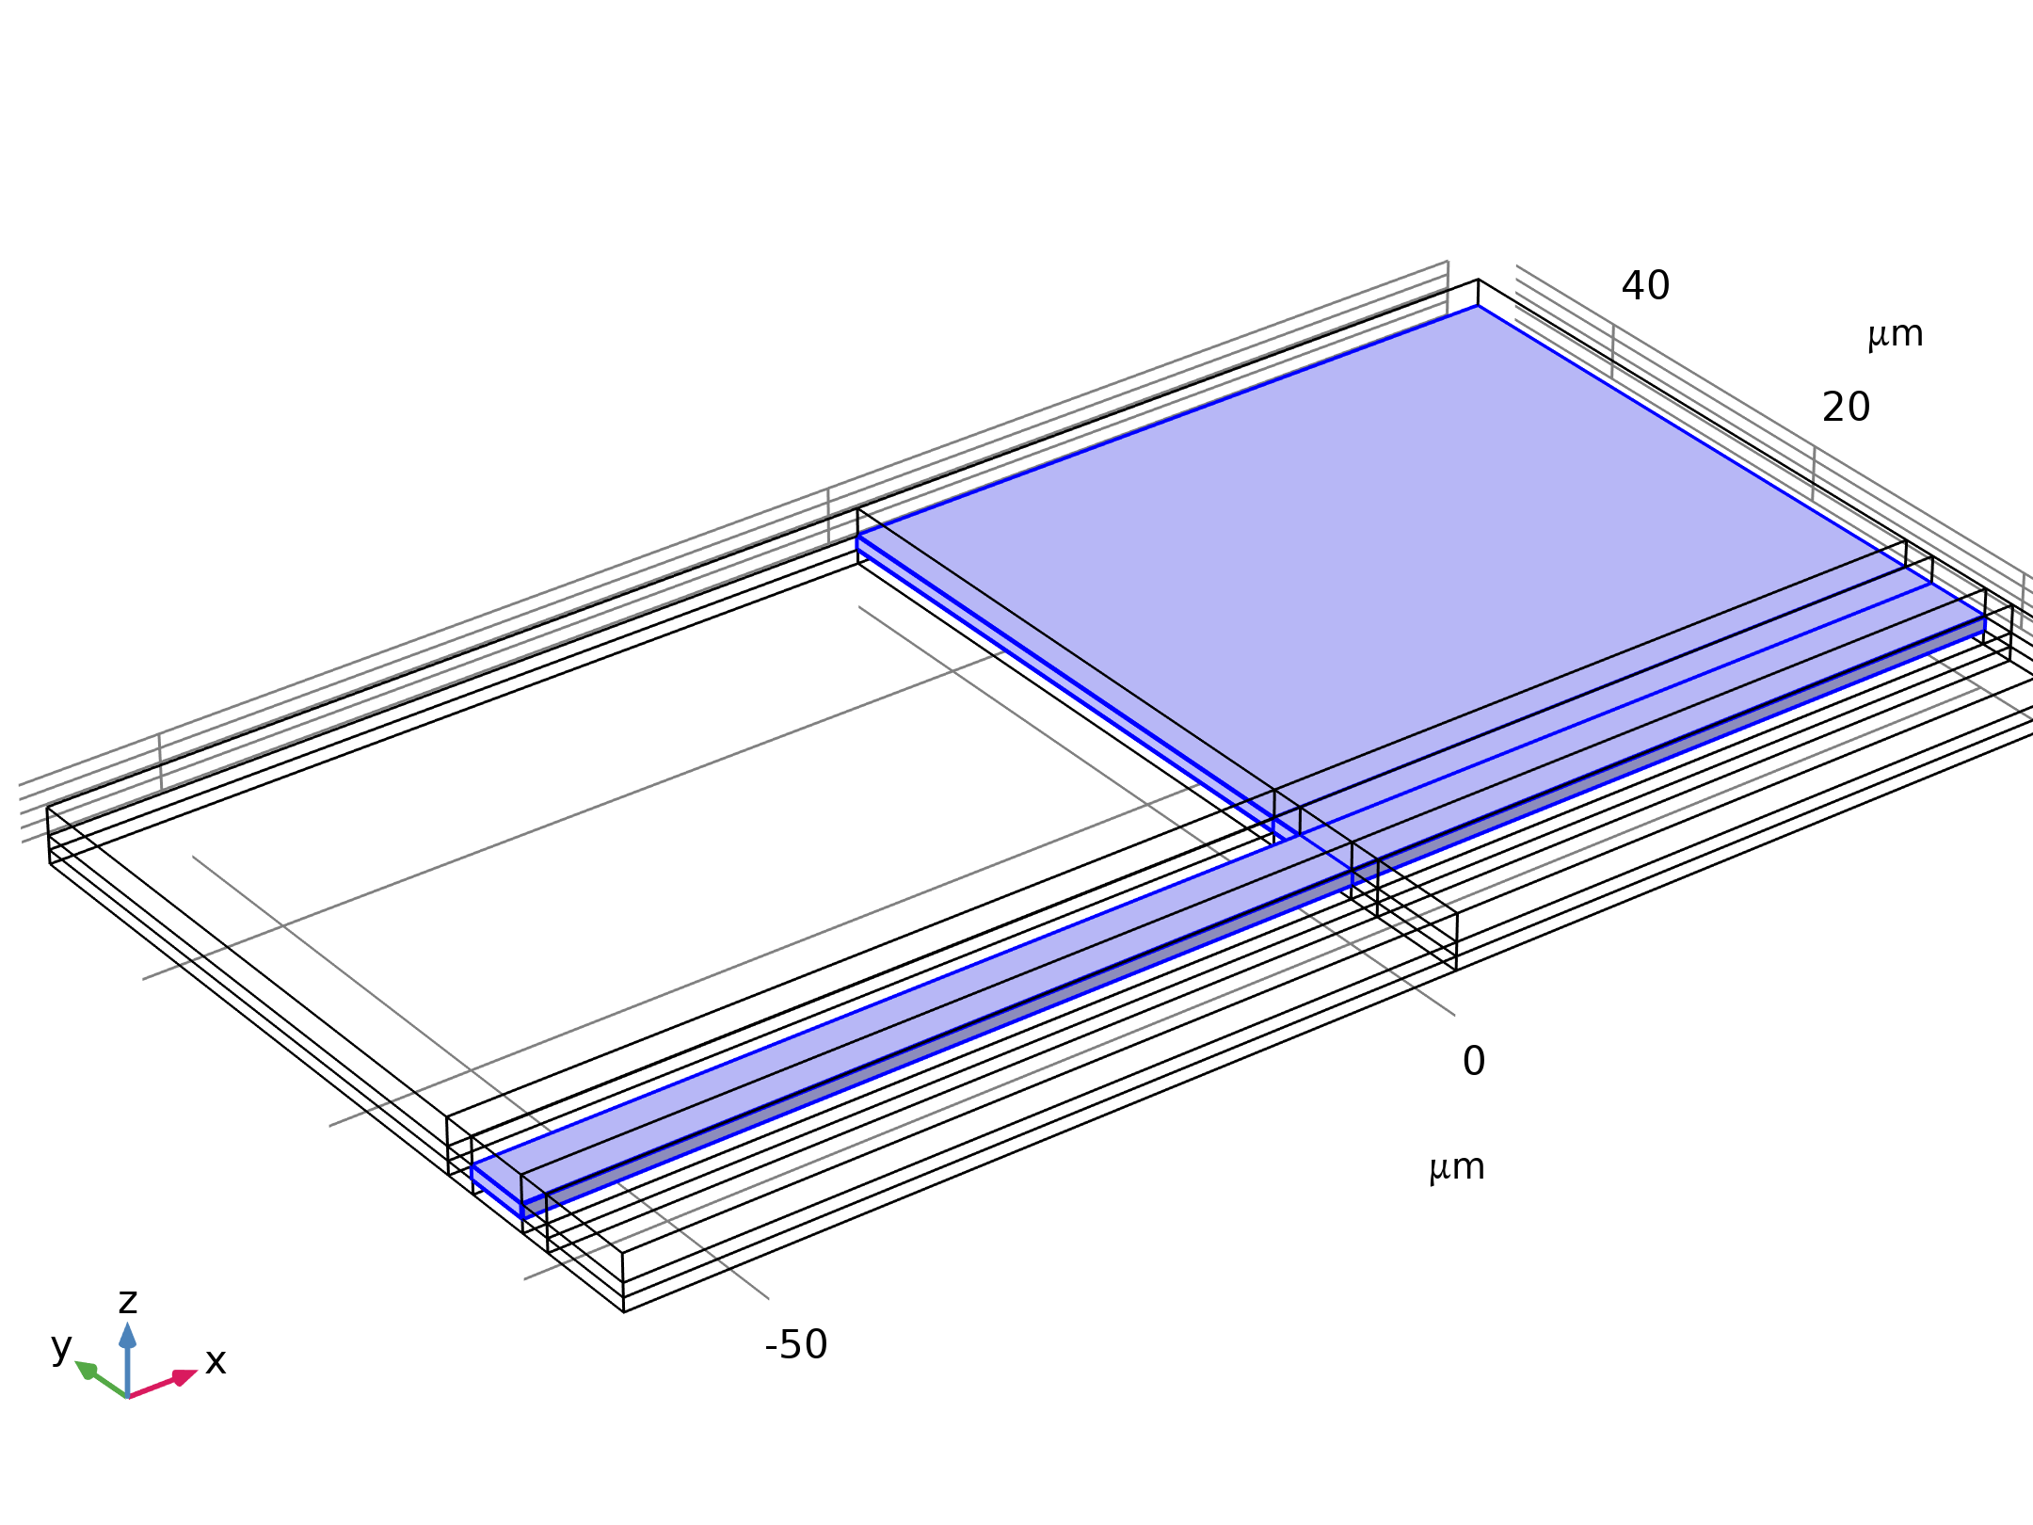

Model Definition
Solid Mechanics

Slide 5
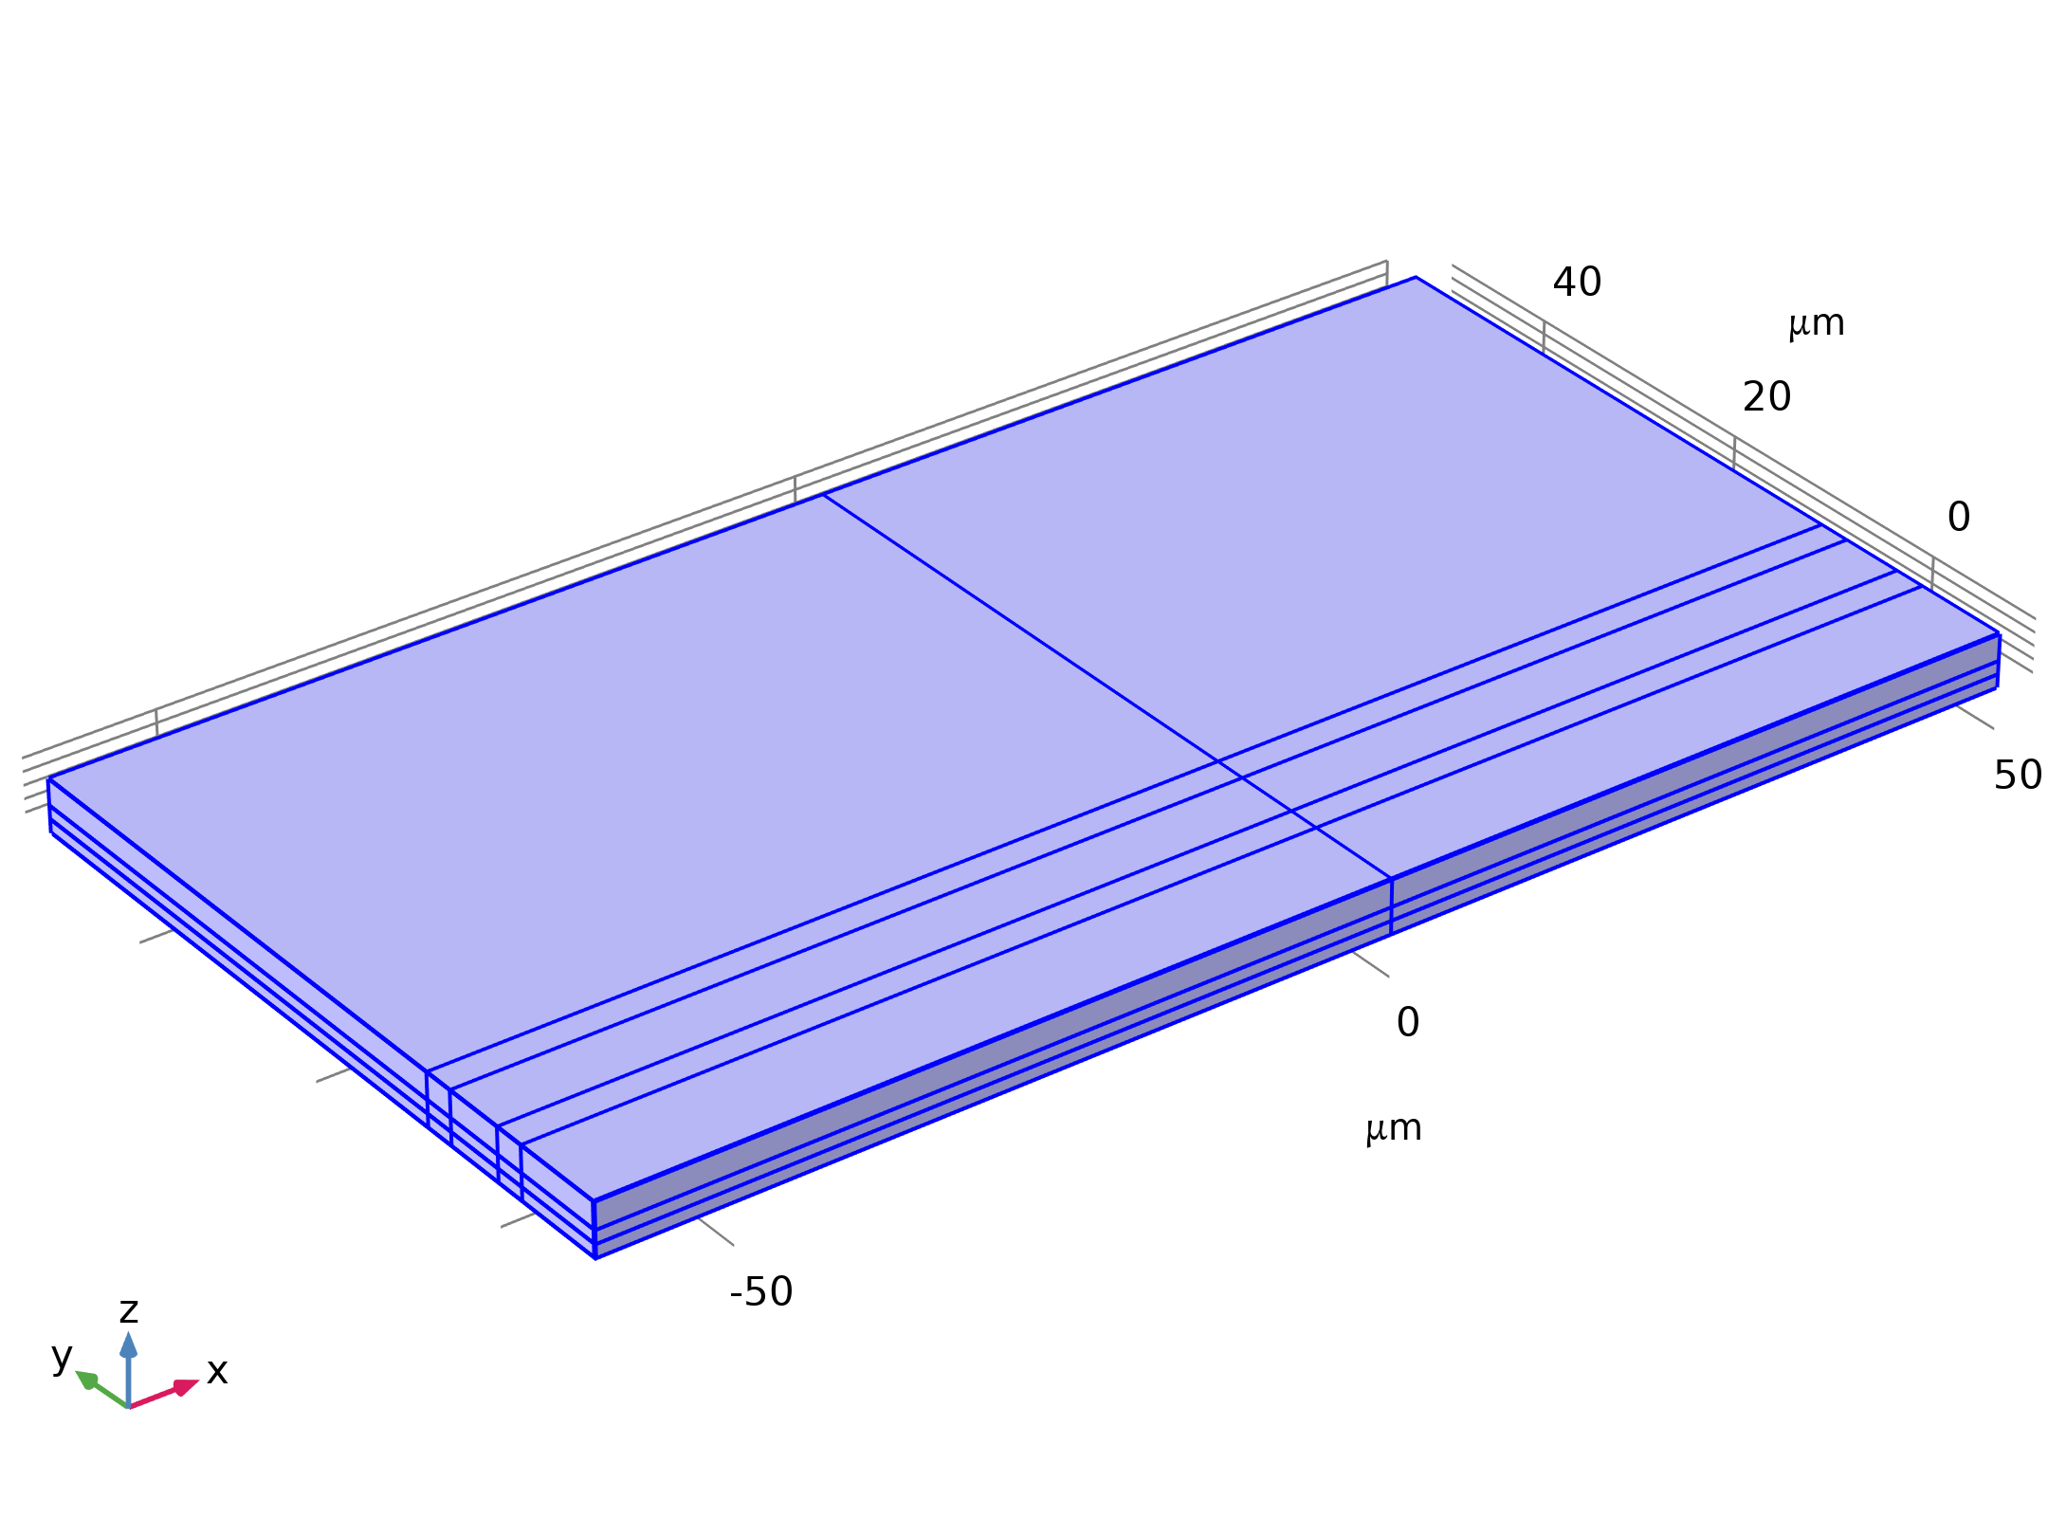


Model Definition
Electrostatics

Slide 6
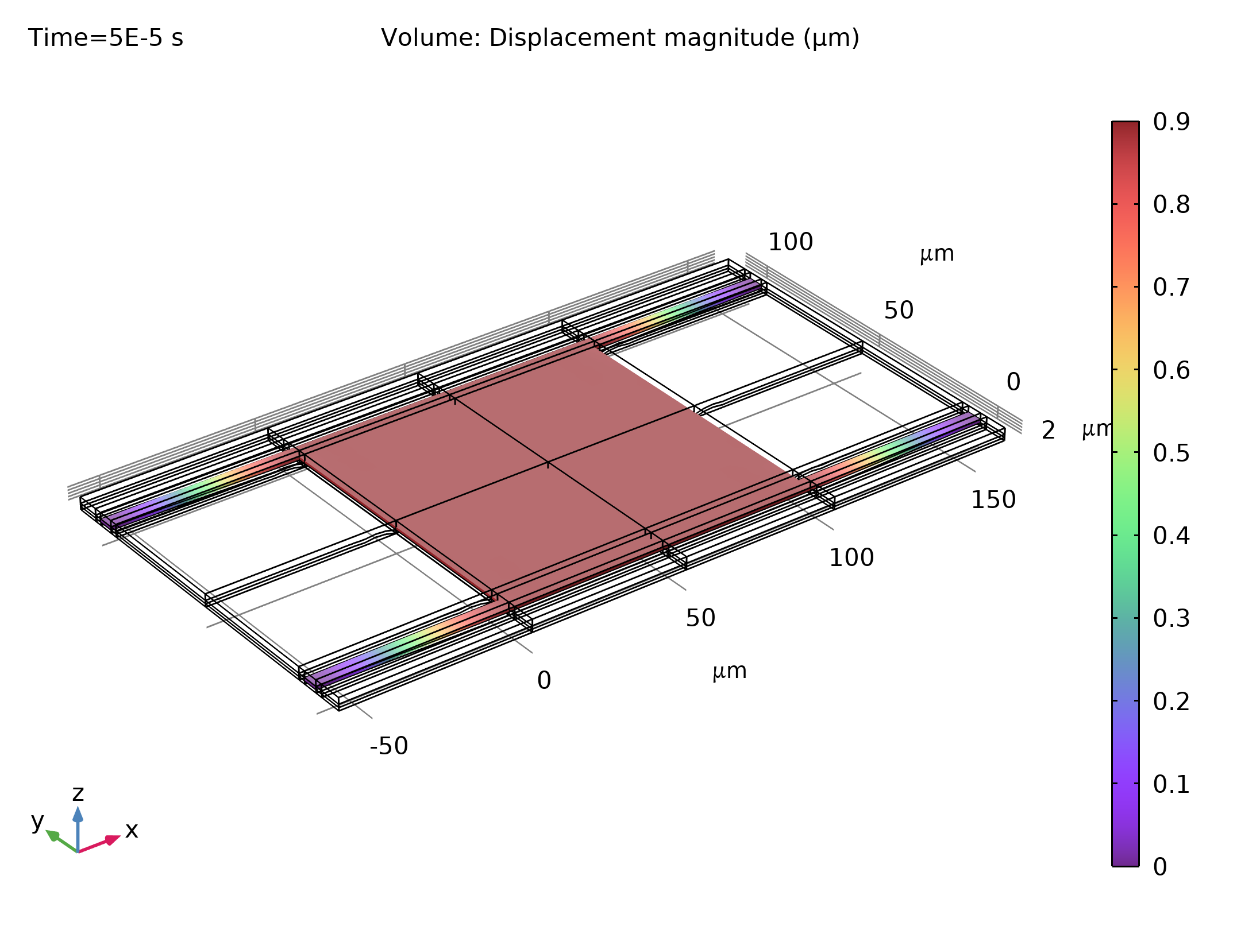
Results
The figure shows the spatial dependence of the total displacement when the device is pulled in
Most of the structure is in contact with the nitride and the bending occurs primarily in the flexures and in the vicinity of their attachment points
Displacement of the polysilicon when pulled in. Most of the polysilicon structure is in contact with the silicon nitride with a displacement of 0.9 μm

Slide 7
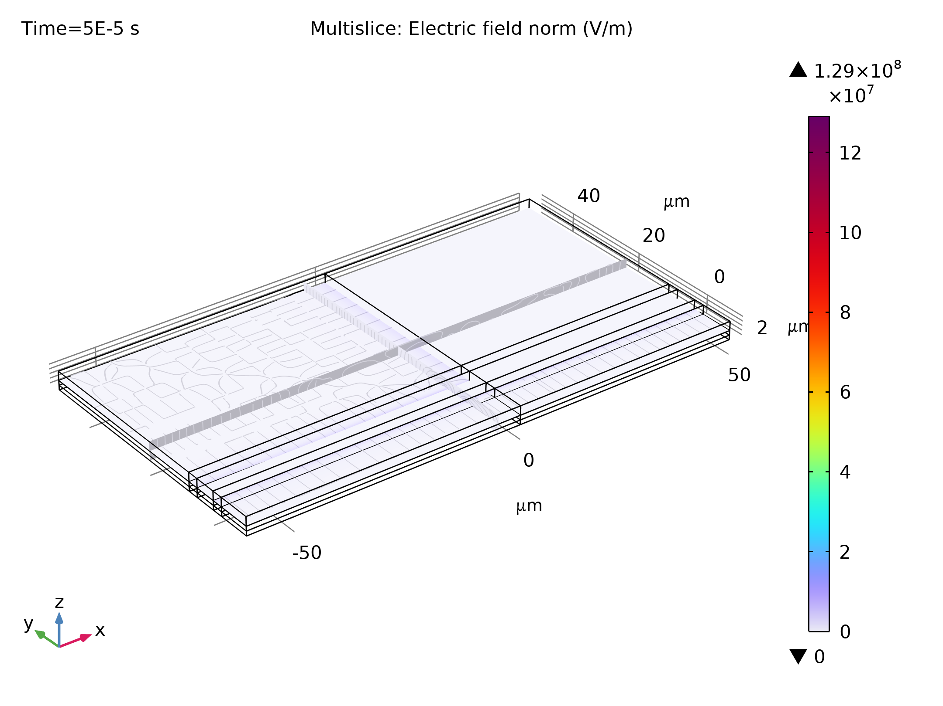
Results
The form of the contact pressure, shown in the figure, is consistent with this observation and it is interesting to note that the largest forces occur in the vicinity of the flexures
Contact forces acting on the polysilicon when the structure is pulled in

Slide 8
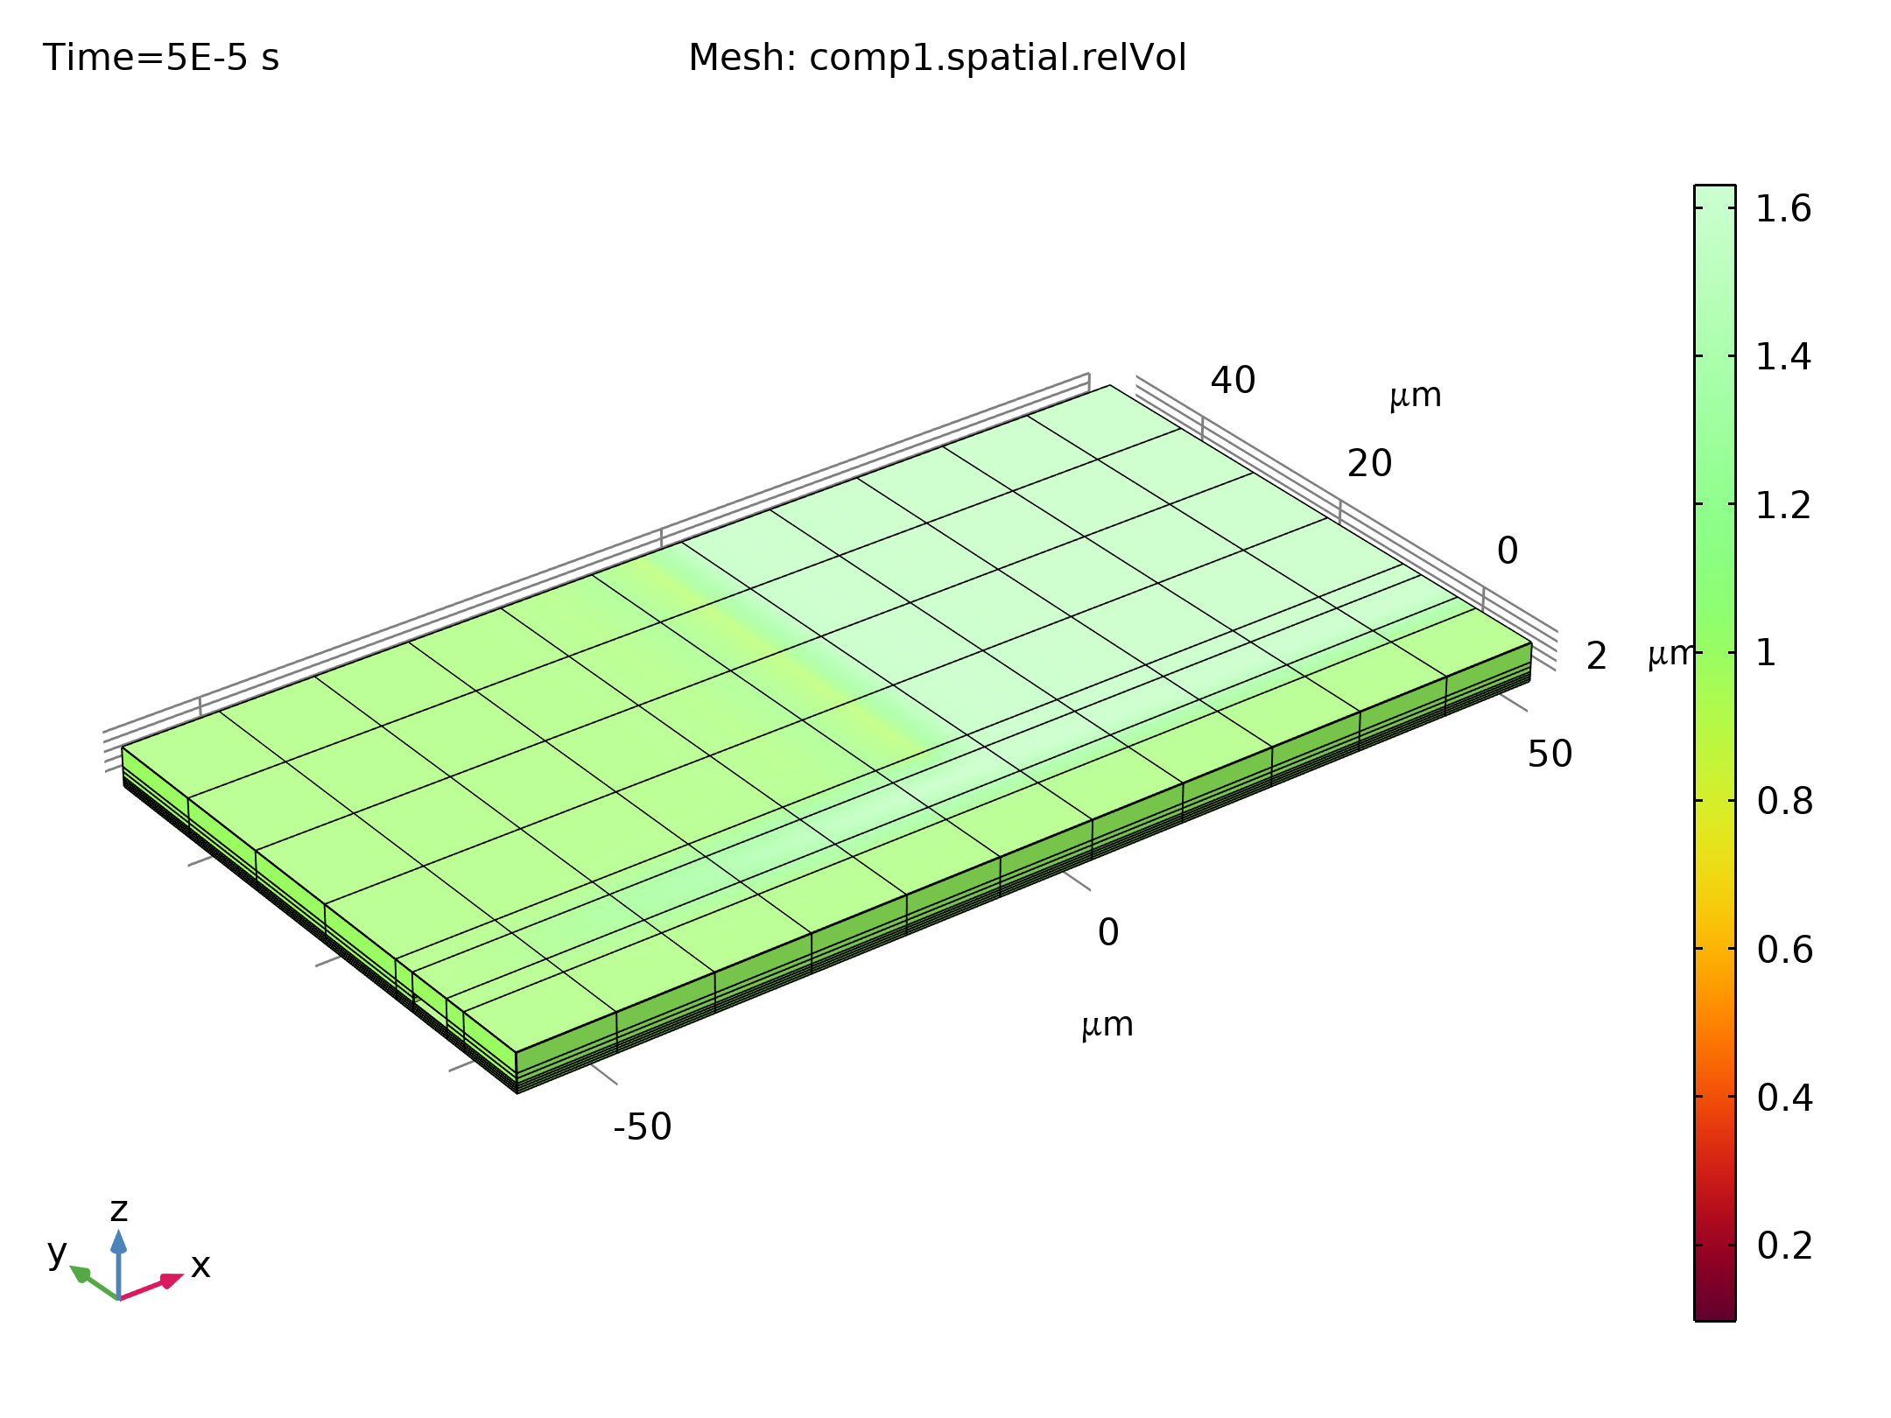
Results
The figure shows the displacement of the switch as a function of time
The switch takes significantly longer to close than the time scale on which the applied voltage changes, primarily due to its inertia
Displacement of the center of the device as a function of time

Slide 9
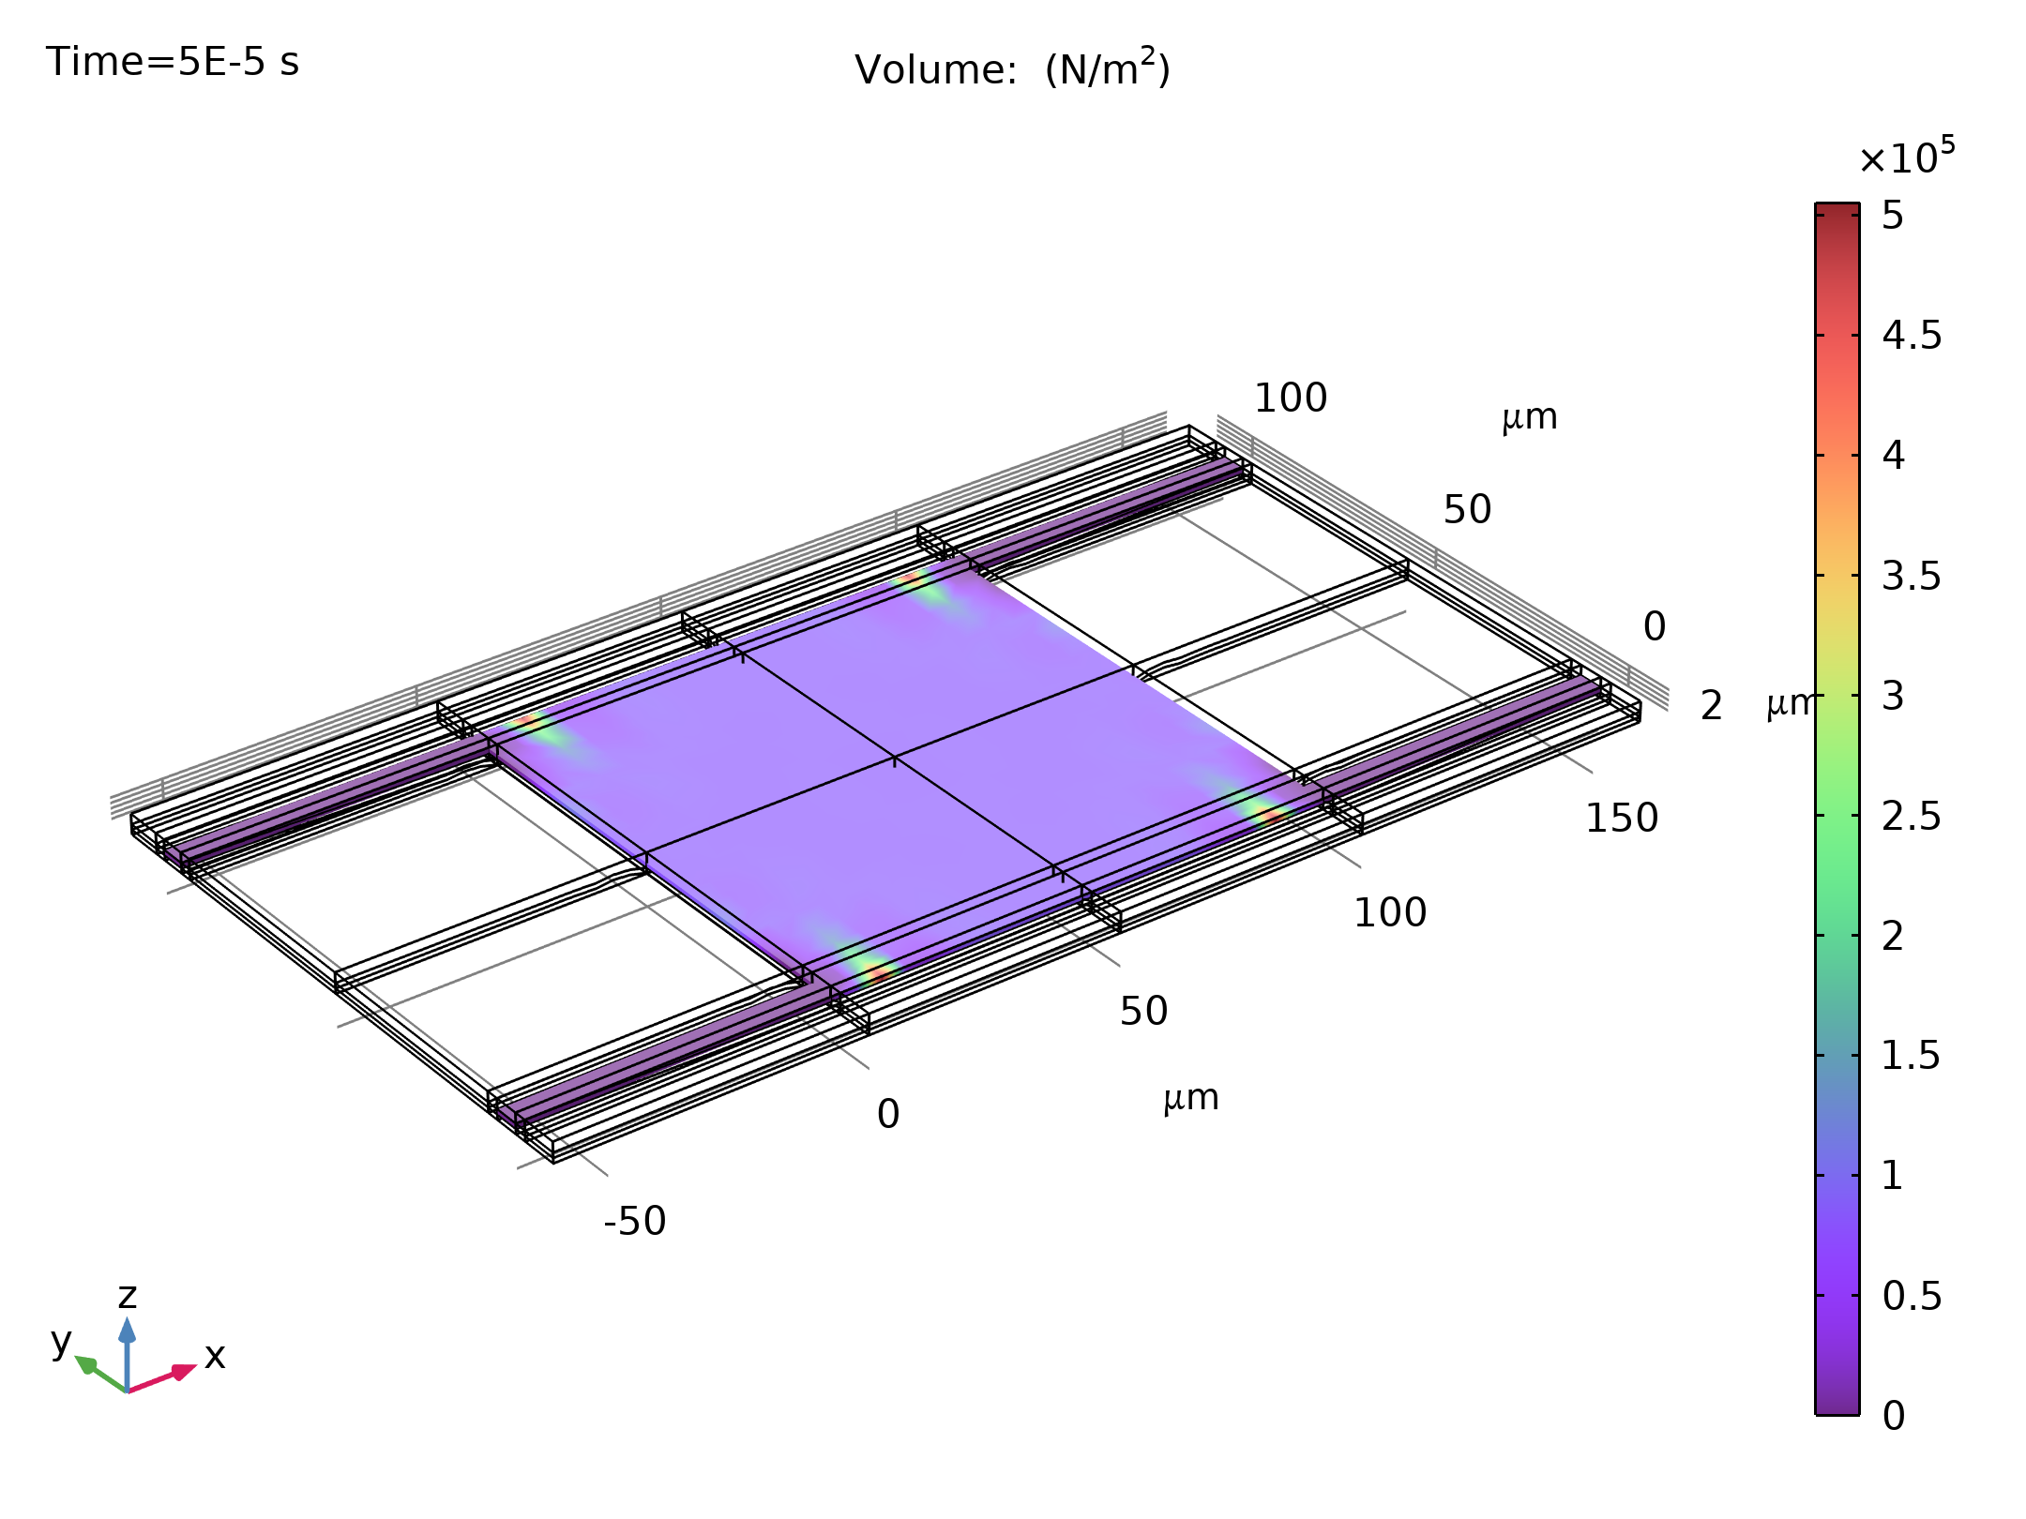
Results
The figure shows the capacitance of the device as a function of time
The capacitance increases by a factor of approximately 65
Note that the capacitance changes on a significantly shorter time scale than the displacement
Capacitance of the device as a function of time. The transients in this plot that occur after the point of contact are not physical. The capacitance of the structure changes from 0.1 pF to 6.5 pF as a result of the pull-in

