Slide 1
Fluid–Structure Interaction
COMSOL

Slide 2
Introduction
The following example demonstrates techniques for modeling fluid-structure interactions in COMSOL Multiphysics
It illustrates how fluid flow can deform structures and how to solve for the flow in a continuously deforming geometry using the arbitrary Lagrangian-Eulerian (ALE) method

Slide 3
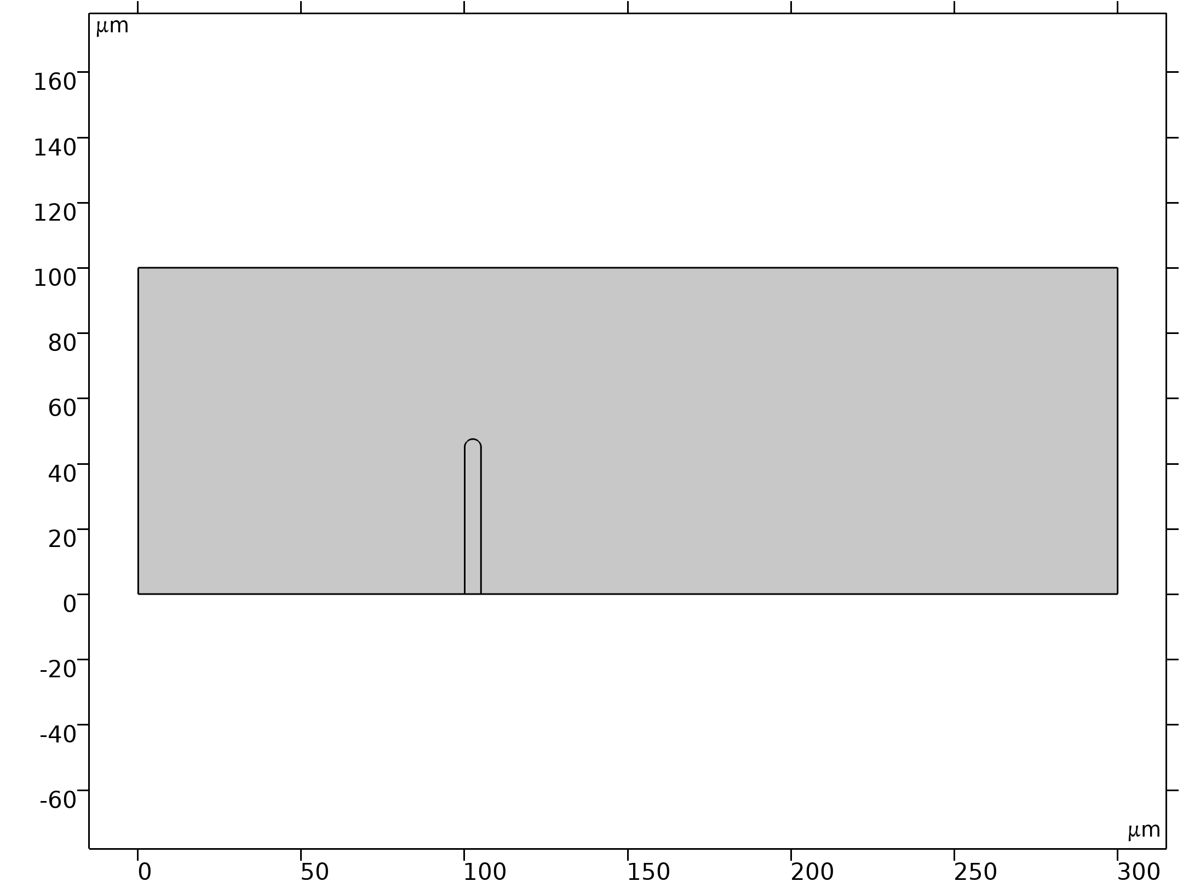
Model Definition
The model geometry consists of a horizontal flow channel with a thin wall-shaped obstacle in the middle
The fluid flows mainly from left to right, except for some regions behind the obstacle
The fluid imposes a force on the structure’s walls resulting from the viscous drag and pressure
The structure, made of a deformable material, bends under the applied load
Consequently, the fluid flow also follows a new path, so solving the flow in the original geometry would generate incorrect results
Geometry 1

Slide 4
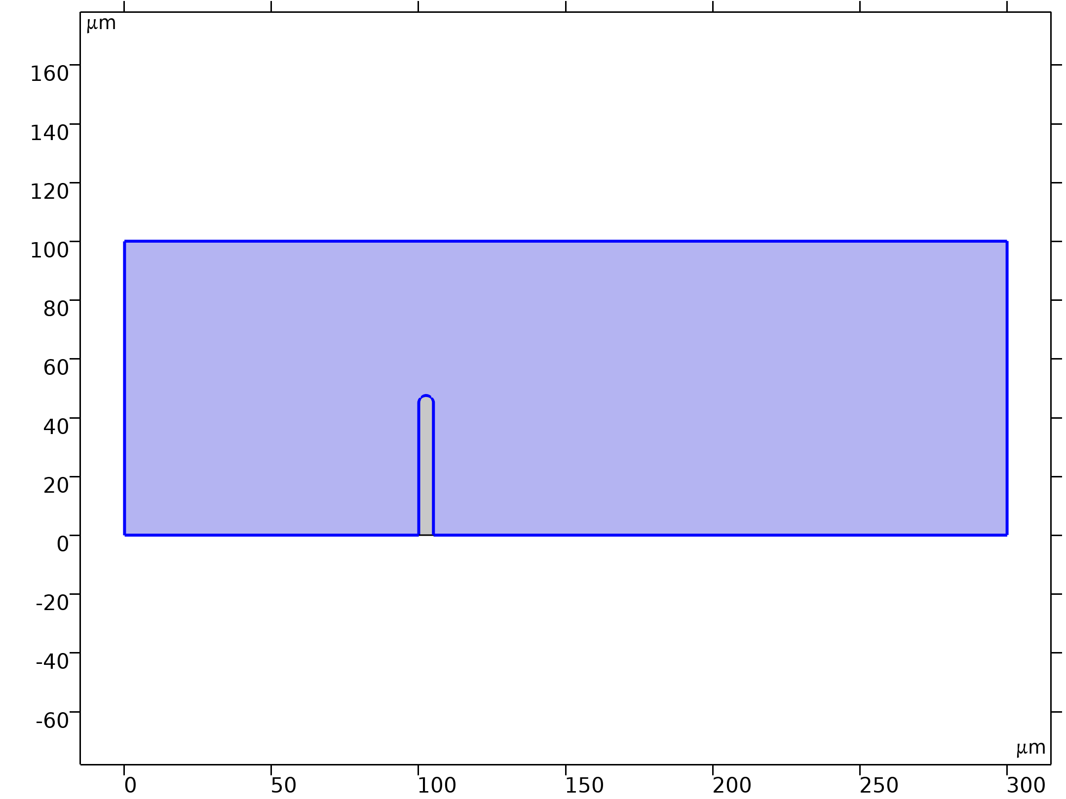
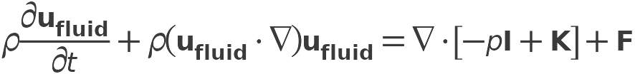

Model Definition
Laminar Flow

Slide 5
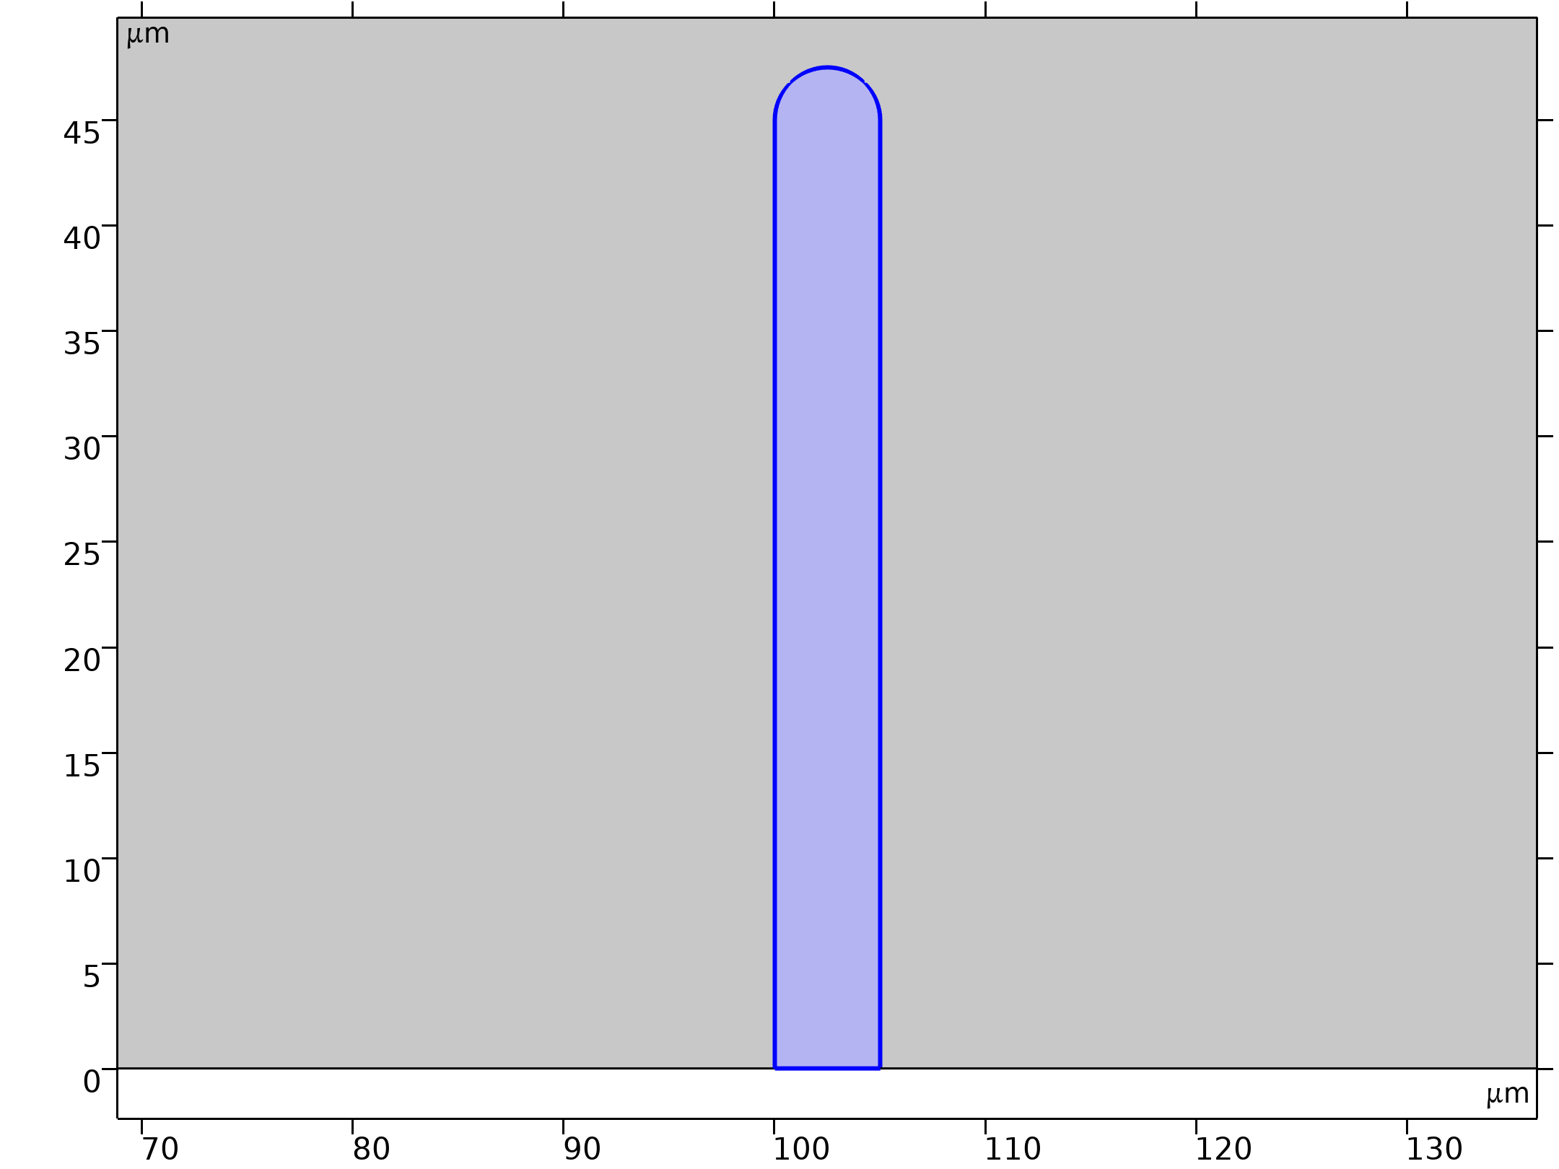
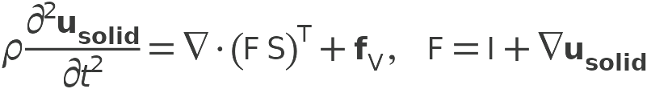
Model Definition
Solid Mechanics

Slide 6
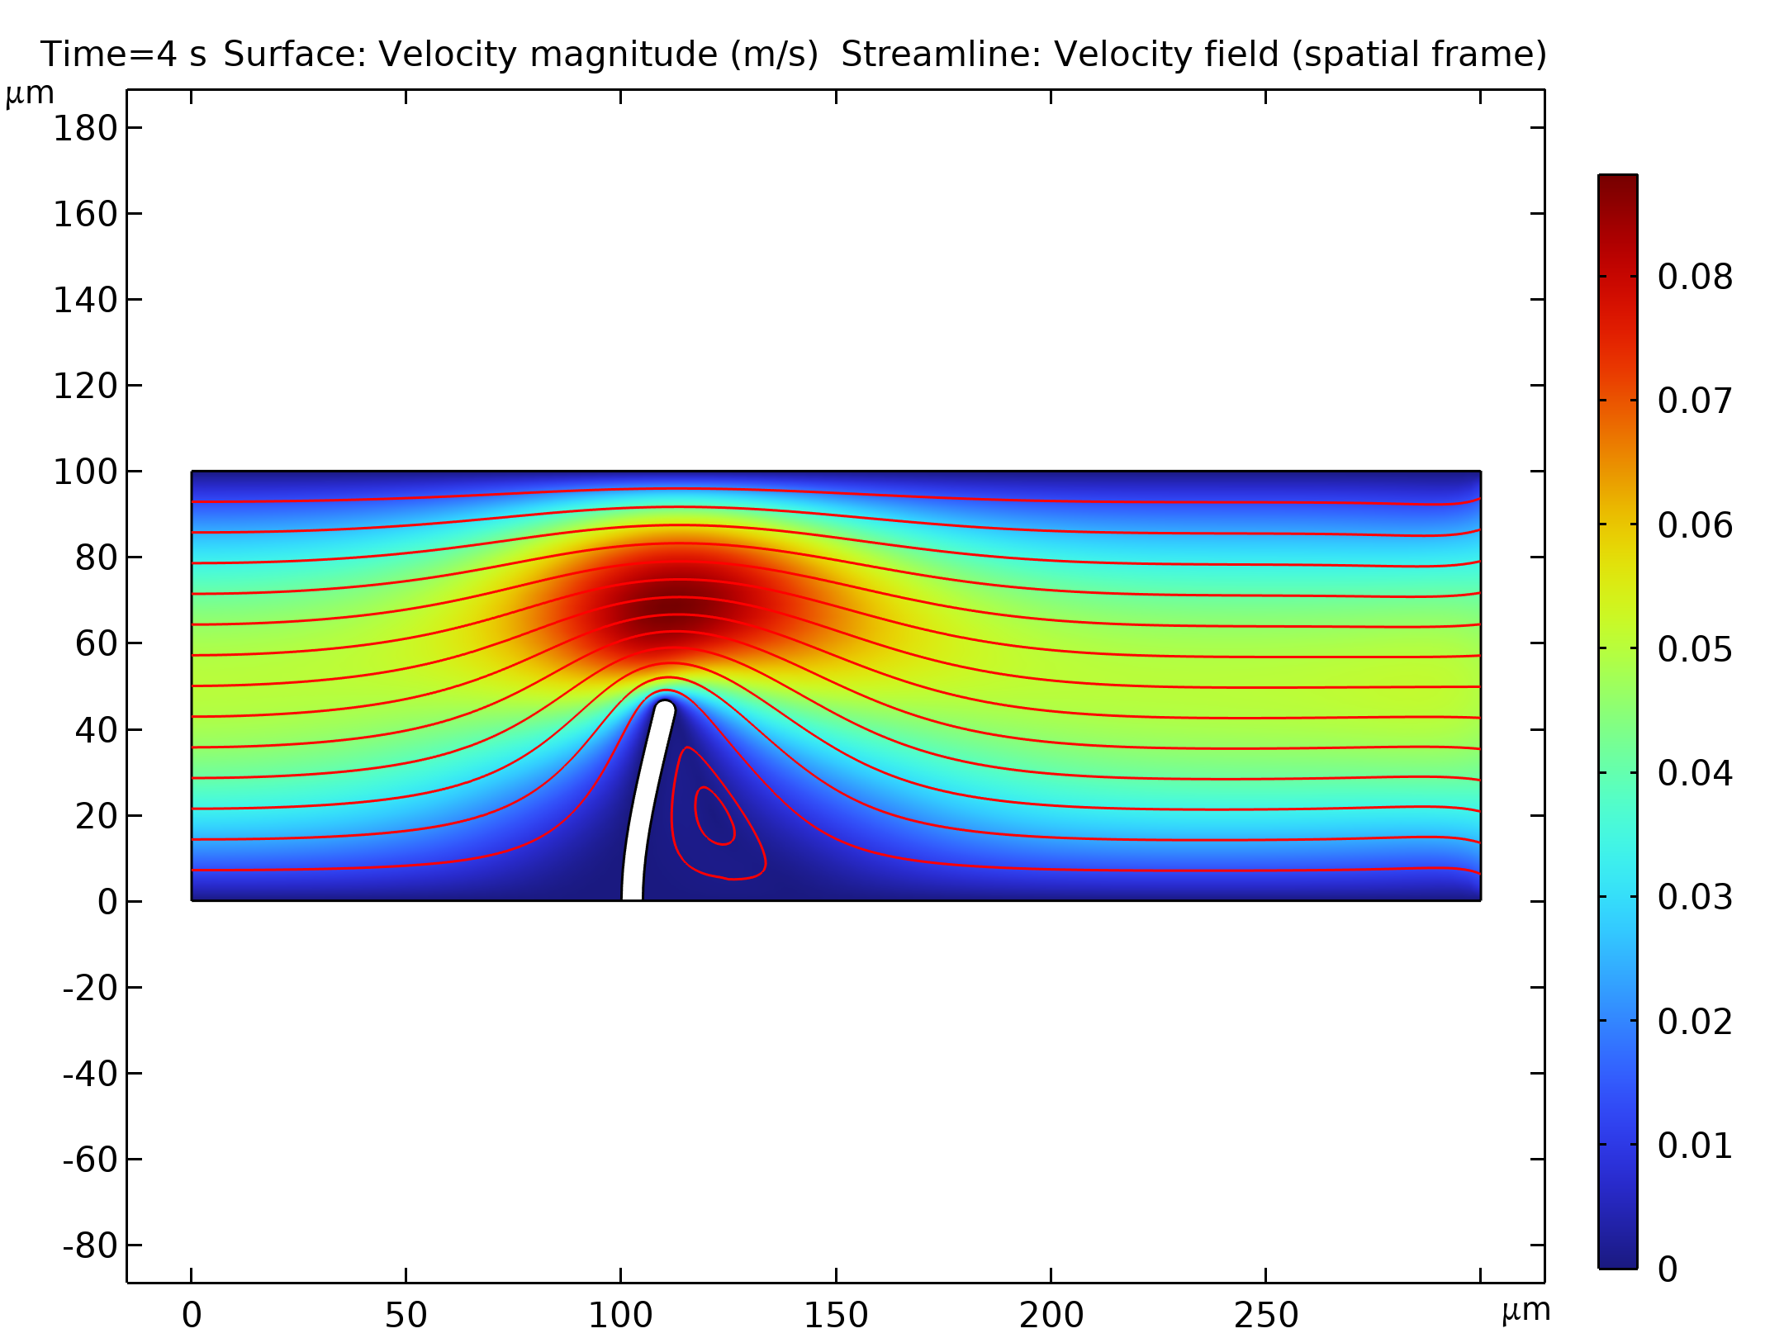
Results
The figure shows the geometry deformation and flow at t = 4 s, when the system is close to its steady state
Due to the channel’s small dimensions, the Reynolds number of the flow is small (Re << 100), and the flow stays laminar in most of the domain
The eddies are restricted to a small area behind the structure
The amount of deformation as well as the size and location of the swirls depend on the magnitude of the inflow velocity
Flow velocity and geometry deformation at t = 4 s. The streamlines indicate the flow-velocity magnitude

Slide 7
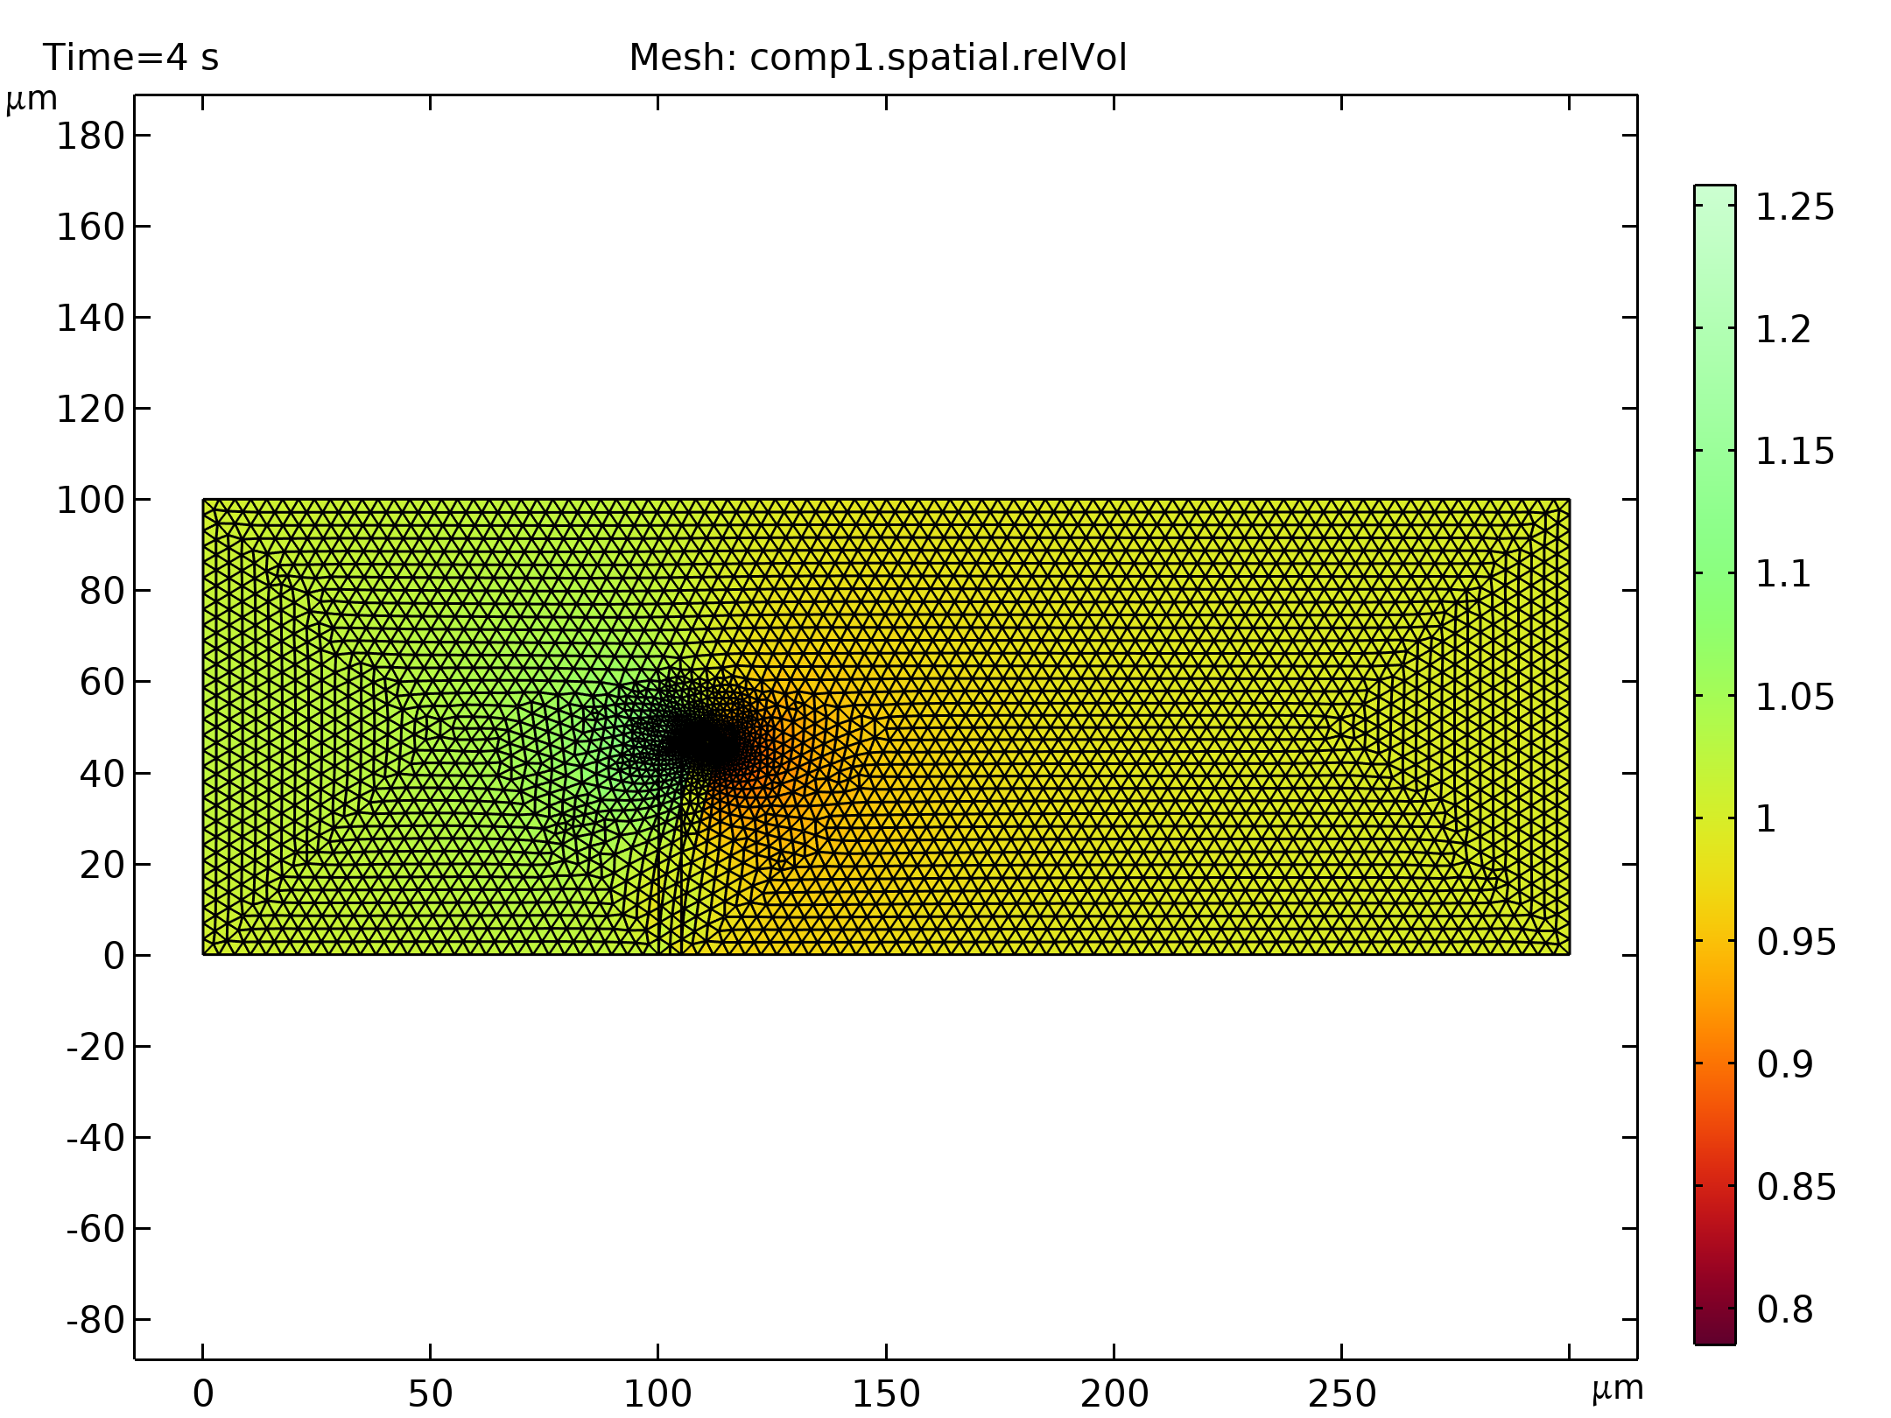
Results
The figure shows the mesh velocity at t = 0.15 s
The boundaries of the narrow structure are the only moving boundaries in the domain
Therefore the mesh velocity also has its largest values near the structure
Depending on the current state of the deformation — whether it is increasing, decreasing, or stationary — the mesh velocity can have a very different distribution
Mesh velocity (arrows) and mesh and geometry deformation at t = 0.15 s

Slide 8
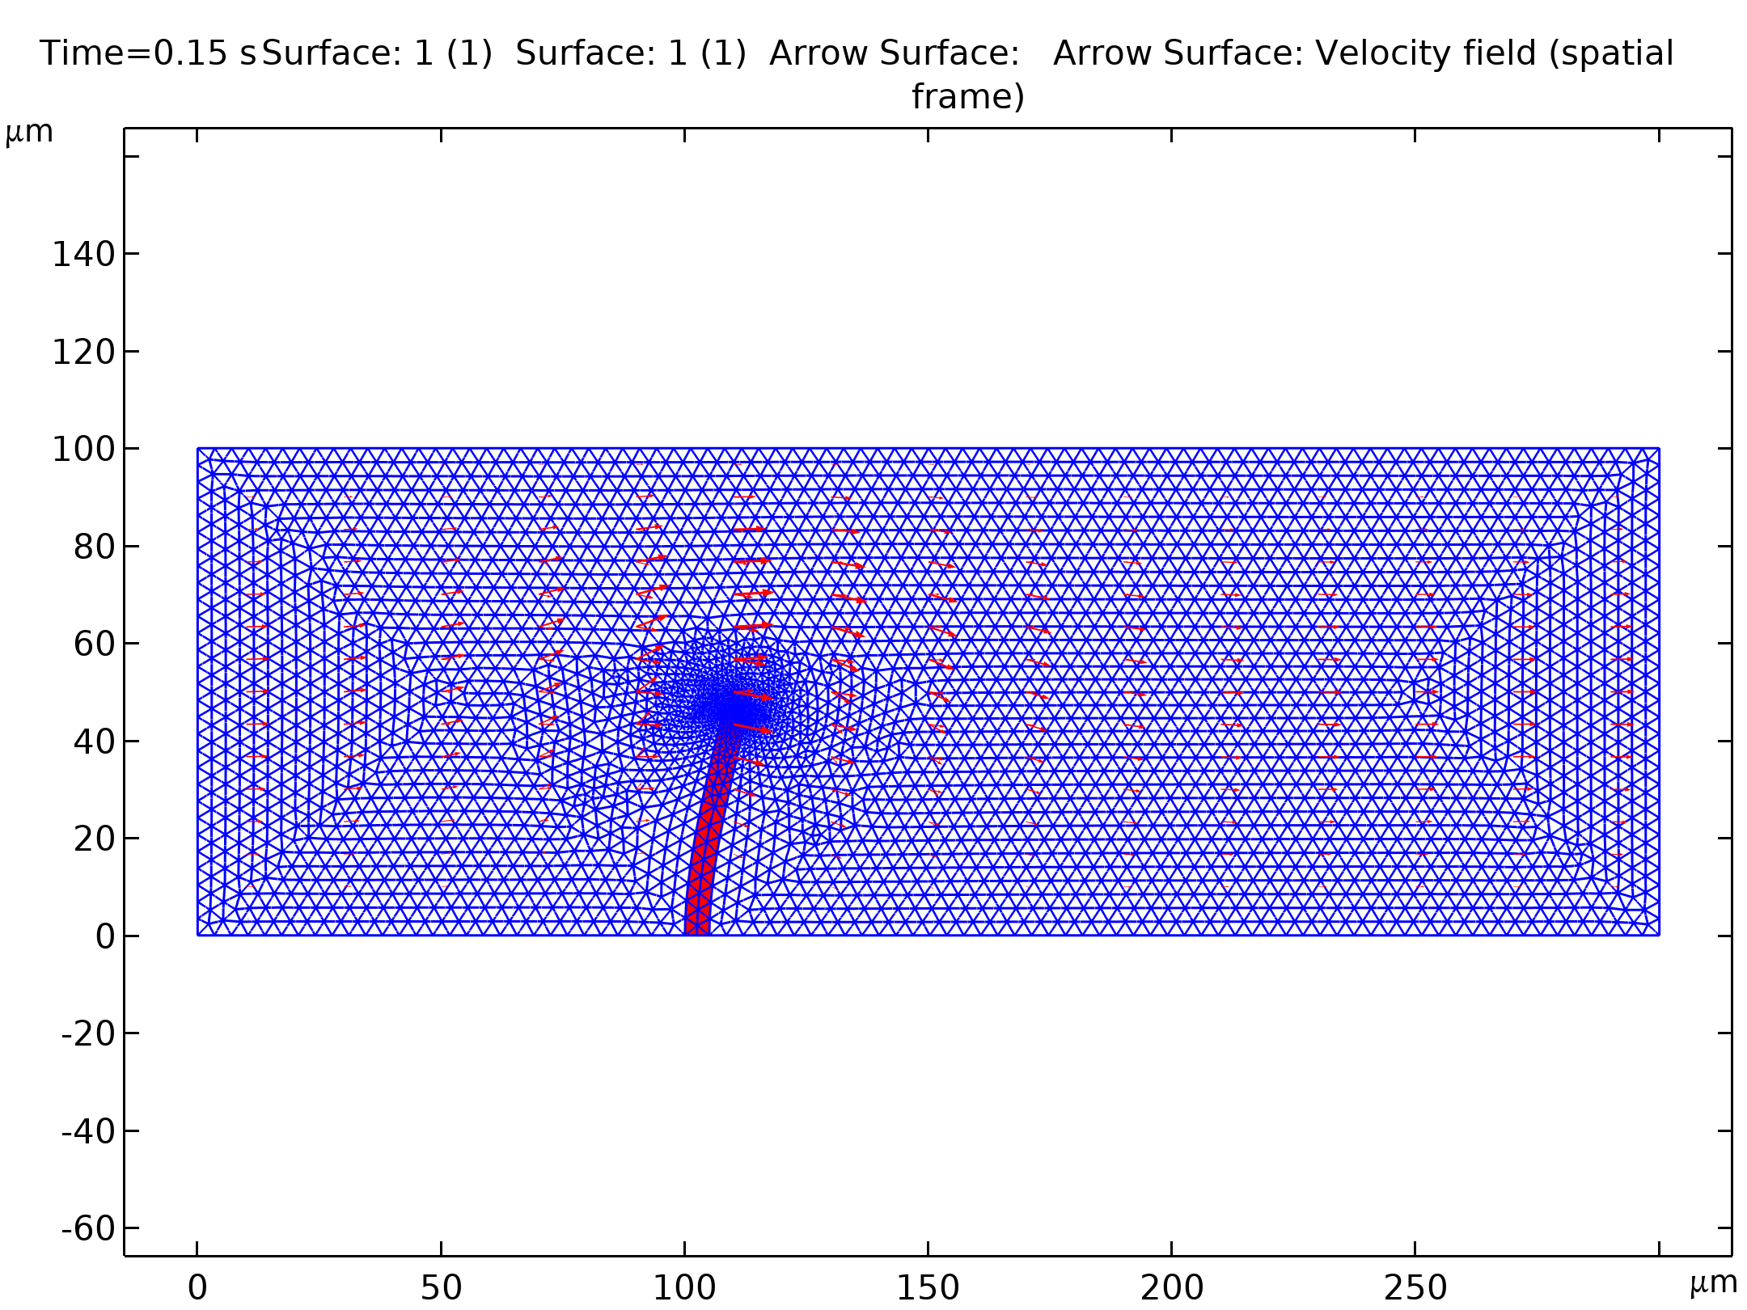
Results
The figure compares the average inflow velocity to the horizontal mesh velocity and the horizontal mesh displacement just beside the top of the structure
Most of the time the deformation follows the inflow velocity quite closely
Whenever the inflow velocity starts to decrease, the deformation also decreases, which you can observe as the negative values on the horizontal mesh velocity
Toward the end of the simulation, when inflow and structure deformation approach their steady-state values, the mesh velocity also decreases to zero
Inflow velocity, horizontal mesh velocity, and mesh deformation. The blue curve shows the average x direction velocity at the inflow boundary (m/s); the green shows 10⁴×mesh displacement in the x direction (dx_ale; m) at the geometry point (1.05·10⁻⁴, 0.5·10-⁻⁴); and the red curve shows 10³×mesh velocity in the x direction (xt; m/s), also at the point (1.05·10⁻⁴, 0.5·10⁻⁴)

Slide 9
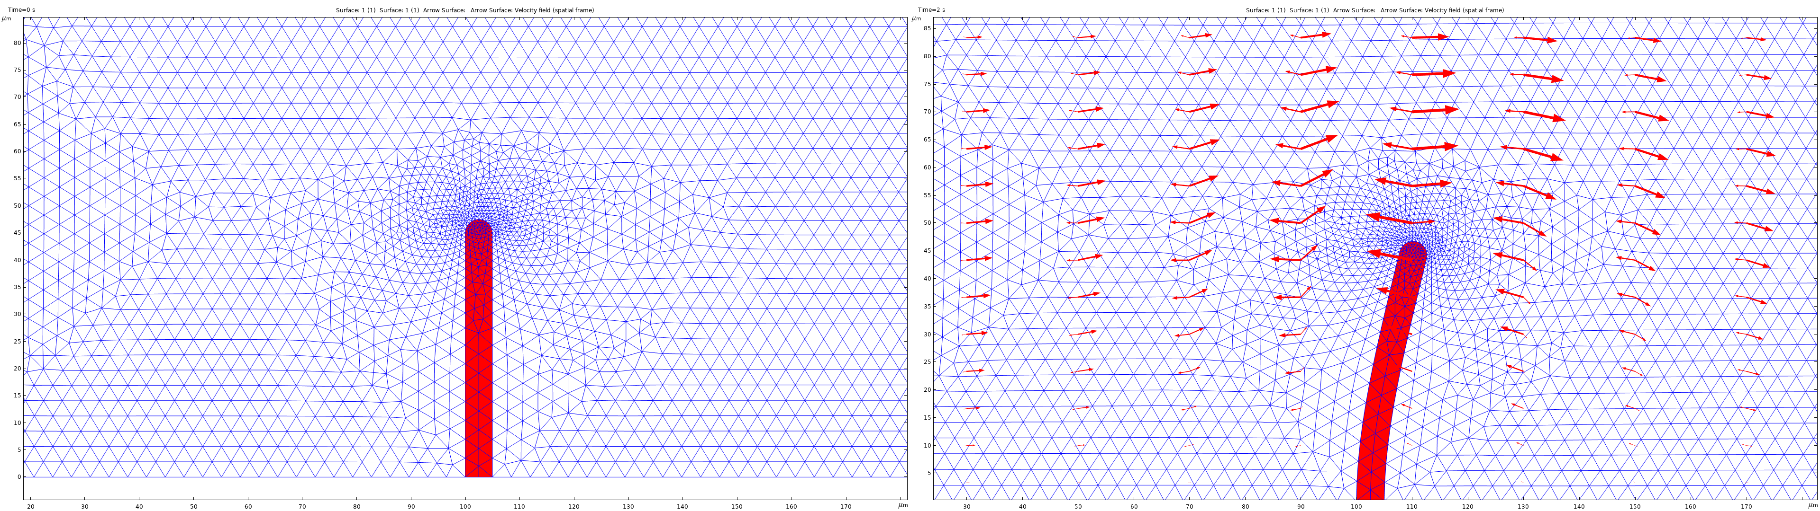
Results
The figure compares the meshes at different times
The first image shows the initial mesh, which you generate prior to solving the model. This mesh is equally distributed around the top of the structure
The second image shows the mesh in its deformed form
Because the structure deforms more in the horizontal direction, the mesh also changes more in this direction: On the left, the mesh elements are stretched; on the right, they are compressed in the x direction
Geometry and mesh near the top of the structure at t = 0 s and 2 s

