Slide 1
Freeze-Drying
COMSOL

Slide 2
Background
Freeze-drying is a dehydration process that is often used to preserve high value products in the pharmaceutical and food industries
It is also frequently used as a way of removing water from products to reduce weight
Freeze-drying is based on sublimation, where a frozen liquid undergoes a phase change directly from a frozen solid state to a gaseous state. The vapor flows through the pores of the dried product before leaving the vial
Heat and mass transfer mechanisms are considered
This models illustrates the primary freeze-drying process in a vial under vacuum chamber conditions

Slide 3
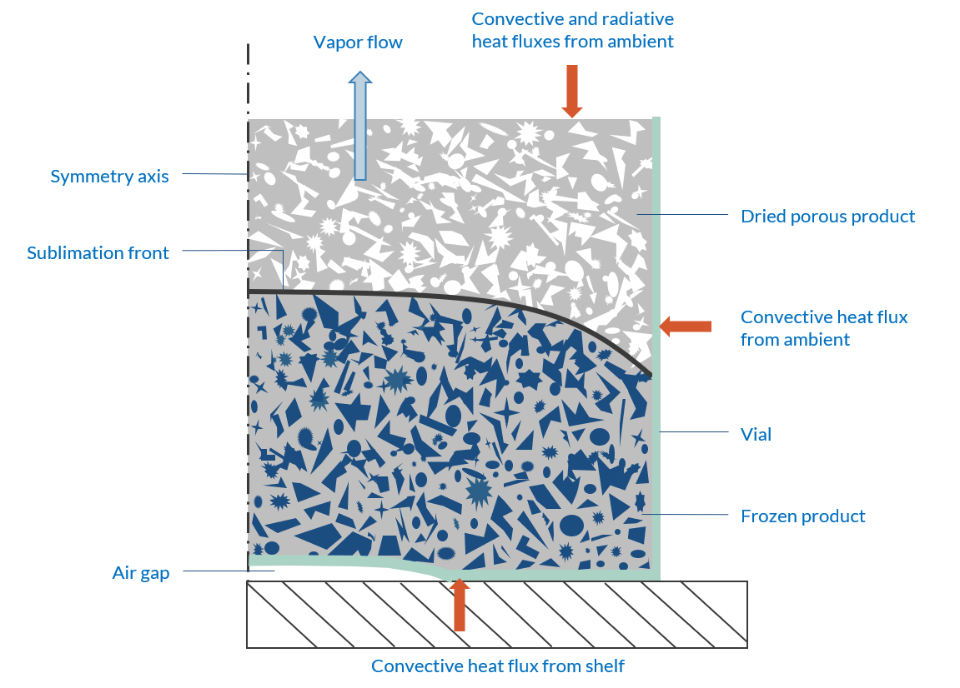
Model Schematic
A frozen product is inside a vial under vacuum conditions
The product is subjected to heat transfer with the outside
As it heats up, the frozen product changes into a gaseous state
A sublimation front appears where the phase change occurs
The vapor flows out of the vial since the dried product is porous
An air gap is considered at the bottom, inducing a nonuniform heat flux
Model schematic

Slide 4
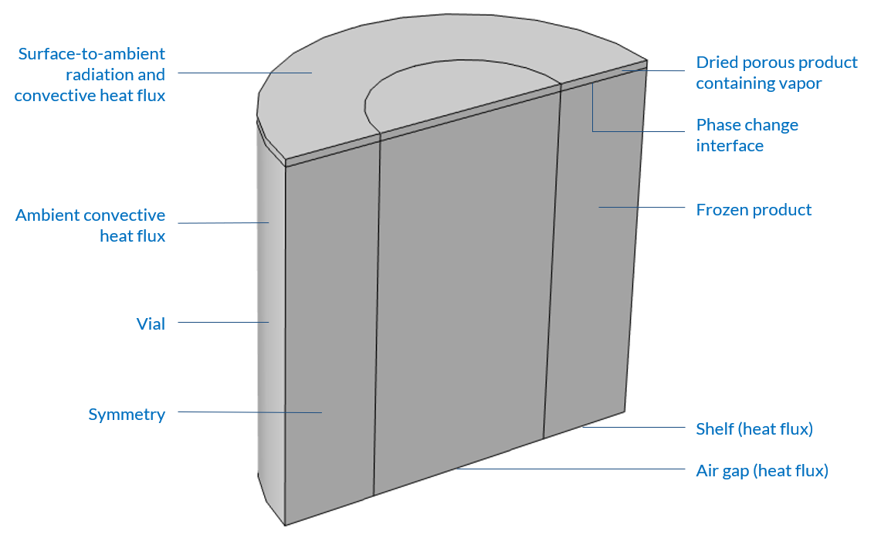
Model Definition
The geometry and boundary conditions are axisymmetric. For demonstration purposes, the model is solved in 3D
The vial is initially filled to 98% with a frozen product, in this case skim milk. On the top lies a domain of dried product
The evolution of the sublimation front is followed thanks to a deformed geometry
Model geometry and boundary conditions

Slide 5
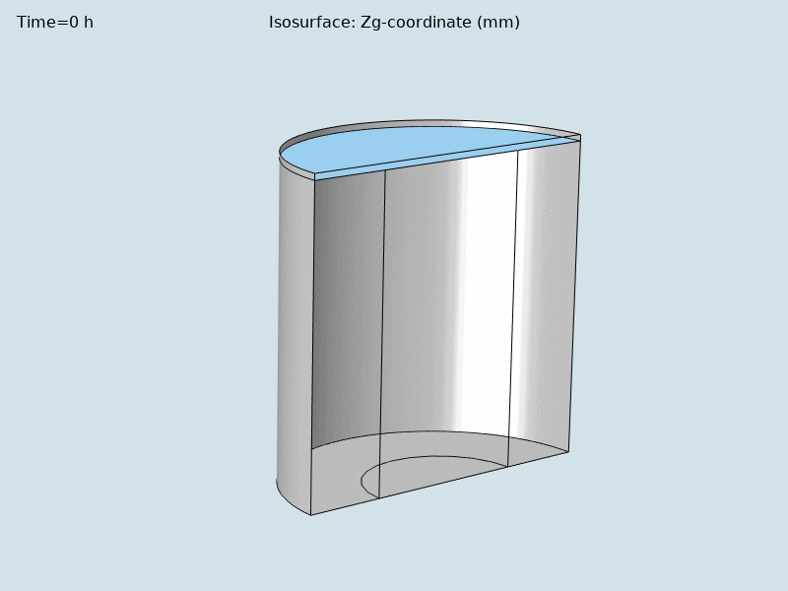
Results
The sublimation front gradually takes a convex shape
The simulation stops when the sublimation front approaches the base of the vial (smallest edge <3% of total height)
Sublimation front evolution during the first 10 hours

Slide 6
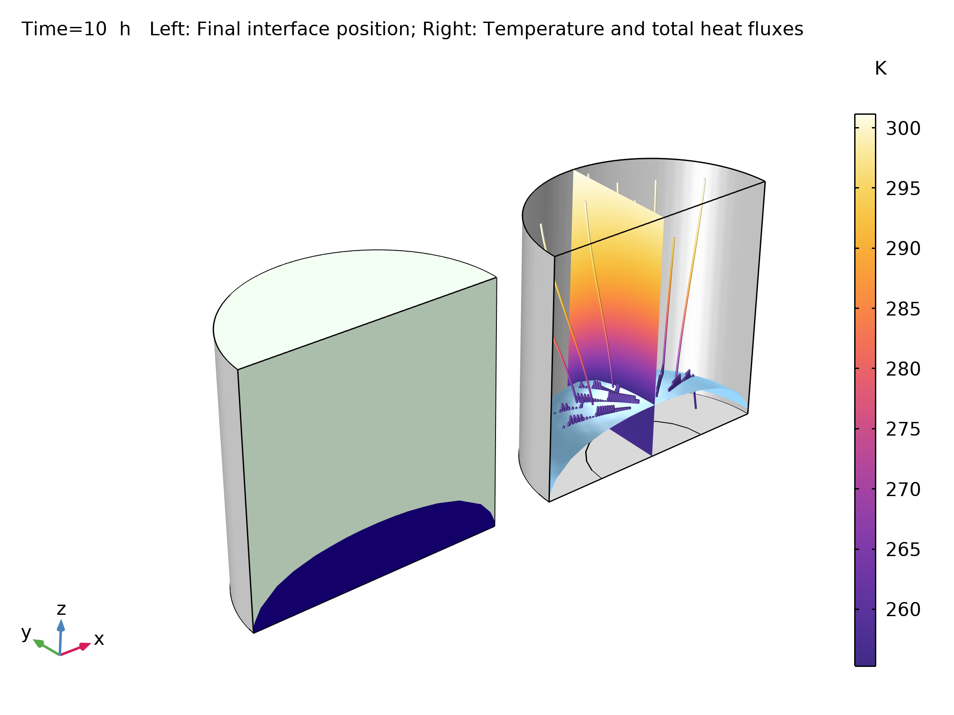
Results
It takes about 10 hours to sublimate 85% of the initial ice amount, which represents about 3.3 g of water
Freeze-drying process after 10 hours

Slide 7
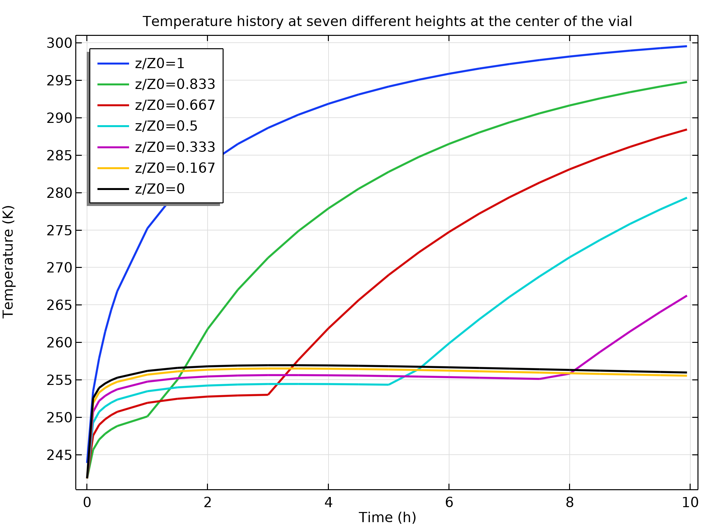
Results
The heat fluxes quickly raise the temperature in the vial
The temperature then reaches a plateau at the sublimation temperature
The lower the point in the vial, the higher the pressure, and the higher the sublimation temperature
As long as the water has not been sublimated, the temperature remains almost constant
After sublimation, the temperature increases again
Temperature evolution on the centerline of the domain

