Slide 1
Dynamic Wall Heat Exchanger
COMSOL

Slide 2
Background
The dynamic wall heat exchanger aims to improve heat transfer in small-scale heat exchangers
The deformation helps mixing the fluid, reducing the formation of thermal boundary layers, and thus increasing heat transfer
The wave shape deformation induces a pumping effect that compensates for pressure losses

Slide 3
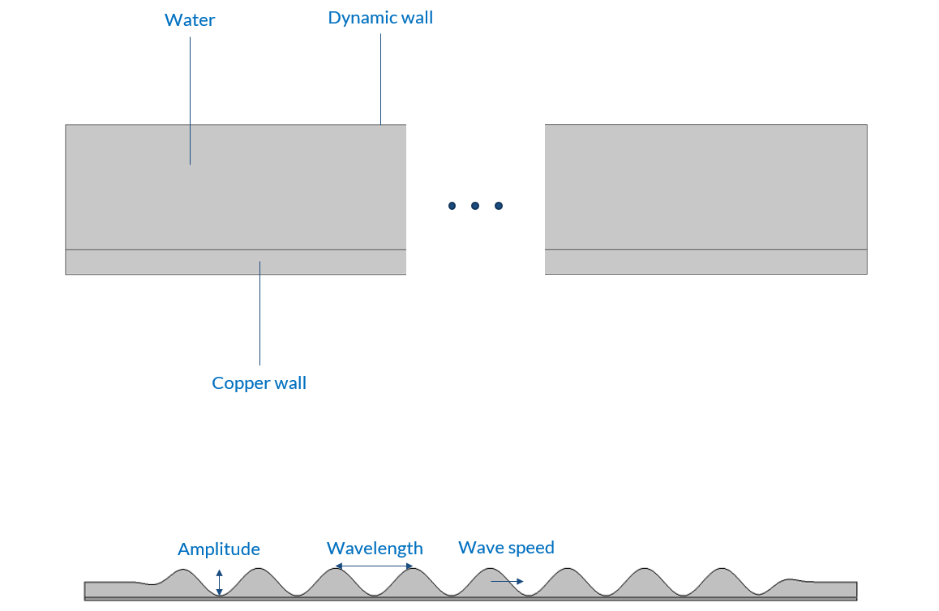
Model Definition
The geometry is divided into two domains: the lower one represents a copper wall, and the upper one represents the water used for cooling
The top boundary is a dynamic wall
The shape of the wave on the dynamic wall is created using a moving mesh
The amplitude, frequency, and number of waves can be modified using the parameter settings
Model geometry

Slide 4
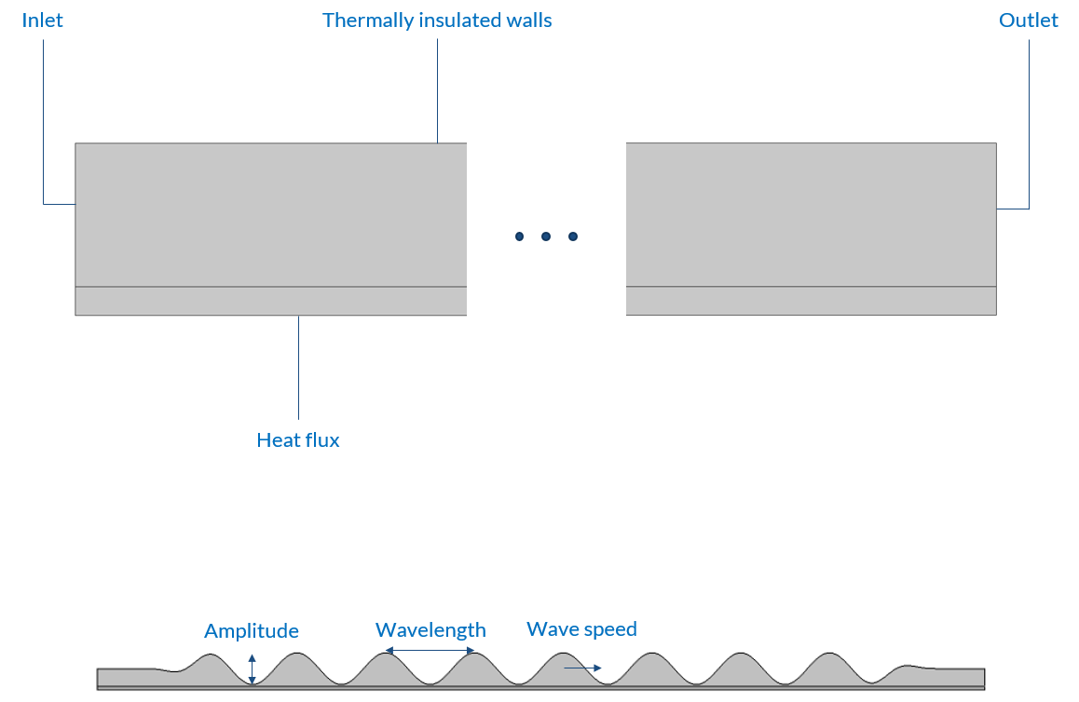
Model Definition
The boundary conditions (inlet, outlet, thermally insulated walls) are described on the figure on the top
A heat flux is imposed on the base surface of the copper wall
The flow is pressure-driven
Model boundary conditions

Slide 5
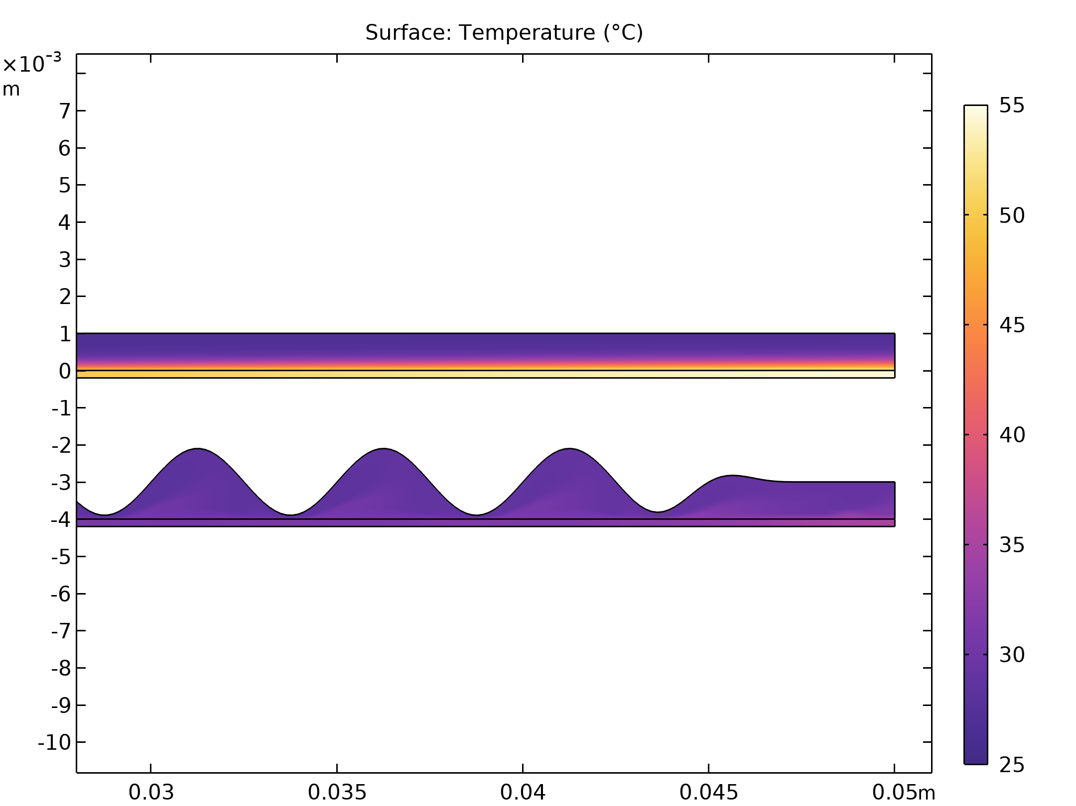
Results
In the static case, the water is not mixed. A hot water film develops at the interface with the copper wall, reducing the heat transfer
With a dynamic wall, there is no longer a thermal boundary layer
The global heat transfer coefficient is about 6.5 times higher with the dynamic wall
The maximum temperature in the copper wall is therefore greatly reduced with a dynamic wall
Temperature field at the end of the heat exchanger (top: static wall, bottom: dynamic wall)

Slide 6
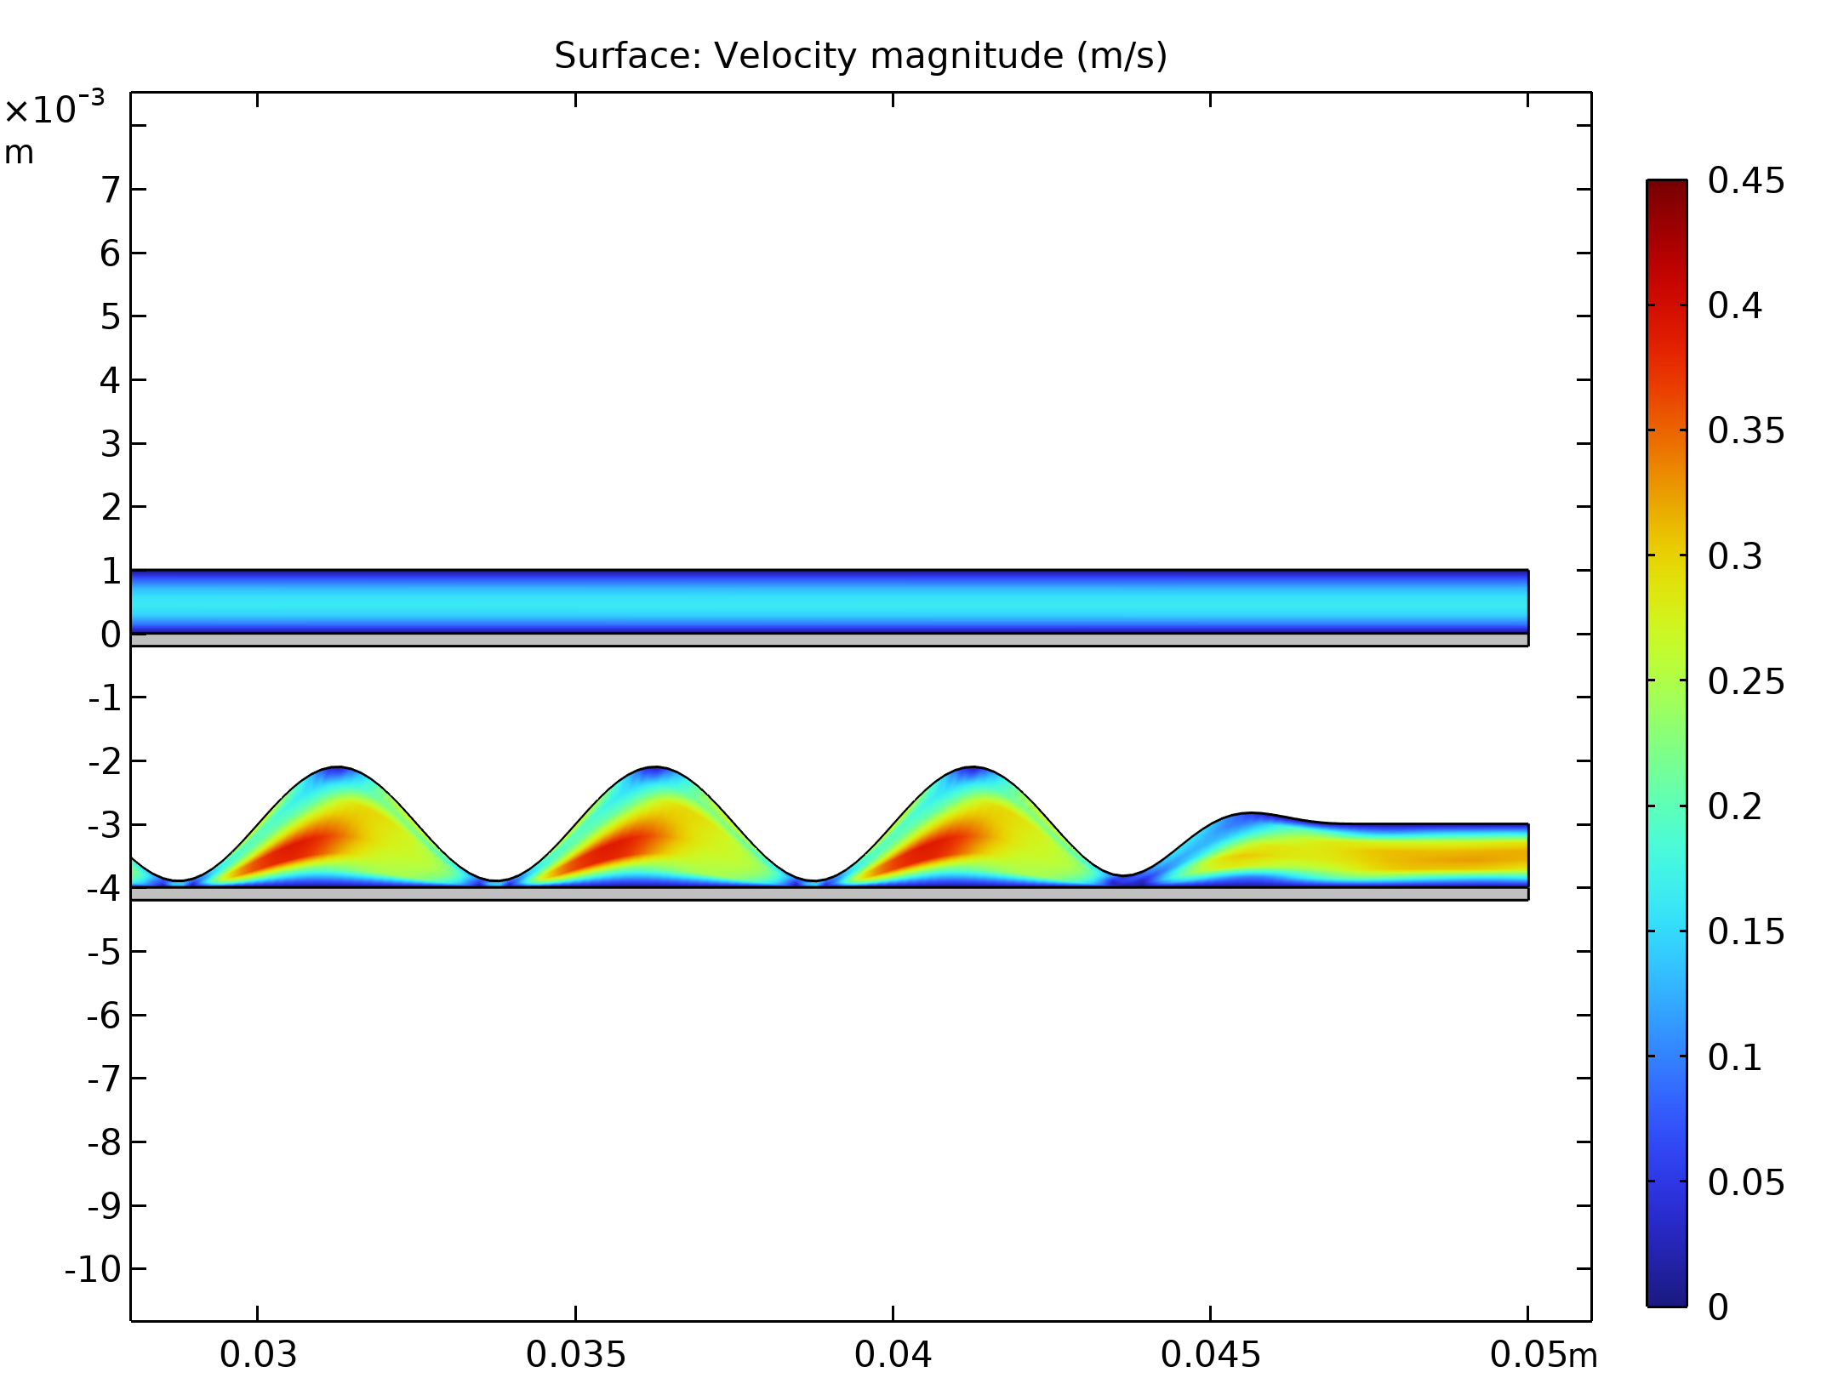
Results
The pumping effect of the dynamic wall compensates for the pressure losses and increases the velocity
For the same pressure drop between inlet and outlet, the flow rate with a dynamic wall is almost twice as high as with a static wall
Velocity field at the end of the heat exchanger (top: static wall, bottom: dynamic wall)

Slide 7
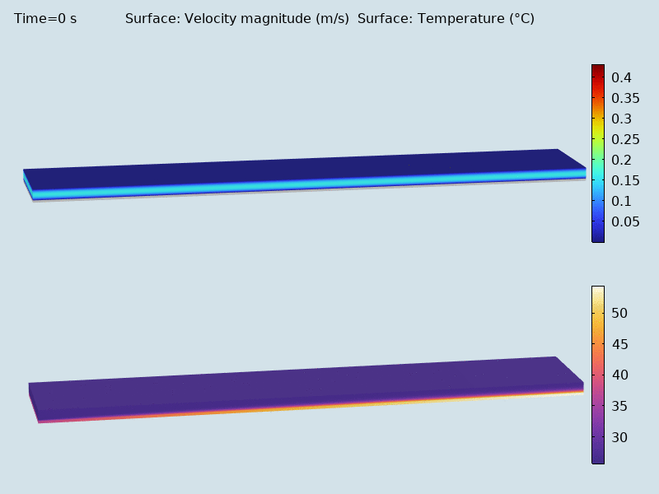
Results
Starting from the static case, the flow is rapidly mixed as the oscillation develops
Then the temperature decreases in the copper wall
Evolution of velocity (top) and temperature (bottom) in the domain

