Slide 1
Current Density Distribution in a Solid Oxide Fuel Cell
COMSOL

Slide 2
Introduction
This example studies the current density distribution in a solid oxide fuel cell (SOFC)
It includes the full coupling between the mass balances at the anode and cathode, the momentum balances in the gas channels, the gas flow in the porous electrodes, the balance of the ionic current carried by the oxide ion, and an electronic current balance

Slide 3
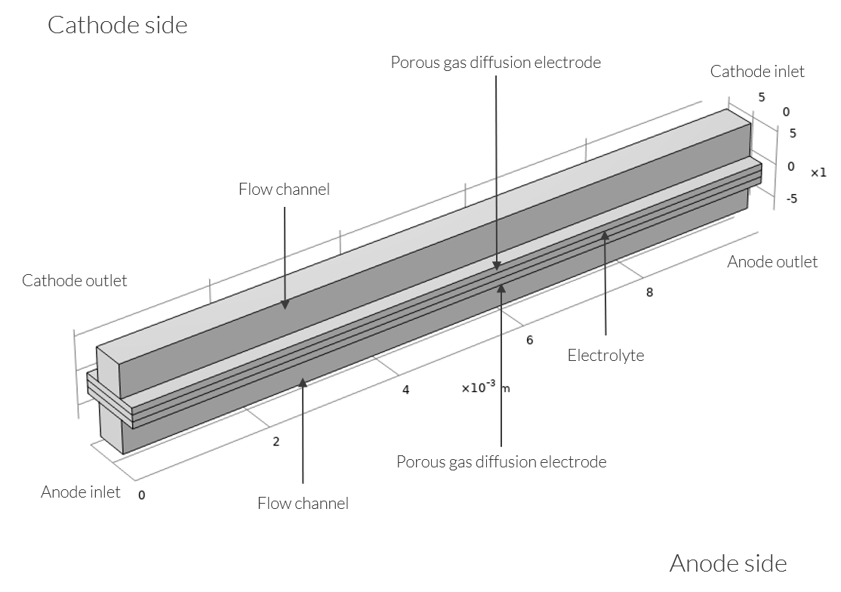
Model Definition
An SOFC is constructed with two porous gas diffusion electrodes (GDEs) with an electrolyte sandwiched in the middle
Geometry of the unit cell, with anode at the bottom and cathode at the top

Slide 4
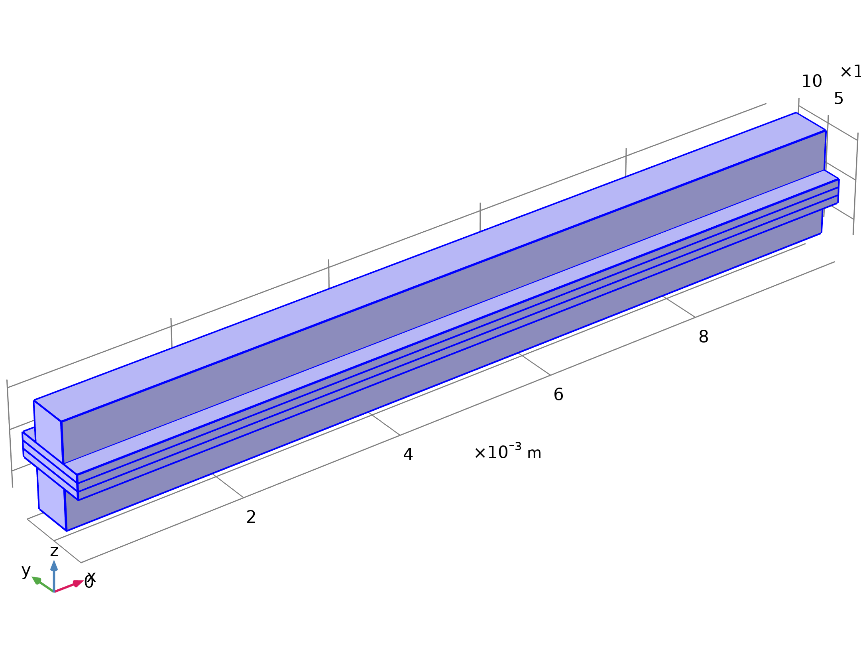




Model Definition
Hydrogen Fuel Cell

Slide 5

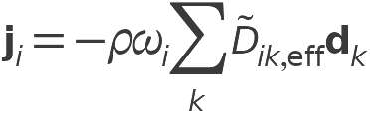
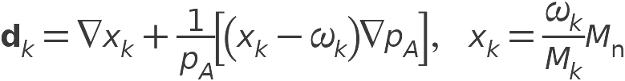
Model Definition
Hydrogen Fuel Cell

Slide 6
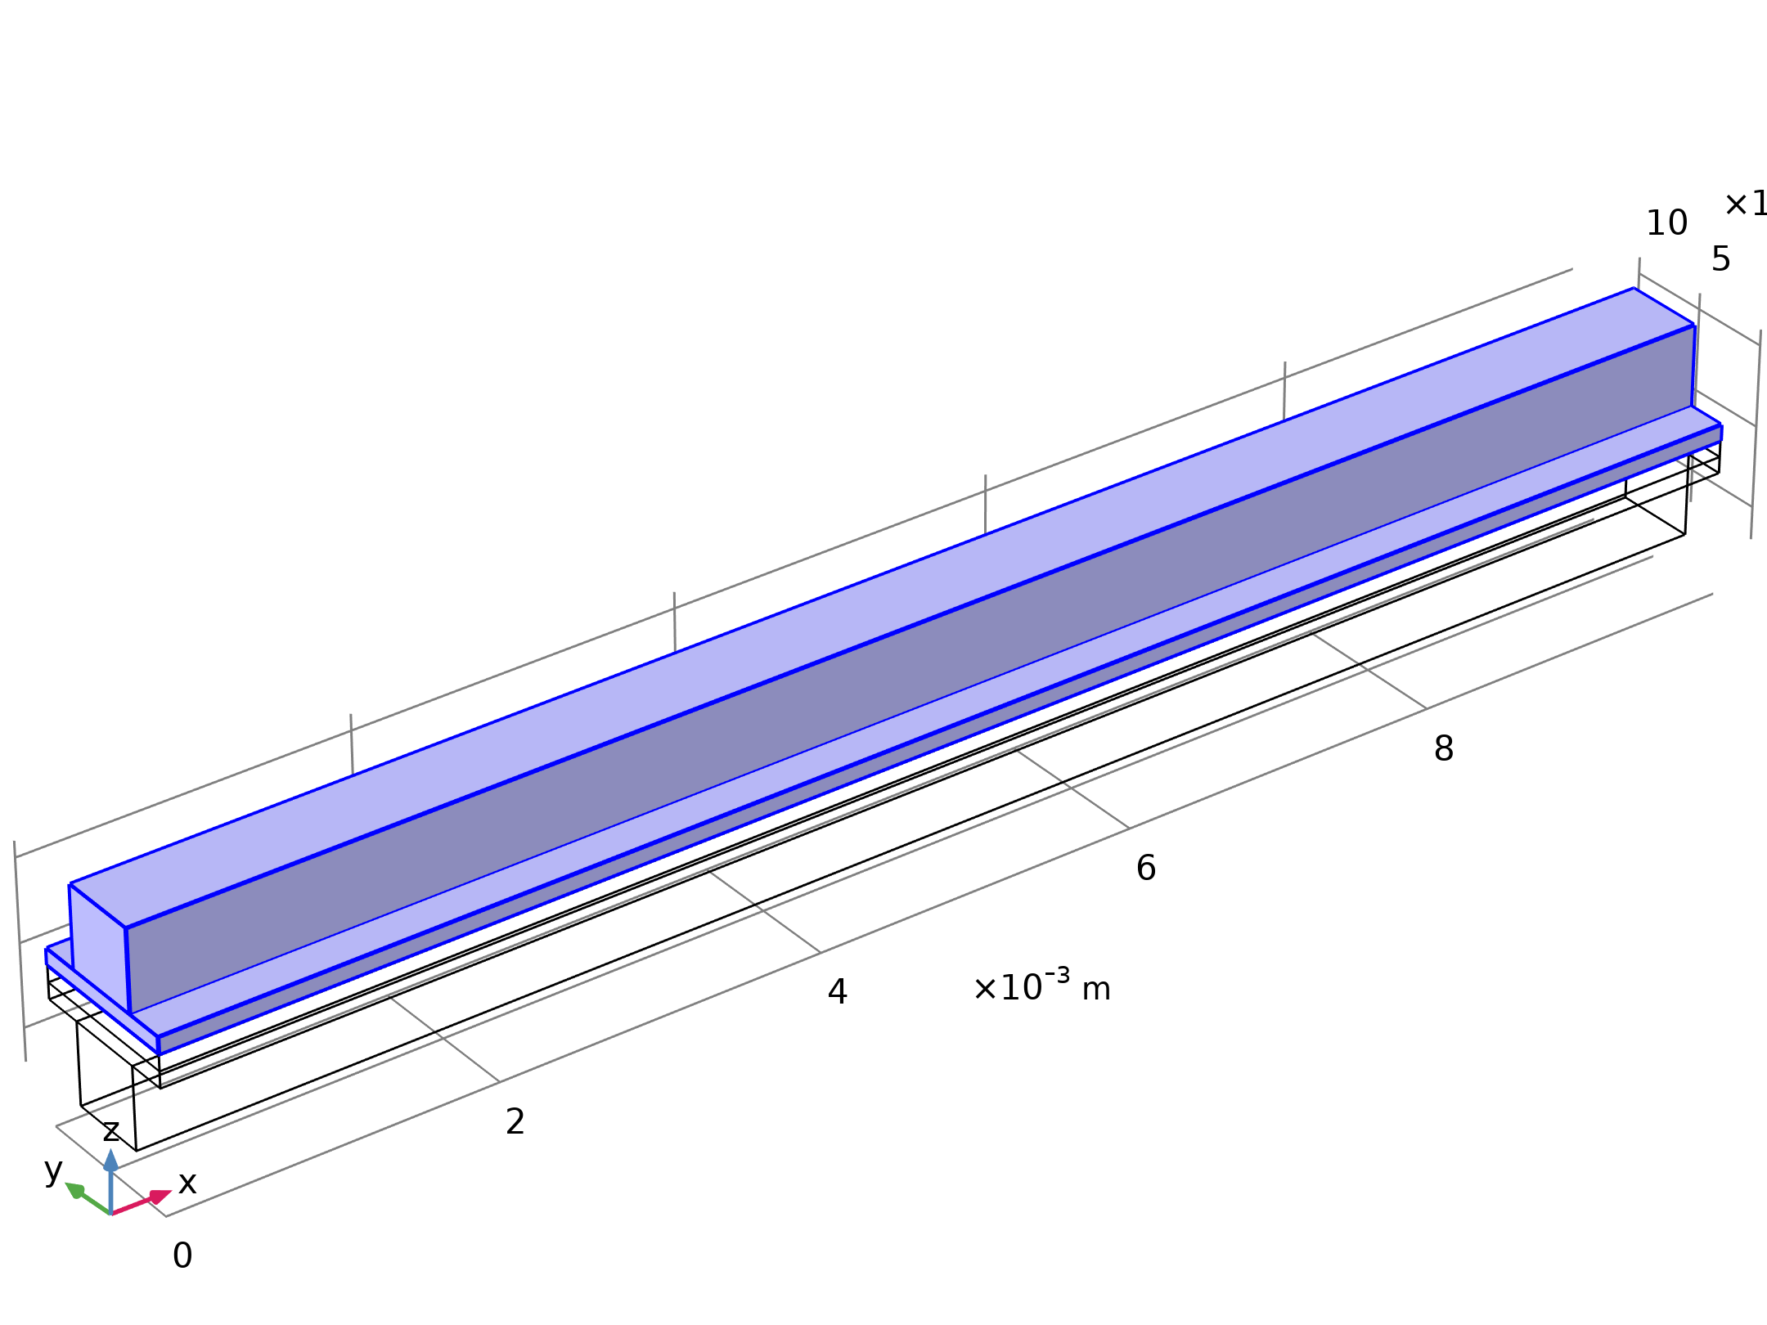


Model Definition
Free and Porous Media Flow - Cathode

Slide 7
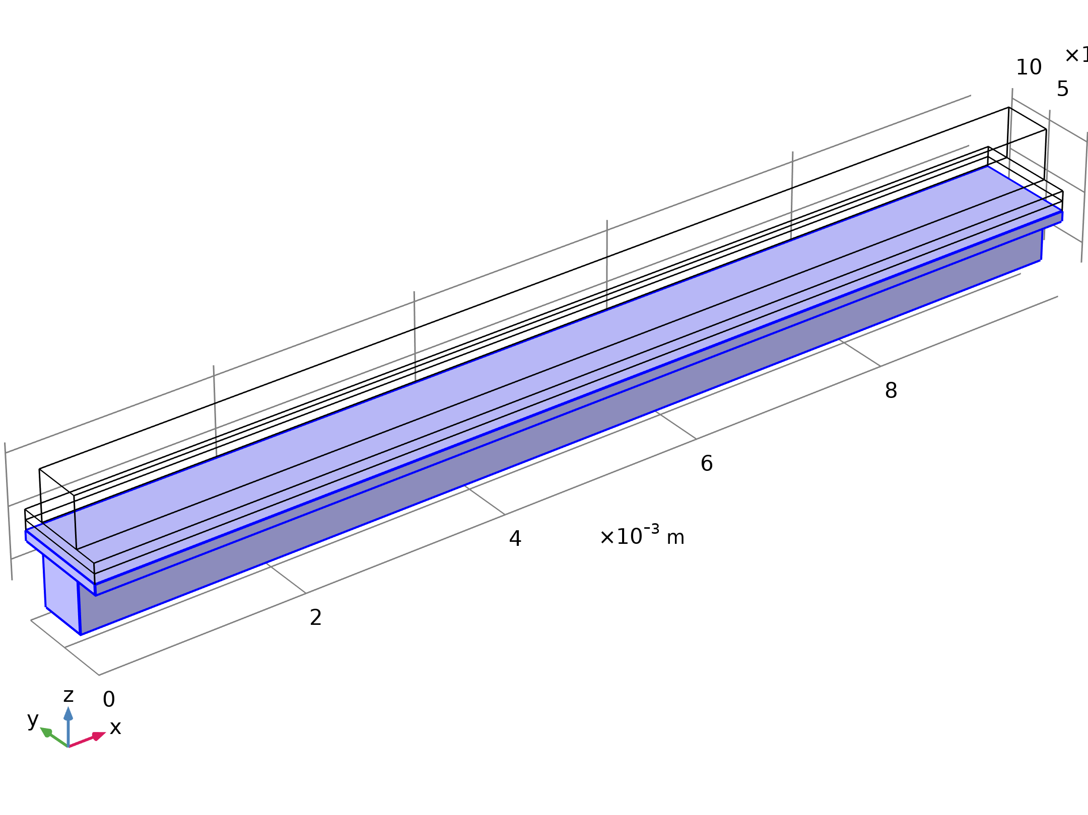


Model Definition
Free and Porous Media Flow - Anode

Slide 8
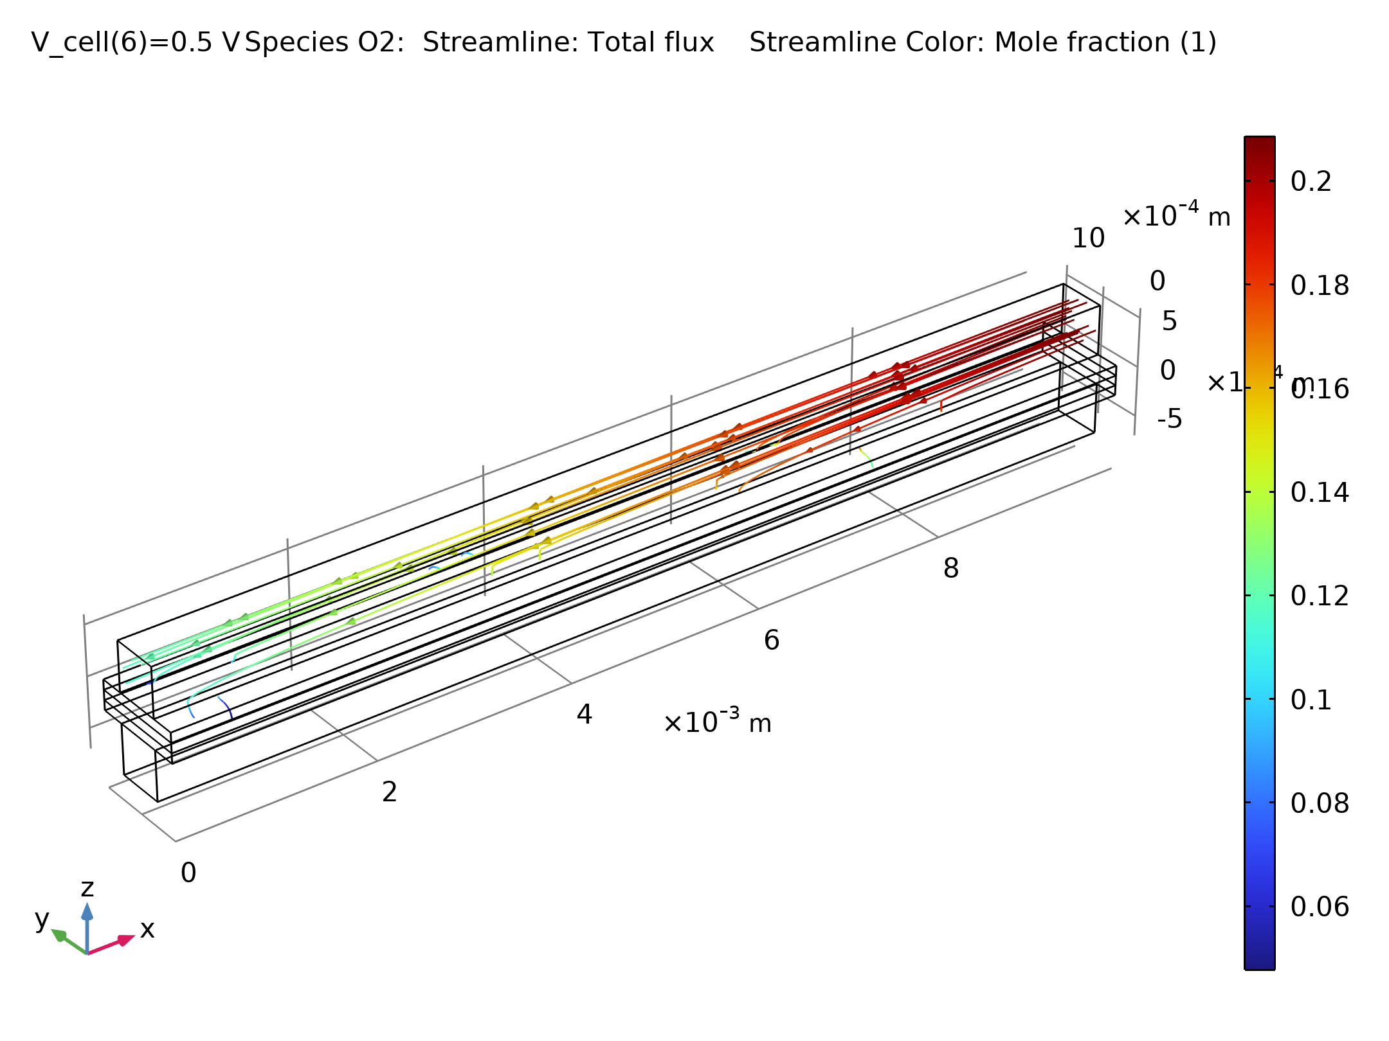
Results
The figure shows the oxygen mole fraction in the cathode at a cell polarization of 0.8 V
The oxygen depletion is substantial, which has implications for the reaction distribution at the cathode
Oxygen mole fraction in the gas channel and in the gas diffusion cathode while operating at a cell voltage of 0.8 V

Slide 9
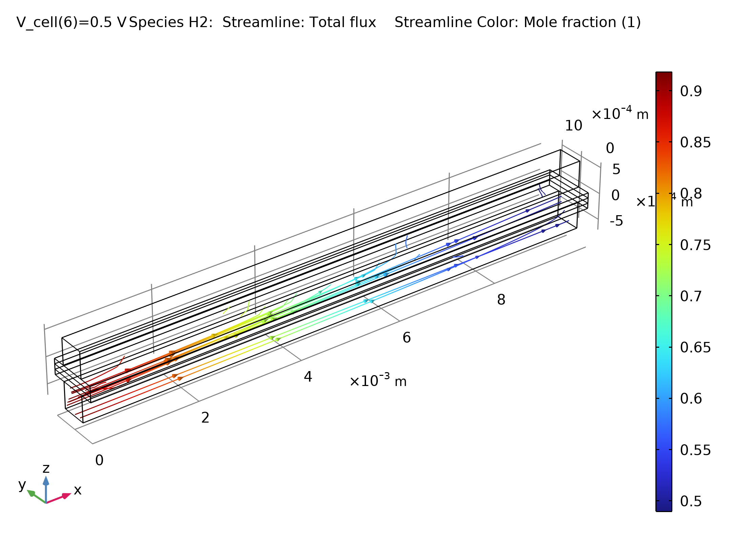
Results
The mole fraction of hydrogen in the anode also decreases along the channel
The figure shows the distribution of hydrogen
It shows that the depletion is not as pronounced as for the cathode
Hydrogen distribution in the anode at 0.8 V cell voltage

Slide 10
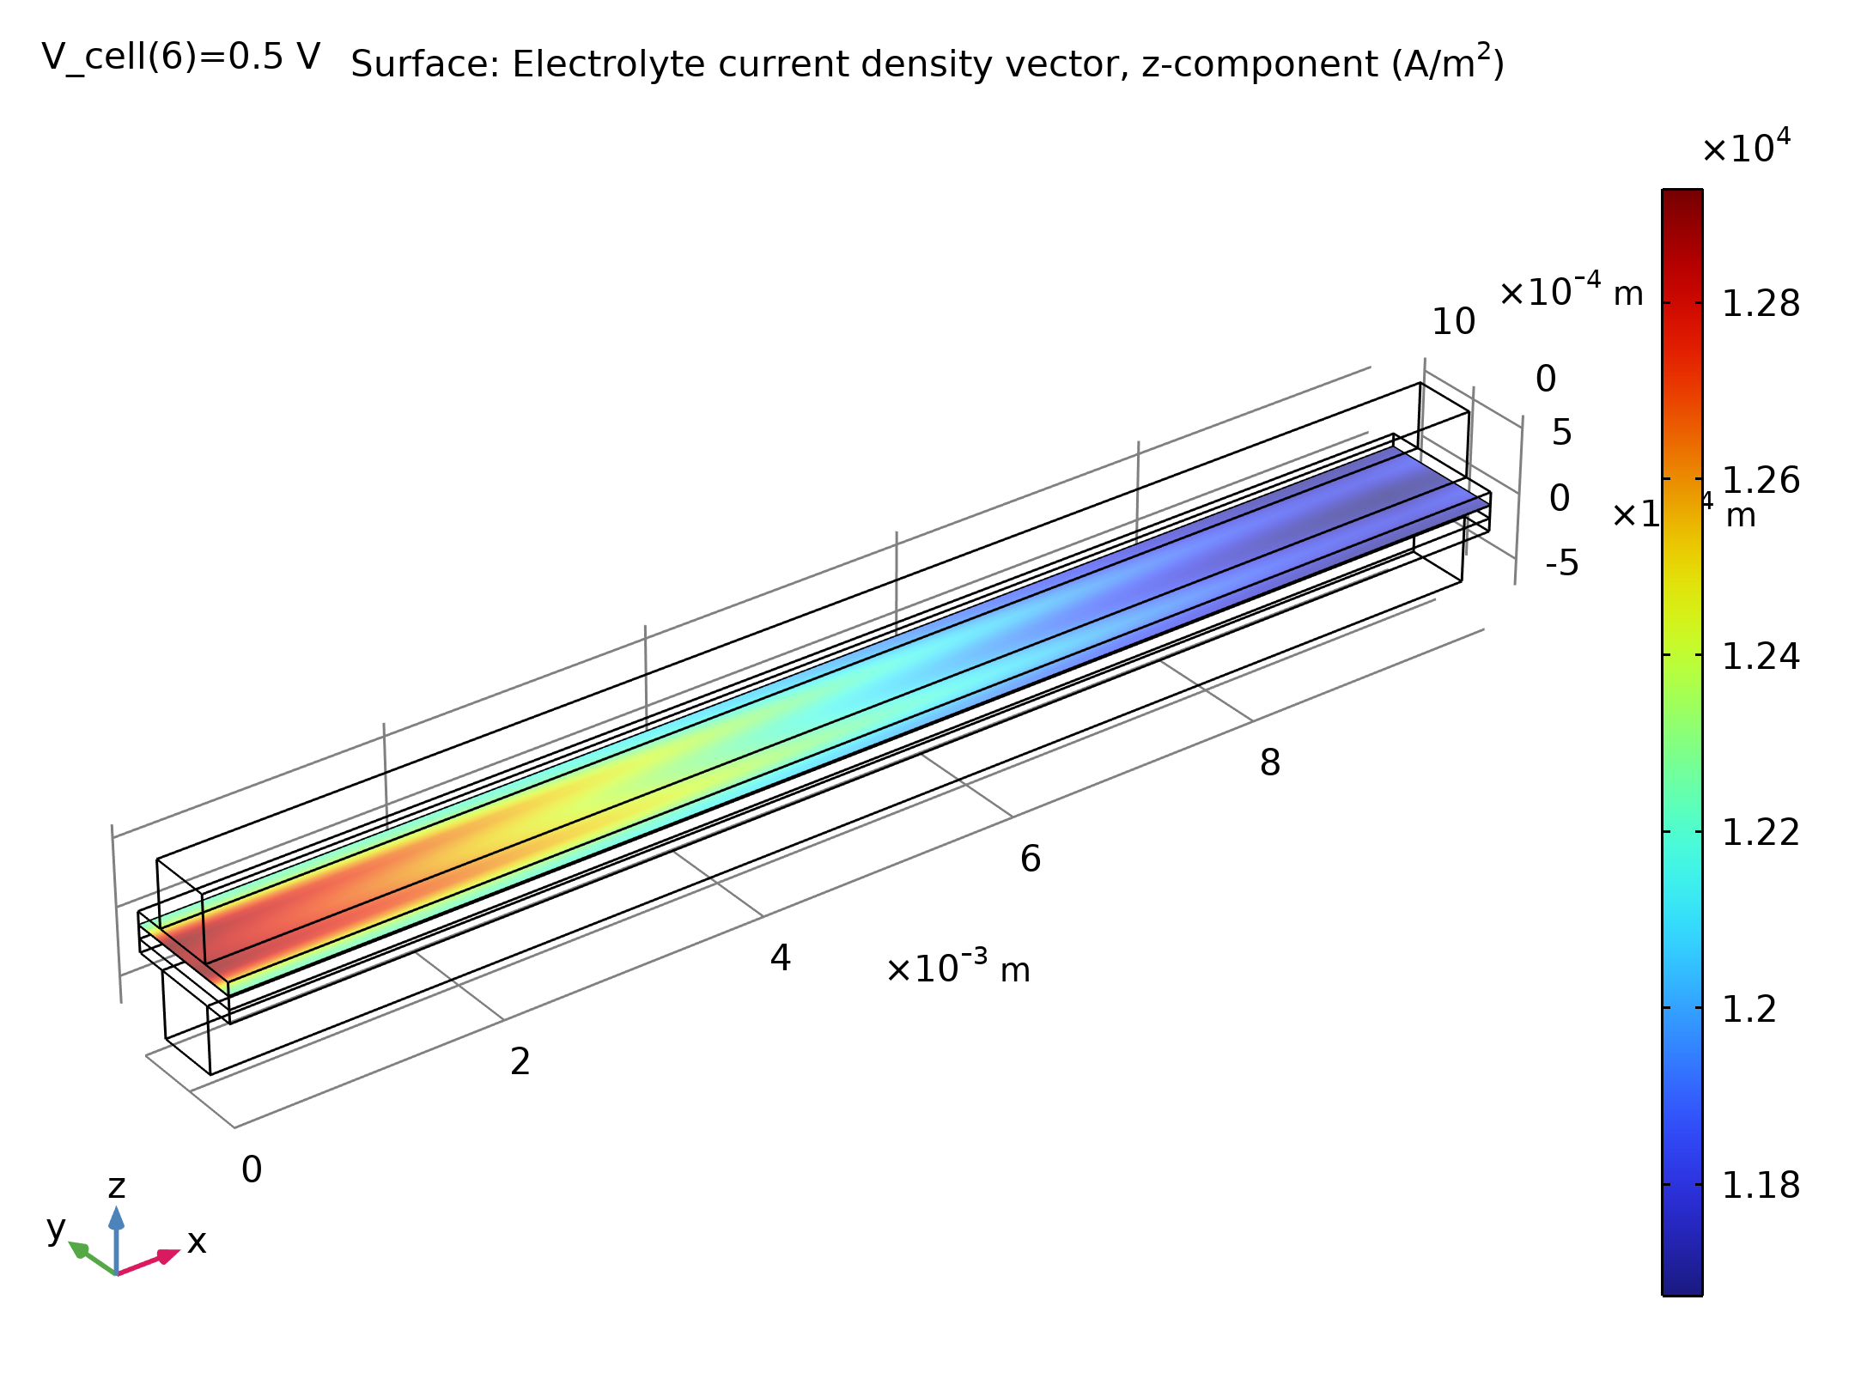
Results
A consequence of the concentration distribution is that the current density is nonuniform in the GDEs
The figure depicts the current density distribution at the cathode side of the ionic conductor
The electrolyte current density in the unit cell operating at 0.8 V. The cathode inlet is to the right

Slide 11
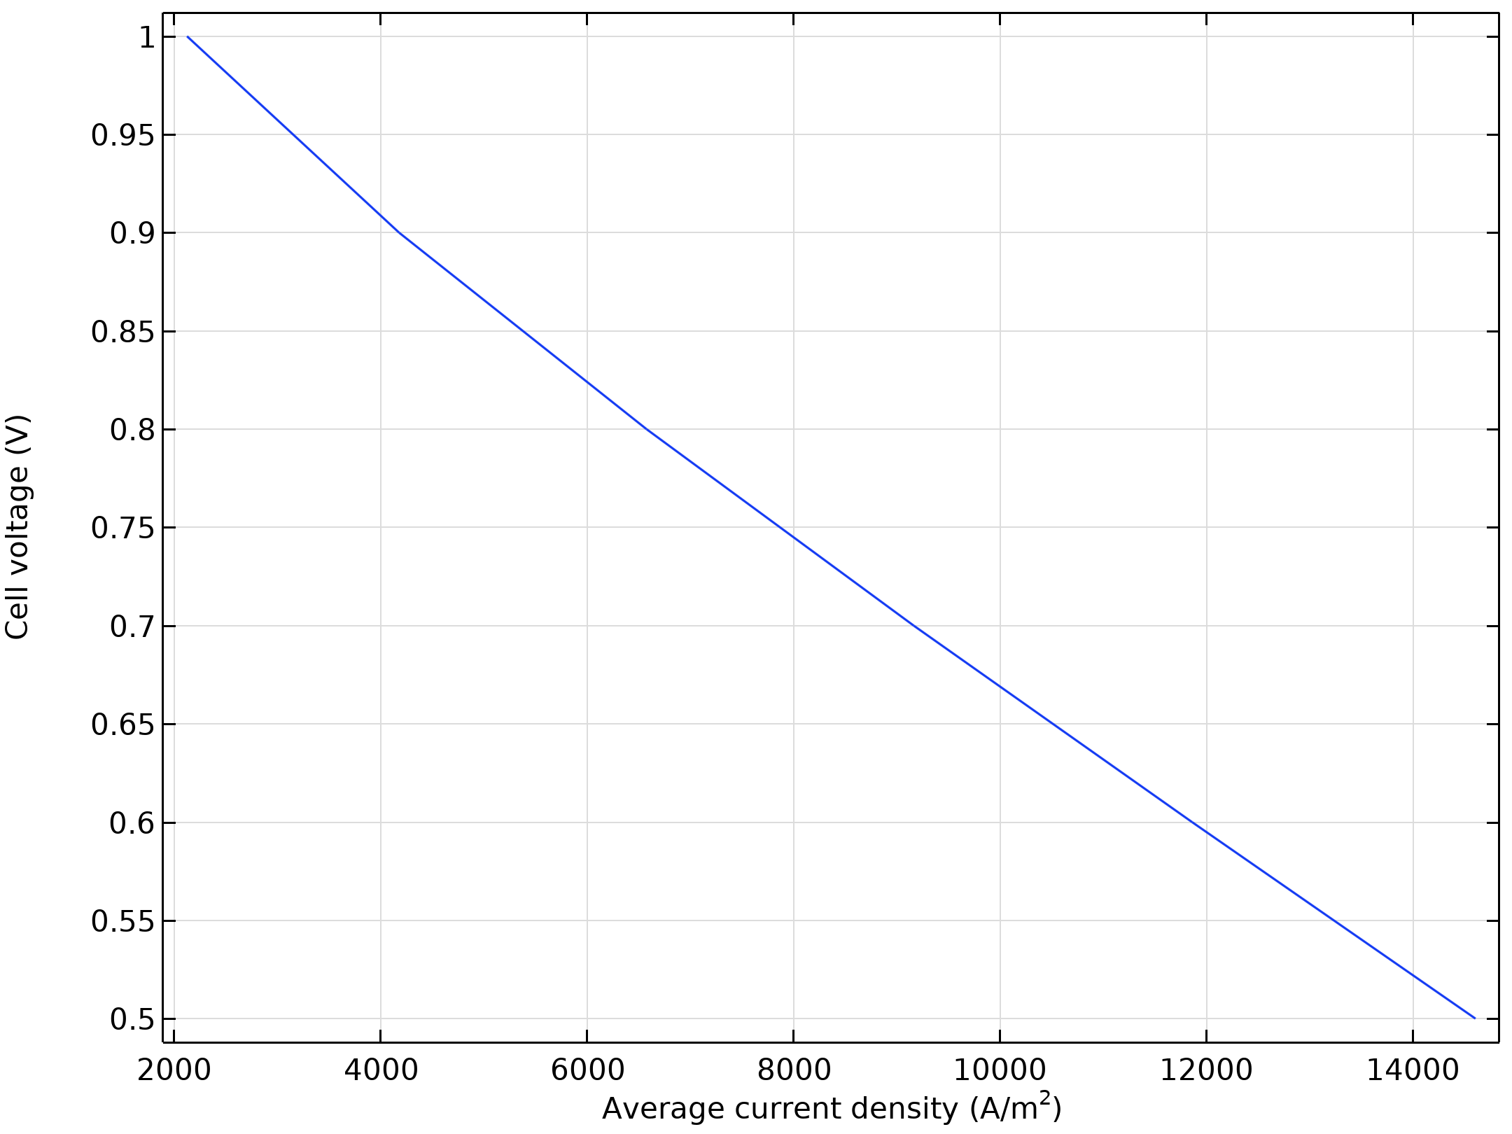
Results
As a consequence of oxygen depletion, the current density distribution is poor, with most of the current produced close to the cathode inlet
One way to improve the operating conditions is to increase the cathode flow rate, thus improving the oxygen mass transport
The figure shows the voltage as a function of the total current (polarization curve)
Polarization curve

Slide 12
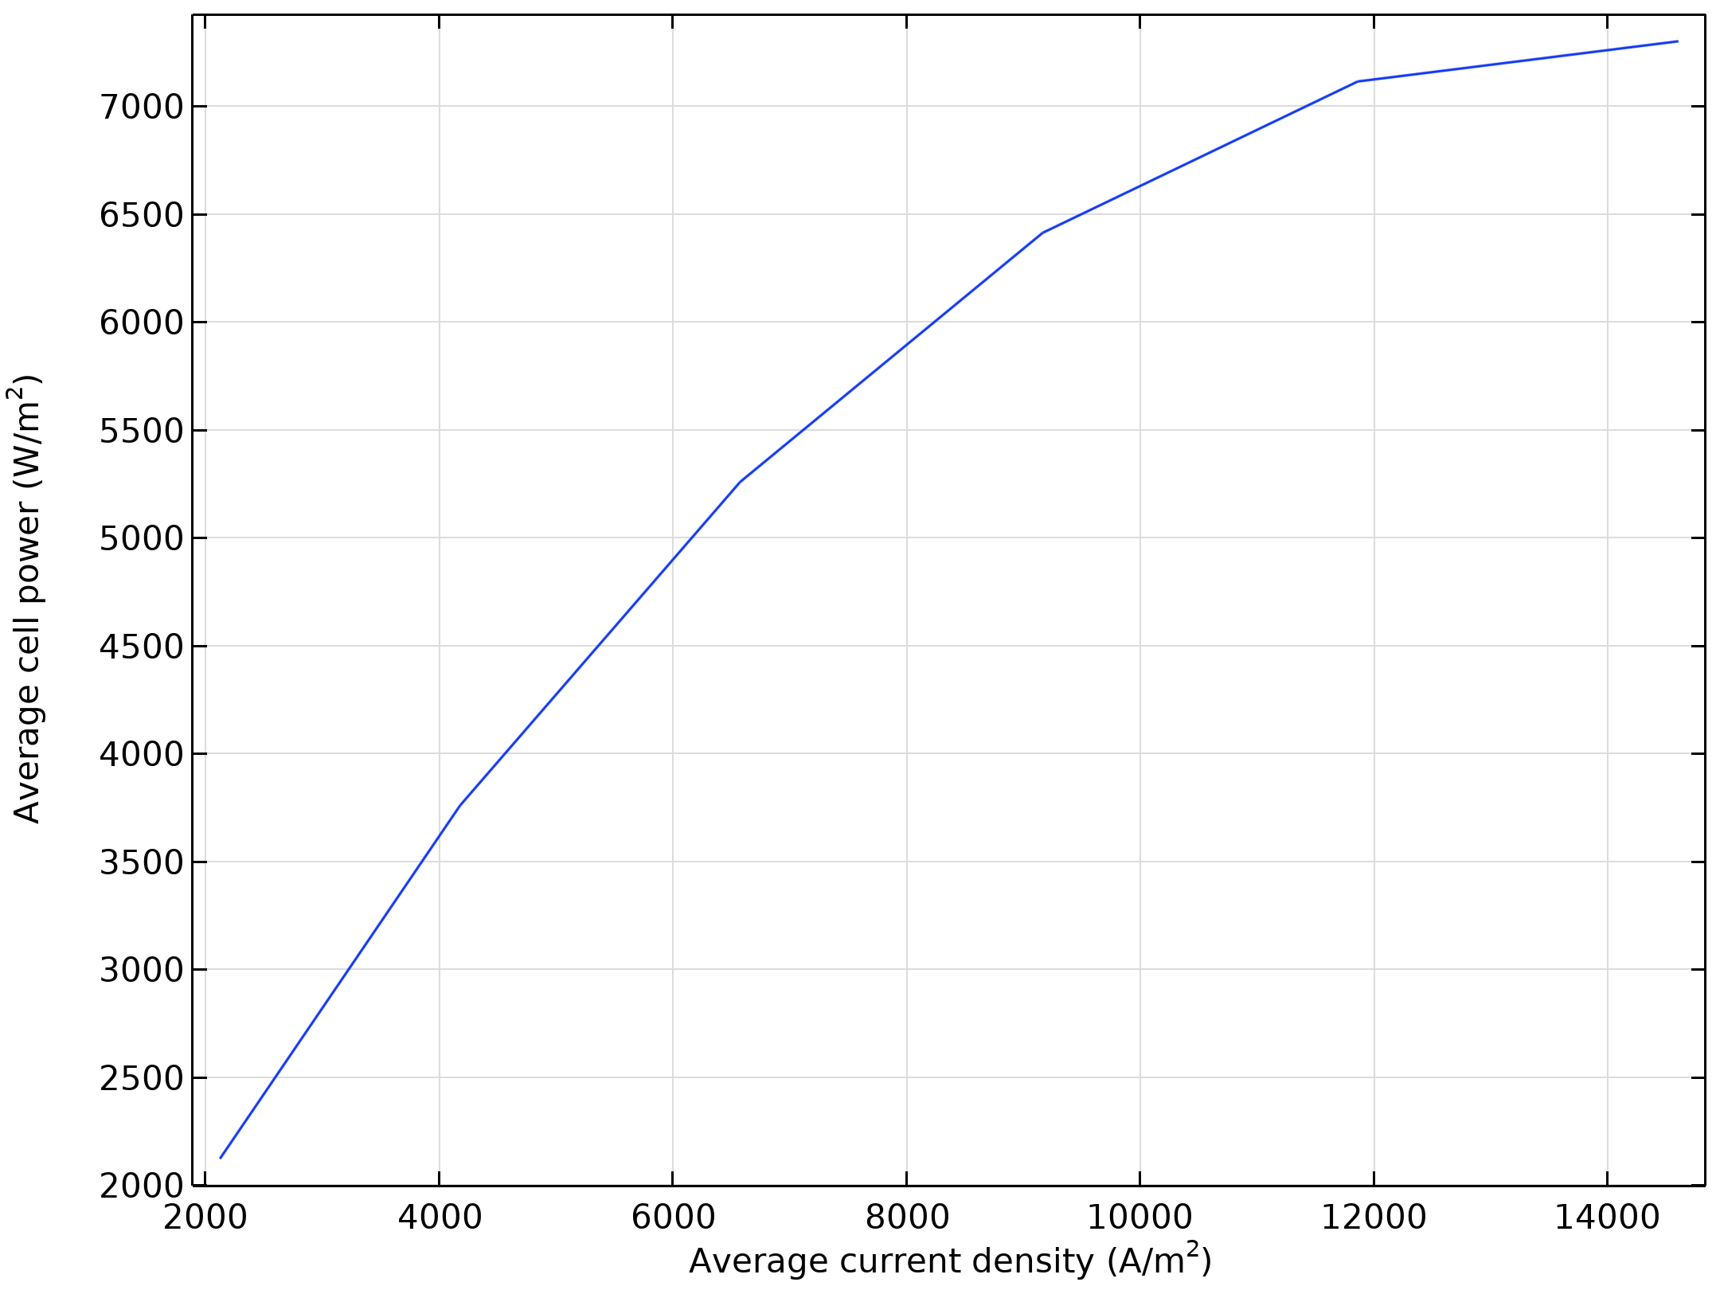
Results
The figure shows the power output as a function of the cell voltage The model predicts a maximum power-output of about 1000 W/m² for the unit cell

