Slide 1
Engine Coolant Properties
COMSOL

Slide 2
Introduction
The engine block of a car includes a cooling jacket to remove excess heat from combustion
The cooling jacket consists of open spaces in the cylinder block and the cylinder head
When the engine is running, a coolant fluid is pumped through the jacket to keep the engine from overheating
Optimizing the heat removal is important to minimize coolant boiling, prevent engine failure, and, more recently, improve overall efficiency through waste heat recovery
This example demonstrates how the thermodynamics feature can be used to evaluate the performance of different engine coolants
Although pure water works well as a coolant, to prevent freezing at low temperatures, a mixture of ethylene glycol and water is normally used to lower the freezing point
The thermodynamics feature is used here to show how the boiling point, density, viscosity, thermal conductivity, and heat capacity also depend on the composition of the coolant mixture and how changes in these properties affect the cooling process

Slide 3
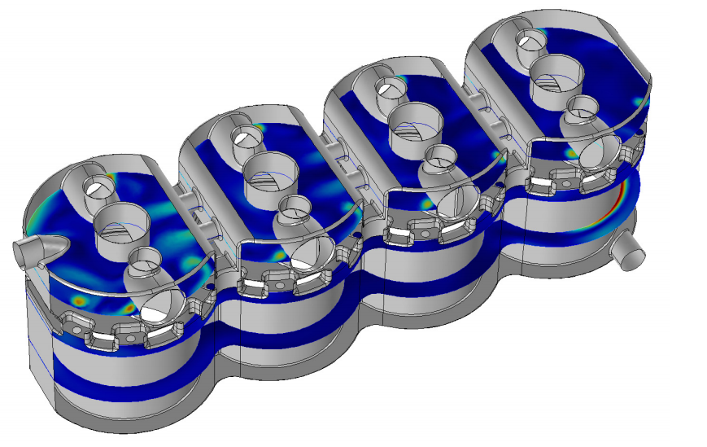
Model Definition
The figure shows the flow pattern inside the cooling jacket of a representative four cylinder engine
Solving a fully coupled nonisothermal turbulent flow problem with temperature, pressure, and composition dependent coolant properties in this complex geometry typically requires a significant number of computer hours
The coolant flow inside the cooling jacket of a four cylinder engine

Slide 4
Model Definition
One approach to obtain a reliable approximate solution in a shorter time is to use the functionality available in the thermodynamics feature to investigate the coolant property behavior and determine where simplifying assumptions can be made
The consequences of these assumptions can be investigated efficiently in a simplified geometry to provide confidence in their use in more complex geometries
The coolant flow inside the cooling jacket of a four cylinder engine

Slide 5
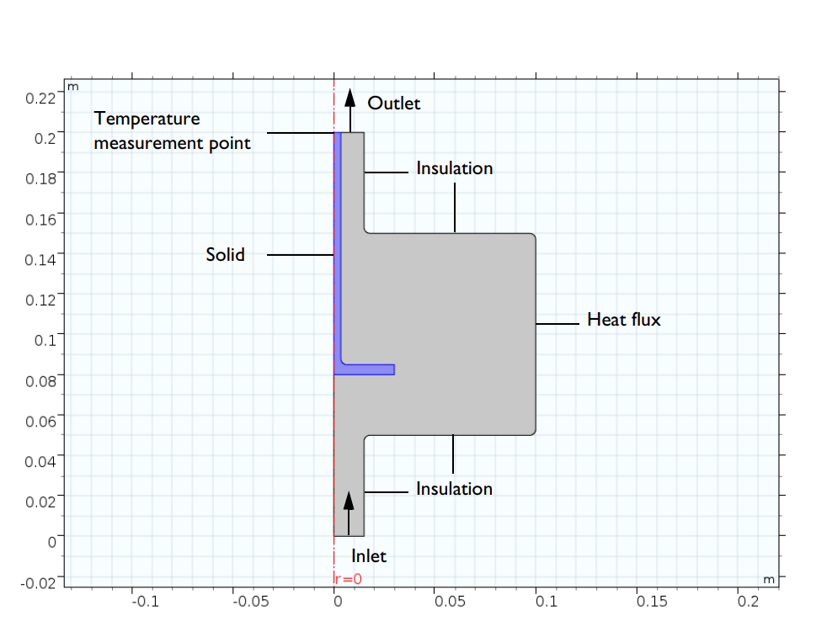
Model Definition
Here a simplified 2D-axially symmetric geometry, shown in the figure, is considered as an engine coolant test apparatus
Coolant is introduced at a specified flow rate in the bottom of the device, the coolant hits a solid steel part and is then deflected into a larger flow domain
A heat flux is applied on the outer boundary of the larger section
The resulting temperature is measured at steady state in the solid structure near the coolant outflow at the top
Axially symmetric engine coolant test apparatus

Slide 6
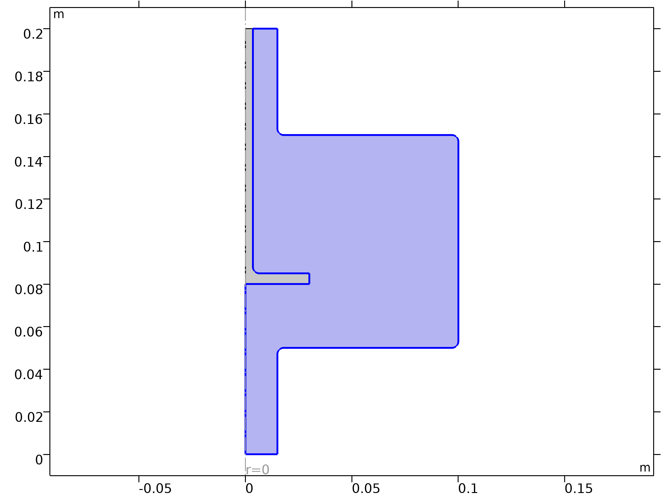


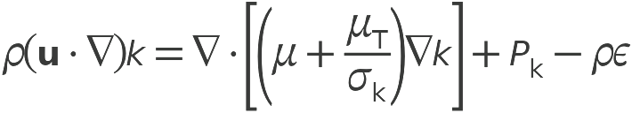
Model Definition
Turbulent Flow, k-ε

Slide 7
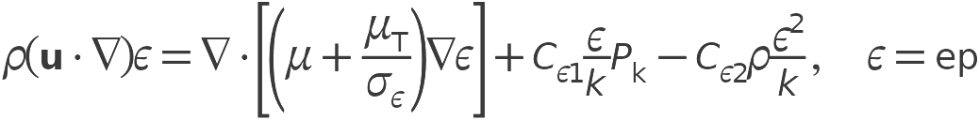

Model Definition
Turbulent Flow, k-ε

Slide 8
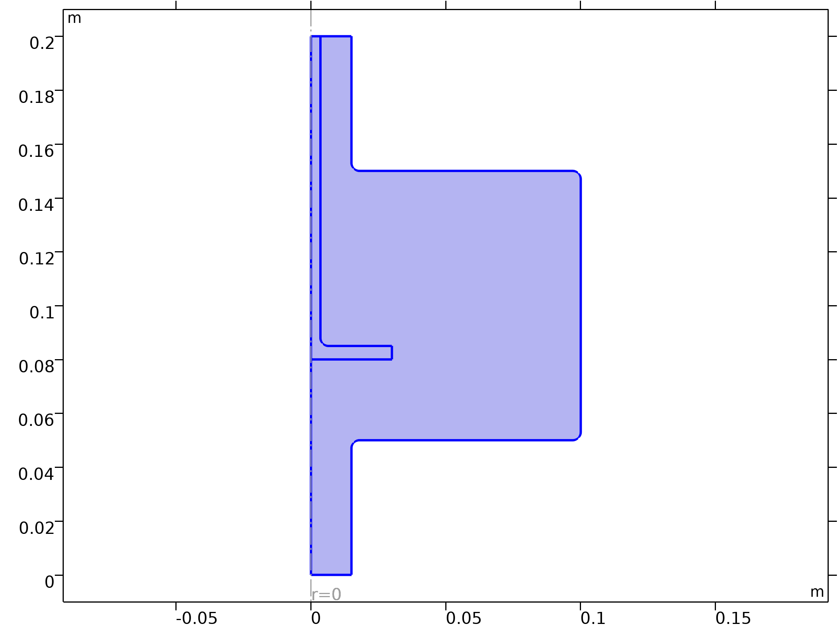

Model Definition
Heat Transfer in Fluids

Slide 9
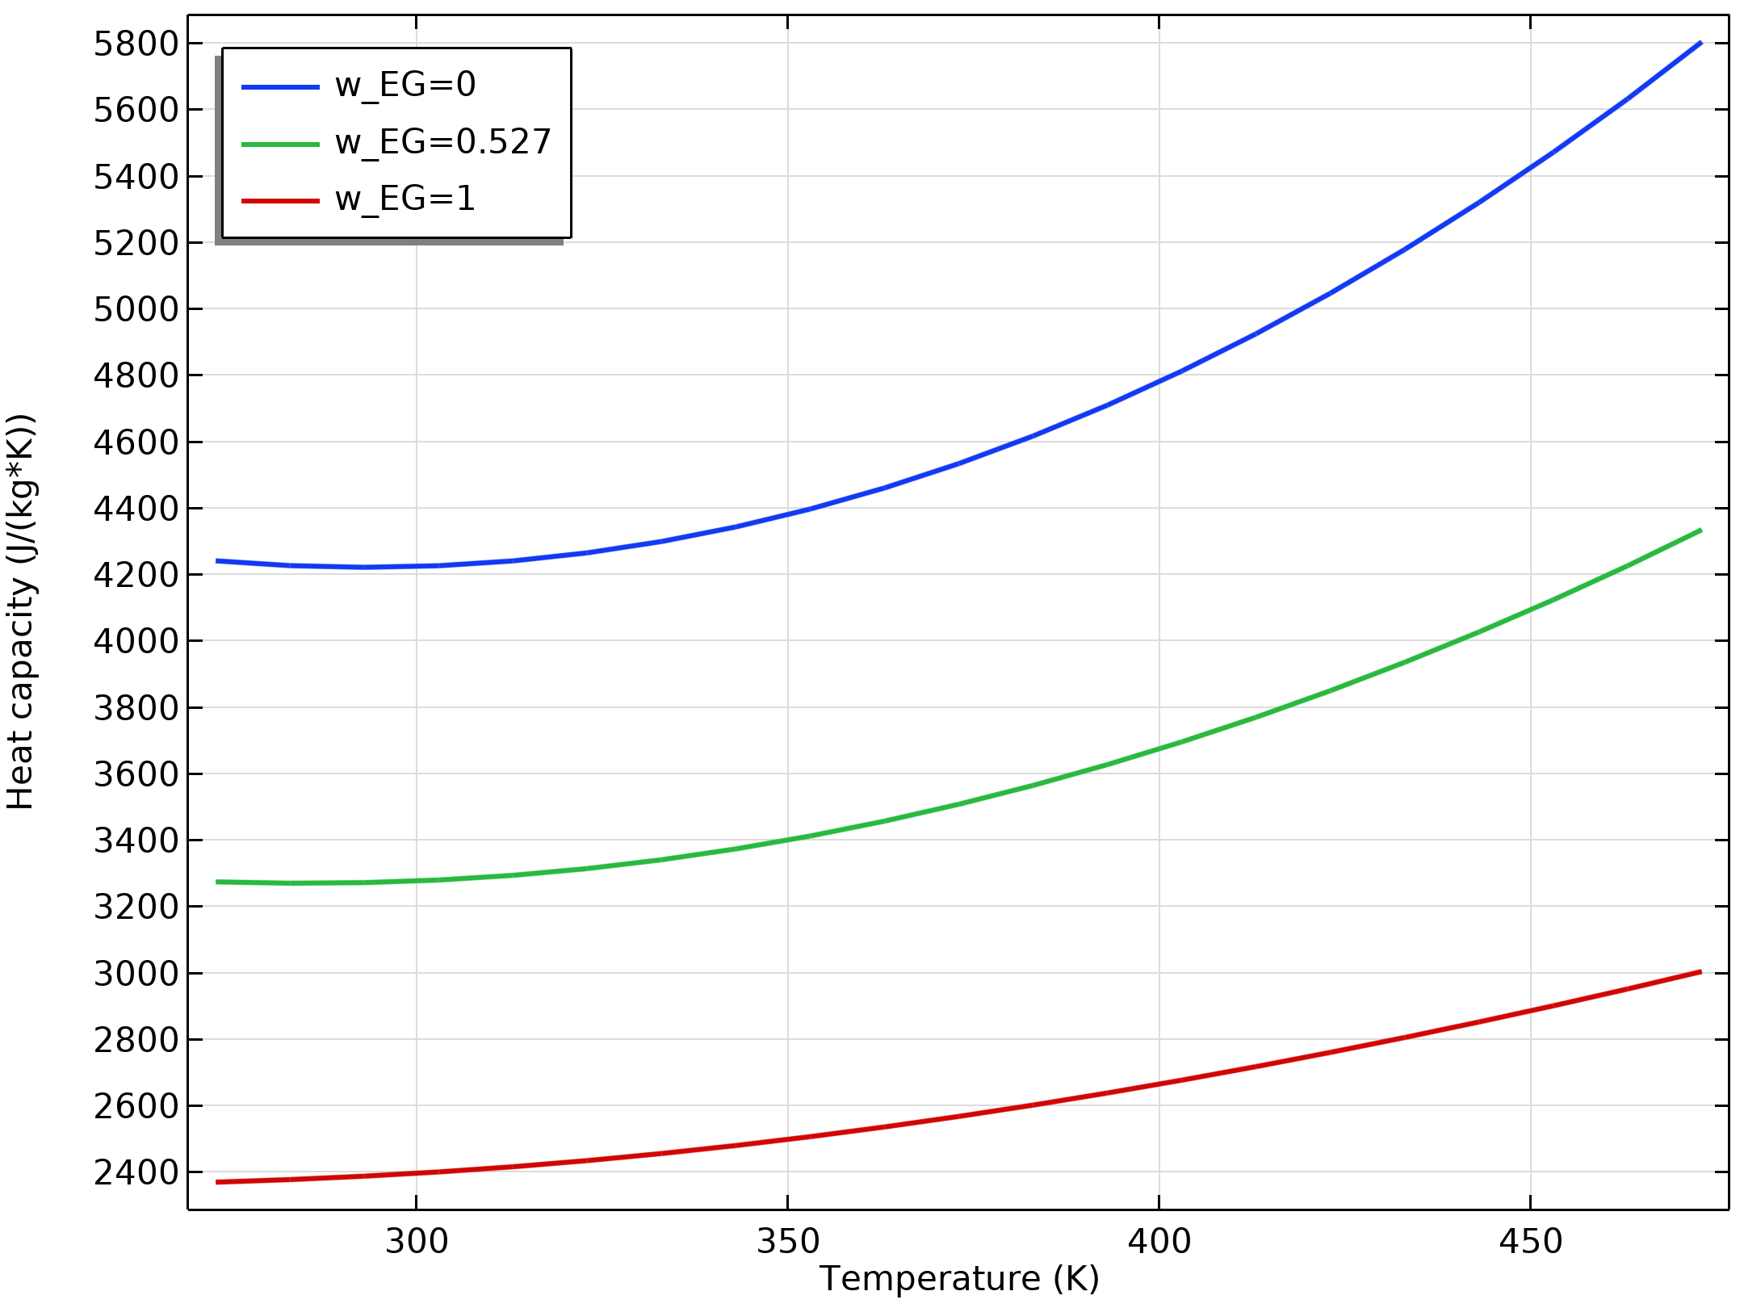
Results
The figure shows the temperature and composition dependence of the heat capacity
Similar graphs are generated for density, viscosity, and thermal conductivity
Studying these graphs reveals that the addition of ethylene glycol increases the density and viscosity, but decreases the thermal conductivity and heat capacity when compared with pure water
It should be expected that a 50 volume percent mixture will yield more pressure drop and require a higher flow rate to achieve the same cooling effect as that of pure water
Heat capacity as a function of temperature and composition for ethylene glycol water mixtures

Slide 10
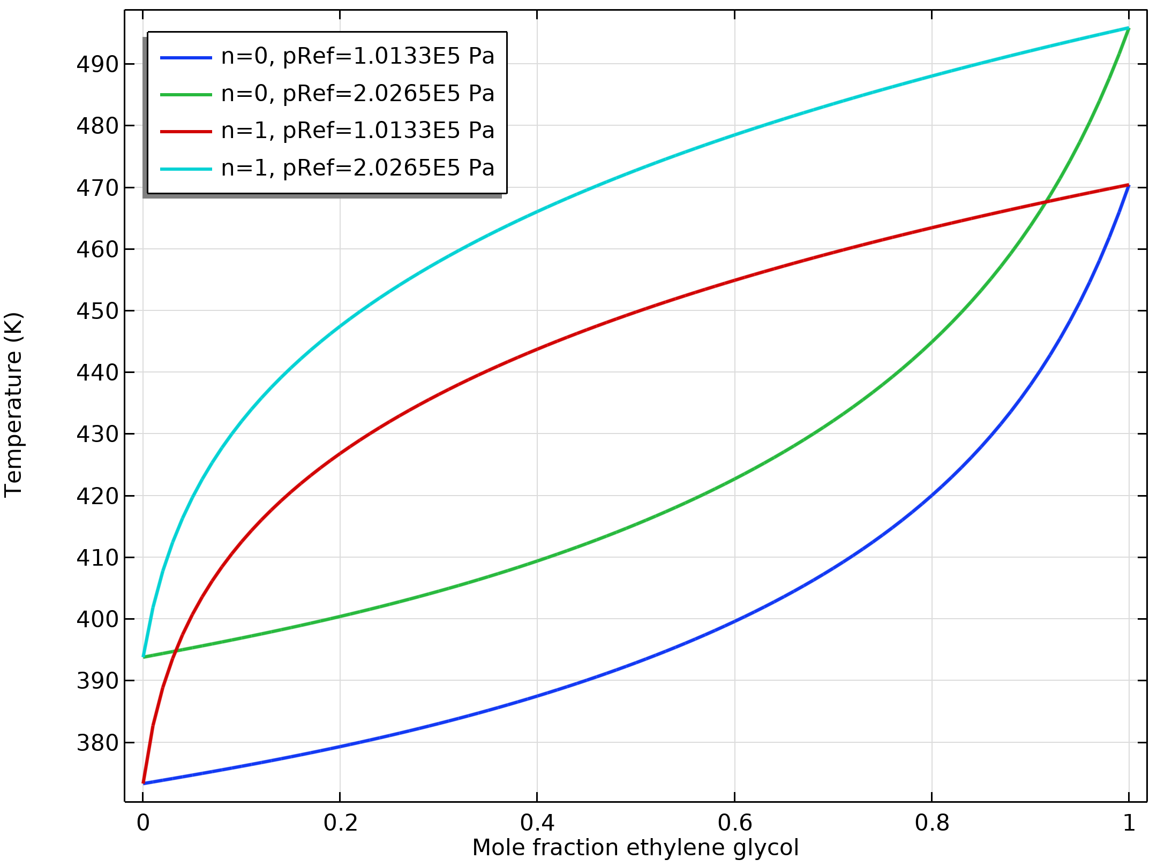
Results
The figure shows the phase envelope for ethylene glycol-water mixtures produced using the equilibrium calculation feature of the thermodynamic system
A car coolant system typically operates at about 2 atm pressure
Here we can see that a 50 volume percent (24.4 mole percent) mixture should boil at a temperature slightly higher than 400 K at this pressure
Phase envelope for the equilibrium temperature of ethylene glycol-water mixtures at two pressures

Slide 11
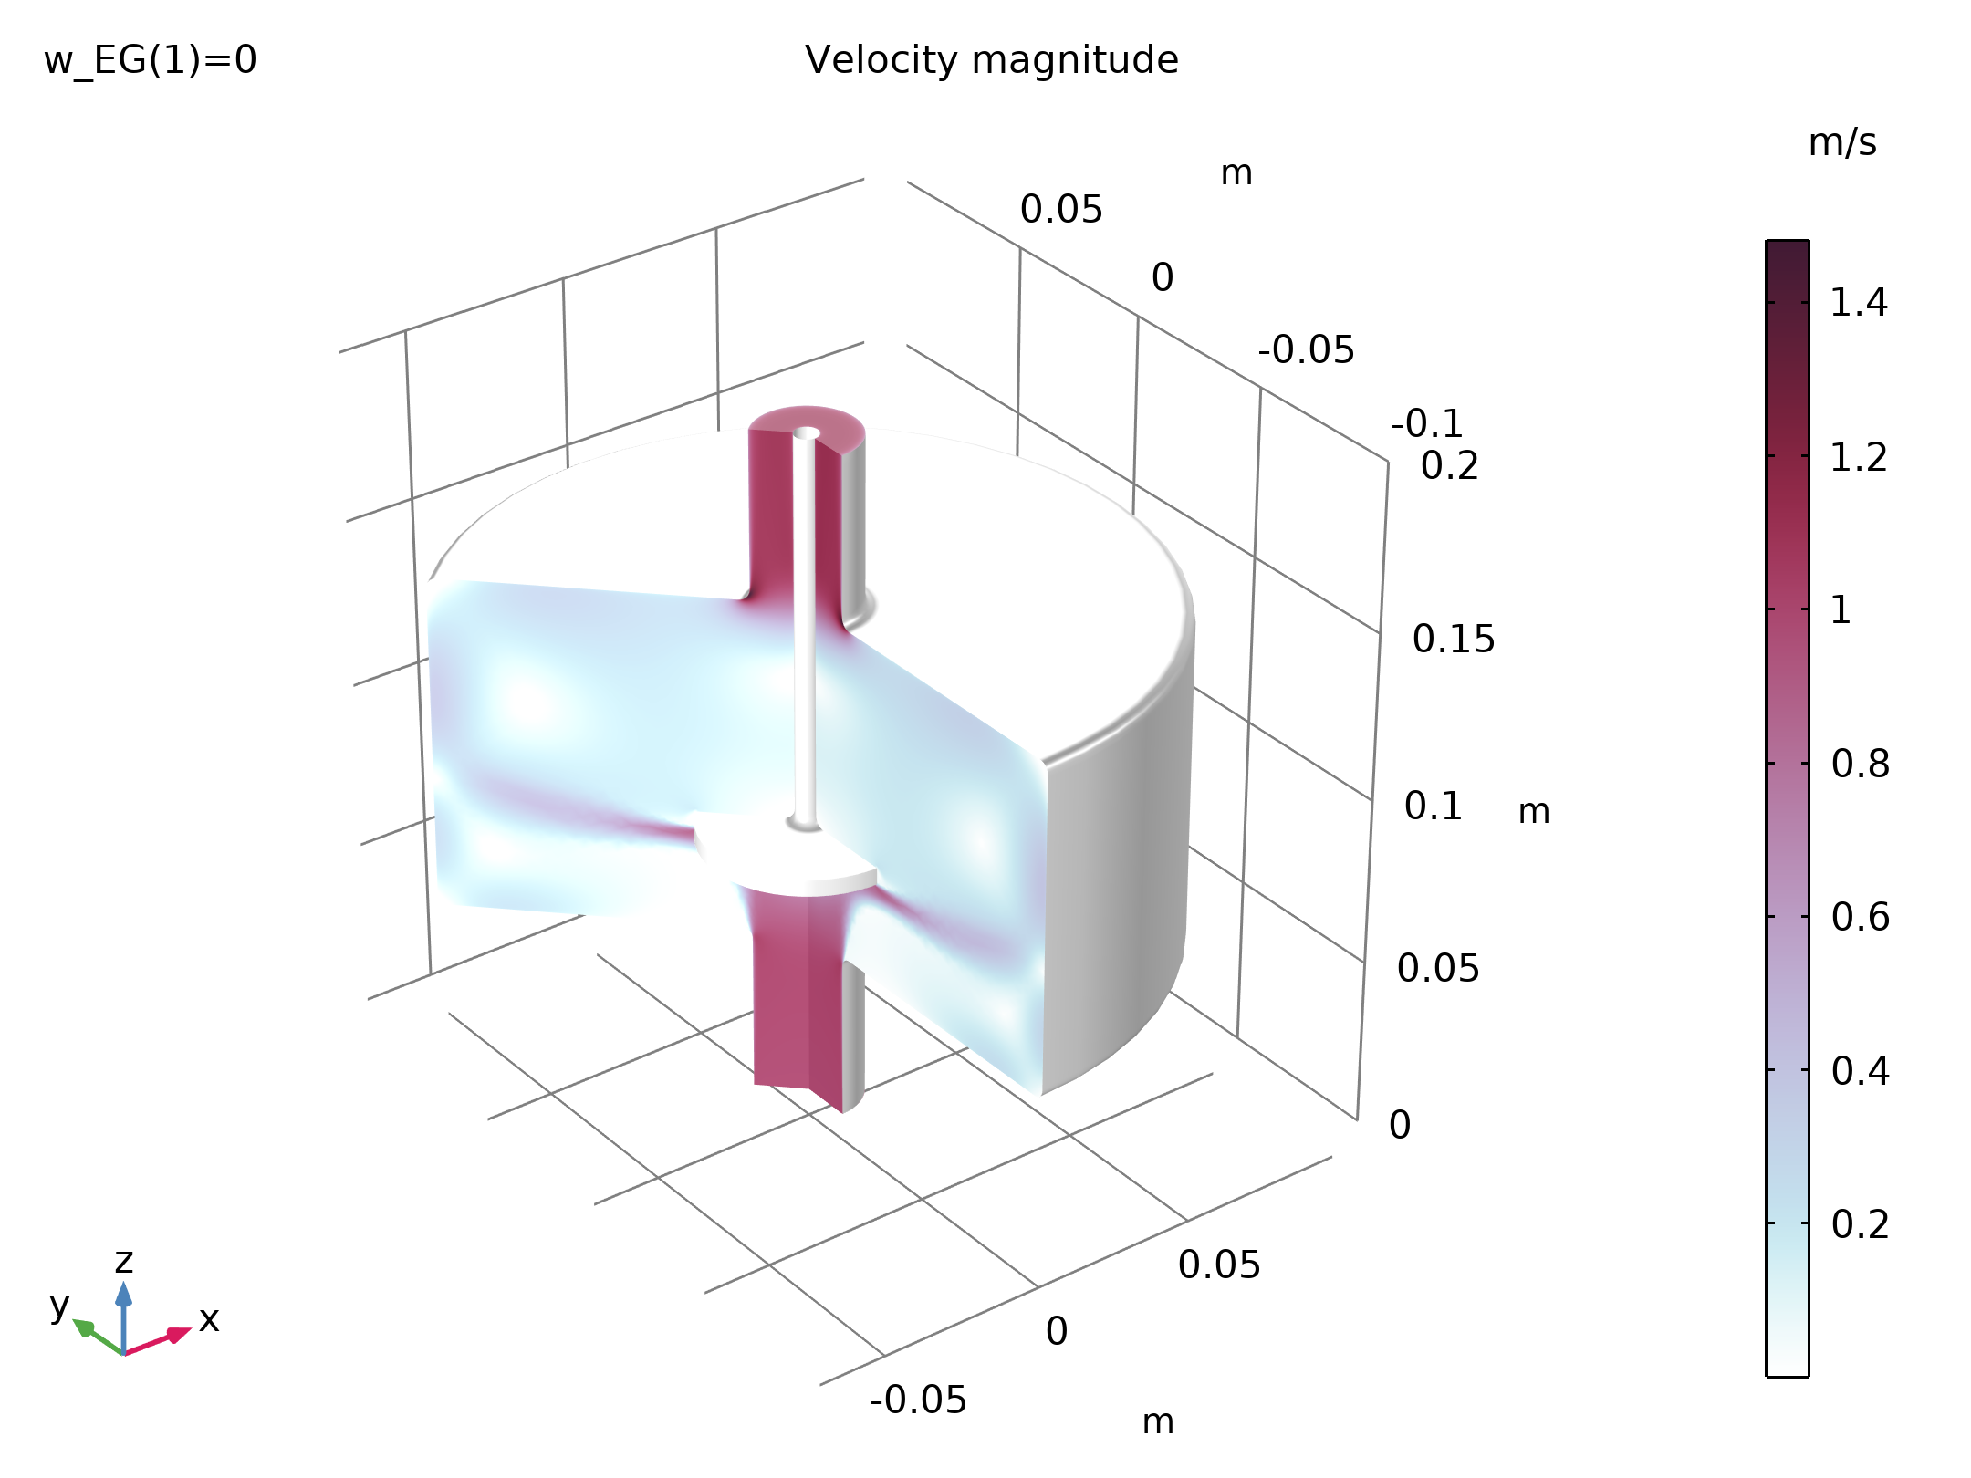
Results
The figure shows the flow pattern inside the test apparatus with water entering at 1 m/s
The coolant flow of 42 l/min and a heat input of 50 kW used here in the test apparatus are on the same order of magnitude as in a conventional car cooling system
Flow patterns inside the test apparatus with water at 1 m/s

Slide 12
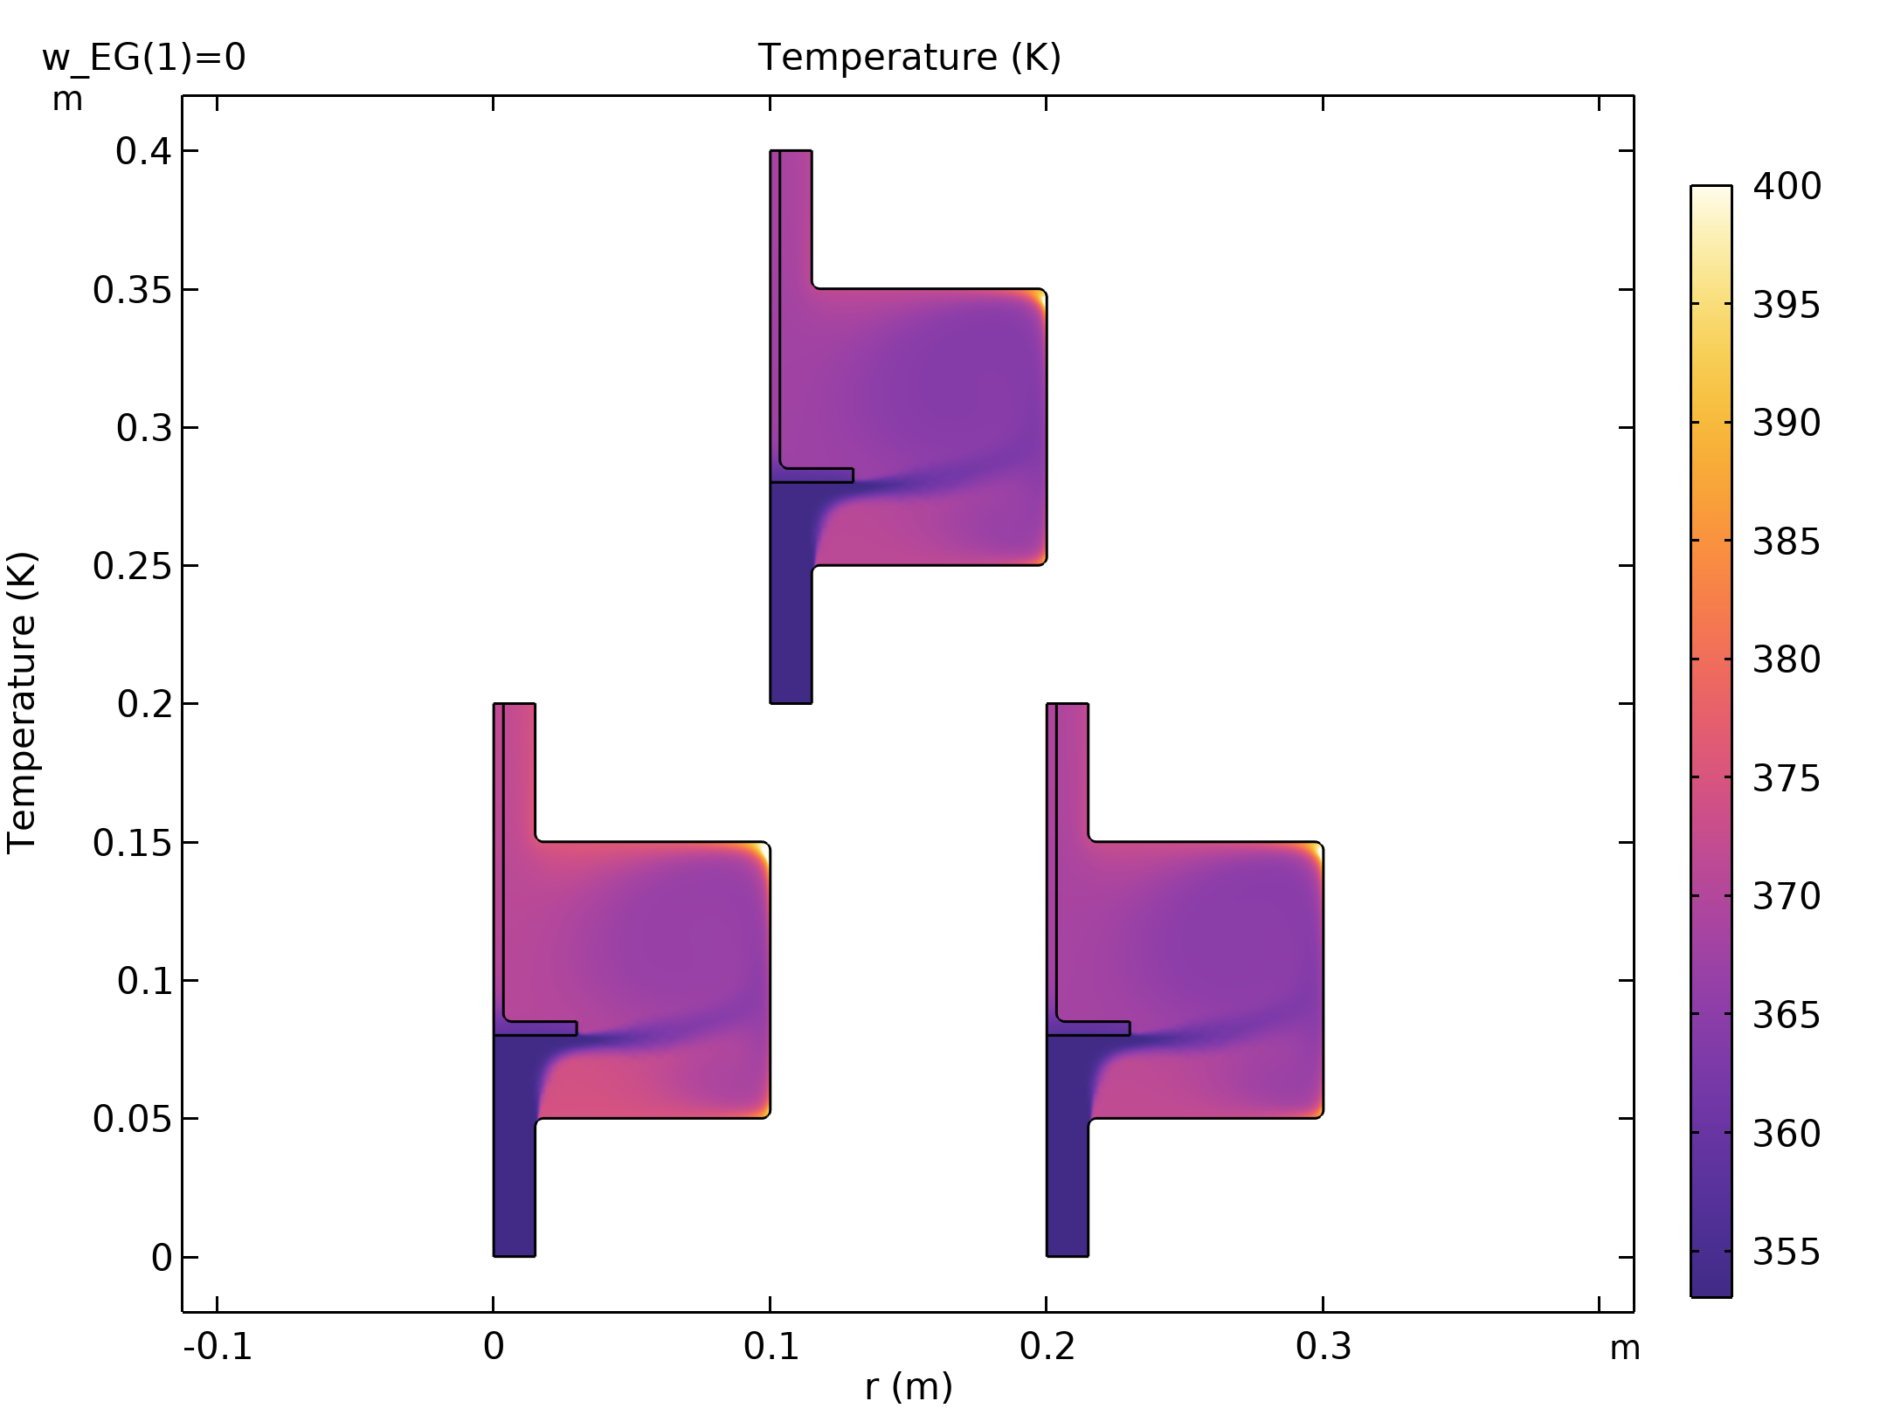
Results
As expected, the figure shows that an ethylene glycol-water mixture will provide less cooling than pure water at a fixed flow rate
About 15 percent more coolant flow is required to produce the same cooling as when using pure water
It can also be seen that some boiling of the coolant (at T > 400 K) is expected in the recirculation zones in the outer corners of the apparatus
Temperature within the test apparatus for three cases: (a) water at 1 m/s, (b) 50 volume percent ethylene glycol at 1 m/s, and (c) 50 volume percent ethylene glycol at 1.15 m/s

Slide 13
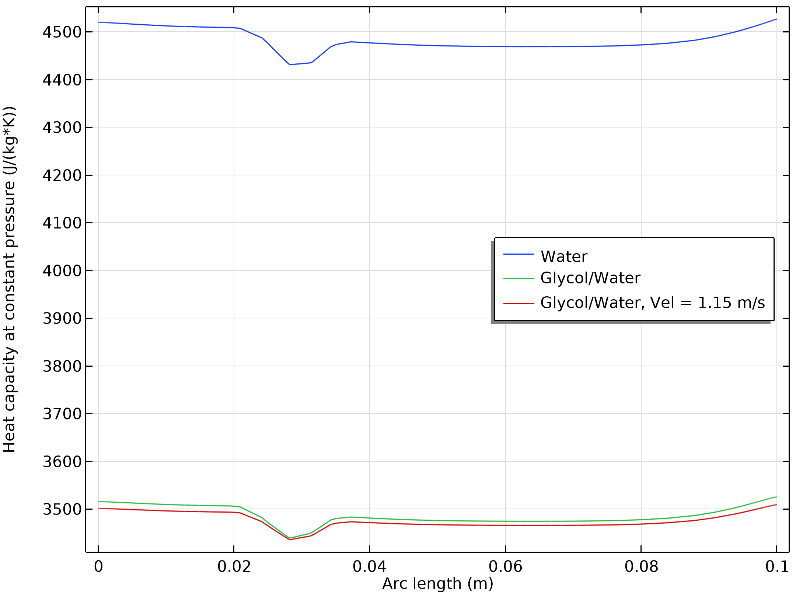
Results
Considering the graphical results for the various coolant properties, it might be reasonable to use approximate averages for the relatively small temperature range considered, between 353 and 400 K
In the figure the resulting heat capacity for the pure water and the two ethylene glycol-water mixture cases is plotted
As seen before, the heat capacity differs significantly when comparing pure water and the mixture
But, the individual variation for each coolant however is seen to be small, about 2% for this mixture property and location
Coolant heat capacity plotted along a vertical cut line at half the radius of the test apparatus chamber

Slide 14
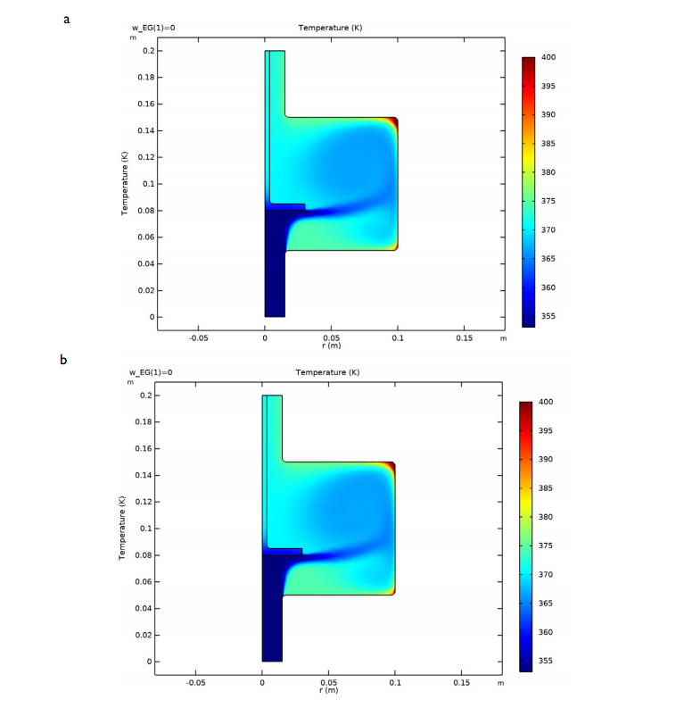
Results
Using the solution for a mixture with 50 volume percent ethylene glycol in water, the following average values are computed; density = 1010 kg/m³, viscosity = 9.07·10⁻⁴ Pa·s, thermal conductivity = 0.574 W/(m·K), and heat capacity = 3486 J/(kg·K)
The figure shows a comparison of the temperature results obtained using these approximations with those using the fully coupled temperature dependent properties in our test device
The similarity between these results is sufficient to justify the use of the approximate average values in a cooling jacket model with a realistic geometry
Comparison of temperature within our test apparatus for 50 volume percent ethylene glycol in water at 1 m/s using: (a) temperature dependent properties, (b) approximate average properties

Slide 15
Results
Solving the flow and heat transfer equations requires considerably less computational effort for the constant average property value case
Comparison of temperature within our test apparatus for 50 volume percent ethylene glycol in water at 1 m/s using: (a) temperature dependent properties, (b) approximate average properties

