Slide 1
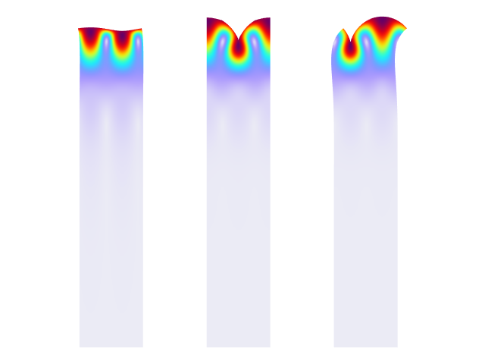
SAW Velocity Calculations from a Unit Cell Model

Slide 2
Problem Definition
FEM simulation can be used to obtain a SAW velocity and some related parameters (Squared electromechanical coupling coefficient, reflectivity, etc.) for different typical configurations
  Such parameters are input data for various analytical and semi-analytical methods of SAW device design, like the Delta-Function model, the COM method, and so on
The typical setup is a unit cell model (one wavelength usually) with the periodic conditions and the Eigenfrequency study
In this entry the following unit cell is investigated:
  128 YX cut LiNbO3 crystal and aluminum IDTs
  Typical sizes for a center frequency of about 433[MHz]
Three configurations are shown:
  Free surface case: No IDT, no electric terminals
  IDT case: Two typical aluminum grounded electrodes
  Grounded surface case: No IDT, the fully grounded surface

Slide 3
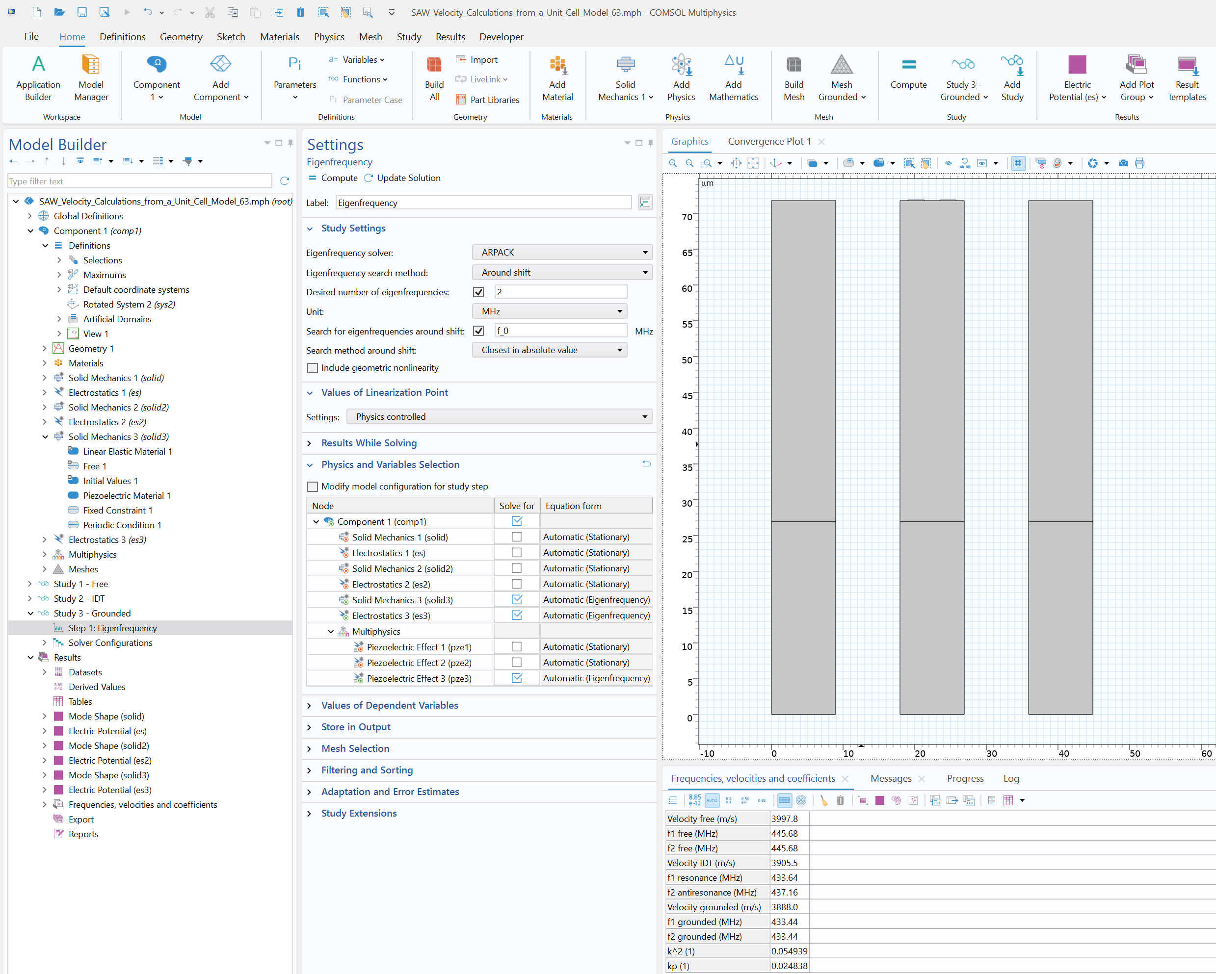
Setup
The Piezoelectricity interface with Periodic Conditions
The Rotated System & PML
The Eigenfrequency study
  Search for freq1 (resonance) & freq2 (antiresonance), which are equal for free and grounded surfaces
Postprocessing
  SAW velocities: c=period*(freq1+freq2)/2
  Squared electromechanical coupling coefficient: k2=2*(c_free-c_grounded)/c_free
  Reflectivity: kp=pi*(freq1_IDT-freq2_IDT)/freq_free

Slide 4
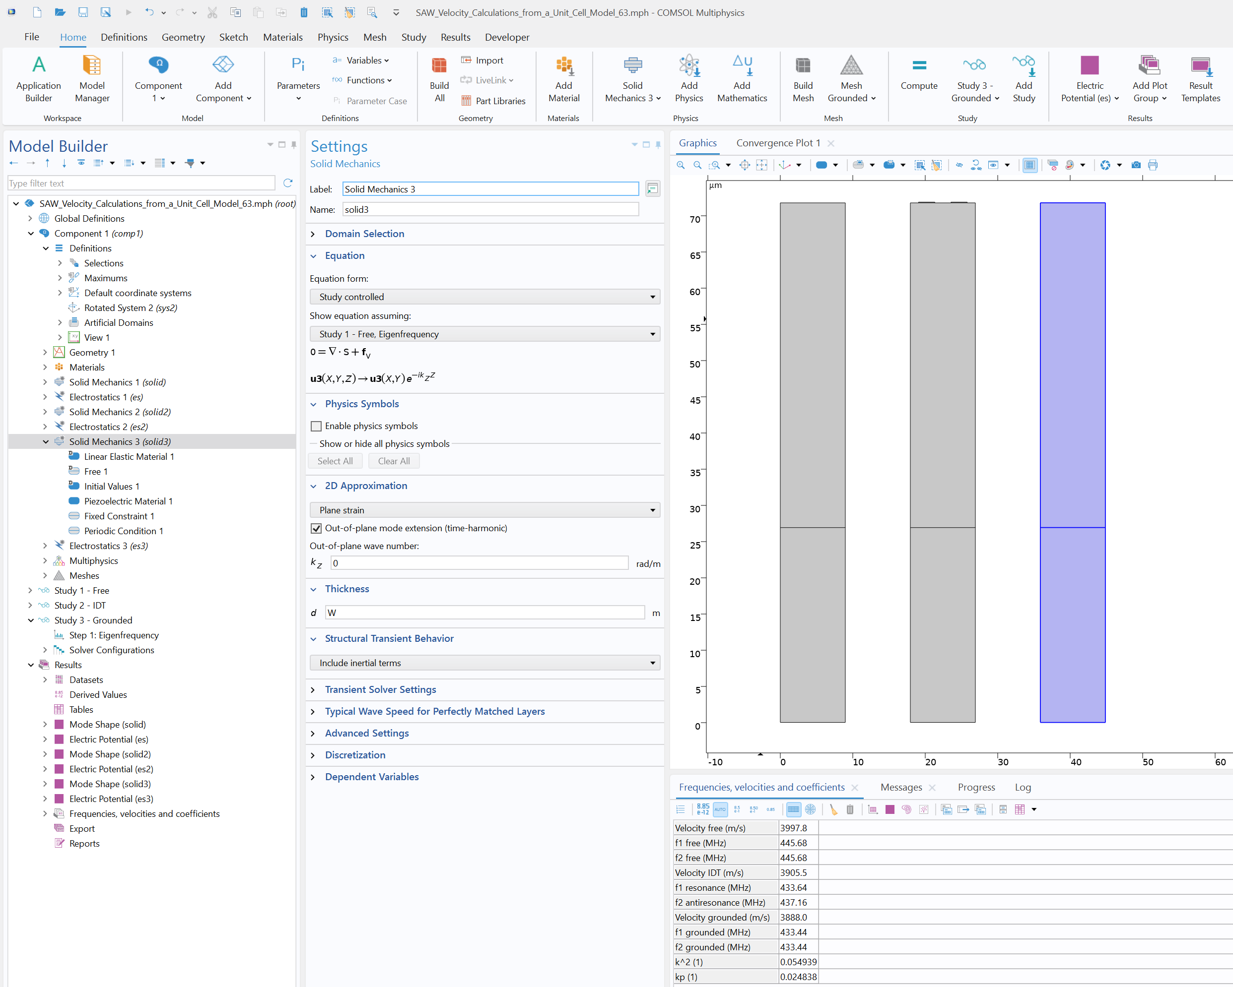
2.5D Approach
Activate the Out-of-plane mode extension (time-harmonic) check box in the Solid Mechanics interface for the 2d component
It might be used to obtain results for all three components of displacements
  Without it one component of displacements and corresponding derivates will be zero

Slide 5
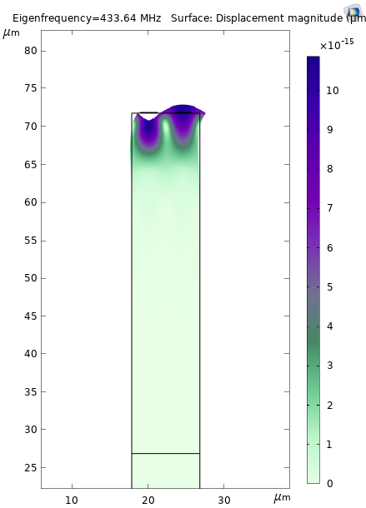
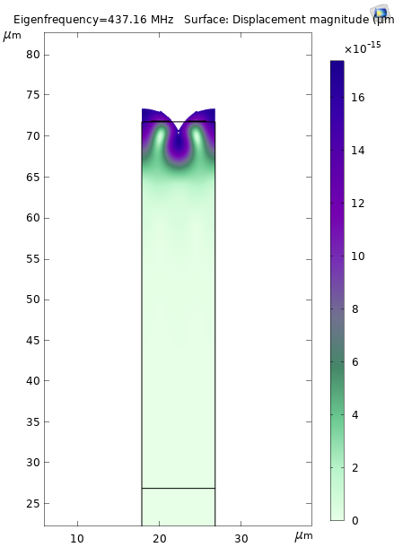
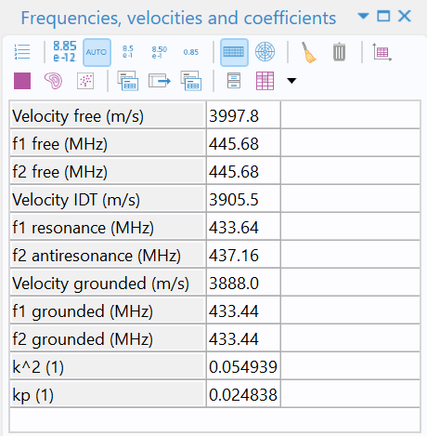
Results
Left: Surface plots of solid displacements across the XY sagittal plane. Resonance and antiresonance modes for the case with IDTs are shown. Right: Table containing the evaluation results for eigenfrequencies, SAW velocities, squared electromechanical coupling coefficient & reflectivity.

Slide 6
Conclusions
The typical model setup is shown with some handy postprocessing
COMSOL gives accurate results for different configurations, including:
  Double-electrode designs, SPUDT (Unidirectional IDTs), Trapezoid-shaped electrodes, multilayered structures, etc.
  Not only IDTs: all kinds of reflectors, including different projections, grooves, etc.
FEM formulation helps to resolve the SAW velocity regardless of the IDT size and grating pattern, and automatically includes parameters such as electrode mass loading, internal reflections, scattering, and BAW radiation.
We encourage users to perform a simple unit-cell verification before moving forward for more complex finite-sized configurations

