Slide 1
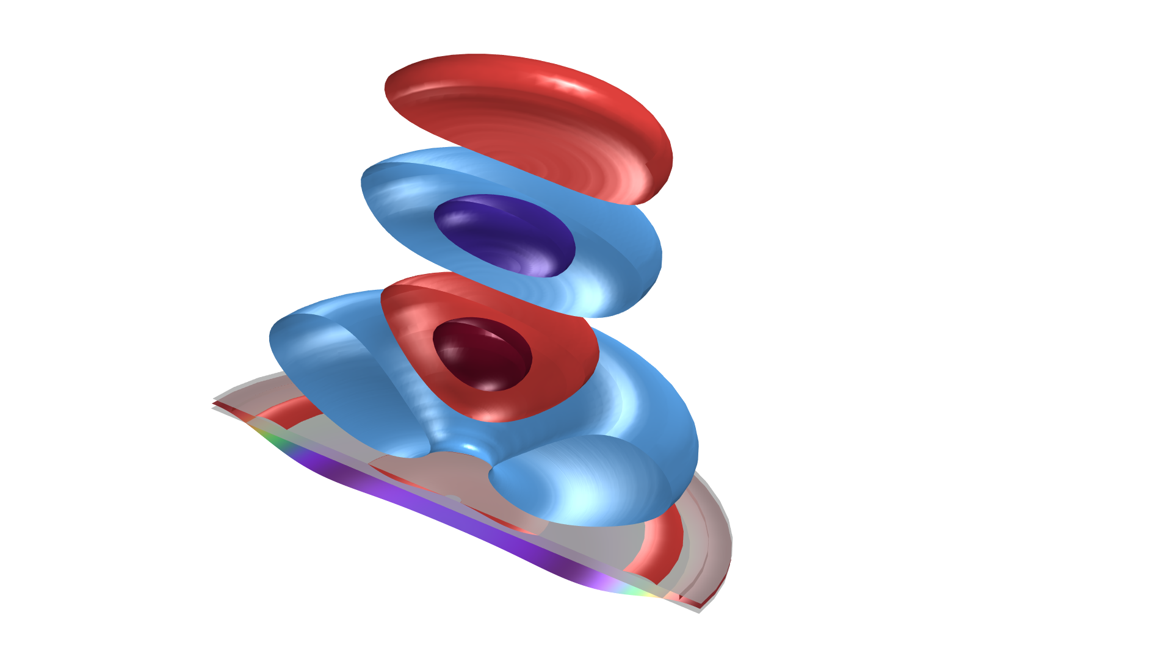
Electrostatic Speaker Driver

Slide 2
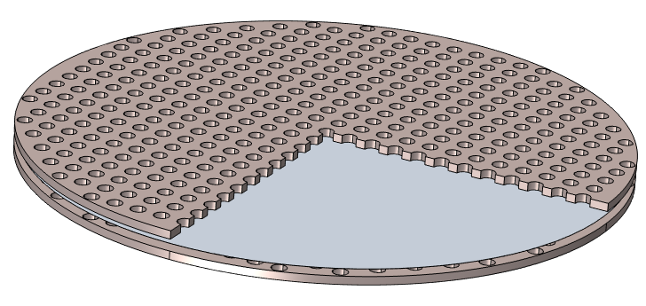
Abstract
This tutorial demonstrates a full vibroelectroacoustic analysis of a conceptual electrostatic speaker driver
  A thin conducting plastic diaphragm resides between two perforated metal sheets called grids or stators
  An electric signal applied to the grids (out of phase) results in an electrostatic force between the charged diaphragm and the grids on both sides
  While one grid causes the diaphragm to push, the other causes it to pull, thus moving air and creating sound
The model is inspired by:
  H-Y Chiang and Y-H Huang, “Vibration and sound radiation of an electrostatic speaker based on circular diaphragm,” JASA 137, 1714 (2015); https://doi.org/10.1121/1.4916275
  H-Y Chiang and Y-H Huang, “Experimental modeling and application of push-pull electrostatic speakers,” JASA 146, 2619 (2019); https://doi.org/10.1121/1.5130196
Perforated metal sheets
Thin conductive diaphragm

Slide 3
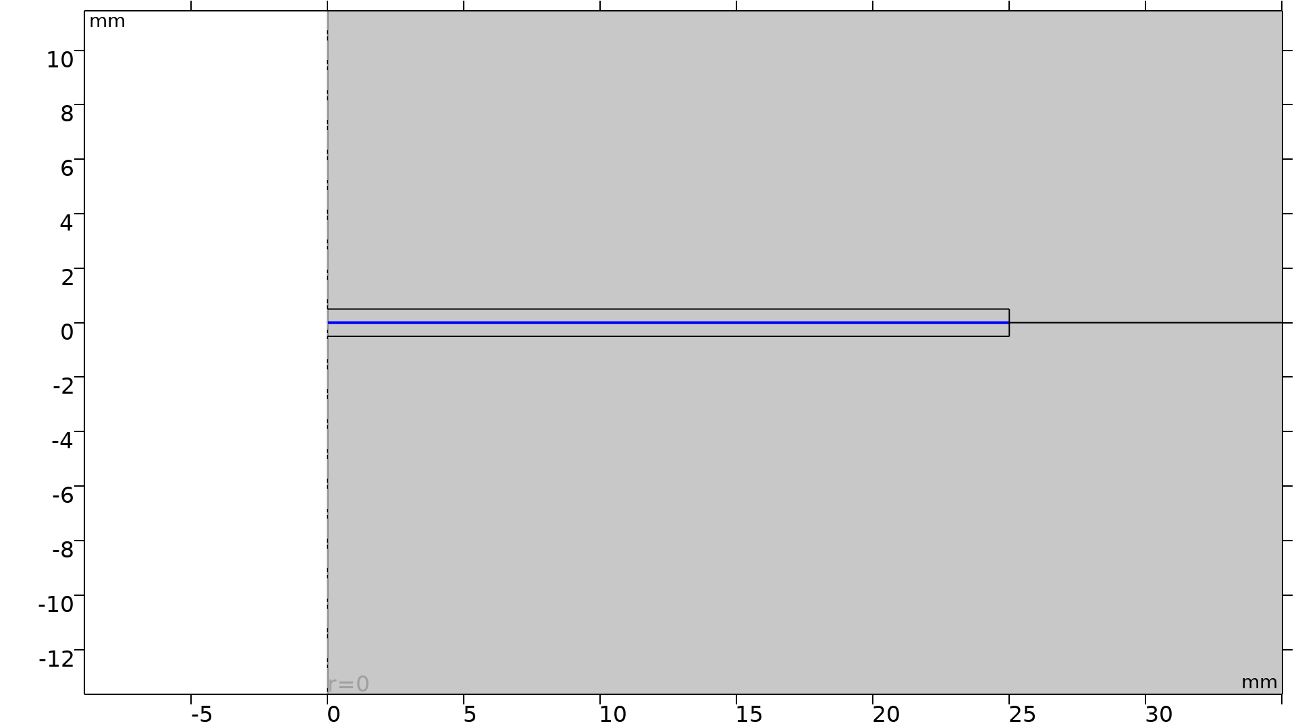
Model Definitions
The model is set up in 2D axisymmetry and solved for in the frequency domain
The diaphragm has a radius of 25 mm and a thickness of 5 µm and is modeled as a solid domain in the Solid Mechanics interface
The Electrostatics physics is solved in the diaphragm domain and the air gap between the diaphragm and the two grids
  The diaphragm is electrically grounded
  A DC voltage V_{DC} of 500 V is applied to both grids
  An out-of-phase AC voltage V_{AC} of 100 V RMS magnitude is applied to the top and the bottom grids
Electromechanics multiphysics coupling is defined in the diaphragm domain
The Moving Mesh feature is used in the air gap to capture the geometry change due to the moving diaphragm
Diaphragm
Grids
Zoomed-in view of the diaphragm, grids, and air gap

Slide 4
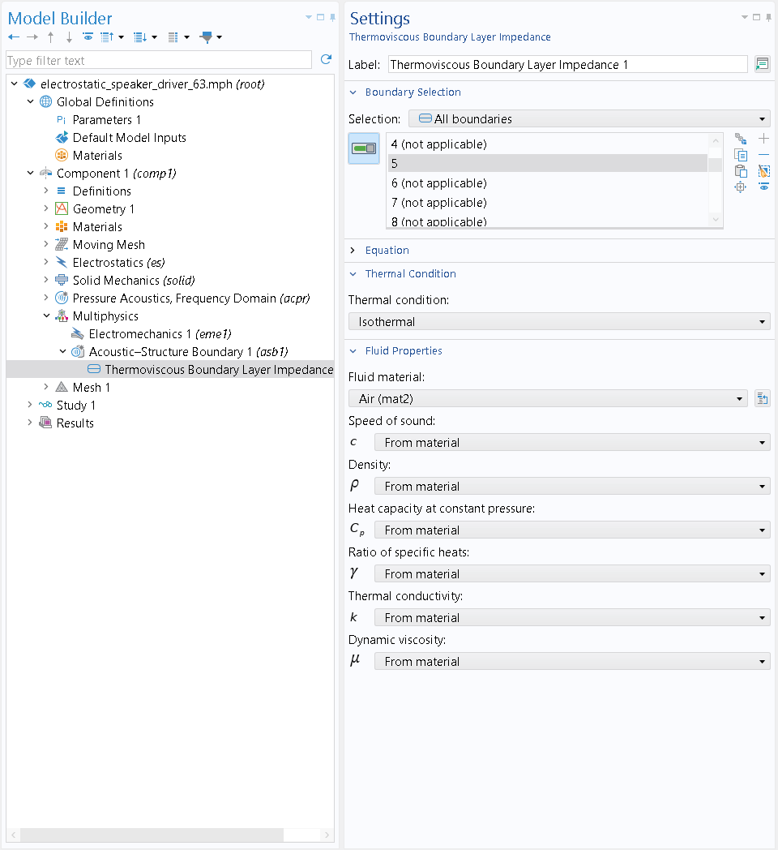
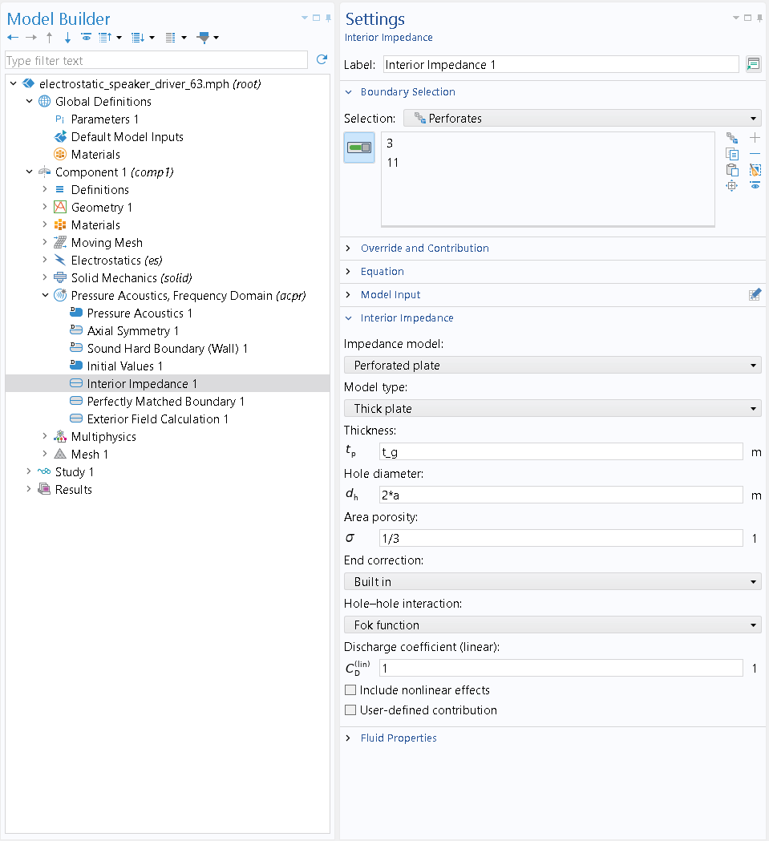
Model Definitions
Acoustic-Structure interaction and thermal and viscous losses near the diaphragm and through the grids
Acoustic-Structure Boundary
Interior Impedance
Thermoviscous Boundary Layer Impedance subfeature
Perforated plate option

Slide 5
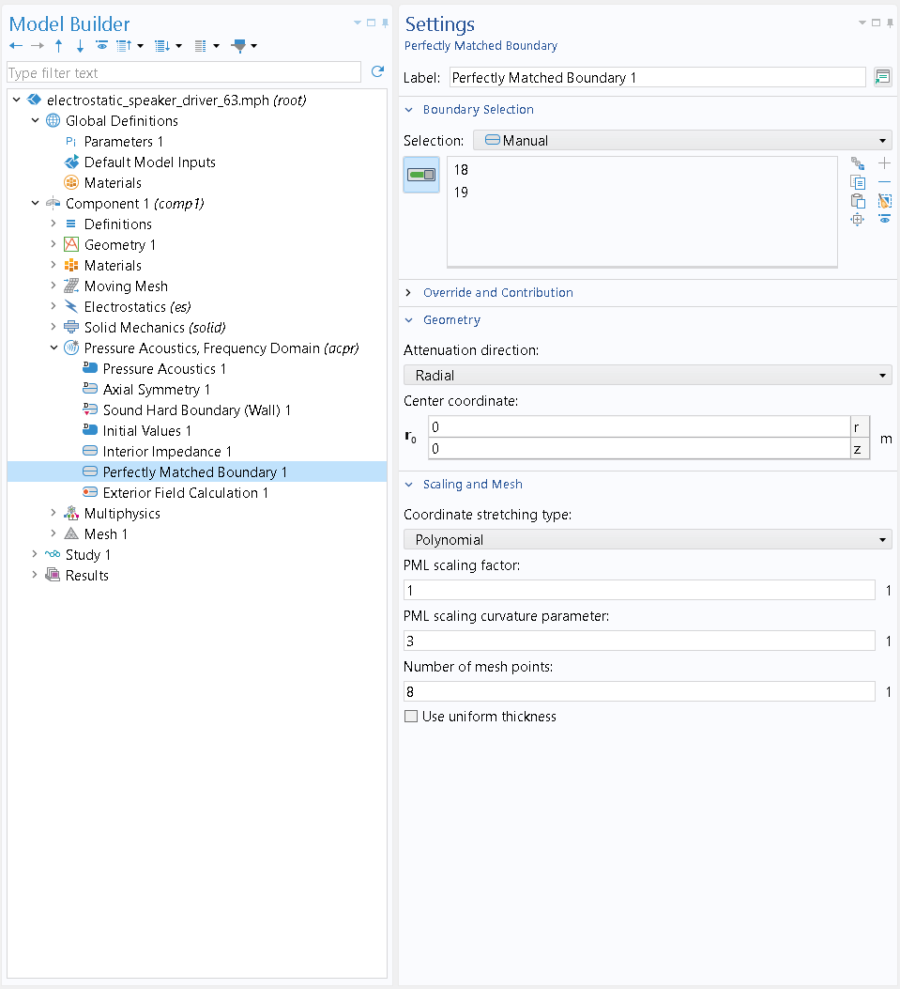
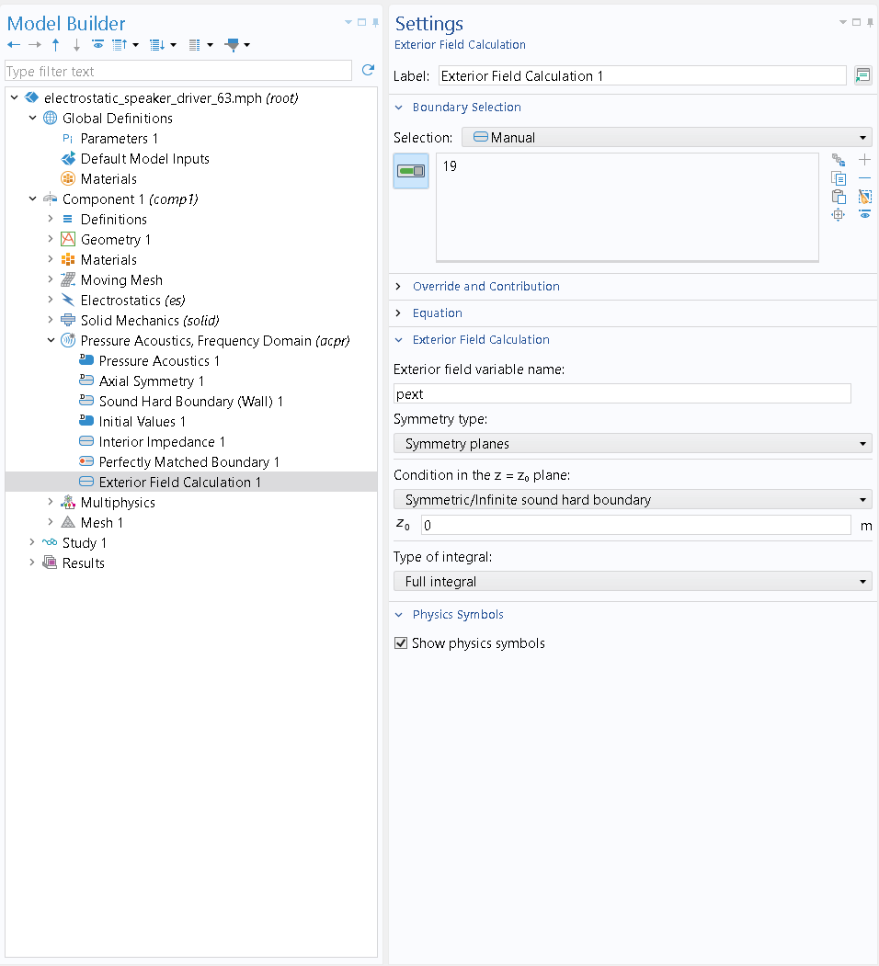
Model Definitions
Open domain propagation and Exterior Field Calculation
Perfectly Matched Boundary
Exterior Field Calculation
Radial attenuation direction
Use symmetry plane at z = 0

Slide 6
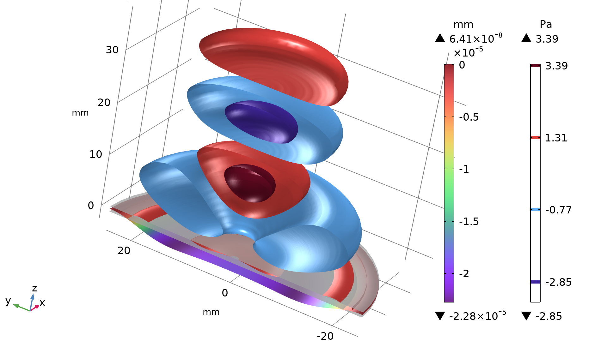
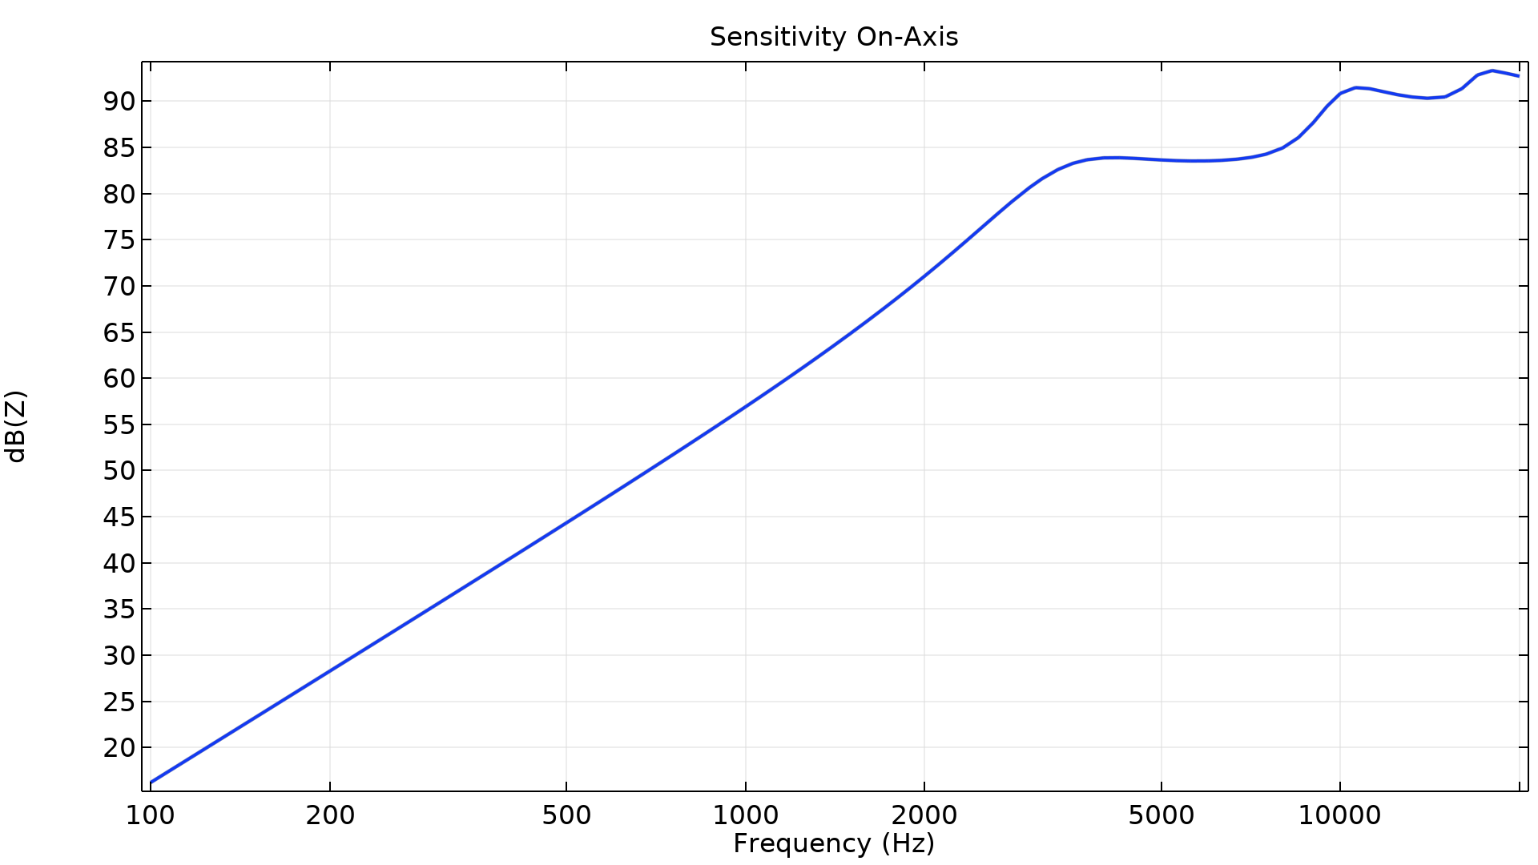
Results
Diaphragm deformation and acoustic pressure above the upper grid at f = 18 kHz
On-axis sensitivity 10 cm above the diaphragm

Slide 7
comsol.com

