Slide 1
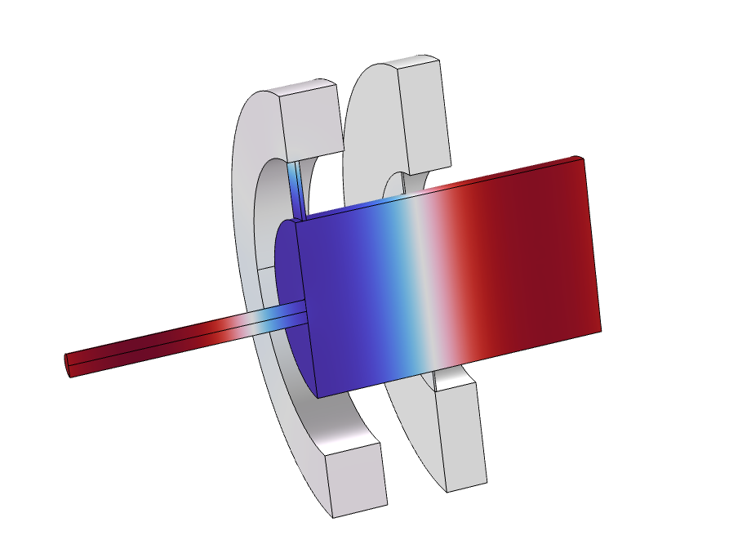
Transfer Matrix of a Tube and Coupler Measurement Setup

Slide 2
Background
This tutorial computes the transfer matrix T_{ij} of a tube and coupler measurement test setup. This type of setup is used for standardized testing, for example, for miniature loudspeakers or hearing aids.
The Port boundary condition in Pressure Acoustics, Frequency Domain is used together with the Port sweep functionality to automatically extract all four transfer matrix elements.
The computed transfer matrix is exported to a text file. The generated data is used in the Balanced Armature Transducer tutorial model to simplify the model setup using the Lumped Port feature.
The coupler geometry is taken from Generic 711 Coupler - An Occluded Ear Canal Simulator library tutorial. Besides certain details the geometry corresponds to the Brüel & Kjær Ear Simulator Type 4157.
Transfer matrix results are exported and used in Balanced Armature Transducer.

Slide 3
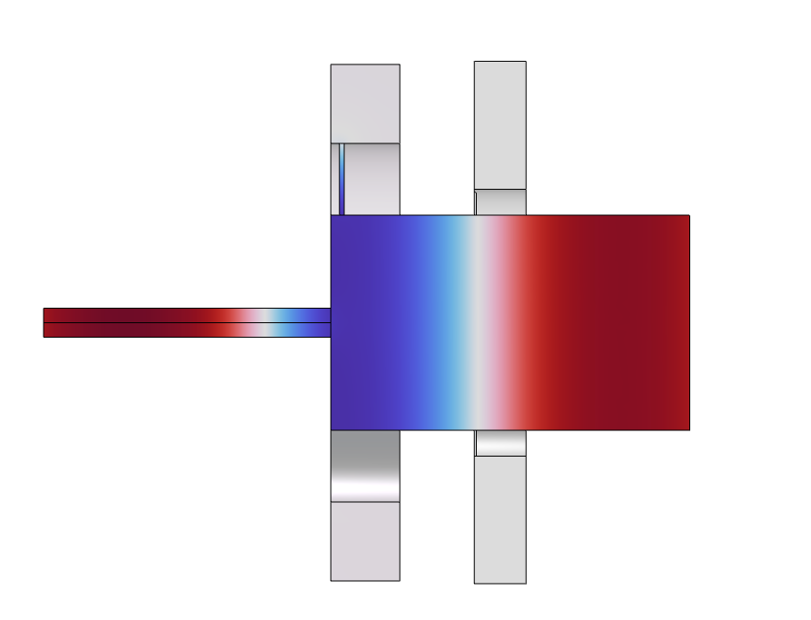
Model Definition
711 Coupler
Port 1:
Typical connection to device being tested
Tube
Port 2:
Location of measurement microphone
Compute transfer matrix T_{ij} of the system

Slide 4
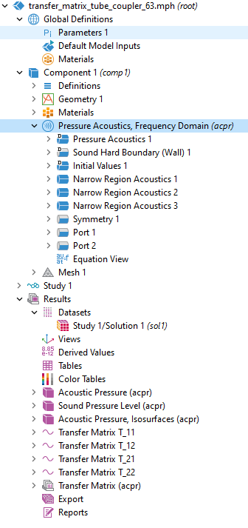
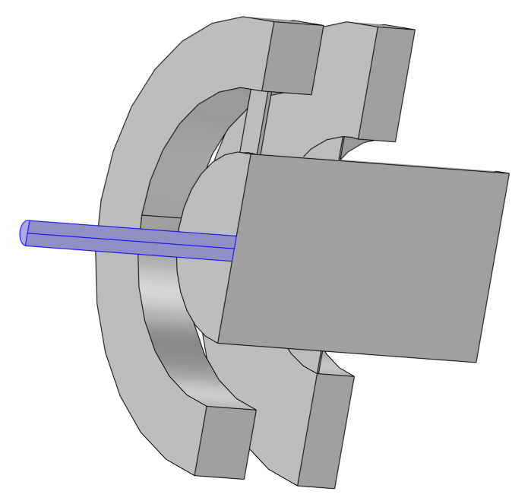
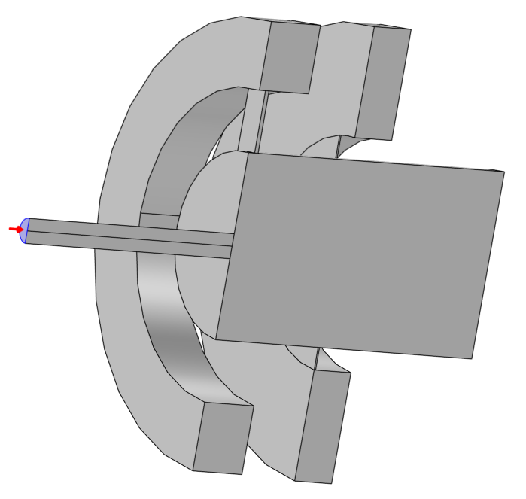
Implementation
Activate port sweep
Narrow region acoustics
  Homogenized thermoviscous losses in slits and tube
Port conditions
Evaluate real and imaginary part of T_{ij} for export to a text file

Slide 5
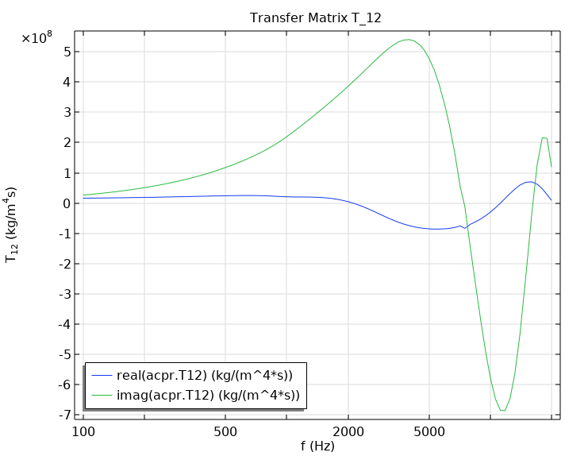
Results
The real and imaginary part of the four transfer matrix elements are computed and exported.
Plot of the real and imaginary part of T₁₂

