Slide 1
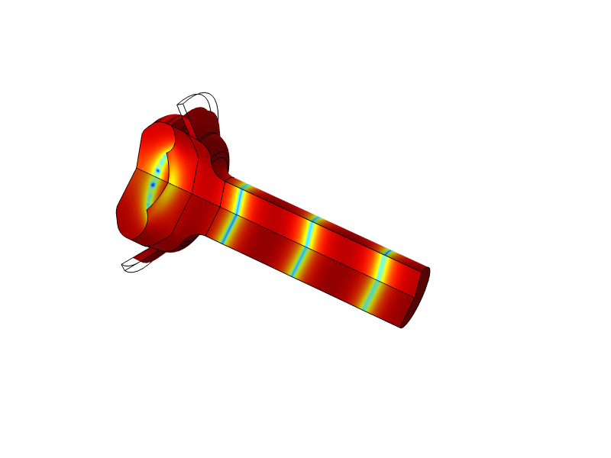
Acoustic Analysis of Leaks Around an Earbud

Slide 2
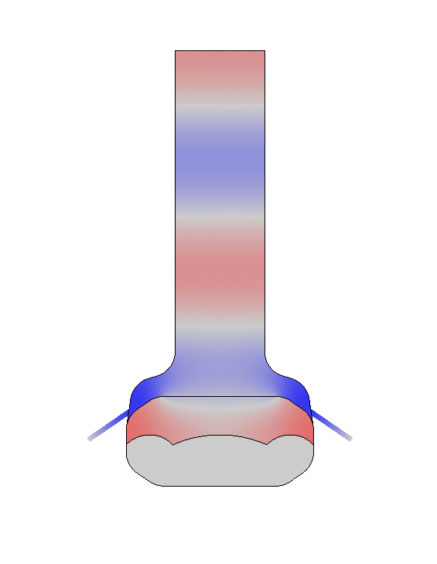
Model Setup
Perforated plate
Predicts the acoustic response of an earbud
Analyzes the sensitivity to leaks at different frequencies
A small gap represents the leak
Three built-in impedance models are used:
  Perforated plate
  Human skin
  Human ear drum
Skin impedance
Ear drum impedance
Leak
Earbud

Slide 3
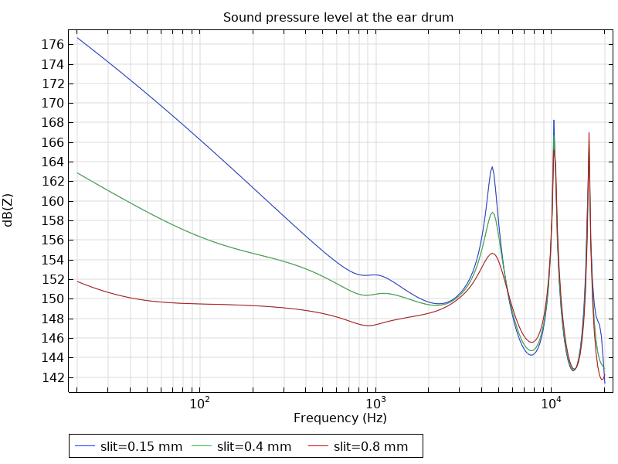
Results: Sound pressure level

