Slide 1
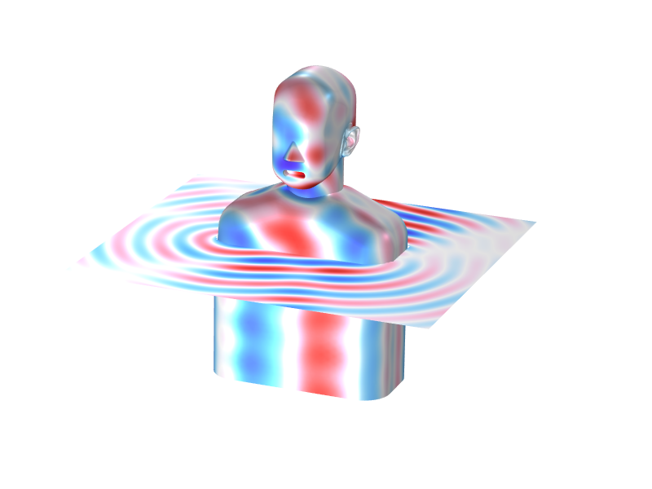
Head and Torso
Simulator Acoustics

Slide 2
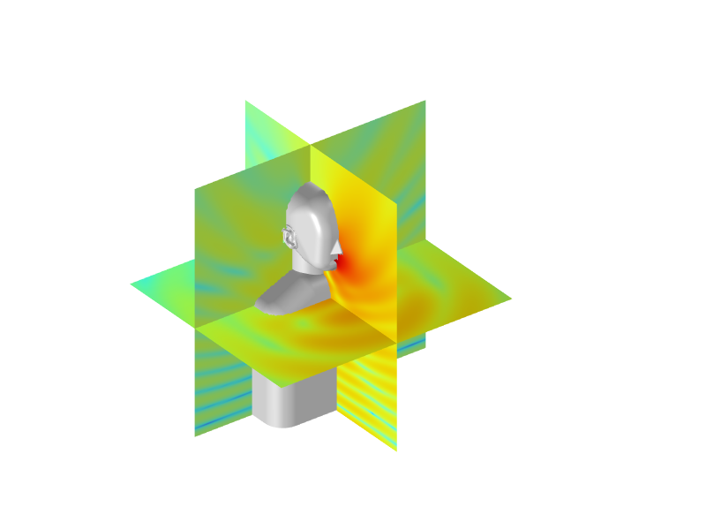
Introduction
The human body plays a major role in transforming acoustic signals from the free field (away from the head) to the eardrum (the human microphone)
In order to generate standardized measurements for hearing aids, mobile phones, and headphones, different standard shapes representing the human head and torso have been developed by test equipment manufacturers
This model presents a generic head and torso simulator and showcases some of the postprocessing methods, like the head-related transfer function (HRTF) or the mouth-to-ear transfer function
The effects of the head, torso, concha, pinna, and ear on the pressure level gain at the eardrum is discussed in Ref. 1

Slide 3
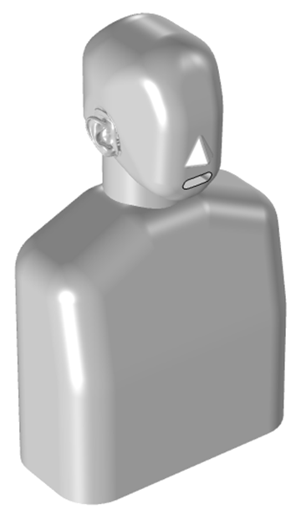
Model Definition
The head and torso simulator, or manikin geometry, is a generic geometry representing the main features of the human body contributing to the acoustic response of the body. The ear geometry is based on a 3D scan of an actual human head/ear.
The model uses the Pressure Acoustics, Boundary Elements physics interface to study the acoustic field in the half space domain exterior to the manikin. An infinite sound hard boundary is located at the bottom of the manikin. This can be removed to model a full space response.
The ear canal is represented in the model using an impedance condition. The built-in Physiological impedance model, Human ear without pinna option, is used.

Slide 4
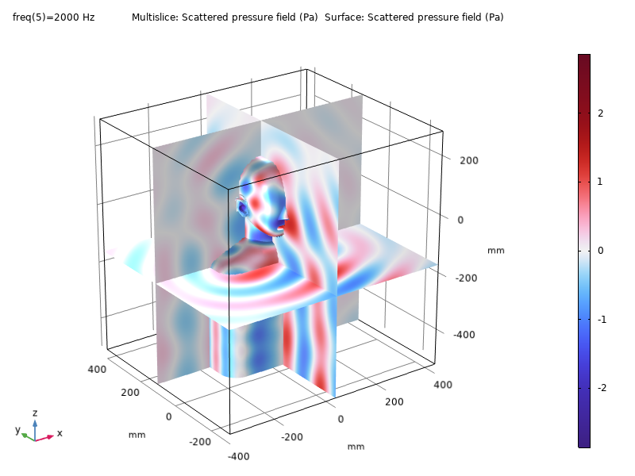
Study: Incident Wave Analysis
In this study, we look at the response of the manikin immersed in a background acoustic field of plane waves
It is interesting to see how the manikin starts to create a shadow in the acoustic field as the frequency of the incident waves increases
With the infinite sound hard boundary in use, the plane wave direction needs to be in-plane (in the xy-plane)

Slide 5
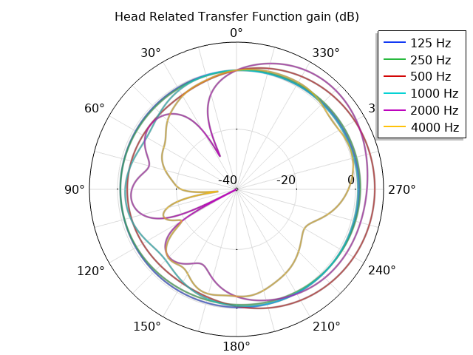
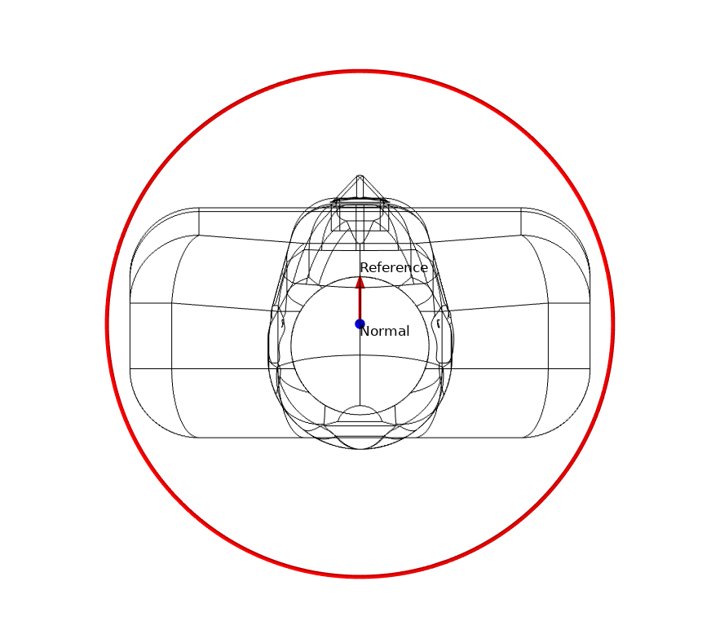
Study: Head-Related Transfer Function (HRTF)
In this study, we impose a velocity at the ear canal entrance to compute the sound pressure level at a circle of radius 1 m around the center of the head of the manikin.
The response in this circle is normalized to the sound pressure level at 1 meter exactly in front of the manikin head.
It is interesting to note how the HRTF starts to show more complex patterns as the frequency increases. This is where the wavelength becomes comparable to various geometric features. See Ref. 3 and 4.

Slide 6
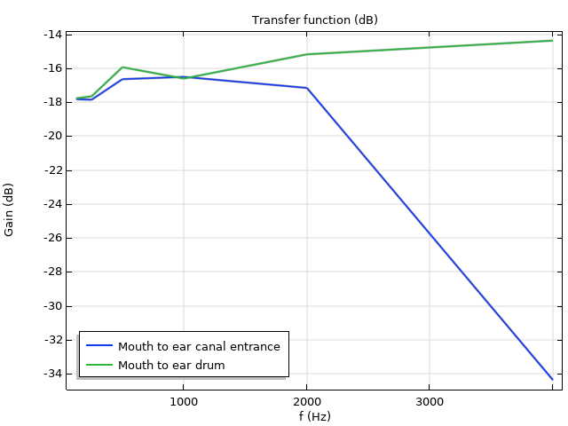
Study: Mouth-to-Ear Transfer Function
In this study, we impose a velocity at the mouth entrance to compute the sound pressure level at the ear canal entrance and the eardrum. The difference defines the transfer function.
Some test results to compare with are presented in Ref. 2 and 4.

Slide 7
References
E. A. G. Shaw, “The external Ear”, Handbook of Sensory Physiology/Sensory, vol. 5/1.
D. Cabrera, H. Sato, W.L. Martens, and D. Lee, “Binaural measurement and simulation of the room acoustical response from a person’s mouth to their ears”, Acoustics Australia/Australian Acoustical Society, 37(3):98–103.
M.H. Jensen “Improving the Performance of Hearing Aids Using Acoustic Simulations”, COMSOL Conference 2009, www.comsol.com/paper/7227.
”HATS Off to the Boundary Element Method,” Multiphysics Simulation 2018, www.comsol.com/zmags/multiphysics-simulation-2018.

