Slide 1
Sub-Component Lumping in Acoustics Using the Impedance Boundary Condition

Slide 2
Background and Motivation
This model illustrates how to convert complex sub-components into an impedance boundary condition in the Acoustics Module.
This allows for faster solution times and therefore can be used to optimize the modeling workflow when using COMSOL as a tool during product development phases.
The starting point is a fully coupled Thermoviscous Acoustics and Pressure Acoustics model, based on the gallery tutorial Energy Conservation with Thermoviscous Acoustics.
The model is reduced to a simplified Pressure Acoustics model with custom impedance boundary conditions handling the additional complexity.

Slide 3
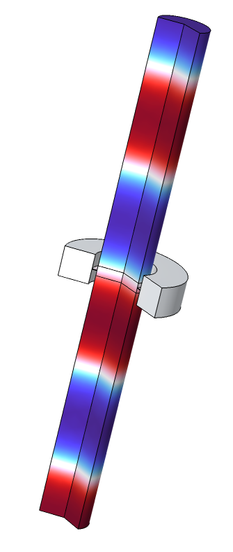
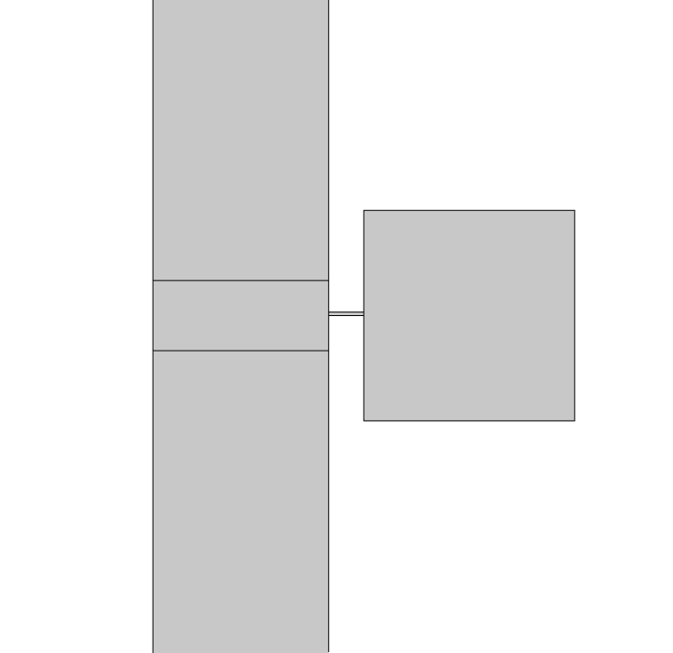
Geometry and Operating Conditions
outlet port
This is a model of a simple muffler-like system consisting of a long tube with a side Helmholtz resonator.
A plane wave is incident at the inlet. Port boundary conditions are used at the inlet and outlet.
The narrow neck connecting the resonator to the main tube includes thermoviscous losses. The neck and resonator are modeled with
Thermoviscous Acoustics. These are eventually replaced by an equivalent impedance condition.
z
impedance
condition
2D axi
inlet port
narrow neck

Slide 4
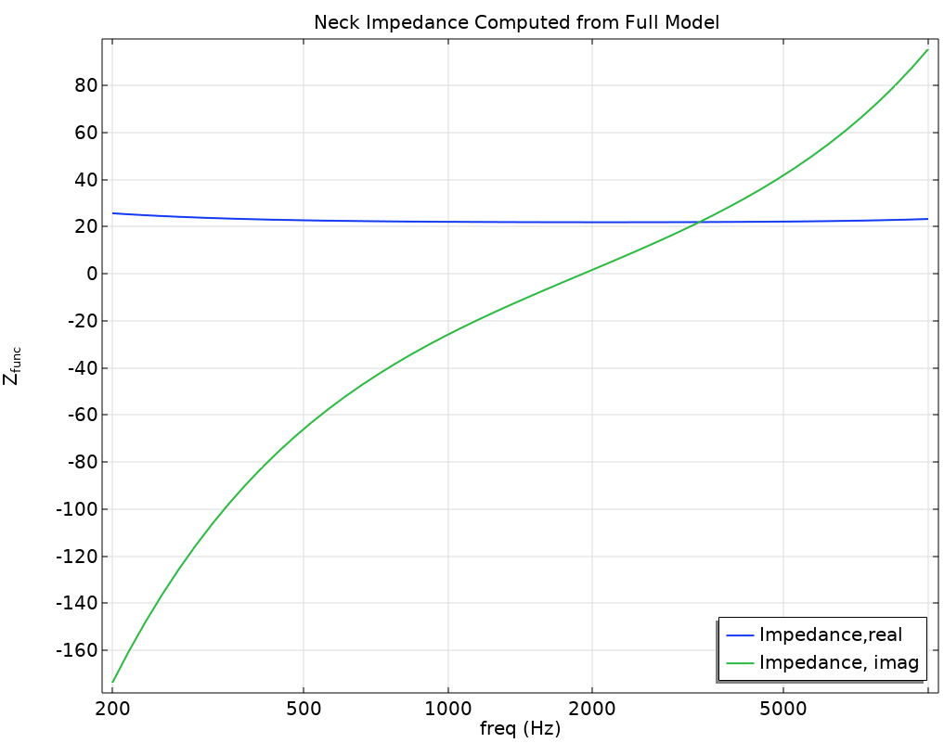
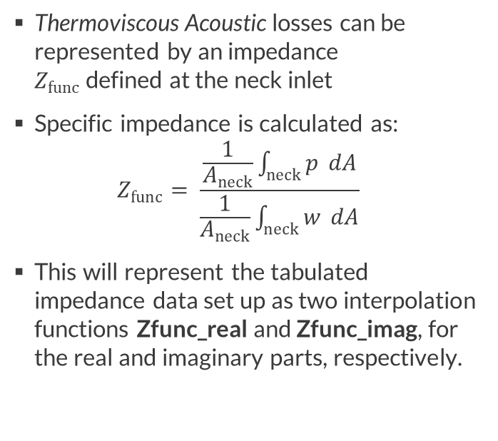
Calculate impedance in full model
Thermoviscous Acoustic losses can be represented by an impedance
$Z_{func}$ defined at the neck inlet
Specific impedance is calculated as:
$Z_{func}= \frac{\frac{1}{A_{neck}}\int_{neck}{p} dA}{\frac{1}{A_{neck}}\int_{neck}{w} dA}$
This will represent the tabulated impedance data set up as two interpolation functions Zfunc_real and Zfunc_imag, for the real and imaginary parts, respectively.

Slide 5
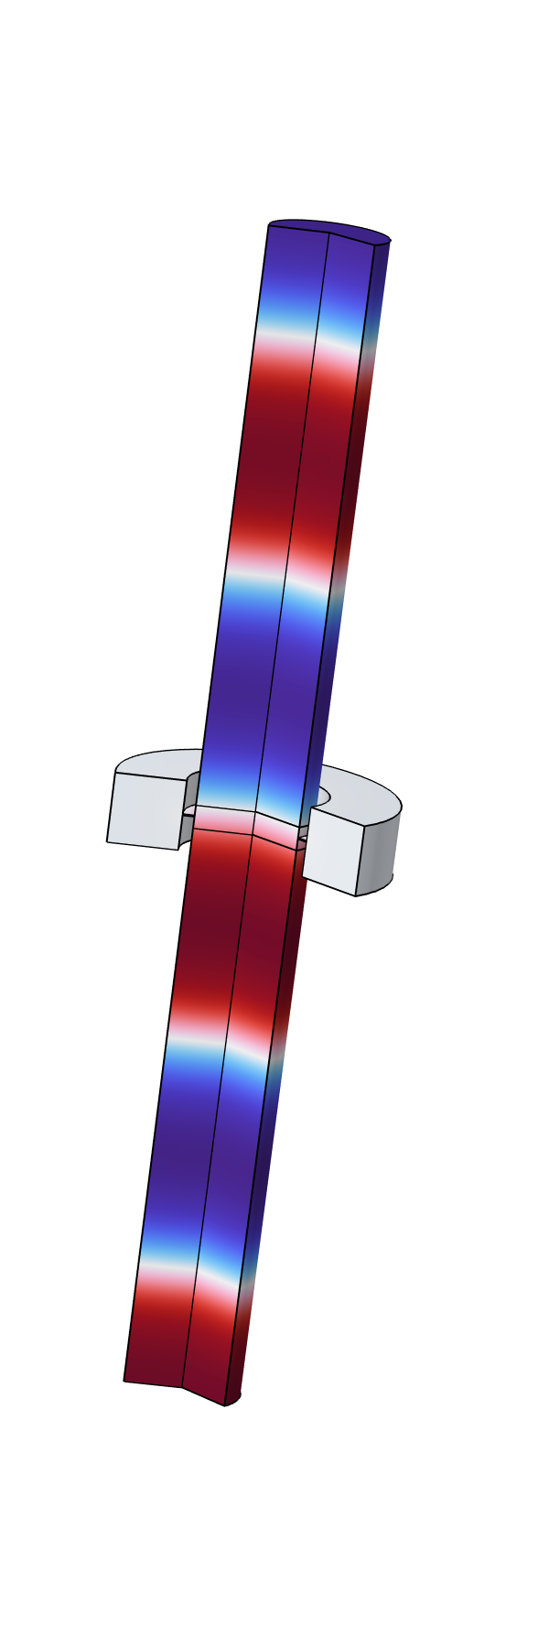
Model with Tabulated Impedance
In Study 3 of the model the Helmholtz resonator and the narrow neck are replaced with an impedance boundary condition.
The impedance boundary condition (User defined) is set equal to the values given by the interpolation functions (the tabulated data):
Zfunc_real(freq)+i*Zfunc_imag(freq)
This impedance condition mimics the actual system.

Slide 6
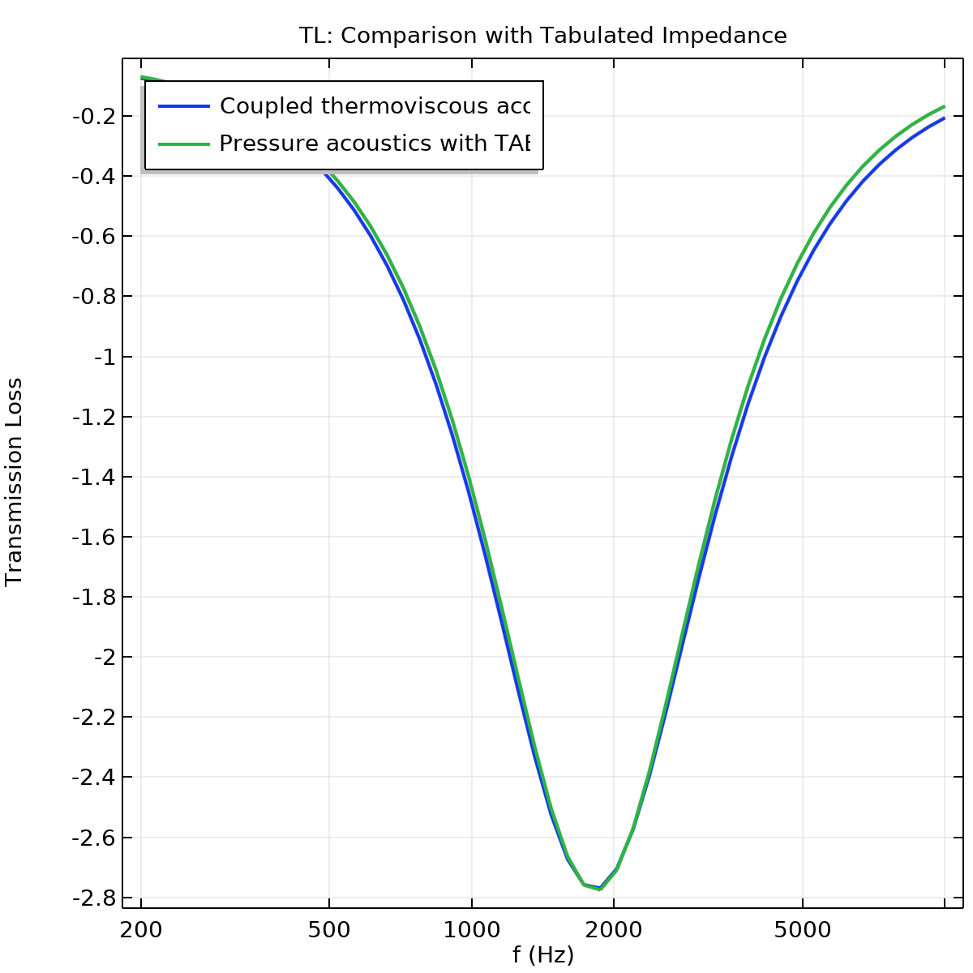
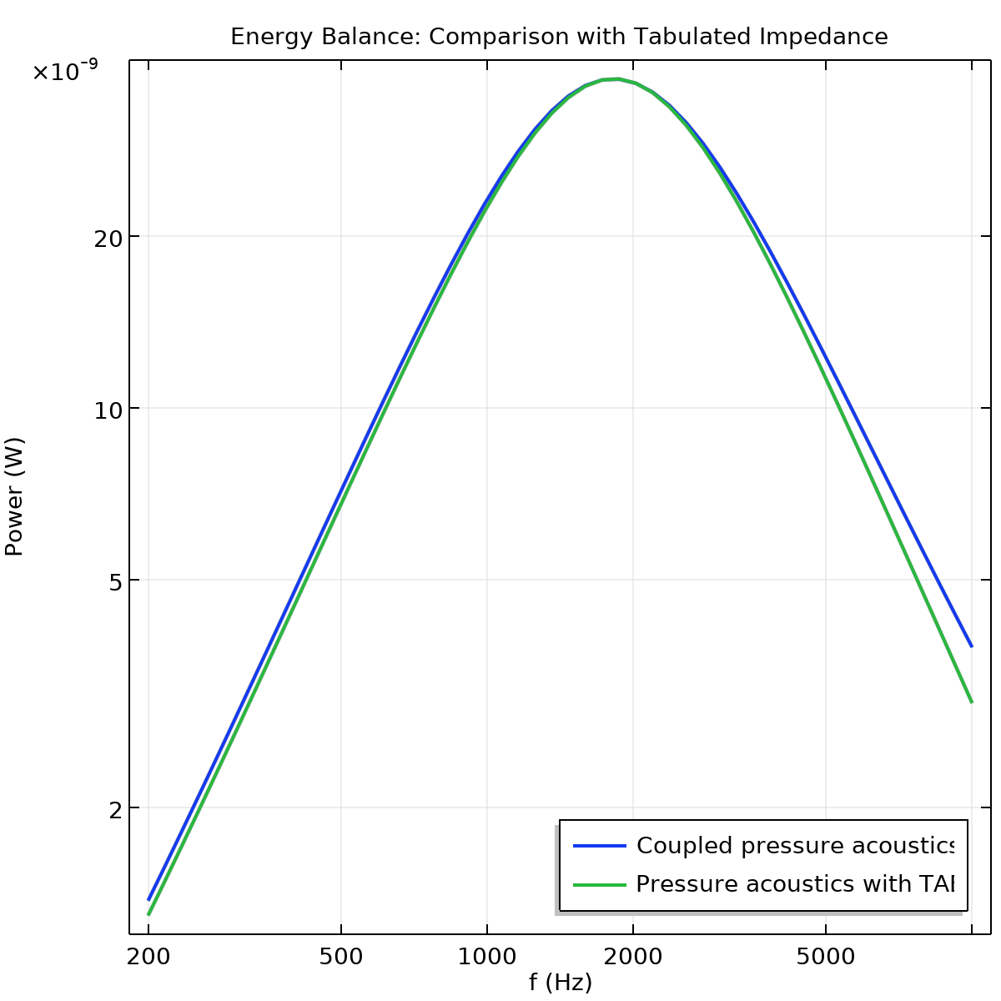
Model with Tabulated Impedance

Slide 7
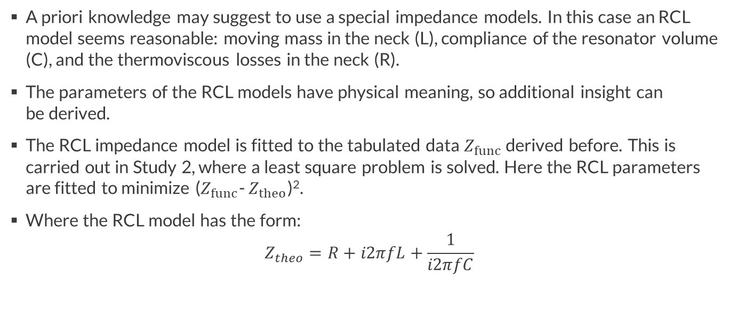
Model with Fitted RCL Impedance
A priori knowledge may suggest to use a special impedance models. In this case an RCL model seems reasonable: moving mass in the neck (L), compliance of the resonator volume (C), and the thermoviscous losses in the neck (R).
The parameters of the RCL models have physical meaning, so additional insight can
be derived.
The RCL impedance model is fitted to the tabulated data $Z_{func}$ derived before. This is carried out in Study 2, where a least square problem is solved. Here the RCL parameters are fitted to minimize ($Z_{func}$- $Z_{theo}$)².
Where the RCL model has the form:
$$Z_{theo}=R+i2πfL+\frac{1}{i2πfC}$$

Slide 8
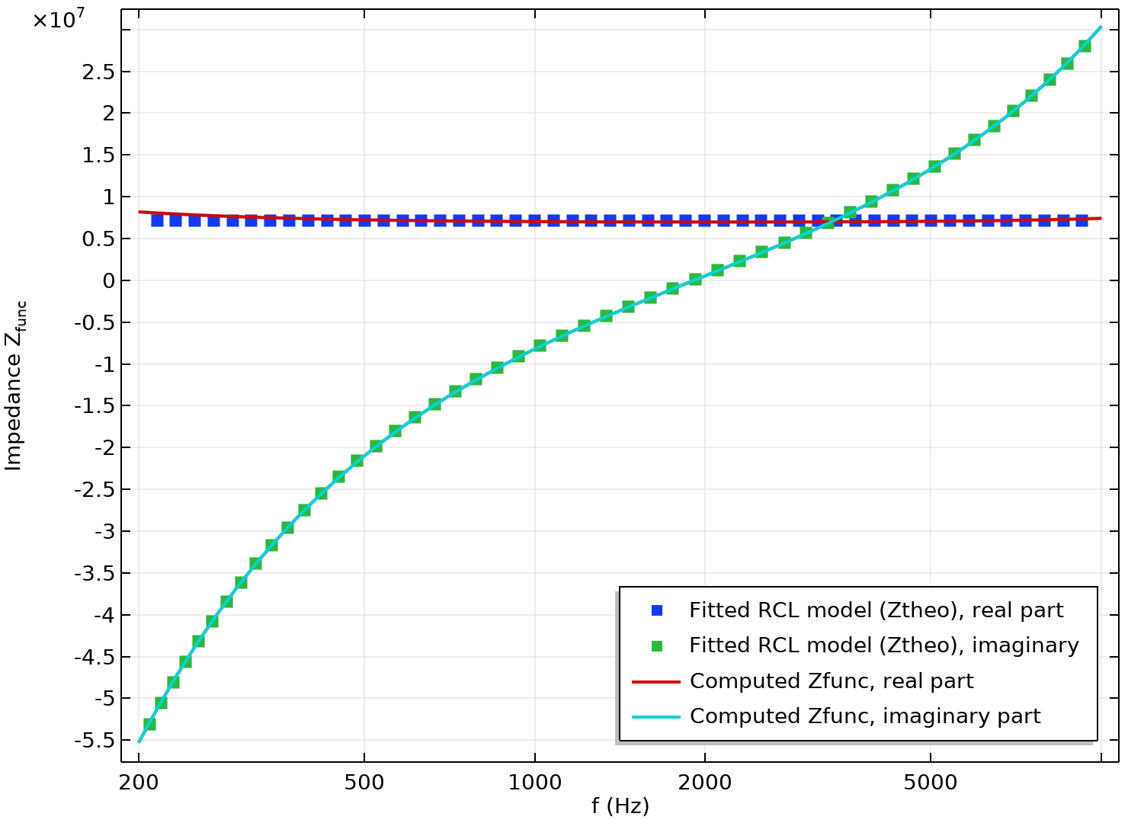
Model with Fitted RCL Impedance
Dots: fitted impedance model
Lines: target computed from fully coupled model

Slide 9
Model with RCL Impedance
Set up new Pressure Acoustics model (similar to first simplified model with the interpolated impedance)
Add an RCL impedance boundary condition and plug in the optimized parameter values
The values are evaluated in the las Evaluation Group of the model

Slide 10
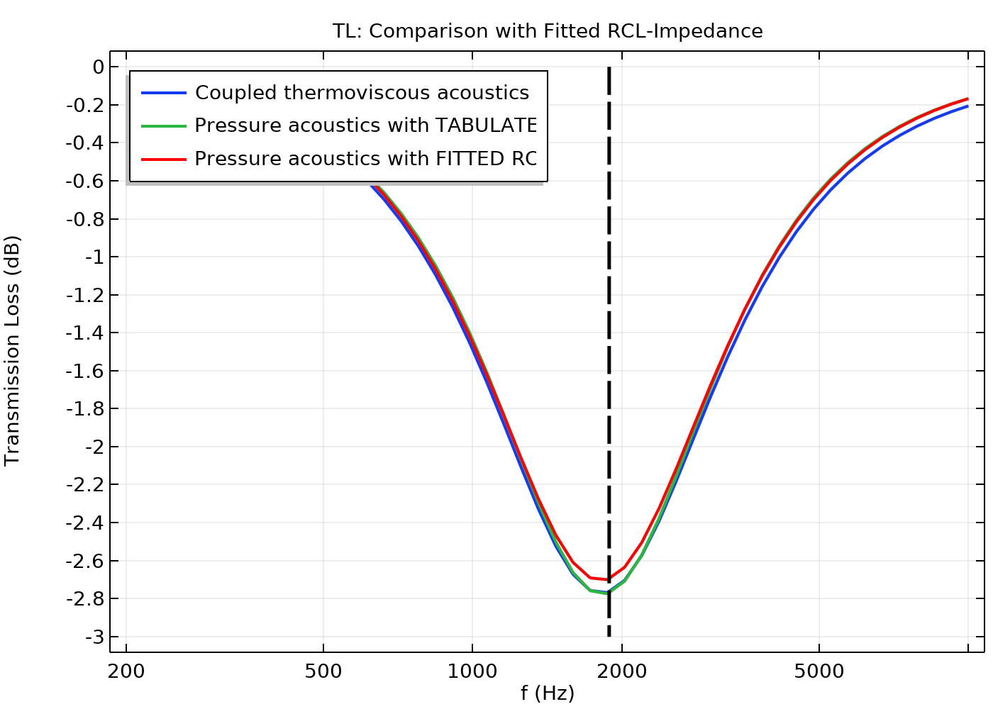
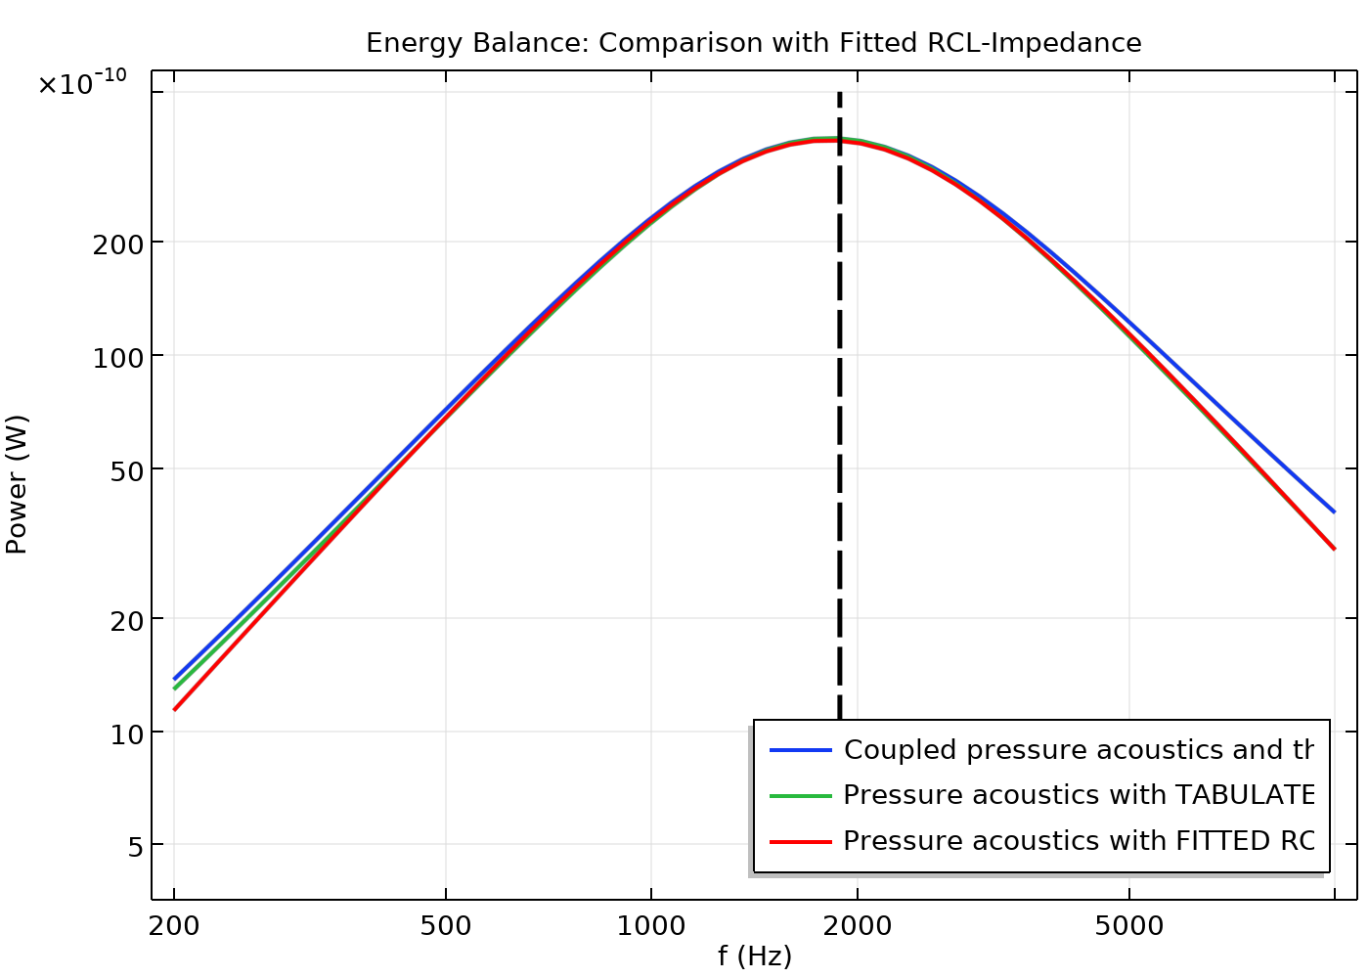
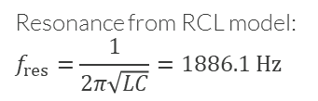
Results and Comparison
Resonance from RCL model:
$$f_{res}=\frac{1}{2π\sqrt{LC}}=1886.1 Hz$$
Losses are again well-captured using the impedance RCL condition.

Slide 11
comsol.com

