Slide 1
Transient Sound Pressure Levels

Slide 2
Application Background
For transient acoustic problems, there are different sound pressure level metrics that have been defined in the literature and in measurement standards. These metrics are important to know when comparing results from a transient acoustic simulation to measurements from a sound level meter or when trying to make results from a transient simulation easier to interpret on a logarithmic scale.
This application demonstrates the following:
  Step I: Compute the Frequency Weighted pressure for a transient signal using a window function
  Step II: Compute the Time Weighted Sound Level using a convolution in the time domain
  Step III: Compute Time Average Sound Level over a user defined time period using a parametric sweep
Reference: IEC 61672-1:2013 Electroacoustics - Sound level meters - Part 1: Specifications

Slide 3
Application Background
This application contains two models:
transient_SPL_sine.mph is a verification example using a sinusoidal waveform as the noise source.
transient_SPL_gearbox.mph is a model that uses a more realistic noise source from a gearbox

Slide 4



Step I: Frequency Weighting
Goal: Given a pressure signal $P(t)$, compute the A weighted pressure $P_{A}(t)$.
Standard IEC 61672-1:2013 defines frequency weighting functions which are used to modify a signal in a way which accounts for the frequency dependent perception of the ear.
The A-weighted gain function in dB is given in IEC 61672-1:2013.
For weighting a signal amplitude, use the transfer function definition $H(f)$
Here, $f$ is the frequency and constants $f1=20.6 Hz, f_{2}=107.7 Hz, f_{3}=737.9 Hz,$and $f_{4}=12194$ $Hz$. The function is defined to have 0 dB gain ($H\left(f\right)=1$) at 1000 Hz.
$$A\left(f\right)=20\log_{10}\left[\frac{f_{4}^{2}f^{2}}{\left.{\left(f\right.}^{2}+f_{1}^{2}){\left(f^{2}+f_{2}^{2}\right)}^{\frac{1}{2}}{\left(f^{2}+f_{3}^{2}\right)}^{\frac{1}{2}}{\left(f\right.}^{2}+f_{4}^{2}\right)}\right] −A_{1000}$$
$$A\left(f\right)=20\log_{10}\left[H\left(f\right)\right]$$
$$H\left(f\right)=\frac{f_{4}^{2}f^{2}}{\left.{\left(f\right.}^{2}+f_{1}^{2}){\left(f^{2}+f_{2}^{2}\right)}^{\frac{1}{2}}{\left(f^{2}+f_{3}^{2}\right)}^{\frac{1}{2}}{\left(f\right.}^{2}+f_{4}^{2}\right)}H_{1000}$$
$$H_{1000}=\frac{\left.{\left(1000\right.}^{2}+f_{1}^{2}){\left({1000}^{2}+f_{2}^{2}\right)}^{\frac{1}{2}}{\left({1000}^{2}+f_{3}^{2}\right)}^{\frac{1}{2}}{\left(1000\right.}^{2}+f_{4}^{2}\right)}{f_{4}^{2}{1000}^{2}}$$

Slide 5
Step I: Frequency Weighting
The transfer function H(f) is defined in an analytic function
A global ODE is used for 3 studies
Time dependent (store the signal to a dependent variable)
Time to frequency FFT
Frequency to time FFT
In 3) the transfer function H(f) is used in a user defined window function

Slide 6
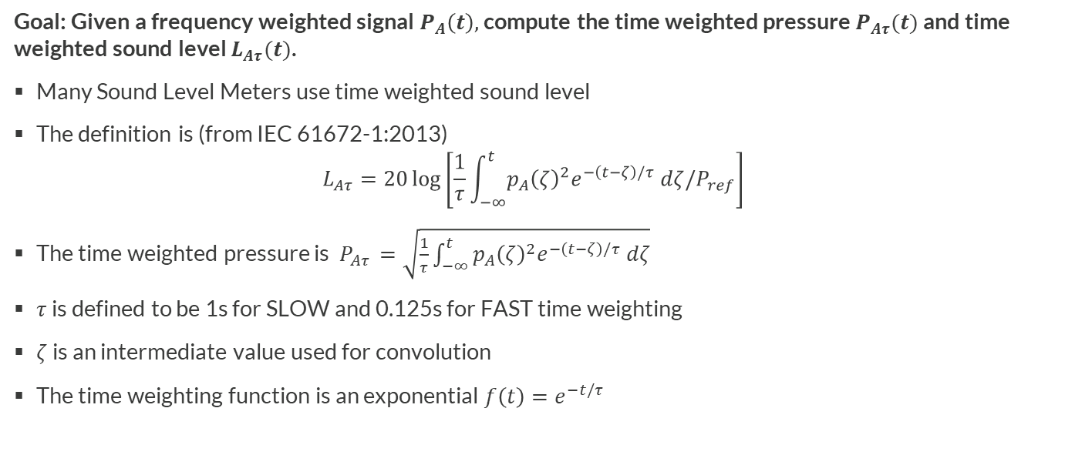
Step II: Time Weighted Sound Level
Goal: Given a frequency weighted signal $P_{A}\left(t\right),$ compute the time weighted pressure $P_{Aτ}(t)$ and time weighted sound level $L_{Aτ}(t)$.
Many Sound Level Meters use time weighted sound level
The definition is (from IEC 61672-1:2013)
$$L_{Aτ}=20\log\left[\frac{1}{τ}\int_{−∞}^{t}{p_{A}{\left(ζ\right)}^{2}e^{−\left(t−ζ\right)/τ} dζ/P_{ref}}\right]$$
The time weighted pressure is $P_{Aτ }=\sqrt{\frac{1}{τ}\int_{−∞}^{t}{p_{A}{\left(ζ\right)}^{2}e^{−\left(t−ζ\right)/τ} dζ}}$
$τ$ is defined to be 1s for SLOW and 0.125s for FAST time weighting
$ζ$ is an intermediate value used for convolution
The time weighting function is an exponential $f\left(t\right)=e^{−t/τ}$

Slide 7
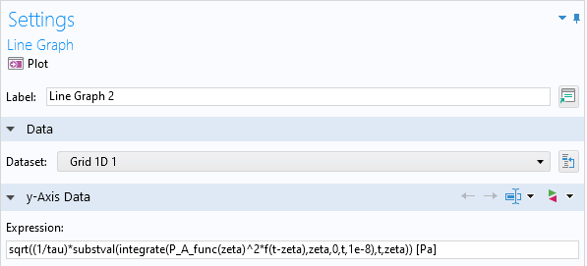
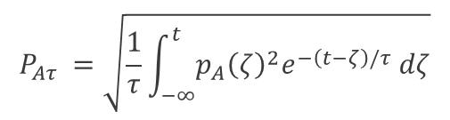
Step II: Time Weighting
A Line Graph is used to compute the convolution using the Grid 1D data set.
P_A_func is the A-weighted pressure from step 1, stored in an interpolation function
In the expression, zeta is the integration variable coordinate defined by the grid. “t” is a new variable introduced for the shifting of the exponential weighting function. The primary expression in substval() is integrate(P_A_func(zeta)^2*f(t-zeta),zeta,0,t,1e-8). This defines an integration over zeta from 0 to some varying quantity t, with an integration tolerance of 1e-8. substval() replaces t with a current value of zeta, which allows the convolution to be computed.
$$P_{Aτ }=\sqrt{\frac{1}{τ}\int_{−∞}^{t}{p_{A}{\left(ζ\right)}^{2}e^{−\left(t−ζ\right)/τ} dζ}}$$

Slide 8
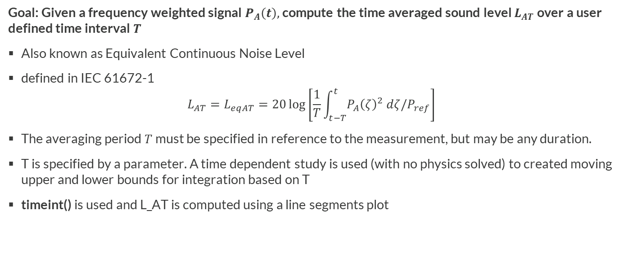
Step III: Time-Averaged Sound Level
Goal: Given a frequency weighted signal $P_{A}\left(t\right),$ compute the time averaged sound level $L_{AT}$ over a user defined time interval $T$
Also known as Equivalent Continuous Noise Level
defined in IEC 61672-1
$$L_{AT}=L_{eqAT}=20\log\left[\frac{1}{T}\int_{t−T}^{t}{P_{A}{\left(ζ\right)}^{2} dζ/P_{ref}}\right]$$
The averaging period $T$ must be specified in reference to the measurement, but may be any duration.
T is specified by a parameter. A time dependent study is used (with no physics solved) to created moving upper and lower bounds for integration based on T
timeint() is used and L_AT is computed using a line segments plot

Slide 9
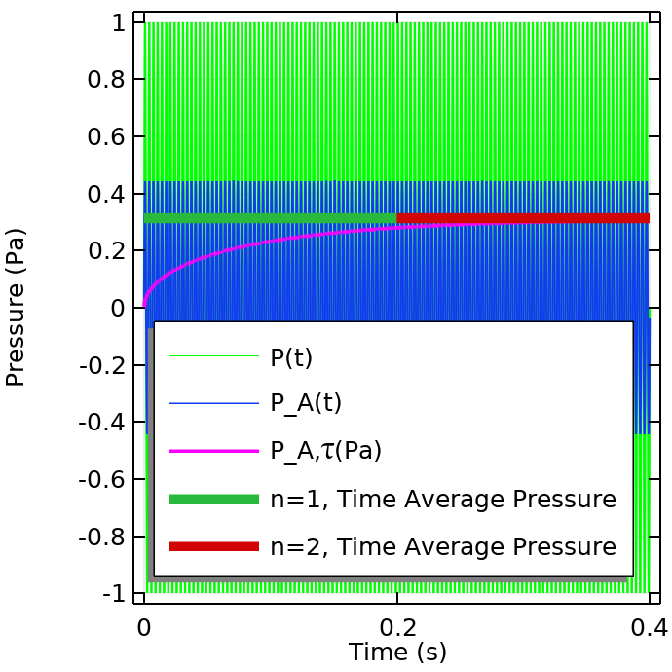
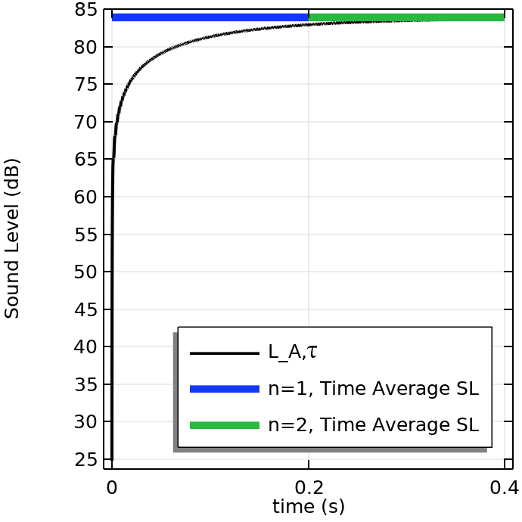
Sinusoidal Excitation Example

Slide 10
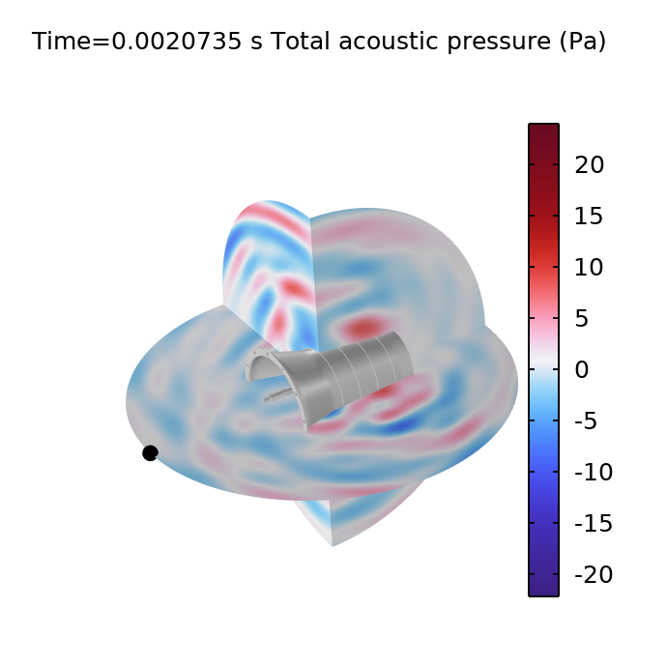
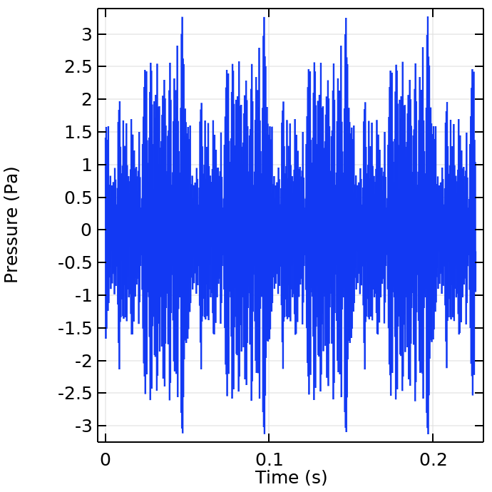
Gearbox Noise Example
This example uses the time dependent pressure from a virtual microphone located at (-0.75, 0, 0) in the gearbox_vibration_noise.mph model. This data is loaded and stored in an interpolation function. The metrics are computed in the same way as the sine verification example.

Slide 11
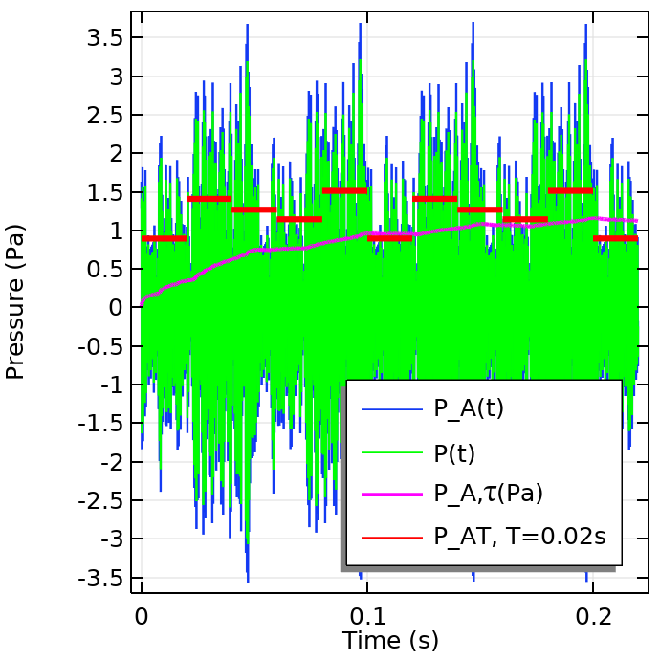
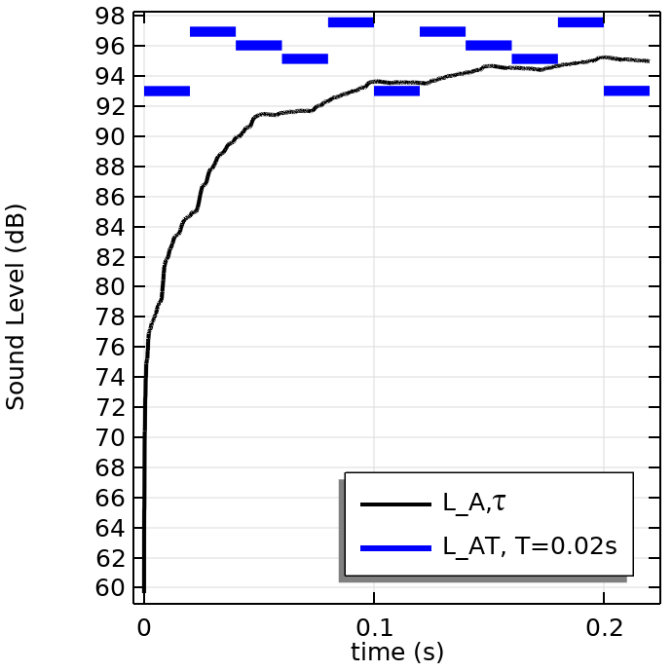
All Metrics Comparison
Most of the energy in the signal is between 1000-3000 Hz, therefore the A-weighted pressure is slightly amplified.

