Slide 1
Topology Optimization of a Torsion Sphere with Milling Constraints

Slide 2
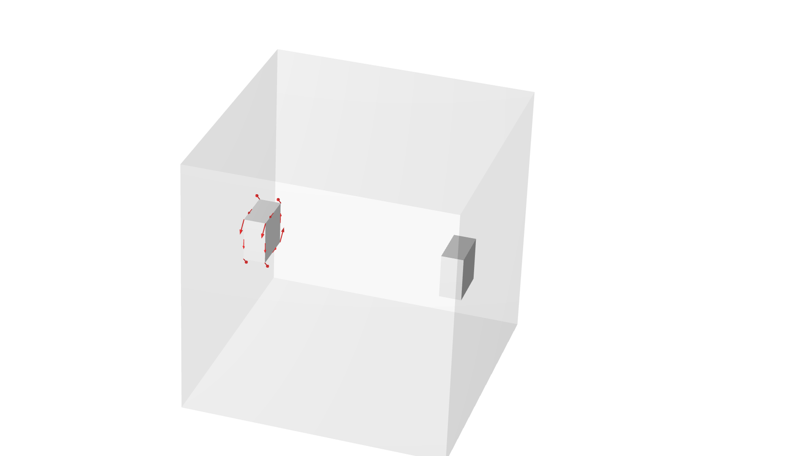




Torsion sphere
Torsion sphere
The torsion sphere problem is a good test case for milling, because the optimal design is a closed sphere
Topology optimization is a method that generates designs without a particular initial geometry
We consider a 10 % volume fraction and two milling directions
$${\vec{m}}_{1}$$
Setup
$${\vec{m}}_{2}$$
Single torsion load case
Continuation in the SIMP exponent parameter
1st milling direction
2nd milling direction
$${\vec{m}}_{1}$$
$${\vec{m}}_{2}$$

Slide 3
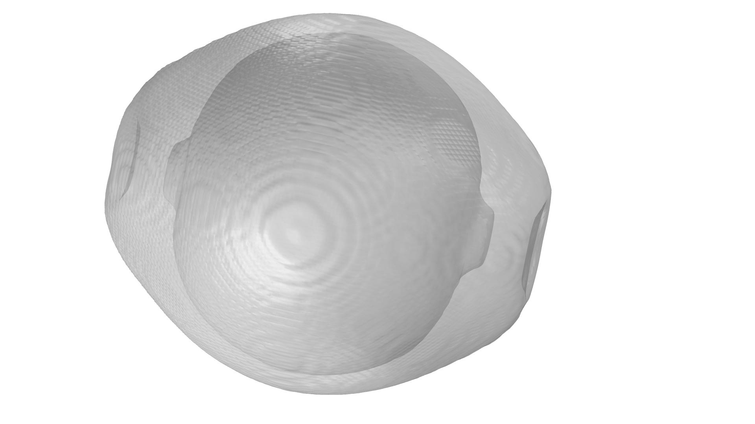
Torsion sphere
Setup
Single torsion load case
Continuation in the SIMP exponent parameter
Topology optimization is a method that generates designs without a particular initial geometry
Closed voids are problematic for many manufacturing techniques.
Results
The optimal design is a closed sphere, but too large filter radii (relative to the material volume) gives a truss design

Slide 4
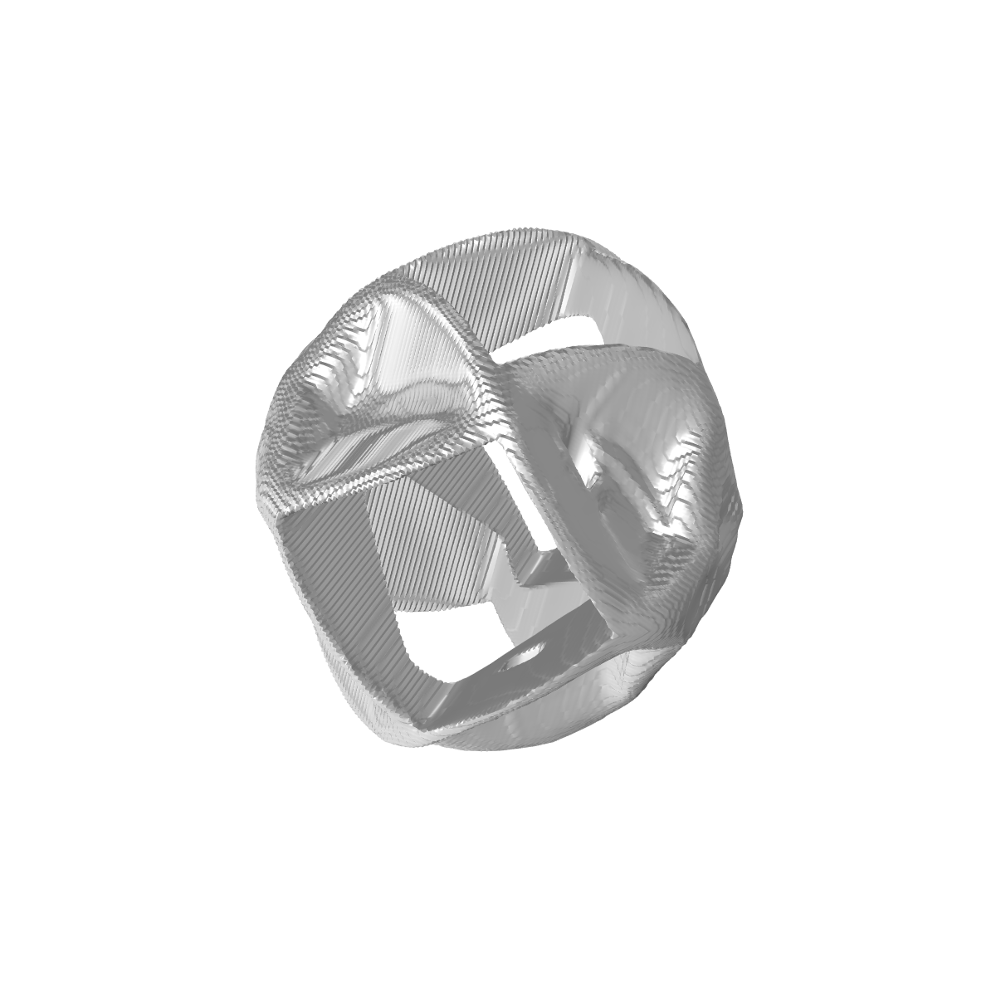
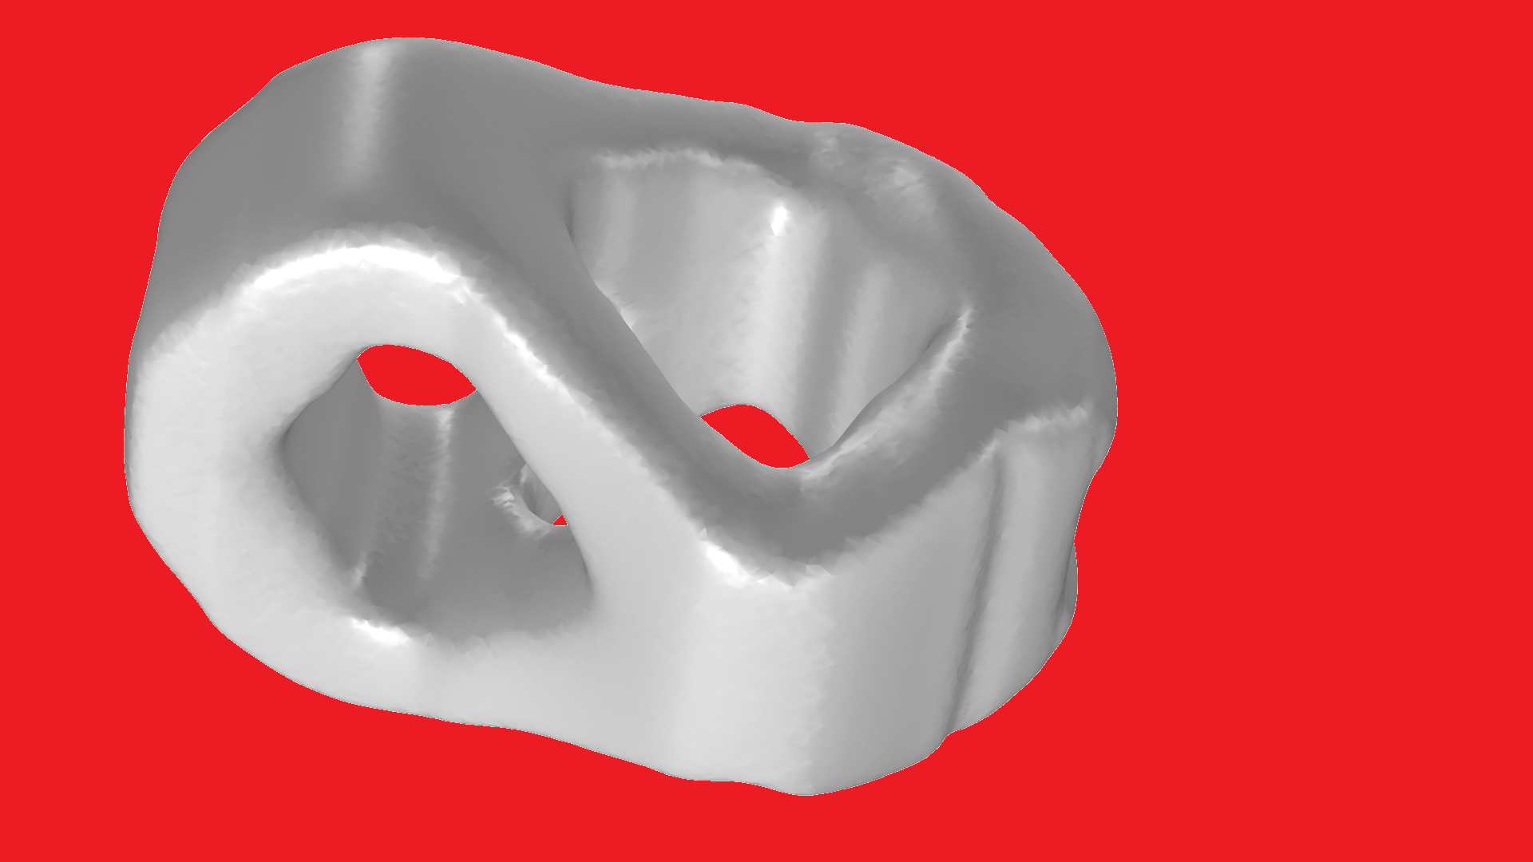

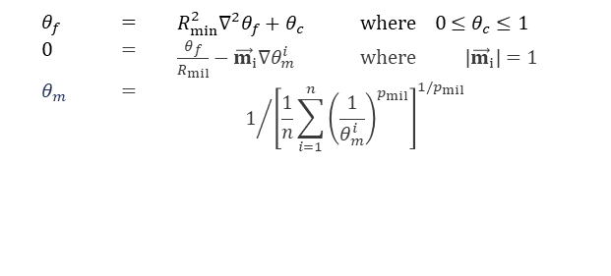
Milling Constraints
Milling directions
Symmetry is exploited so there are only two milling directions in the computational domain
The constraints are implemented with a PDE based approach
The milling directions, ${\vec{m}}_{i}$, define the convective velocities
Continuation
$$θ_{f}$$ | $$=$$ | $$R_{min}^{2}∇^{2}θ_{f}+θ_{c} where 0≤θ_{c}≤1$$
$$0$$ | $$=$$ | $\frac{θ_{f}}{R_{mil}}−{\vec{m}}_{i}∇θ_{m}^{i}$ where ${ |\vec{m}}_{i}|=1$
$$θ_{m}$$ | $$=$$ | $$1/{{\left[\frac{1}{n}\sum_{i=1}^{n}{{\left(\frac{1}{θ_{m}^{i}}\right)}^{p_{mil}}}\right]}^{1/p_{mil} }}$$
Continuation strategy is critical for finding good topologies
”Surface finish” depends on chosen discretization for convective equation

Slide 5
References
[1] T Lewiński, Michell structures formed on surfaces of revolution, SMO 28(1), 20-30 (2004)
[2] L Høghøj, E A Träff, An advection--diffusion based filter for machinable designs in topology optimization, Comp. App. Mech. Eng. 391, 114488 (2022)
[3] J Gasick, X Qian, Simultaneous topology and machine orientation optimization for multiaxis machining, Int. J. Num. Meth. Eng. 122 (24), 7504 (2021)
The example problem is from [1]. The implementation is inspired by [2].

