Slide 1
Preconditioning of Surface-Mount Devices (SMDs) for Testing

Slide 2
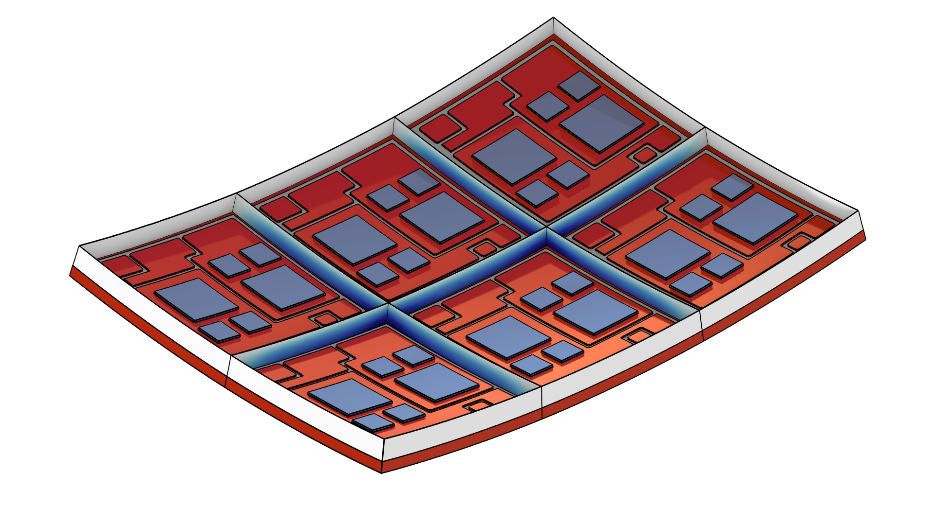
Overview
Prior to reliability testing, surface-mount devices (SMDs) are required to go through a preconditioning process.
The preconditioning process is the modeling and simulation of the surface mount process, to represent the effects of storage and the reflow operation in the device’s assembly process.
Test samples are subjected to temperature cycling, dry bake, moisture soaking, and solder flow operations.
This model analyzes the stress on an SMD, its deformation, and potential damage caused by temperature and humidity changes.

Slide 3
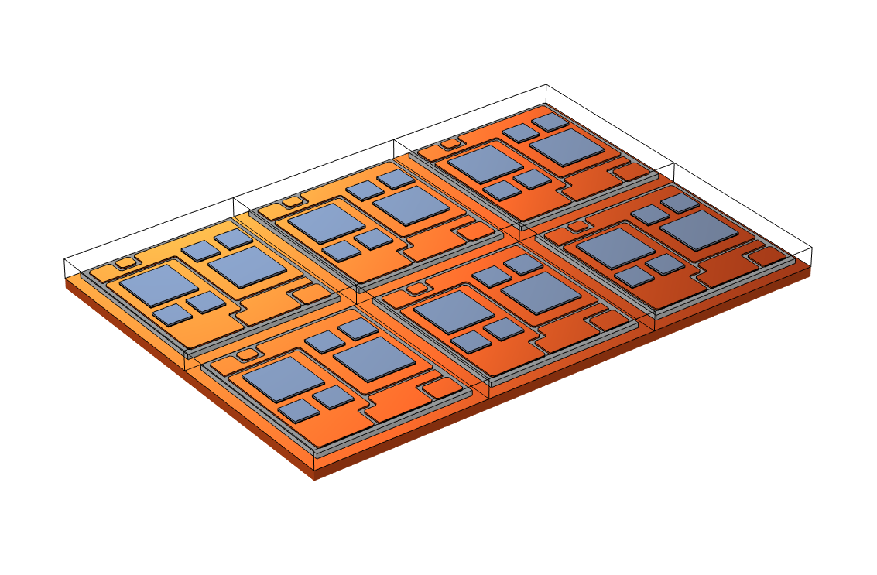
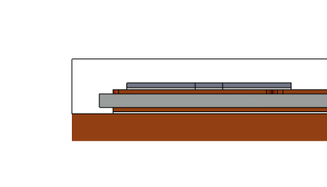
Geometry
An insulated-gate bipolar transistor (IGBT) module is studied in this model.
EMC
Die
Sn3Ag
Copper
Ceramics

Slide 4
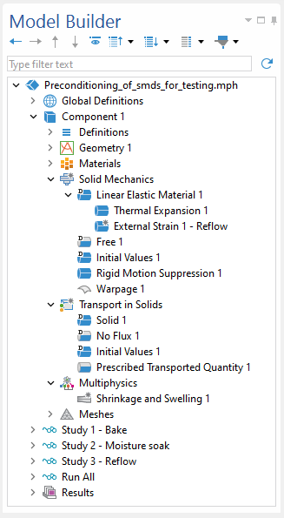
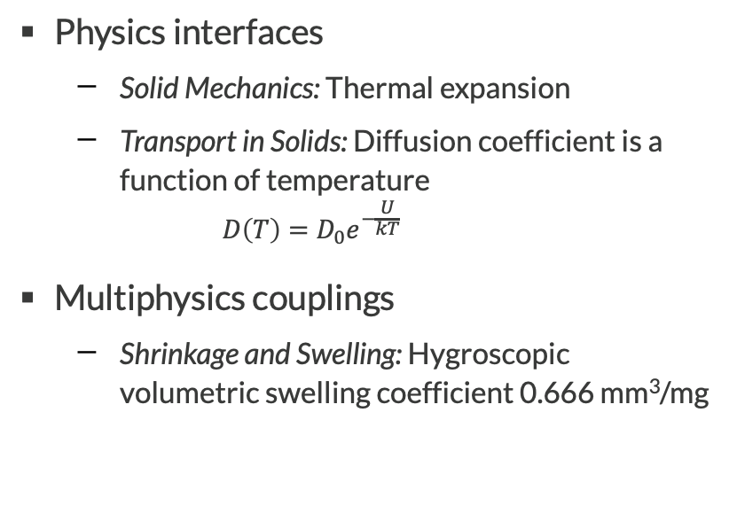
Physics and Multiphysics
Physics interfaces
  Solid Mechanics: Thermal expansion
  Transport in Solids: Diffusion coefficient is a function of temperature
    $$D\left(T\right)=D_{0}e^{−\frac{U}{kT}}$$
Multiphysics couplings
  Shrinkage and Swelling: Hygroscopic volumetric swelling coefficient 0.666 mm³/mg

Slide 5
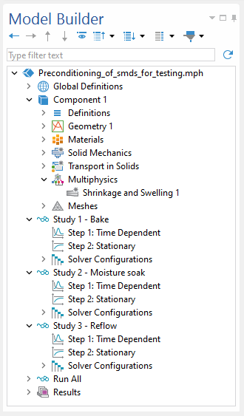
Preconditioning Process Steps
Bake
  Removal of moisture in the structure
Moisture soak
  Absorption of moisture in the plastic seal
Reflow
  Reflow of molten solder

Slide 6
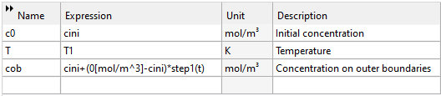
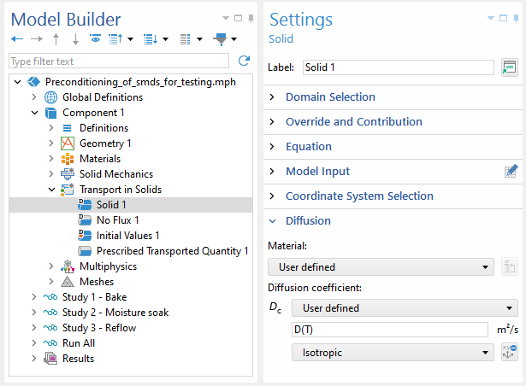
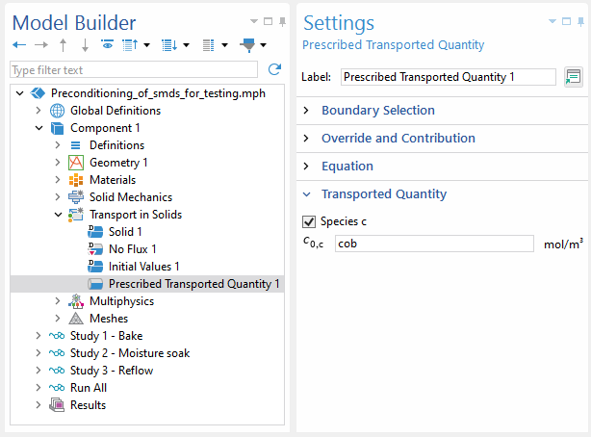
Step 1 – Bake
Duration
  24 h
Temperature
  T1 = 125ºC
  Reference temperature is 25ºC
Moisture conditions
  Initial concentration is 10 mol/m³
  Reference concentration for hydroscopic swelling is 10 mol/m³
  Concentration at outer boundary of plastic seal is set to 0 mol/m³

Slide 7
Step 2 – Moisture soak
Duration
  192 h
Temperature
  T = 40ºC
Moisture conditions
  Initial concentration is 0 mol/m³
    The structure is regarded to be completely dry after baking
  Concentration at outer boundary of plastic seal is kept as 140 mol/m³
    Assuming the moisture is saturated at outer boundary during the step
    The saturation concentration is temperature independent

Slide 8
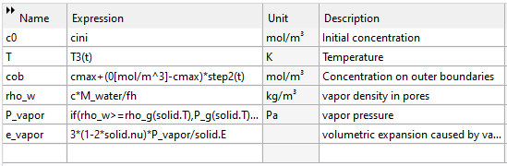
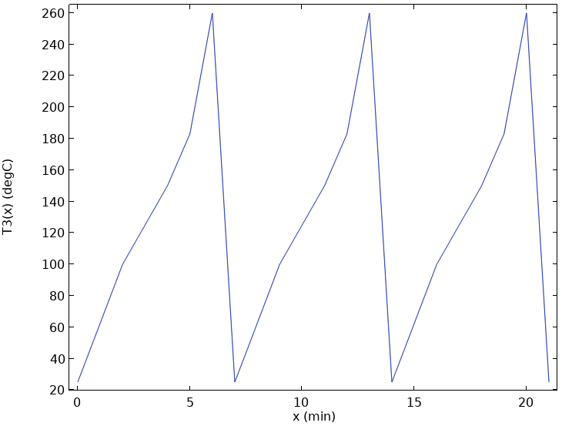
Step 3 – Reflow
Duration
  21 min (3 cycles)
Temperature
  Temperature variation T3(t) is defined
    Tmax = 260ºC
    Finally reach room temperature (25ºC)
Moisture conditions
  Initial concentration is taken from the final result of step 2
    Reflow test is conducted immediately after moisture soak
  Concentration at outer boundary of plastic seal is set to 0 mol/m³

Slide 9

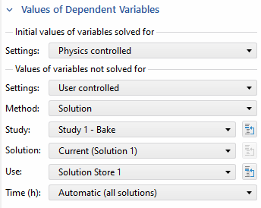
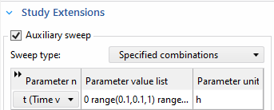
Study
For each process step, includes a transient step and a steady step
  Transient step for moisture diffusion only
  Steady step for structure deformation only: Inherit the concentration results of the transient step by scanning the parameter “t”

Slide 10
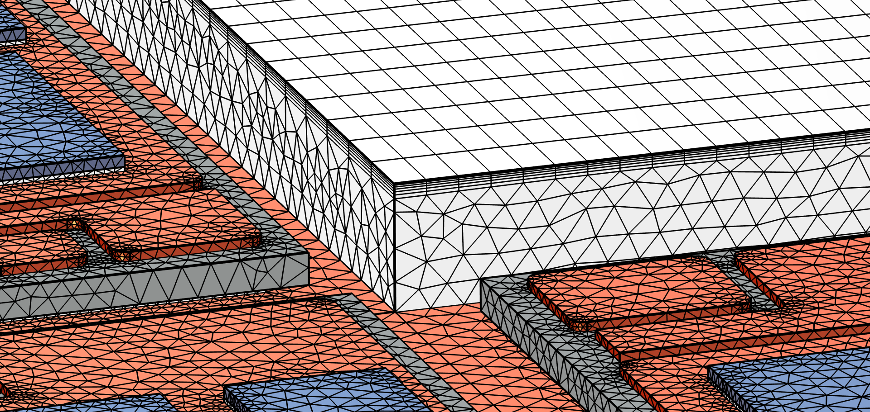
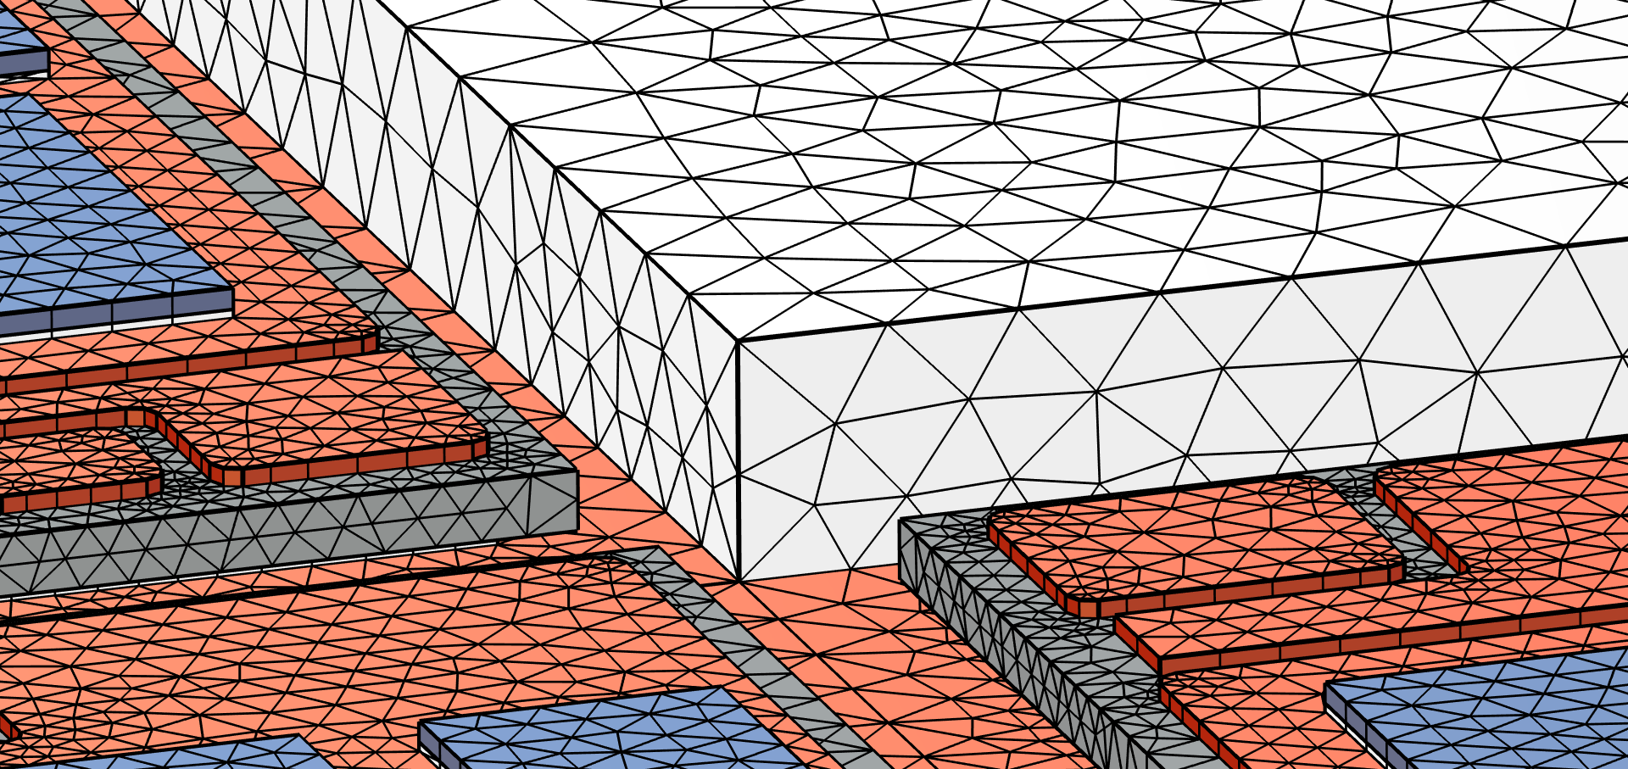
Mesh
Diffusion
Deformations
Use a boundary layer at the outer boundary of the plastic seal where strong gradients are present.
To model the deformation of the plastic seal, use a coarser mesh to save computational resources.

Slide 11
Materials
Materials | CTE (1/K) | Density (kg/m³) | Young’s modulus (GPa) | Poisson’s ratio
Copper | 17e-6 | 8960 | 110 | 0.35
Die | 2.6e-6 | 2320 | 160 | 0.22
Sn3Ag | 23e-6 | 7440 | 40 | 0.40
EMC | 10e-6 | 1900 | 22 | 0.40
Ceramics | 23e-6 | 2700 | 70 | 0.33

Slide 12
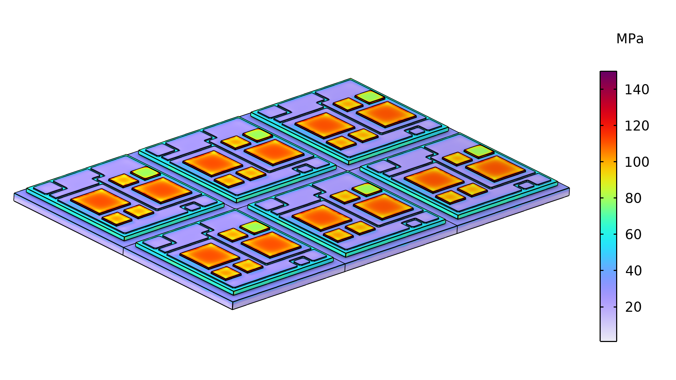
Results, Bake
Stress distribution after baking step finished

Slide 13
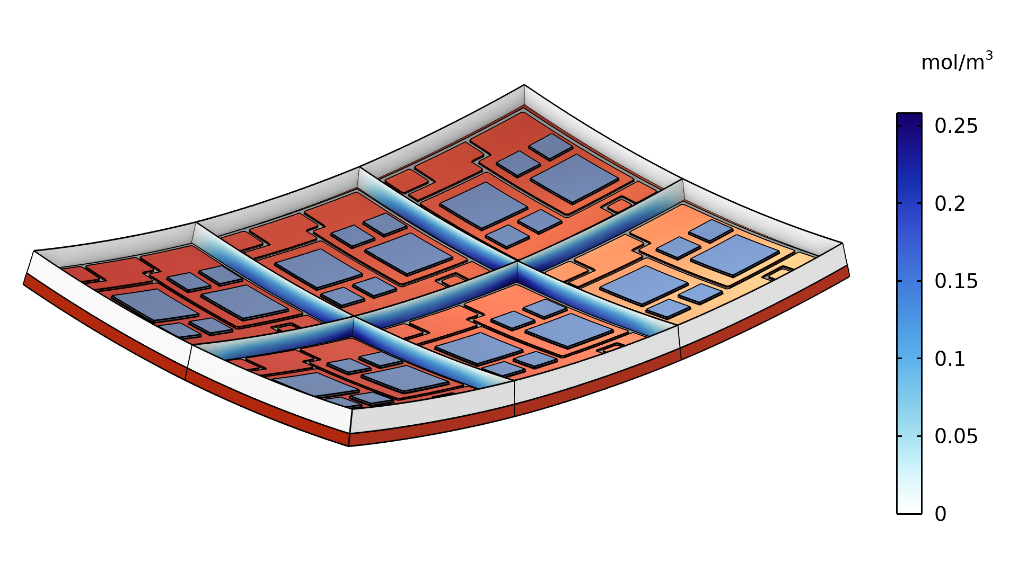
Results, Bake
Moisture concentration in the plastic seal after baking step finished
With the structure deformation shown.

Slide 14
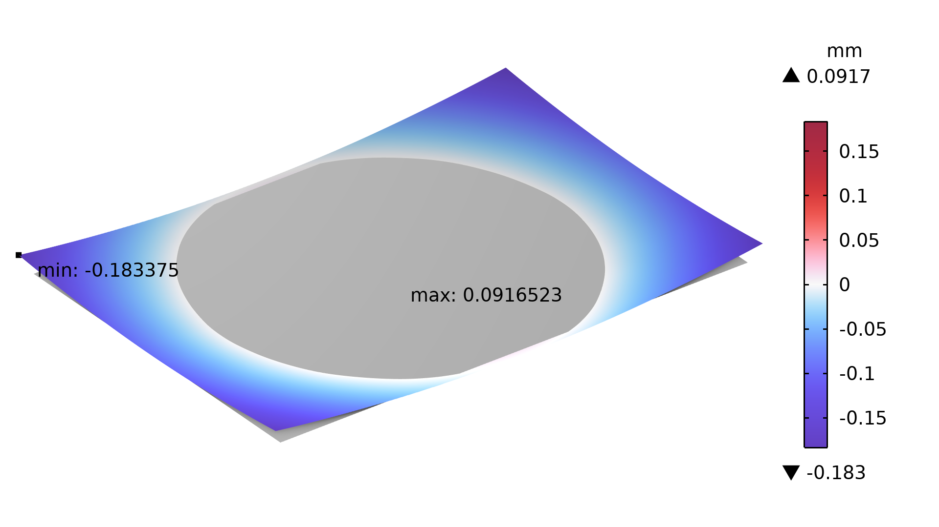
Results, Bake
Structure warpage during the baking step

Slide 15
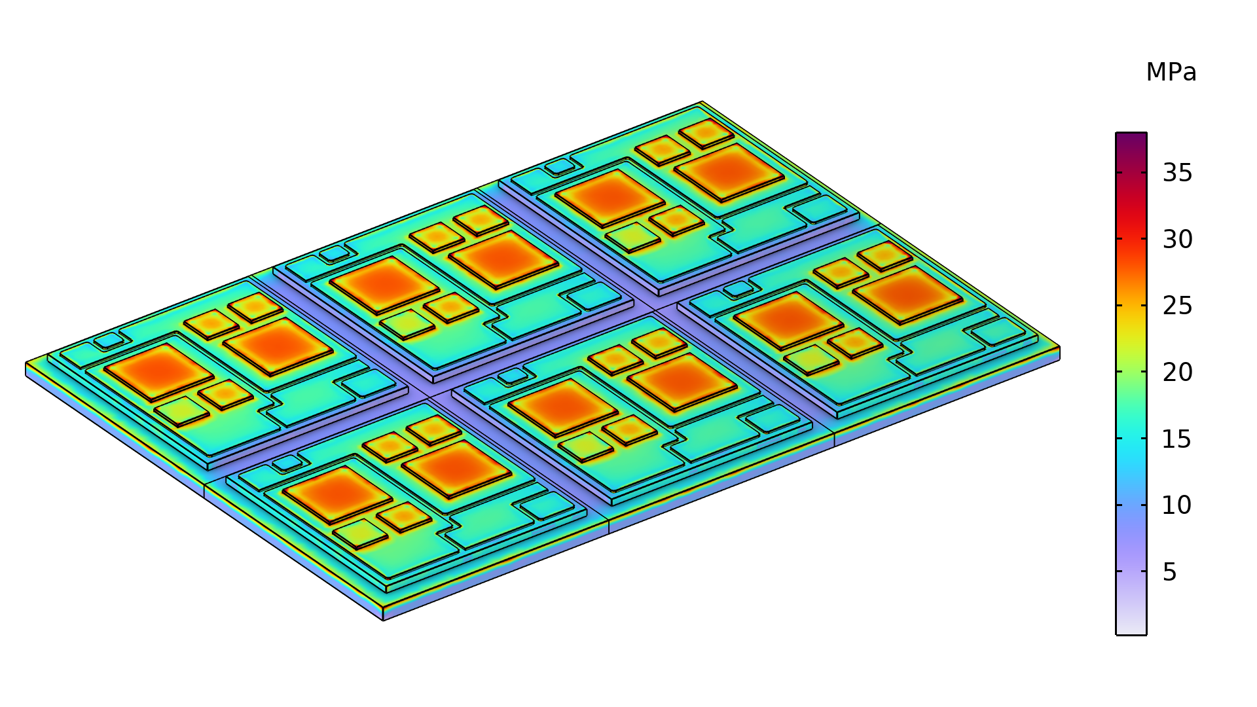
Results, Moisture Soak
Stress distribution after moisture soak step finished

Slide 16
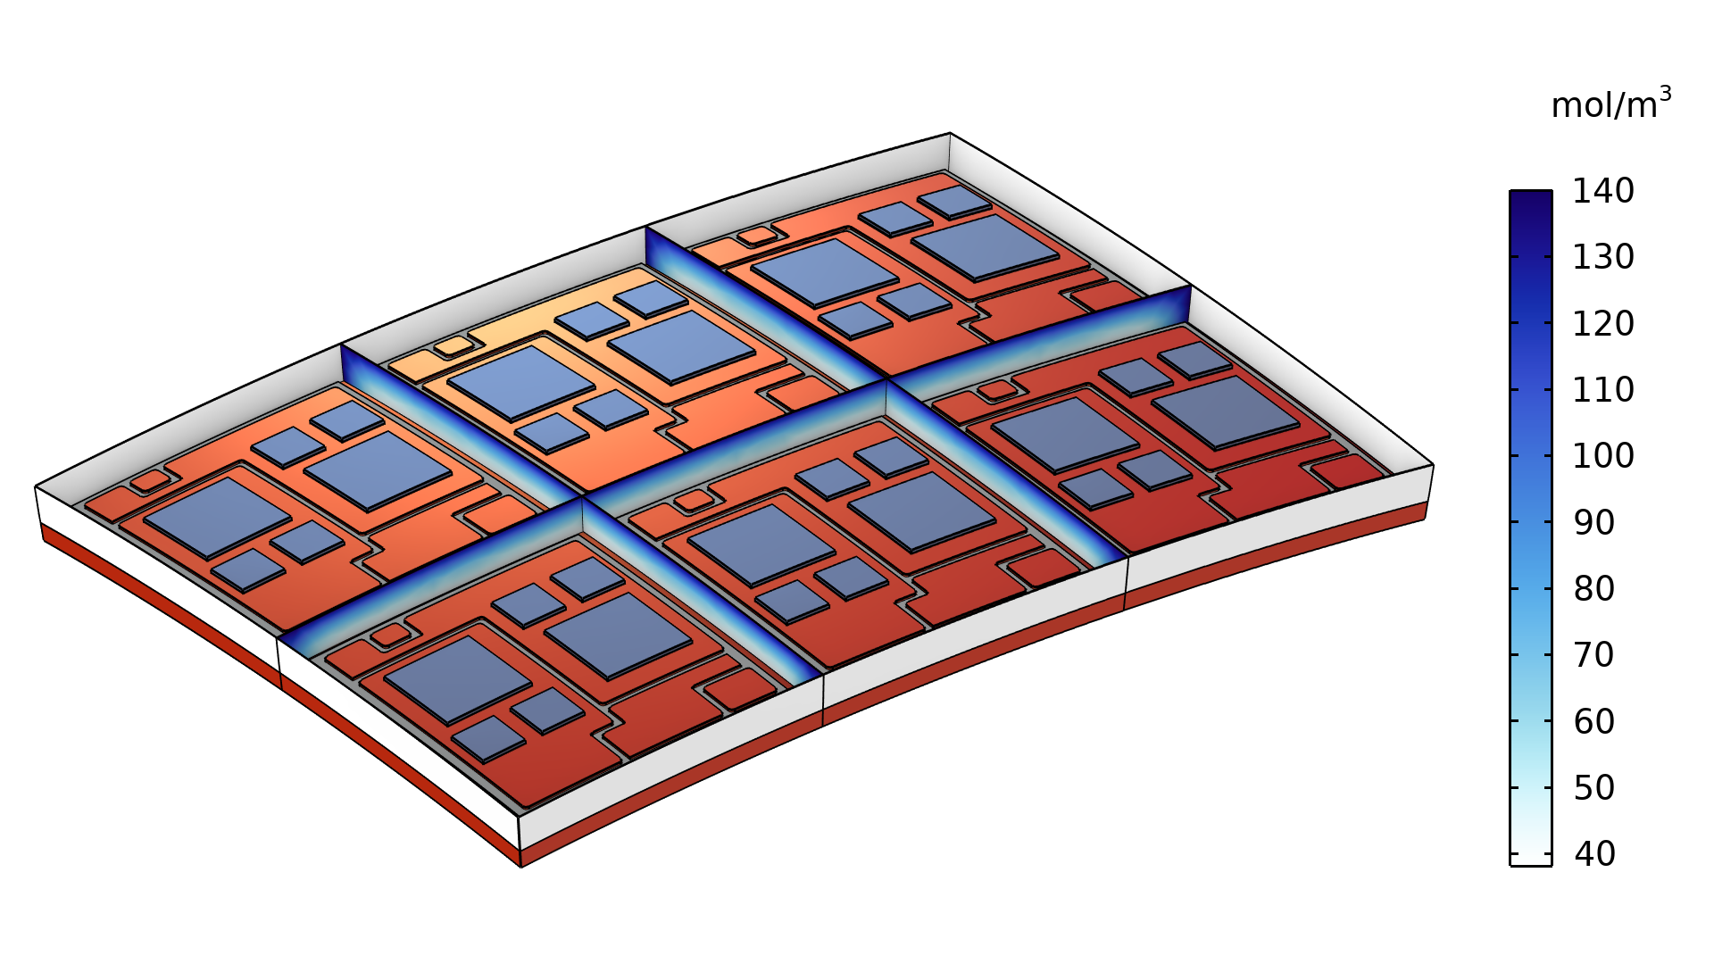
Results, Moisture Soak
Moisture concentration in the plastic seal after moisture soak step finished
With the structure deformation shown.

Slide 17
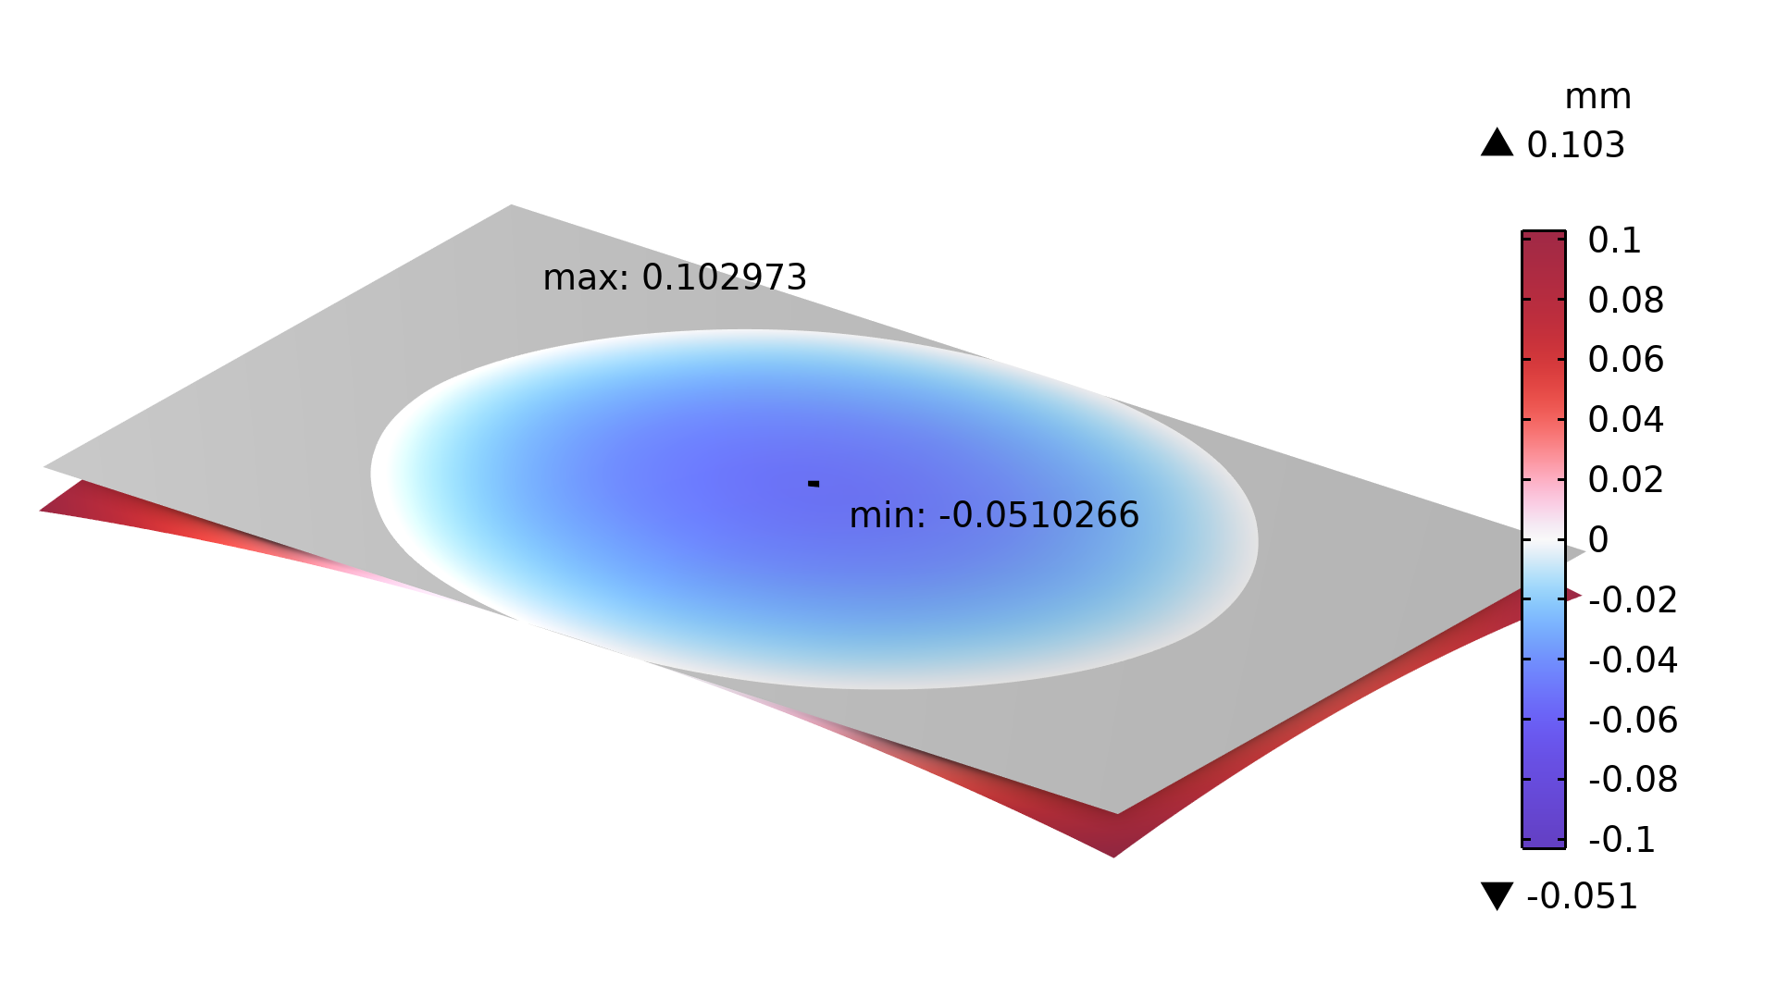
Results, Moisture Soak
Structure warpage during the moisture soak step

Slide 18
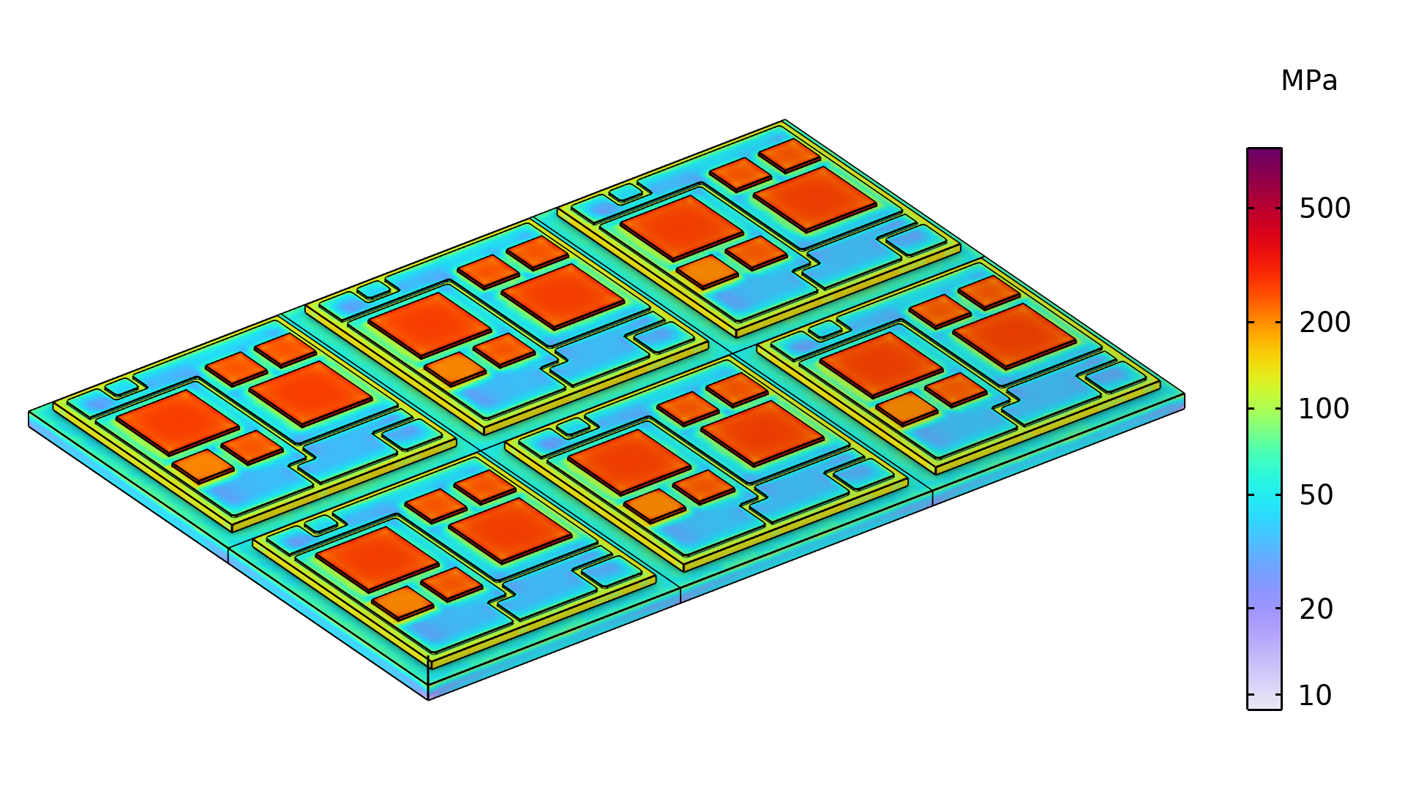
Results, Reflow
Stress distribution when the temperature peak for the reflow step is reached at t = 6 min

Slide 19
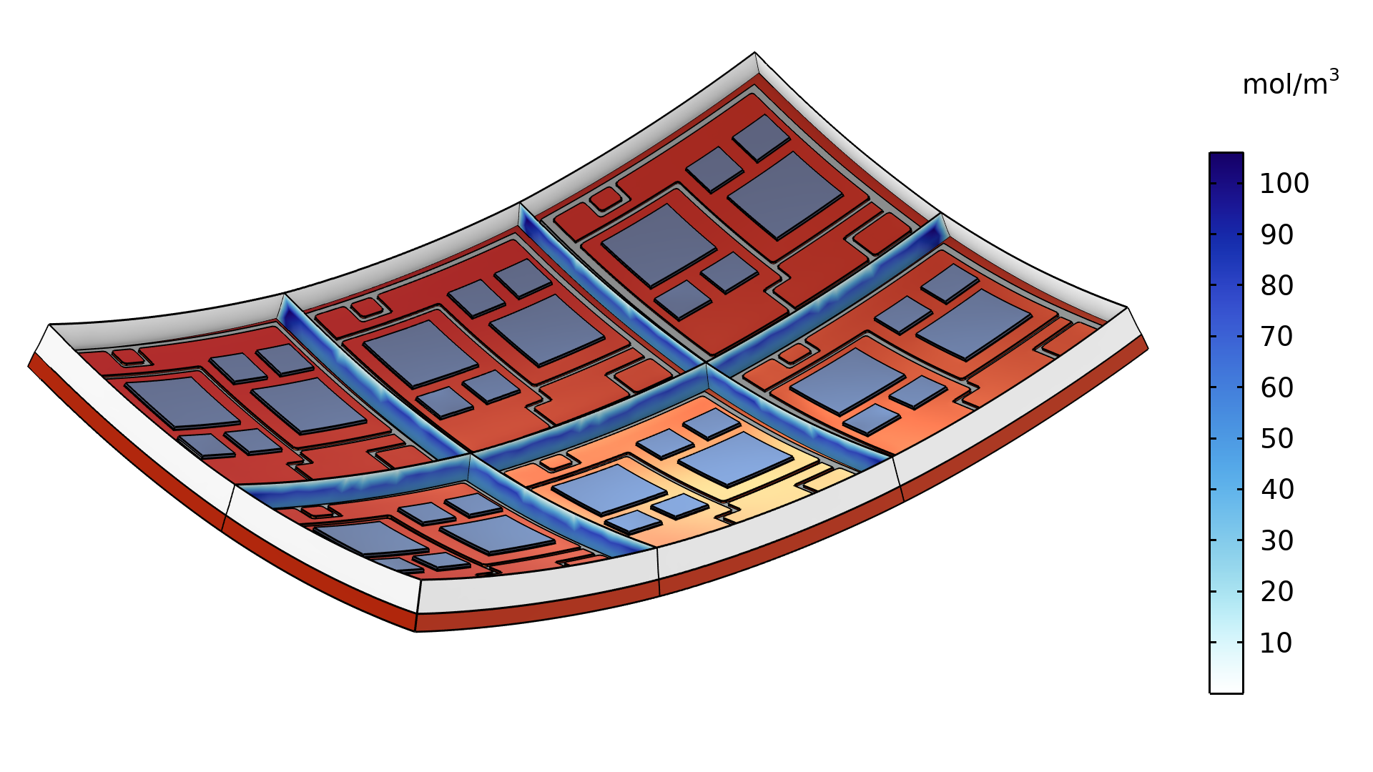
Results, Reflow
Moisture concentration in the plastic seal when the temperature peak for the reflow step is reached after t = 6 min
With the structure deformation shown.

Slide 20
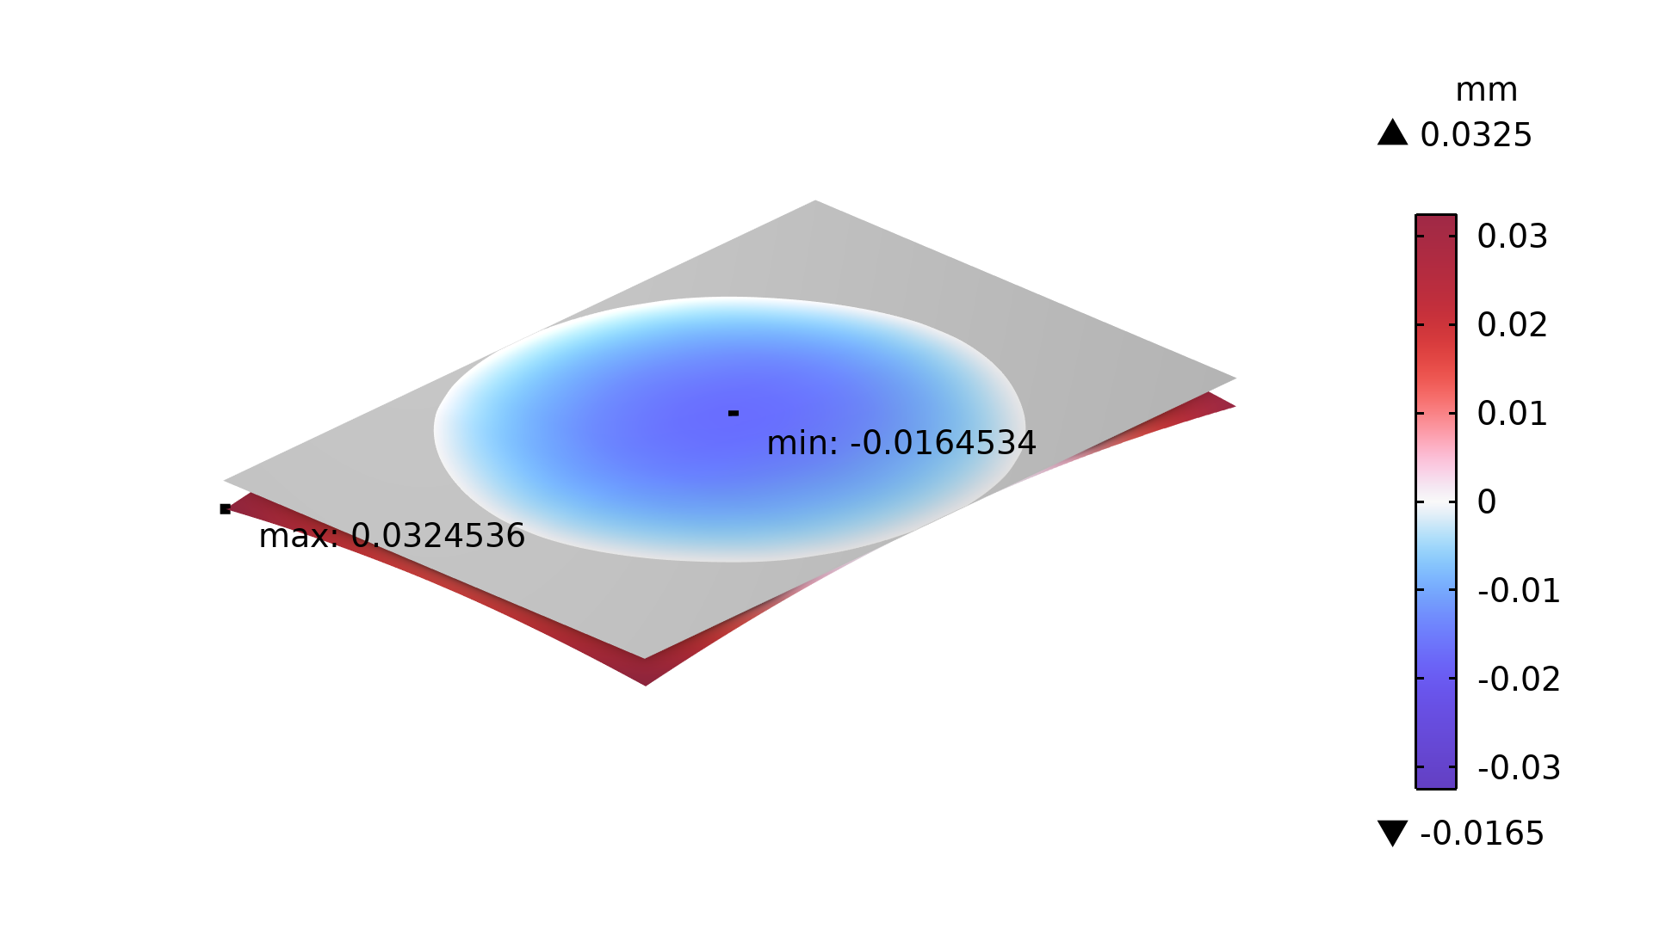
Results, Reflow
Structure warpage during the reflow step (3 cycles)

Slide 21
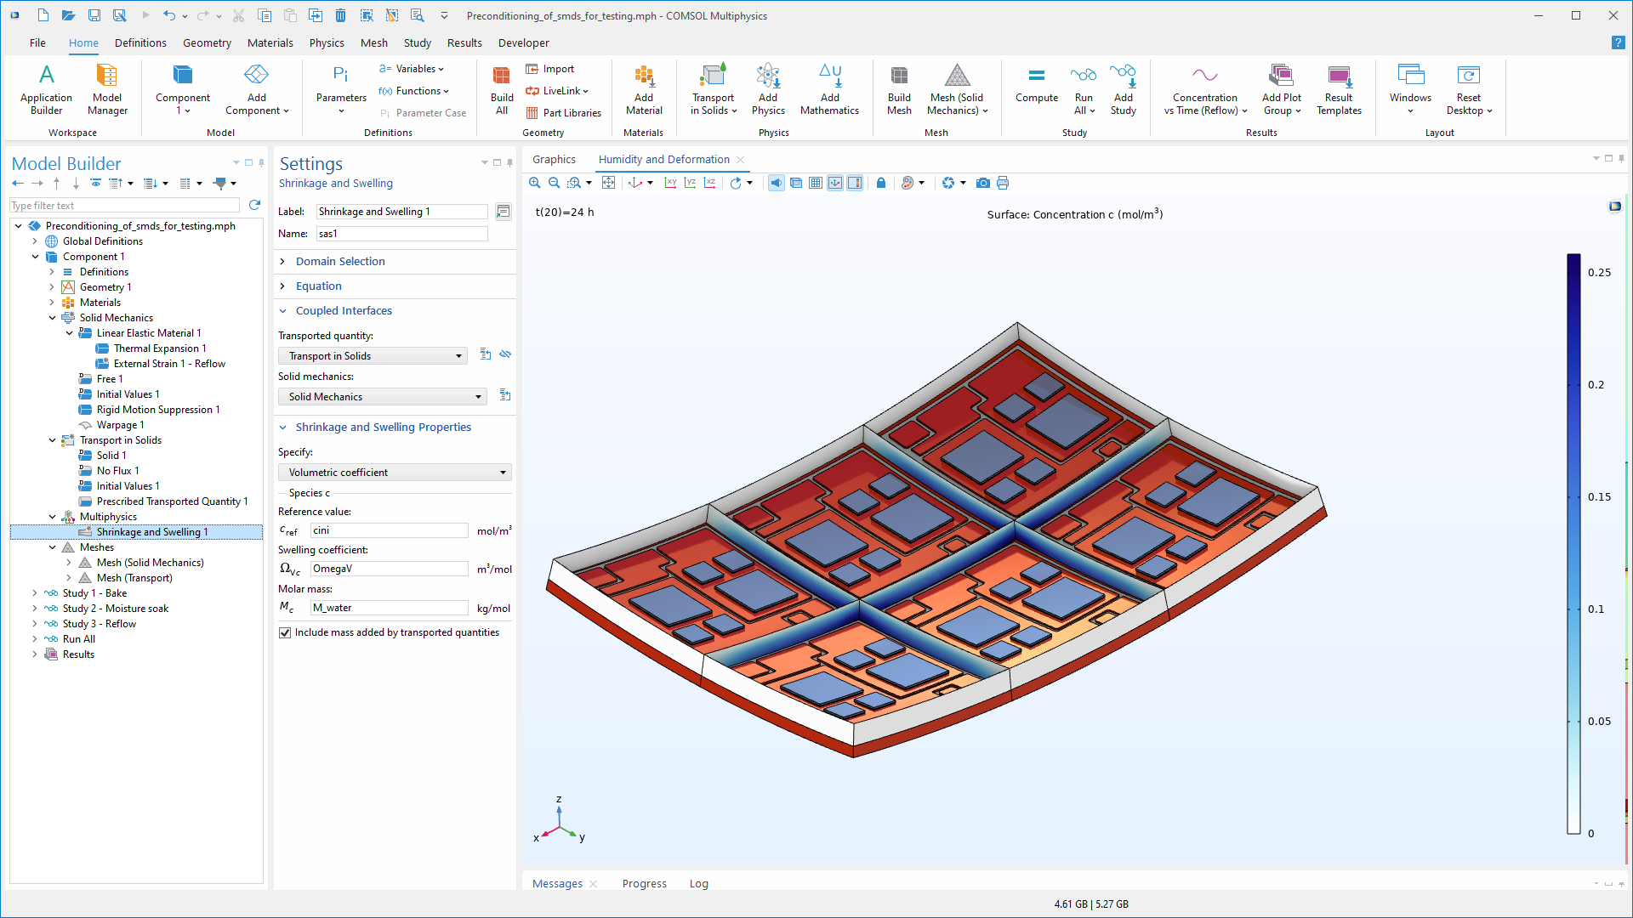
Summary
Thermal expansion and hygroscopic swelling are considered to mimic the preconditioning test of an IGBT module.
Further extension:
  Heat transfer between structures and surroundings
  More complex constitutive models such as the viscoplasticity for solder materials

