Slide 1
Membrane Dialysis Model

Slide 2
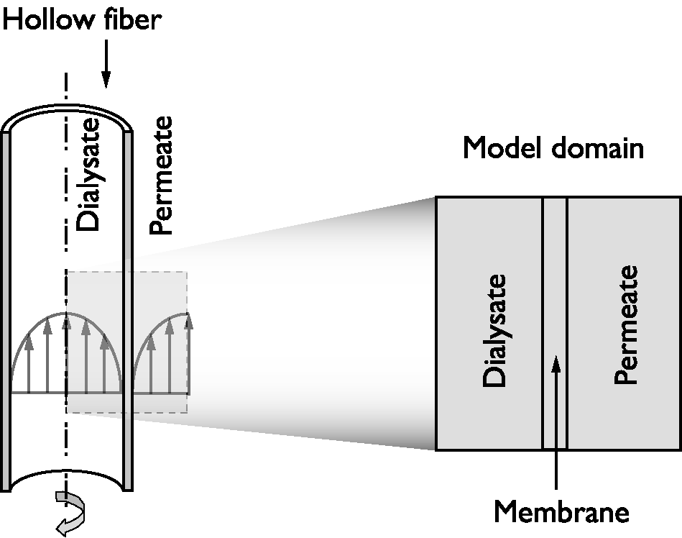
Model Representation: Hollow Fiber
The transport of the species is modeled with the Transport of Diluted Species interface
Transport occurs through diffusion and convection
Schematic description of a hollow fiber. The discontinuities between the dialysate and permeate with the membrane are described with partition coefficients.

Slide 3
Example With
Two Membrane Layers

Slide 4
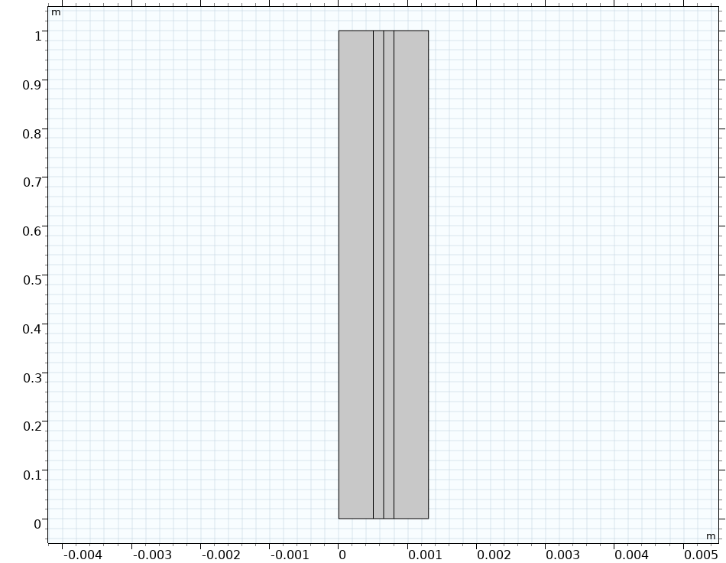


Model Definition
$$δ_{m,1}+δ_{m,2 }=0.3 mm$$
Diffusion-convection in the channels
Diffusion in the two membrane layers with two different diffusivities and with partition coefficients:
Transport of one diluted solute that enters at the bottom of the left channel
Dialysate
Permeate
$D_{1}, D_{2 };K_{s1}$, $K_{s2},K_{12}$
Membrane 1
Membrane 2

Slide 5
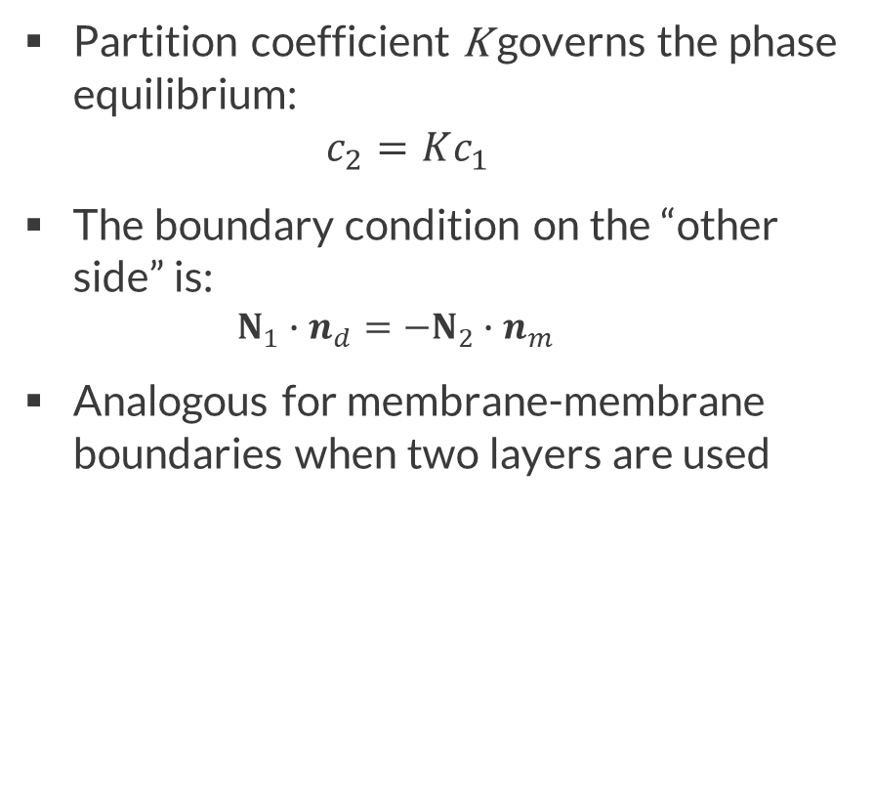
Boundary Conditions
Dialysate
Permeate
Partition coefficient K governs the phase equilibrium:
$c_{2}=Kc_{1}$
The boundary condition on the “other side” is:
  $$N_{1}∙n_{d}=−N_{2}∙n_{m}$$
Analogous for membrane-membrane boundaries when two layers are used
Membrane
c₁
c₁
c₂
Concentration profile

Slide 6
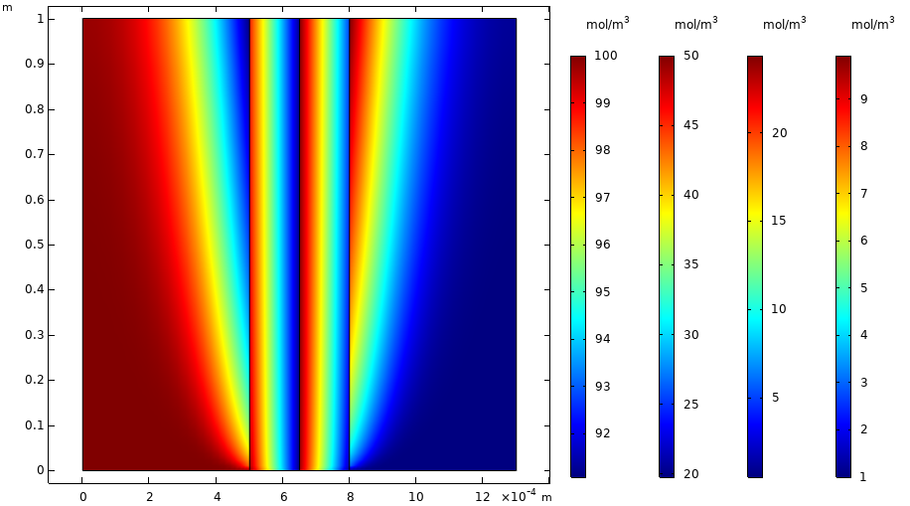
Results:
Solute concentration
The flux is continuous over the membrane boundaries
The concentration is discontinuous and the partition coefficient determines the extent of the “jump” in concentration

Slide 7
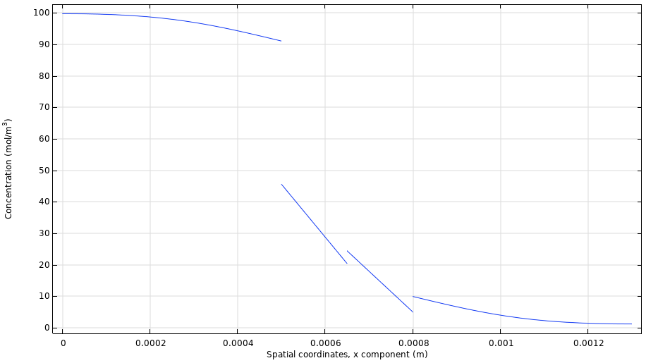
Results:
Solute concentration
The flux is continuous over the membrane boundaries
The concentration is discontinuous and the partition coefficient determines the extent of the “jump” in concentration

Slide 8
Model Definition
Time-dependent problem
Tank connected to the membrane unit
Residence time in the tank = 100 s
Initial condition in the membrane unit:
  Stationary solution for an inlet solute concentration of 100 mol/m³
Initial condition in the tank
  Solute concentration of 100 mol/m³
Dialysate
Permeate

Slide 9
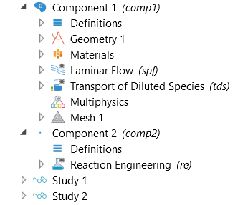
Implementation in COMSOL
Two model components
  2D membrane unit
  0D continuous stirred tank reactor (CSTR with no reactions)
Coupling between components
  Flow out from the membrane unit defined as feed to the CSTR
    Concentration
    Volumetric feed rate
  Flow out from the CSTR defined as inlet condition to the membrane unit
    Concentration

Slide 10
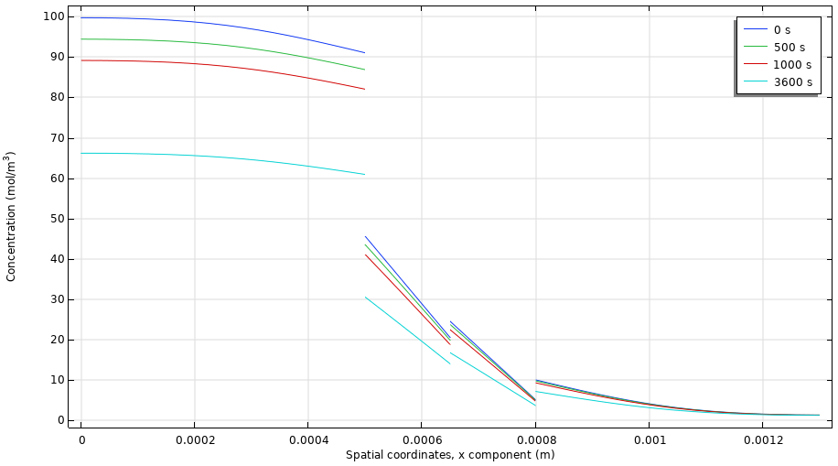
Results of Time-Dependent Study

Slide 11
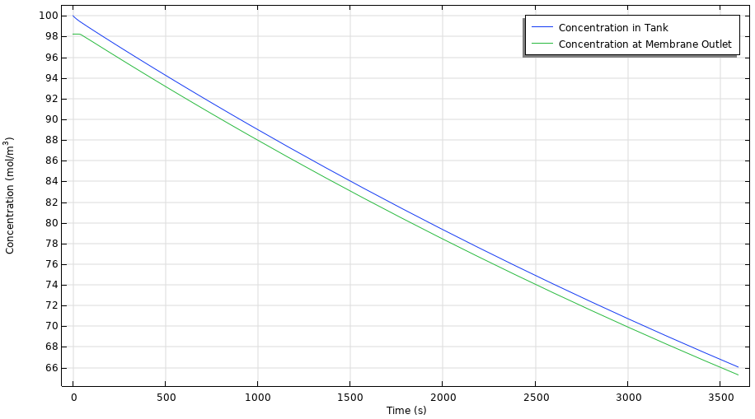
Results of Time-Dependent Study

