Slide 1
Car Cabin Acoustics − Iterative Solver Suggestion for Cubic Elements

Slide 2
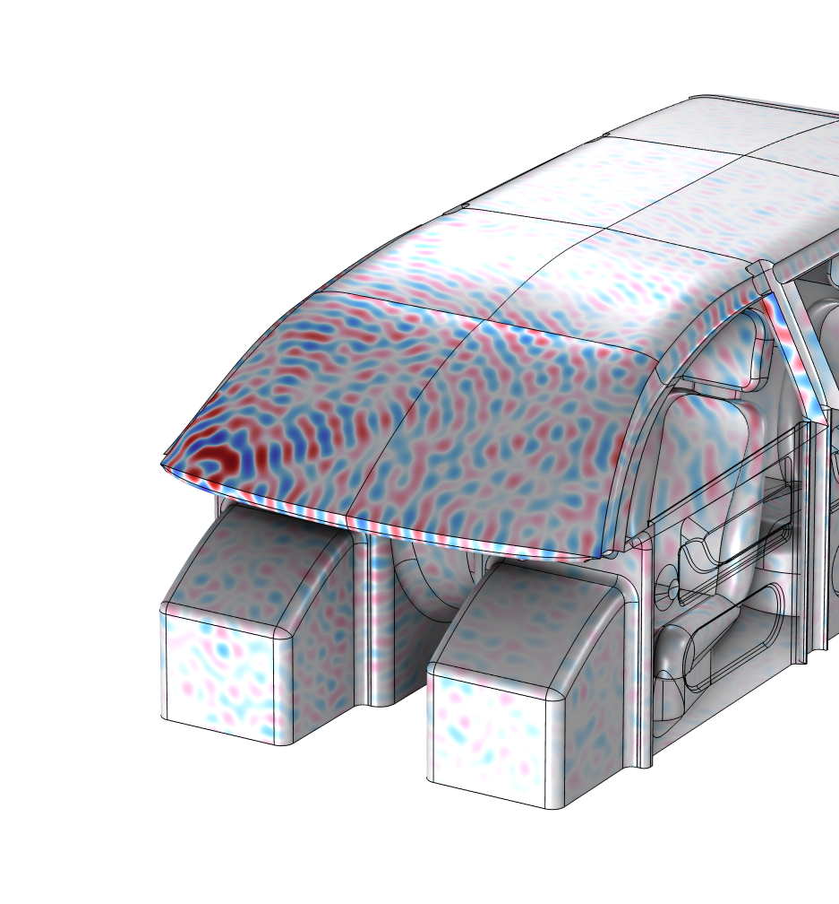
Background
Solving very large pressure acoustics models in the frequency domain can be challenging. Several iterative solver suggestions exist for the default physics setups and the default quadratic Lagrange discretization.
For very large models it can be advantageous to switch from quadratic to cubic discretization. This will allow for the use of a coarser mesh and the use of an optimized two-level multigrid solver approach.
This model explains how to set up the solver.
The model is based on the Car Cabin Acoustics - Frequency-Domain Analysis tutorial.
Car cabin model solved at 5 kHz

Slide 3
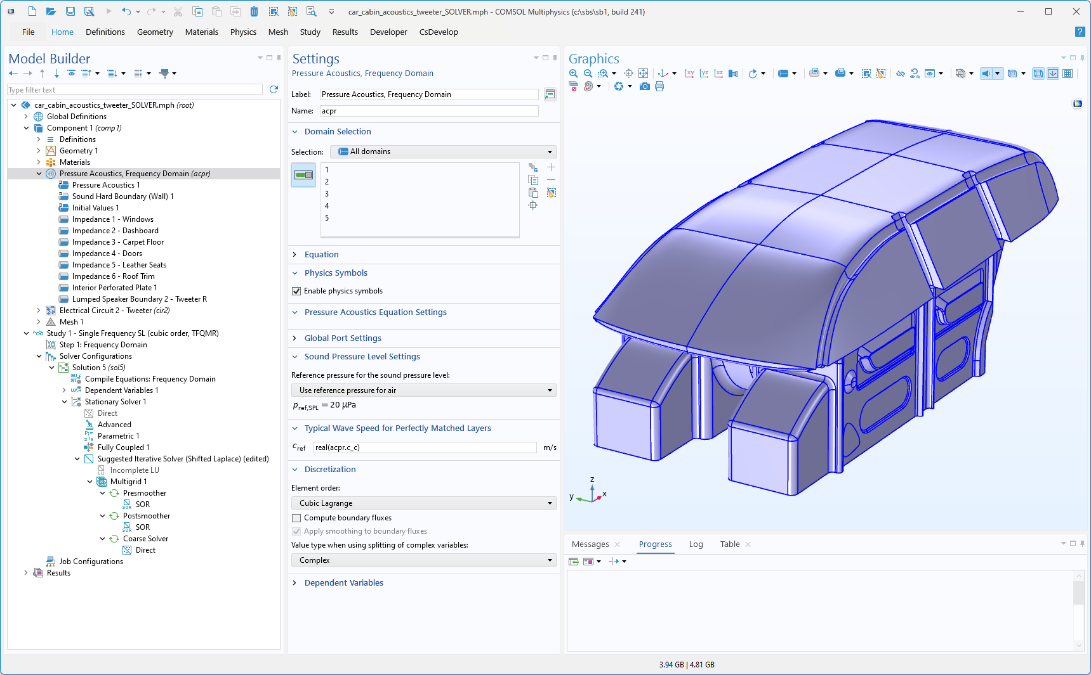
Discretization
Use Cubic Lagrange discretization for the model

Slide 4
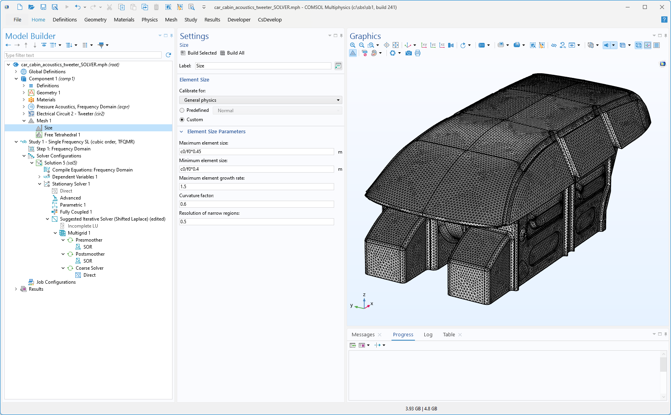
Mesh
Mesh the model with a Maximum element size set to 0.45⋅λ, with the wavelength λ
If a PML is present in the model use 4 mesh elements in the thickness

Slide 5
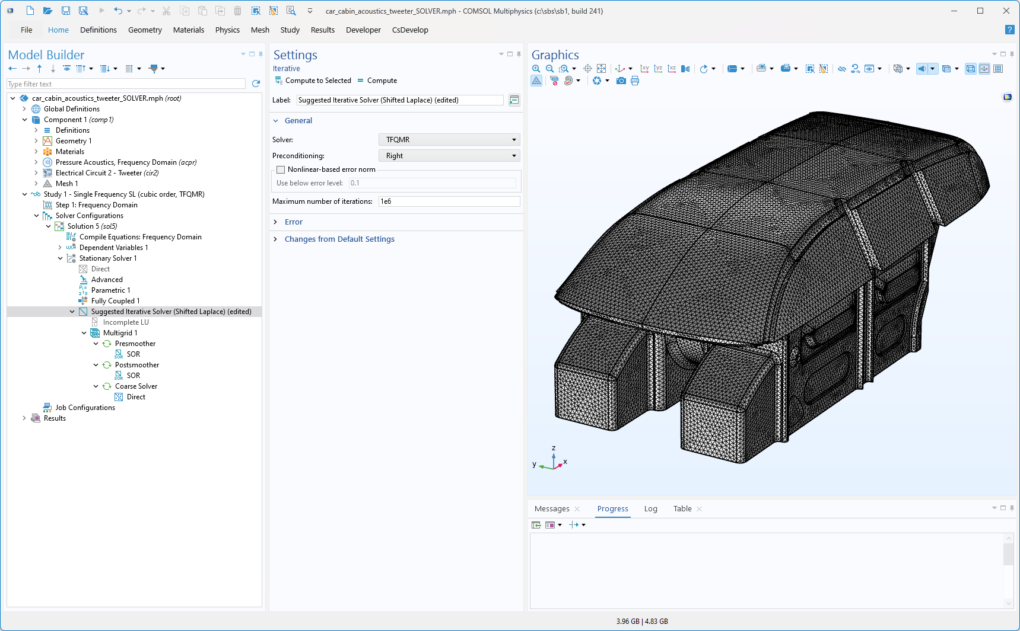
Solver
Edit the default added Shifted Laplace solver suggestion
  Solver = TFQMR
  Preconditioning = Right
  Maximum number of iterations = 1e6

Slide 6
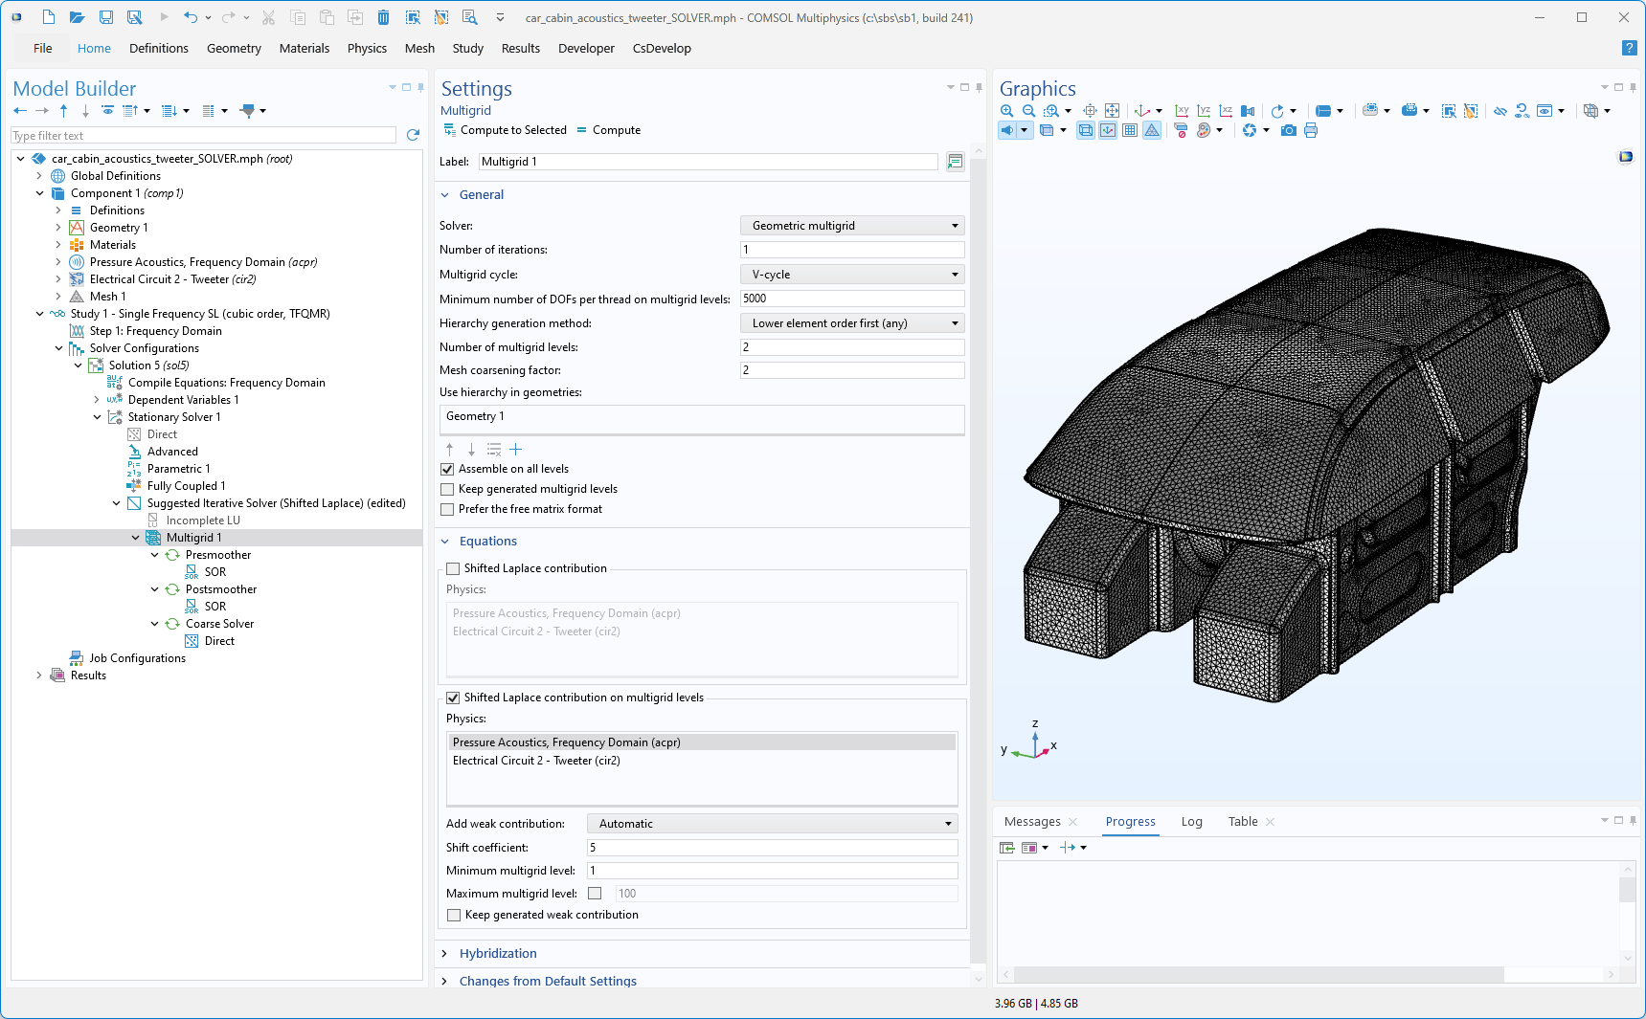
Solver
Multigrid
  Lower element order first (any)
  Number of multigrid levels = 2
  Mesh coarsening factor = 2
Shifted Laplace contributions on multigrid levels
  Shift coefficient = 5
  Minimum multigrid level = 1

Slide 7

Solver
Presmoother
  Solver = SOR
  Number of iterations = 1
  Relaxation factor = 0.5
Postsmoother
  Solver = SORU
  Number of iterations = 1
  Relaxation factor = 0.5
Coarse Solver (Direct)
  Solver = MUMPS
  Use Block low rank factorization

Slide 8
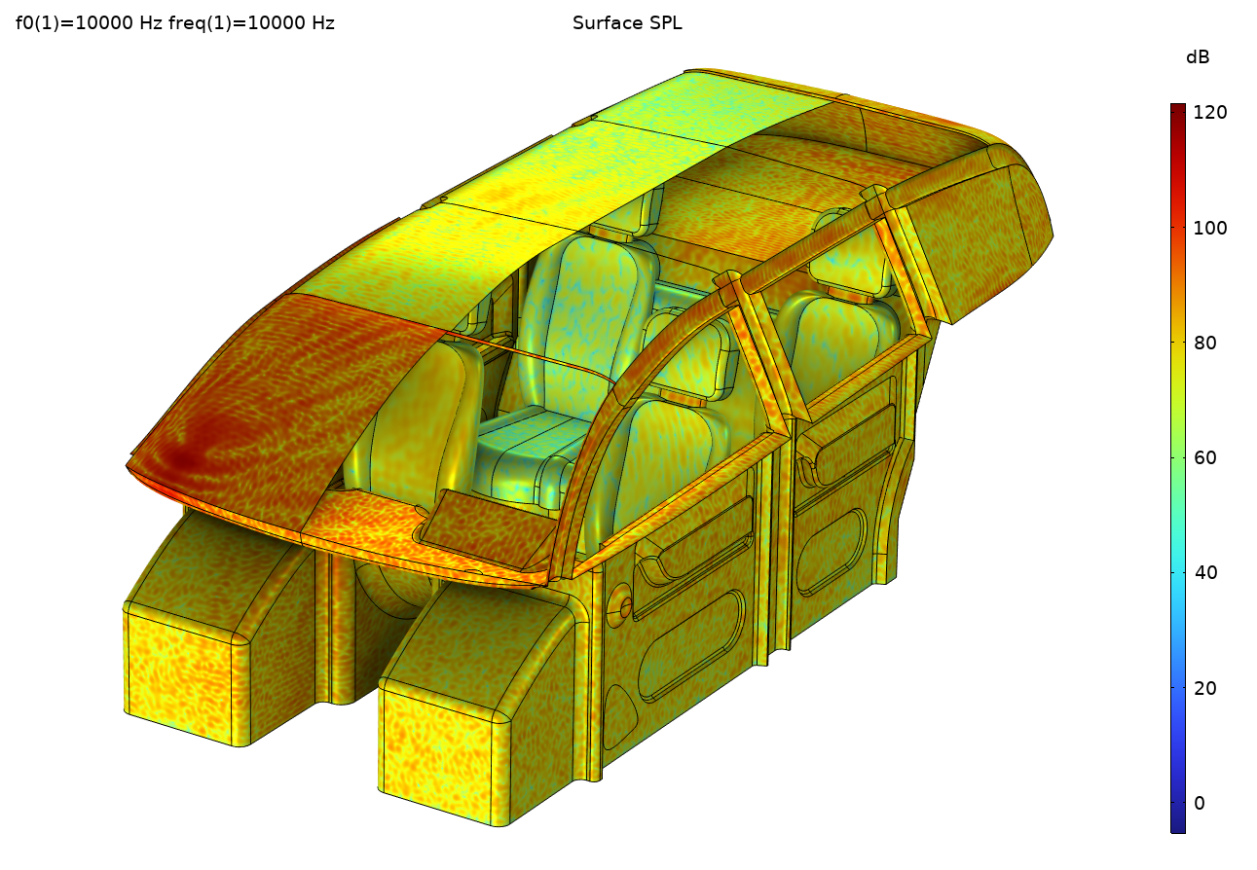
Results
Non-distributed configuration, on a powerfull modern workstation.
Model solved at 5,000 Hz
  9e6 DOFs
  30 GB RAM
Model solved at 8,000 Hz
  37e6 DOFs
  150 GB RAM
Model solved at 10,000 Hz
  72e6 DOFs
  235 GB RAM

