Slide 1
Topology Optimization of an MBB Beam with a Maximum Length Scale

Slide 2
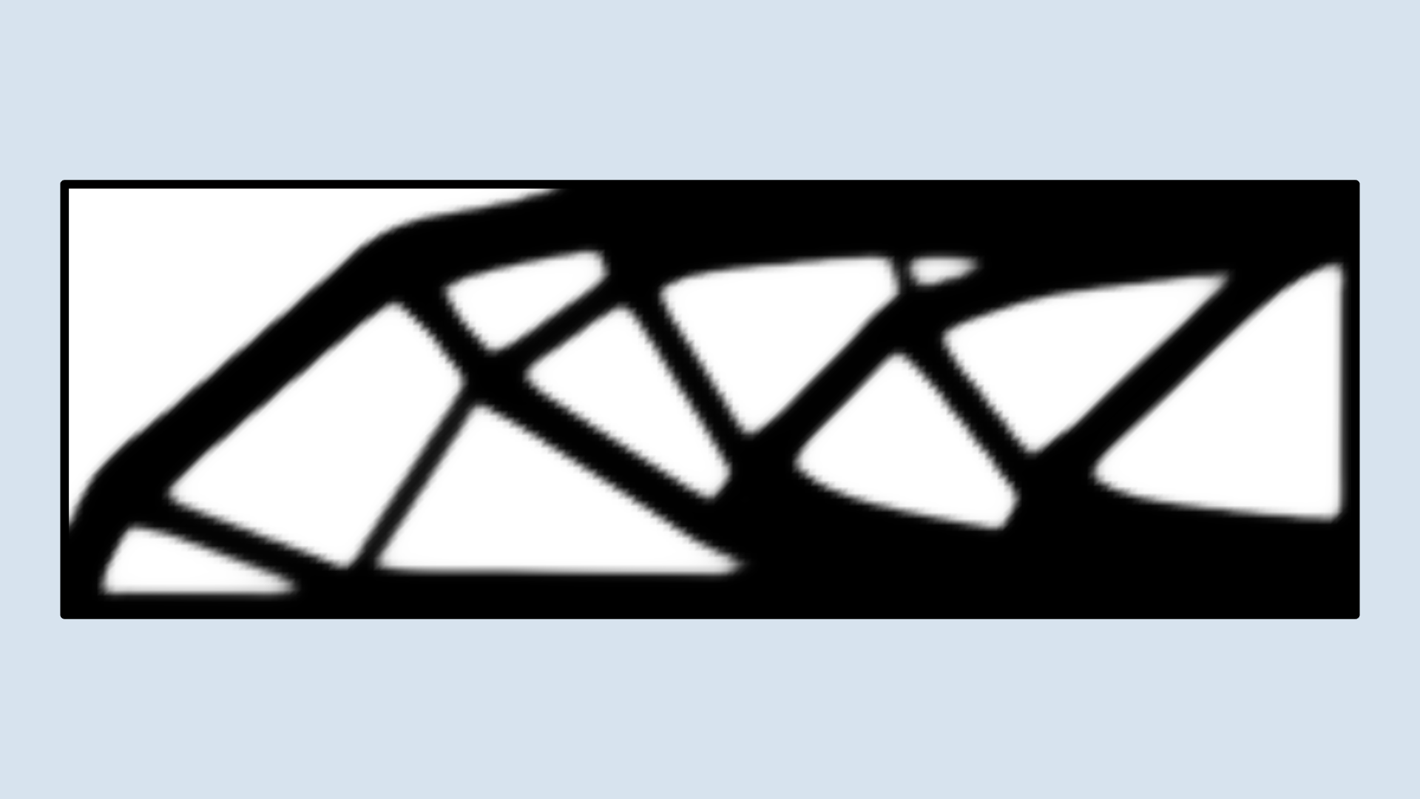
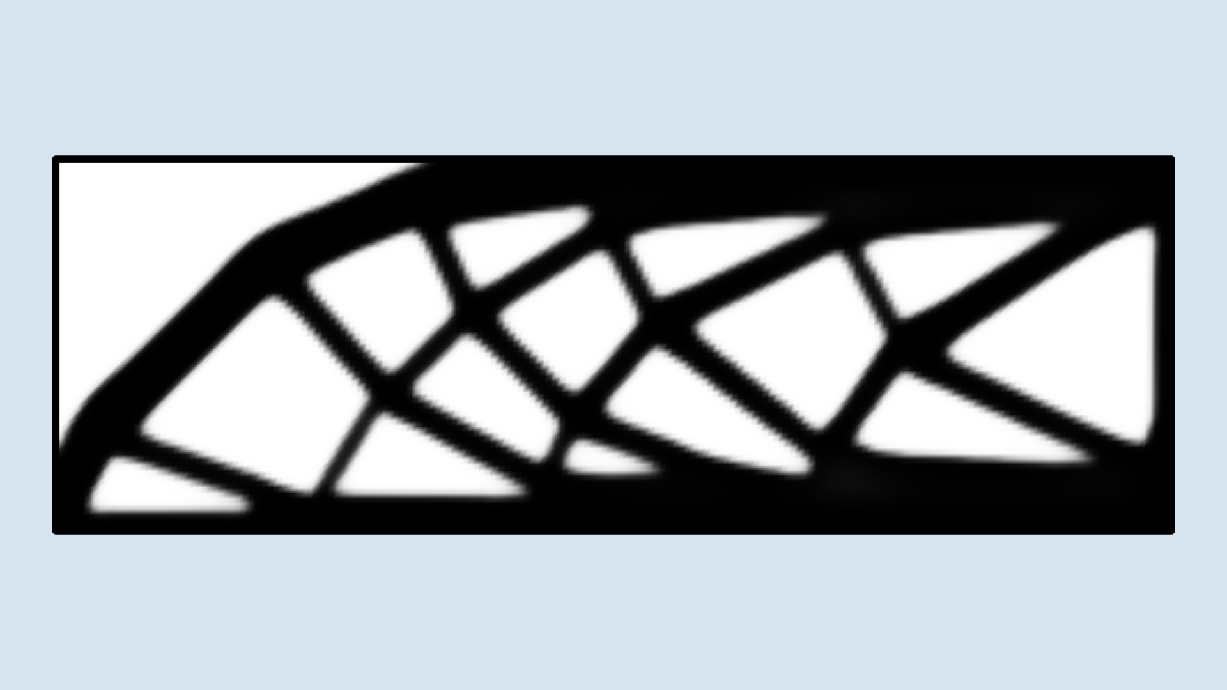
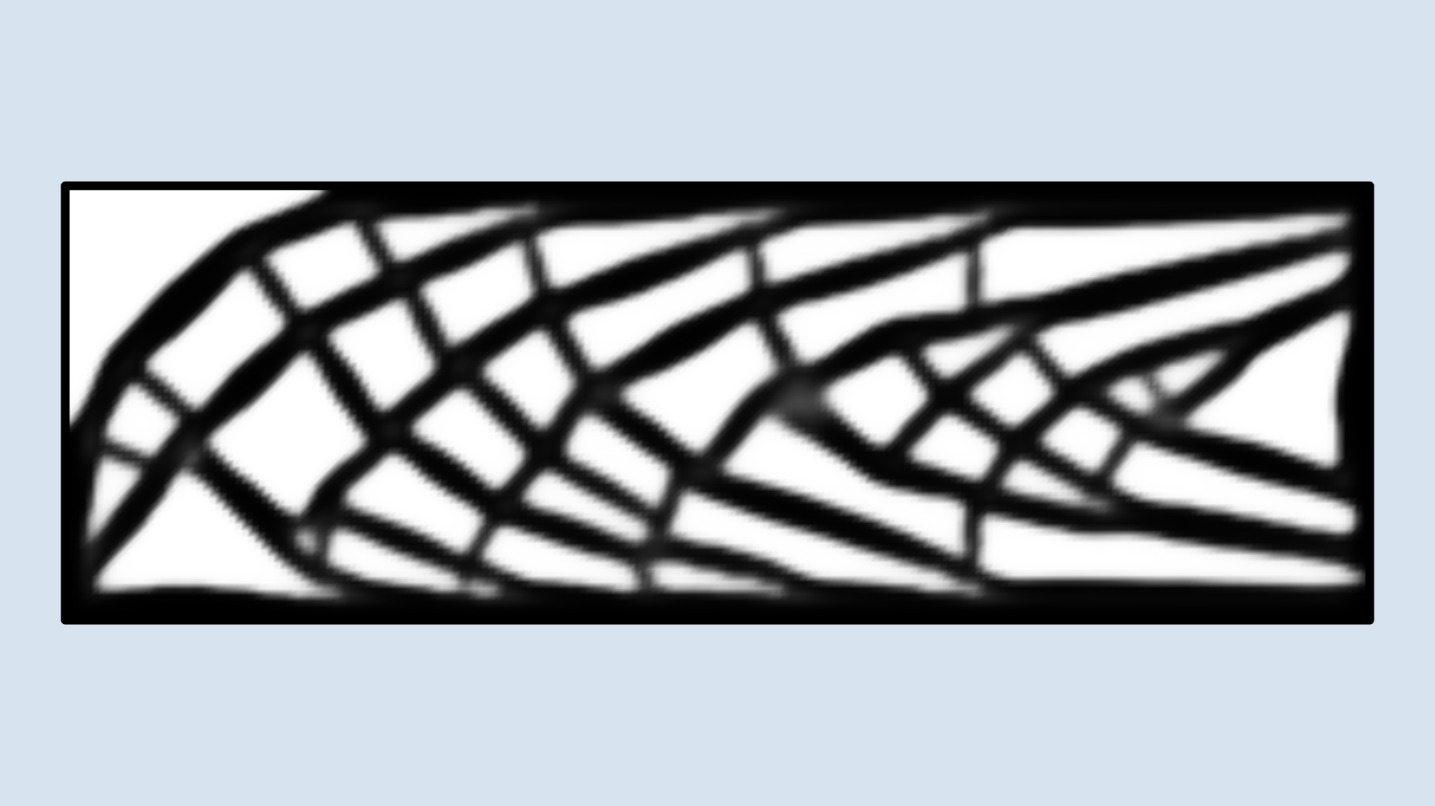
Results: MMB Beam
Rmax = 10 Rmin = 0.3 H
Rmax = 5 Rmin = 0.15 H
Rmax = 2 Rmin = 0.06 H
A large maximum length scale has little effect on the design
A medium maximum length scale increases the complexity of the topology
A small maximum length scale results in a complex design. This can even result in an inactive volume constraint.

Slide 3
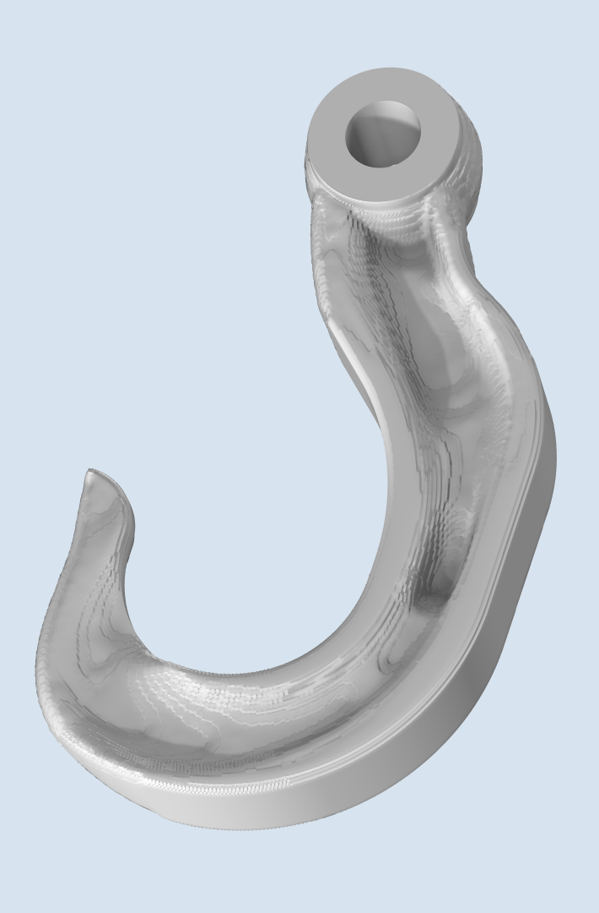
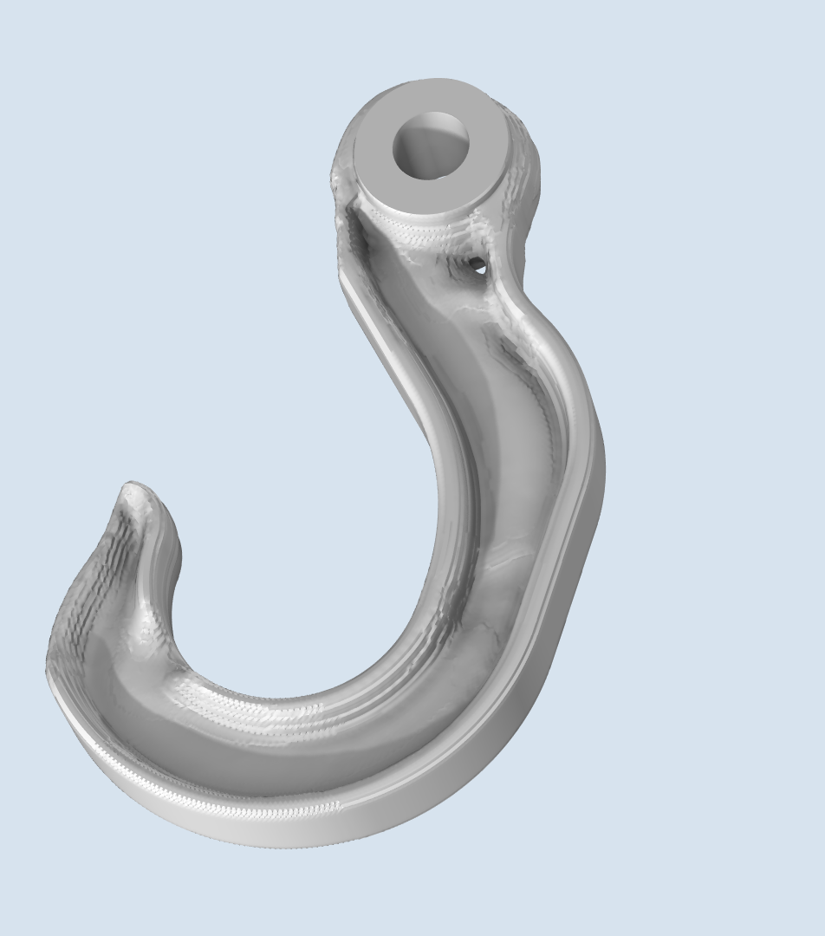
Results: Hook (milling constraint)
Rmax = ∞
Rmax = 2Rmin
The stiffness of the hook is maximized for a 50 % volume constraint considering two load cases.
The volume constraint is no longer active, so material removal is caused exclusively by the constraint on the maximum length scale.

Slide 4
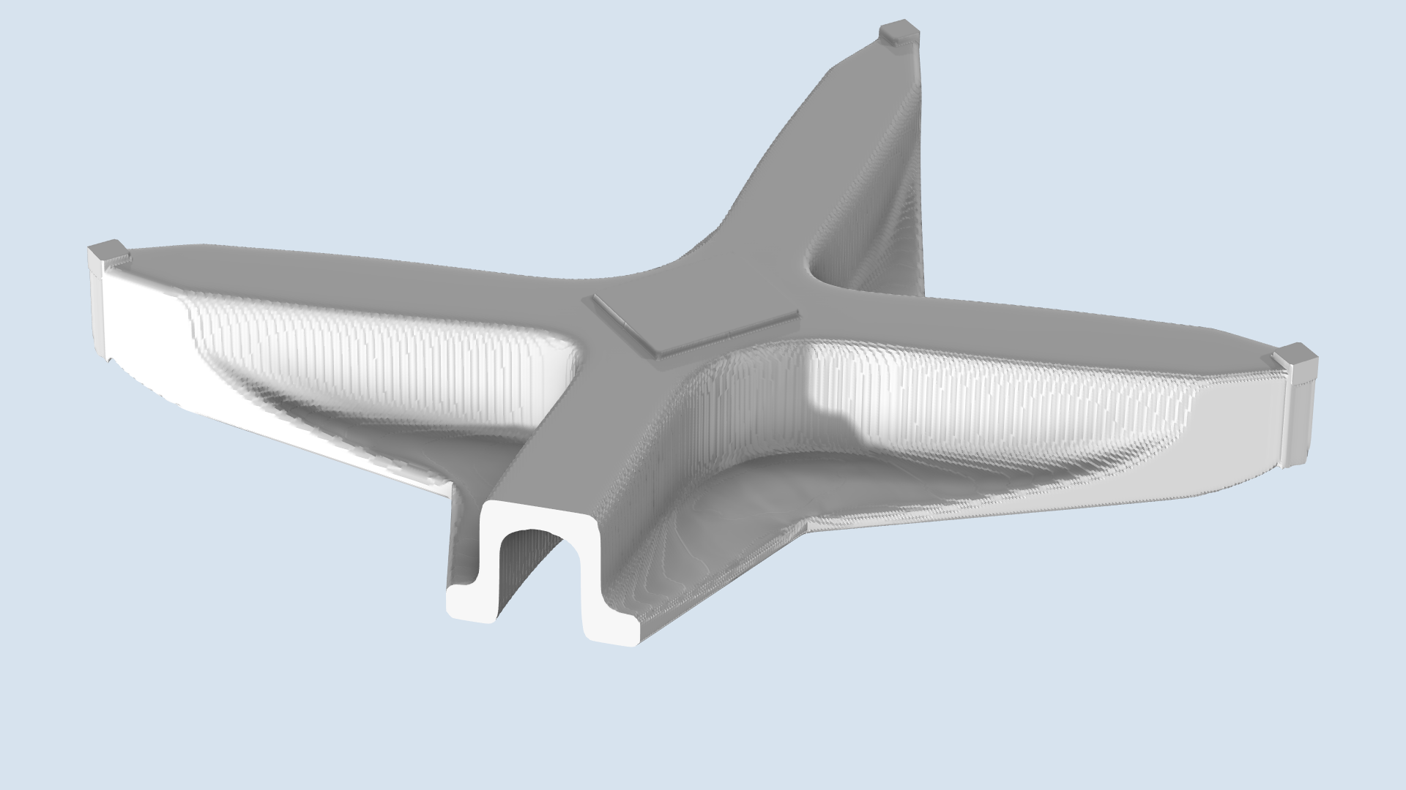
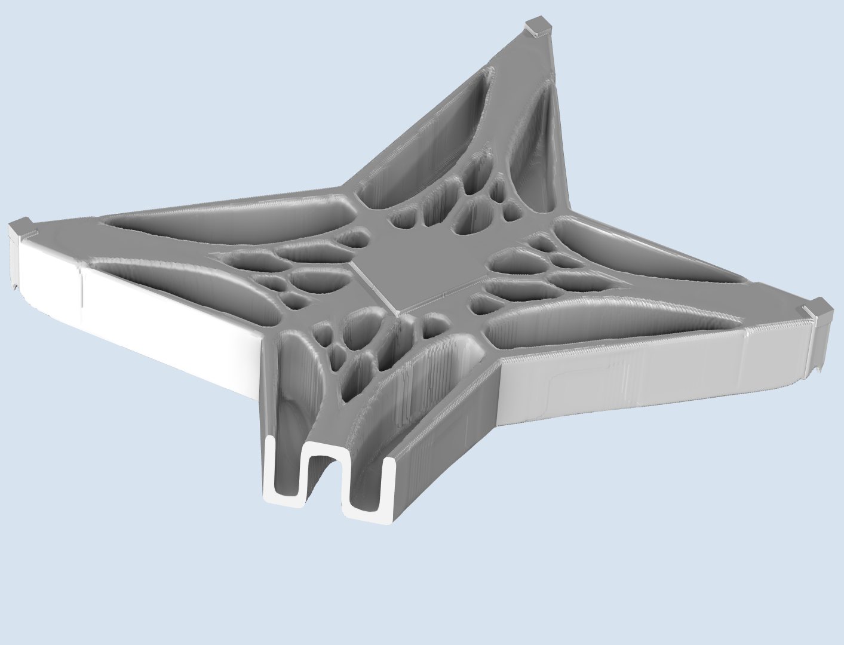
Results: Drone (milling constraints)
Rmax = ∞
Rmax = 3Rmin
The volume fraction has been increased to 40 % and milling constraints have been imposed.
The maximum length scale results in a ribbed design.

Slide 5
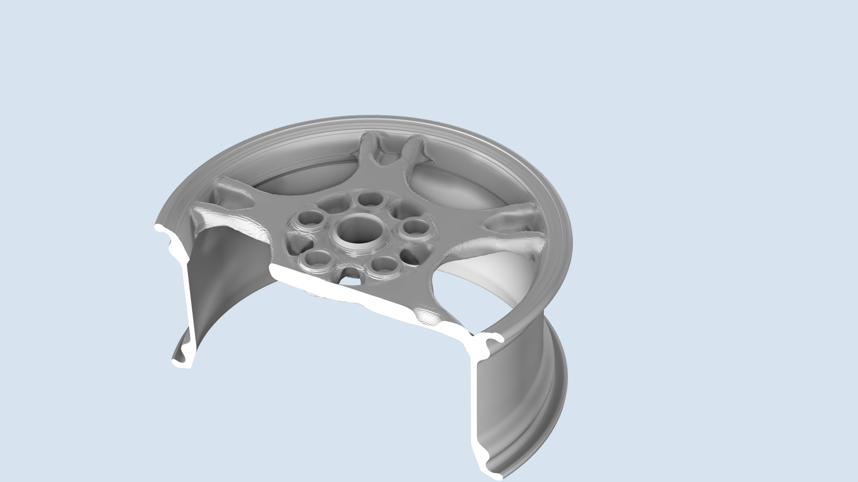
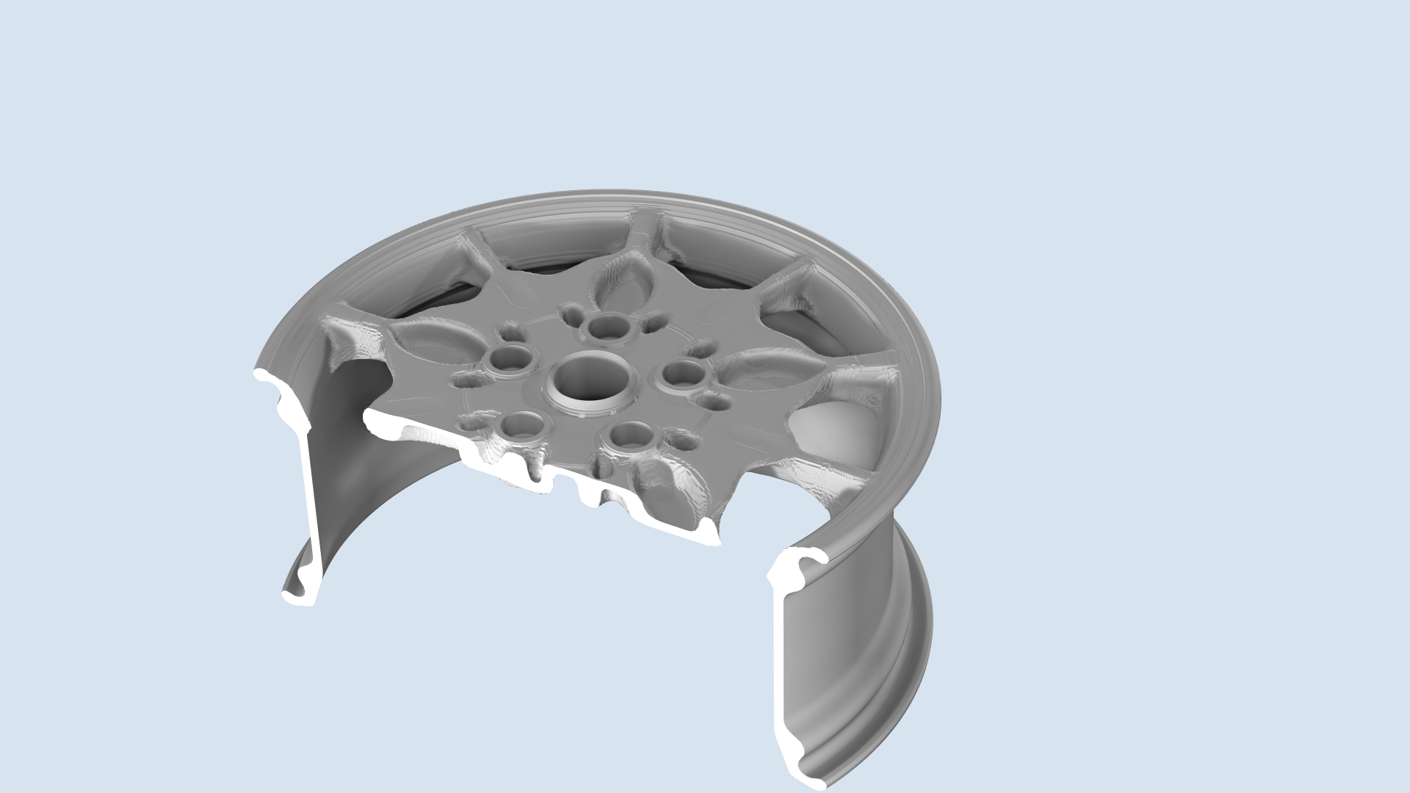
Results: Wheel (milling constraints)
Rmax = ∞
Rmax = 3Rmin
The volume fraction kept at 30 %.
The maximum length scale results in a more complex design.

Slide 6
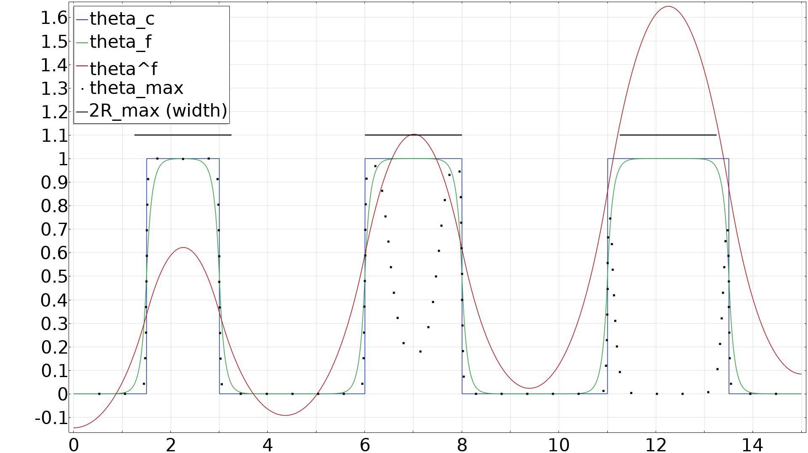
An example with three hat functions having width equal to 1.5𝑅_max, 2𝑅_max, and 2.5𝑅_max. The filter length is 0.1𝑅_max, and the projection slope, β = 8.

Slide 7
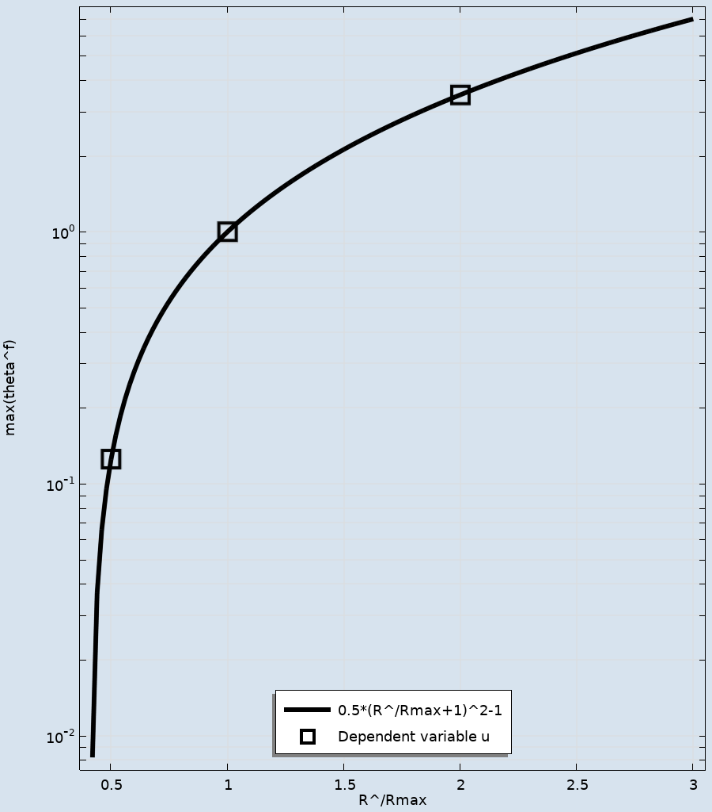
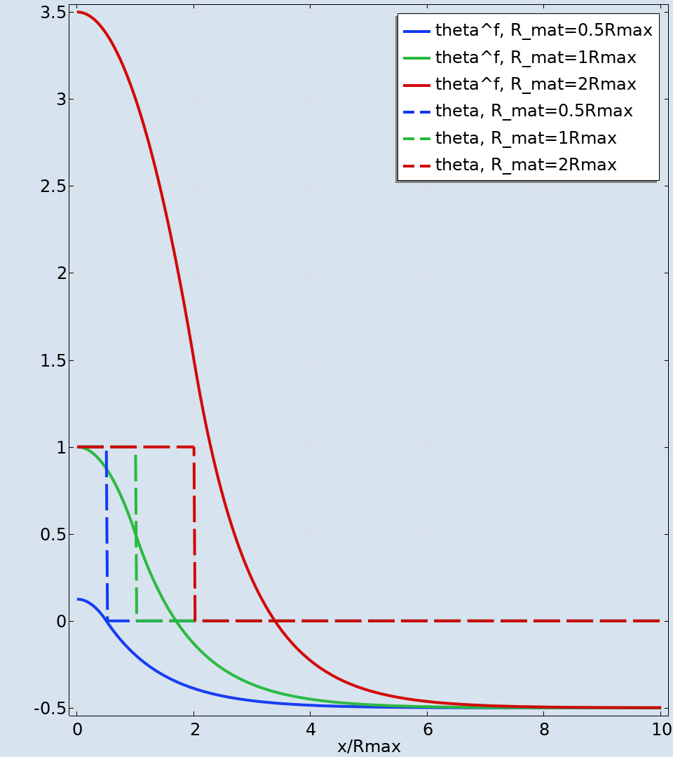


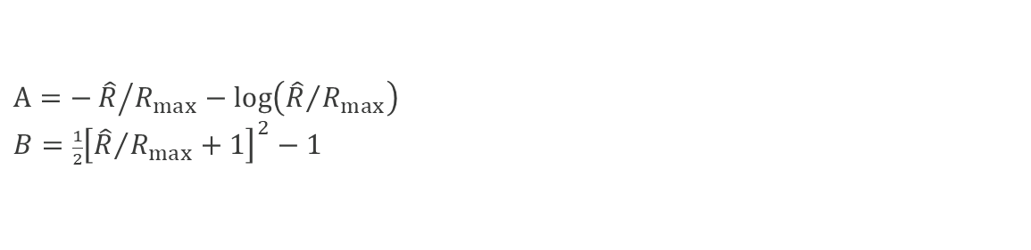
Theory
The aim is to construct a PDE in a variable, $θ^{f}$, so that ${1< θ}^{f}$
when the material dimension exceeds $R_{max}$.
This allows implicit enforcement of the maximum length scale.
Poisson/Helmholtz equation
Void phase $(θ=0)$ :
$θ^{f}=R_{max}^{2}∇^{2}θ^{f}−0.5$
Material phase $(θ=1)$:
$0=R_{max}^{2}∇^{2}θ^{f}+1$
Combined case:
$θ^{f}\left(1−θ\right)=R_{max}^{2}∇^{2}θ^{f}+1.5θ−0.5$
Solution for a hat function with width $2\hat{R}$:
$θ^{f}=\left\{\begin{aligned}{−0.5+e}^{−|x|/R_{max}−A} for \hat{R}<\left|x\right| \left(void, θ=0\right) \\ {B−0.5\left(\frac{x}{R_{max}}\right)}^{2} for \left|x\right|<\hat{R}(material, θ=1)\end{aligned}\right.$
Use ${ θ}_{p}=θ_{min}+\left(1−θ_{min}\right) {\left(θ_{max}\right)}^{p}$
$$where θ_{max}=θ\left[0.5−0.5 tanh⁡(β\left(θ^{f}−1\right) \right]$$
$$A=−{\hat{R}}/{R_{max}−log\left({\hat{R}}/{R_{max}}\right)}$$
$B=\frac{1}{2}{\left[{\hat{R}}/{R_{max}}+1\right]}^{2}−1$
Topology Optimization of an MBB Beam with a Maximum Length Scale

Slide 8
References (inspired by)
Suguang Dou, A projection approach for topology optimization of porous structures through implicit local volume control, SMO 2020 62, 835-850

