Slide 1
Copper Current-Collector Dissolution

Slide 2
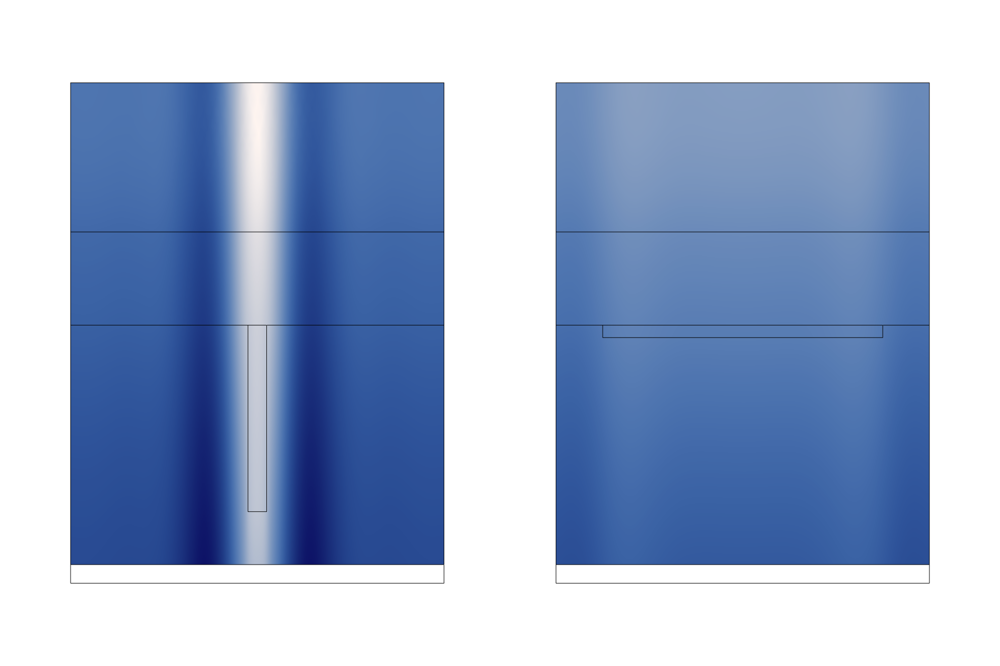
Introduction
The copper current collector on negative graphite electrodes in lithium-ion batteries have been seen to dissolve at overdischarge
The dissolution damages the current collector irreversibly and dissolved copper ions can re-deposit and form dendrites
Operation within the specified voltage limits avoids overdischarge but can be a concern locally within a cell
This example models the copper current-collector dissolution from an electrode with uneven graphite electrode material coating

Slide 3
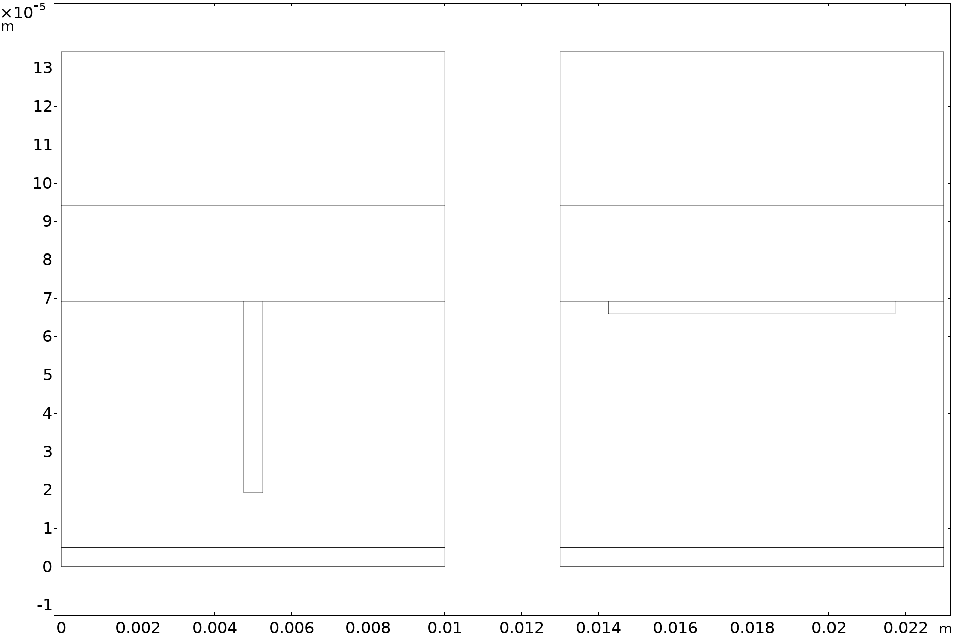

Setup
Positive porous electrode
(NMC 811)
Two shapes of dents in the negative porous electrode
Copper reaction in the negative electrode and at the internal current collector boundary:
Galvanic discharge from a fully charged state to -0.05 V.
Separator
Deep dent
Shallow dent
Negative porous electrode
(graphite)
$$Cu\left(s\right) ↔{ Cu}^{+}+e^{−}$$
Copper current collector

Slide 4
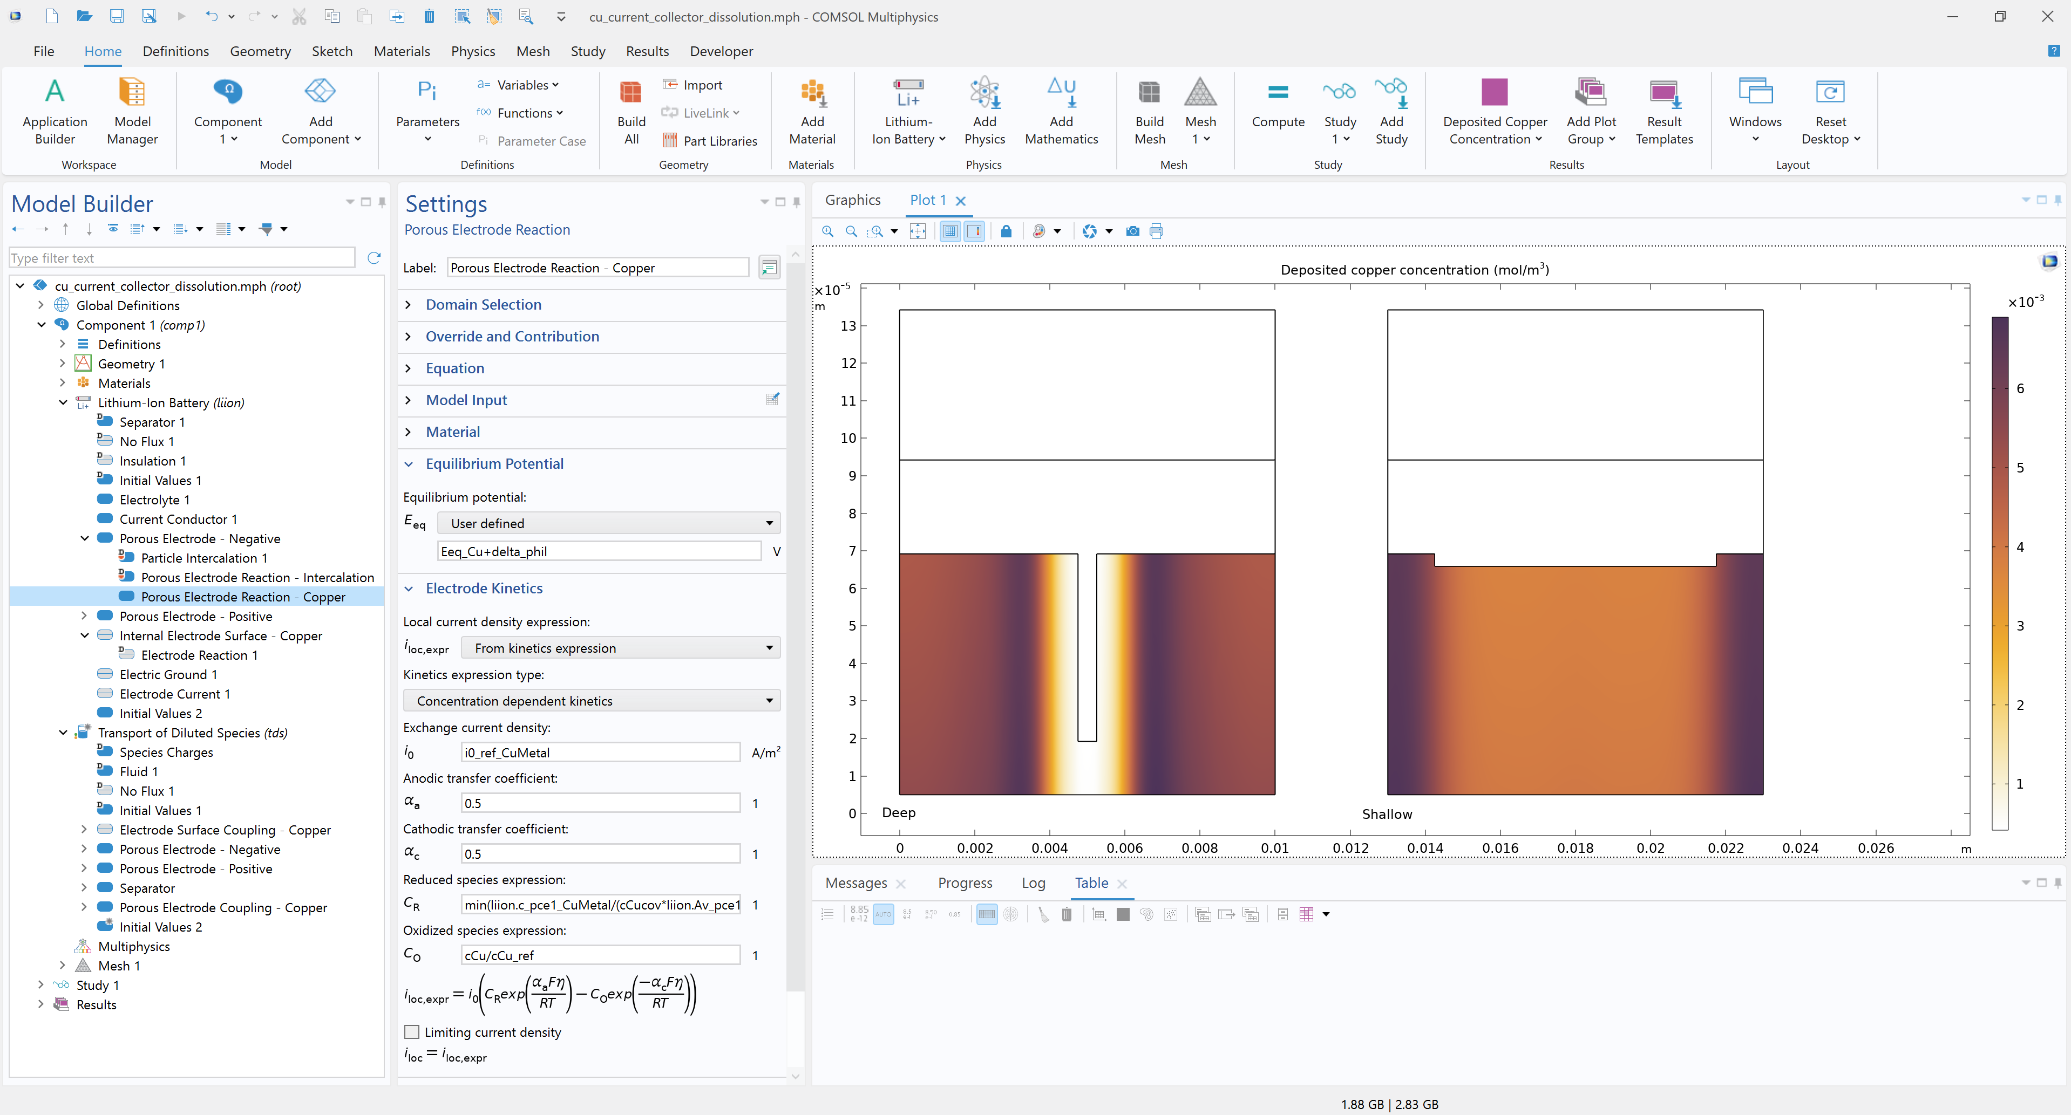
Lithium-Ion Battery Interface
Copper reaction: Add a Porous Electrode Reaction sub-feature in the Porous Electrode - Negative feature

Slide 5
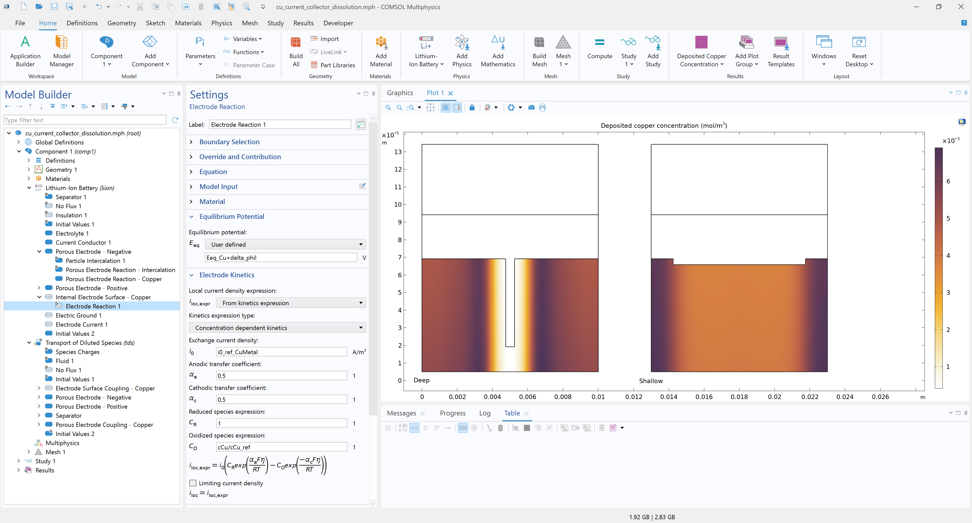
Lithium-Ion Battery Interface
Copper reaction: Add an Internal Electrode Surface feature with an Electrode Reaction sub-feature at the copper current-collector boundary

Slide 6
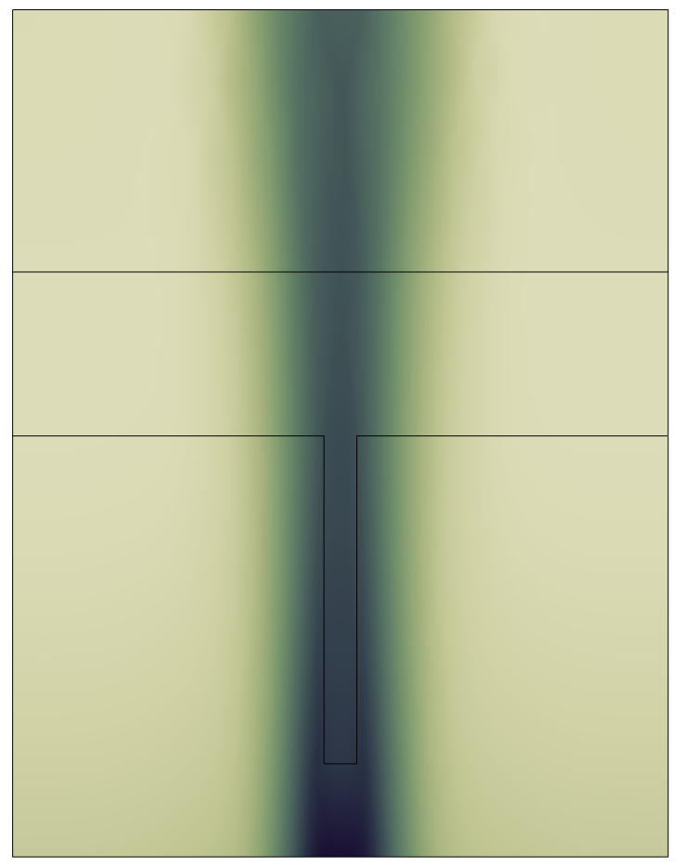
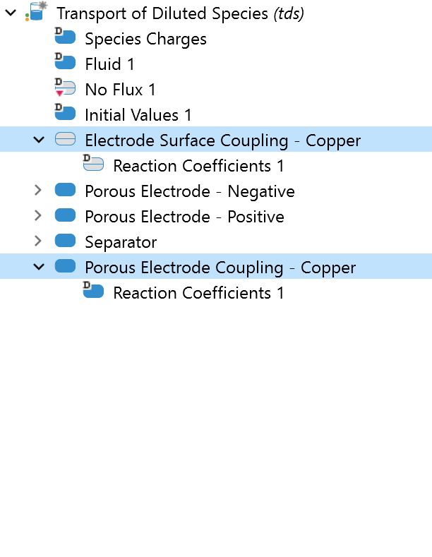
Transport of Diluted Species Interface
Copper deposition/dissolution
Dissolving copper boundary
Defines the copper reaction and transport of cuprous ions in the cell under the assumption that the electric field is fully governed by electrolyte salt species

Slide 7
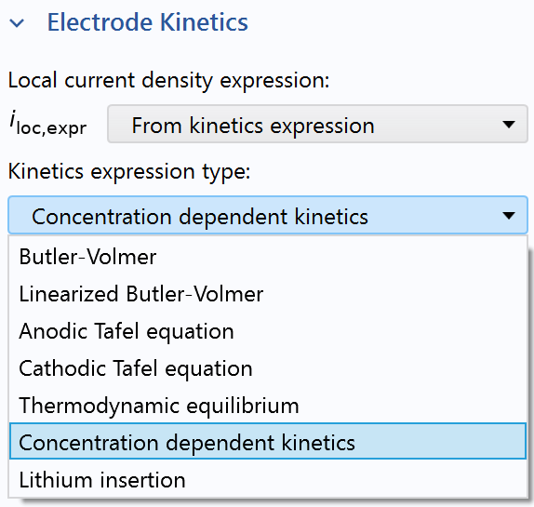
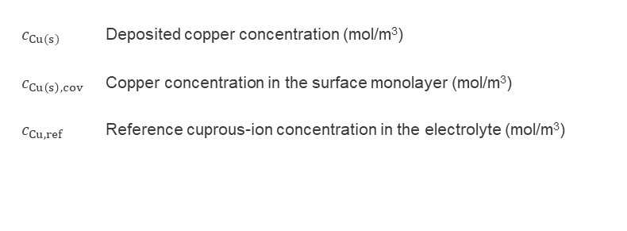
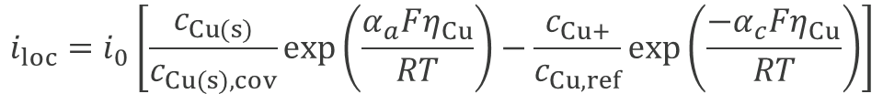
Copper Electrode Reaction Kinetics
Concentration dependent Butler-Volmer expression describes the deposition/re-deposition local current density of the copper reaction.
$$i_{loc}=i_{0}\left[\frac{c_{Cu(s)}}{c_{Cu(s),cov}}exp\left(\frac{α_{a}Fη_{Cu}}{RT}\right)−\frac{c_{Cu+}}{c_{Cu,ref}}exp\left(\frac{{−α}_{c}Fη_{Cu}}{RT}\right)\right]$$
${c_{Cu(s)}}_{ }$ Deposited copper concentration (mol/m³)
${c_{Cu\left(s\right),cov}}_{ }$ Copper concentration in the surface monolayer (mol/m³)
${c_{Cu,ref}}_{ }$ Reference cuprous-ion concentration in the electrolyte (mol/m³)

Slide 8
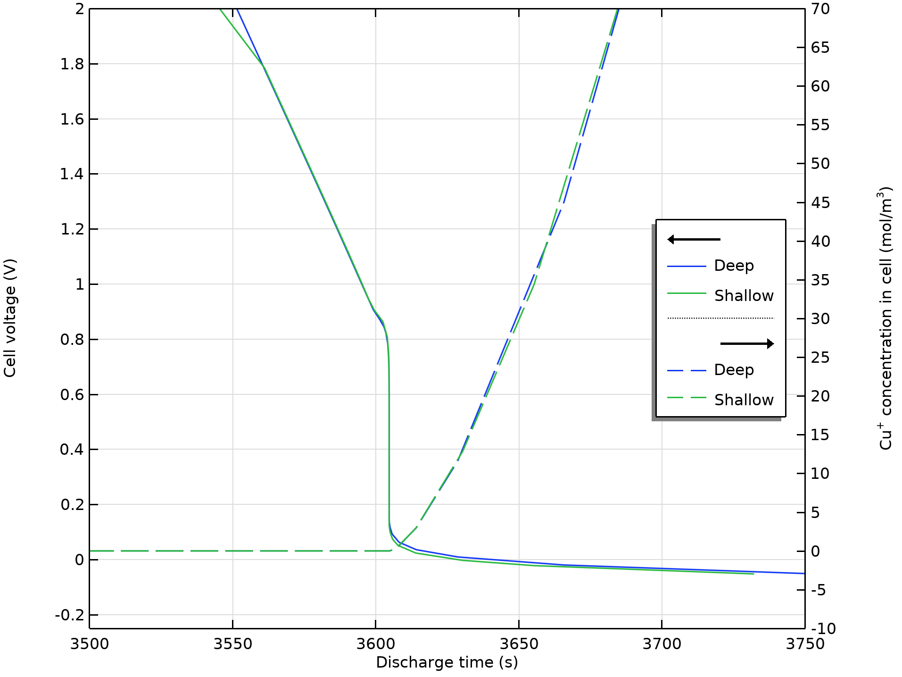
Results
After about an hour (3604 s) the current collector starts to dissolve
The cell is severely overdischarged when dissolution initiates

Slide 9
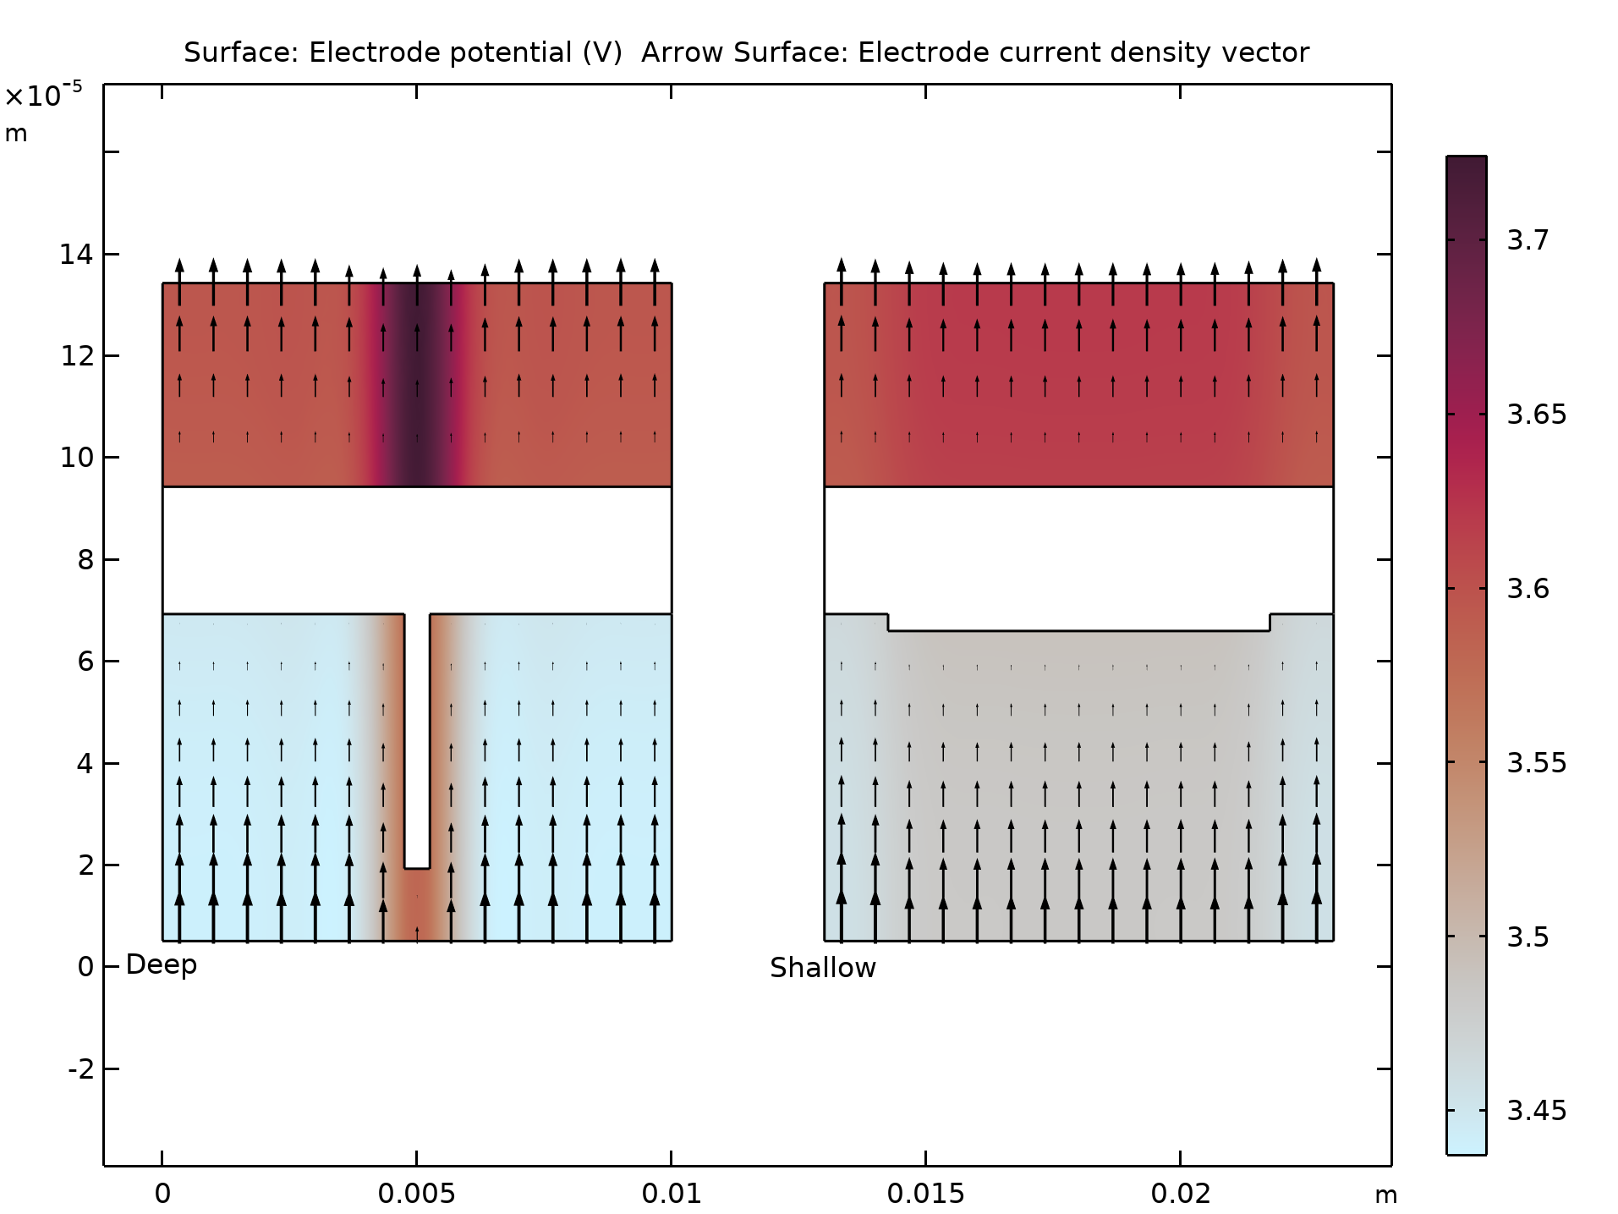
Results
Copper dissolution when the negative electrode potential is higher than 3.5 V (the equilibrium potential of the copper reaction)
The potential distribution differs with dent shape

Slide 10
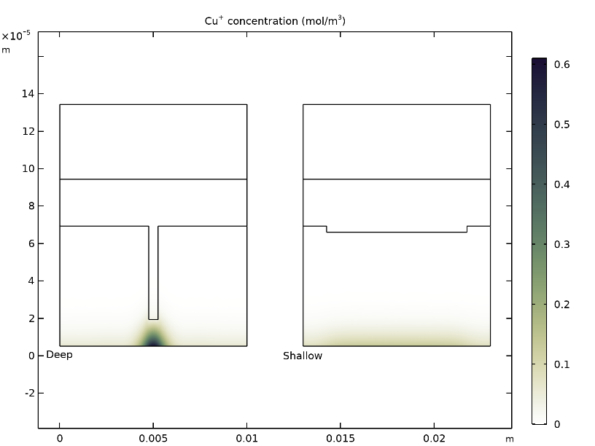
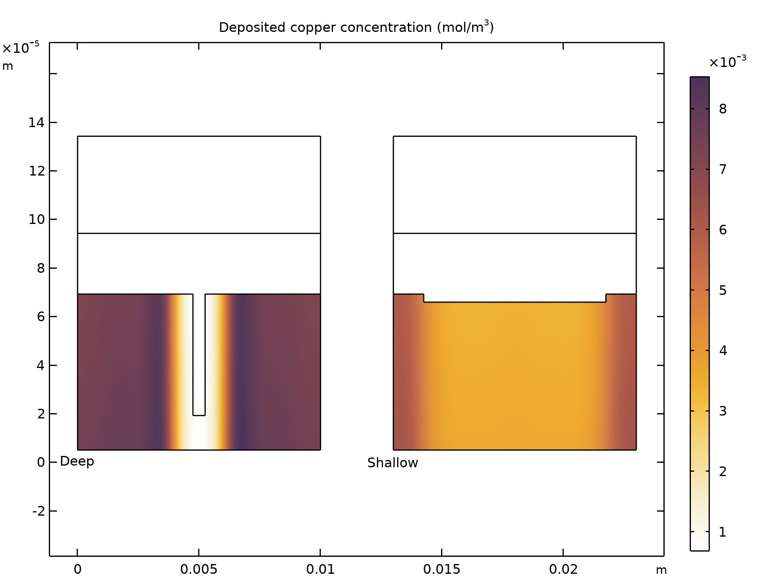
Concentrations
Cuprous-Ion Concentration
Deposited Copper Concentration
Indicatory of local current collector damage (after 3604 s discharge)
Deposition evenness indicates dendrite formation probability (at cell voltage -0.05 V)

Slide 11
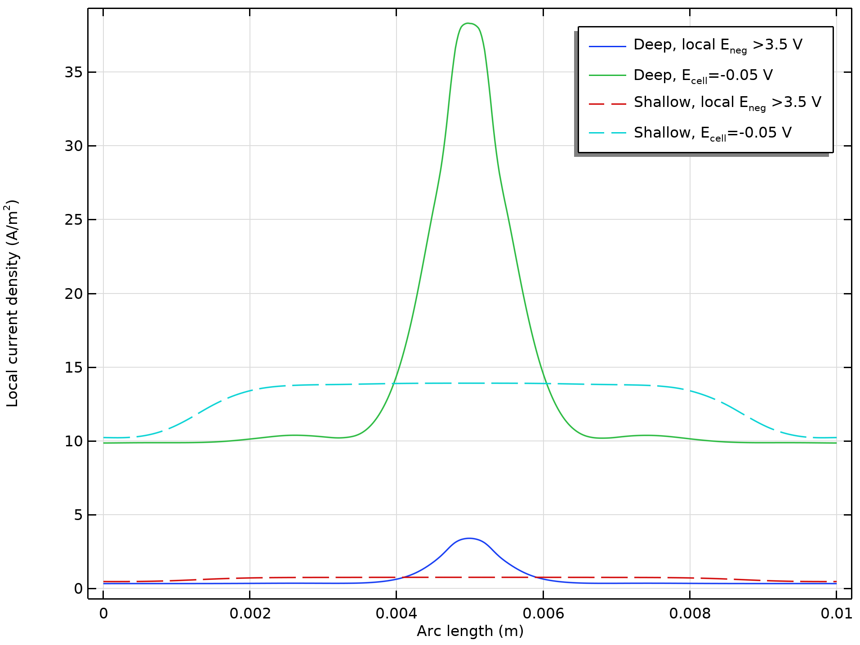
Dissolution Current
Current along the copper current collector
Faster dissolution of current collector beneath the tip of the dent
Local damage higher with deeper dent

Slide 12
Further Reading
L. Guo, D. B. Thornton, M. A. Koronfel, I. E. L. Stephens, and M. P. Ryan, “Degradation in lithium ion battery current collectors”, J. Phys. Energy, vol. 3, pp. 2874, 2000.
S. E. J. O’Kane, I. D. Campbell, M. W. J. Marzook, G. J. Offer, and M. Marinescu, “Physical Origin of the Differential Voltage Minimum Associated with Lithium Plating in Li-Ion Batteries,” J. Elec. Soc., vol. 167, pp. 090540, 2020.

