Slide 1
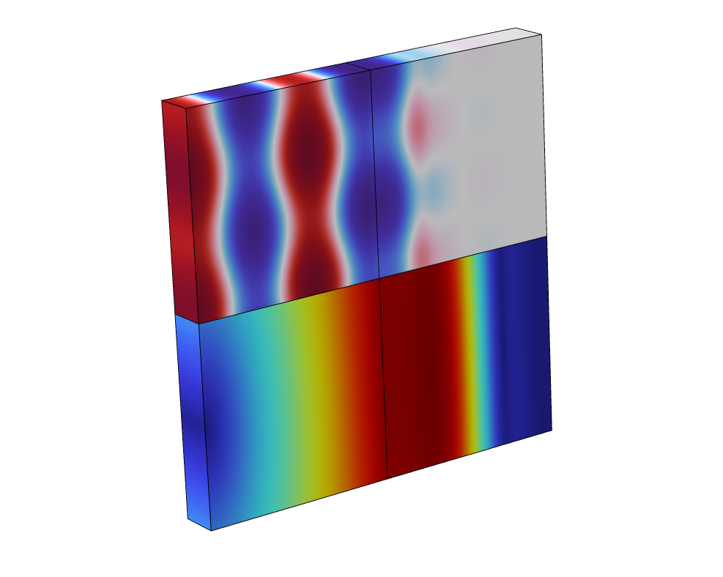
Acoustic-Structure Interaction with a Perfectly Matched Layer (PML)
Notes:
You can use the heading from the application documentation for the title.

Slide 2
Background and Motivation
This small tutorial model shows how to set up a model with both a solid mechanics and a pressure acoustics domain including a perfectly matched layer (PML). The PML is used to model an open or infinite domain for both the elastic waves and the pressure waves.
The important lessons are:
  One PML should be added when the PML region of two physics touches. Set the PML typical wavelength manually and tweak the scaling (as described in this document).
  If the PML regions do not touch you should add two PMLs – one for each physics. In this case use the appropriate typical wavelength using the default From physics option.

Slide 3
Different PML Configurations
source
solid
PML 1
fluid
solid
PML 2
actuation
PML
fluid
  If the PML regions do not touch you should add two PMLs – one for each physics. In this case the typical wavelength associated with each physics should be selected (from Physics interface option).
  One PML should be added when the PML region of the two physics touches. Set the PML typical wavelength equal to the longest wavelength in the model (User defined option as in the model).

Slide 4
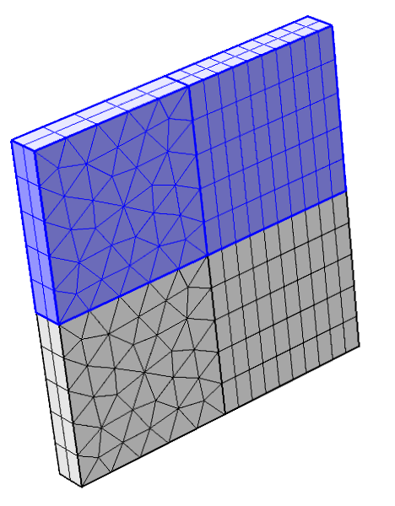
Meshing and Operating Conditions
In general a structured mesh is preferred in the PML domains: swept or mapped. In the geometry step use the Layer option to create the PML layer geometry.
In a typical situation when the scaling in the PML is controlled by a single physics use around 6 elements.
In the situation where one PML is used for two physics (the touching PML configuration) use more mesh layers inside the PML region to get good attenuation performance (e.g. double the amount).
PMLs with swept mesh
Fluid layer
Solid layer

Slide 5
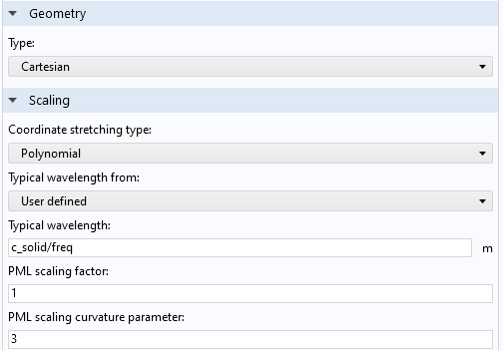
Perfectly Matched Layer (PML)
Use Polynomial scaling for these coupled problems.
Use the largest speed of sound to define the typical wavelength* equal to the longest in the system.
Increase the PML curvature factor to effectively increasing the resolution near the physical boundary. This will damp the small wavelengths.

Slide 6
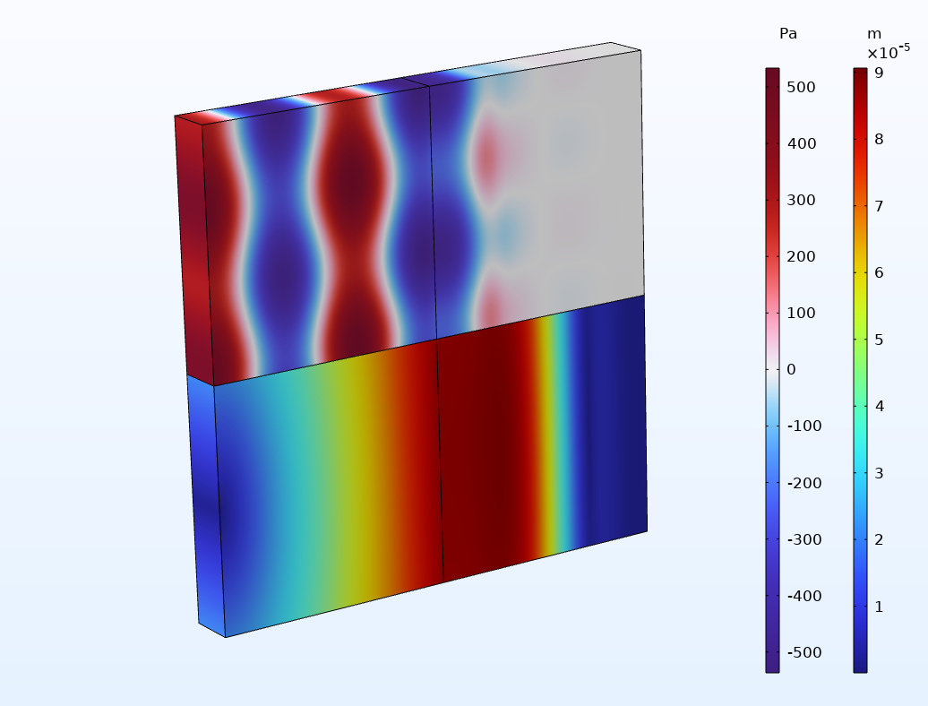
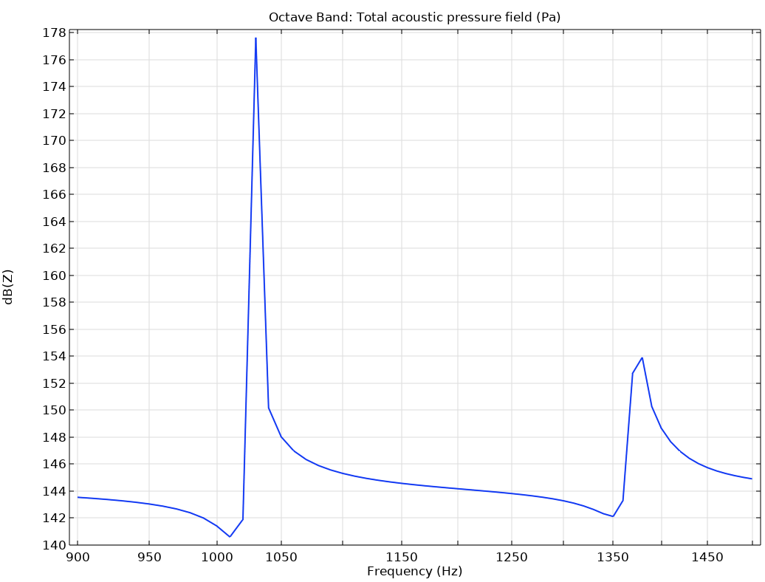
Results: Pressure and Displacement

Slide 7
Special Case: Actuation in PML
In case of an infinite actuation plane.
  Continue actuation through the PML
In this case the pressure and displacement field will NOT vanish at the back of the PML
  Modes travelling into the PML will be damped but modes travelling parallel inside the PML is not damped.
It is a good idea to test the implementation of the PML layer.
  Vary the position, d, of the PML and ensure that the position does not influence the results outside the PML.
d
solid
actuation
PML
fluid
  One PML should be added when the PML region of the two physics touches. Set the PML typical wavelength equal to the longest wavelength in the model (User defined option as in the model).

