Slide 1
Acoustic Trap in Glass Capillary with Bias Flow
Movement of Fluid and Microparticles due to Nonlinear Acoustic Effects

Slide 2
Background and Motivation
Recent advances in the fabrication of microfluidic systems require handling of live cells and other microparticles as well as mixing. All this can, for example, be achieved using acoustic radiation forces and the viscous drag from the streaming flow.
Streaming: Due to the nonlinear terms in the Navier-Stokes equations, harmonic perturbation of the flow will lead to a net time-averaged flow called acoustic streaming. Acoustic streaming is a second order (nonlinear) acoustic effect. The effect can be simulated in two ways: either by direct simulation solving the nonlinear Navier-Stokes equations, or as shown here by perturbation theory (2nd order perturbation).
Radiation Force: Due to nonlinear terms in the governing equations momentum can be transferred from an acoustic field to particles. This results in a net force acting on the particles – the acoustic radiation force.
The trajectory of particles in devices will be governed by the balance between the viscous drag force (from the streaming flow and background flow) and the acoustic radiation force.

Slide 3
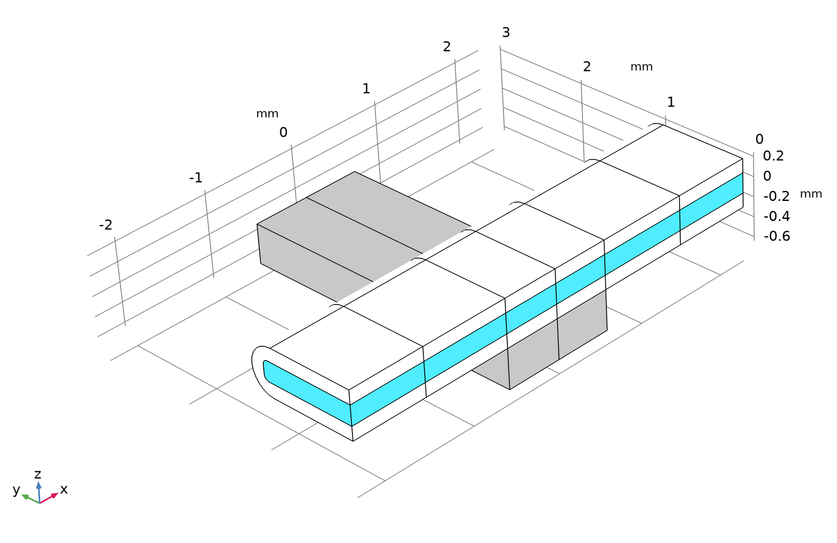
System – Acoustic Trap in Glass Capillary
A long glass capillary (white) with water (blue) is actuated by a thin piezoelectric transducer (grey). Two PML layers are used to attenuate waves travelling out of the system.
The system works as an acoustic trap for microparticles in the fluid.
The piezoelectric transducer heats the system and creates gradients in the material properties.
The streaming flow is dominated by bulk thermoacoustic streaming due to the acoustic field and the heating from the piezoelectric transducer.
Reference:
J.H. Jørgensen and H. Bruus, “Theory for pressure acoustics with thermoviscous boundary layers and streaming in elastic cavities,” J. Acoust. Soc. Am. 149, 3599-3610 (2021).

Slide 4
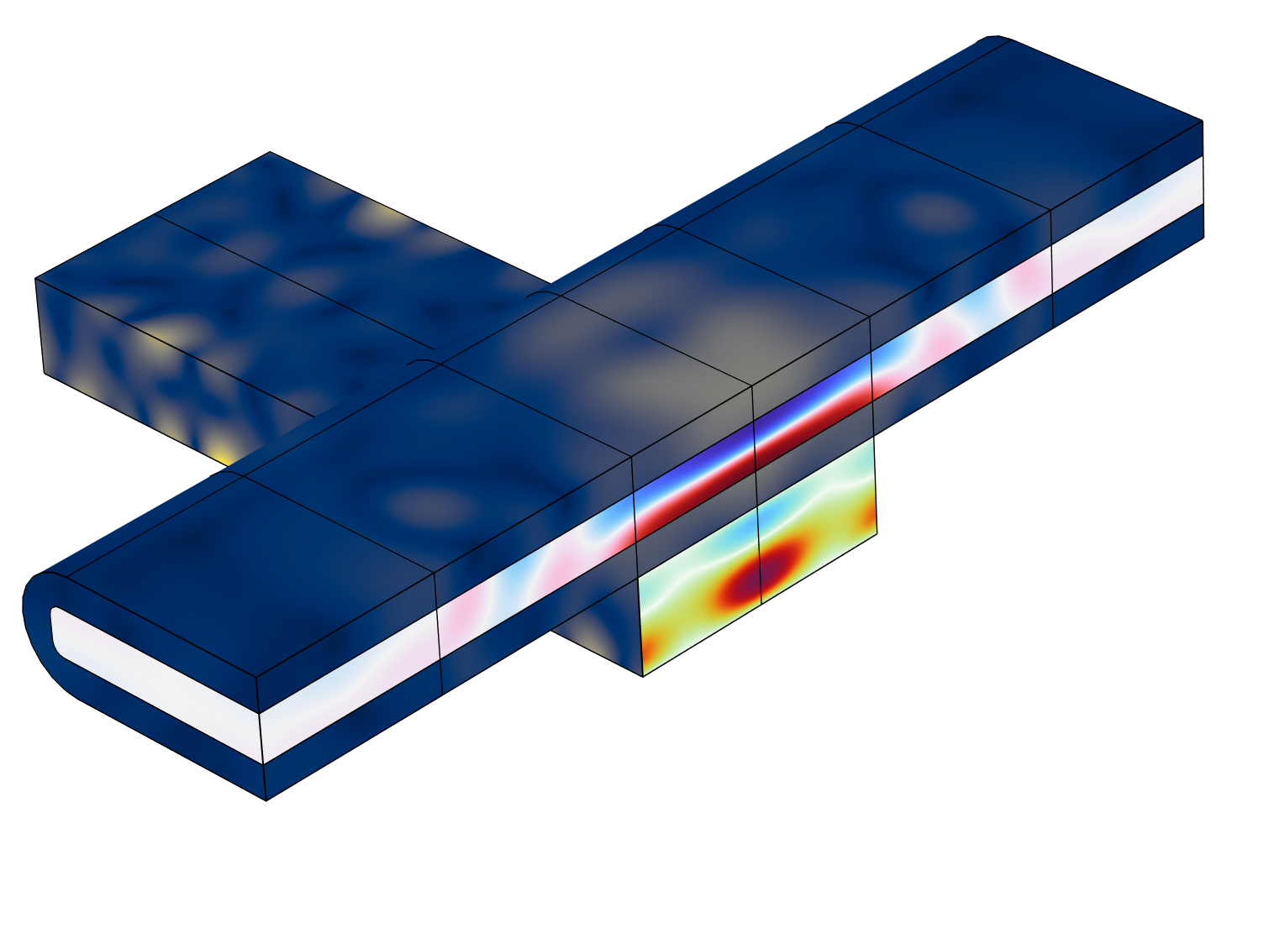
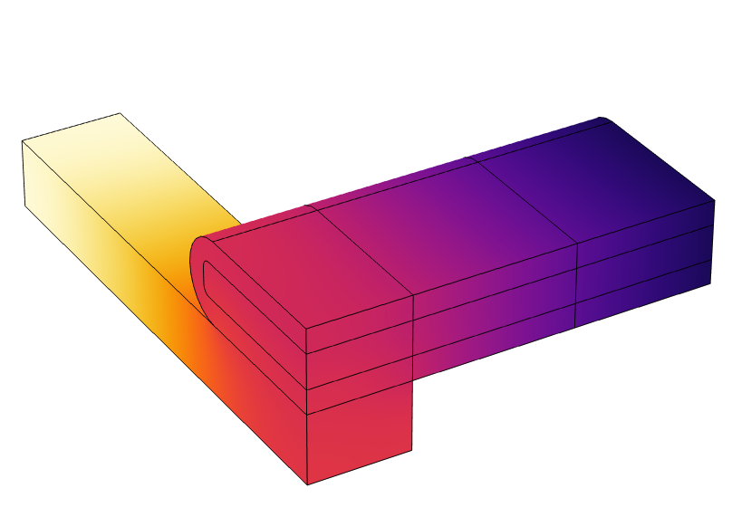
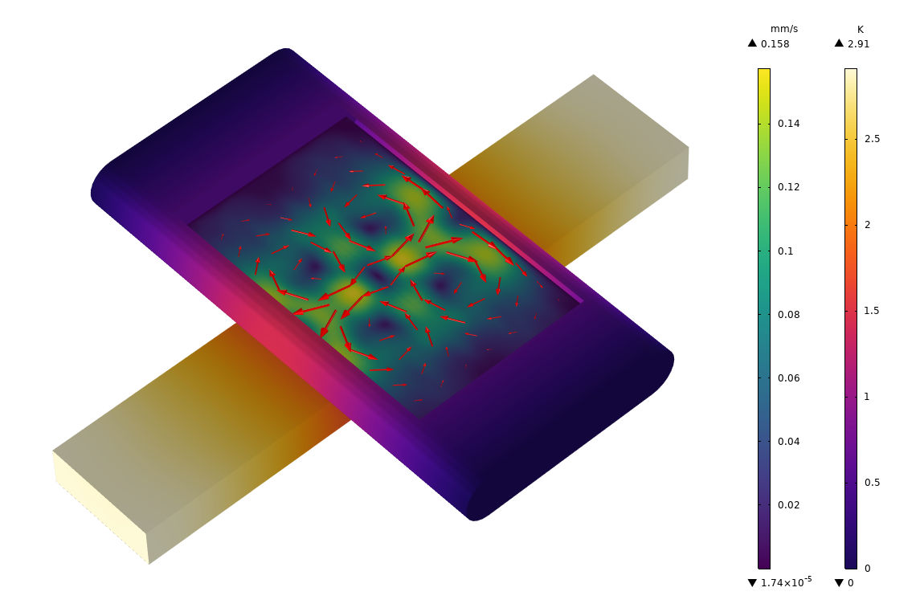
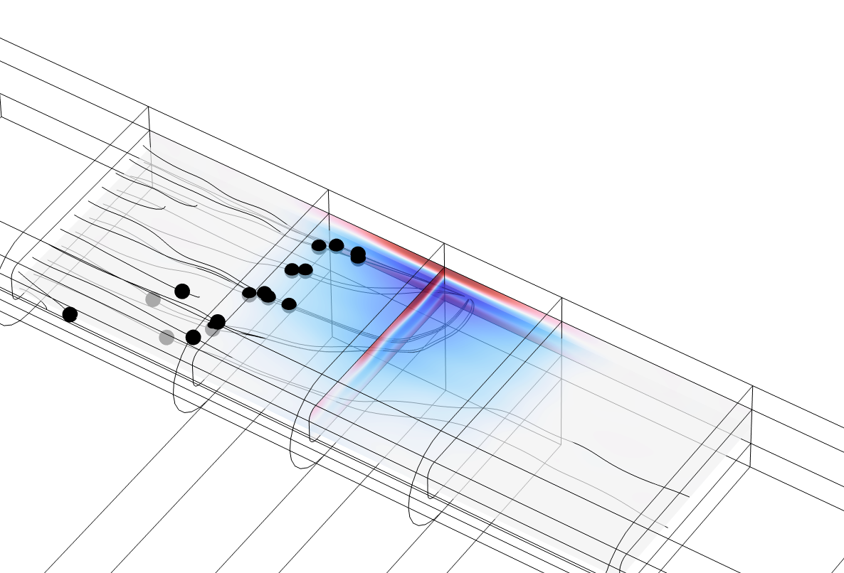
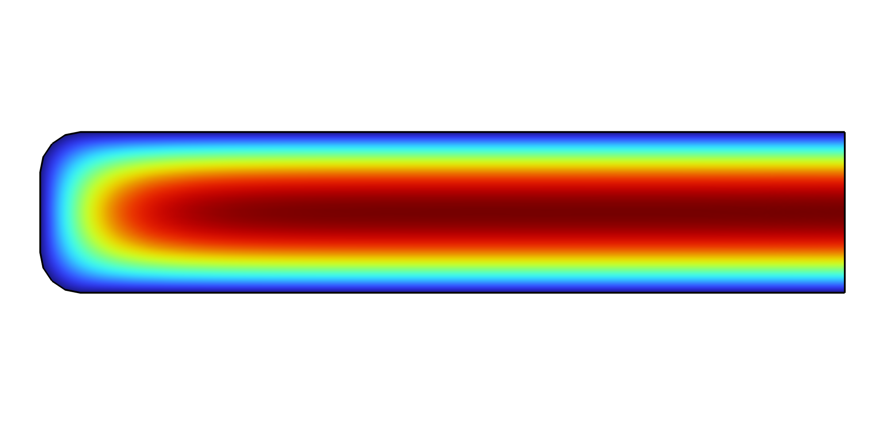
Simulation Approach
Poiseuille Flow
Acoustic Fields
Heating
Acoustic Streaming
Particle Trajectories
Background flow without acoustics
The Electrostatics, Solid Mechanics, and Pressure Acoustics, Frequency Domain interfaces. Coupled by Multiphysics couplings.
Heating from losses in the piezo-electric transducer
Fluid flow induced by the acoustic field and the gradient in the temperature field.
Streamlines in postprocessing calculates the particle trajectories.
Notes:
The model first solves the acoustic fields using the Electrostatics, Solid Mechanics, and Pressure Acoustics, Frequency Domain interfaces. The Multiphysics couplings Acoustic-Structure Boundary and Piezoelectric Effect are used to ensure the correct coupling of the solid and fluid on their boundary and the coupling between electric and mechanical fields in the piezoelectric domain.
The Heat Transfer in Solids and Fluids interface is used to model the heating from the piezoelectric transducer. The heat source is modeled by the total power dissipation in the solid.
Thirdly, the streaming flow in the fluid is solved. This is achieved by using the two Multiphysics couplings Acoustic Streaming Domain Coupling and Acoustic Streaming Boundary Coupling to couple the Pressure Acoustic interface to the Laminar Flow interface.
Finally, the path of polystyrene microparticles in the acoustic trap is modeled using the Particle Tracing for Fluid Flow interface. The forces on the particles are added using the built-in Acoustophoretic Radiation Force and the Drag Force features.

Slide 5
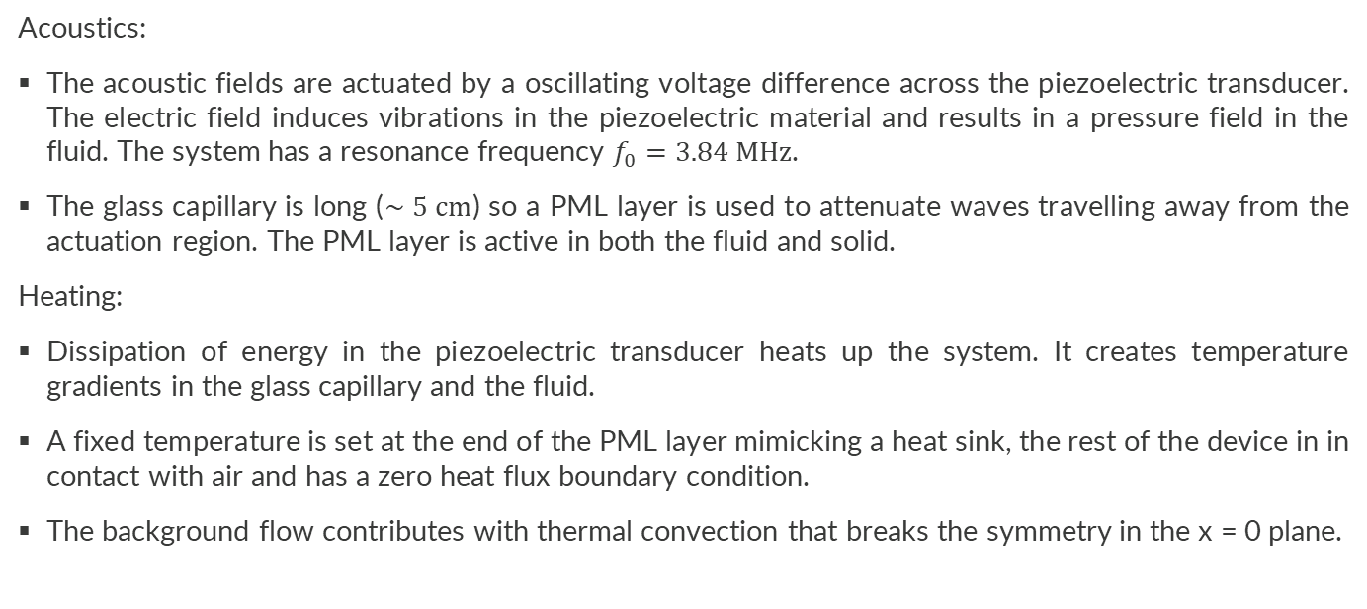
Implementation of Acoutics and Heating
Acoustics:
The acoustic fields are actuated by a oscillating voltage difference across the piezoelectric transducer. The electric field induces vibrations in the piezoelectric material and results in a pressure field in the fluid. The system has a resonance frequency $f_{0}=3.84 MHz$.
The glass capillary is long ($∼5 cm$) so a PML layer is used to attenuate waves travelling away from the actuation region. The PML layer is active in both the fluid and solid.
Heating:
Dissipation of energy in the piezoelectric transducer heats up the system. It creates temperature gradients in the glass capillary and the fluid.
A fixed temperature is set at the end of the PML layer mimicking a heat sink, the rest of the device in in contact with air and has a zero heat flux boundary condition.
The background flow contributes with thermal convection that breaks the symmetry in the x = 0 plane.

Slide 6

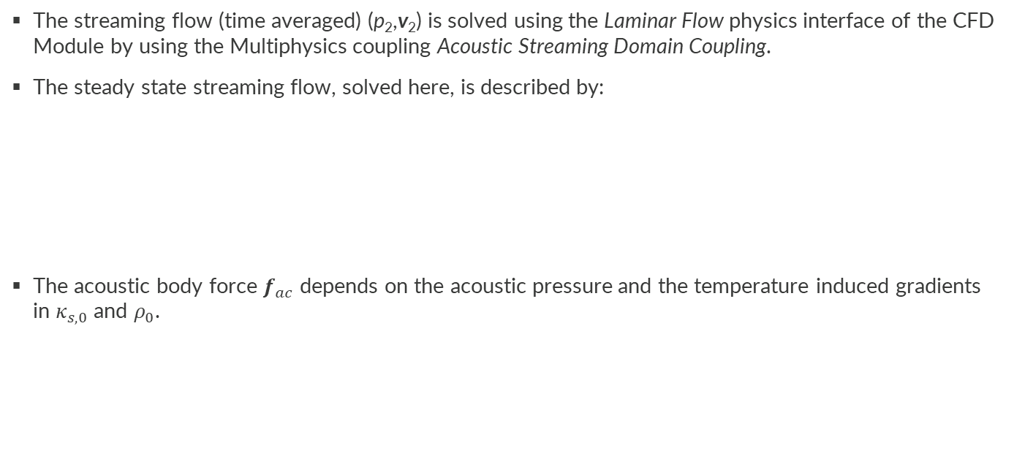
Implementation of Streaming Flow
The streaming flow (time averaged) (p₂,v₂) is solved using the Laminar Flow physics interface of the CFD Module by using the Multiphysics coupling Acoustic Streaming Domain Coupling.
The steady state streaming flow, solved here, is described by:
The acoustic body force $f_{ac}$ depends on the acoustic pressure and the temperature induced gradients in $κ_{s,0}$ and $ρ_{0}$.
$$0=−∇⋅\left(ρ_{0}v_{2}\right)$$
$$0=∇⋅σ_{2}+f_{ac}$$
$$f_{ac}=−\frac{1}{4}{\left|p_{1}\right|}^{2}∇κ_{s,0}−\frac{1}{4}\left|v_{1}\right|∇ρ_{0}$$

Slide 7
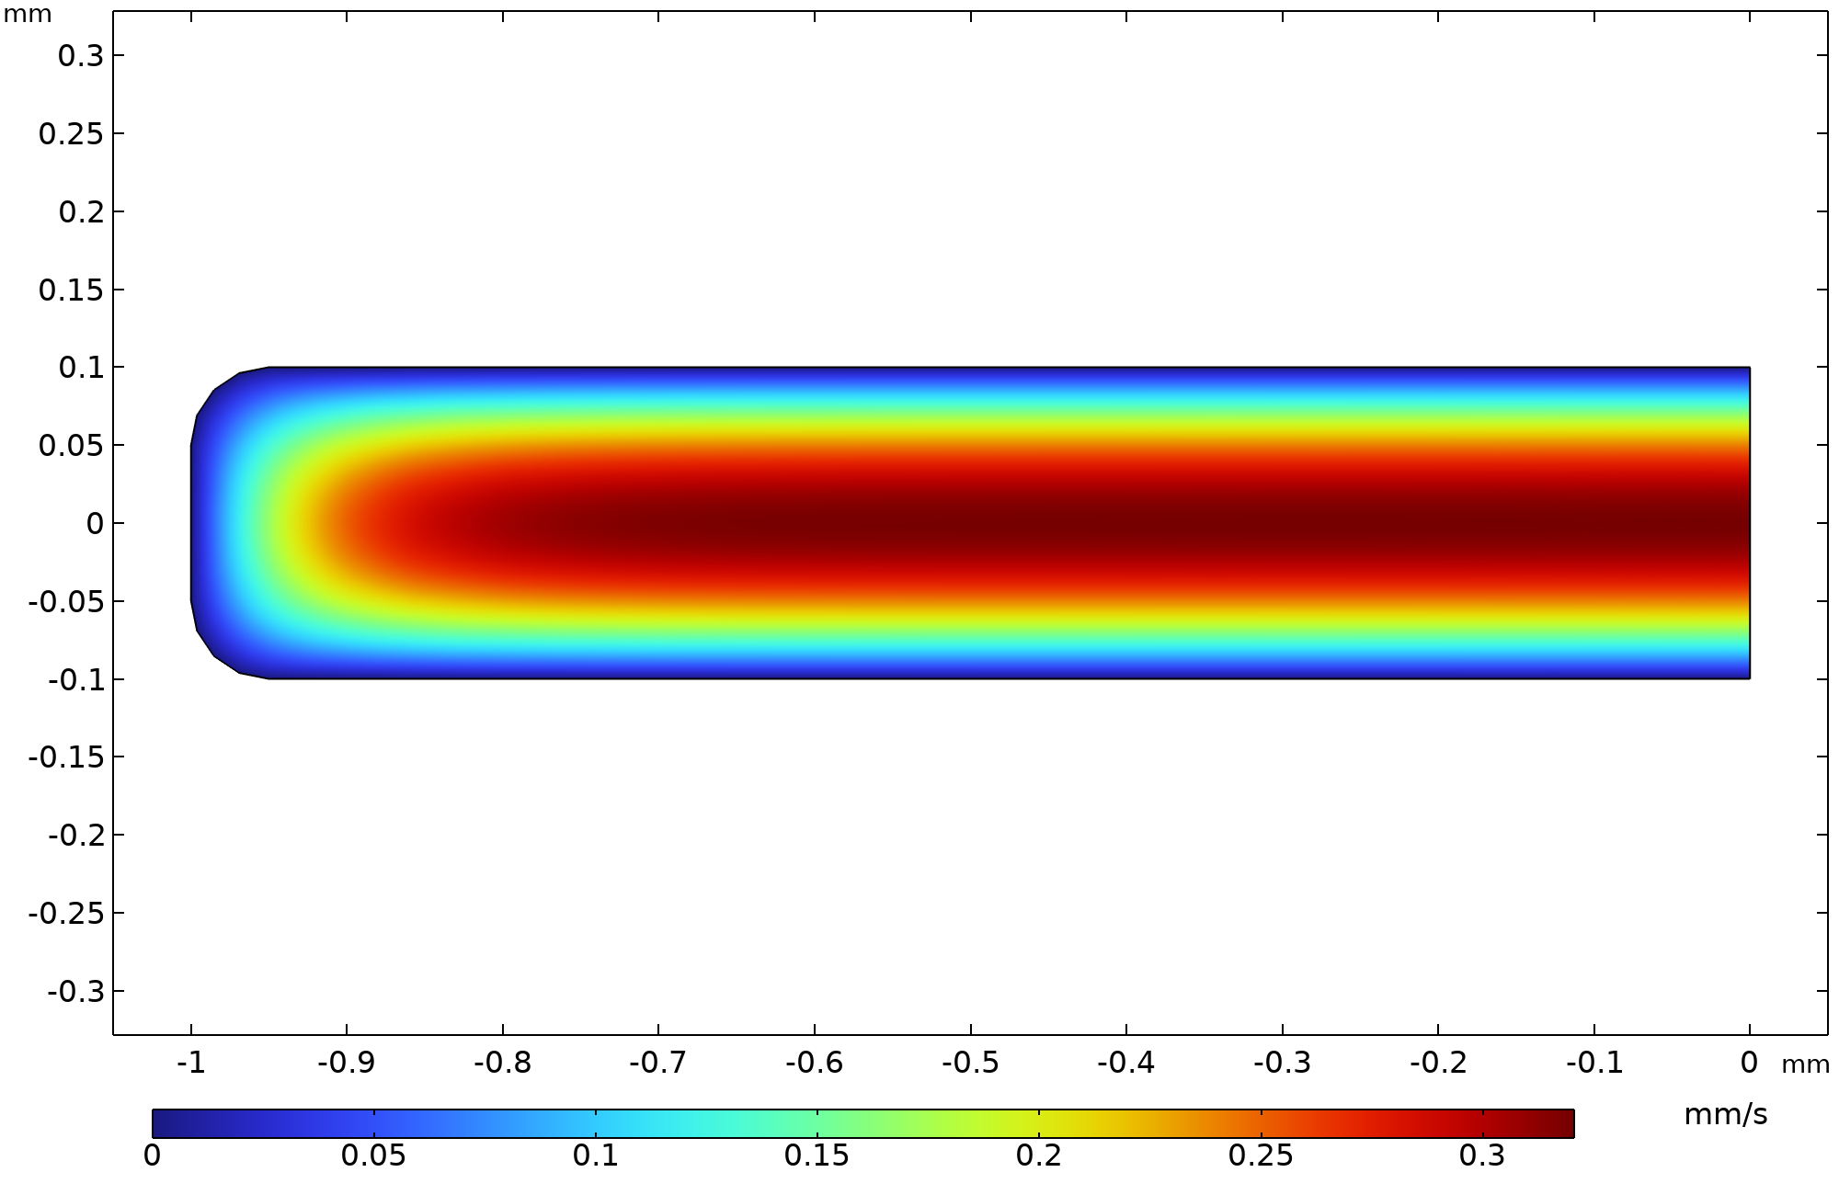
Background Flow
Poiseuille flow
Volume flow of ranging from 0 to 0.8 µL/s.
The resulting Pouseuille flow for a volume flow of 0.08 µL/s

Slide 8
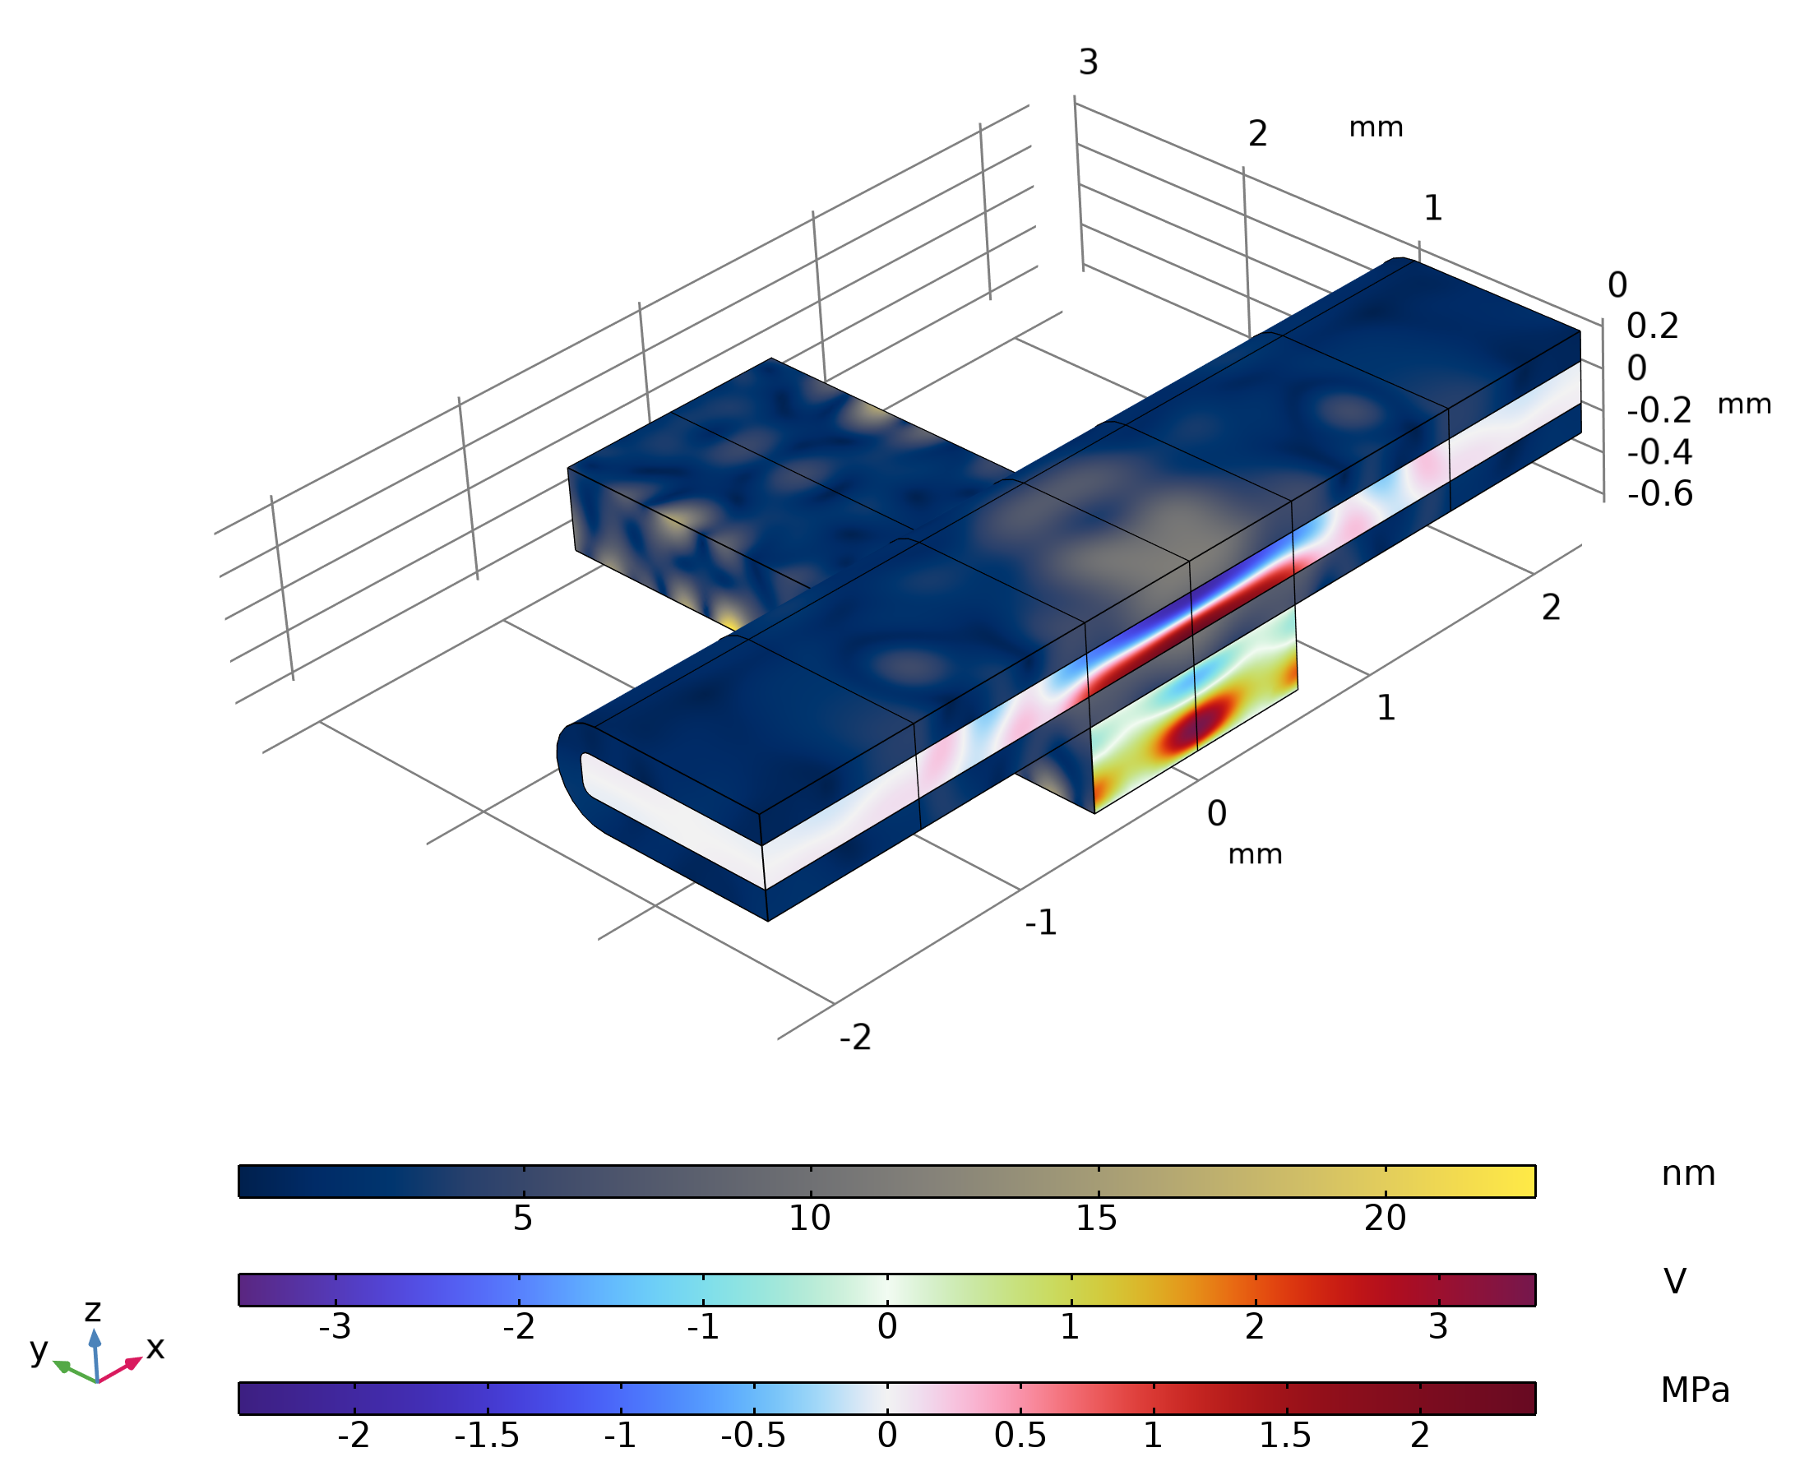



Acoustic Fields
f₀ = 3.84 MHz
Actuated with 10 𝑉 peak-to-peak over the piezoelectric transducer.
The piezoelectric effect results in a displacement field in the piezoelectric transducer and glass capillary.
The vibrating glass capillary sets up a height resonance mode in the fluid channel resulting in a strong pressure field near the piezo electric transducer.
$$|u_{1}|$$
$$p_{1}$$
$$V_{1}$$
Electric field V₁, displacement field u₁, and pressure field p₁

Slide 9
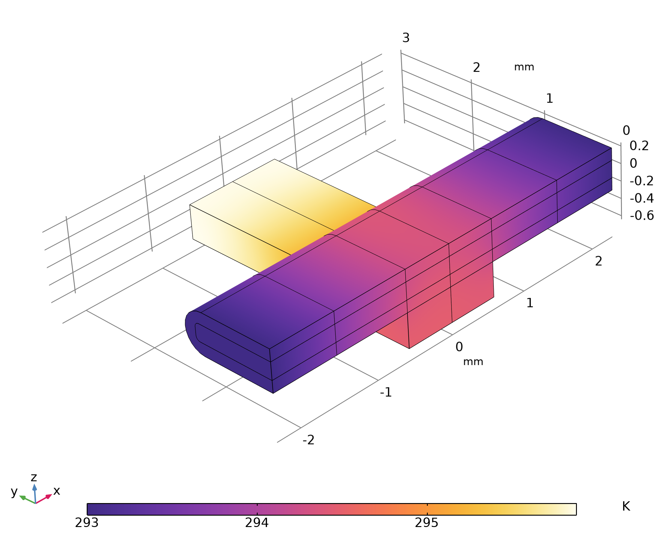
Temperature Field
Temperature field T₂
Created due to heating in the piezoelectric transducer.
The temperature field creates gradients in the material parameters. Which leads to the thermoacoustic body force.

Slide 10
Streaming Field
Symmetry planes folded out. In reality the glass capillary is very long.
Streaming field shown at the center plane 𝑧 = 0, with amplitude and velocity field.
Four characteristic streaming rolls are observed in the acoustic trapping glass capillary. This can only be explained by including gradients in the temperature field.
Streaming velocity magnitude and velocity field v₂ and temperature field T₂

Slide 11
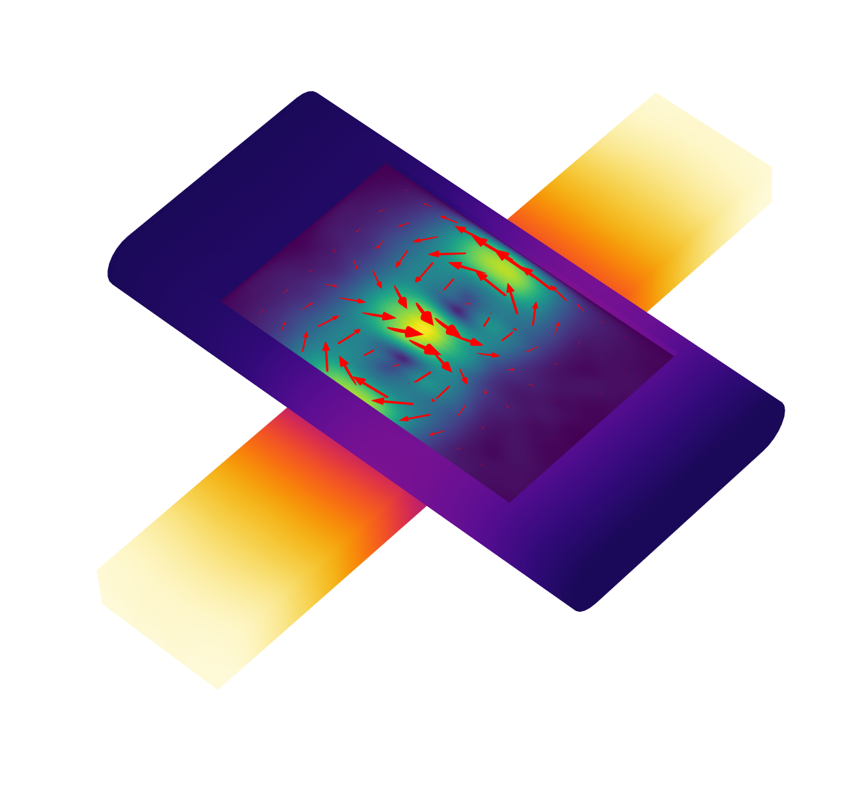
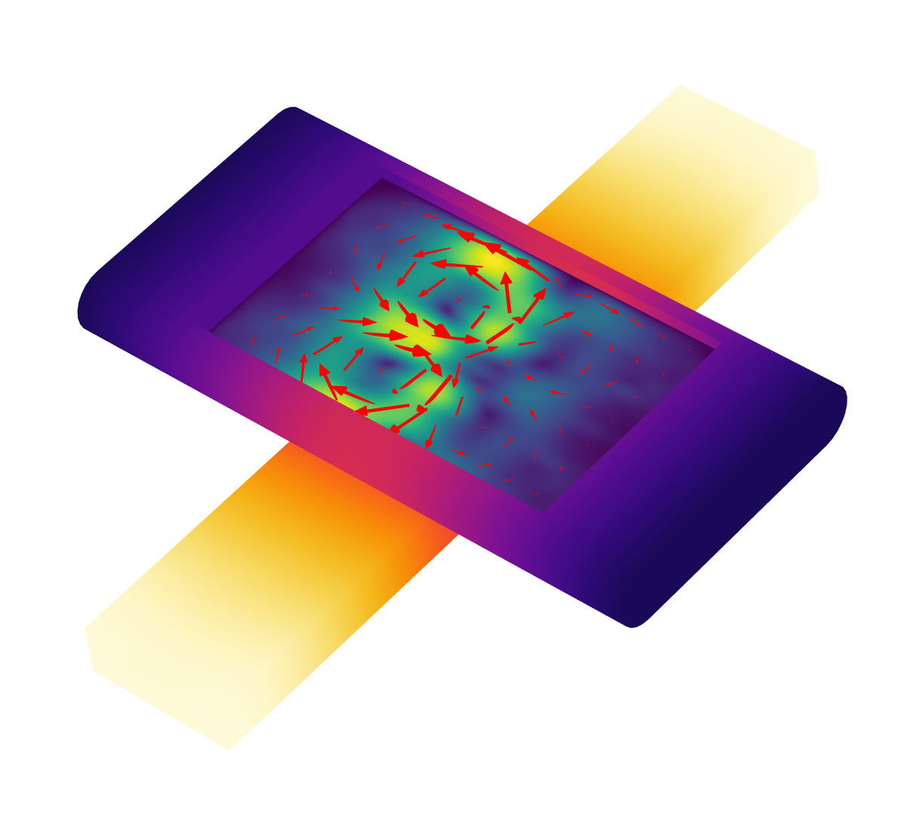
Streaming:
Influence of flow
Volume flow = 0.8 µL/s
No flow
Volume flow = 0.08 µL/s
Convection from background flow breaks symmetry in the temperature field.
Leads to two dominant acoustic streaming rolls on the upstream side of the acoustic trap.
Acoustic Streaming
The structure of the acoustic streaming depends on the background flow.

Slide 12
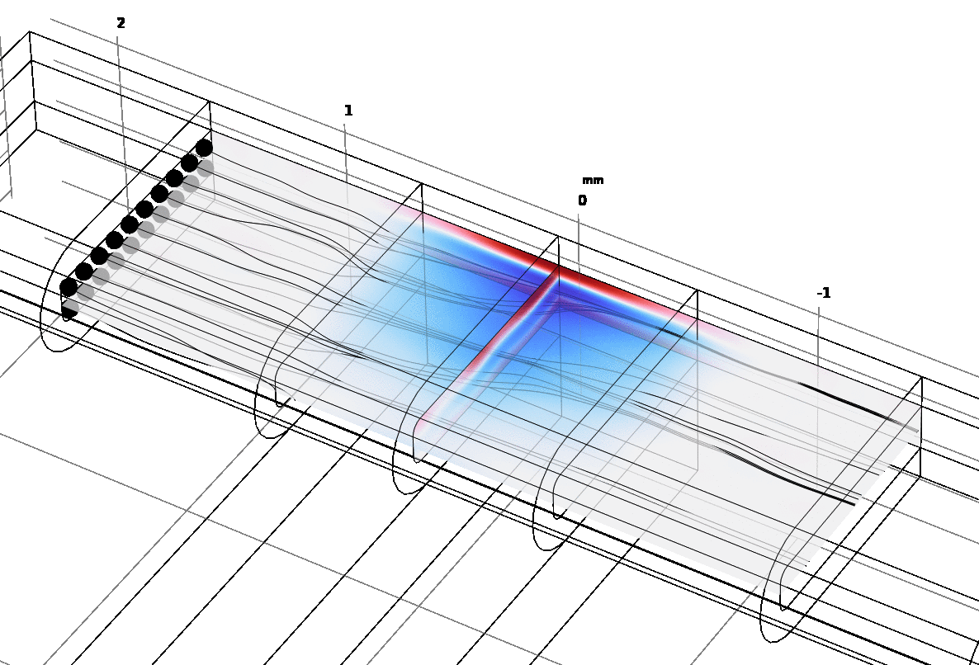
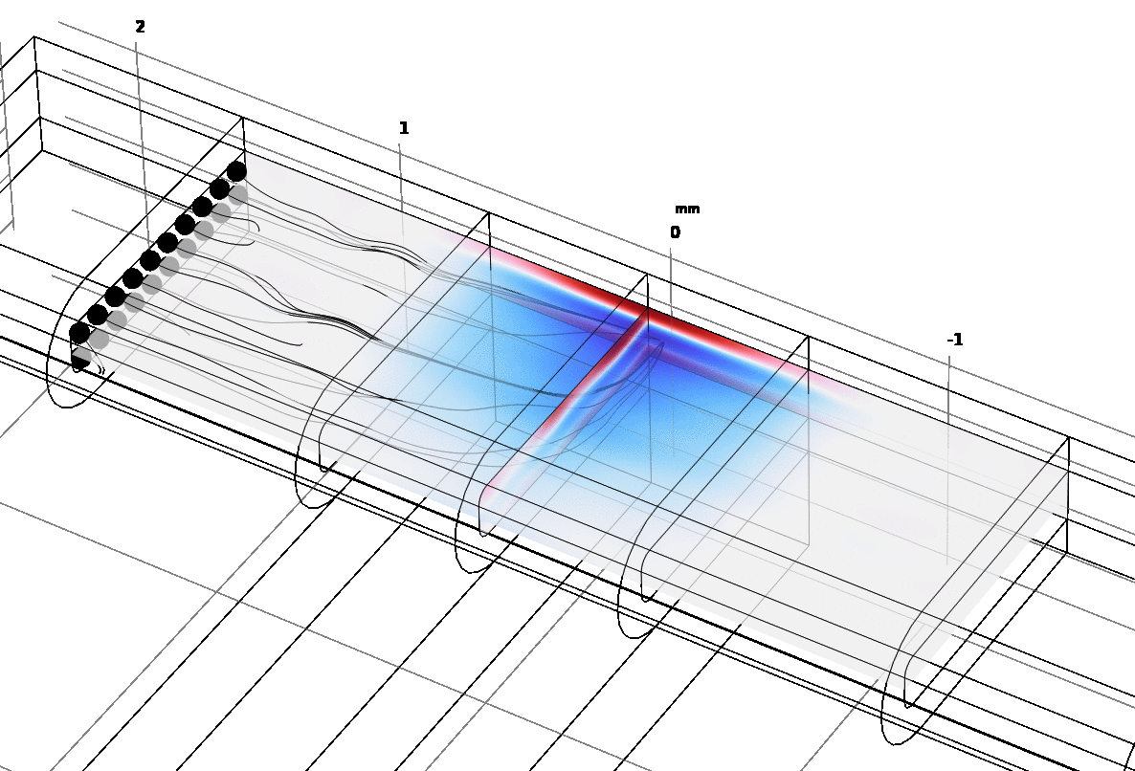

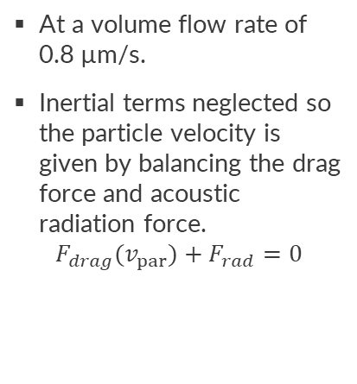
Particle trajectories
a = 2 µm
a = 4 µm
At a volume flow rate of 0.8 µm/s.
Inertial terms neglected so the particle velocity is given by balancing the drag force and acoustic radiation force.
$$F_{drag}(v_{par})+F_{rad}=0$$
a = 3 µm
Particle size
Trajectories for silica particles with radii 2, 3, and 4 µm.
The Gor’kov potential for the acoustic radiation force is shown in color plot.

