Slide 1
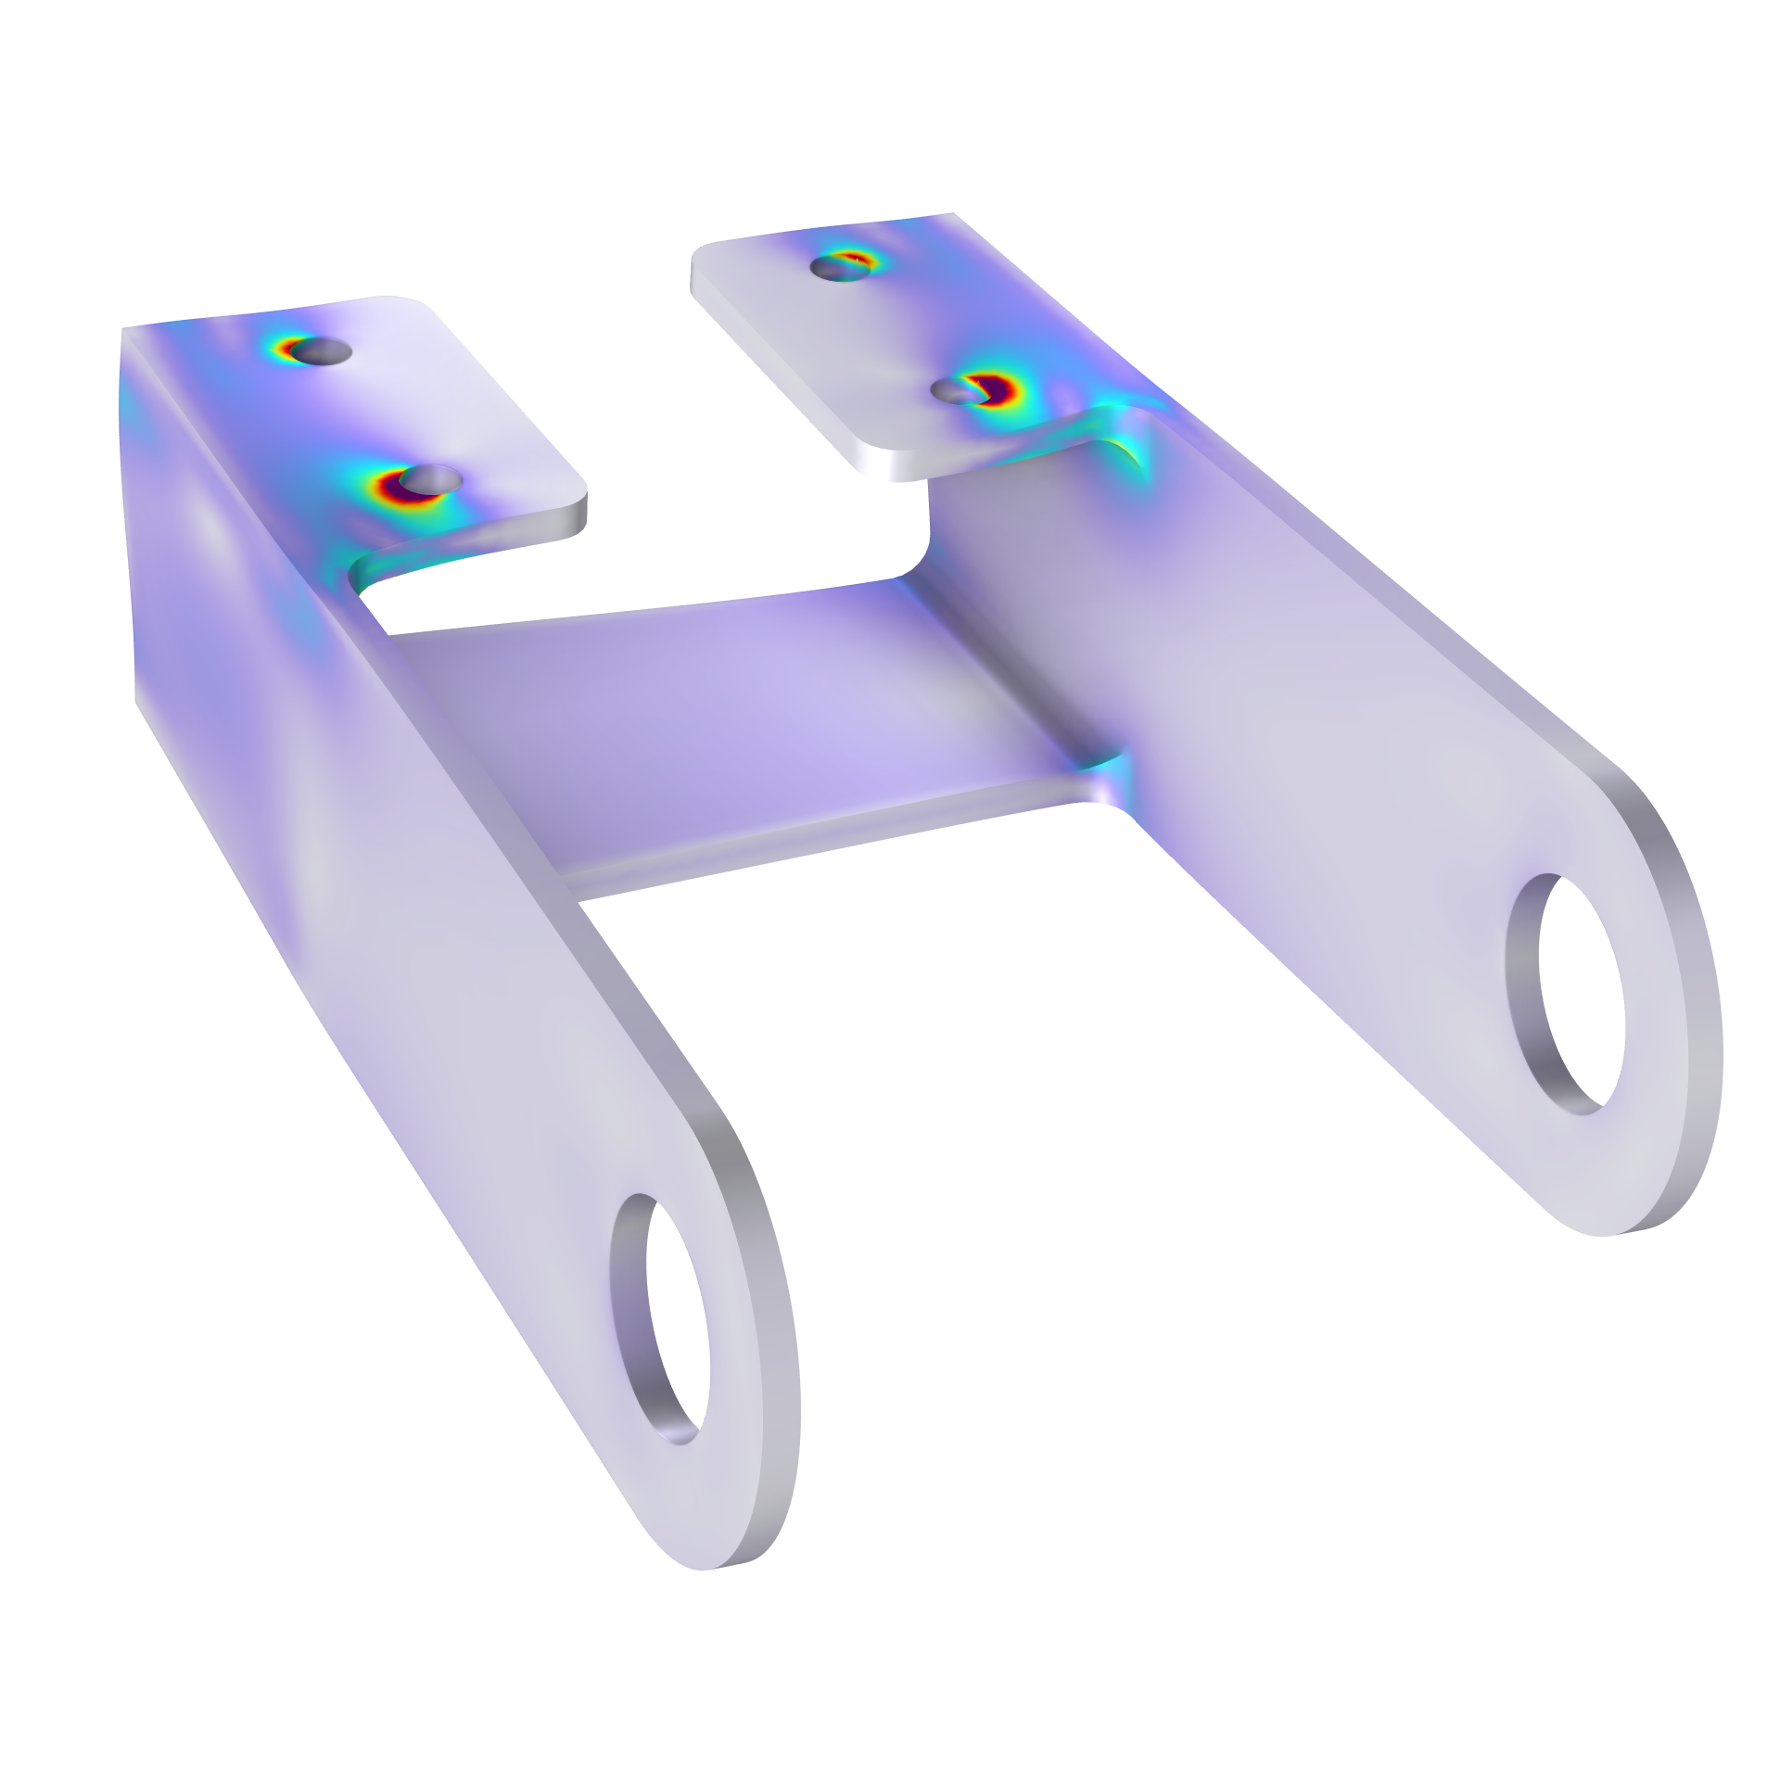
Uncertainty Quantification

Slide 2
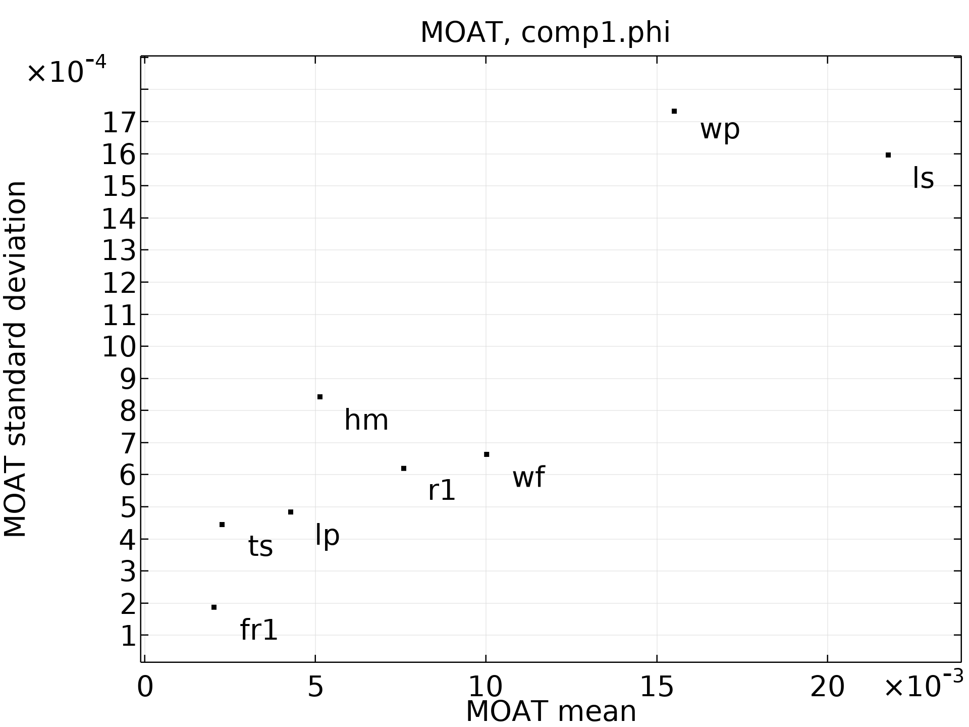
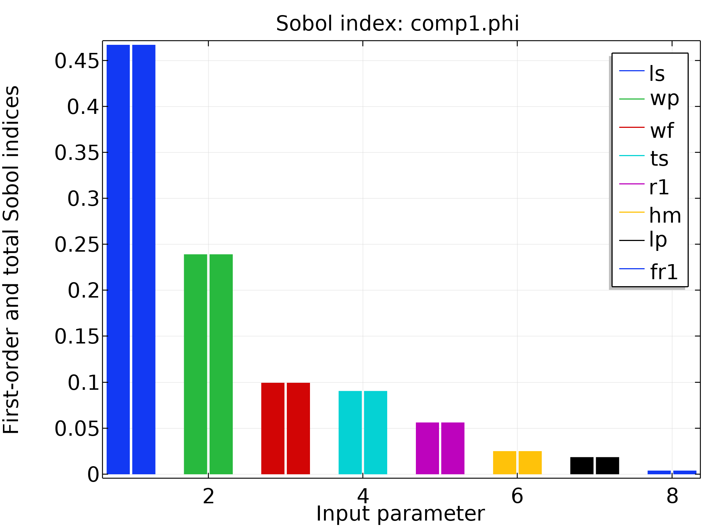
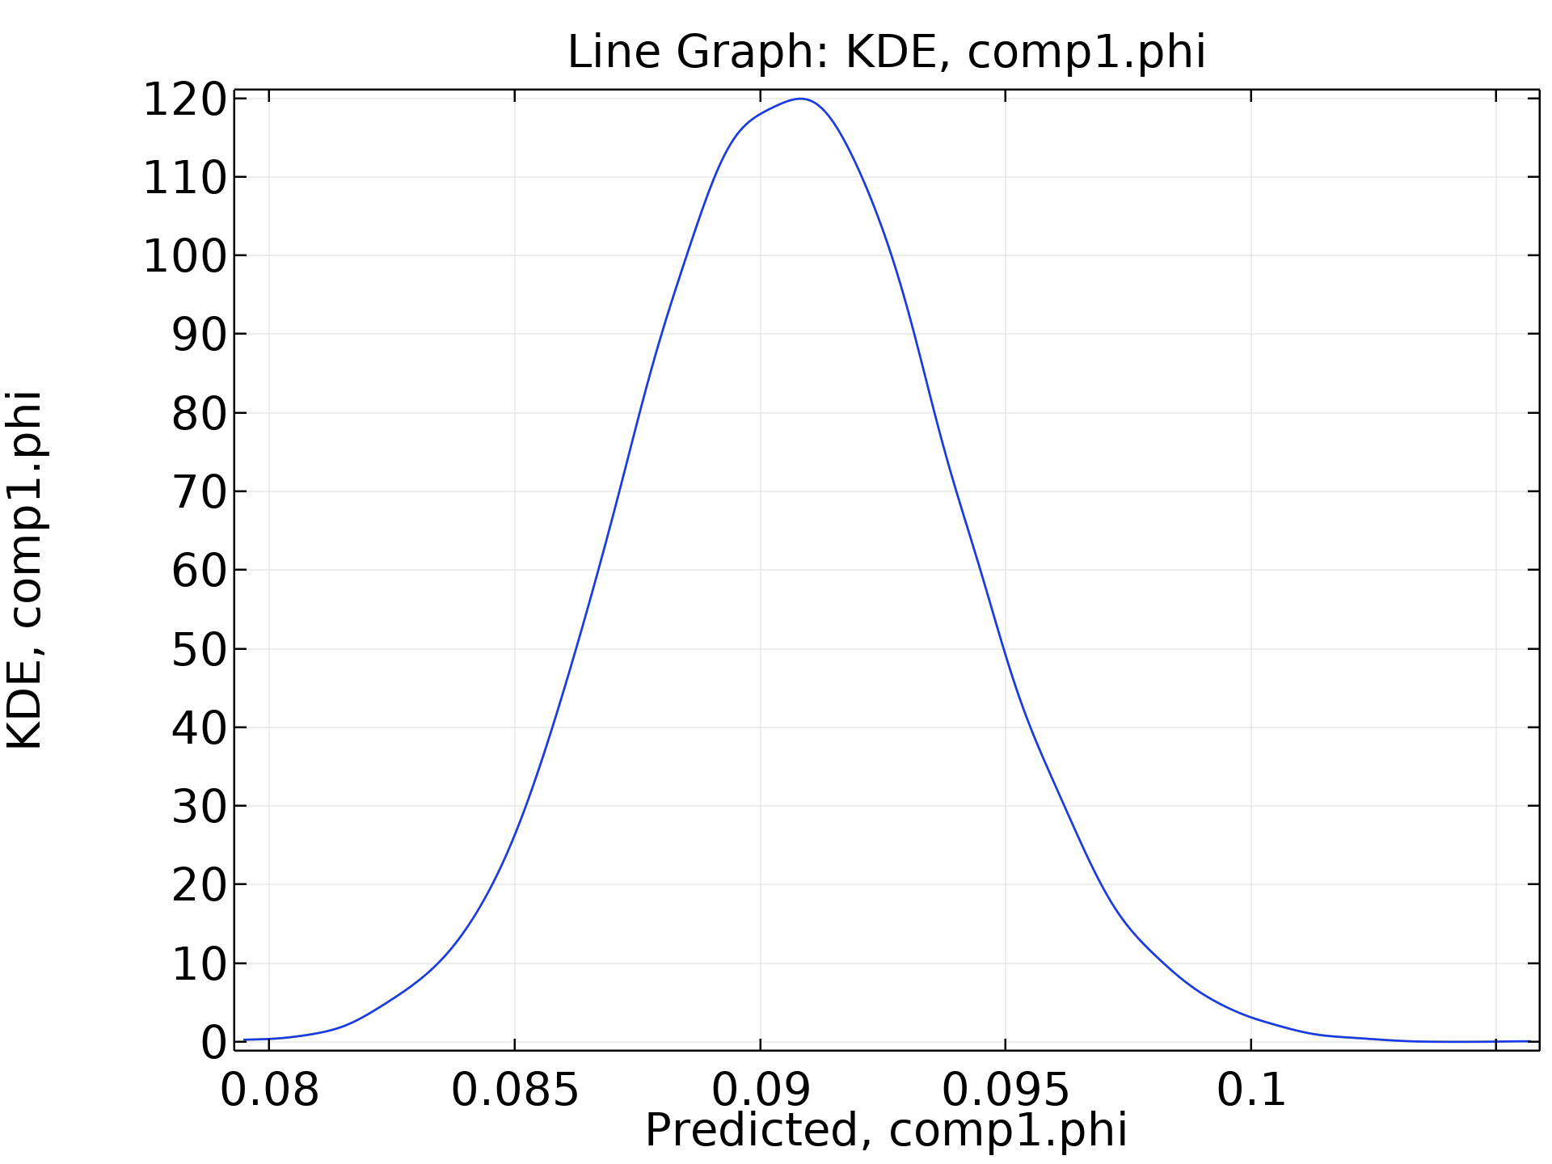
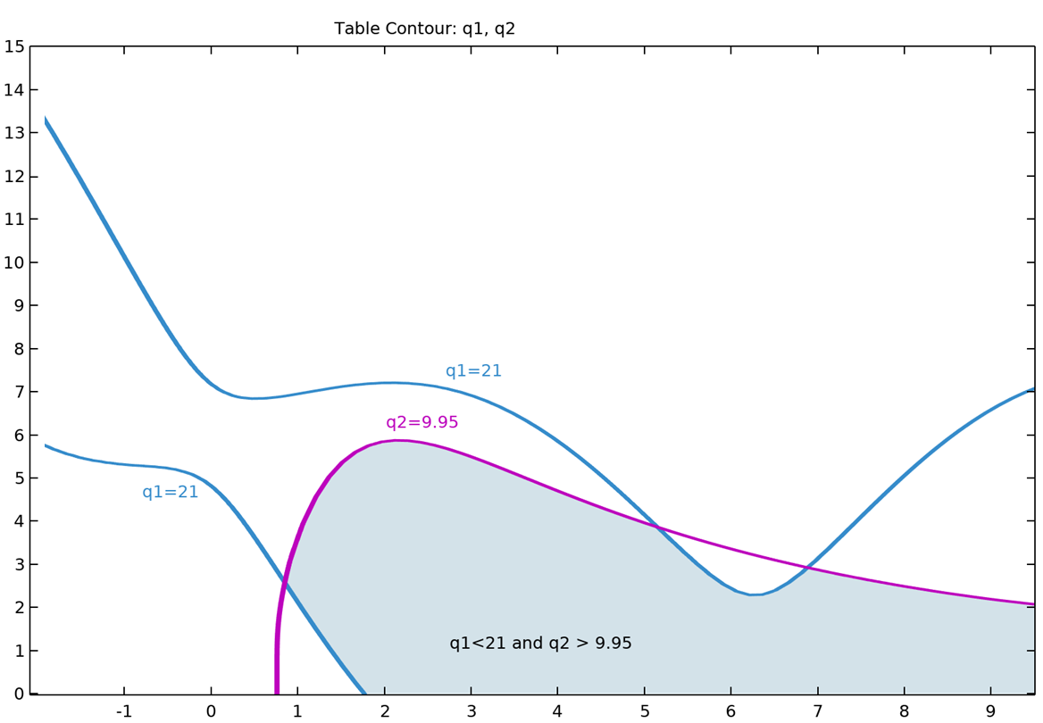
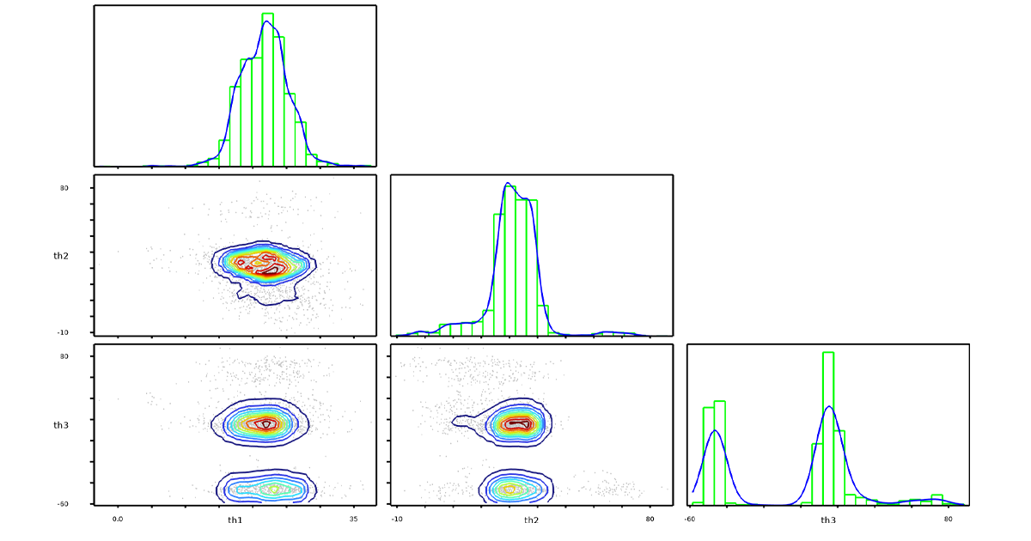

Uncertainty Quantification (UQ) Study Types
Screening, MOAT
Sensitivity Analysis
Uncertainty Propagation
Reliability Analysis
Inverse UQ
Identify the most influential inputs for each QoI
Morris one-at-a-time method
Compute the fraction of impact for the inputs for each QoI
Sobol indices
  What is the probability for a condition based on the QoI?
  E.g.:
  $$P(\overline{\left[N_{2}H_{4}\right]}<{\overline{c}}_{max})$$
What is the calibrated input parameter distribution based on the prior information and the experimental data?
Compute the variation of each QoI
Estimate the probability density function of each QoI

Slide 3
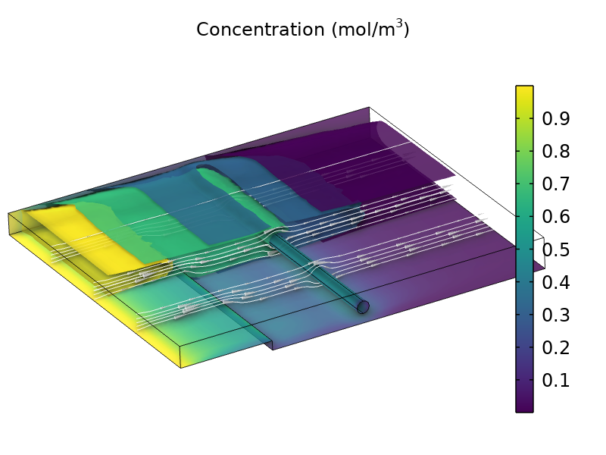
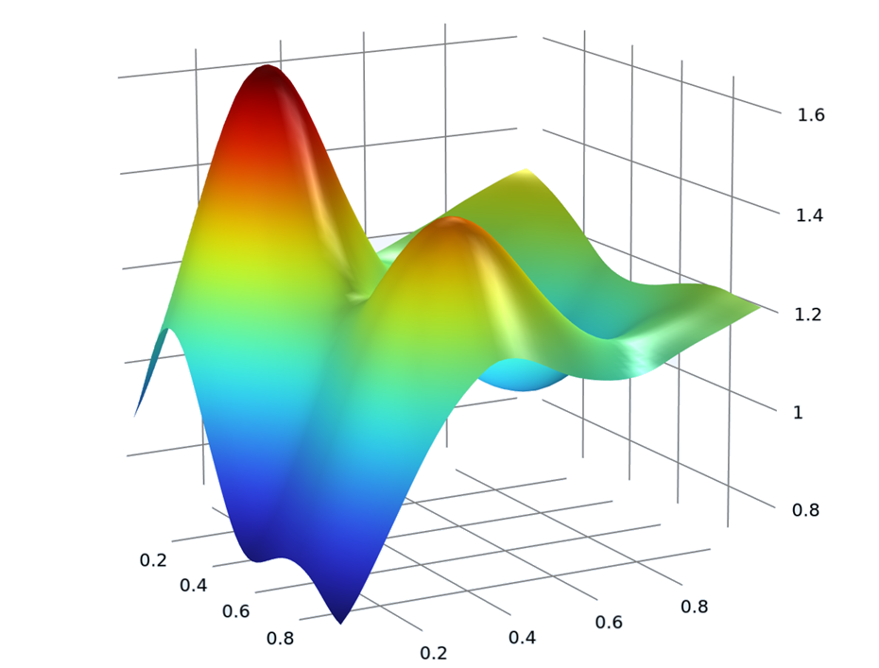
Monte Carlo Simulations
Input parameter
QoI
Input distribution
Model evaluation
Output distribution
Training
Surrogate model
Monte Carlo simulations can be used to obtain
statistical properties of a model.
The Uncertainty Quantification Module uses
surrogate models that are much faster to evaluate.
  Randomize the input parameters according to their input distributions.
  Evaluate the model (solve) for each set of random inputs = direct Monte Carlo simulation.
  Analyze and plot the quantities of interest.
  This often requires too many model evaluations to be practical.
  Instead, indirect Monte Carlo simulations are needed.
  Using a surrogate model makes Monte Carlo-based UQ analysis affordable and practical.
  To create a surrogate model, it must first be trained by solving the original model for as few input parameters as possible.
  The surrogate model is then used instead of the original model for Monte Carlo simulations.

Slide 4
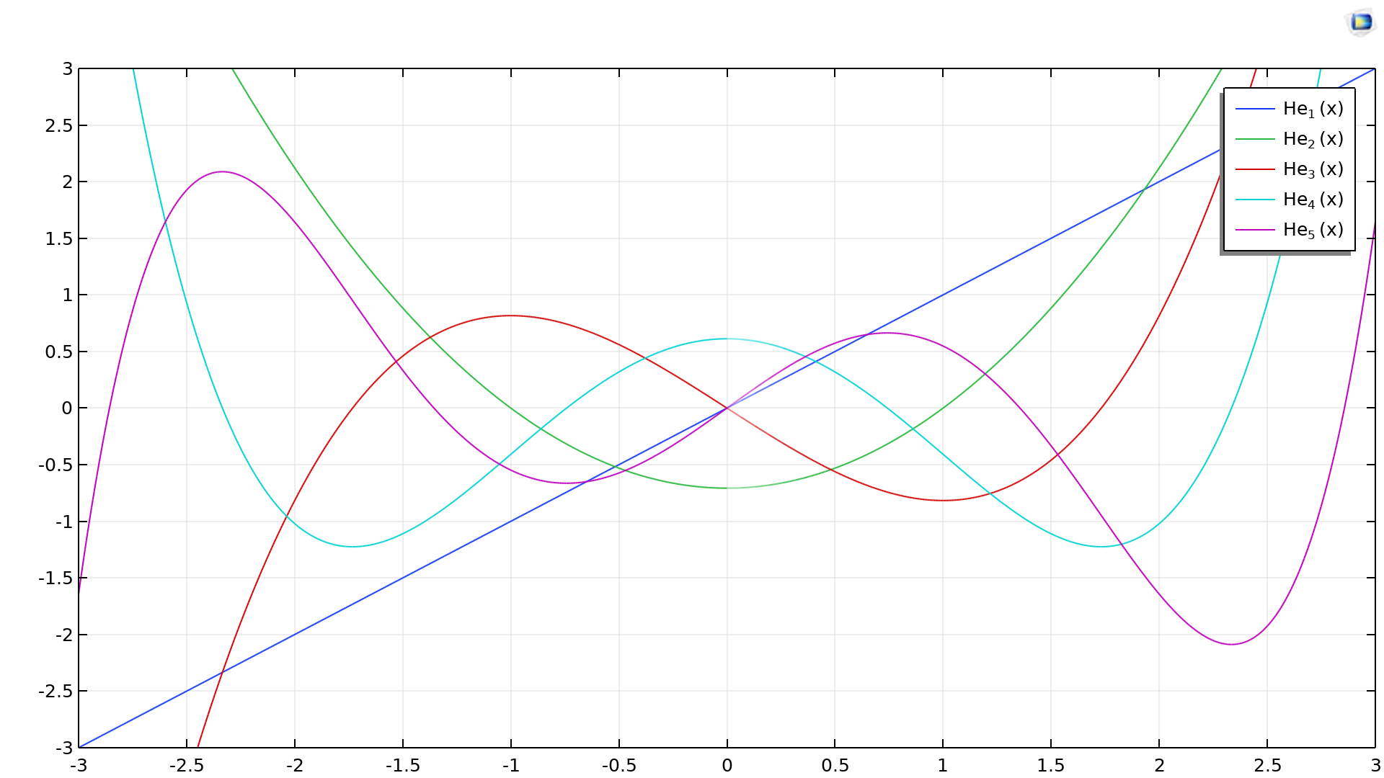
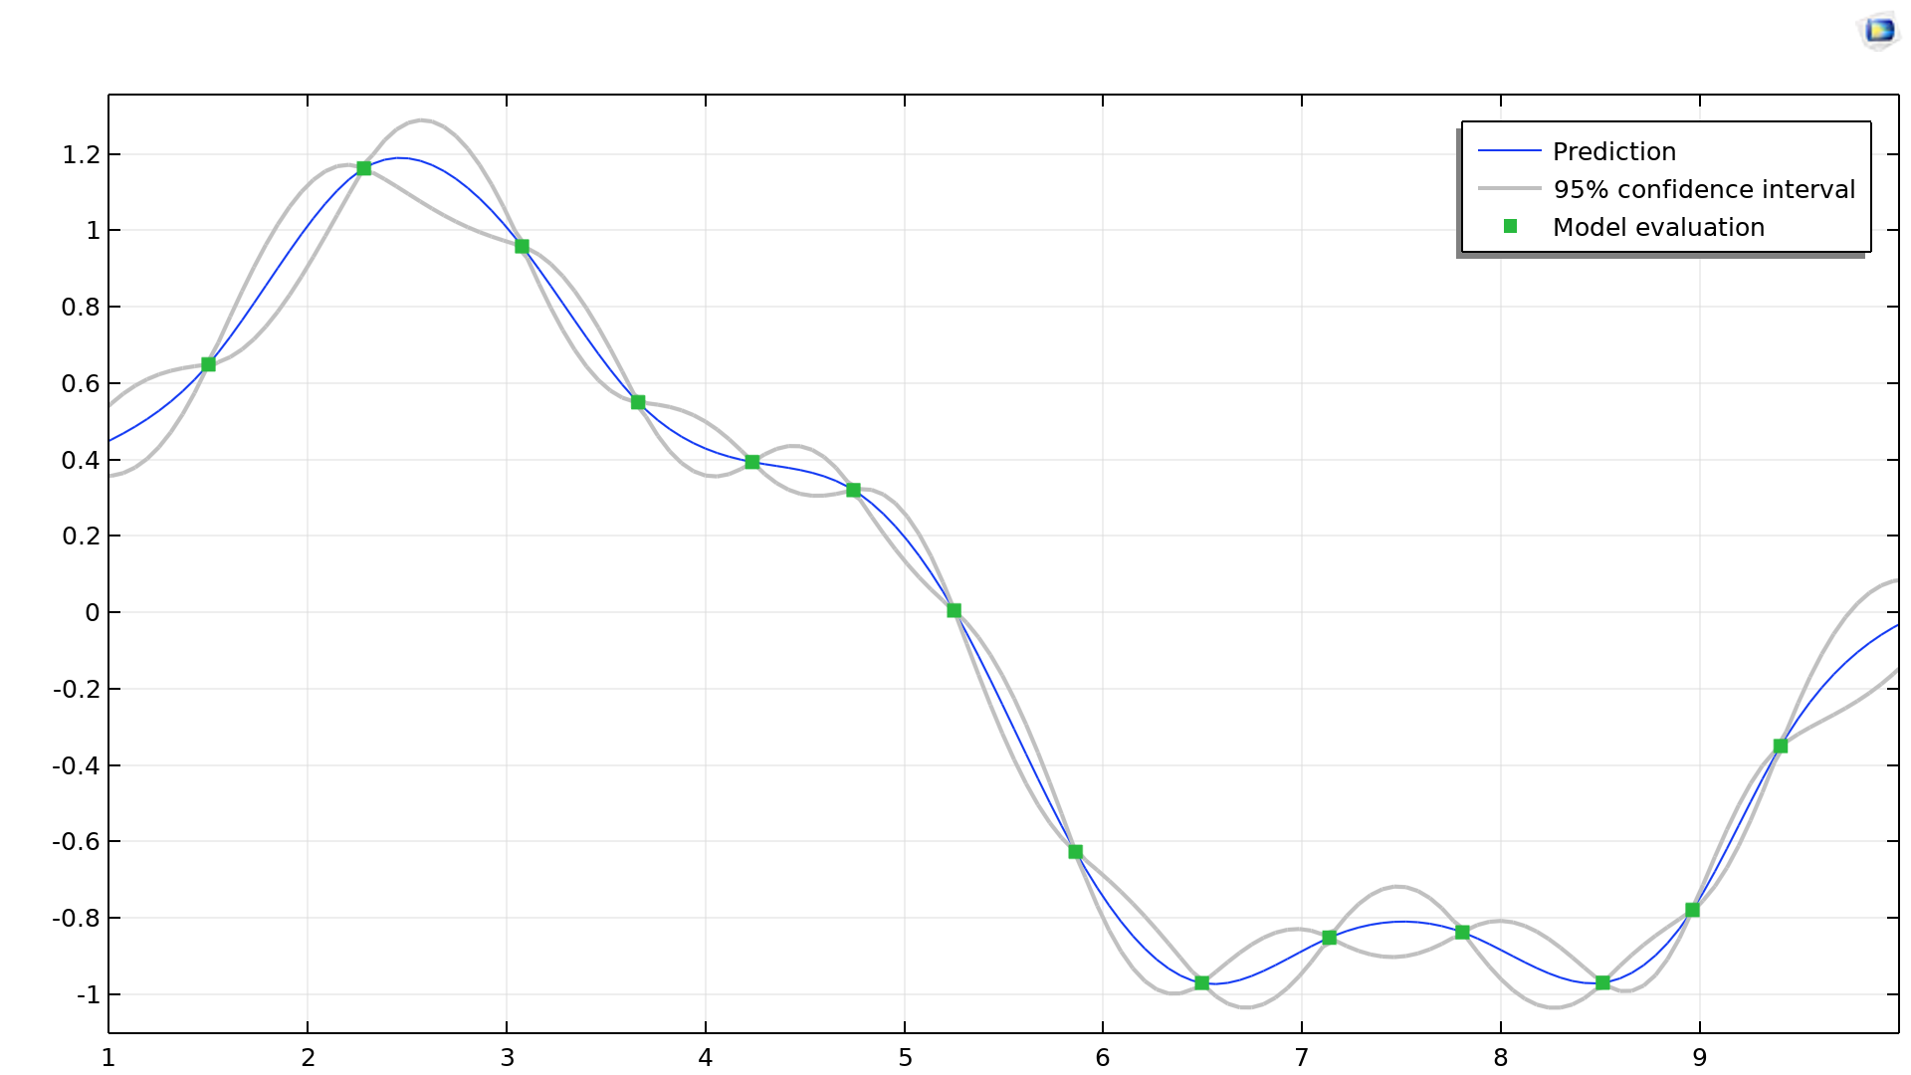
Surrogate Models
The Uncertainty Quantification Module supports two kinds of surrogate models.
Sparse Polynomial Chaos Expansion (SPCE)
Gaussian Process (GP)
Spectral representation with a basis of polynomial functions with respect to input distributions
Sparse representation makes the model more accurate for new data
Adaptive SPCE covers more input parameters’ space iteratively
A PCE function is created from the UQ study
Compute both the prediction and its variance
Adaptive GP uses the current prediction and variance to find out where to add new data points
A GP function is create from the UQ study

Slide 5
Surrogate Model Defaults for Study Types
Screening, MOAT
Sensitivity Analysis
Uncertainty Propagation
Reliability Analysis
Inverse UQ
Identify the most influential inputs for each QoI
Morris one-at-a-time method
Compute the fraction of impact for the inputs for each QoI
Sobol indices
  What is the probability for a condition based on the QoI?
What is the calibrated input parameter distribution based on the prior information and the experimental data?
Compute the variation of each QoI
Estimate the probability density function of each QoI
No surrogate model
Polynomial Chaos Expansion
Gaussian Process
Also Suitable: Polynomial Chaos Expansion

Slide 6
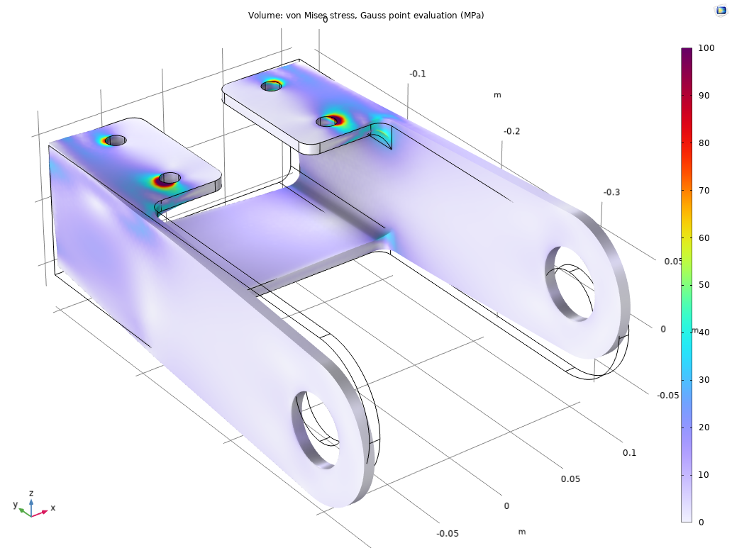
Overview
This example demonstrates using the Uncertainty Quantification Module by running a series of uncertainty quantification studies for a steel bracket.
This type of bracket can be used to install an actuator that is mounted on a pin placed between the two holes in the bracket arms.
The design objective is that the actuator’s horizontal misalignment shouldn’t be too large.
LES model of the flow around a sports car

Slide 7
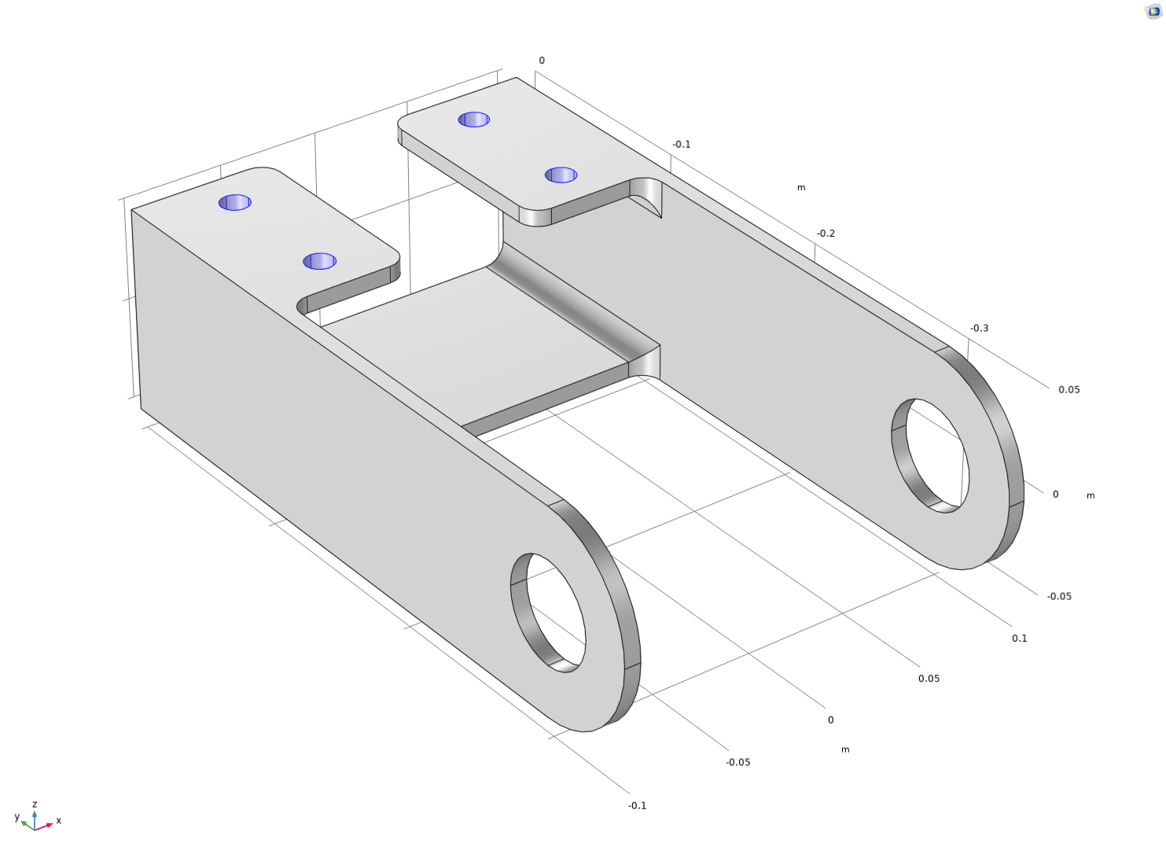
Mounting: Constraints
In this analysis, the mounting bolts are assumed to be fixed and securely bonded to the bracket.
This is represented with a Fixed Constraint boundary condition at the mounting holes.

Slide 8
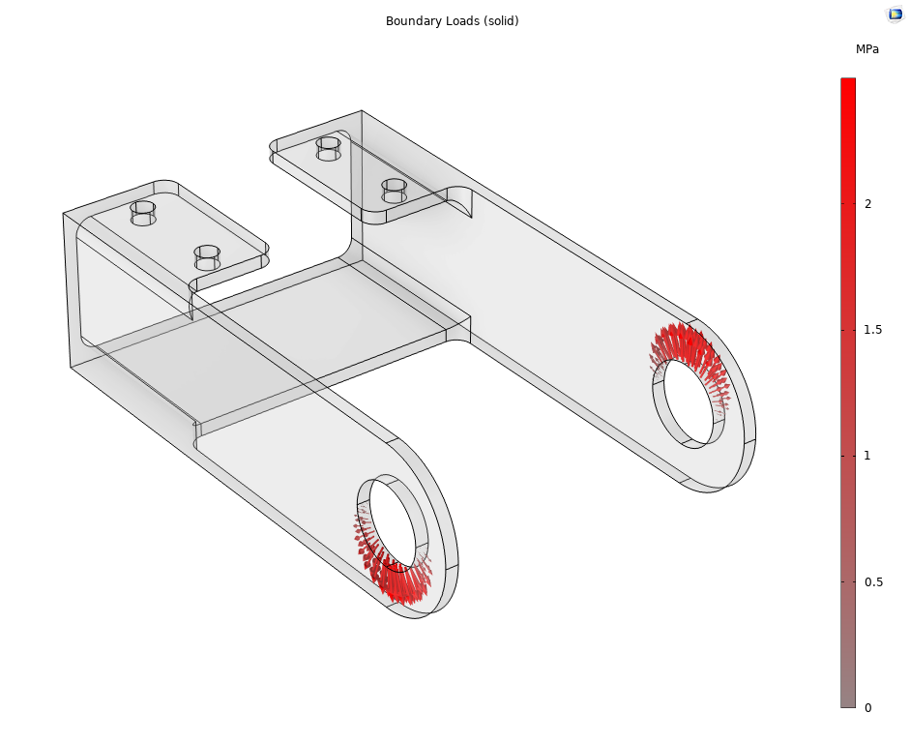
Force and Materials
One of the arms is loaded upward and the other downward.
The loads are applied as a pressure on the inner surfaces of the holes, and their intensity is P₀cos(α), where α is the angle from the direction of the load resultants.
The red arrows in the figure illustrates the distributed load.
This force is assumed not to vary in the uncertainty quantification study.
Similarly, the material properties for a generic structural steel are assumed not to vary.

Slide 9
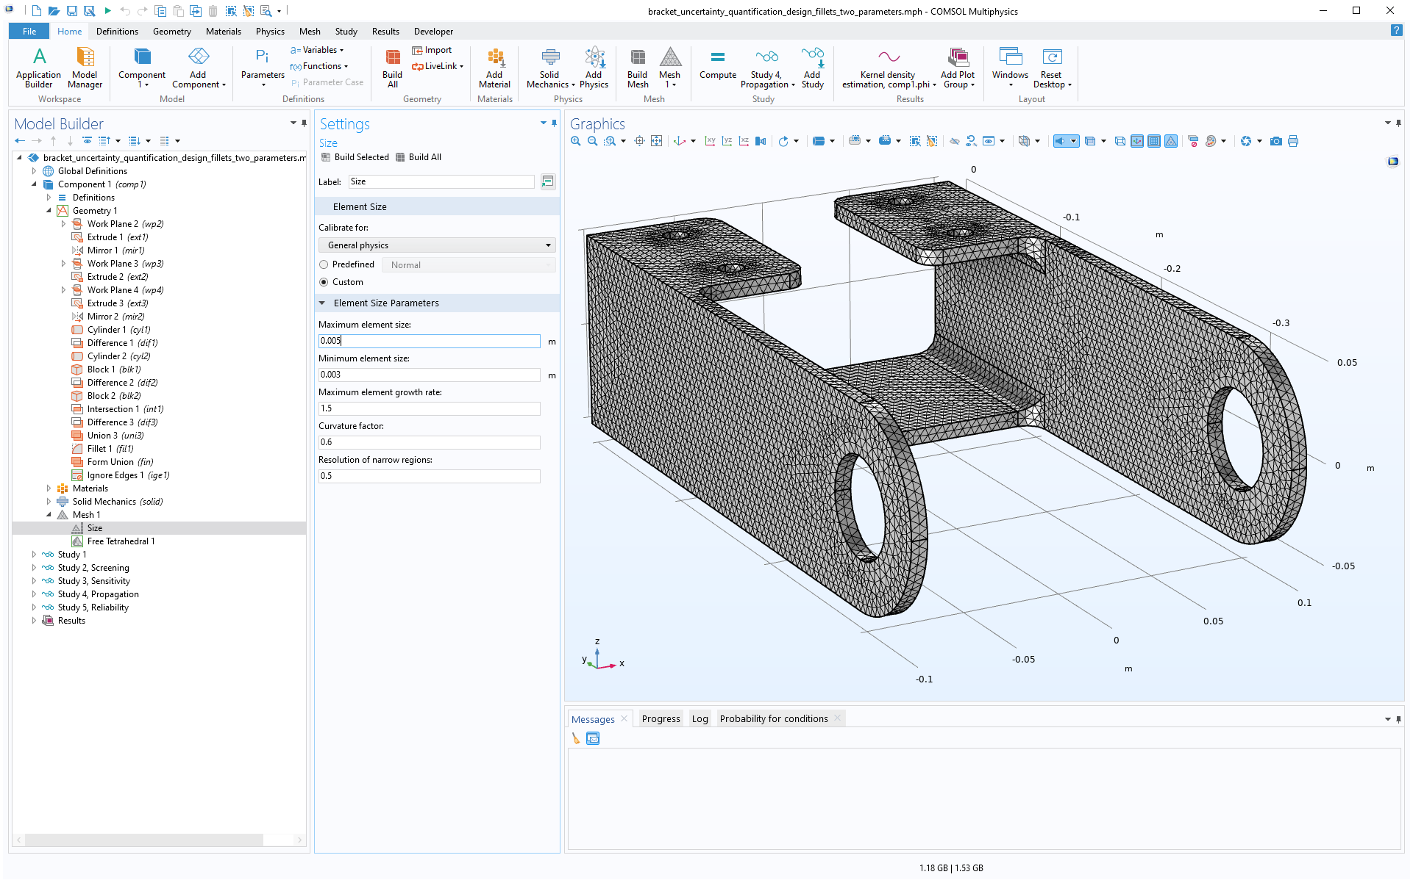
Geometry and Mesh
Using the Design Module
The Geometry is created using 3D Fillets which are available in the Design Module.
If you do not have access to the Design Module, a version without 3D Fillets is provided. The parameters is slightly changed for this model.
For more information see the end of this presentation.
The mesh is customized to have about two elements across the thickness of the material.

Slide 10
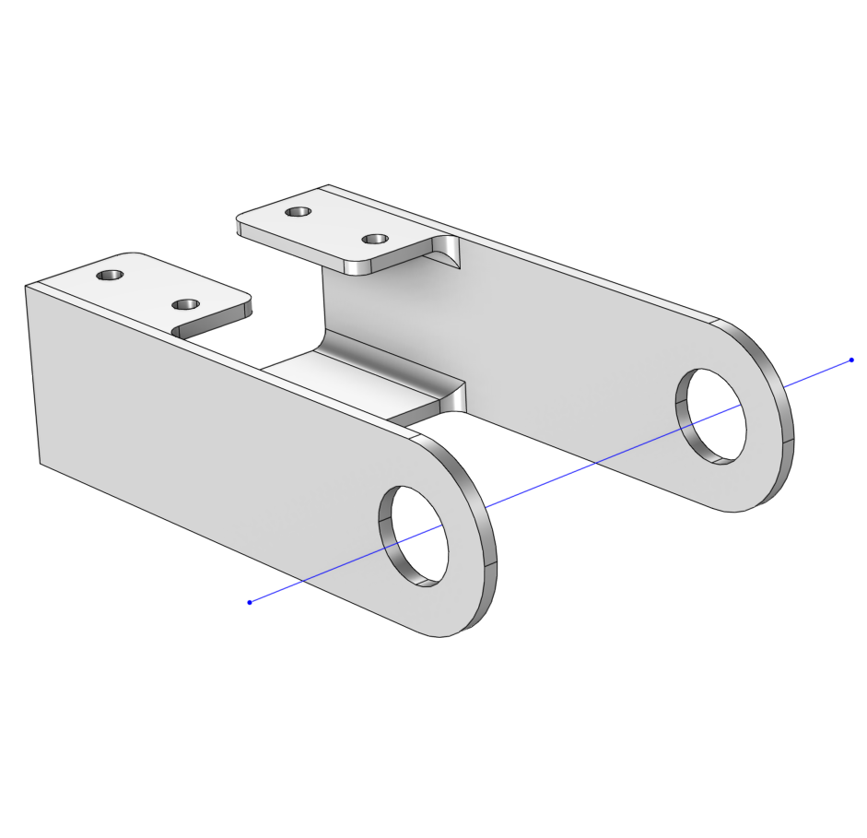
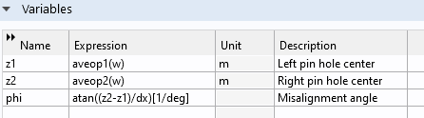
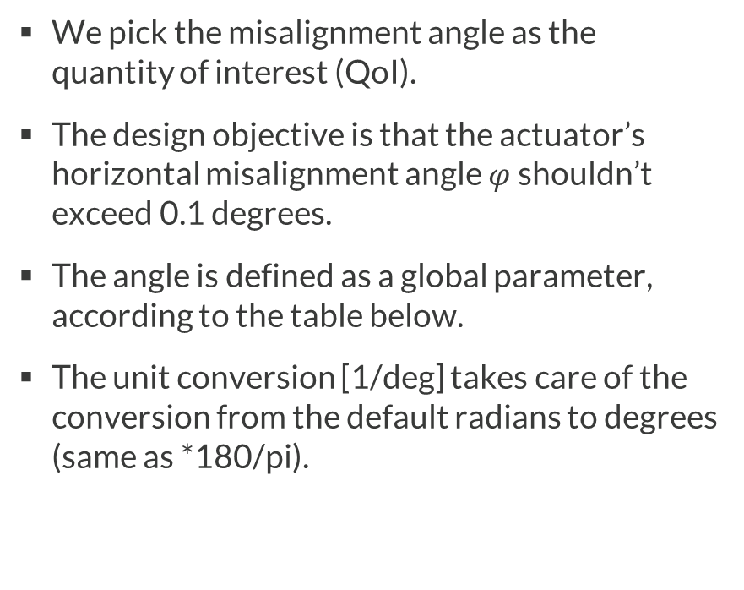

Quantity of Interest
We pick the misalignment angle as the quantity of interest (QoI).
The design objective is that the actuator’s horizontal misalignment angle $φ$ shouldn’t exceed 0.1 degrees.
The angle is defined as a global parameter, according to the table below.
The unit conversion [1/deg] takes care of the conversion from the default radians to degrees (same as *180/pi).
$$φ$$
The definition of phi, the quantity of interest in this example.

Slide 11
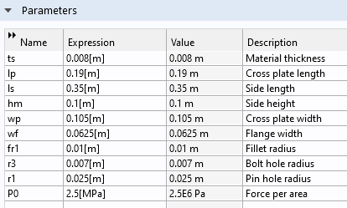
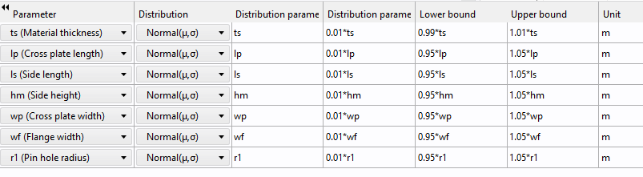

Parameters
The parameters to be varied are some of the geometric dimensions of the bracket.
The parameters that participate in the uncertainty quantification are all assumed to be normally distributed around their nominal values, according to the tables below which corresponds to a screening study, explained later.
$$φ$$
Global Parameters
UQ Screening Parameters

Slide 12

Lower and Upper Bounds
The parameters to be varied are a subset of the geometric dimensions of the bracket.
The lower and upper bounds reflect that for values outside of this range either the geometry model is not well-defined or parts are rejected as part of the manufacturing quality assurance process.
In this demo example these bounds are made quite generous and in a real-life scenario the bounds may be tighter.
$$φ$$
UQ Screening Parameters

Slide 13
Screening

Slide 14
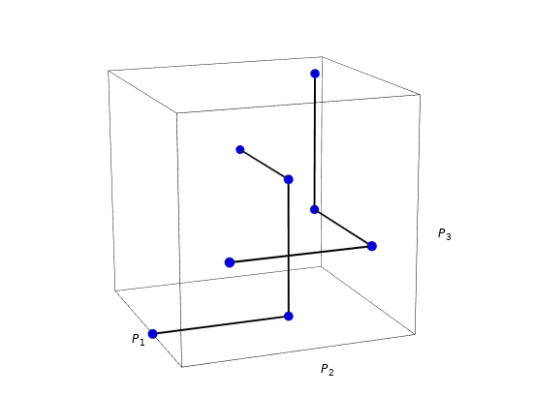
The Screening Study
The first step is to perform a screening study. This will give us a first rough estimate in order to see which parameters influence the quantity of interest (misalignment angle).
The screening method is called Morris One-Step-At-A-Time, or MOAT.
The MOAT method assumes that you would like to explore a relatively large number of parameters and that the model is expensive to solve.
The method will explore the parameter design space by using an as small number of solutions as possible.
The MOAT evaluation pattern for a model with 3 parameters.

Slide 15
The MOAT Method
The MOAT (Morris One-at-a-Time) method involves sampling each input parameter one at a time to study its effect on the output.
The MOAT sampling generates a minimum number of samples in a structured way.
Given its structured approach, the calculation of the statistical mean and standard deviation needs to be carefully adapted to ensure they are representative and unbiased.
MOAT mean:
  The statistical mean is computed as if the samples had been independently and randomly sampled from the input parameter space. This means that the mean calculation does not take into account any specific sampling scheme used by the MOAT method but rather treats the samples as if they were obtained through simple random sampling.
MOAT standard deviation:
  The standard deviation is computed using an unbiased variance estimation that is adapted to the MOAT sampling method. This adaptation is necessary because the MOAT method uses a structured sampling approach rather than simple random sampling, and thus the variance estimation must account for this structure to remain unbiased.
The MOAT evaluation pattern for a model with 3 parameters.

Slide 16
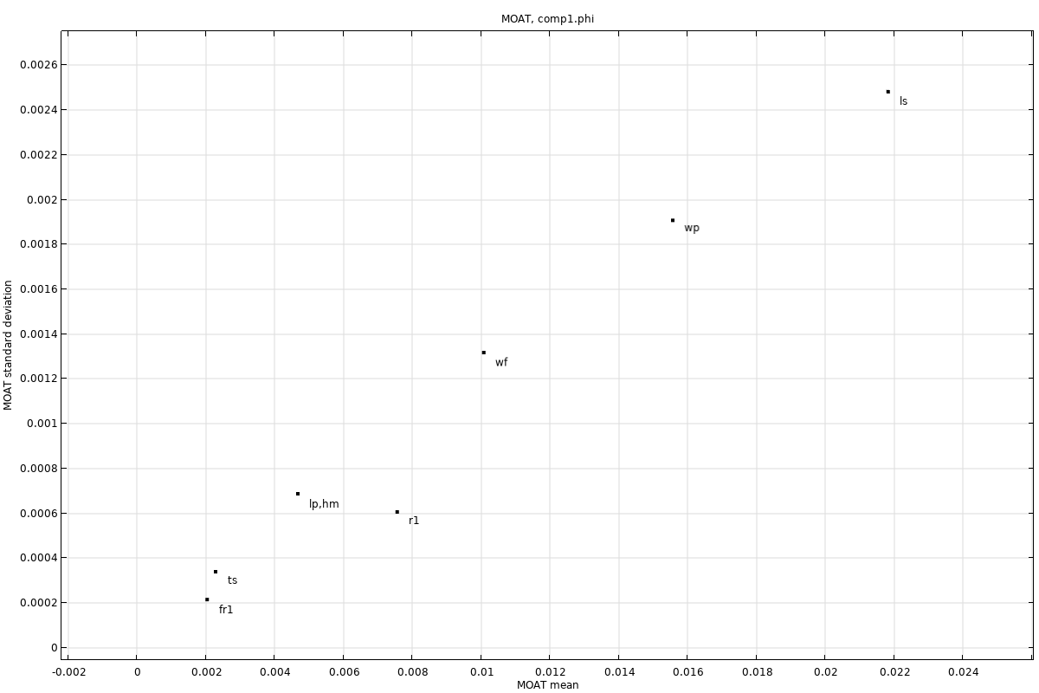
Screening of the Bracket
Screening of the bracket geometry parameters indicates that the Side length (ls) and the Cross plate width (wp) are the parameters that are most influential on the quantity of interest.
A high value of the MOAT mean means that the parameter is significantly influencing the quantity of interest.
A high value of the MOAT standard deviation means that the parameter is influential and that it is either interacting with other parameters and/or that it has a nonlinear influence.
Influential parameters that are nonlinear and/or interacting with other parameters
Influential parameters
Non-influential parameters
The MOAT mean and standard deviation for the bracket.

Slide 17
Sensitivity Analysis

Slide 18
Choosing Parameters for Sensitivity Analysis
The next step is a sensitivity analysis.
We use the results from the screening to decide which parameters to include in the sensitivity analysis.
Sensitivity is more computationally demanding than screening and for this reason we would prefer to pick a subset of the parameters used for the screening study.
However, in this example, we would like to learn as much as possible about the model and we pick all the available design parameters.
Influential parameters that are nonlinear and/or interacting with other parameters
Influential parameters
Non-influential parameters
The MOAT mean and standard deviation for the bracket.

Slide 19
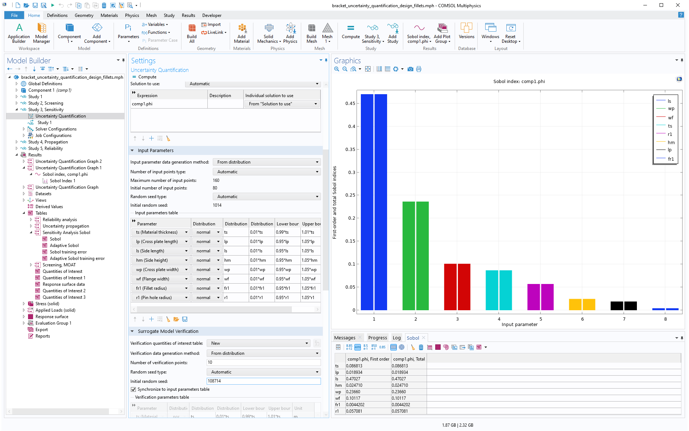
Sensitivity Analysis
The sensitivity analysis is based on the Sobol method, also known as Variance-based sensitivity analysis.
The result of the sensitivity analysis is a set of Sobol indices and an associated Sobol table and Sobol plot.
There are two different types of Sobol indices: First order index and Total index.
The first order index of a parameter shows the sensitivity by varying this parameter alone.
The total index shows how much a parameter contributes to the overall sensitivity .
Sensitivity analysis and Sobol indices.

Slide 20
Sensitivity Analysis, Theory, First-Order Sobol Index
Let Y be the model output, and X be the vector of input variables.
The total variance of Y is Var(Y).
The first-order Sobol index is defined by considering the “explained variance” in one variable X_{i}, an element of the vector X.
The total variance of Y can be decomposed, conditioned on X_{i} (law of total variance):
  Var(Y)=E[Var(Y | X_{i})]+Var(E[Y | X_{i}])
  where:
    E[Var(Y | X_{i})] is the expected value of the variance of Y given X_{i} ​. This is called the "unexplained variance" because it is the residual variability in Y that cannot be attributed to X_{i} ​.
    Var(E[Y | X_{i}]) is the variance of the expected value of Y given X_{i} , averaged over variations in the other input parameters X_{~i}. This is called the "explained variance" because it represents the portion of the total variance in Y that is directly attributable to the variability in X_{i} ​.
The first order Sobol index is defined in terms of the explained variance as a fraction relative to the total variance. It represents the fraction of the total variance in Y that is directly attributable to the variability in X_{i} :
  S_{i} = Var(E [Y | X_{i}]) /Var(Y)

Slide 21
Sensitivity Analysis, Theory, Total Sobol Index
Let Y be the model output, and X be the vector of input variables.
The total variance of Y is Var(Y).
Define X_{~i} as all variables except X_{i .}
The total Sobol index is defined by considering the unexplained variance in all variables X_{~i}, except X_{i}.
The total variance of Y can be decomposed, conditioned on X_{~i} (law of total variance):
  Var(Y)=E[Var(Y | X_{~i})]+Var(E[Y | X_{~i}])
  where:
    E[Var(Y | X_{~i})] is the expected value of the variance of Y given X_{~i} ​. This is called the "unexplained variance" because it is the residual variability in Y that cannot be attributed to X_{~i} ​ (all variables except X_{i}).
    Var(E[Y | X_{~i}]) is the variance of the expected value of Y given X_{~i} , considering variations in the input parameter X_{i}. This is called the "explained variance" because it represents the portion of the total variance in Y that is directly attributable to the variability in X_{~i} .
The total Sobol index is defined as:
  S_{Ti} = E[Var(Y | X_{~i})] /Var(Y)
By using the decomposition, this can alternatively be formulated in terms of the explained variance of X_{~i} as:
  S_{Ti} = 1- Var(E[Y | X_{~i}])/Var(Y)

Slide 22
Sensitivity Analysis of the Bracket
For the bracket model, the first and total indices are equal, up to the computed accuracy, for all parameters indicating very little or no interaction between the parameters.
The Sobol plot indicates that the misalignment angle is most sensitive to the parameters Side length (ls) and Cross plate width (wp). This is consistent with the screening results.
For the final two studies, Uncertainty Propagation and Reliability Analysis, we will in a first step pick the dominant two parameters ls and wp.
Sensitivity analysis and Sobol indices.

Slide 23
A Function with Large Total Sobol Indices
Ishigami Function: f(x₁,x₂,x₃)=sin(x₁)+a (sin(x₂))²+b x₃⁴ sin(x₁)
First-Order Sobol Indices:
  The first-order Sobol index S_{i}​ represents the “individual” contribution of a single variable x_{i} to the output variance.
    S₁ ​: This index is significant because x₁ ​ appears directly in the function as sin⁡(x₁) and also in the interaction term bx₃⁴ sin(x₁).
    S₂ ​: This index is significant due to the term a(sin(x₂))².
    S₃ ​: This index is small because x₃ ​ appears only in the interaction term and not on its own.
Total Sobol Indices:
  The total Sobol index S_{Ti}​ represents the total contribution of variable x_{i} to the output variance, including its interaction with other variables.
    S_{T1} ​: This index is high because x₁ has both direct and interaction contributions.
    S_{T2} ​: This index is significant due to the term a(sin(x₂))².
    S_{T3} ​: This index is significant since x₃ is interacting strongly with x₁.
Variable | First-Order Index | Total Index
x₁ | 0.302316412 | 0.556692848
x₂ | 0.443182792 | 0.443321341
x₃ | 8.90E-05 | 0.254420634

Slide 24
Uncertainty Propagation

Slide 25
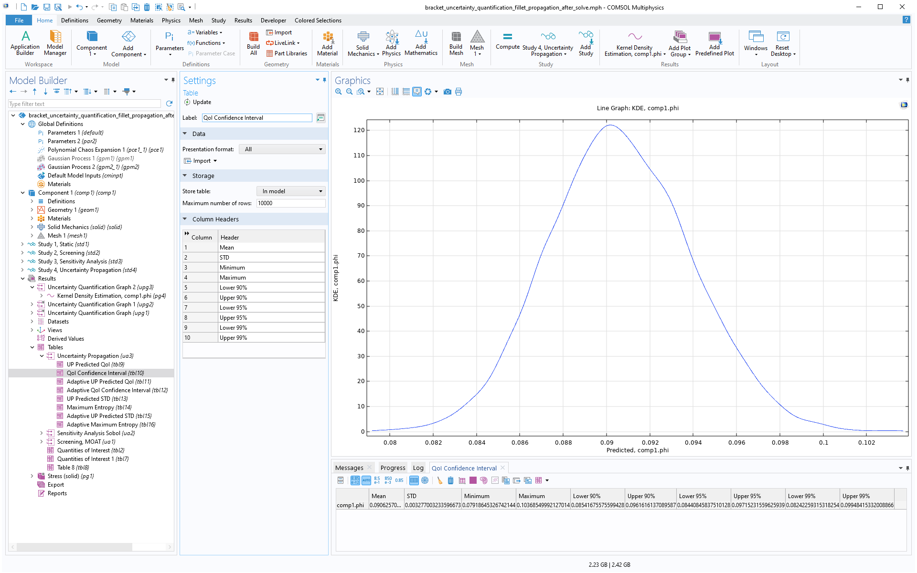

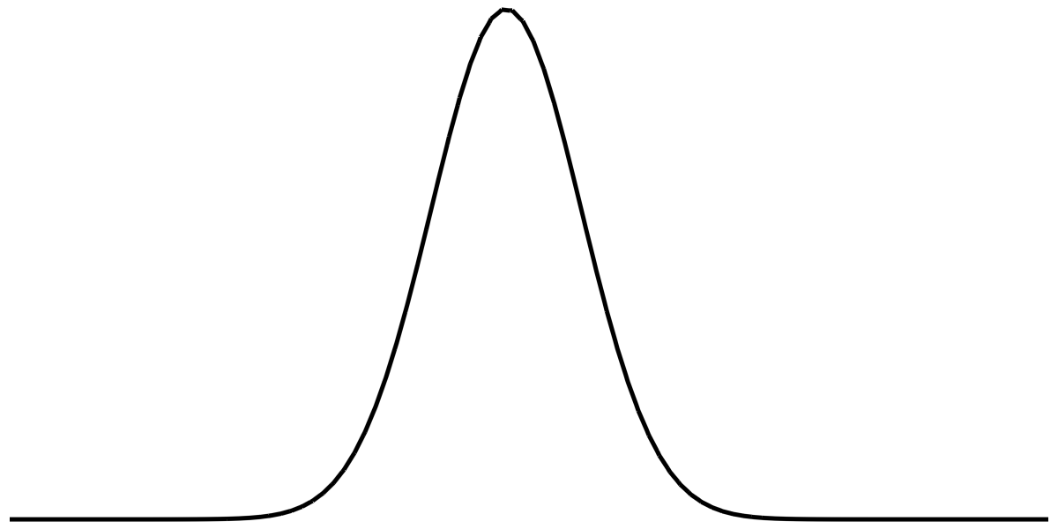
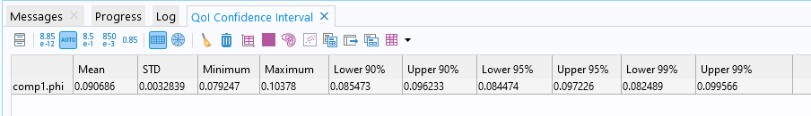
Uncertainty Propagation
The uncertainty propagation study will compute a so called kernel density estimation or KDE.
You can think of the KDE as a smooth form of a histogram showing an estimate of the probability density function of the quantity of interest, given the input parameters and their distributions.
We can see from the QIO confidence interval table that the mean is about 0.09 degrees with a standard deviation of 0.0033 degrees.
From the table we can also see that there appears to be very little risk that the angle exceeds 0.1 degrees.
To get a more accurate estimate of the risk for exceeding 0.1 degrees, we will later also run a reliability analysis.
A Kernel Density Estimation plot.
Confidence interval and statistical information.

Slide 26
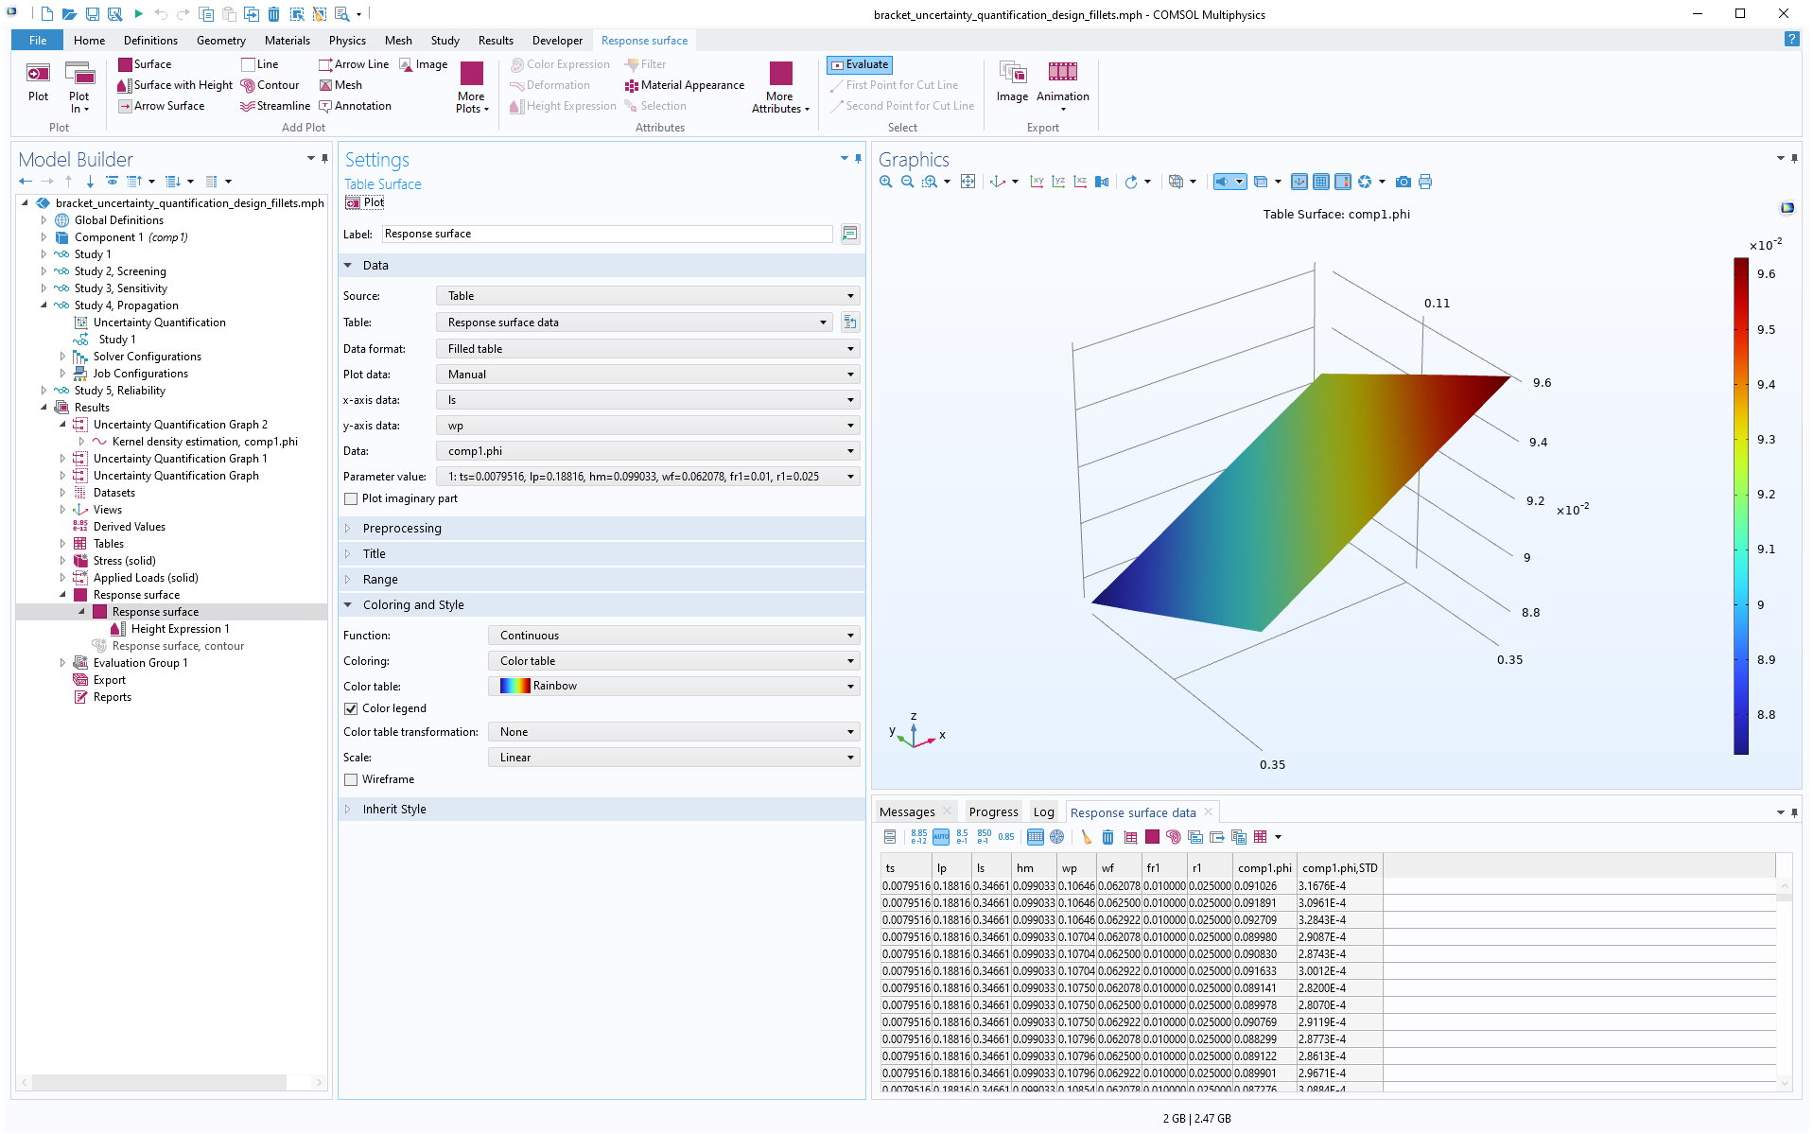
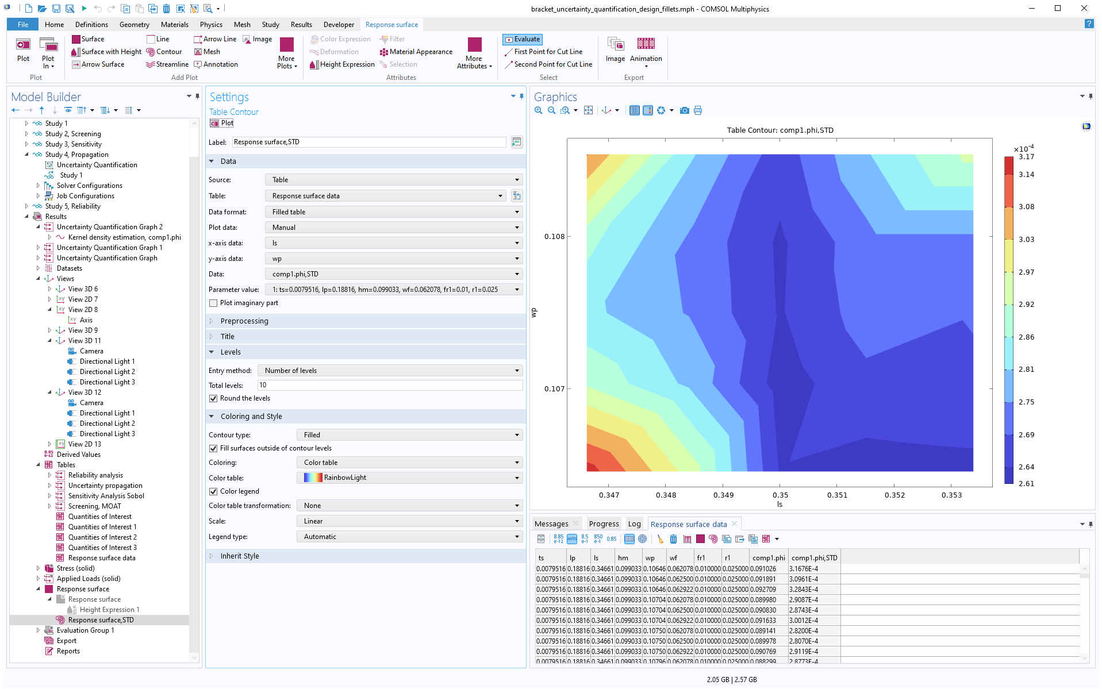
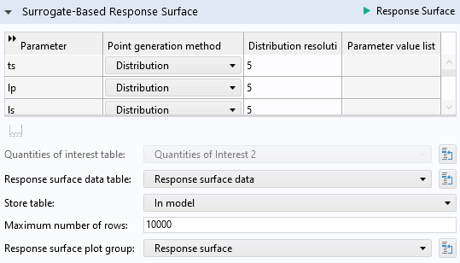
Response Surfaces
For study types where there is an underlying surrogate model (sensitivity analysis, uncertainty propagation, and reliability analysis) you can plot response surfaces for any pairs of input parameters.
This option is available in the Settings window of the Uncertainty Quantification Study in a separate section Surrogate-Based Response Surface. In this section, click the Response Surface button to create the plot.
The plots to the right shows the response surface for the Misalignment angle vs. Side length (ls) and Cross plate width (wp).
The 3D plot shows the surface for the angle and the 2D contour plot shows the standard deviation for the angle response surface.

Slide 27
Reliability Analysis

Slide 28
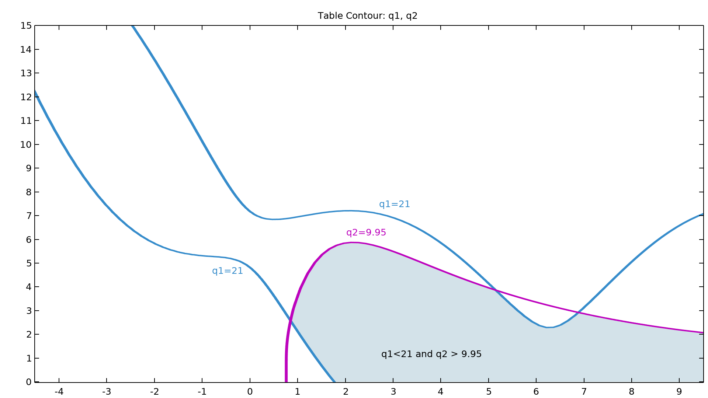
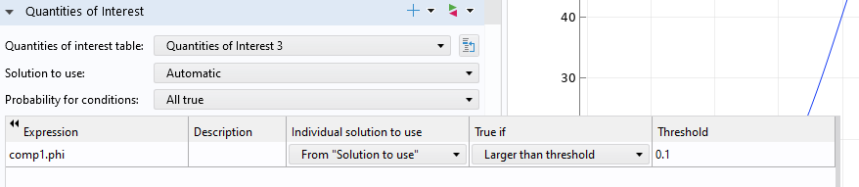
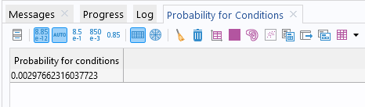
Reliability Analysis
The reliability analysis will perform so called importance sampling that refines the full model results near the threshold that we give for our quantity of interest.
We are asking for the probability that this angle exceeds 0.1 degrees.
The reliability analysis study gives us a table named Probability for condition having the value ~0.003.
This means that with the given conditions, there is a ~0.3% risk of the misalignment angle to exceed 0.1 degrees.
It is now up to the designer to decide whether this is an acceptable level or risk or if a redesign and/or further studies are needed.
To be more conservative about the uncertainty propagation and reliability analysis, we can choose to include all parameters in the analysis. This will be computationally much more demanding.

Slide 29
Uncertainty Propagation Using All Parameters

Slide 30
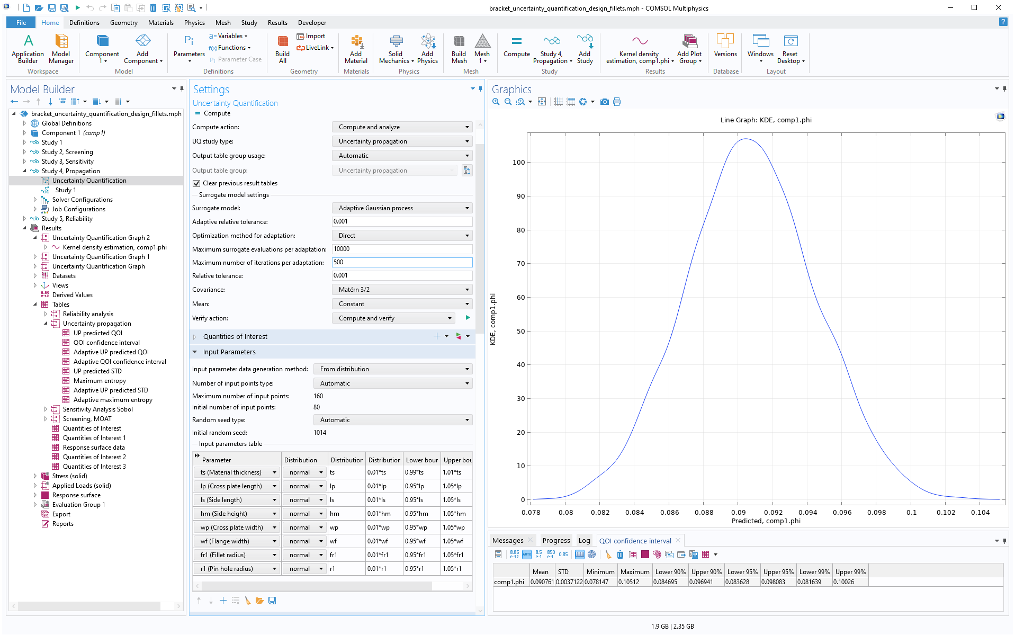
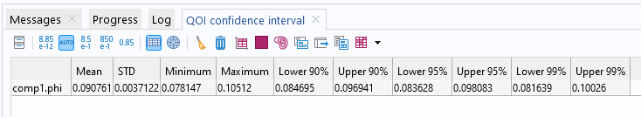
Uncertainty Propagation Using All Parameters
We can see from the QIO confidence interval for the analysis using all 8 parameters that the mean is about 0.09 with a standard deviation of 0.0037.
This is consistent with the previous result that only used 2 input parameters.

Slide 31
Reliability Analysis Using All Parameters

Slide 32
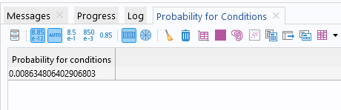
Reliability Analysis Using All Parameters
The reliability analysis study gives us a Probability for condition at ~0.009.
This means that, using this more conservative calculation, there is a ~0.9% risk of the misalignment angle to exceed 0.1 degrees.

Slide 33
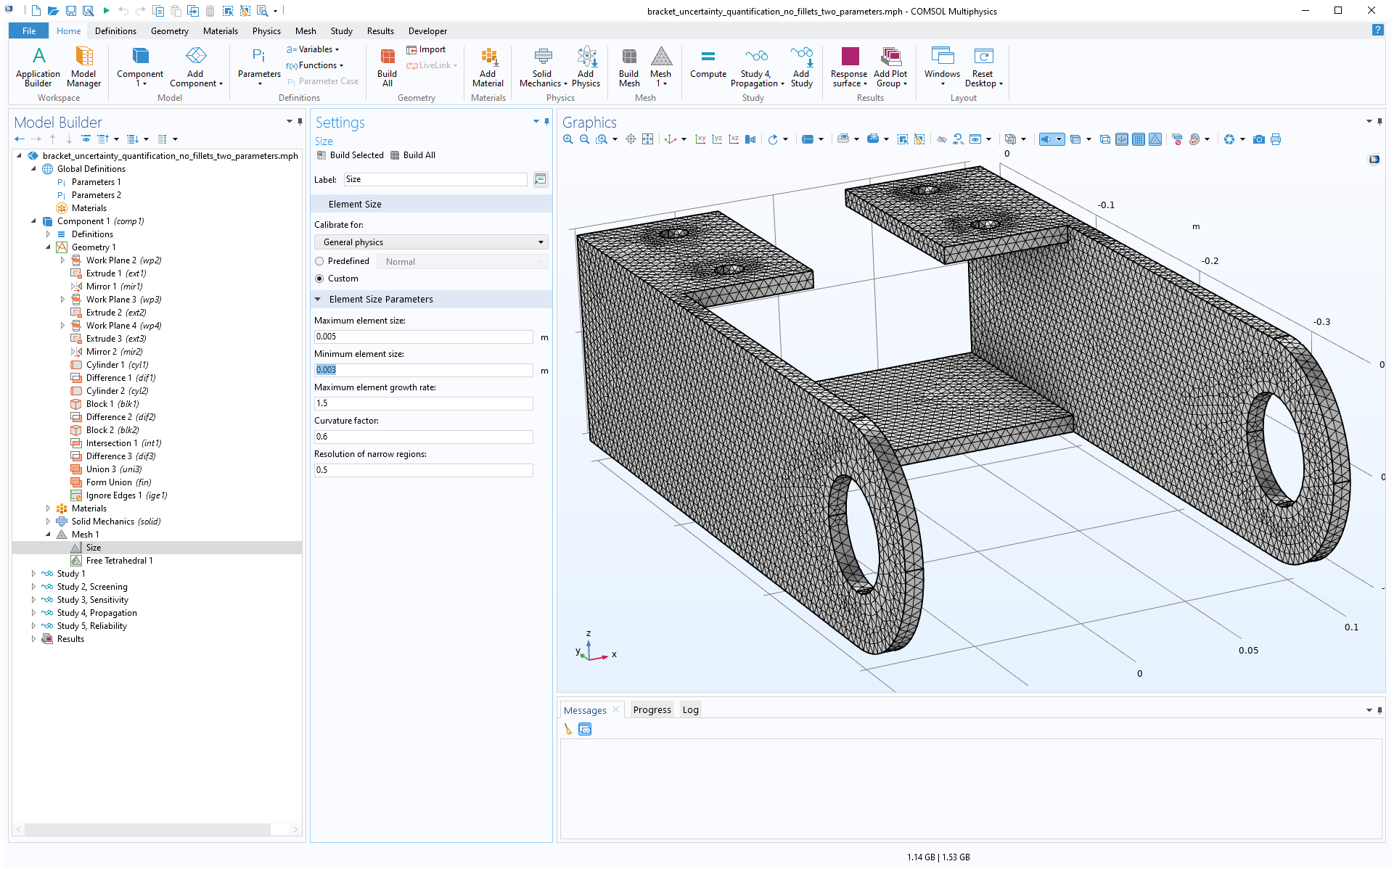
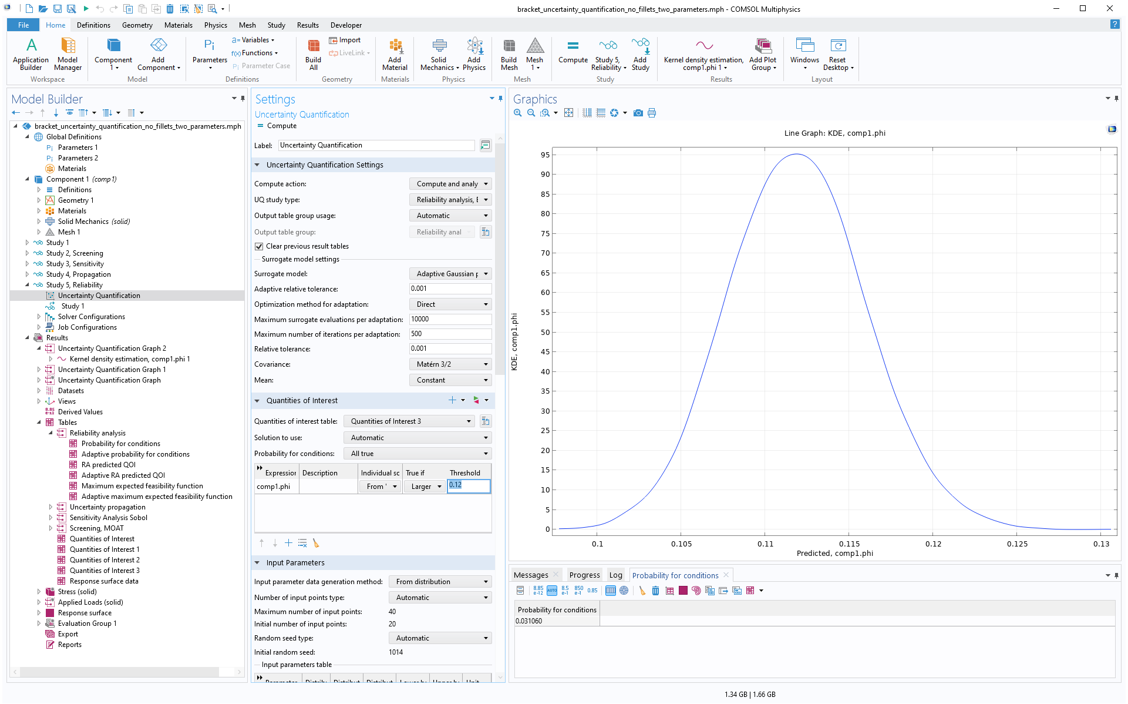
Geometry and Mesh, Using the Native Geometry Kernel
If you do not have access to the Design Module, a version without 3D Fillets is provided.
This model uses the native COMSOL geometry kernel.
The parameters are slightly changed for this model due to the changed stiffness for the bracket without fillets.
The misalignment angle mean is 0.11 degrees and the threshold for the reliability analysis is set to 0.12 resulting in a 3% risk of exceeding this value when analyzing for the two dominant parameters.

Slide 34
Ishigami Function: f(x₁,x₂,x₃)=sin(x₁)+a (sin(x₂))²+b x₃⁴ sin(x₁)
First-Order Sobol Indices:
  The first-order Sobol index S_{i}​ represents the “individual” contribution of a single variable x_{i} to the output variance.
    S₁ ​: This index is significant because x₁ ​ appears directly in the function as sin⁡(x₁) and also in the interaction term bx₃⁴ sin(x₁).
    S₂ ​: This index is significant due to the term a(sin(x₂))².
    S₃ ​: This index is small because x₃ ​ appears only in the interaction term and not on its own.
Total Sobol Indices:
  The total Sobol index S_{Ti}​ represents the total contribution of variable x_{i} to the output variance, including its interaction with other variables.
    S_{T1} ​: This index is high because x₁ has both direct and interaction contributions.
    S_{T2} ​: This index is significant due to the term a(sin(x₂))².
    S_{T3} ​: This index is significant since x₃ is interacting strongly with x₁.
Variable | First-Order Index | Total Index
x₁ | 0.302316412 | 0.556692848
x₂ | 0.443182792 | 0.443321341
x₃ | 8.90E-05 | 0.254420634

