Slide 1
Modeling the 3-𝜔 Method with Frequency-Domain Analysis of Heat Transfer

Slide 2
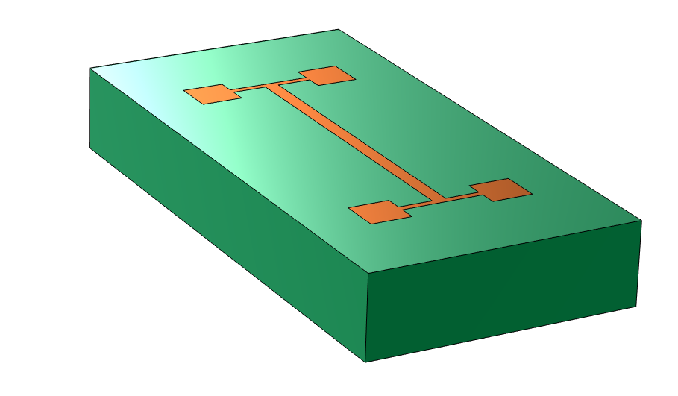
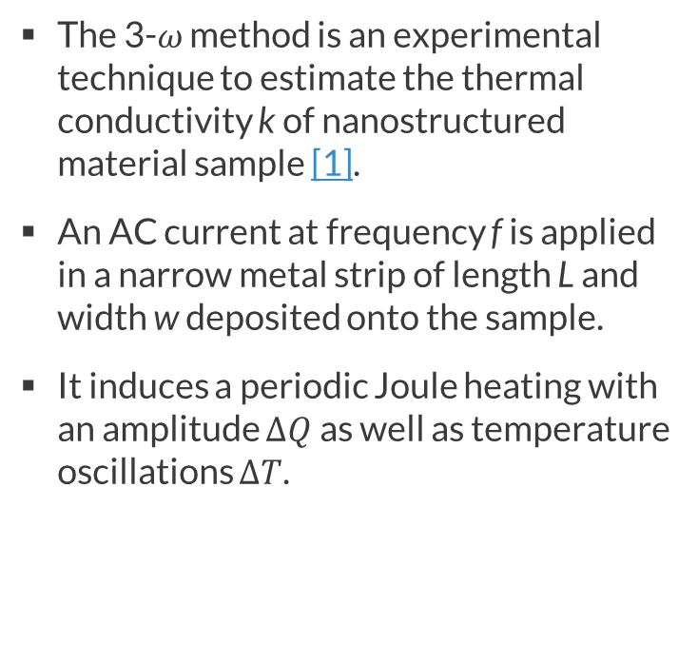
Background
Connector pads
Narrow heater strip
The 3-𝜔 method is an experimental technique to estimate the thermal conductivity k of nanostructured material sample [1].
An AC current at frequency f is applied in a narrow metal strip of length L and width w deposited onto the sample.
It induces a periodic Joule heating with an amplitude $∆Q$ as well as temperature oscillations $∆T$.
L
Sample
w
Schematic image of the sample and the heater.

Slide 3
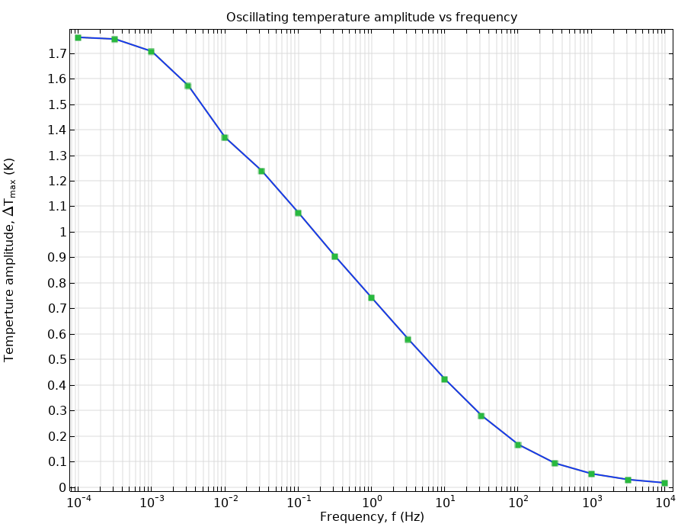
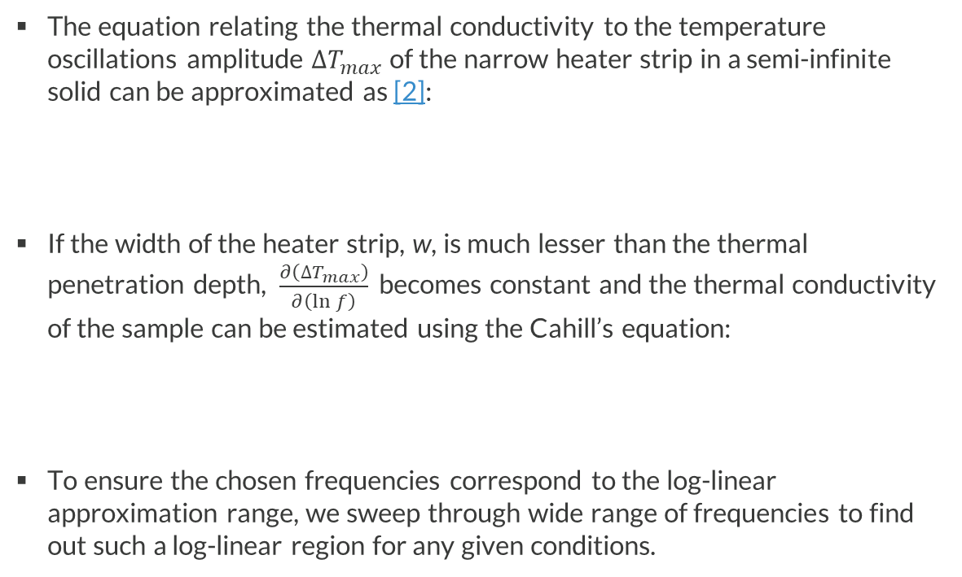
Background
The equation relating the thermal conductivity to the temperature oscillations amplitude $∆T_{max}$ of the narrow heater strip in a semi-infinite solid can be approximated as [2]:
If the width of the heater strip, w, is much lesser than the thermal penetration depth, $\frac{∂\left(∆T_{max}\right)}{∂\left(ln⁡f\right)}$ becomes constant and the thermal conductivity of the sample can be estimated using the Cahill’s equation:
To ensure the chosen frequencies correspond to the log-linear approximation range, we sweep through wide range of frequencies to find out such a log-linear region for any given conditions.
$$\frac{∂\left(∆T_{max}\right)}{∂\left(ln⁡f\right)}=−\frac{∆Q}{2πkL}$$
$$k=−\frac{ΔQ}{2πL}\frac{lnf_{2}−lnf_{1}}{ΔT_{max}(f_{2})−ΔT_{max}(f_{1})}$$
log-linear region
Average temperature oscillation amplitude vs frequency.

Slide 4
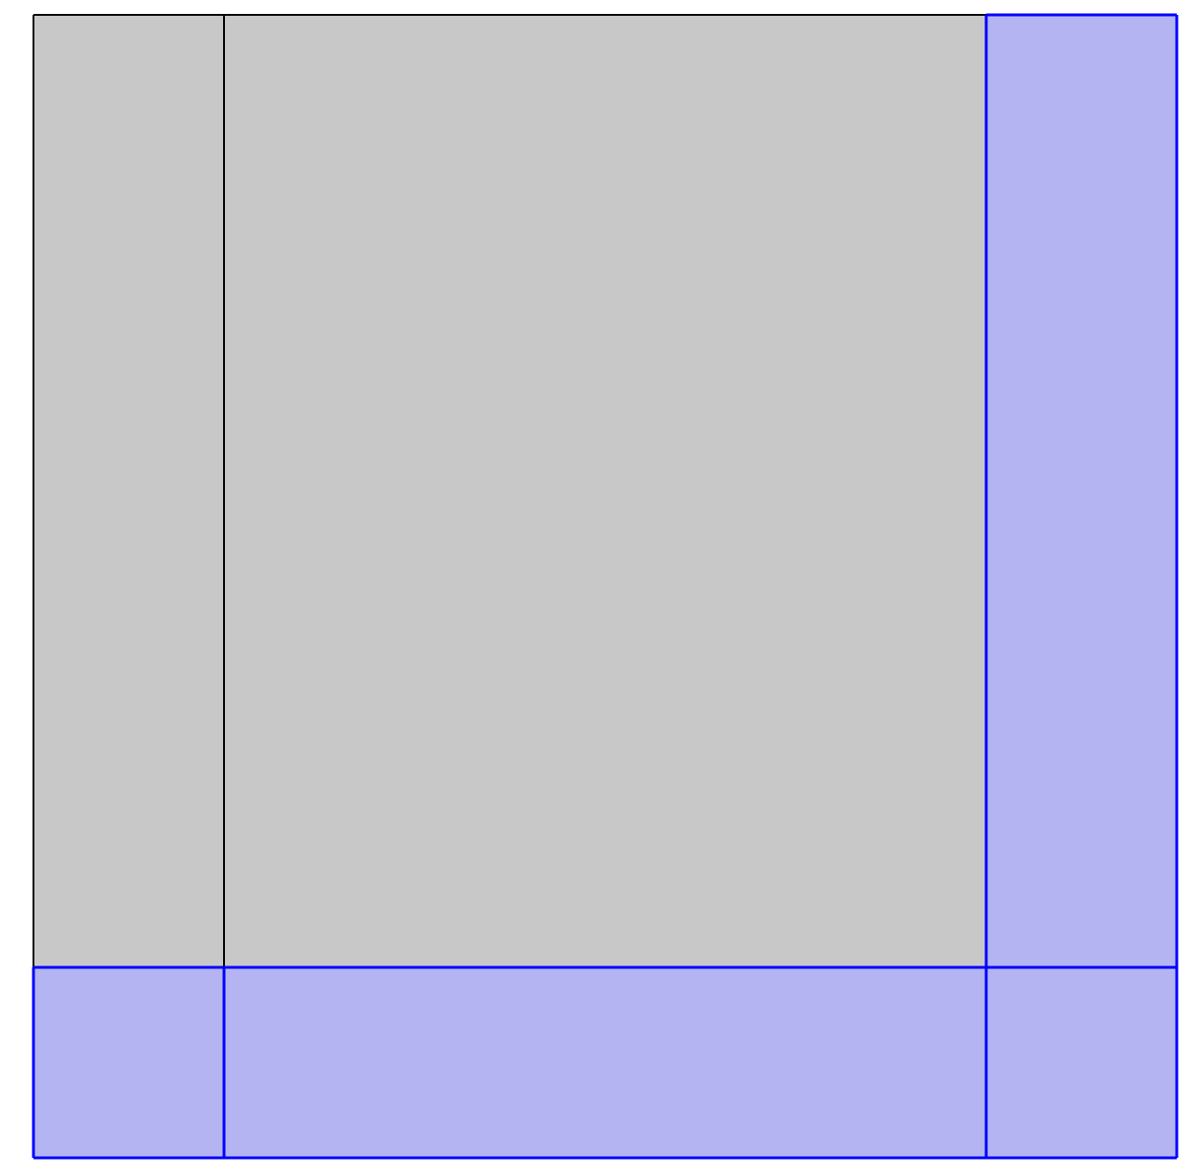
Model Definition
Geometry & Model Assumptions
3w
w/2
q
2D symmetrical cross section of the sample
  Only one half of the section is modeled
  w = 0.1 mm, d = 0.3 mm
Physical properties of the sample are constant
The radiation and convection losses are negligable
Sample is semi-infinite solid
  The “infinite domains” (shown in blue color) are used
The heat flux q at the interface between the metal strip and the sample is uniform
d
2D model geometry.

Slide 5
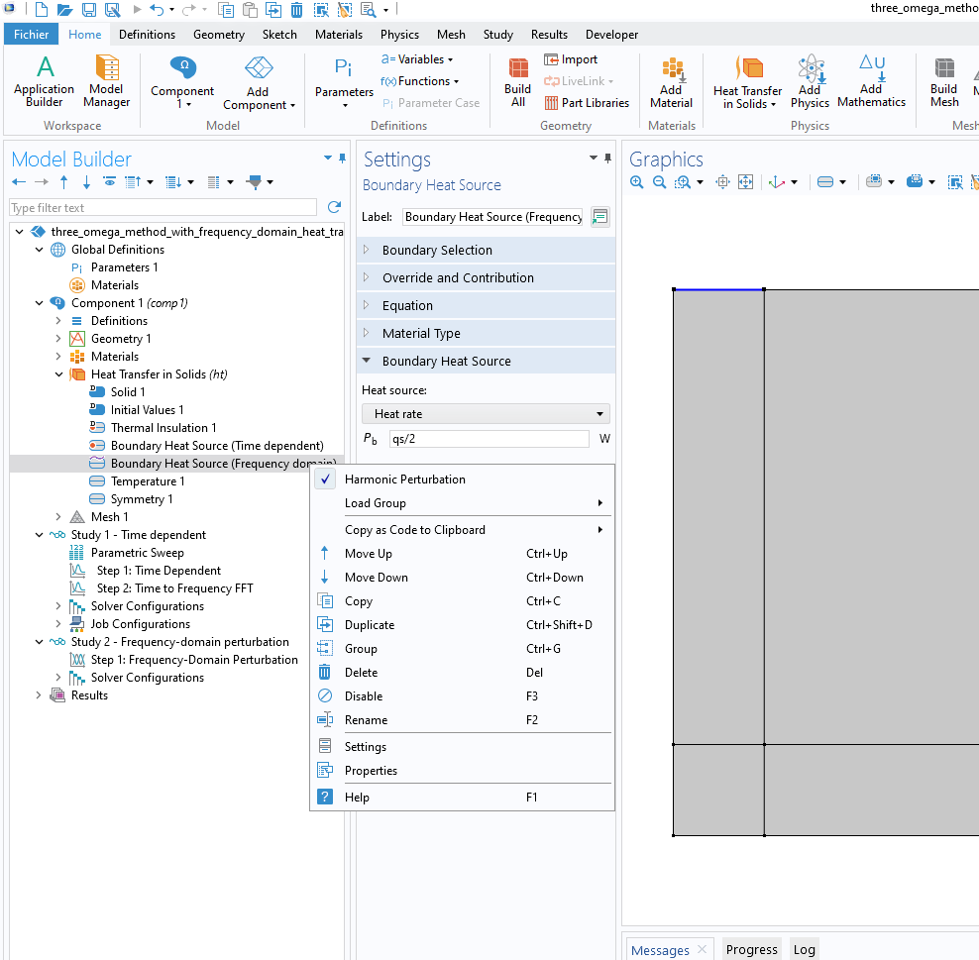
Model Definition
Boundary Conditions
Boundary Heat Source on the surface of the heater
  Time Dependent Analysis: the heat rate is defined as harmonic function of time
  Frequency Domain Analysis: the amplitude of the heat rate oscillations is defined, Harmonic Perturbation option is activated
Temperature on the lower external boundary
Symmetry on the left external boundary
Thermal Insulation on the remaining external boundaries

Slide 6
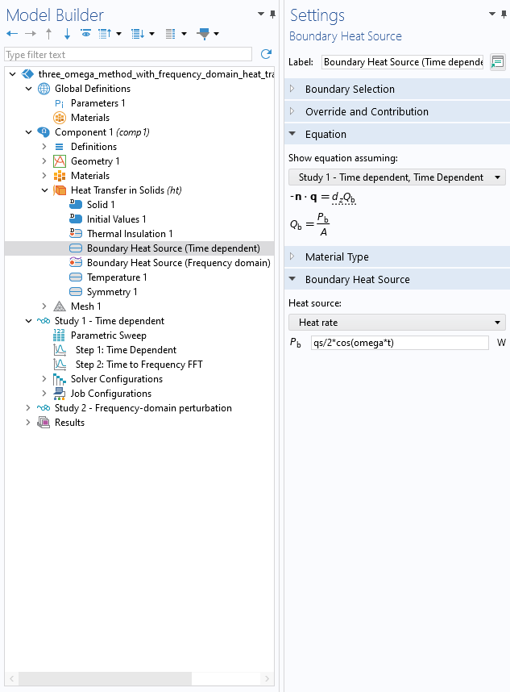
Model Definition
Approach 1: Time Dependent Analysis
Solves the transient heat transfer equation with the Time Dependent solver
  Time Dependent study step is used to compute the temporal evolution of average heater temperature. The transient heat transfer is modeled within N periods of heat rate oscillations
  Time to Frequency FFT study step performs the fast Fourier transform to evaluate the amplitude of temperature oscillations
  Parametric Sweep is used to sweep over the frequency range to find the log-linear region

Slide 7
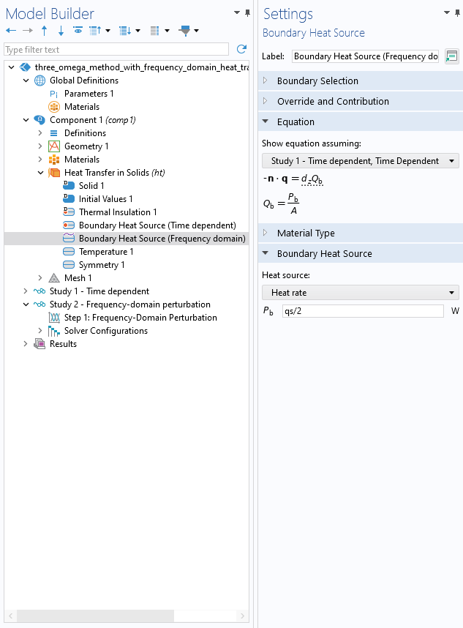
Model Definition
Approach 2: Frequency Domain Analysis
Frequency-Domain Perturbation study type is used to analyze the frequency dependence of temperature oscillation amplitude
  Requires only one Frequency-Domain Perturbation study step

Slide 8
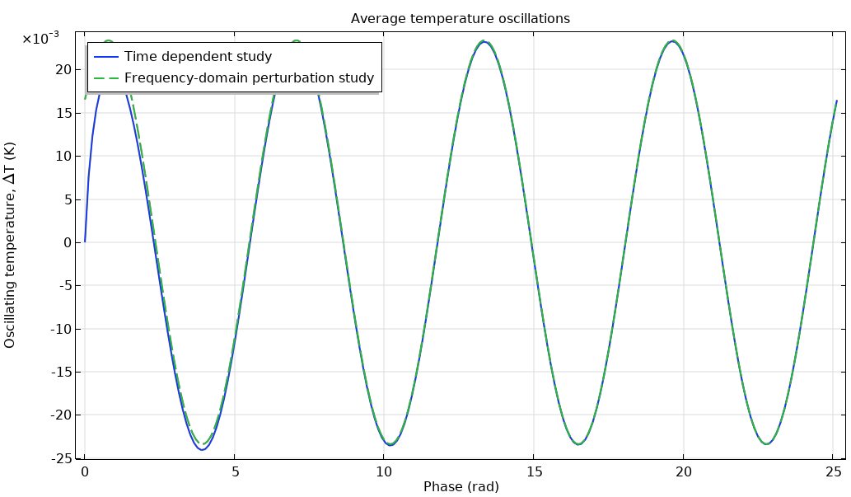
Results
Average temperature oscillations
The results of time dependent study are in perfect agreement with the results of the frequency domain study.
Both approaches give the same results, but the frequency domain approach is much faster and has easier setup.
Average temperature oscillations computed with time dependent (blue curve) and frequency-domain perturbation (green dashed curve) solvers.

Slide 9
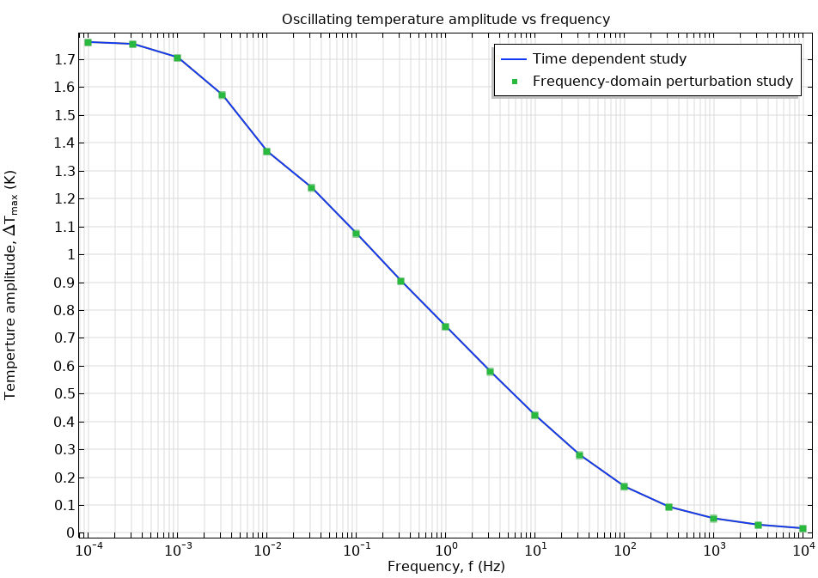
Results
Thermal Conductivity
The thermal conductivity is estimated by substituting two values from log-linear region of the curve into the Cahill’s equation
Selected frequencies f₁=0.1 Hz and f₂=10 Hz are defined in the
Results > Parameters node
Approach | Thermal conductivity
Exact value | 1.11 [W/m/K]
Time dependent | 1.1228 [W/m/K]
Frequency domain | 1.1228 [W/m/K]
The frequency dependence of the average temperature oscillations: results of the time dependent study (the blue curve) and of the frequency domain study (green points)

Slide 10
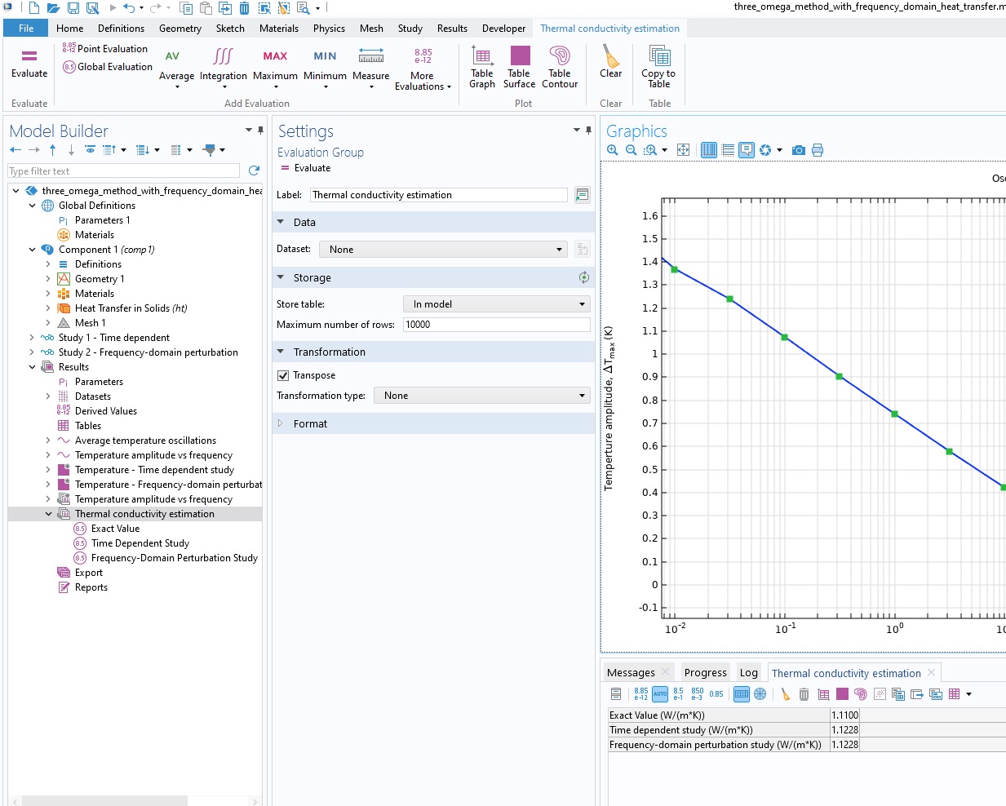
Conclusion
Both approaches give the same results for thermal conductivity, very close to the exact value used in the simulation.
The frequency domain approach is more effective because it gives accurate results but requires less time to compute.

Slide 11
References
[1] Cahill, D.G. and Pohl R.O. (1987) Thermal conductivity of amorphous solids above the plateau. Phys. Rev. B 35(8), 4067-4073.
[2] F.P. Incropera, D.P. DeWitt, T.L. Bergman, and A.S. Lavine, Fundamentals of Heat and Mass Transfer, 6th ed., John Wiley & Sons, 2006.

