Slide 1
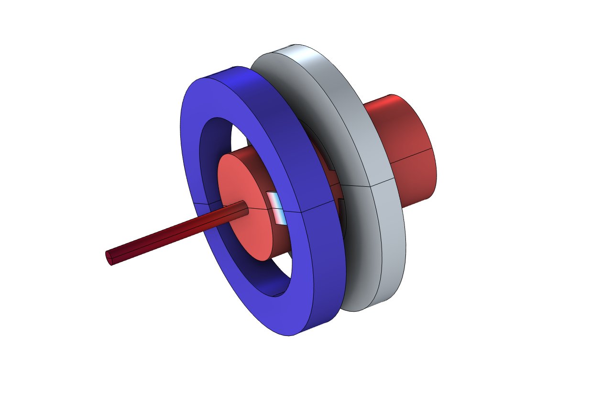
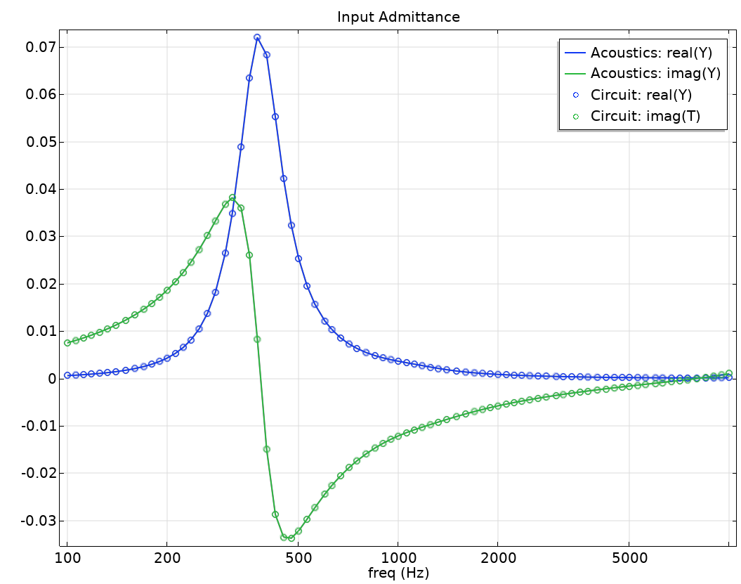
Input Impedance of a Tube and Coupler Measurement Setup: Time Domain MOR using Partial Fraction Fit

Slide 2
Abstract
This model computes the input impedance/admittance to an acoustic system in the frequency domain. The system here represents a typical measurement setup used for testing hearing aids and includes domains with thermoviscous boundary layer losses.
The input admittance computed in the frequency domain is fitted using the Partial Fraction Fit function. Then an equivalent electrical circuit model is set up to demonstrate a powerful model order reduction approach. The circuit is here automatically generated using a method call.
The equivalent circuit can be used to represent the input impedance/admittance of the measurement system in time domain simulations, including the frequency dependent thermoviscous damping.
The model is related to the Transfer Matrix of a Tube and Coupler Measurement Setup tutorial.
The coupler geometry is taken from Generic 711 Coupler - An Occluded Ear Canal Simulator library tutorial. Besides certain details the geometry corresponds to the Brüel & Kjær Ear Simulator Type 4157.

Slide 3
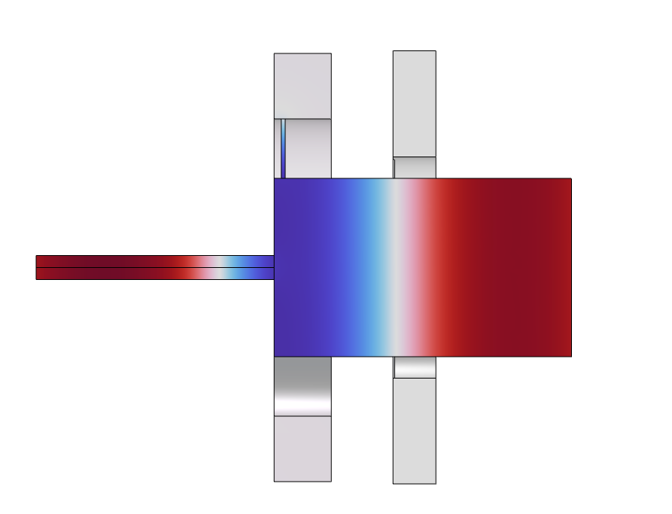
Measurement System
Ear Canal Simulator (711 coupler)
Test system input, typical connection to device being tested like a hearing aid or an ear bud.
Input admittance Y of the system is computed here.
Narrow tube
Measurement microphone represented by an RCL impedance model.

Slide 4
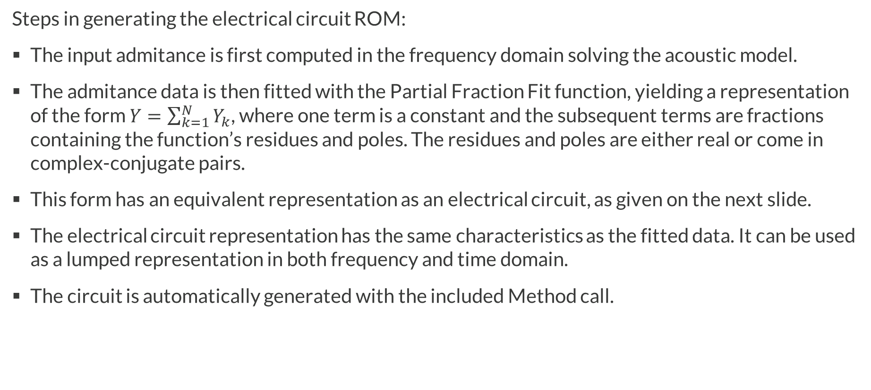
Input Impedance Representation
Steps in generating the electrical circuit ROM:
The input admitance is first computed in the frequency domain solving the acoustic model.
The admitance data is then fitted with the Partial Fraction Fit function, yielding a representation of the form $Y=\sum_{k=1}^{N}{Y_{k}}$, where one term is a constant and the subsequent terms are fractions containing the function’s residues and poles. The residues and poles are either real or come in complex-conjugate pairs.
This form has an equivalent representation as an electrical circuit, as given on the next slide.
The electrical circuit representation has the same characteristics as the fitted data. It can be used as a lumped representation in both frequency and time domain.
The circuit is automatically generated with the included Method call.

Slide 5
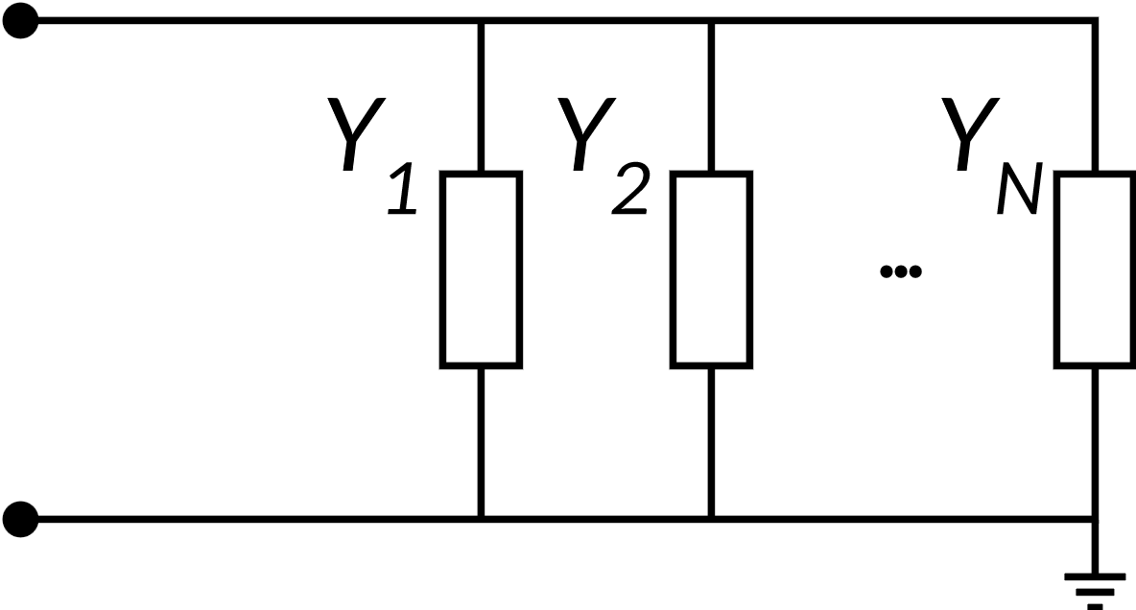
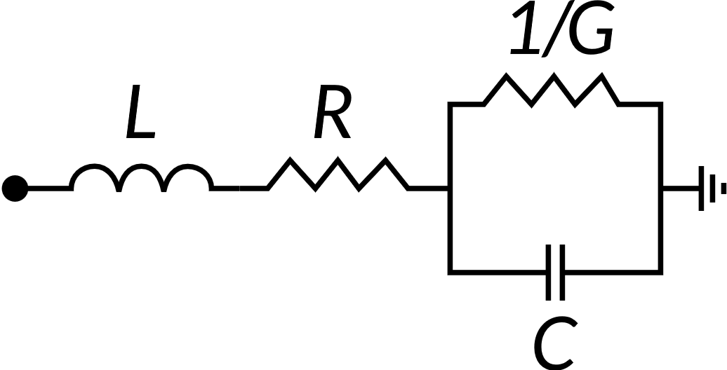
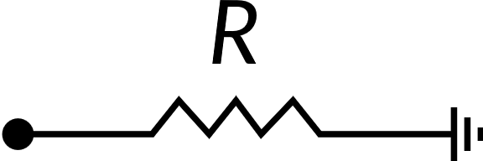
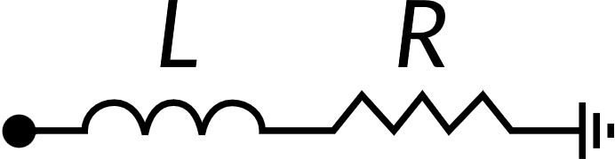




Equivalent Circuit Representation of PFF
Sum of N-terms
Constant term
Real pole
Conjugate pole pair
$$Y=\sum_{k=1}^{N}{Y_{k}}$$
$$Y_{k}=d$$
$$Y_{k}=\frac{r}{iω−p}$$
$$Y_{k}=\frac{1}{2}\left(\frac{r}{iω−p}+\frac{r^{∗}}{iω−p^{∗}}\right)$$

Slide 6
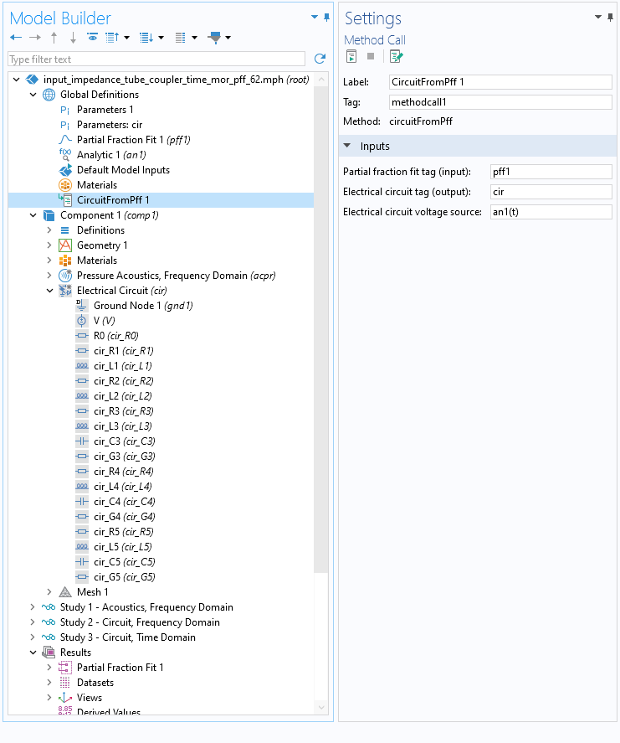
Method Call
A method CircuitFromPff is created in the Application Builder. It is used in the model, with the Method Call functionality.
The method has one input entry reffering to the Partial Fraction Fit to be used (here pff1); and one output entry giving the tag (here cir) of the representative circuit that is generated. Also enter the desired voltage source expression.
If a circuit with the entered output tag already exists, it will be overwritten.
A parameters list with the necessary circuit component values is also generated.

Slide 7
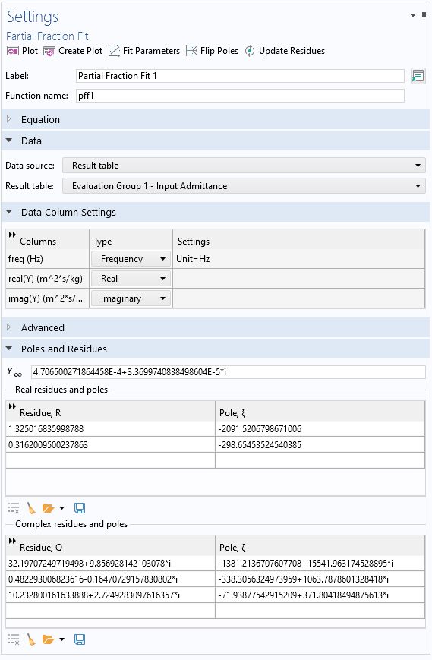
General Model Comments
Partial Fraction Fit
Studies
Click Fit Parameters, then
  One complex pole with a very small residue is removed (remove the row).
  The real pole locted at 20 kHz is removed (remove the row).
Afte removing undesired poles, click the Update Residues buttom.
Click the Plot or Create Plot buttons to check the quality of the fit. Check for passivity.
When the Method for generating the circuit is run, the circuit physics is added to all the three studies. Make sure to disable it where necessary.
When solving the circuit in the frequency domain (study 2), change the voltage source to: 1[V]

Slide 8
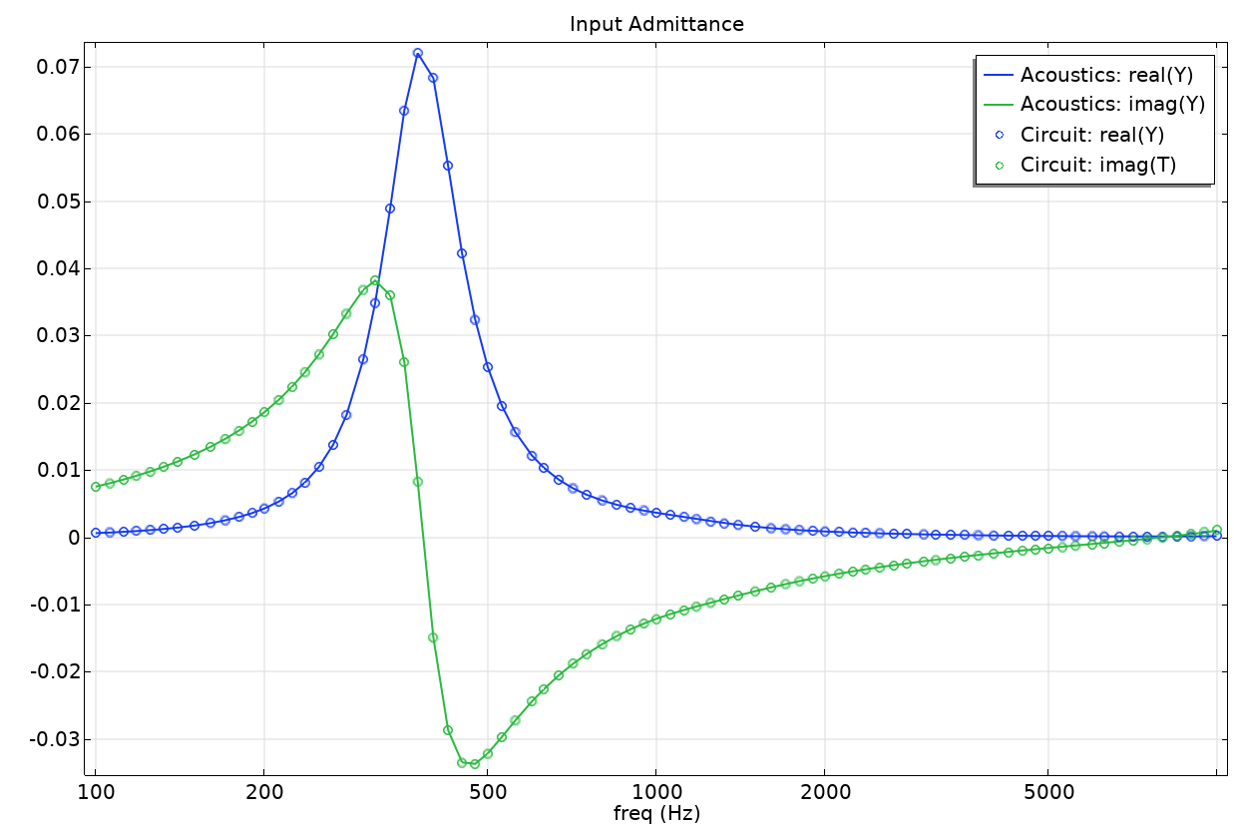
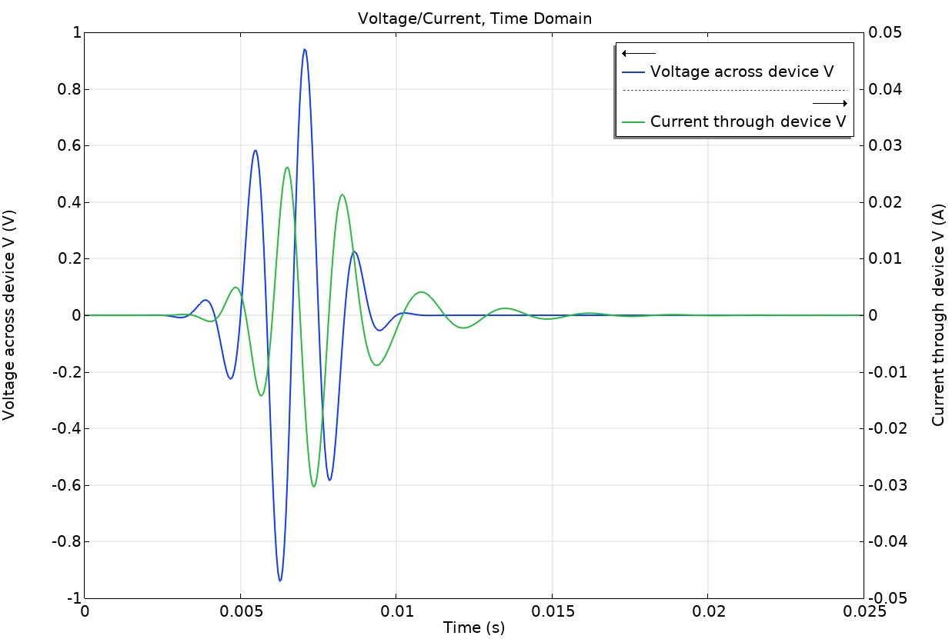
Results

Slide 9
References
A. Zadehgol, “A semi-analytic and cellular approach to rational system characterization through equivalent circuits,” Int. J. Numer. Model., 29(4), pp. 637–652, 2016.
C. -C. Chou and J. E. Schutt-Ainé, “Equivalent Circuit Synthesis of Multiport S Parameters in Pole-Residue Form,” IEEE T. Comp. Pack. Man., 11(11), pp. 1971–1979, 2021.

Slide 10
comsol.com/contact

