Slide 1
Thermal Expansion of a Laminated Composite Shell with Thermal Resistance between Layers

Slide 2
Introduction
This model is an extension of thermal_expansion_of_a_laminated_composited_shell model.
Thermal resistance induced from air gaps between layers are taken in account in the Heat Transfer Model.

Slide 3
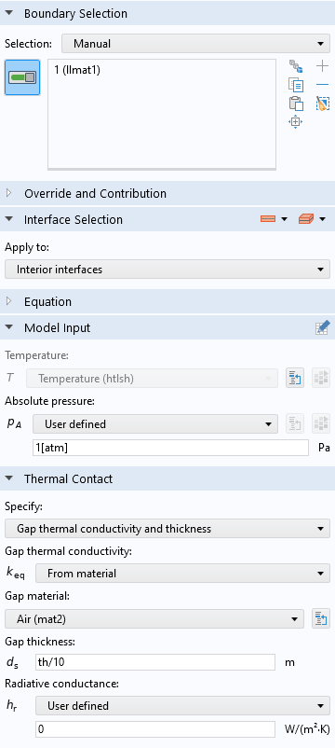
Thermal Contact, Interface
Thermal Contact, Interface is applied on each interior interface of the layered material.
The thermal resistance is determined from the air gap thermal conductivity and thickness.

Slide 4
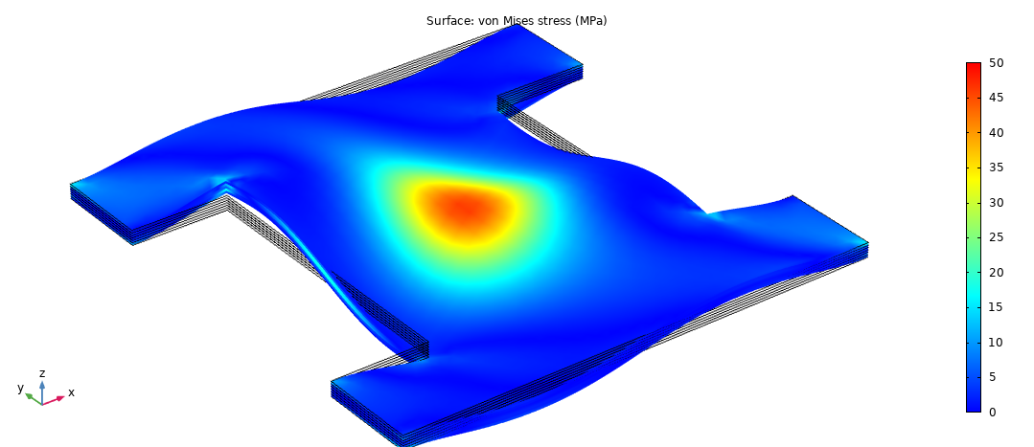

Results
Von Mises fields are closely similar. The maximum value increase about 3% from 47.6 to 49.2 MPa when taking in account thermal contact resistances.
Von mises stress fields inside the laminated composite shell
Up: Without Thermal Contact; Down: With Thermal Contact

Slide 5
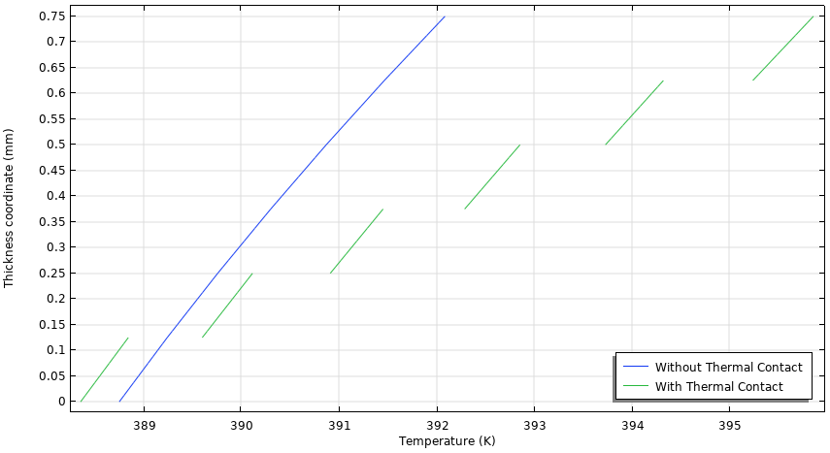
Results
The figure on the right shows the temperature through the composite shell thickness. Temperature discontinuities at each interface are observed when Thermal Contact, Interface feature is applied.
Temperature distribution along layer thickness

