Slide 1
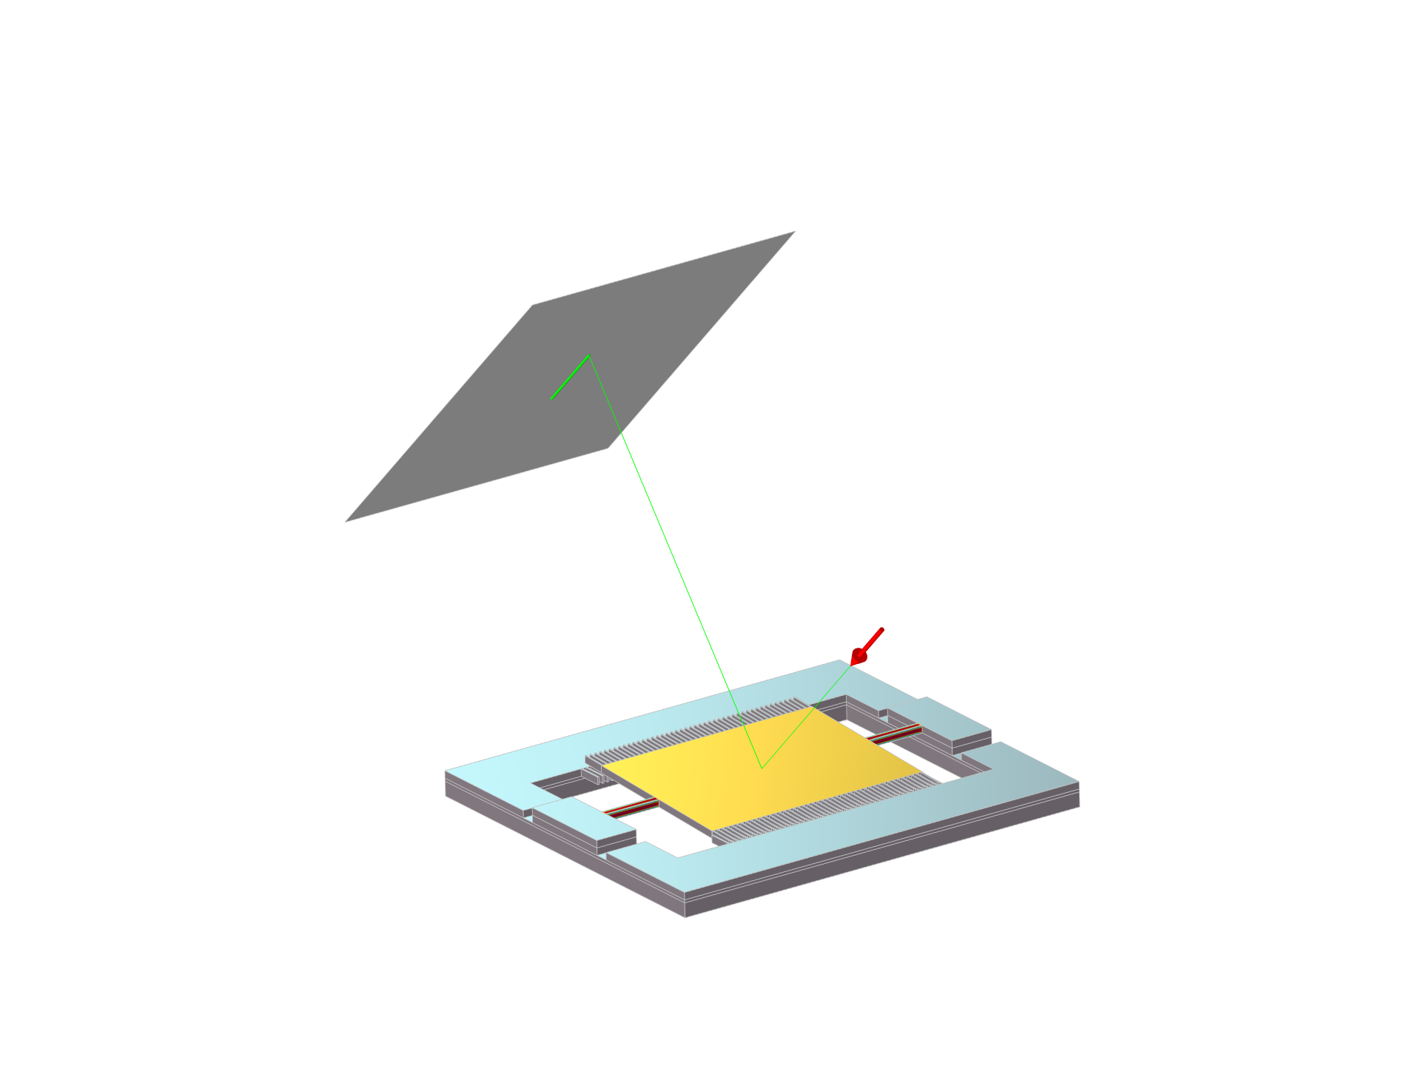
MEMS Scanning Mirror
COMSOL

Slide 2
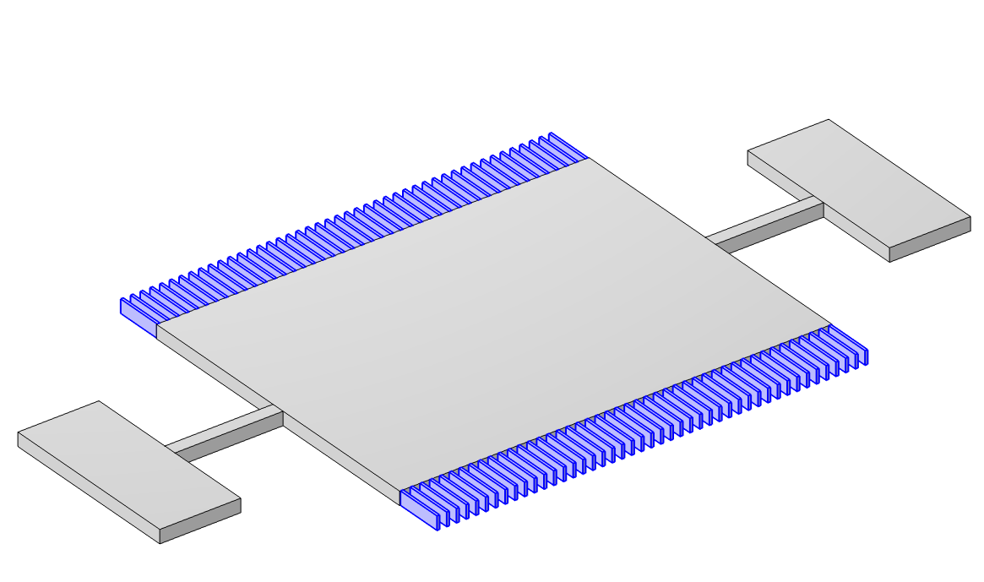
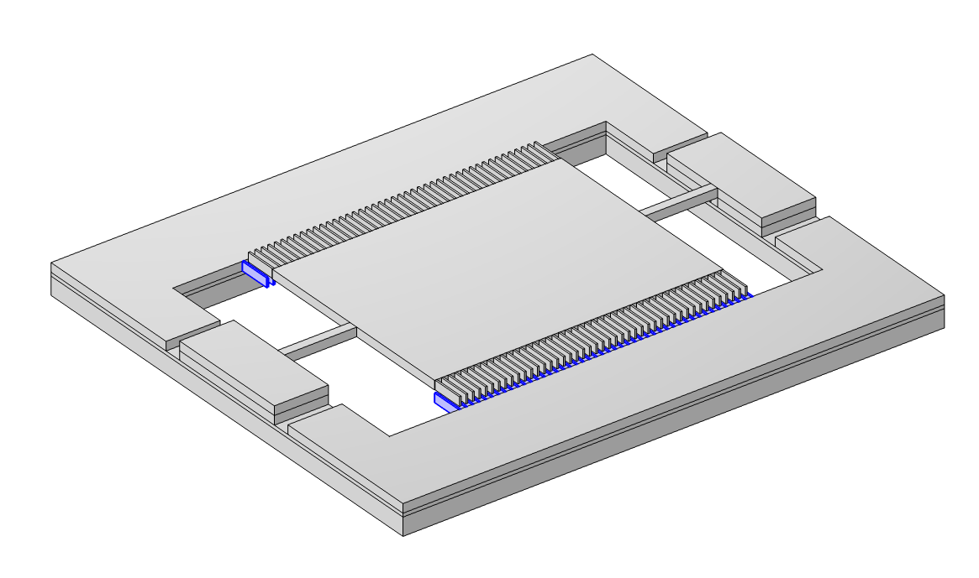
Model Definition
Moving combs
Torsion beam
Anchor point
Reflector
Single-axis electrostatically driven scanning micromirror:
  A reflector attached to two anchor points by two torsion beams
  A vertical comb drive structure formed by moving combs on the mirror sides and fixed combs on the device layer
Model the mirror torsional motion caused by a driving voltage:
  Range: 0~300 V
Validation of an analytical expression for the
electromechanic force
Fixed combs
Base layer
Isolator layer
Device layer

Slide 3
Comparison of Methods for Electromechanics
Analytical Expression
Electromechanics Interface
Advantages: low computational effort and large angle rotations without moving mesh
Disadvantages: limited to cases with fixed motion trajectories
Advantages: predefined multiphysics coupling that can handle any deformation
Disadvantages: longer computation time and requires moving mesh

Slide 4
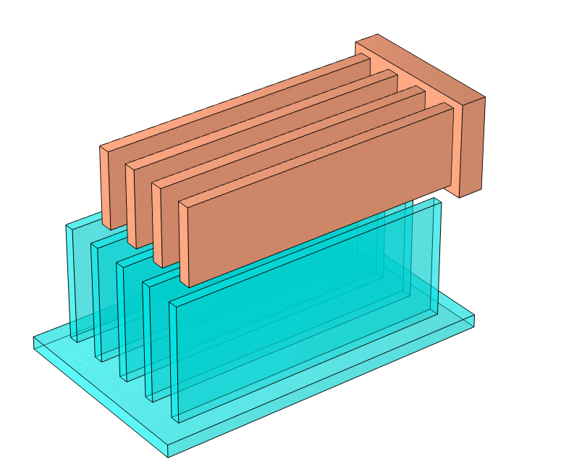
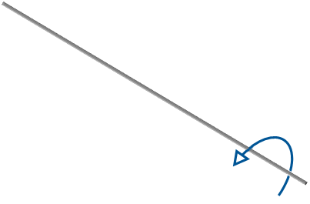
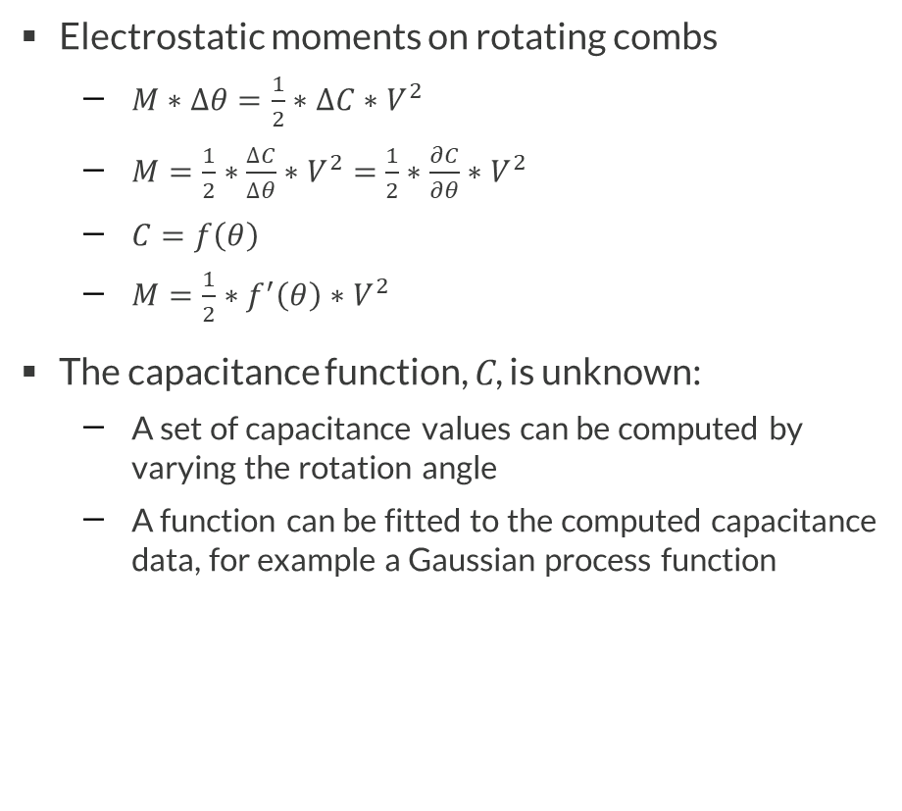
Analytical Expression
Electrostatic moments on rotating combs
  $M∗∆θ=\frac{1}{2}∗∆C∗V^{2}$
  $M=\frac{1}{2}∗\frac{∆C}{∆θ}∗V^{2}=$ $\frac{1}{2}∗\frac{∂C}{∂θ}∗V^{2}$
  $C=f\left(θ\right)$
  $M=\frac{1}{2}∗f^{′}\left(θ\right)∗V^{2}$
The capacitance function, C, is unknown:
  A set of capacitance values can be computed by varying the rotation angle
  A function can be fitted to the computed capacitance data, for example a Gaussian process function

Slide 5
Implementation in COMSOL Multiphysics®
Electrostatic
Solid Mechanics
Calculation of the capacitance between the driven and fixed combs and its sensitivity to the mirror rotation angle
Calculation of the torsion angle of a mirror under the action of an electrostatic driving moment

Slide 6
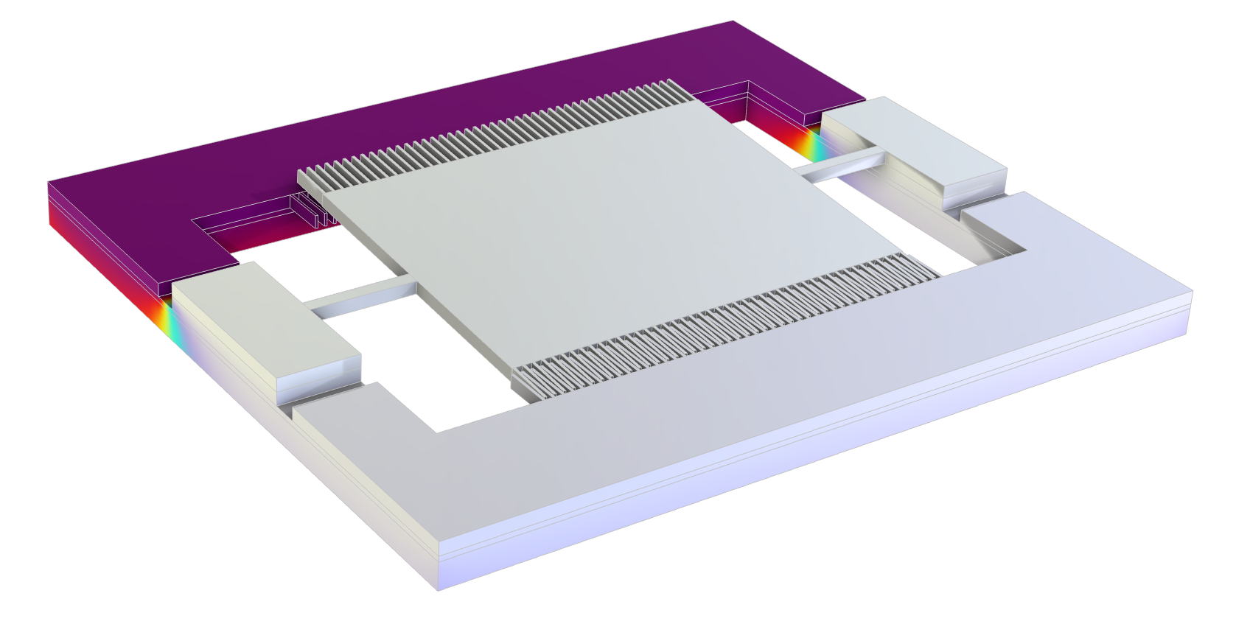
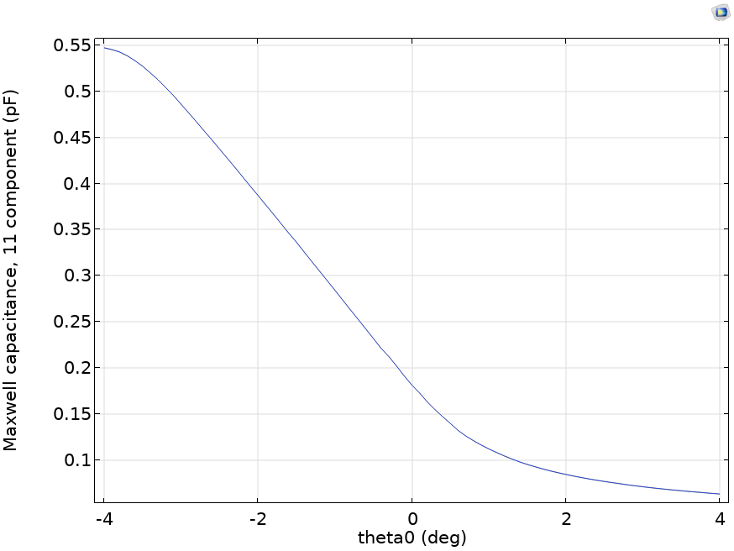

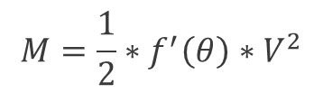

MODEL DEFINITION, ELECTROSTATICS INTERFACE:
Computation of the Electrostatic Moments
Parametric sweep of the rotation angle of the reflector
Calculation of the comb capacitance as a function of the mirror rotation angle:
Derivation of the comb capacitance with respect to the rotation angle:
Moment of the driving combs:
$$C=f\left(θ\right)$$
$$f^{′}\left(θ\right)=\frac{∂f\left(θ\right)}{∂θ}$$
$$M=\frac{1}{2}∗f^{′}\left(θ\right)∗V^{2}$$

Slide 7
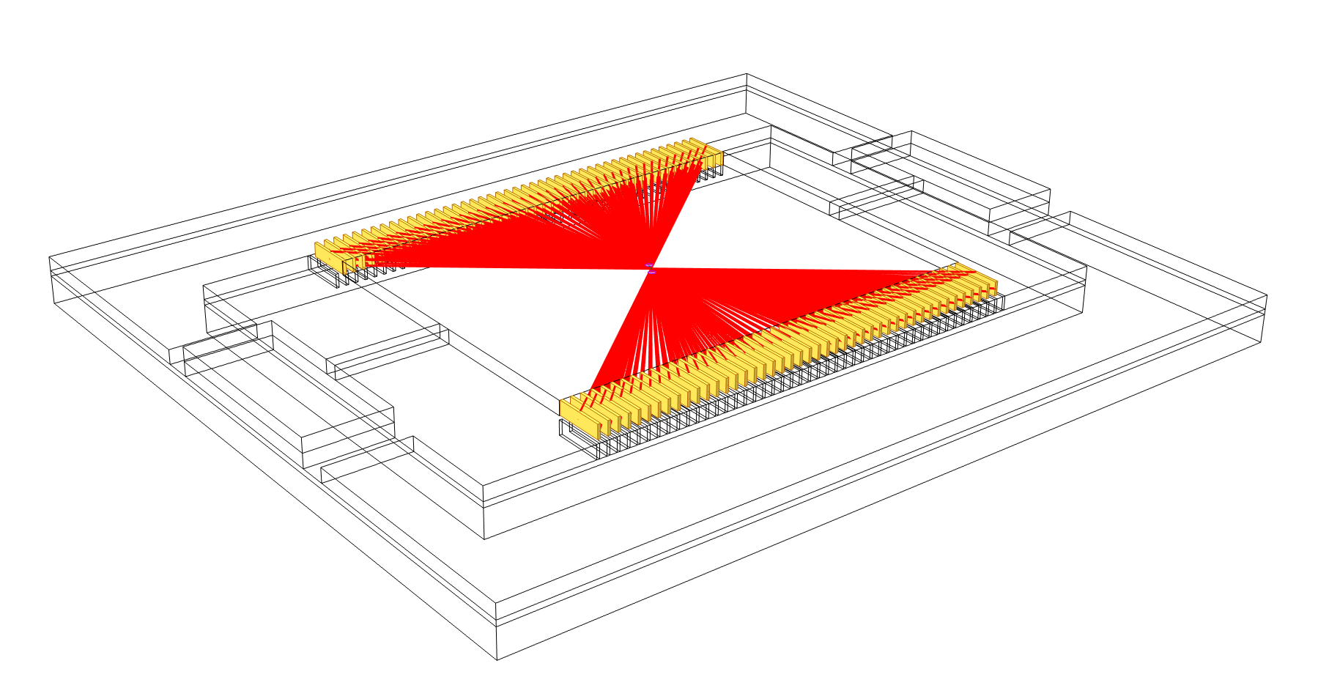
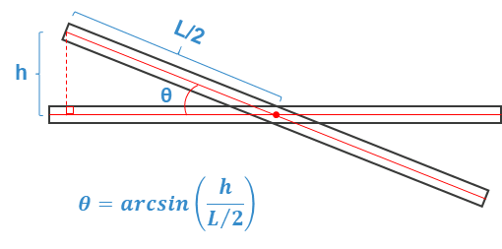
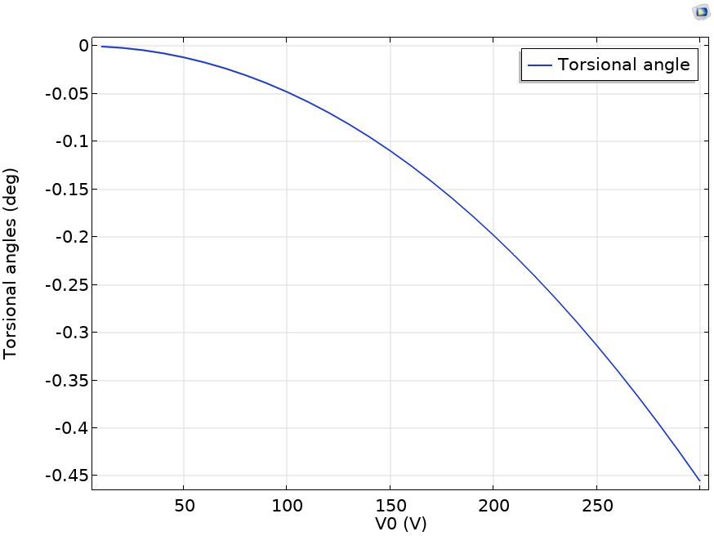
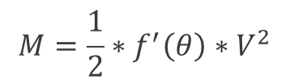
MODEL DEFINITION, SOLID MECHANICS INTERFACE:
Computation of the Rotation Angle
Electrostatic moments defined as loads using rigid connectors
A parametric sweep is used to vary the driving voltage
The rotation angle is computed using an arcsin function
$$M=\frac{1}{2}∗f^{′}\left(θ\right)∗V^{2}$$

Slide 8
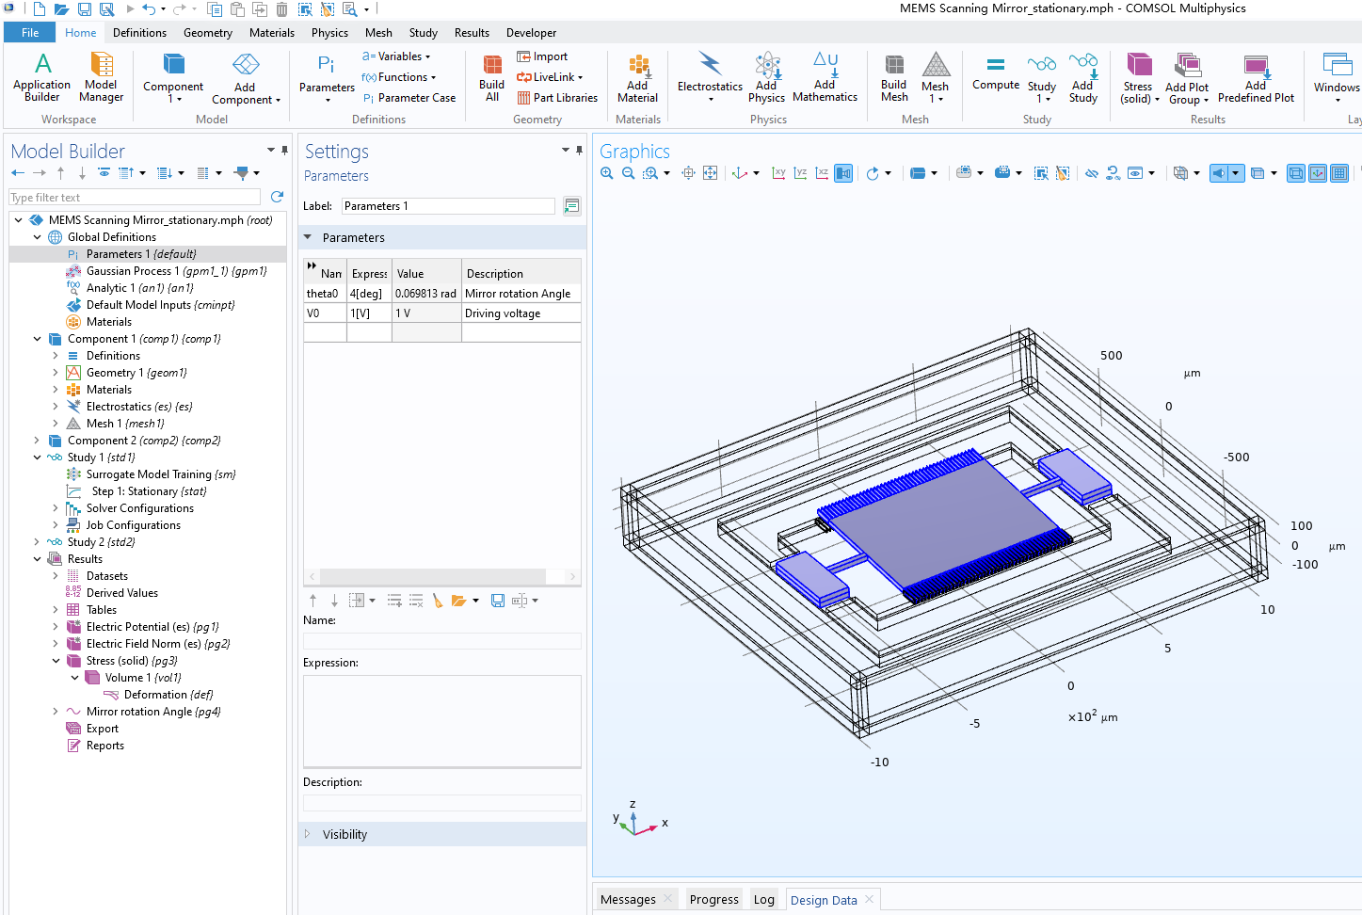
ELECTROSTATICS
Model Parameters
Rotation angle
  Angle of twist of the mirror around the axis of rotation
Driving voltage

Slide 9
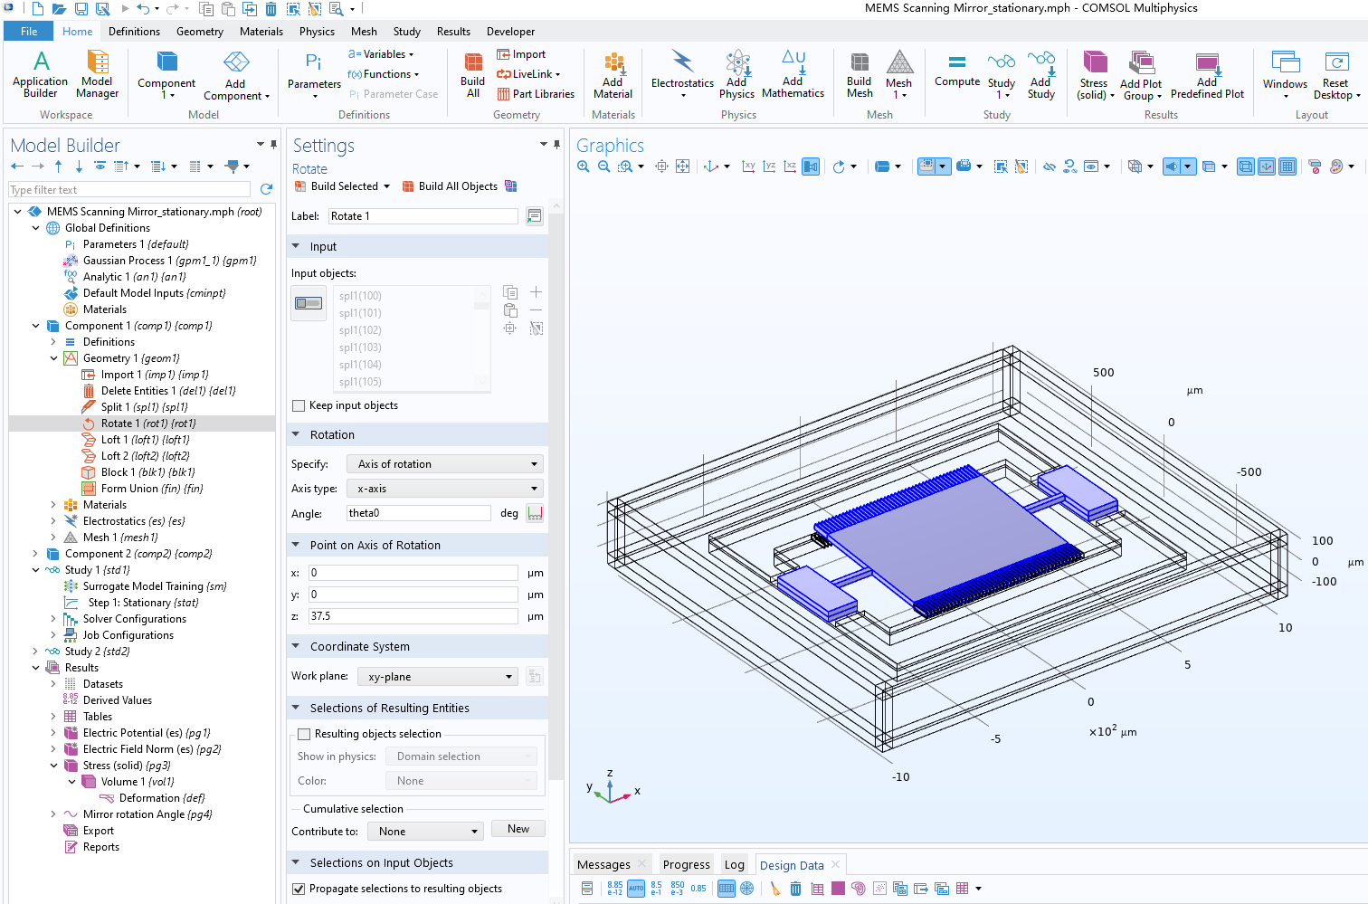
ELECTROSTATICS
Geometry Parameters
Rotation angle: angle of the mirror surface in relation to its undeformed position

Slide 10
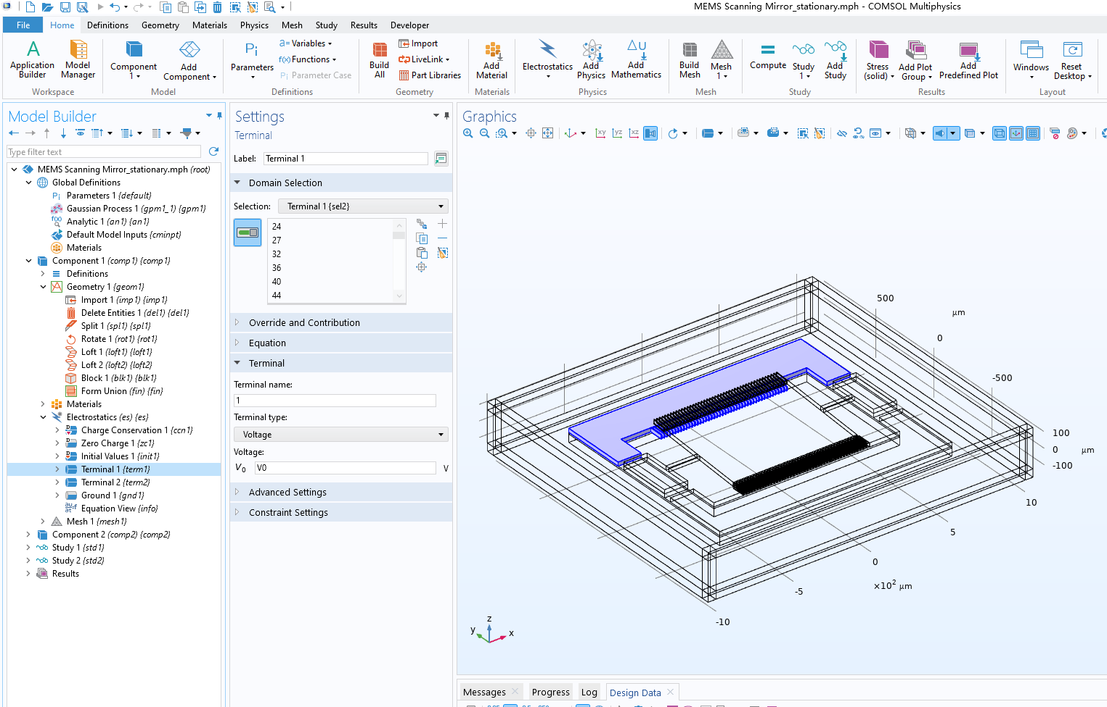
ELECTROSTATICS
BC: Terminal 1
Activating terminal: used to calculate capacitance, the exact value of the voltage is not important, i.e., it can be set to V0 = 1V

Slide 11
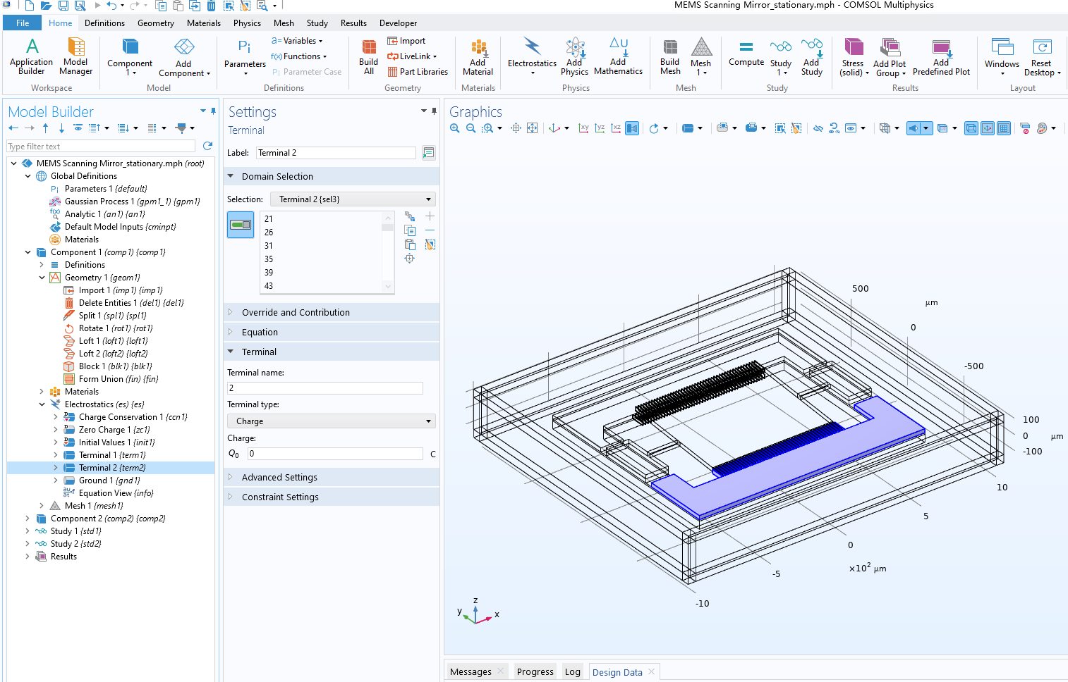
ELECTROSTATICS
BC: Terminal 2
Floating voltage:
  Terminals 1 and 2 are turned on alternately during operation
  Due to the symmetry, only one side is computed

Slide 12
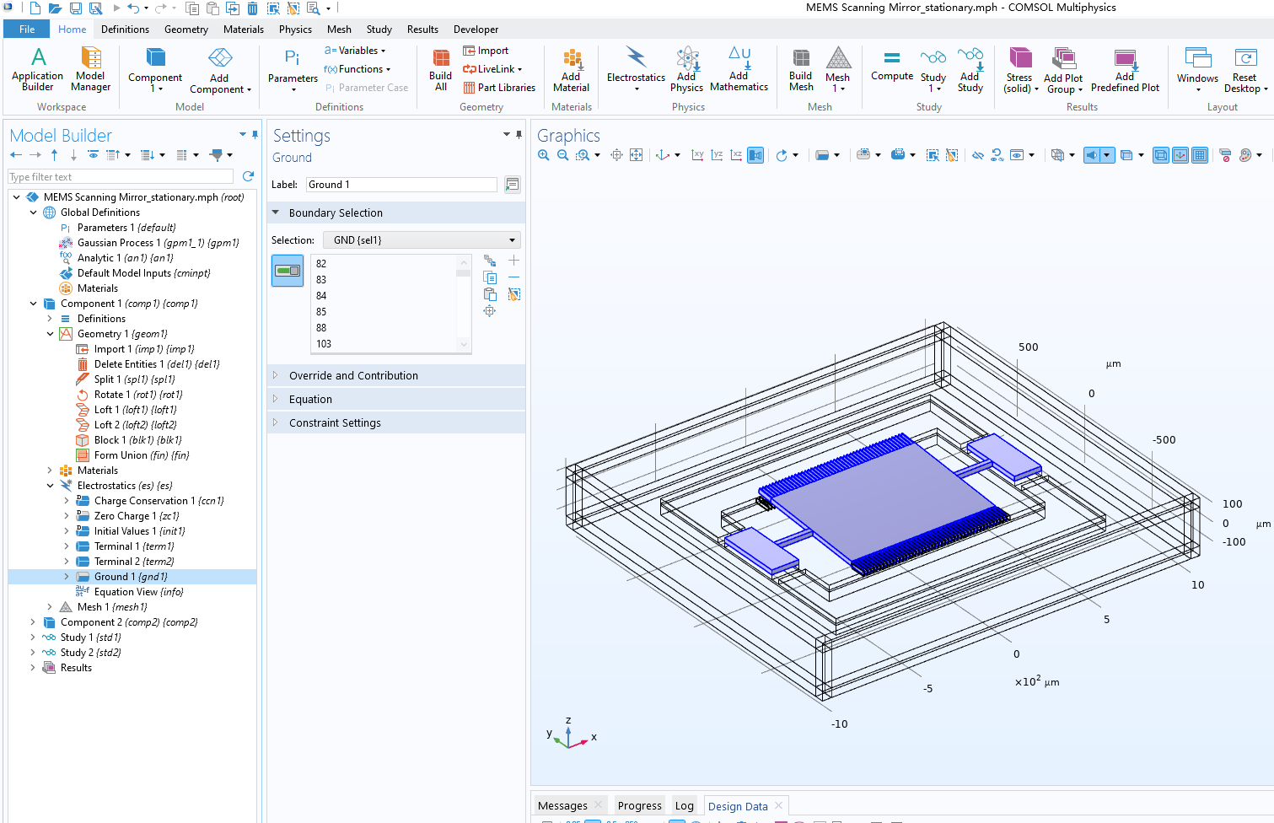
ELECTROSTATICS
BC: Grounded
Mirror and moving combs
are grounded.

Slide 13
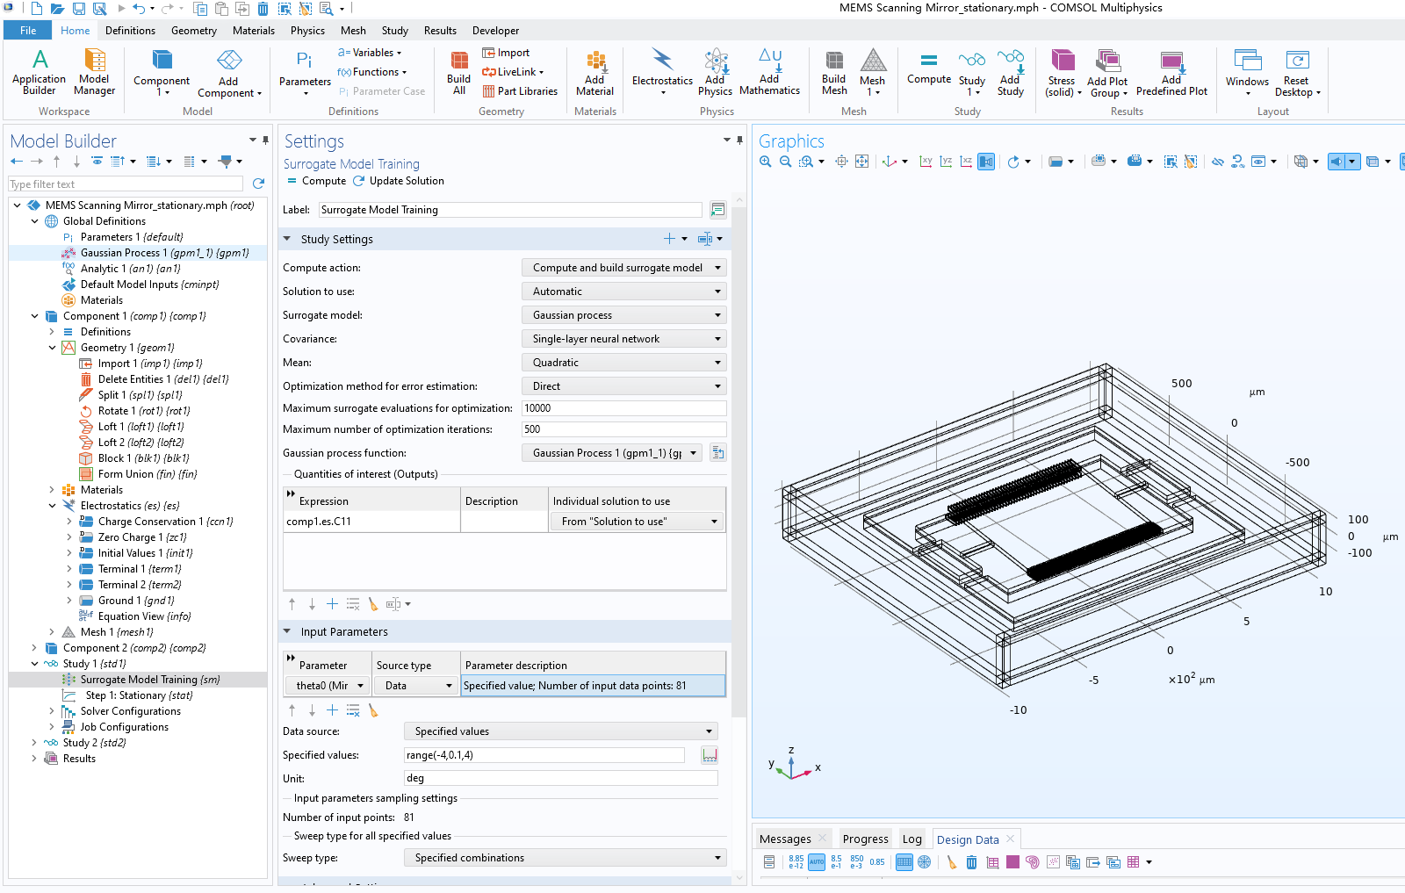
ELECTROSTATICS
Study:
Surrogate Model Training
The study performs a parametric sweep of the mirror rotation angle, calculates the capacitance for each angle, and creates a surrogate model.

Slide 14
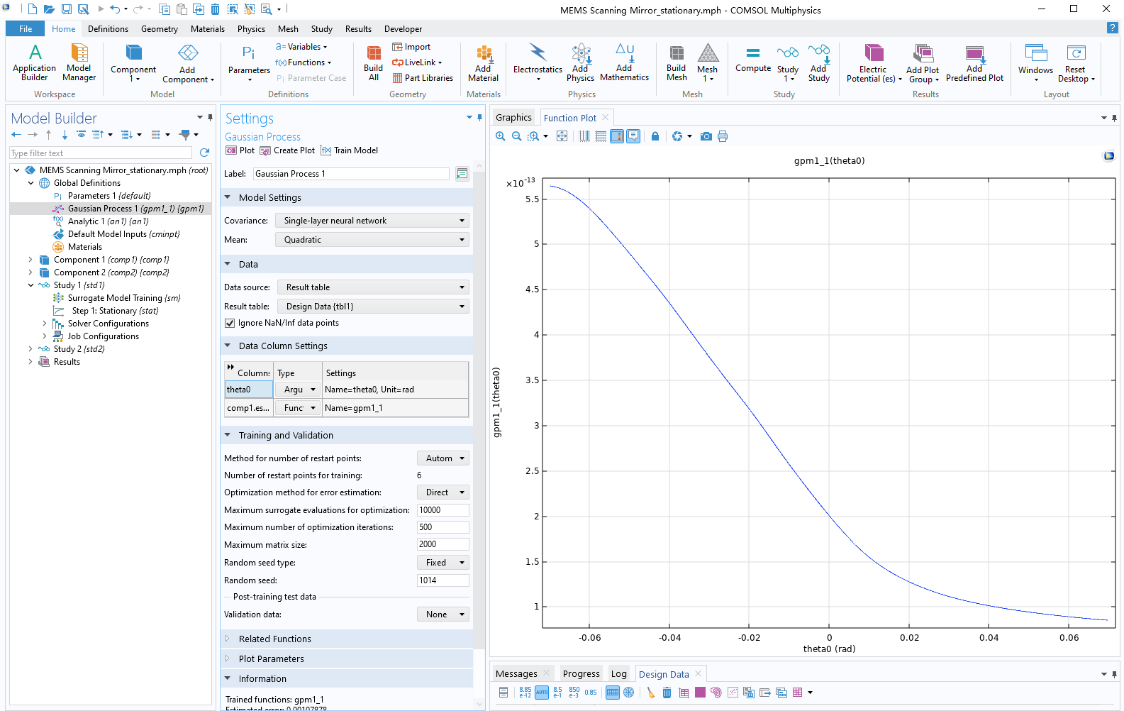
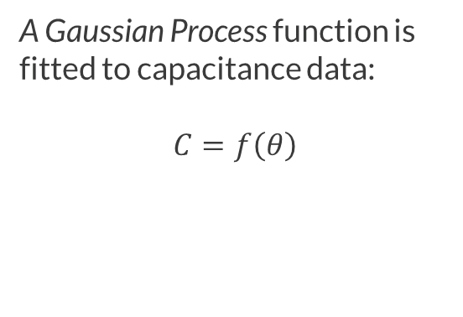
ELECTROSTATICS
Results:
Capacitance Function
A Gaussian Process function is fitted to capacitance data:
$$C=f\left(θ\right)$$

Slide 15
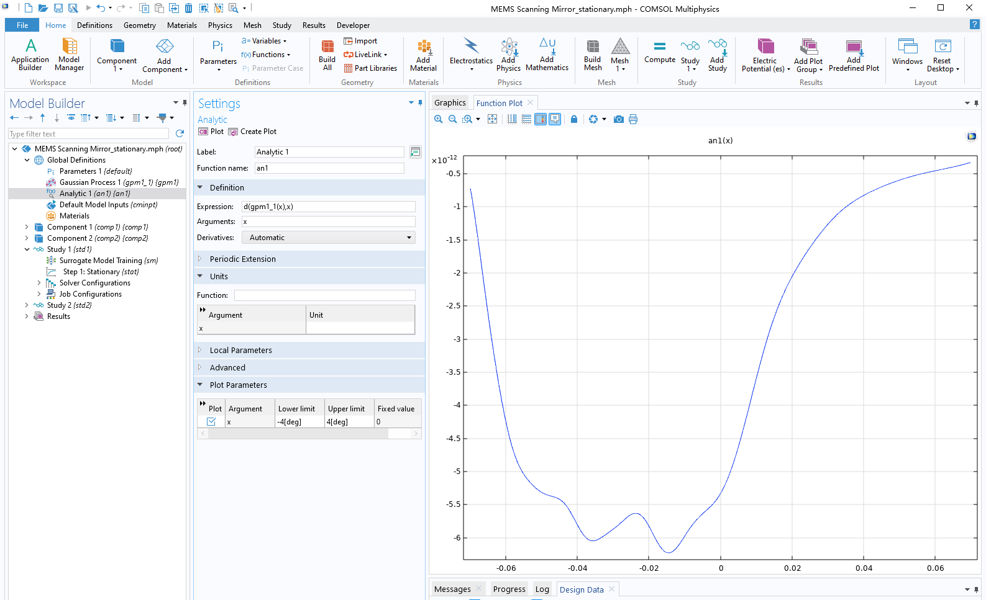
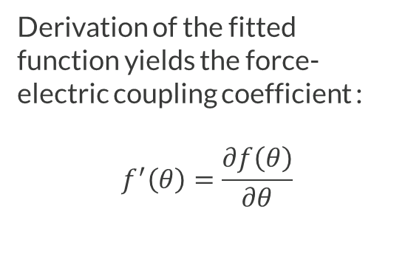
ELECTROSTATICS
Results:
Force-Electric Coupling Coefficient
Derivation of the fitted function yields the force-electric coupling coefficient :
$$f^{′}\left(θ\right)=\frac{∂f\left(θ\right)}{∂θ}$$

Slide 16
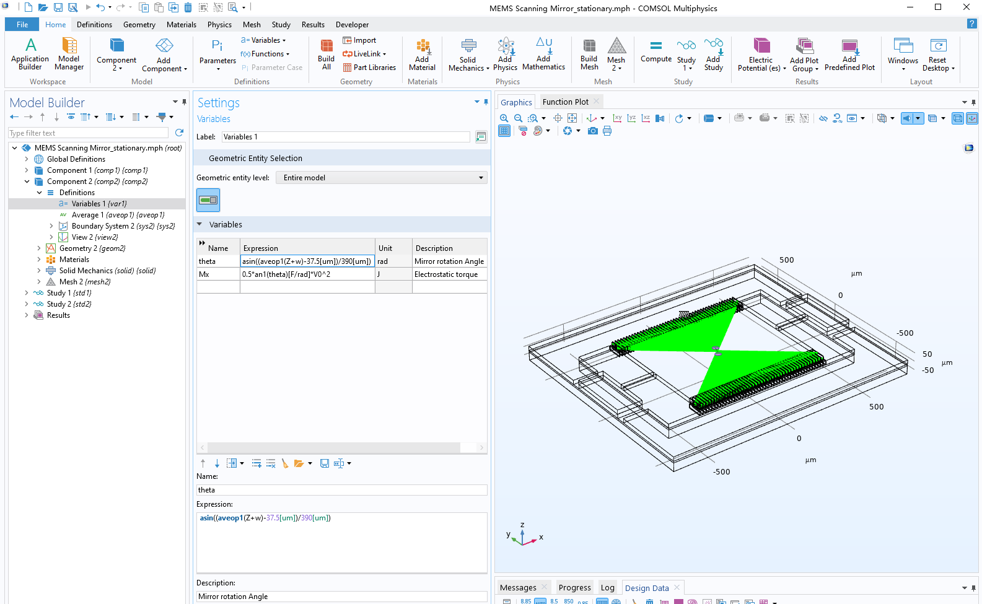

SOLID MECHANICS
Variables
Rotation angle:
  Rotation angle of the mirror under an electrostatic moment
Electrostatic moments:
  Calculated by force-electric coupling coefficients:
$$M=\frac{1}{2}∗f^{′}\left(θ\right)∗V^{2}$$

Slide 17
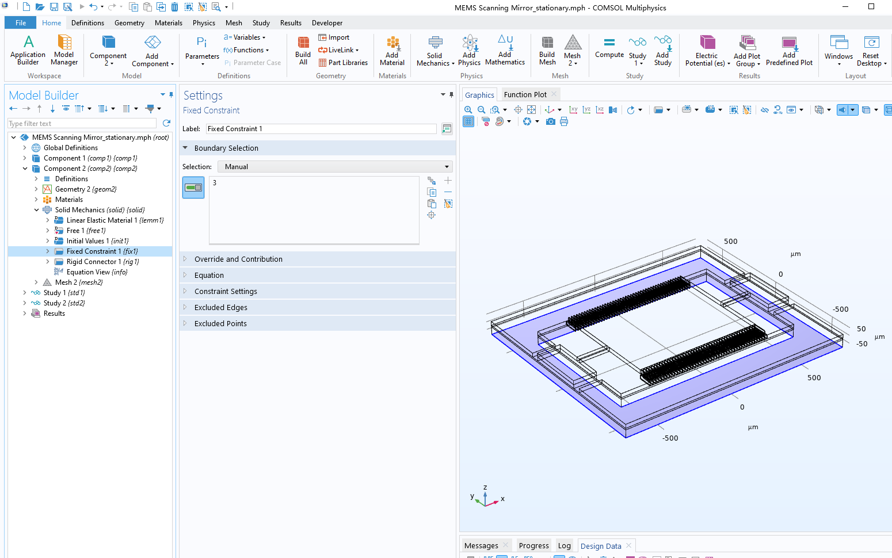
SOLID MECHANICS
Fixed Constraints
The scanning mirror is fixed at the bottom of the frame.

Slide 18
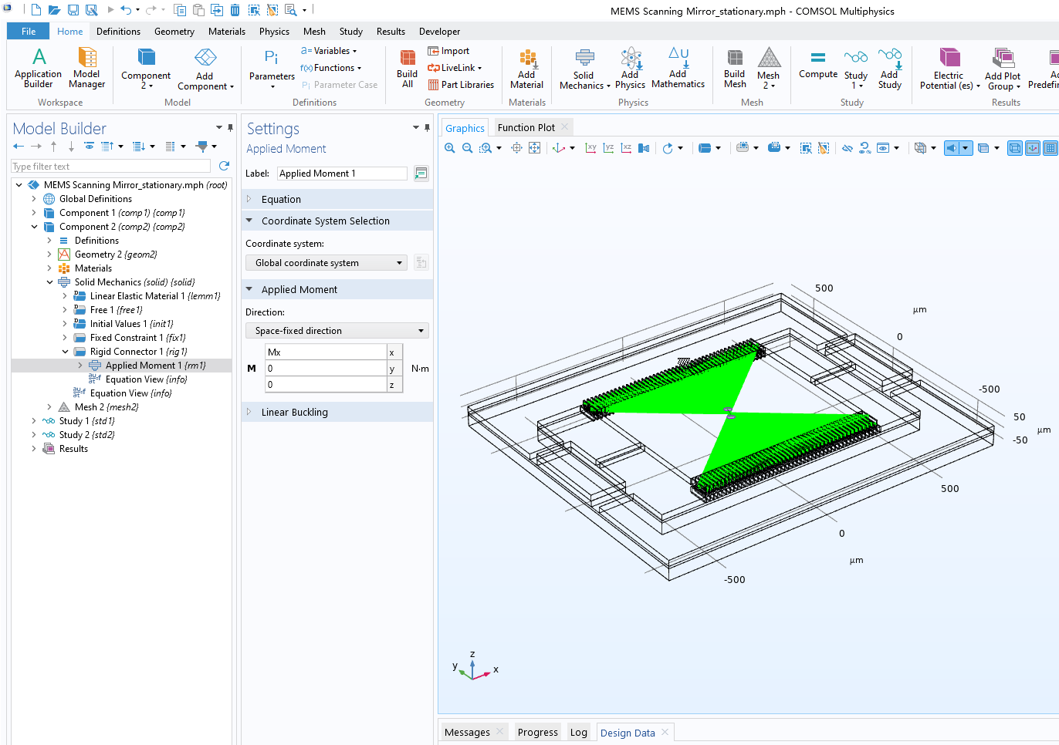
SOLID MECHANICS
Rigid Connector
An electrostatic moment is applied on the drive combs.

Slide 19
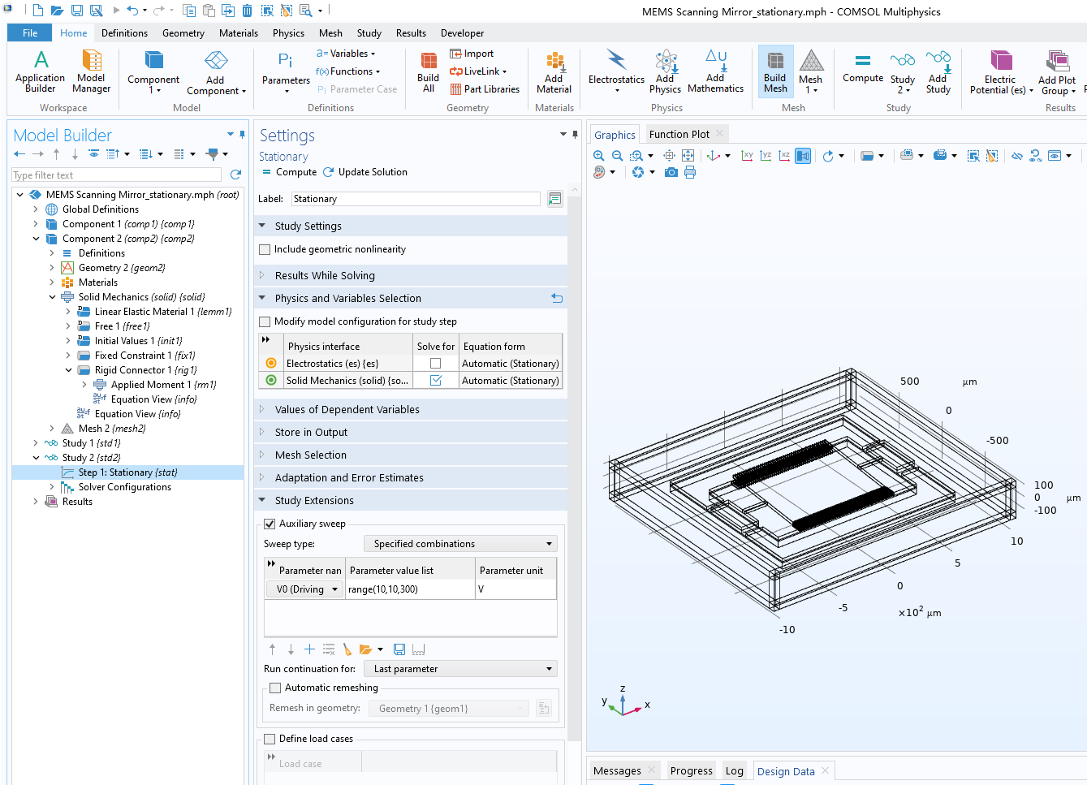
SOLID MECHANICS
Study:
Auxiliary Sweep
The driving voltage is varied in an auxiliary sweep to calculate the rotation angles.

Slide 20
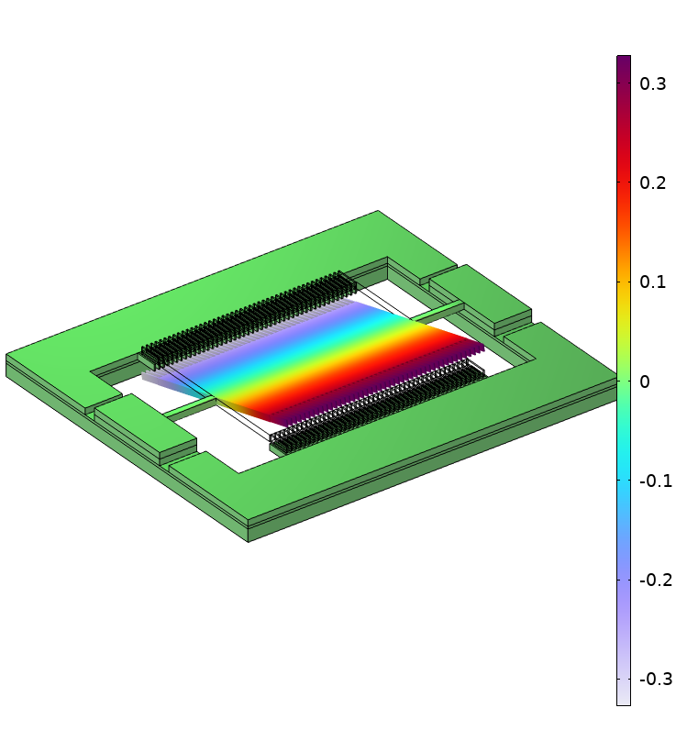
SOLID MECHANICS
Results
Rotation angle at different
driving voltages

Slide 21
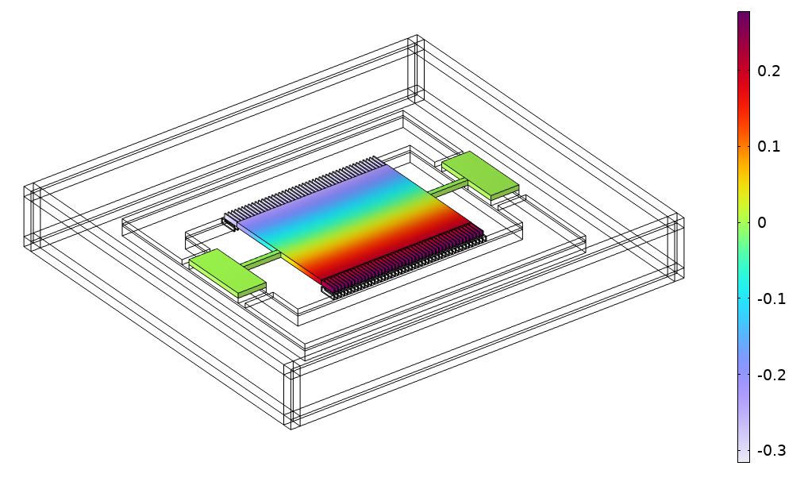
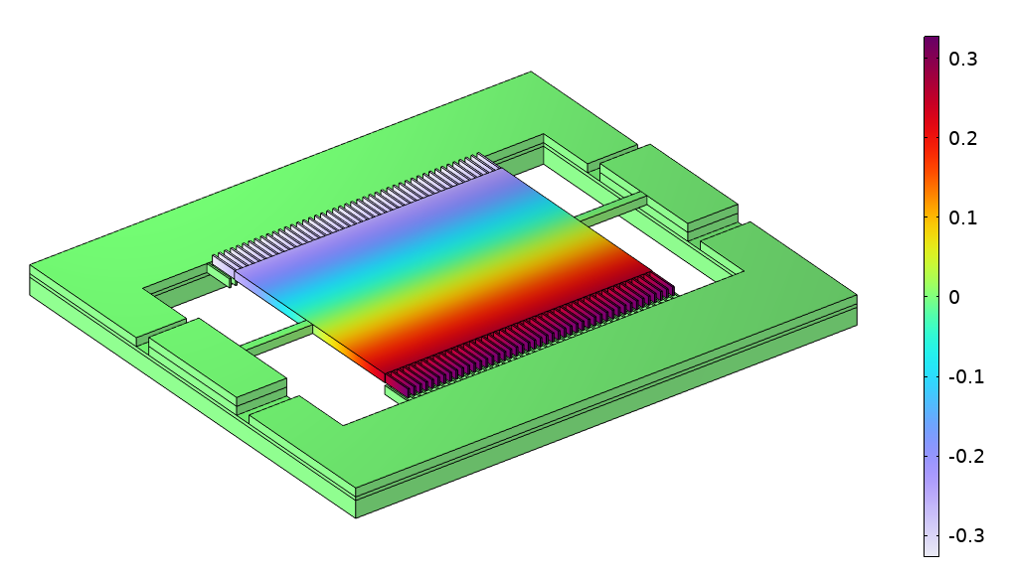
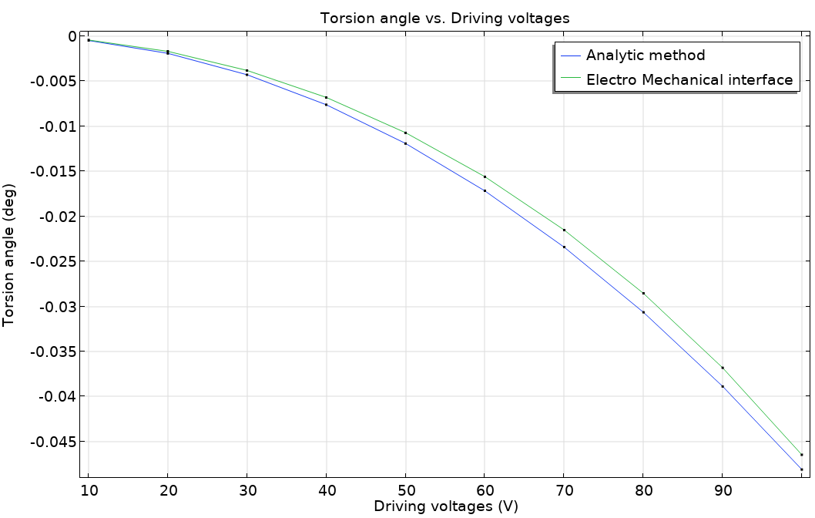
Analytic Expression vs. Electromechanics Interface
Results are in good agreement
Computing time for a sweep range of 10-100 V:
  Analytic expression: 2 m 13 s
  Electromechanics interface: 4 h 40 m
The difference between the two methods increases with voltage.

Slide 22
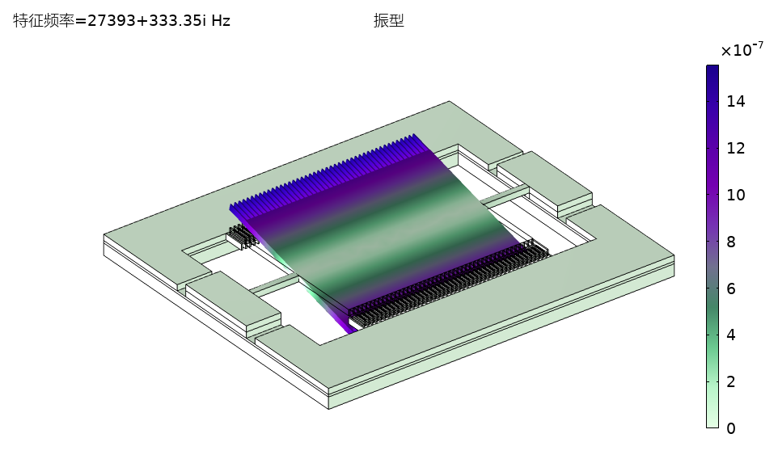
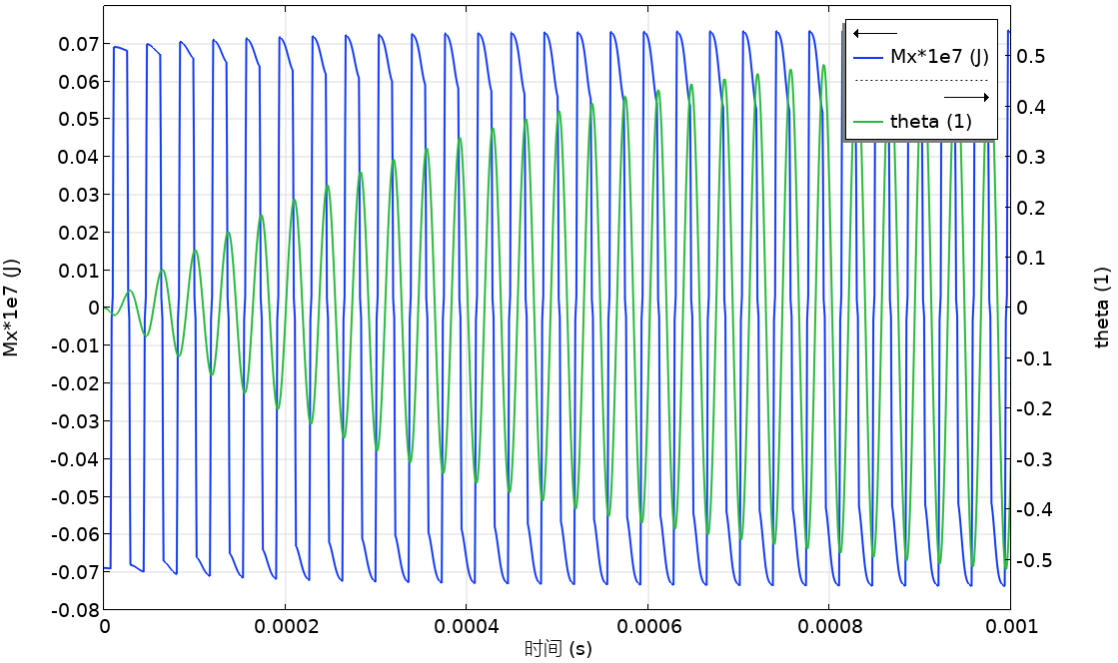
Dynamic Analysis
Mode analysis:
  Search the eigenfrequencies corresponding to torsional modes
Time-dependent analysis:
  Simulation of startup of the oscillation process

Slide 23
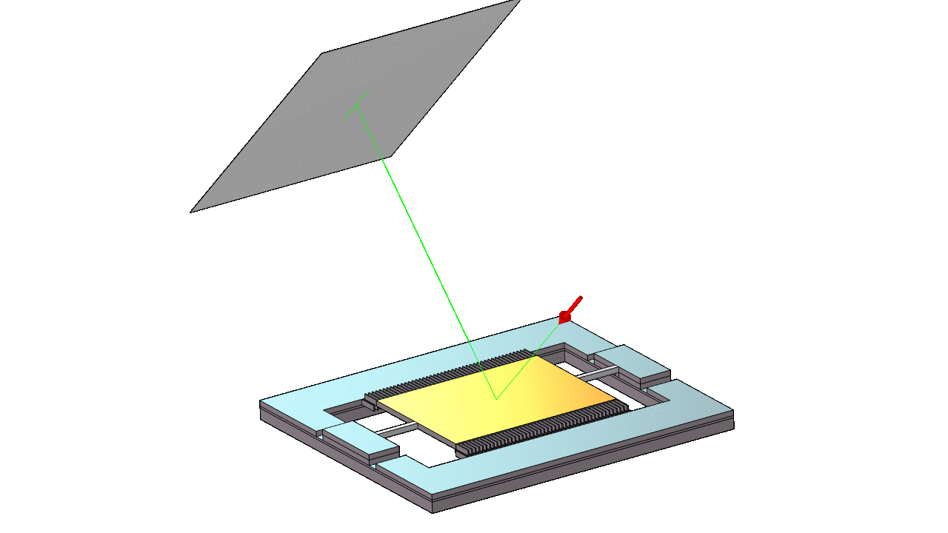
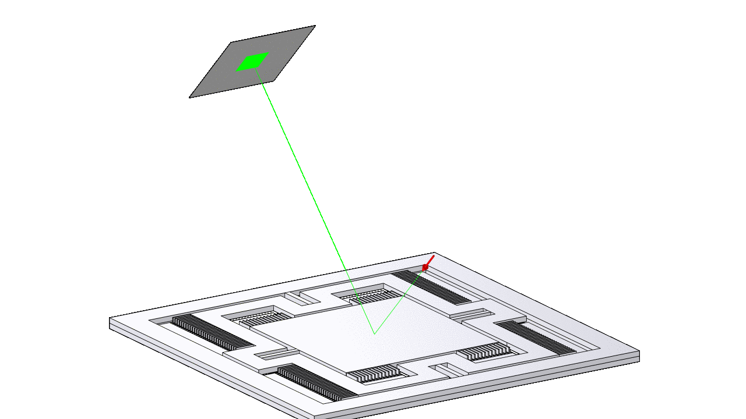
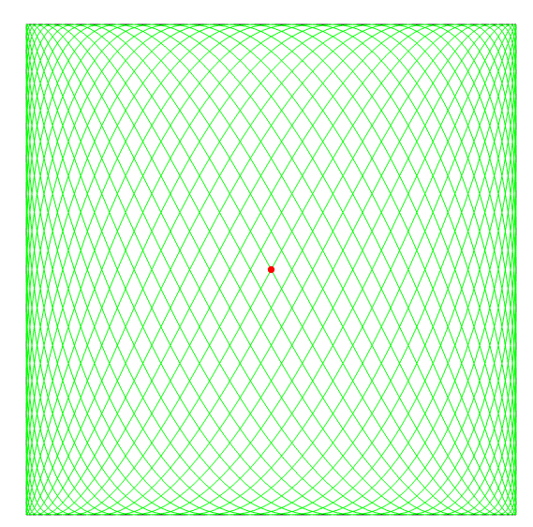
Optical Scanning Using Ray Optics
Coupling between the Solid Mechanics and Geometrical Optics interfaces
Uniaxial torsion enables 1D scanning
Biaxial torsion for 2D surface scanning

