Slide 1
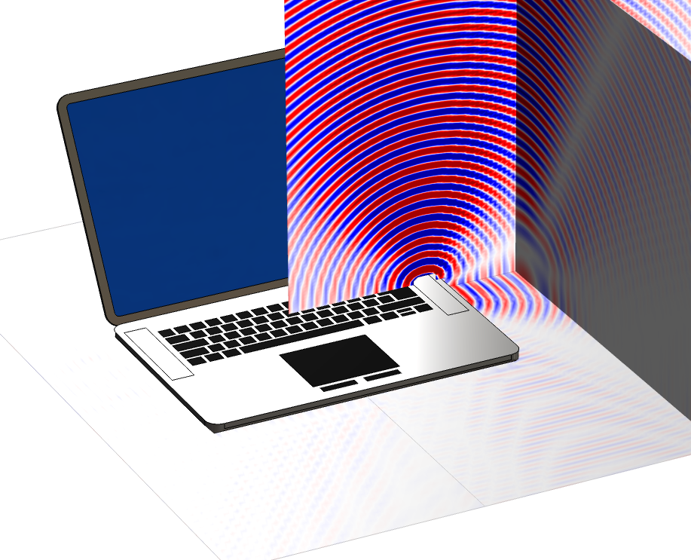
Simulation of the Spatial Response of Speakers and Microphones
… and feedback/echo problems
COMSOL

Slide 2
Content
Use of simulation
Feedback/echo
  Acoustic domain
  Vibroacoustic domain
Modeling strategies
  Full multiphysics
  Lumped multiphysics
Conference Speaker System Example
HRTF and manikins
“Full” virtual test setup
Laptop speaker spatial response at 20 kHz

Slide 3
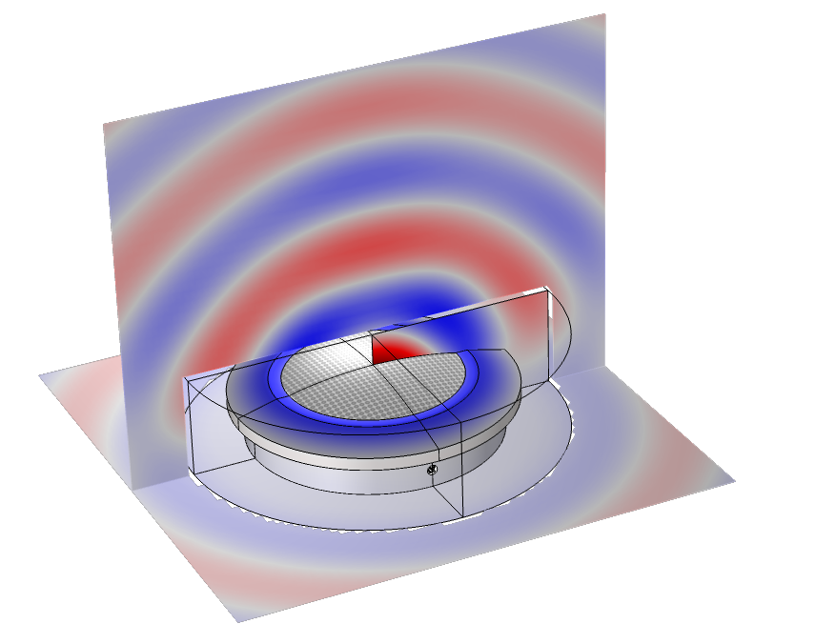
Content
Use of simulation
Feedback/echo
  Acoustic domain
  Vibroacoustic domain
Modeling strategies
  Full multiphysics
  Lumped multiphysics
Conference Speaker System Example
HRTF and manikins
“Full” virtual test setup
Conference speaker system at 2 kHz

Slide 4
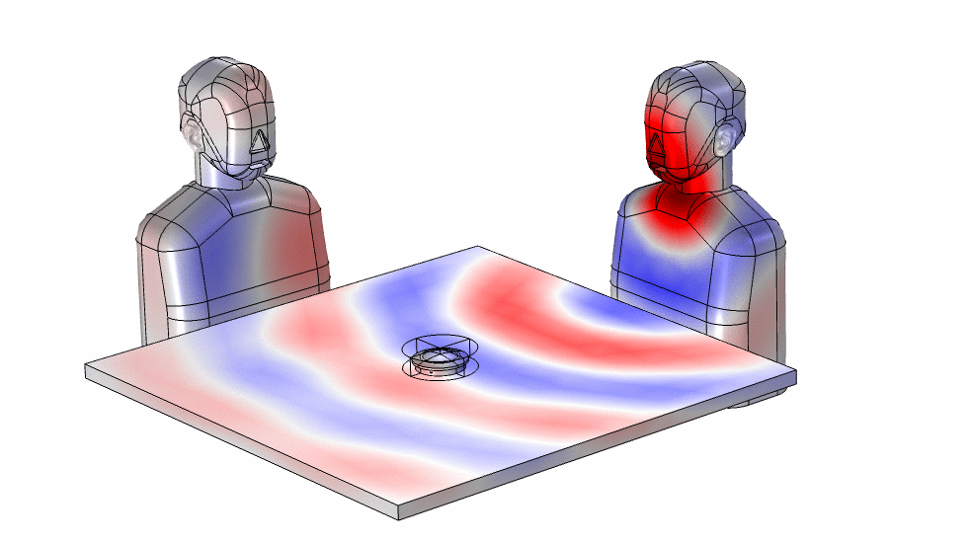
Content
Use of simulation
Feedback/echo
  Acoustic domain
  Vibroacoustic domain
Modeling strategies
  Full multiphysics
  Lumped multiphysics
Conference Speaker System Example
HRTF and manikins
“Full” virtual test setup
“Full” virtual test setup at 1 kHz

Slide 5
Use of Simulation …
Why?
Virtual development and prototypes
Concept and design phase
  Involve industrial designers
Front loading
Decision making
Problem solving/identification
What?
Optimized performance
Input to DSP and algorithm developers
  Transfer functions
  Microphone directivity (multi-mic system) etc.
Identify mechanical/model problems
General acoustic performance

Slide 6
Feedback and Echo
acoustic
feedback path
communication
system
DSP
electronics
mic.
speaker
vibration or
vibroacoustic

Slide 7
Feedback and Echo
acoustic
feedback path
communication
system
in
mic.
speaker
out
vibration or
vibroacoustic

Slide 8
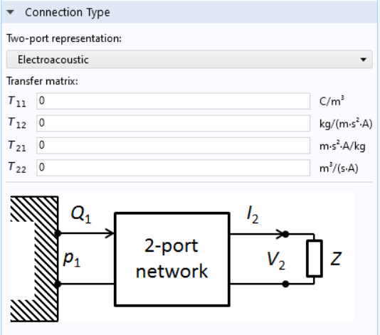
Modeling Strategies
Full multiphysics model
  Electromagnetic
  Structural
  Acoustic
  Thermoviscous acoustics
Lumped multiphysics approaches
  Thiele-Small representation
  Impedance
  Transfer matrix representation
  Impedance models for perforates etc.
GUI example from COMSOL. Lumped port with an electroacoustic two-port representation.
www.comsol.com/acoustics-module

Slide 9
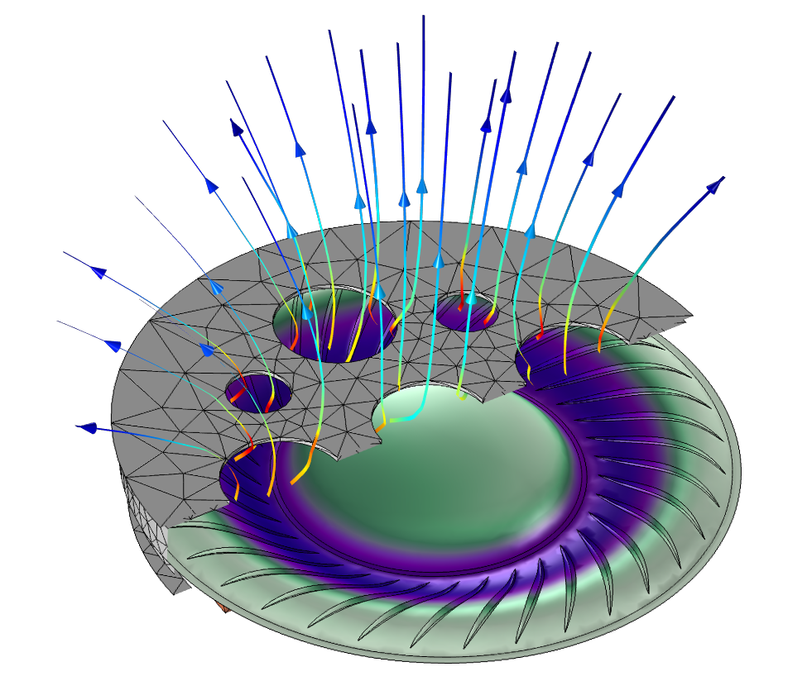
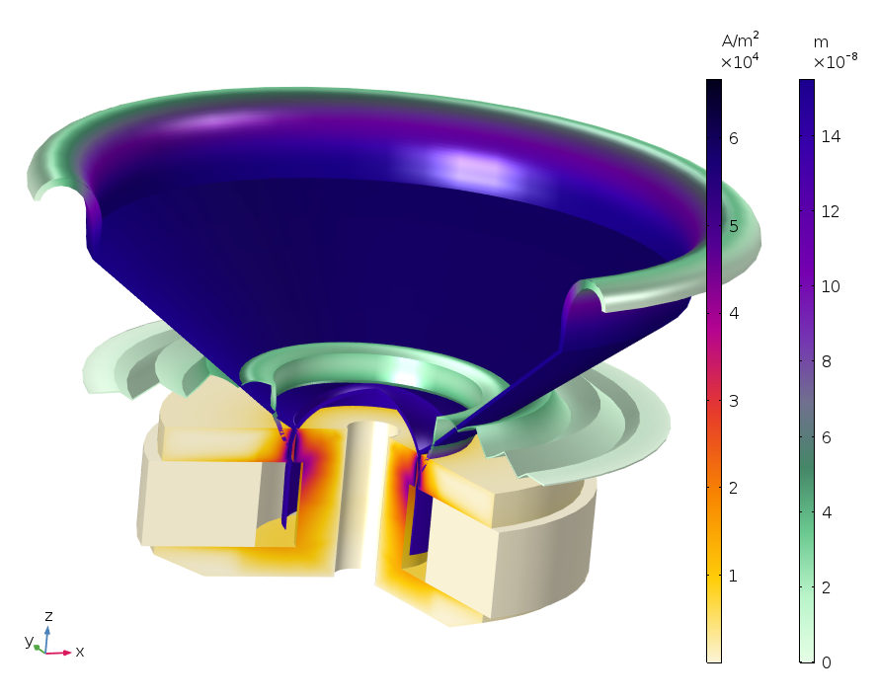
Speaker: Full Multiphysics FEM
  Ole Wolff OWS-1943T-8CP microspeaker (discontinued model). Copyright by Ole Wolff Elektronik A/S.

Slide 10
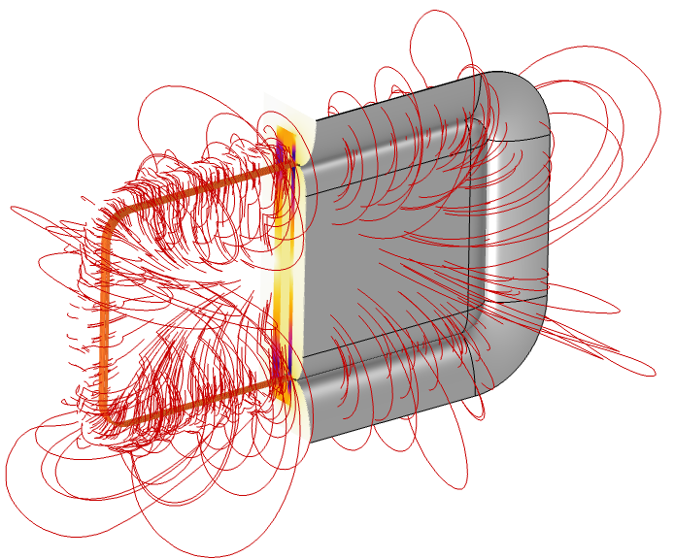
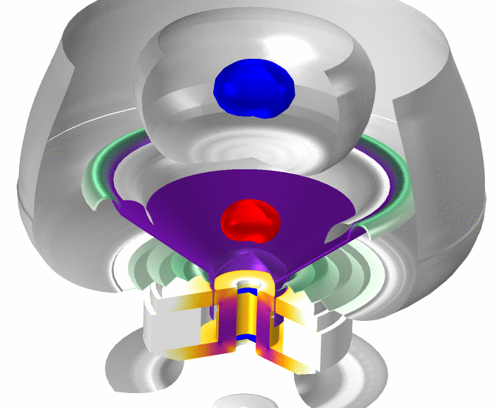
Speaker: Full Multiphysics FEM
3D microspeaker
2D axisymmetric

Slide 11
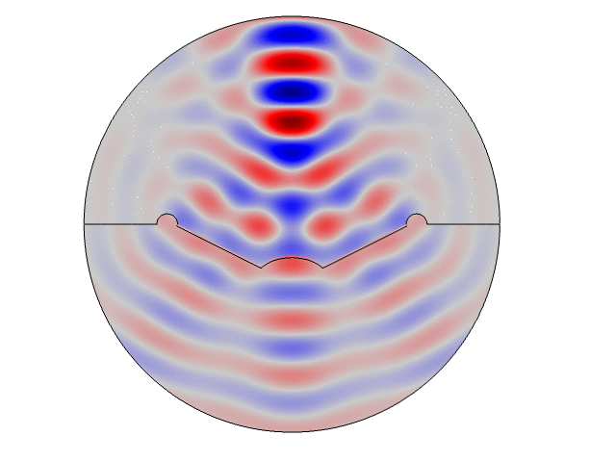
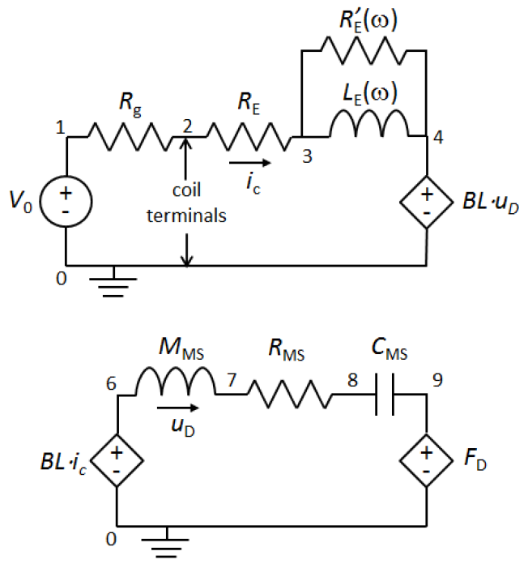
Speaker: Hybrid TS-FEM
u_{D}
  Thiele-Small representation of the electromechanical part of the speaker. System solved as an electric circuit and can have any desired complexity.

Slide 12
Microphone
Microphone modeled as an impedance
Microphone/waveguide modeled as a lumped electroacoustic system
  Lumped port
  Transfer matrix representation
Modeling of thermoviscous losses in mesh/perforates and small ducts
All are built-in options ready to use in COMSOL Multiphysics
GUI example from COMSOL. Lumped port with an electroacoustic two-port representation.

Slide 13
Microphone
exterior
mesh/grill
acoustic
waveguide
transducer

Slide 14
Microphone
exterior
impedance Z
mesh/grill
acoustic
waveguide
transducer
Impedance Z
Measured data
Detailed simulation

Slide 15
Microphone
exterior
T
mesh/grill
acoustic
waveguide
transducer
Transfer matric T
Measured data
Detailed simulation

Slide 16
Microphone
exterior
T
mesh/grill
acoustic
waveguide
transducer
Transfer matric T
Measured data
Detailed simulation

Slide 17
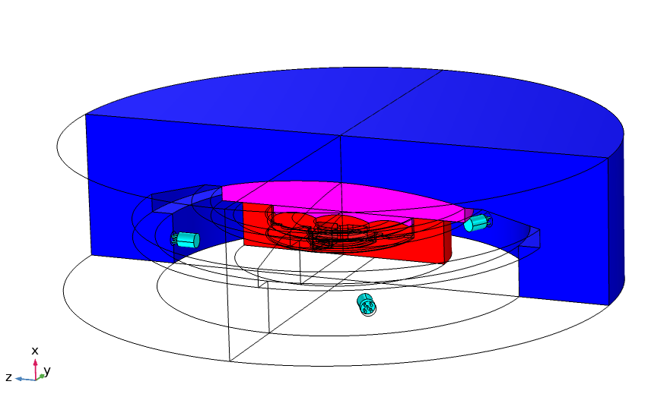
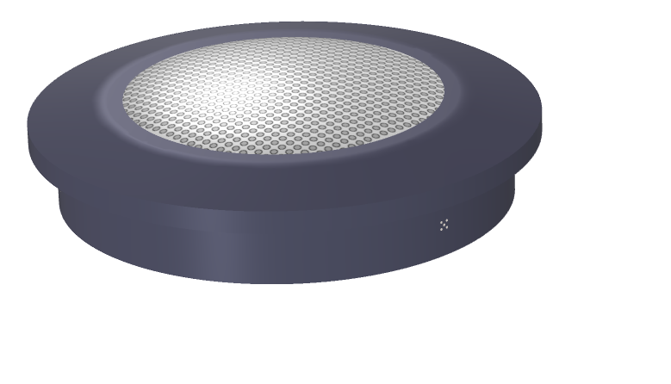
Feedback and Echo: Example
air (BEM)
air (FEM)
perforated plate
microphone
interior air
Lump speaker
microphone

Slide 18
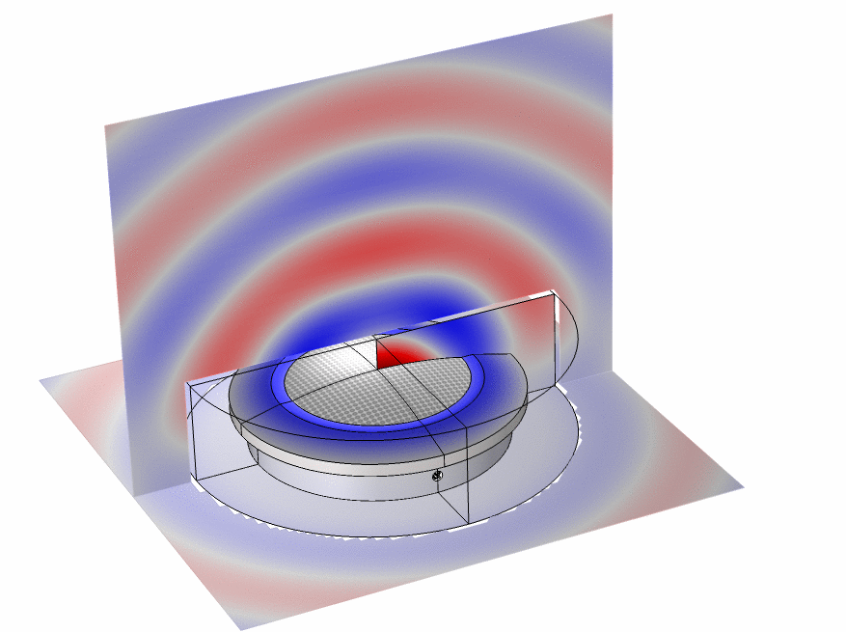
Spatial Response: Speaker
Exterior pressure field from the conference speaker. Here visualized at 6300 Hz

Slide 19
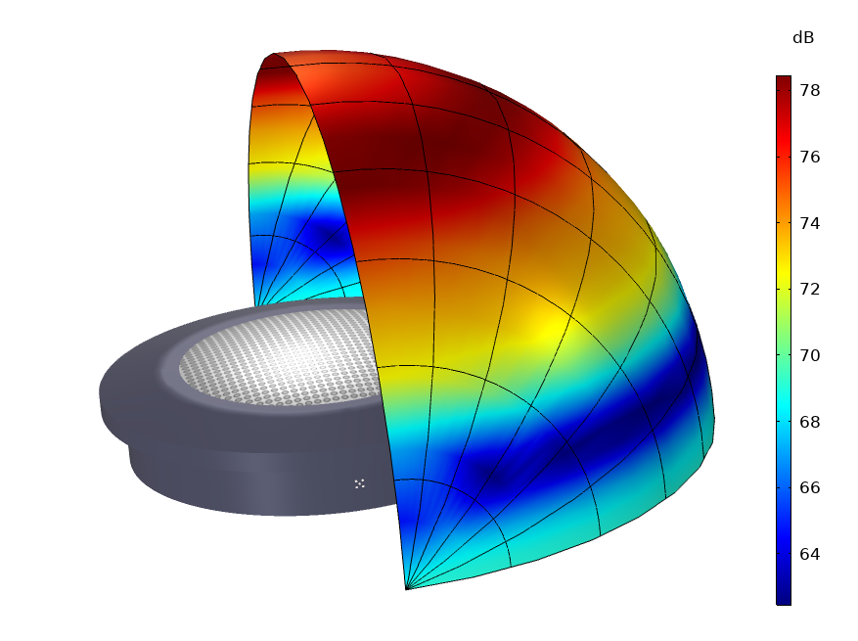
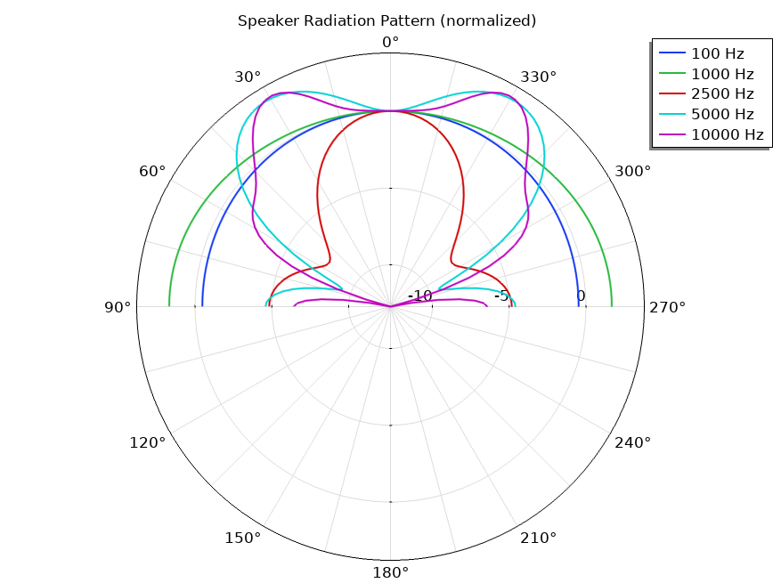
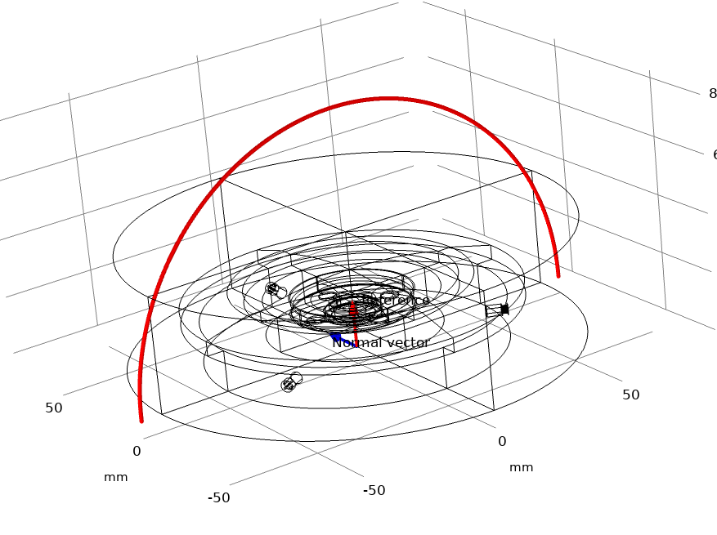
Spatial Response: Speaker

Slide 20
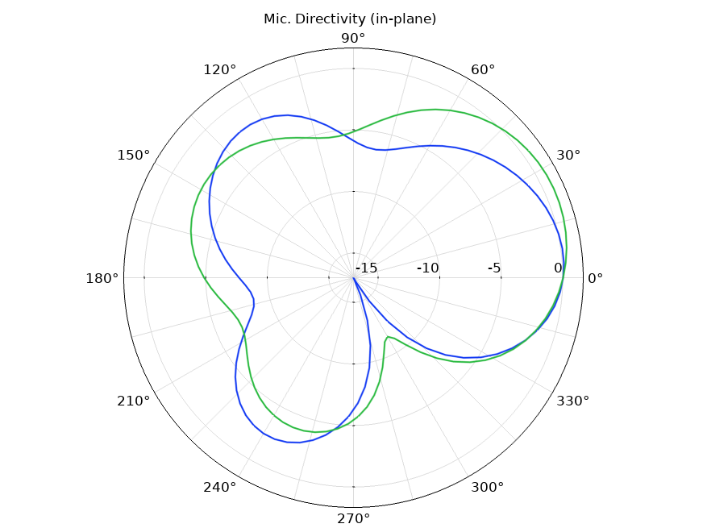
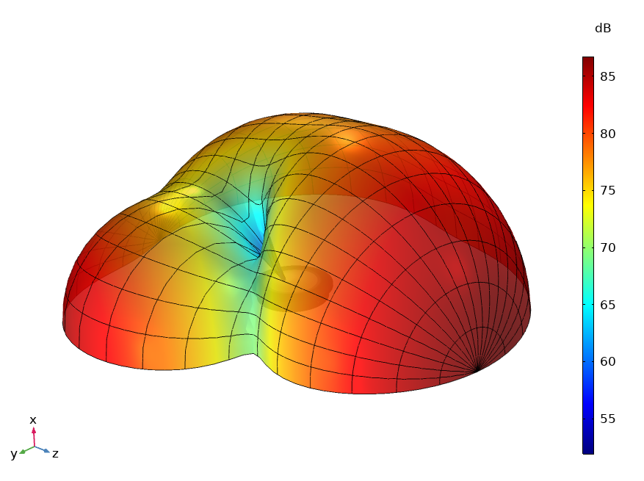
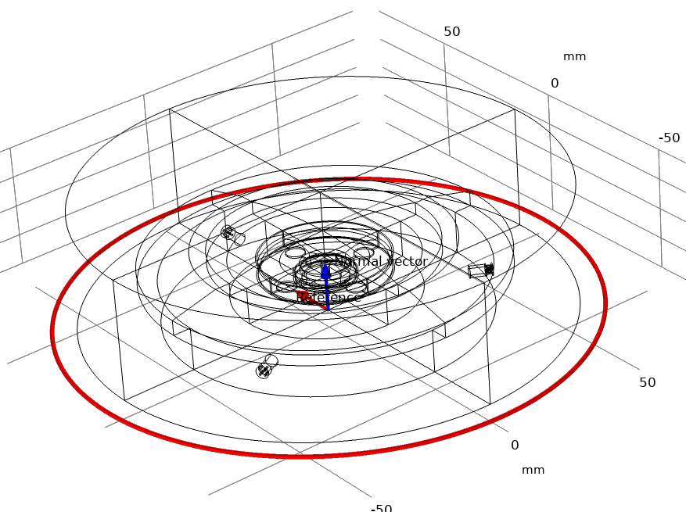
Spatial Response: Directional Microphone
Reciprocity
  Use the microphone as source
  Assign complex phase to each: exp(i ϕ)
ϕ₁ = 0[deg]
ϕ₂ = 90[deg]
ϕ₃ = 180[deg]

Slide 21
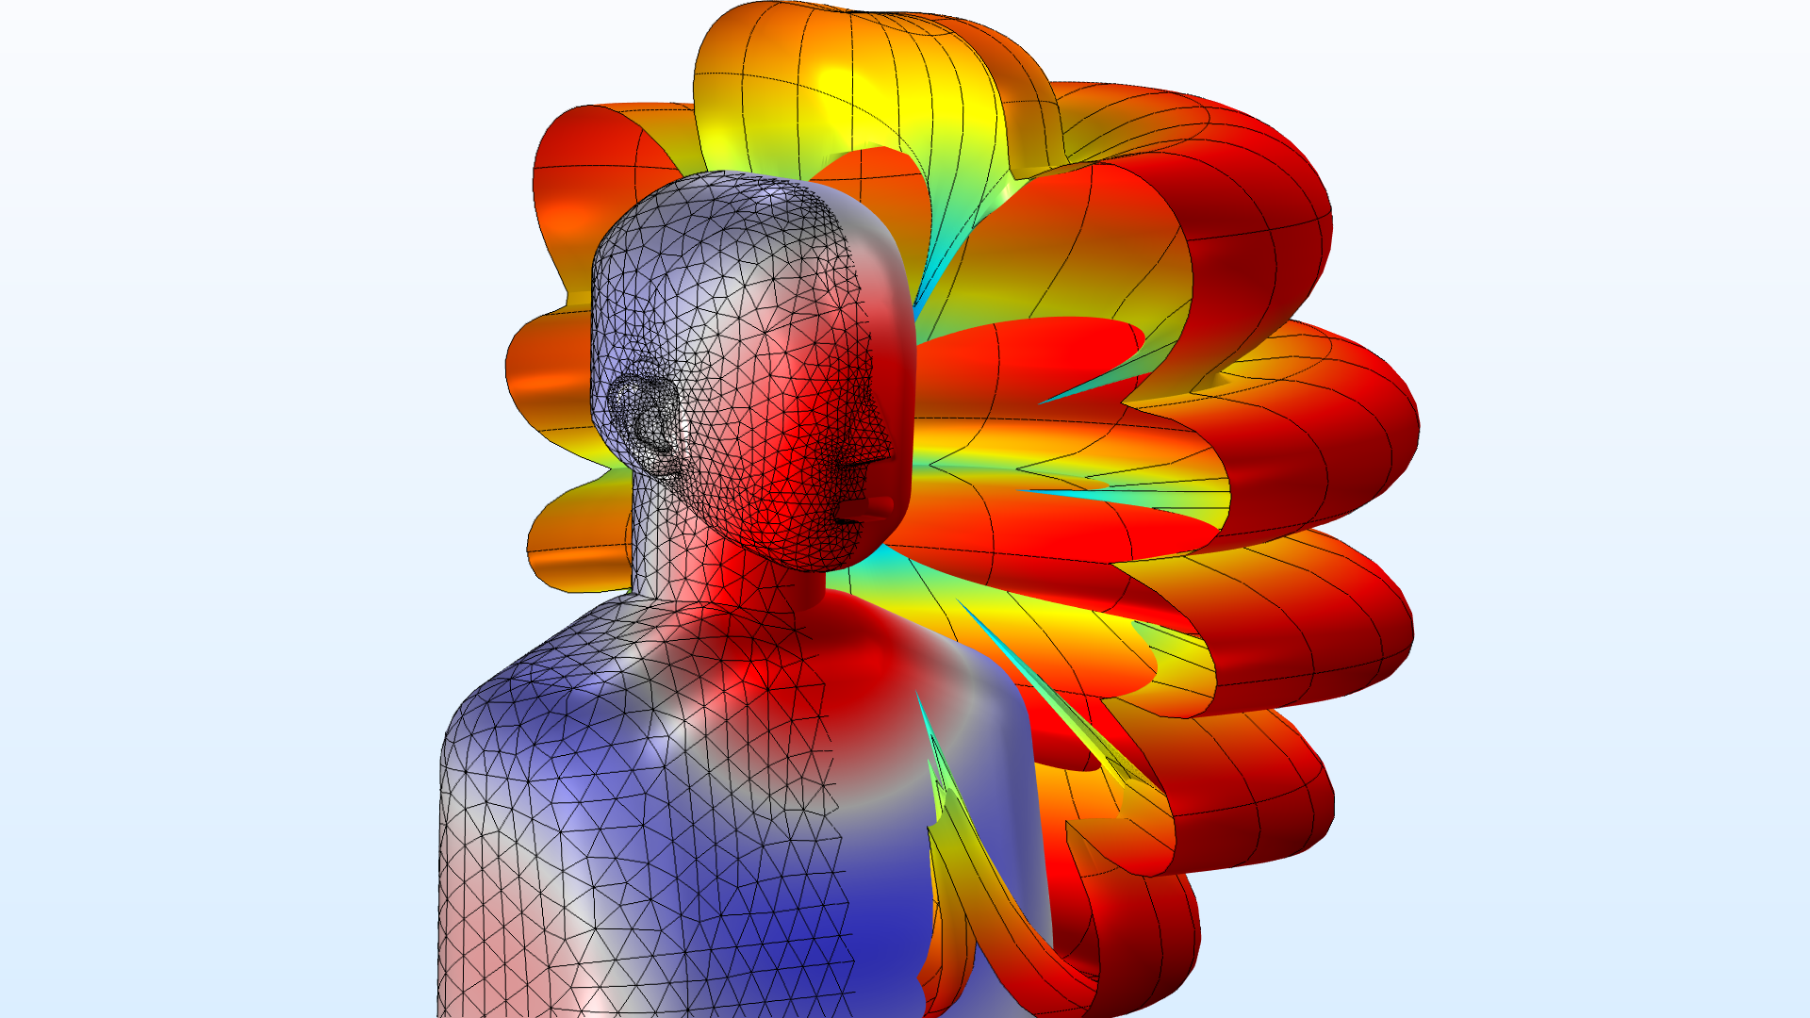
HRTF and Manikins
Communication perspective:
  Wearables, open shoulder mounted units, smart gear etc.
Examples:
  https://www.comsol.com/model/head-and-torso-simulator-acoustics-74381
  https://www.comsol.com/model/head-and-torso-hrtf-computation-75011

Slide 22
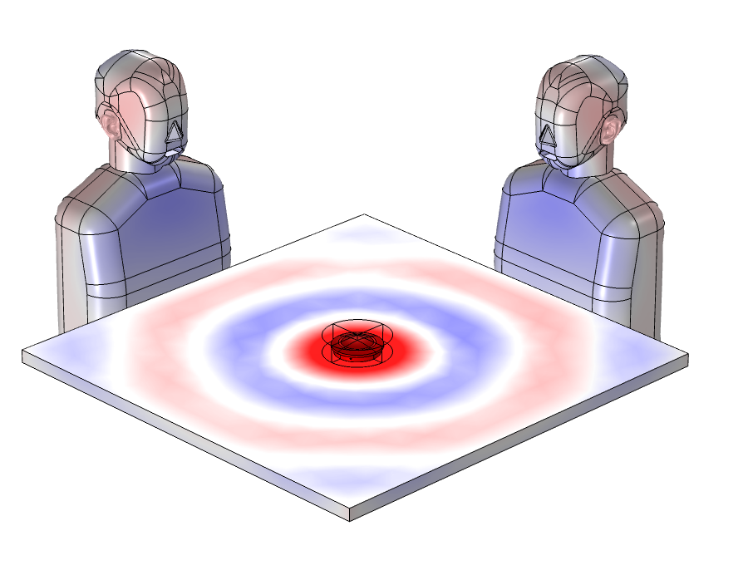
Full Virtual Test Setup
Speaker in conference speaker system as source.
Acoustic manikin mouth as source.

Slide 23
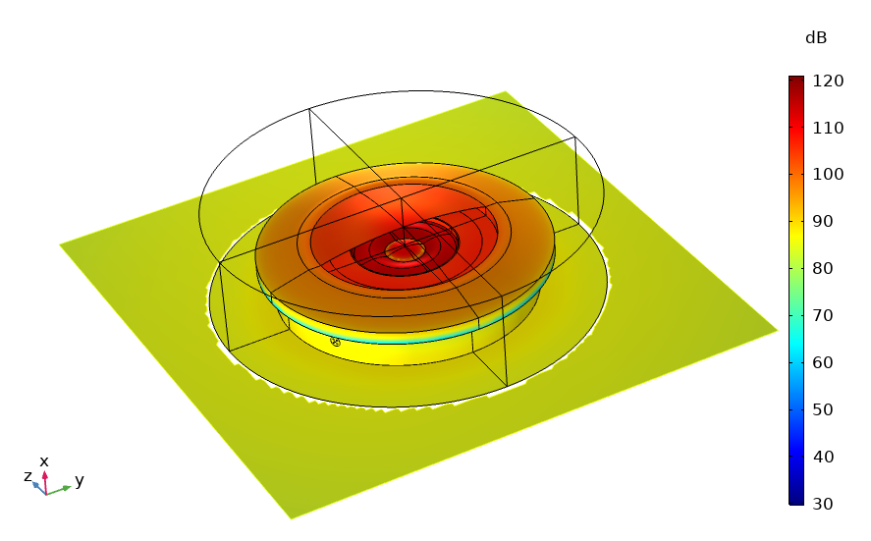
Conclusions
Consider what electroacoustic/acoustic representation is needed!
Start simple!
You do not always need to go full multiphysics
Use the knowledge you have from lumped models and measurements
Measure the transfer-matrix of sub systems
Build-up the complexity
www.comsol.com/acoustics-module

