Slide 1
Topology Verification for
Surface-to-Surface Radiation
COMSOL

Slide 2
Detect Incorrect Radiation Setup with Nonradiating Boundaries

Slide 3
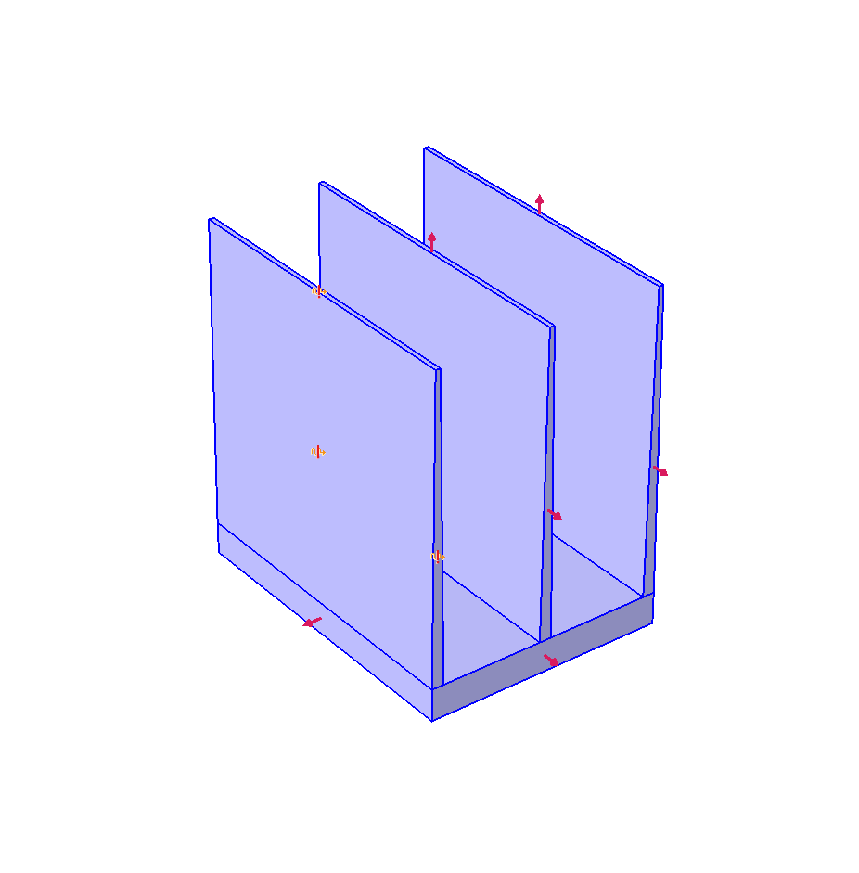
Nonradiating Boundaries
In the Diffuse Surface 1 feature, the red arrows shows the radiation direction for each boundary.
The warning symbol indicates boundaries that do not radiate in any spectral bands.
A warning is also issued when a model is computed with nonradiating boundaries. The warning lists the nonradiating boundaries and the feature where they are selected.
The warning symbol indicates the nonradiating boundaries.

Slide 4
Nonradiating Boundaries
In this case, the boundaries of the front fin are not radiating because domain 2 has not been selected in the feature Opacity 1. This error can be easily spotted with the nonradiating symbol.
All other boundaries radiate towards the outside of the geometry which is expected for an opaque solid.
The warning symbol indicates the nonradiating boundaries.

Slide 5
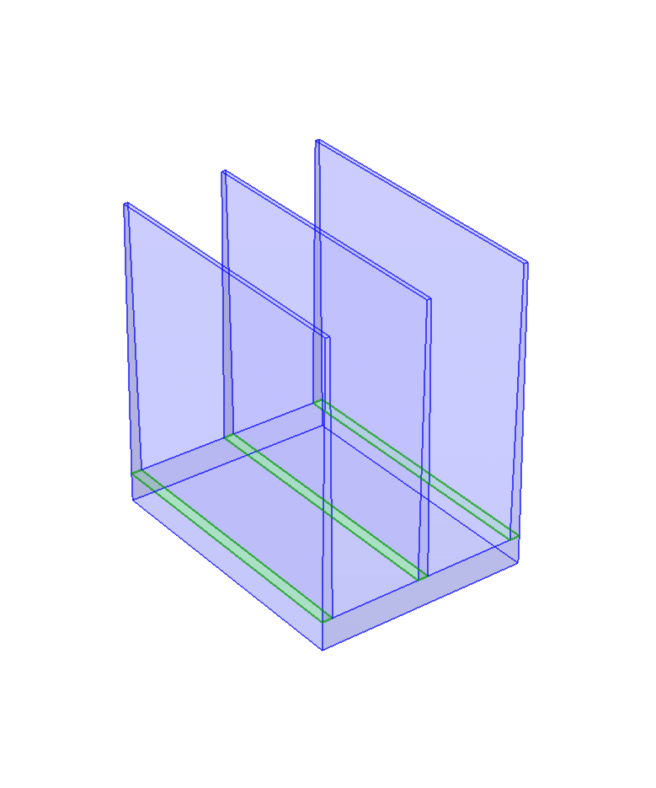
Nonradiating Boundaries
Once the domain 2 is selected in the feature Opacity 1, there is still a warning about nonradiating boundaries (5, 13, 20) when solving.
Here it’s not an error but instead that boundaries between two opaque domains do not radiate. They can simply be removed from the physics as they are ignored.
Removing interior boundaries from the physics selection can be done by using the “All Exterior Boundaries” selection under Definitions.
Nonradiating boundaries (5, 13, 20) in green.

Slide 6
Detect Incorrect Radiation Setup with Boundaries Seen on Their Back Side

Slide 7
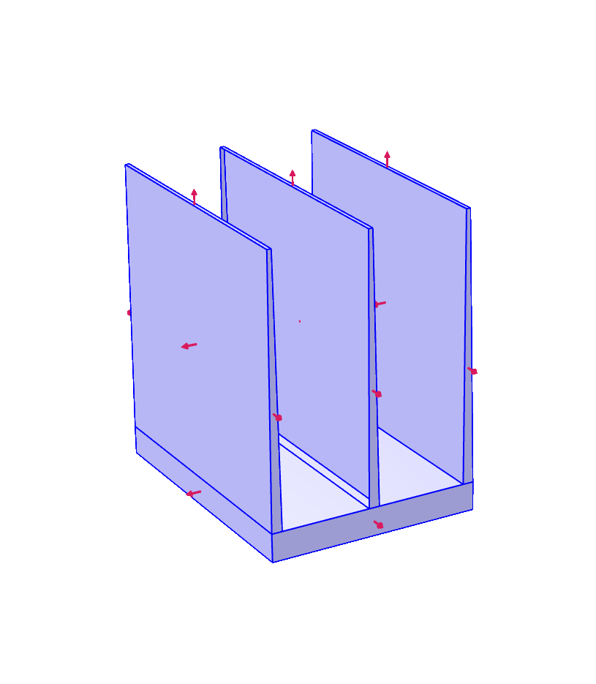
Boundaries Seen on Their Back Side
In this other model, boundary 12 is forgotten from the physics selection.
On compute, a warning is triggered listing the variables that can be plotted to show the faces that see the opposite side of other boundaries. Here the variable mentioned is rad.Fbacksideu.
Red arrows show the radiation direction of each boundary.

Slide 8
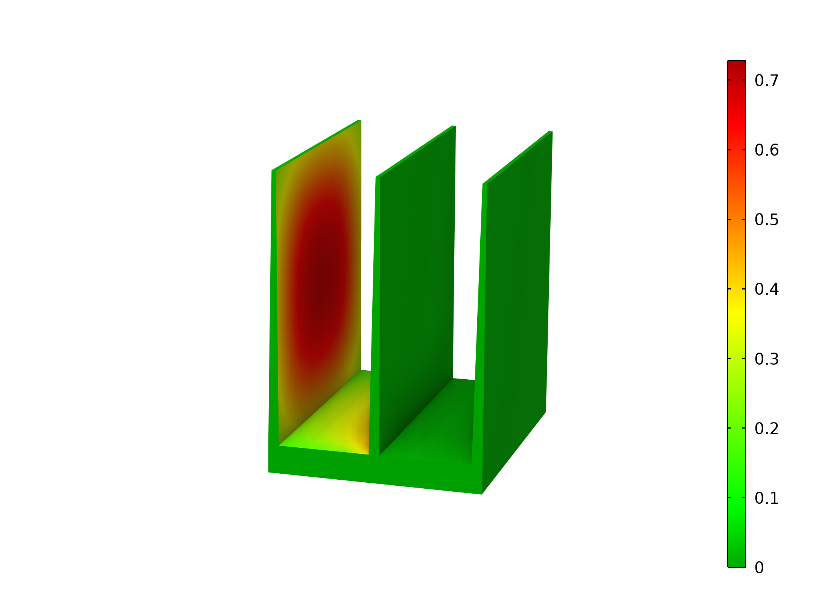
Boundaries Seen on Their Back Side
In this figure showing the back side indicator on the upside (rad.Fbacksideu), boundaries with a non-zero value see the back of other boundaries.
Boundaries (10, 11) have non-zero values because they see the back of boundaries (14, 15, 16 17).
Fraction of the back of other boundaries seen.

Slide 9
Boundaries Seen on Their Back Side
This can be fixed by adjusting the radiation directions so that the faces (14, 15, 16, 17) radiate on both sides or remove them from the physics selection if they should be ignored from the radiation computation. Note that in this model none of these options would be enough to fix the problem. The boundary 13 should be defined as opaque to have a correct configuration.
The expected fix here is to add boundary 12 to the physics selection.
Fraction of the back of other boundaries seen.

Slide 10
Boundaries Seen on Their Back Side
Using high order mesh elements can also trigger this warning because some radiation penetrates a radiation cavity. Refining the mesh or clearing the High order mesh elements checkbox helps reducing the radiation leak.
The verification of radiation directions can be computationally intensive in some cases with the Hemicube radiation algorithm. A warning is triggered in this case. Once the radiation setup is verified, the Check consistency checkbox of the physics interface can be cleared.

