Slide 1
Multilayered Porous Material : Poroelastic Waves with Thermal and Viscous Losses (Biot-Allard Model)

Slide 2
Background and Motivation
In applications where pressure waves and elastic waves propagate in porous materials filled with air both thermal and viscous losses are important. This is typically the case in insulation materials for room acoustics or lining materials in car cabins. Another example is porous materials in mufflers in the automotive industry.
The present models shows how the Biot-Allard (or Biot-JCA) model option of the Poroelastic Waves physics interface is used to model a multilayered porous structure composed of two foam layers, one thin screen, and a blanket. The surface impedance of the system is determined and can be compared with results from a JASA paper by Atalla et al. (see Ref. 2).

Slide 3
Material Parameters
Parameter | COMSOL symbol | Alternate symbols | Unit
Tortuosity (high frequency) | τ∞ | k_{s} | ₁
Drained density | ρ_{d} | ρ₁ | kg/m³
Flow resistivity | R_{f} | σ | Ns/m⁴
Porosity | ε_{p} | h | 1
Drained shear modulus | G_{d} | N | Pa
Structural loss factor | η | - | 1
Drained Poisson’s ratio | υ_{d} | υ | 1
Viscous characteristic length | L_{v} | Λ | m
Thermal characteristic length | L_{th} | Λ’ | m
The typical material parameters provided (and measured) for acoustic insulation materials are the following.

Slide 4
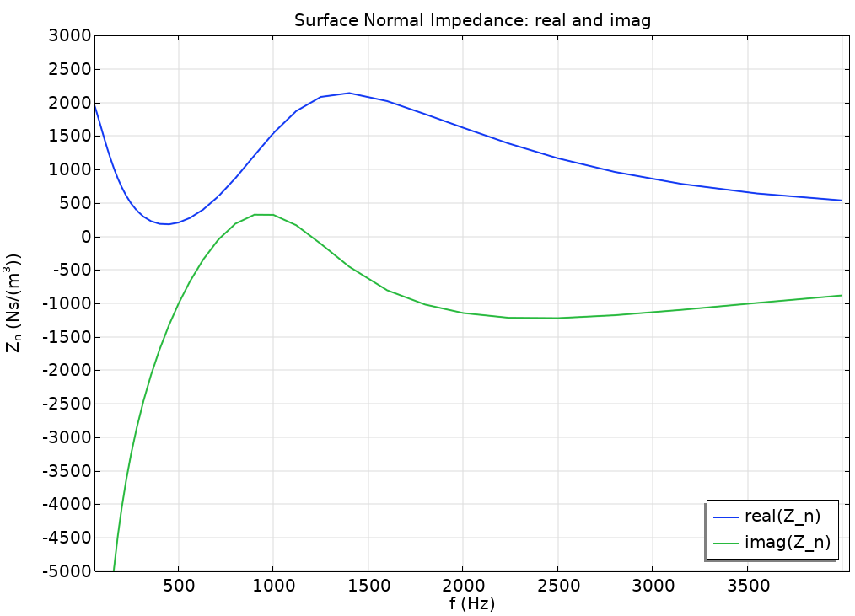
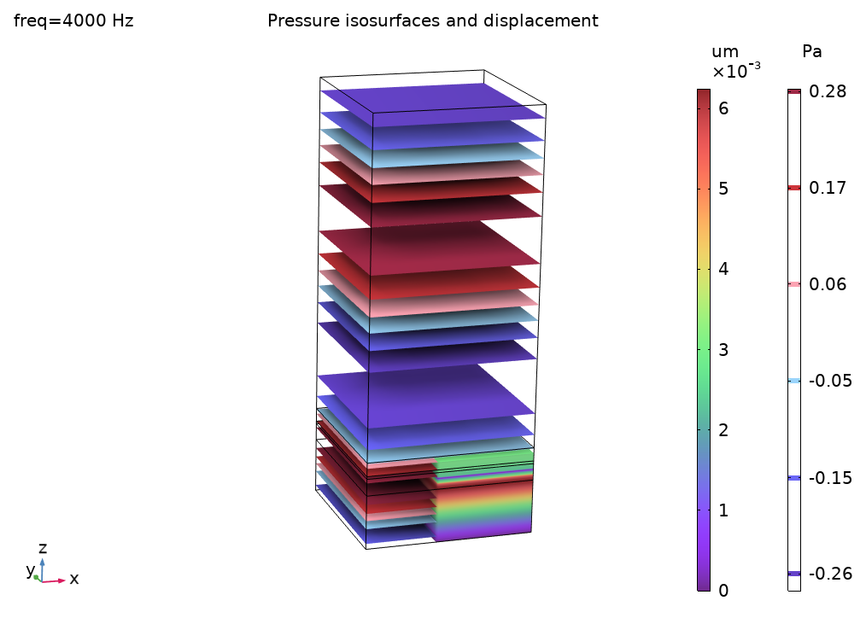
Multilayered Porous Material

Slide 5
References
J. F. Allard and N. Atalla, “Propagation of Sound in Porous Media: Modeling Sound Absorbing Materials,” Second Edition, Wiley (2009).
N. Atalla et al. “A mixed displacement-pressure formulation for poroelastic materials,” JASA, 104, 1444 (1998).
N. Atalla et al. “Enhanced weak integral formulation for the mixed (u,p) poroelastic equations,” JASA, 109, 3065 (2001).
P. Debergue et al. “Boundary conditions for the weak formulation of the mixed (u,p) poroelasticity problem,” JASA, 106, 2383 (1999).
N. Atalla et al. “On the modeling of sound radiation from poroelastic materials,” JASA, 120, 1990 (2006).

