Slide 1
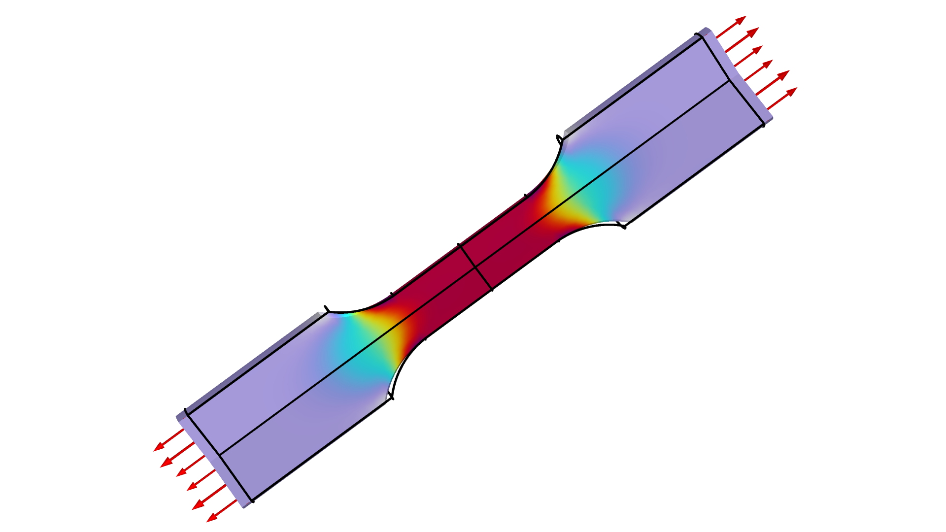
Parameter Estimation for a Tensile Test

Slide 2
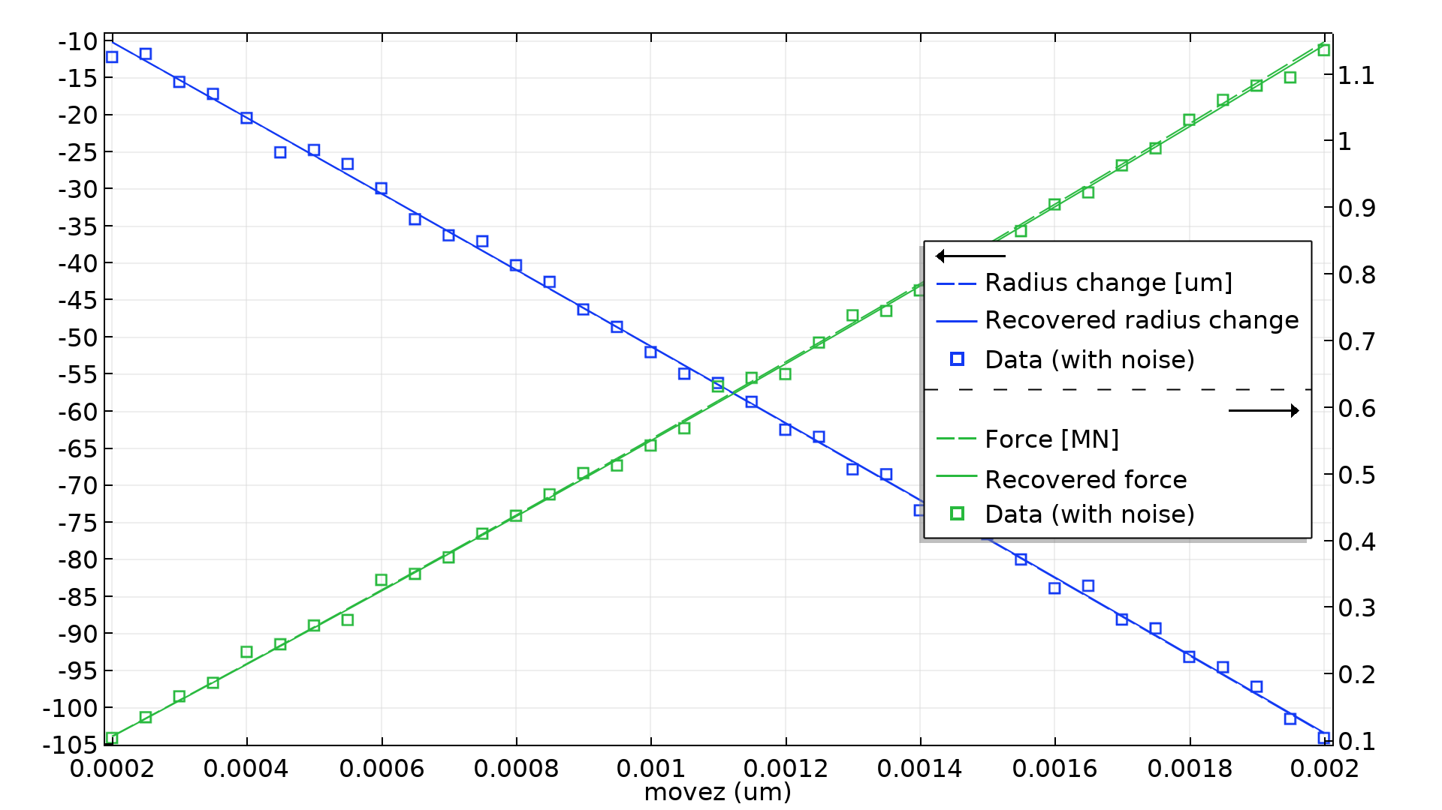
Parameter Estimation for a Tensile Test
The model has two studies
The 1st study generates synthetic data for the
  Tensile force
  Radial displacement
The 2nd study recovers two material parameters
  The Young’s Modulus
  The Poisson ratio
The synthetic noise is normally distributed
  10 kN standard deviation for the force
  1 µm standard deviation for the displacement
This results in 0.5 % error for the parameters
Scaling is critical, when there are several value columns, but in this case the automatic scaling based on the measurement variance is sufficient
Parameter Estimation for a Tensile Test

